Slide 1
Preparations for the
European Spallation Source beam commissioning
Lali Tchelidze
Operations Section Leader
Accelerator Division
October 3, 2018
Workshop on Accelerator Operations

Slide 2
Part 1
EUROPEAN SPALLATION SOURCE

Slide 3
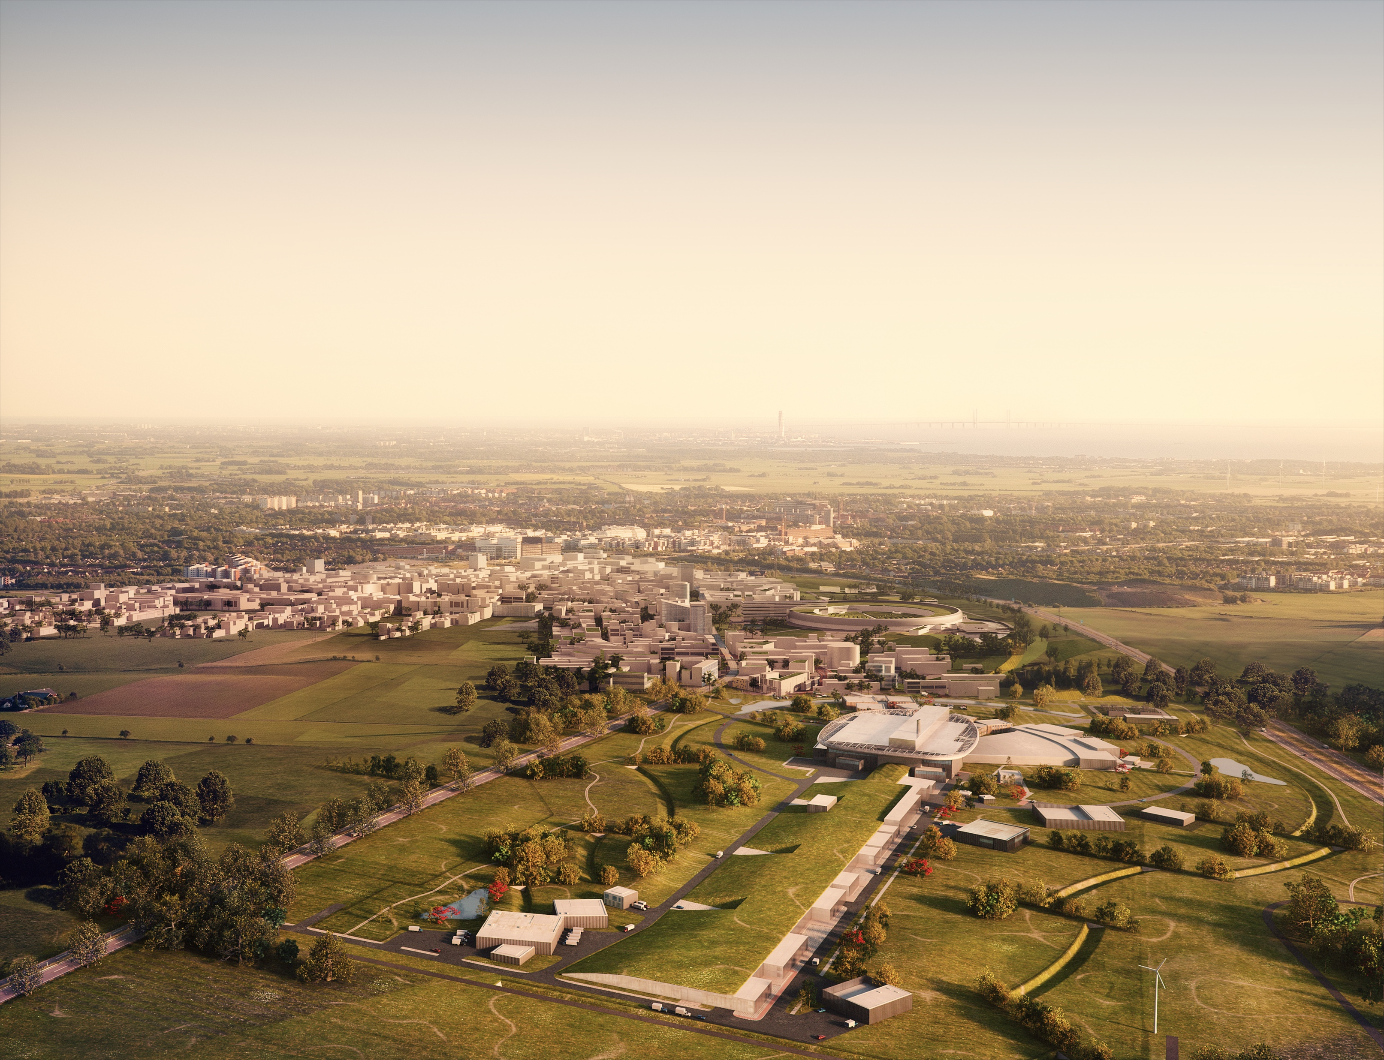

European Spallation Source – what & where – future layout
Copenhagen
Lund
Science Village
MAX-IV
ESS

Slide 4

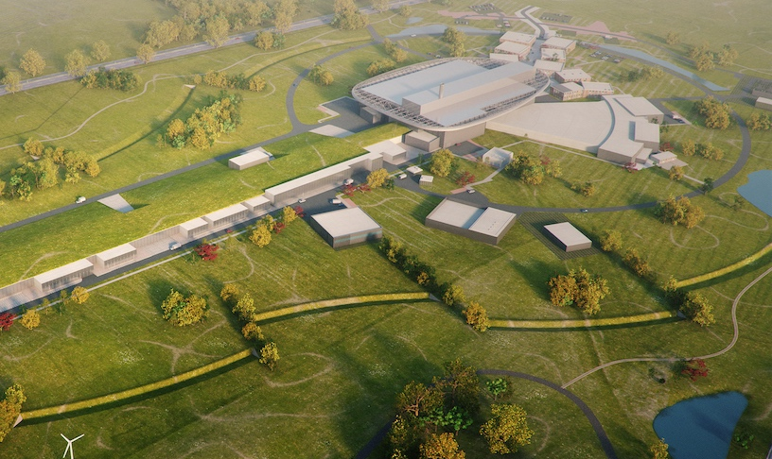
Global ESS schedule
2025
ESS Construction Phase Complete
2014
Construction Starts on Green Field Site
2023
Start Of User Program
(SOUP)
2009
Decision to Site ESS in Lund
2019
Start of Initial Operations Phase
2012
ESS Design Update Phase Complete
2003
European Design of ESS Completed

Slide 5
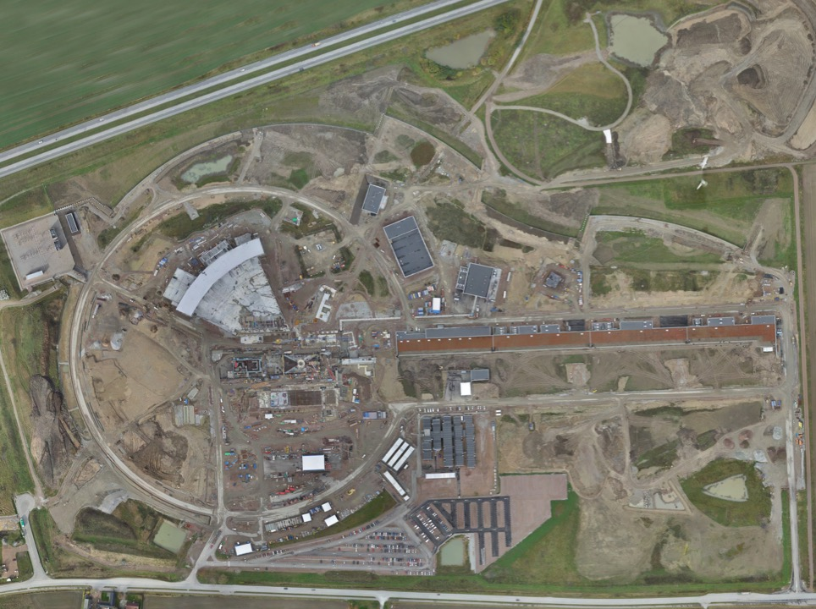
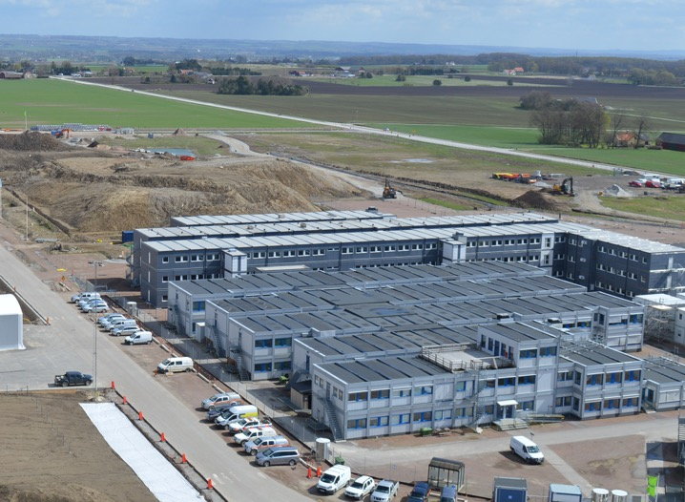
Permanent
Office Campus
2021
New 2018 ESS offices for all staff
PermanentEntrance
Lund Tramway Depot

Slide 6
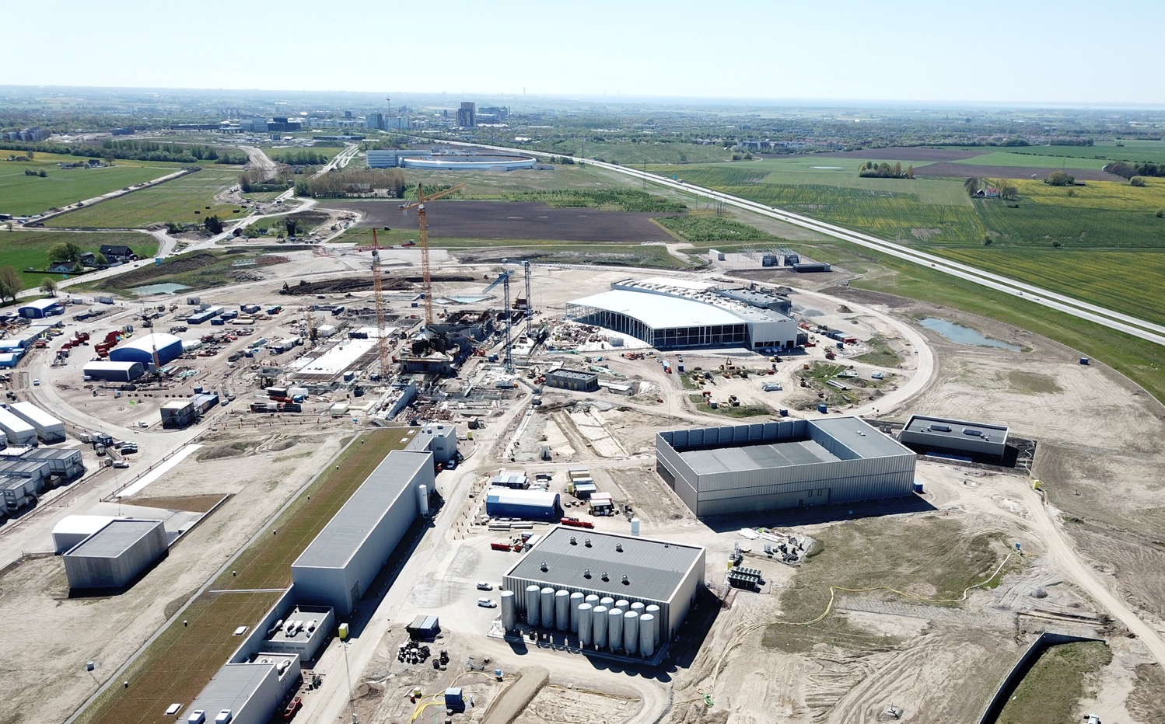

Slide 7
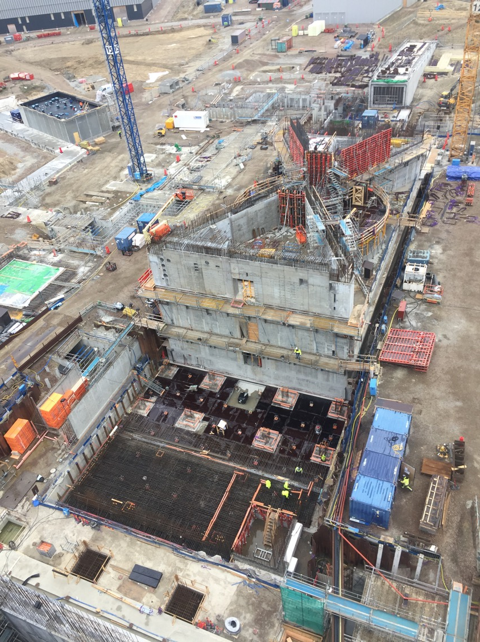
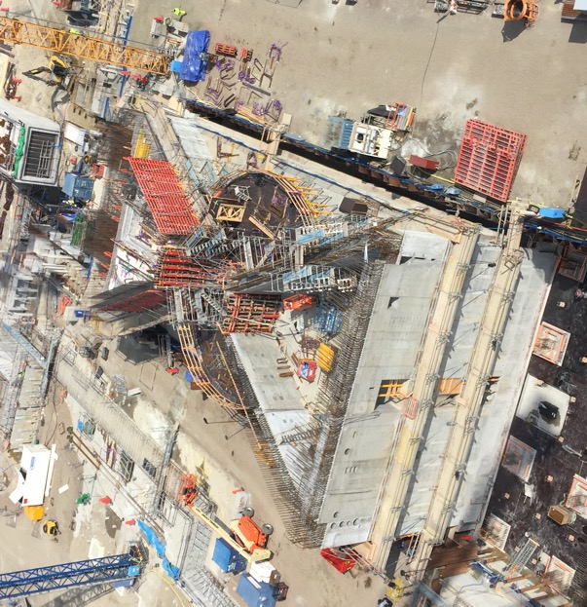
Target
Monolith & Utility
Last set of diagonal walls before high bay in progress.
Utility area, base slab works.

Slide 8
Target, Monolith
Circular walls around puck

Slide 9
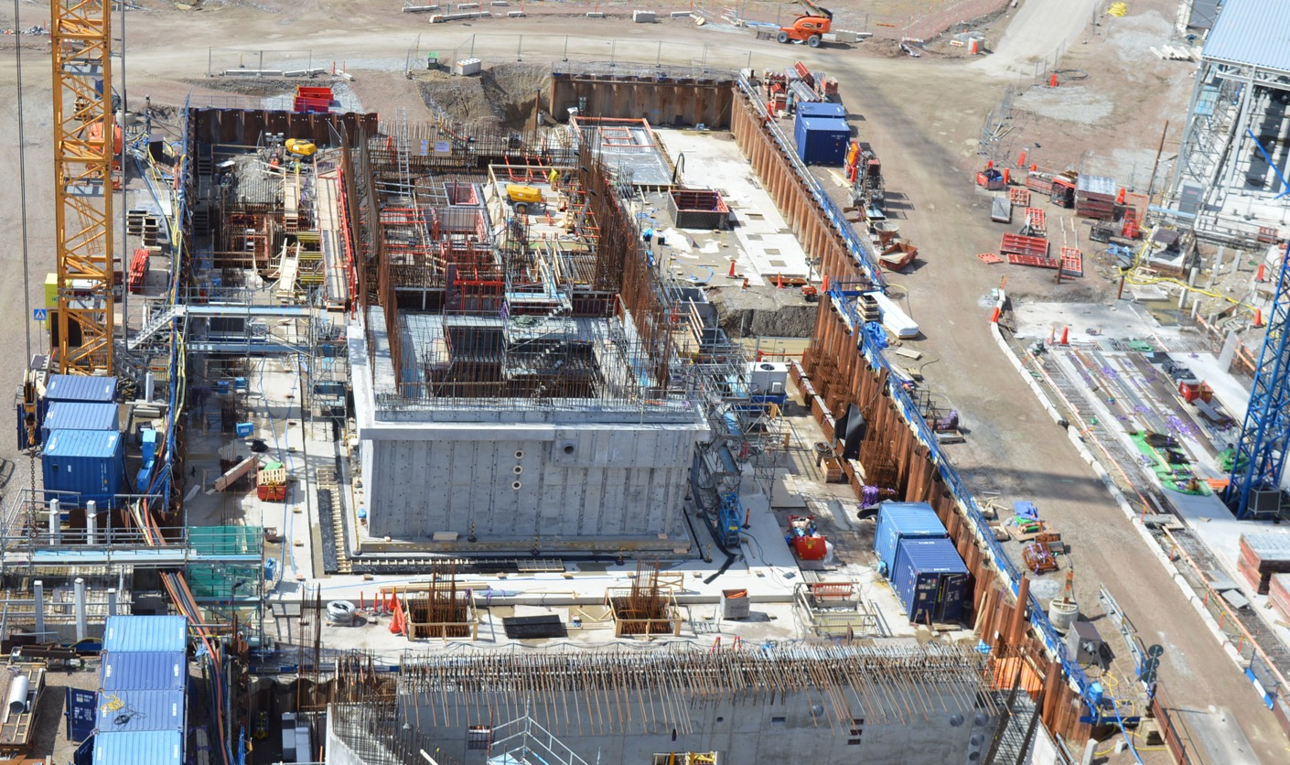
Active Cell

Slide 10
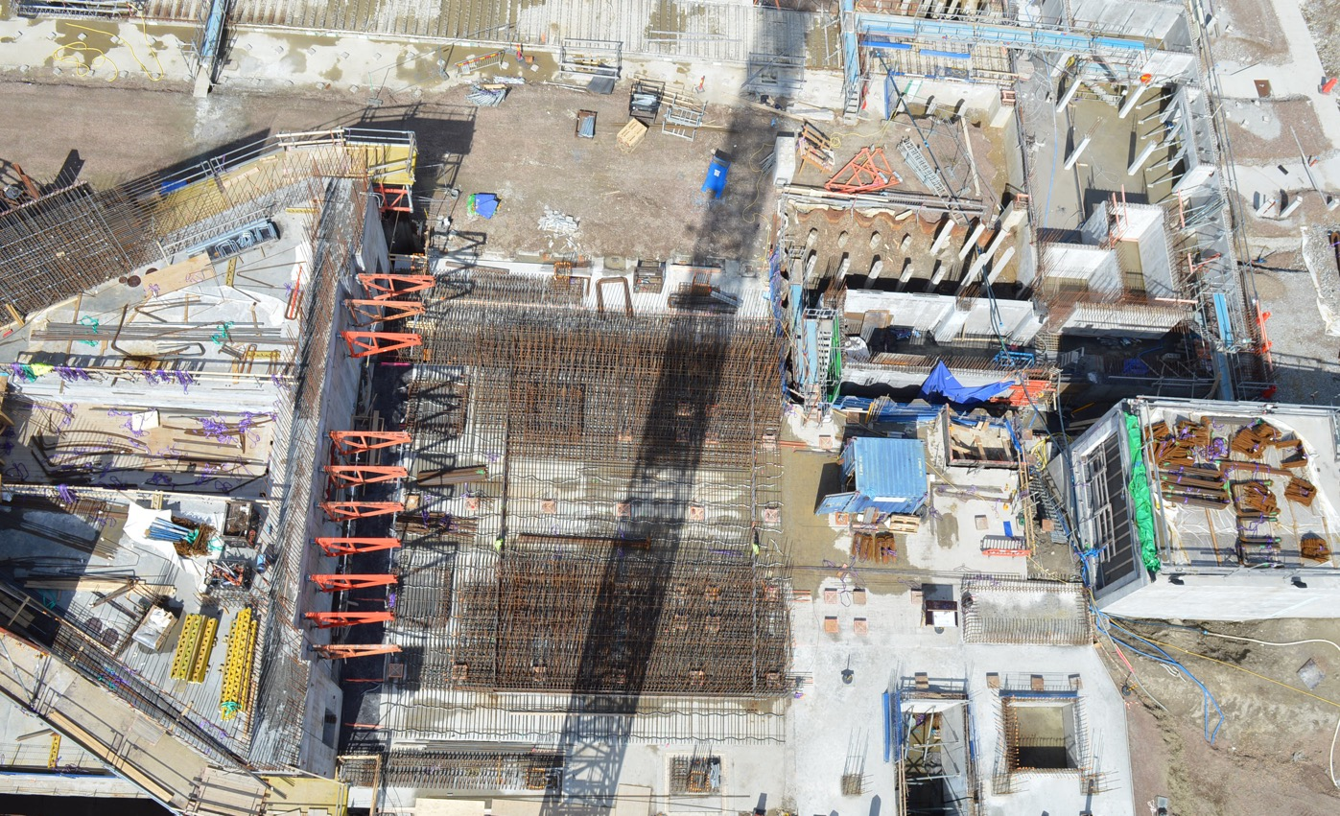
A2T
Accelerator to Target, bottom slab works

Slide 11
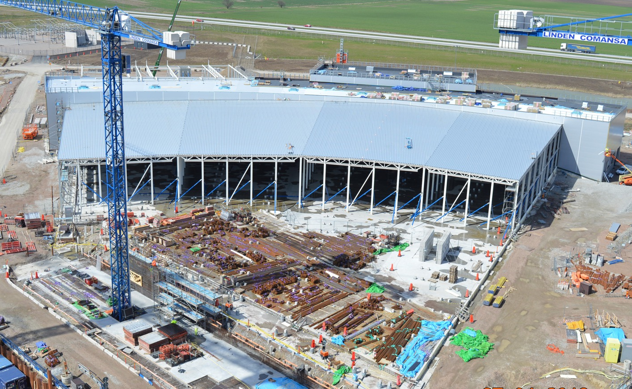
E-buildings

Slide 12
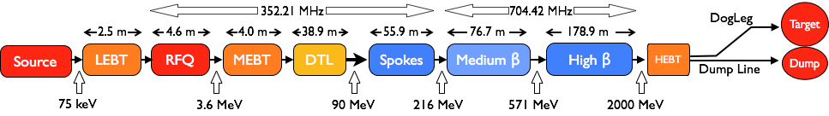
Accelerator – Scope
Key parameters:
    -2.86 ms pulses
    -2 GeV
    -62.5 mA peak
    -14 Hz
    -Protons (H+)
    -Low losses
    -Minimize energy use
    -Flexible design for mitigation and future upgrades
Design Drivers:
High Average Beam Power
5 MW
High Peak Beam Power
125 MW
High Availability
95%
18 IK partners I 8 countries and 5 collaboration partners

Slide 13






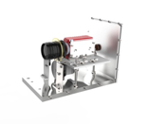
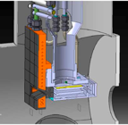
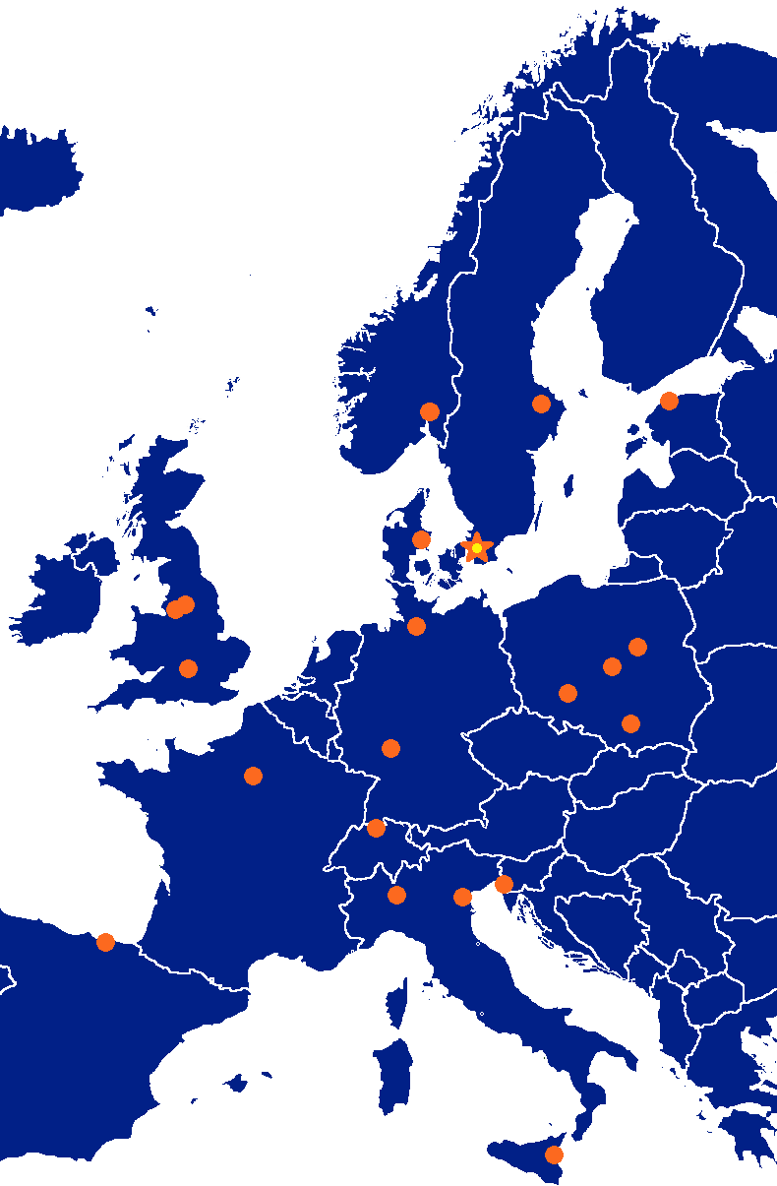




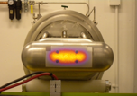






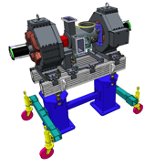









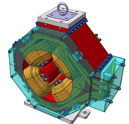

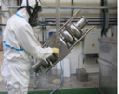

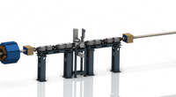













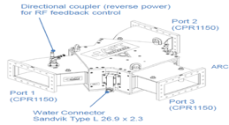
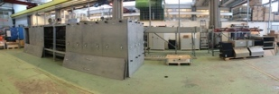
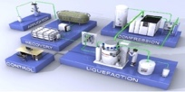











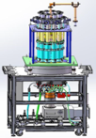
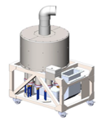



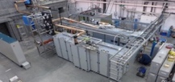
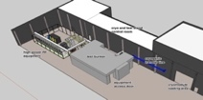
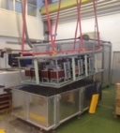
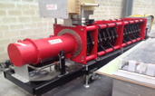
Accelerator Collaboration
13

Slide 14
Part 2
HOW WE ORGANIZE WORK

Slide 15
Process to get to beam commissioning
License
Safety Readiness Review
Beam Permit
Beam commissioning
Operation
Hardware commissioning
NOTE: GREEN FIELD FACILITY/EVERYTHING NEW/TAKES TIME
NOTE: We will be commissioning in stages

Slide 16
Commissioning stages
Ion source and LEBT (75 keV), beam to FC
RFQ and MEBT (3.6 MeV), beam to FC
DTL1 (22 MeV), beam to FC
DTL2 to DTL4 (40 MeV, 57 MeV, 74 MeV), beam to FC
DTL5 and SCL, beam to Beam Dump
Full accelerator, beam to Target

Slide 17
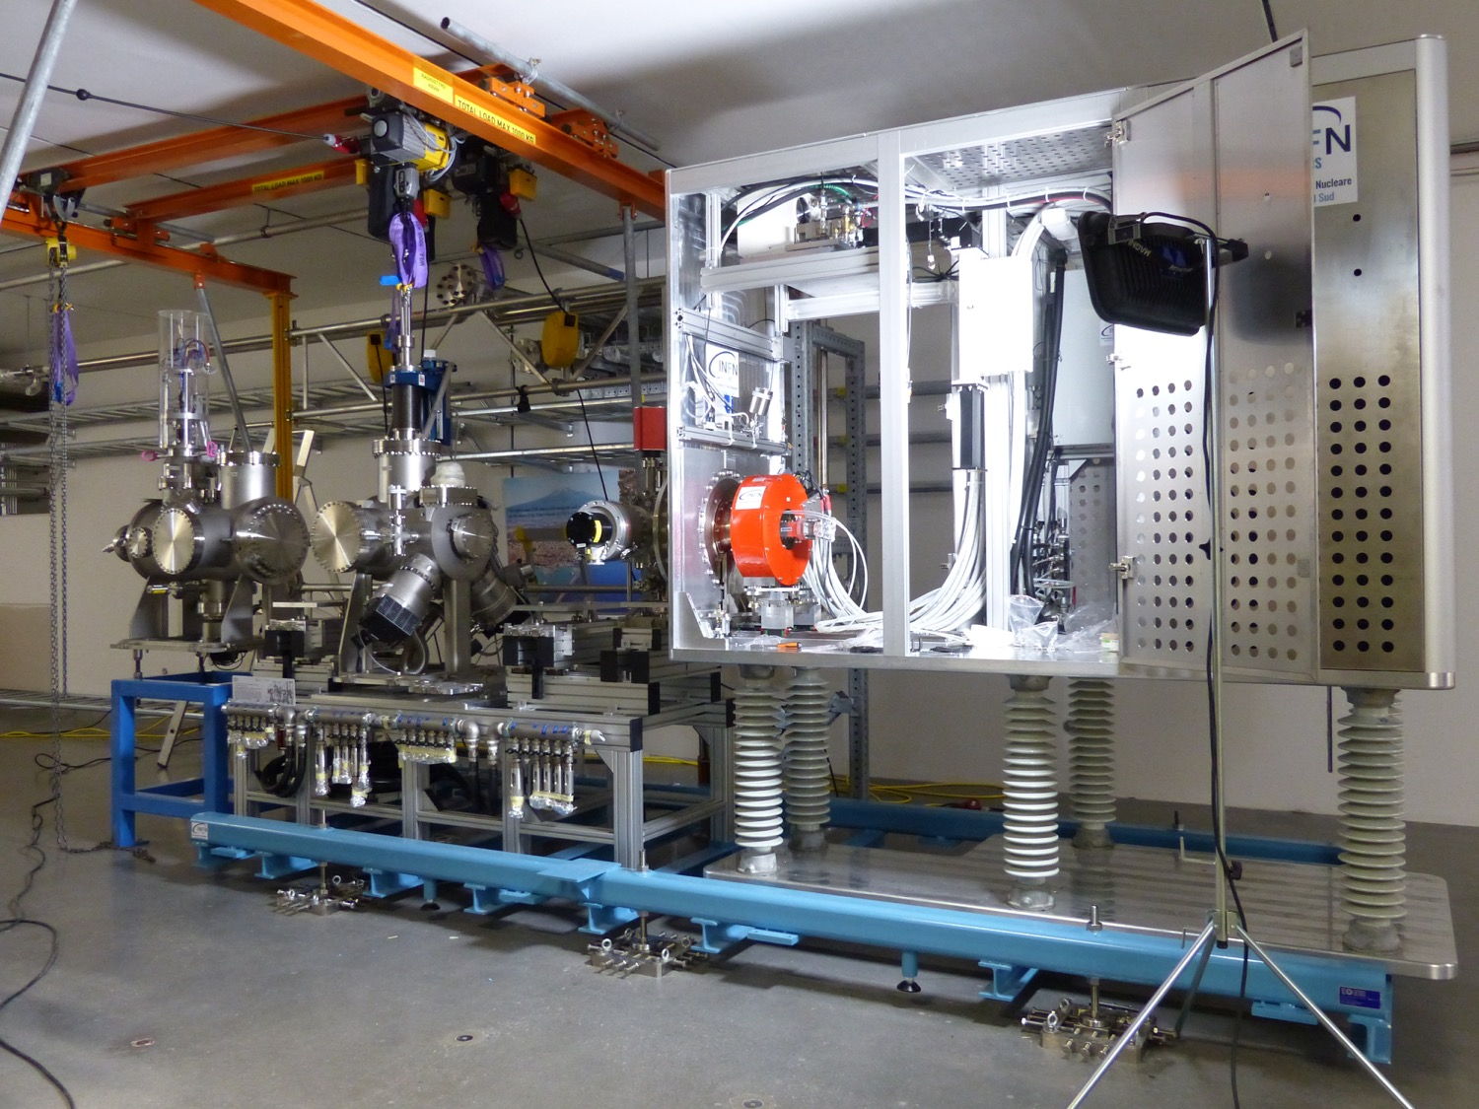
Ion source & LEBT installation

Slide 18
Licensing process and timeline (agreed on June 2018)
Ref Doc ready 2018-06-30
Ref Doc ready 2019-11-15
Ref Doc ready 2020-10-30
PSAR updated
PSAR updated
PSAR updated
Self Assessment
Self Assessment
Self Assessment
ESS
Independent Safety Review
Independent Safety Review
Independent Safety Review
Submission 2018-12-15
Submission 2020-04-30
Submission 2021-04-15
Response to
questions
SRR2
SRR4
SRR5
Subm.
Submission
Submission
SRR1
SRR
RFQBeam
BoD
RBoT
BoT
IoS Beam
2017
2019
2020
2021
2022
IoS
permit
IoS
Extension
For Klystron test
IoS Extension
For cavity test
TS2
Extension
Conditional permit
Conditional permit
Conditional permit
Warm LINAC trial operation review
SC LINAC trial operation review
Intentional neutron production trial operation review
SSM
RFQ – Radio Frequency Quadropole
BoD – Beam on Dump
BoT - Beam on Target
RBoT - Ready for Beam on Target
PSAR – Preliminary Safety Analysis Report
SRR - Safety Readiness Review
SSM – Swedish Radiation Safety Authority
Currently ESS holds a license for construction, installation and operation of ion source and LEBT (as of June 2018); also for storing and using radioactive source

Slide 19
Safety Readiness Review
SRR process at ESS is equivalent of the Accelerator Readiness Review process for the national labs in the US.
The purpose of the SRR process it to review the readiness to safely commission and operate a system.
The SRR is a process by which hardware, personnel and procedures associated with commissioning and operation of the system is verified.
SRR is organized by ESH&Q using external and internal (independent) reviewers.
SRR1 (for ion source and LEBT) was performed on July 2018

Slide 20
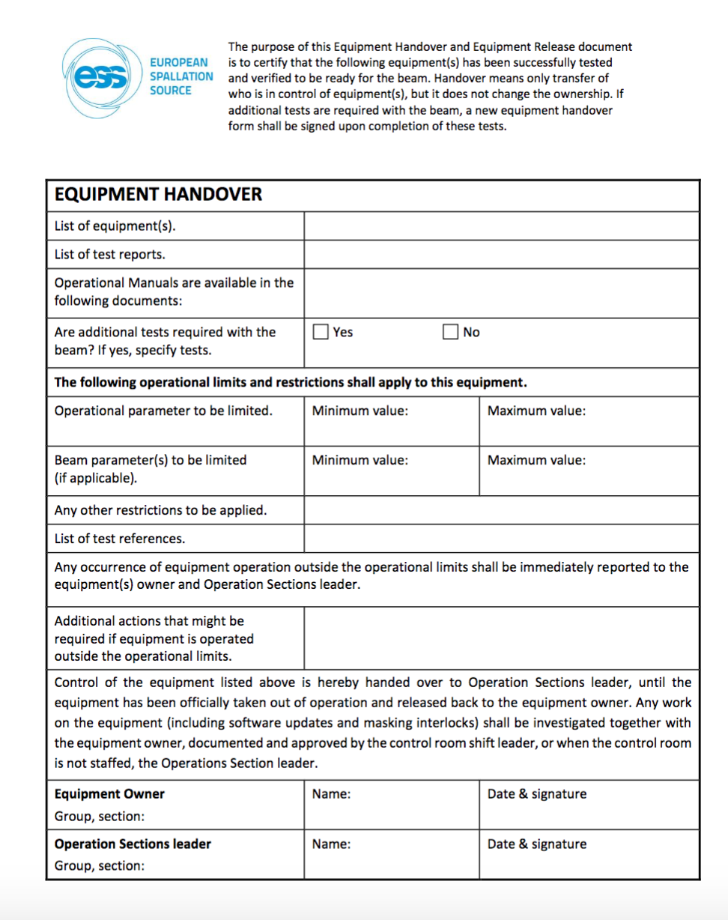
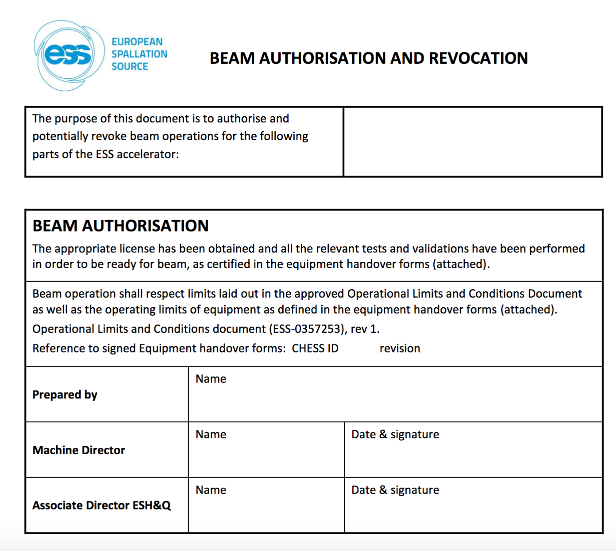
Beam Permit
Pre-start items were finished, relevant equipment was handed over to the operations section and the beam permit was signed by the laboratory management on September 19th
Pre-requisite for beam permit:
  Equipment handover
  Operational Limits and Conditions (safety envelope)

Slide 21



Beam commissioning
We do the beam commissioning under the “operations organization”
The beam commissioning activities are performed from the control room, under the shift leader
A commissioning / study leader is present and the system experts are called as necessary
Operations section
Shift leaders/operators
System group
Study leader
System group
System group
System group
Currently staff from the technical divisions are trained and perform the role of the shift leader on rotation
Training program is generated and run by the operations section
WE WILL BE HIRING SHIFT LEADERS and OPERATORS SOON

Slide 22
Joint installation/commissioning on construction site
We are in construction, installation and commissioning simultaneously
We follow the rules for construction site
A tight link is established between the stakeholders from the installation and operations
8:30 am daily meetings in control room where the plan of the day (commissioning) is announced and installation coordinators are present to comment/inform about possible conflicting activities

Slide 23
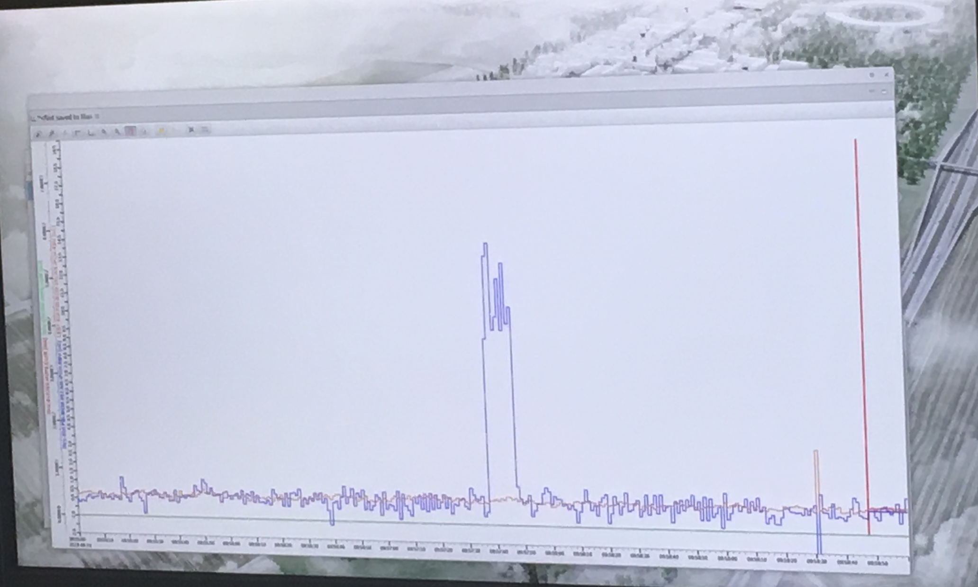
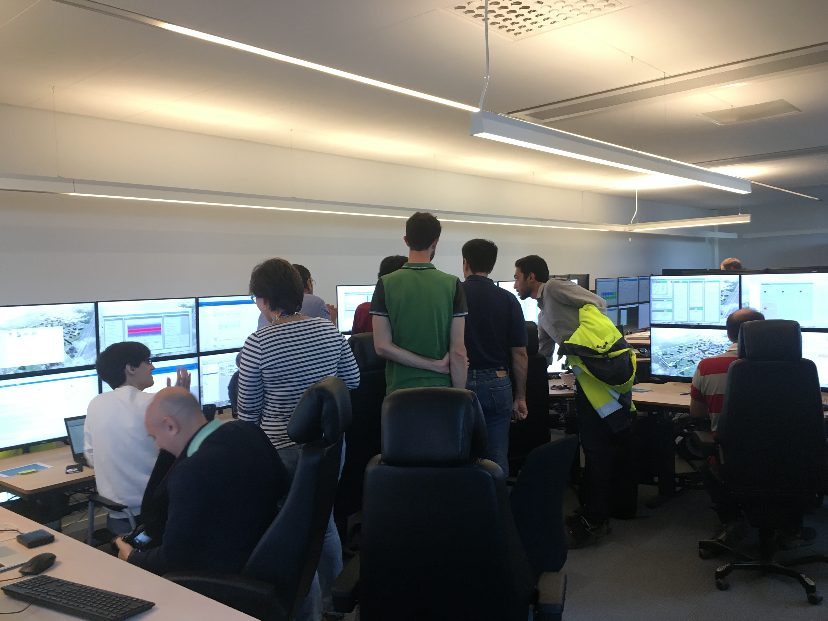
First results of beam commissioning
See Marc Munoz’s poster later

Slide 24
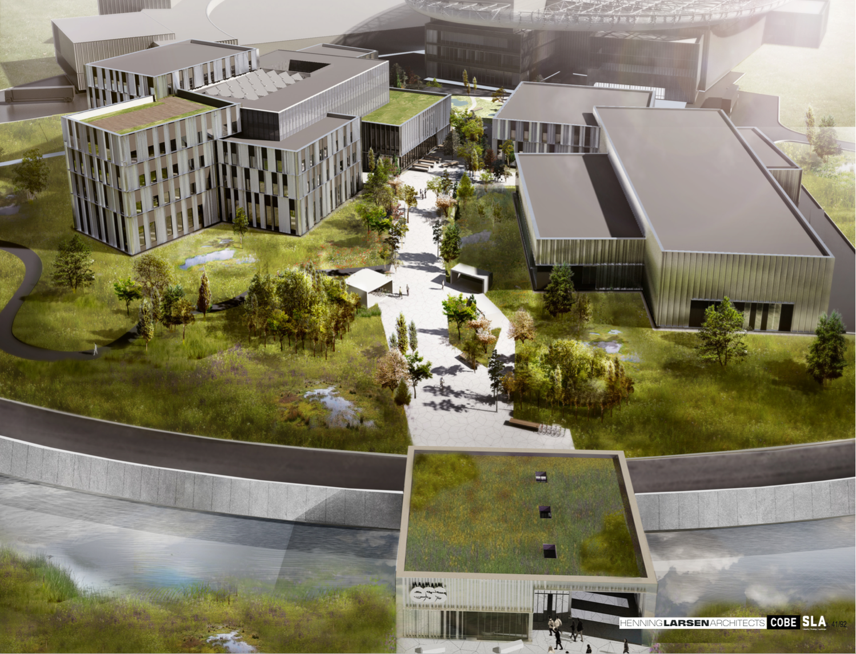


Campus
Thank you!

