Slide 1
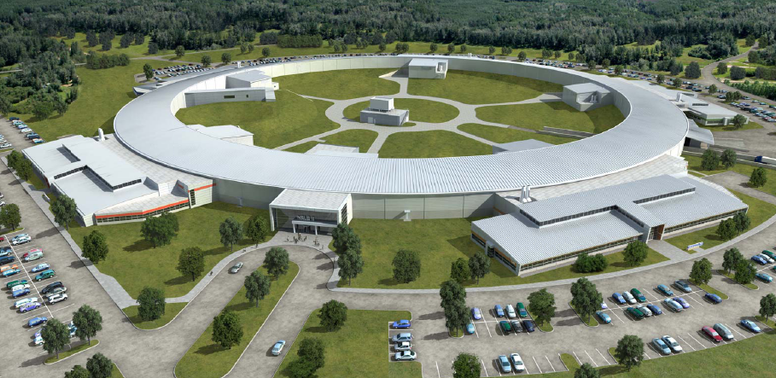
Developing Machine Learning Algorithms for NSLS-II Linac with Operators
Ray Fliller, Charles Gardner, Philip Marino, Robert Rainer, Michael Santana, Gary Weiner, Edward Zeitler
Workshop on Accelerator Operations
October 5, 2018

Slide 2
What is the Problem?
There are long term (hours/days) drifts in the tuning of the linac relative to the booster.
This is usually manifested as:
Changes in the efficiency through the LTB
Changes in booster injection efficiency
Changes in the booster injection orbit
This drift is an energy drift.
The consequences of leaving it uncorrected:
This loss in efficiency will demand more charge from the injector for top off.
If the efficiency from the linac to the storage ring is bad enough, the charge will go out of the acceptable range for the beam loading compensation. This will make the booster injection efficiency worse as the tail bunches in the train will be outside of the momentum acceptance of the LTB and get lost.
This will cause the current in the ring to drop and then require more charge on the next shot, making the issue worse.
The injector may work itself into a place where it cannot keep up with top off.

Slide 3
Subharmonic prebuncher phase

Slide 4
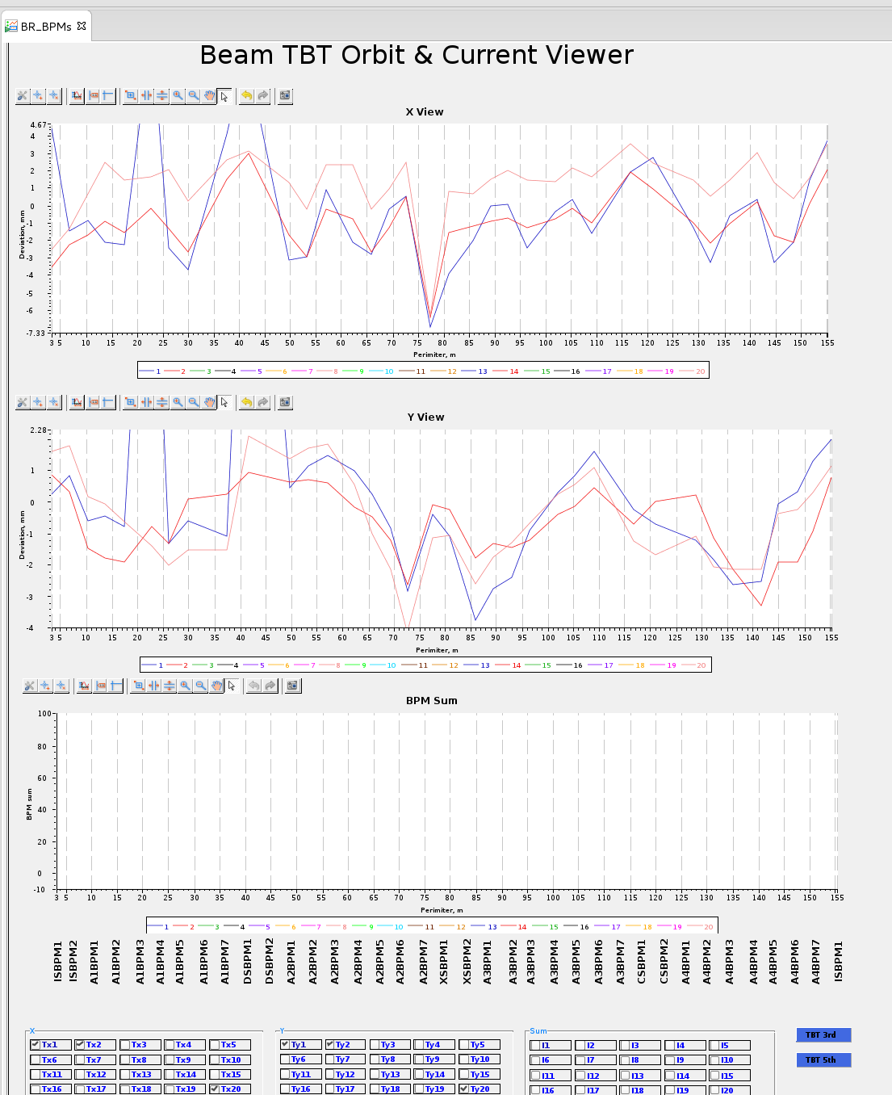
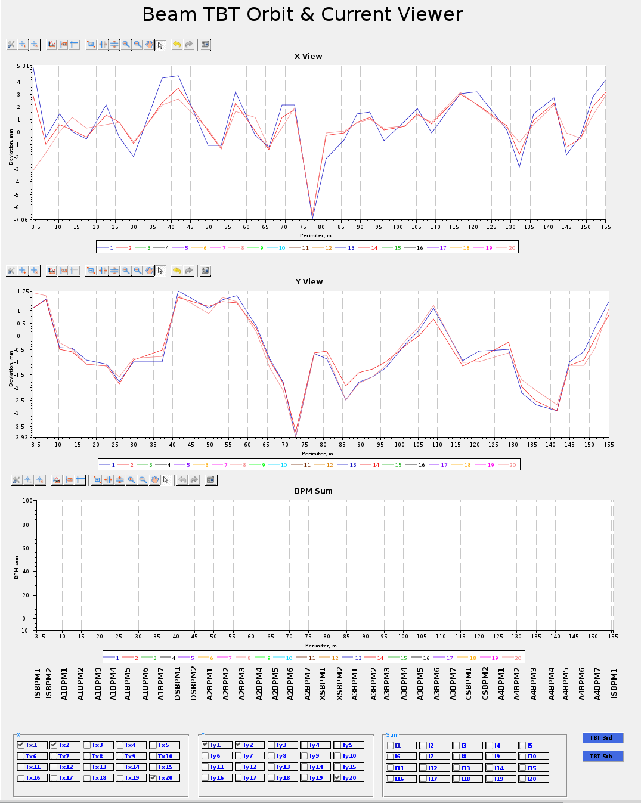
Example
In this example, klystron 2 input was raised from 0.517 (left) to 0.536 (right)
Raising klystron 2 brings all of the turns on top of each other
Turn 20 (salmon) is above turns 1(blue) and 2(red)
This indicates the energy from the linac is too low

Slide 5
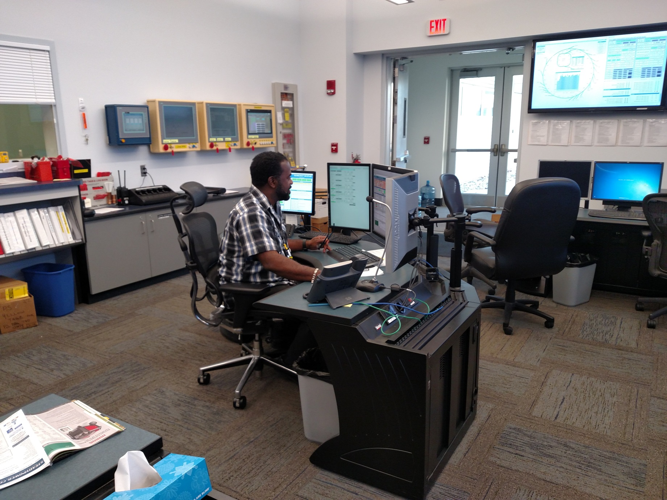
Neural Network
Here is the neural network that corrected this

Slide 6
What are the things to watch
The telltale signs are fairly clear:
Lowered LTB efficiency is a sign that the SPB phase needs to change
If the booster injection efficiency is low, and the LTB efficiency is O.K., then looking at the booster injection orbit in turns 1,2, and 20 will tell you that the energy is mismatched. This can be used to adjust the second klystron.
These are coupled as changing the phase of the SPB effects the beam energy if the adjustments are more than a few degrees.

Slide 7
Difficulties in modeling
The fundamental issue we were facing is that the power from the linac klystrons was changing enough that it induced a drift in the linac beam energy and correlated energy spread.
We knew some of the causes of the drifts:
The klystrons had a record of arcing 1/klystron/shift. After recovery, the power would be high and slowly drop as the vacuum recovered.
We suspected thermal effects in the klystrons as we would see day/night effects sometimes or see changes if the temperature changed a lot during the day or night.
The temperature in the klystron gallery is not well regulated (though it should be!)
It was not worth investing the time to accurately model the klystrons as we were (are) in the process of replacing them all.
Truth be told, this drift was the least of our worries with the klystrons.
Nevertheless we had a problem that needed to be solved and we had a method of solving it.

Slide 8
The plan
The idea was to construct a Neural Network that would look at the LtB and Booster BPMs, along with beam charge measurements to determine what corrections are made.
Did it need to be a Neural Network? No. But why not?
We could start with a simple problem, and if it worked out, we could expand out from there.
Many of the operators were excited about the prospect and were eager to be involved in any way they could.

Slide 9
Involving the Operators – the Good
From the physicists point of view there are advantages to using the operators:
They are there.
As a professor once told me, “The data collection should be the most boring part.”
See point 1.
Some operators are good at controls work.
Frees me up to do other things that the operators can’t do.
Operators are usually very vocal about bad UI
So I let them do it!
Operators are also good at testing the system and finding what doesn’t work – especially “when it should”.
They are very good at following instructions.

Slide 10
Involving the Operators – the Bad
There are some disadvantages.
Shift work may not always be convenient for the project. If one has a specific task that can not be shared with the others, this can lead to staccato progress.
When the controls person is on the night shift and needs to consult with me, we can only discuss at the end of his shift, when he would rather go home to sleep.
They are there to operate – so when something comes up they must respond.
Which means that if your data collection or testing suffers, that is too bad for you.
They are very good at following instructions – exactly as you gave them – even if the instructions are wrong.
Of course this is not their fault…

Slide 11
So what did we do
Much of the work involved data collection – which all of the operators performed.
This was pretty much “set it and forget it”.
On machine studies that did not require the injector, the operators were instructed what data to take and how much.
They had a script which would collect the necessary data.
The UI and the EPICS work was done by an operator.
This way I did not need to focus on making that piece work.
He already had the necessary experience.
Once we had something functional the operators would test it in operations – or gather data to prove it’s functionality.
This could be done during operations – which was highly convenient.
We used the python KERAS package which is a layer on top of TENSORFLOW for the neural network construction

Slide 12
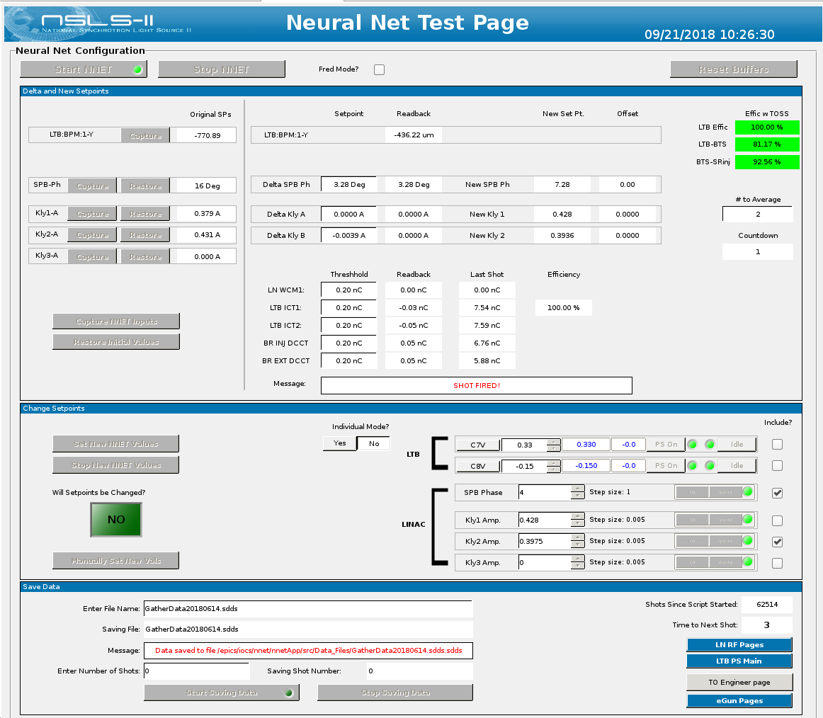

Slide 13
Training Data
For us, we measured:
BPMS in the booster on turns 1,2, 20.
ICTs in the LTB
LB-P1 These will be the inputs to the ANN
And we changed:
SPB phase
Kly2 amplitude
These will be the outputs
Beam charge/ pulse length (just in case)
25% of the data was reserved for validation of the NNET.
We collected 2 datasets using 2 different klystrons for kly2.
2700 points in set 1
5400 points in set 2
We developed 4 models:
A response matrix from set 1
A NNET for set 1
A NNET for set 2
A high order polynomial for set 2.

Slide 14
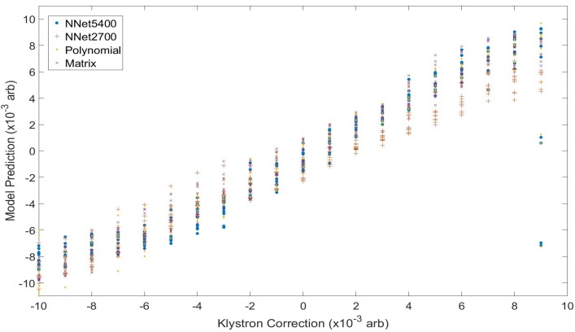
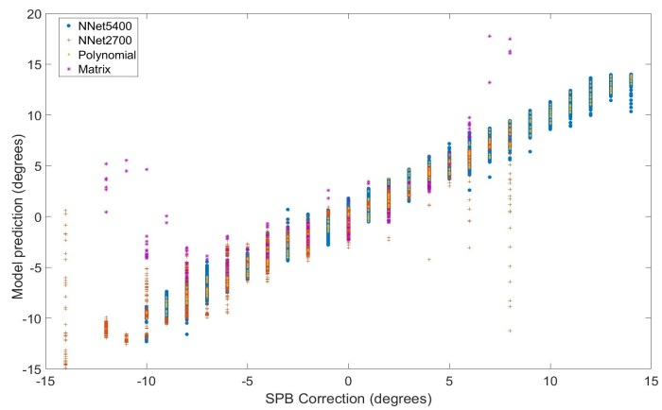
Comparison of all of the models
All models correctly predict the klystron correction
The response matrix fails to make the correct prediction a outside of +/-5 degrees

Slide 15
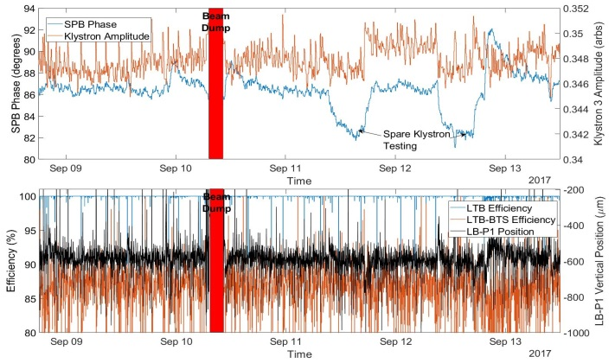
NNet2700

Slide 16
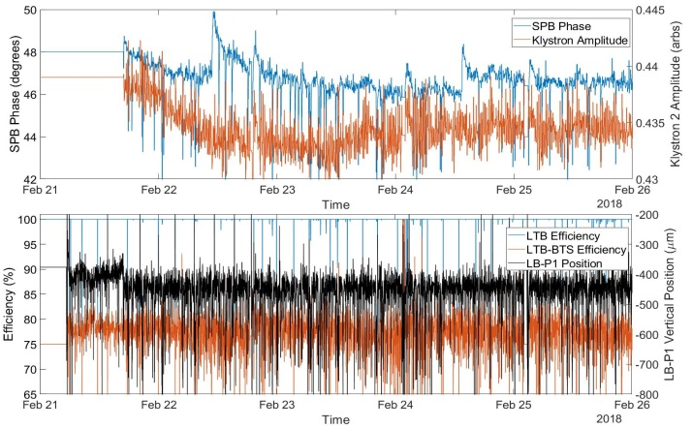
NNet5400

Slide 17
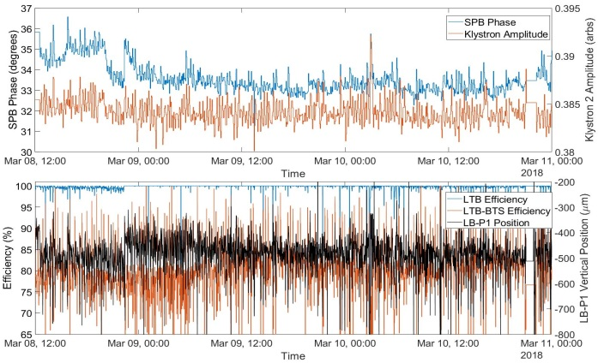
Polynominals

Slide 18
RMS Corrections and Results
Model | SPB Phase | Klystron Amplitude (x10-3) | LTB efficiency (%) | Injector efficiency (%)
NNet2700 | 0.8 | 1.5 | 97.9±7.5 | 83±10
NNet5400 | 2.5 | 3.7 | 99.6±3.5 | 77±4
Polynomials | 1.3 | 2.6 | 99.3±3.9 | 80±8
Each model corrected the linac well
NNet5400 took larger steps in its corrections, compared to NNet2700, which may be because the step size in the dataset is twice as large.

Slide 19
Some Random Thoughts on Machine Learning
In some sense it is the art of black box construction.
It is not clear how, or even what rules of thumb to use, to construct the black box.
It is a way to construct a solution to a problem when the path to the solution is not known or exceedingly difficult (alphaGo).
Some are obviously uncomfortable with machine learning techniques for control, but what about data mining or fault prediction.
It does seem at the moment that “Machine Learning” is the new “Genetic Algorithm”.

Slide 20
Conclusions
The operations group successfully made a Neural Network to correct the NSLS-II linac energy drifts to maintain booster injection efficiency during top off operation.
All operators were involved in the project.
The NNet has been successfully used in operation.
Judgement Day has not arrived.
And the NNet has not put the operators out of a job.
Yet?

