Slide 1
Machine Learning @ SLAC
William Colocho, Matt Gibbs, Chris Zimmer

Slide 2
Outline
A word on Automation and the need for Tuning at LCLS
Machine Learning for Particle Accelerators Workshop 2018
SPEAR3 and LCLS Applications
SLAC NAL science
Questions

Slide 3
SLAC

Slide 4
ML in Particle Accelerators: The Need to Tune
Complex beam parameter space with complex coupling between parameters, sometimes nonlinear responses.
Limited diagnostics
Time varying performance (Jitter, Drift, Reproducibility)
LCLS FEL require configuration changes for dedicated users: different charge, energy, pulse duration, undulator settings…
Different operating modes: twin bunches, two bunches , sliced bunch for two pulses
Restoring configurations does not restore performance → Tune.
For LCLS Tuning = Downtime

Slide 5
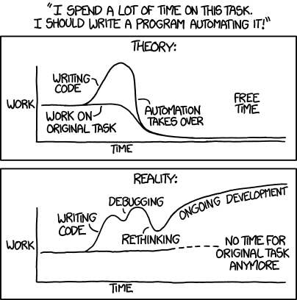
The Need to Automate
Free up person time for other tasks
Improve reproducibility of result
Reduce time to get task done
Let human concentrate on the hard problems
General Approach
Measure effort of task
Person hours per week
Machine time
Personnel training
How to train with no access to machine
Predict effort of automation
Development, Test, Deployment, Maintenance
Risk of acceptance by humans
Options when automatic system fails
What is gained/lost by automation
https://xkcd.com/1319/
Notes:
“Star” operator finding best performance (Lanny on damping rings tuning)

Slide 6
Weekly ML Seminar @SLAC
https://confluence.slac.stanford.edu/display/AI/AI+Seminar

Slide 7
Workshop
Agenda included:
ML Tutorial
Facility Needs (XFEL, LHC, Synchrotrons)
Tuning
Simulations and Modeling
Prognosis
Data Analysis
64 Participants
https://conf.slac.stanford.edu/icfa-ml-2018/

Slide 8
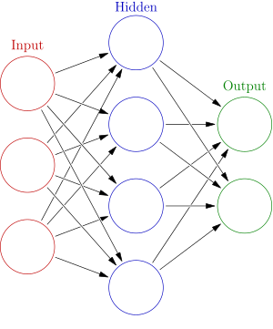
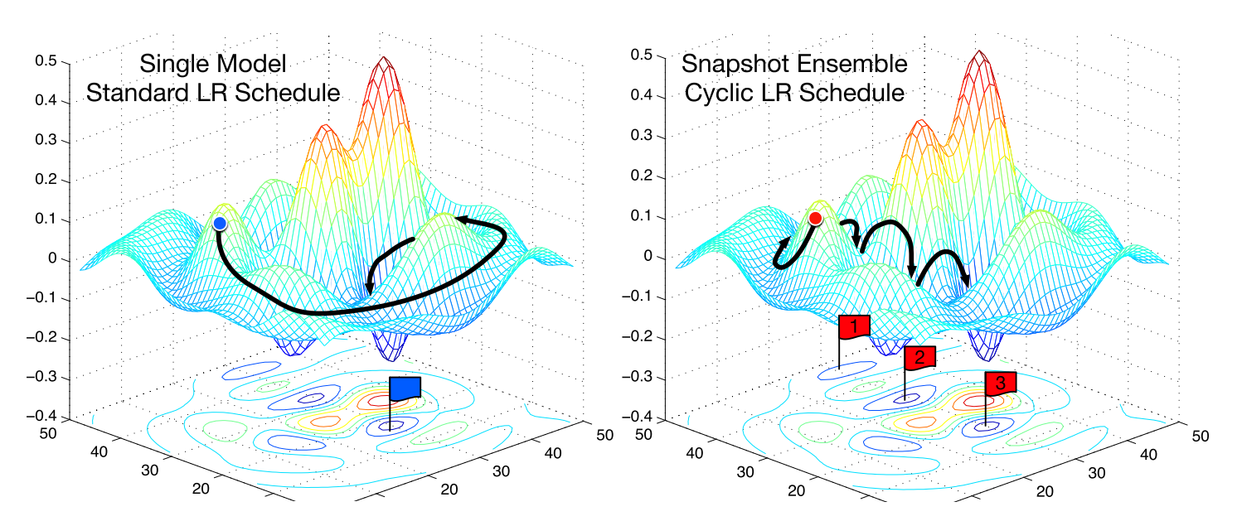
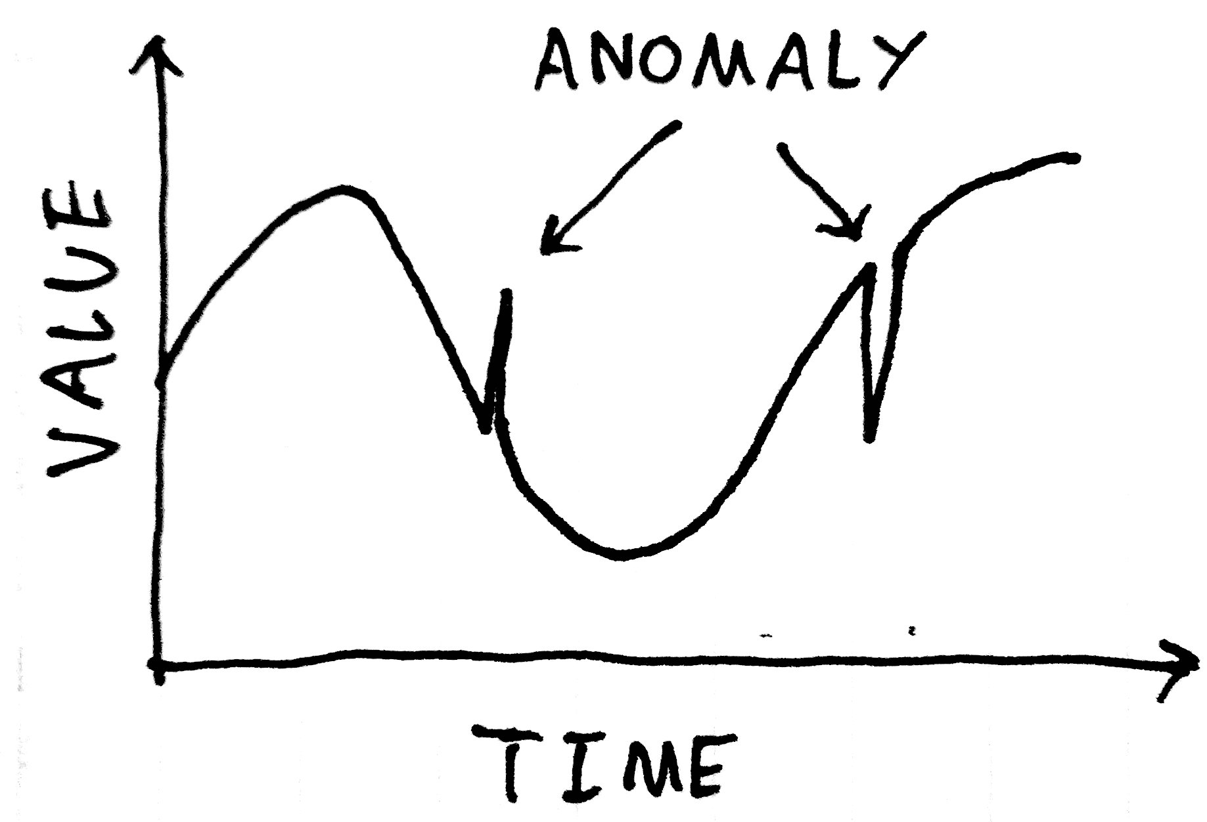
Machine Learning
“An artificial neural network is an interconnected group of nodes, akin to the vast network of neurons in a brain.” Wikipedia
Optimization
Prognostics
Notes:
Input: Pixel representation of a character; Output: Probability of being a letter “a”

Slide 9
Example: Collimator alignment – Spike detection
A predefined threshold is selected such that when the losses exceed the threshold the collimator stops moving and the data must be analyzed for spikes
Courtesy: G. Azzopardi

Slide 10
Collimation Alignment – Spike extraction
5 features extracted:
Collimator Position
Spike Height
3 parameters from exponential decay
Dataset used has about ~1500 samples (e.g. 80% training, 20% test)
Courtesy: G. Azzopardi

Slide 11
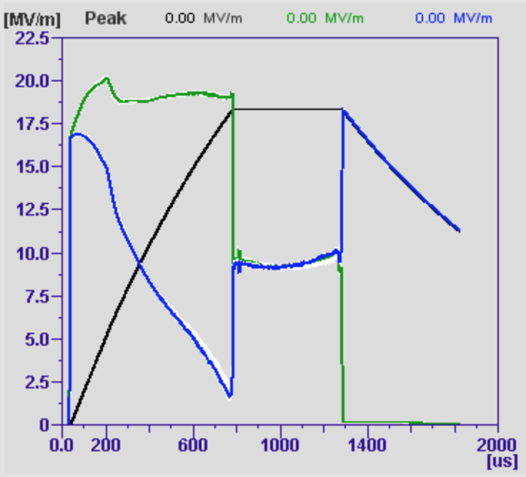
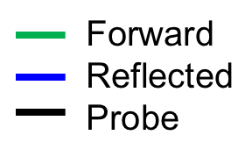
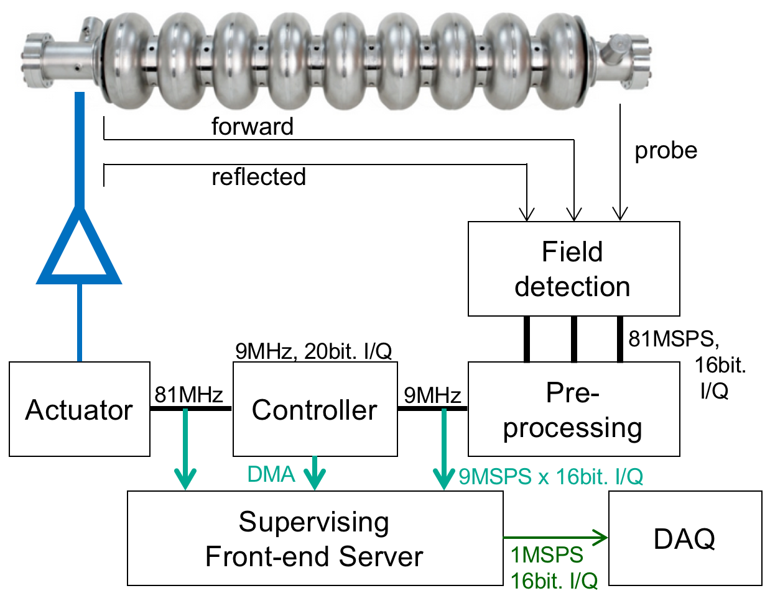
Areas for potential ML applications – Anomaly detection for the cavity signals
Cavity fault detection requires: U_{for}, U_{ref}, U_{probe}
Data rates to DAQ per cavity per pulse:
2048 x 2 x 3 x 16bit = 24.6kB
Pulses per Day = 864000
700 cavities → 604 Mio events/day
Total data/day = 14.8 TB
Good statistics (ensemble & events)
Questions we like to address:
How many cav./pulses behave normally
Cav/Pulses out of nominal operation range
Reliably quench detection and reaction
Anomalies: due to parameter changes
Anomalies: due to digital / communication/ readout

Slide 14
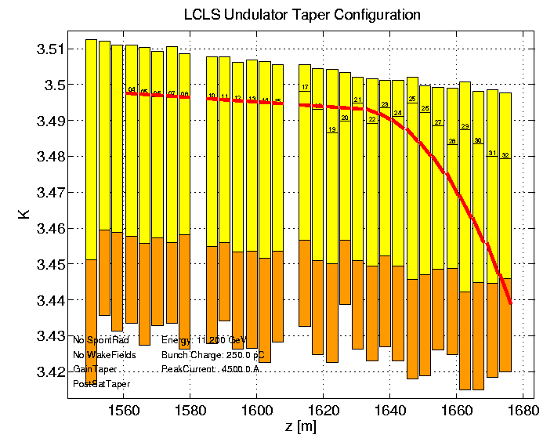
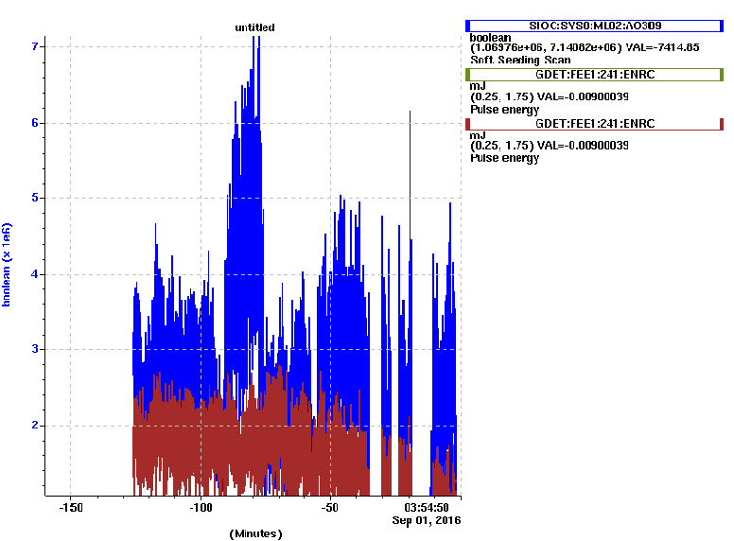
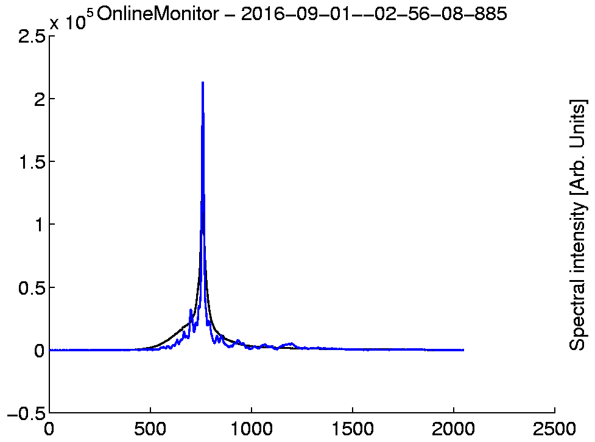
5.5 KeV Self-seeding FEL
More than doubled peak energy
Zig-zag taper profile: ~ 1 mJ in 10 fs
Paper in preparation, 2017

Slide 15
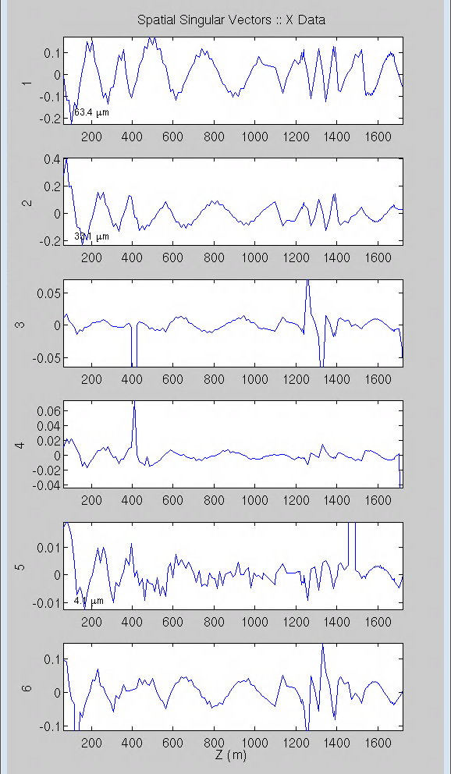
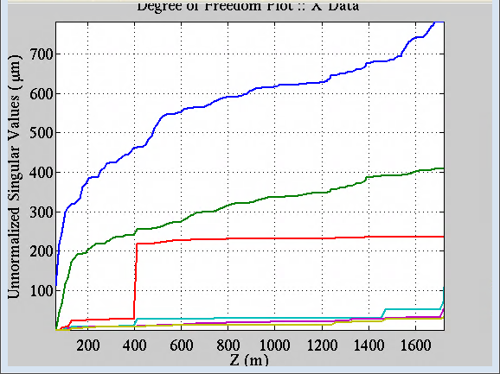
Model Independent Analysis of Beam Centroid Data
Based on principal component analysis and interpretation of SVD
Uses BPM data, mostly non-invasive
Tool to deduce lattice functions from jitter
Possibility to identify other physical functions
New tool to track reproducibility questions
Used to identify questionable BPMs and improve BPM resolution limit
Kick Analysis helpful to find kick sources.
$$β$$
$$η$$
$$β modes$$
W. Colocho

Slide 16
OCELOT - DESY
Multiphysics simulation toolkit
Online control framework for FEL and storage rings based light sources
Open source (Python)
Modules for online beam control and machine performance optimization are available.
https://github.com/iagapov/ocelot

Slide 17
Ocelot tuning @LCLS
Mitch McIntire
Mitch McIntire

Slide 18
Ocelot
The one-sentence summary of Bayesian hyper-parameter optimization is: Build a probability model of the objective function and use it to select the most promising hyper-parameters to evaluate in the true objective function. https://towardsdatascience.com/a-conceptual-explanation-of-bayesian-model-based-hyperparameter-optimization-for-machine-learning-b8172278050f
1 - Probability model from:
Past performance data (now)
Genesis simulation (future)
Neural Net Prediction (future)
2 - Bayes Rule to Select next point

Slide 19
Free Electron Laser Probability Model(s)
Mitch McIntire

Slide 20
Ways to build a training model
Mitch McIntire

Slide 21
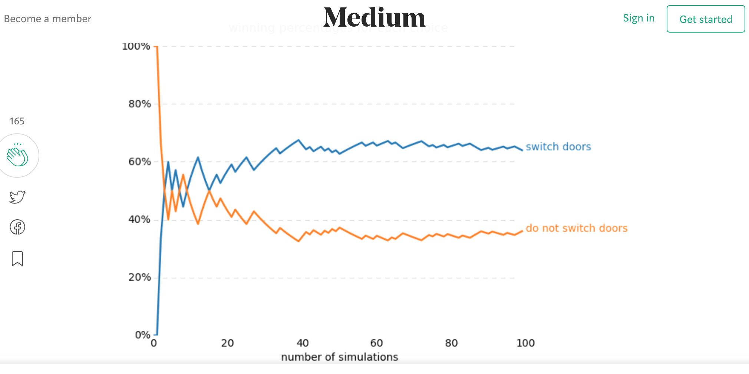
Bayes Rule

Slide 22
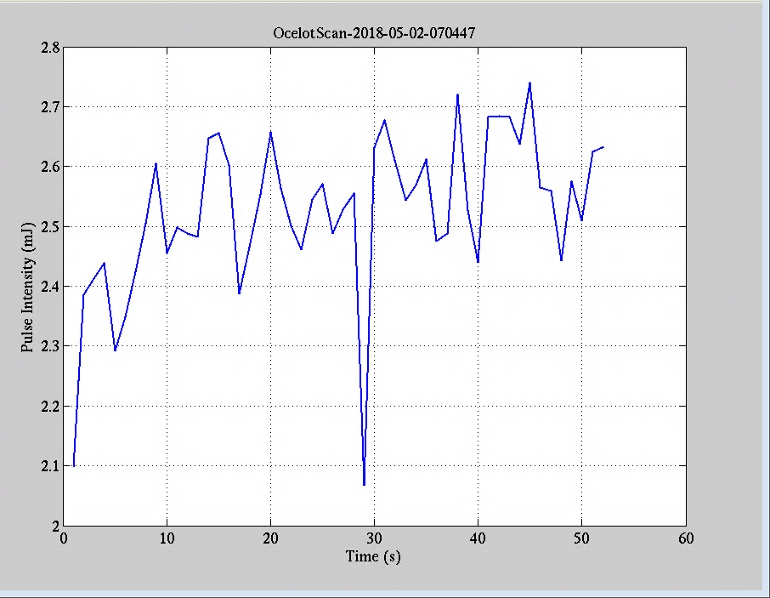
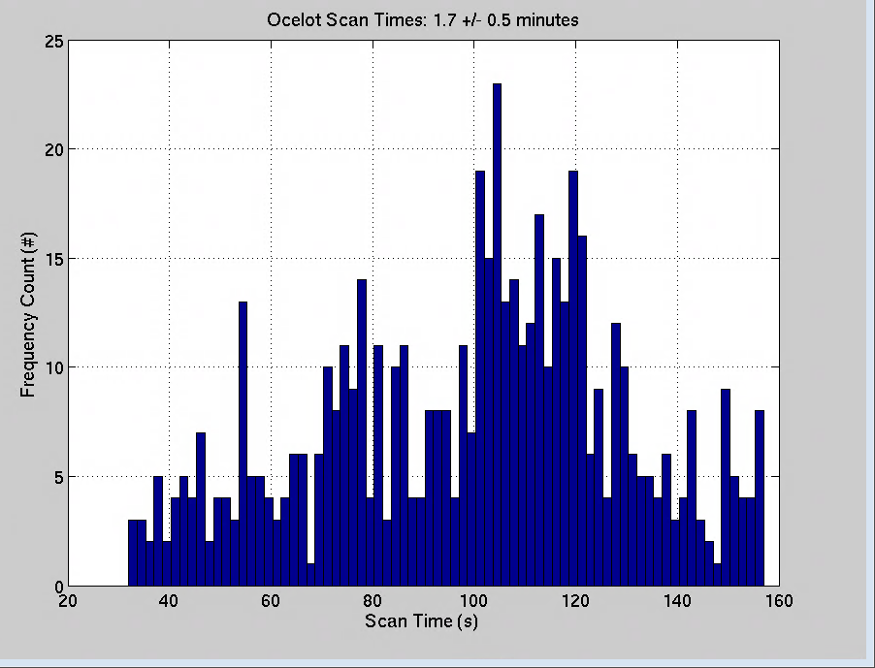
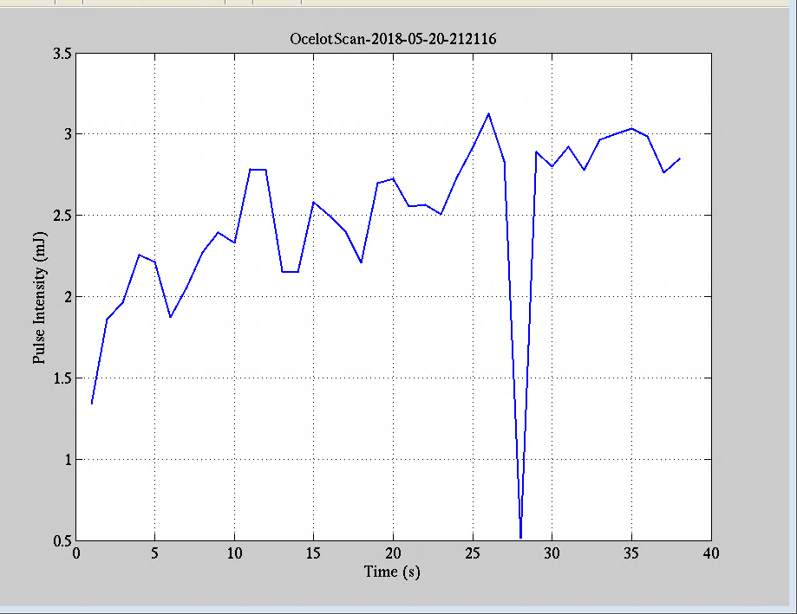
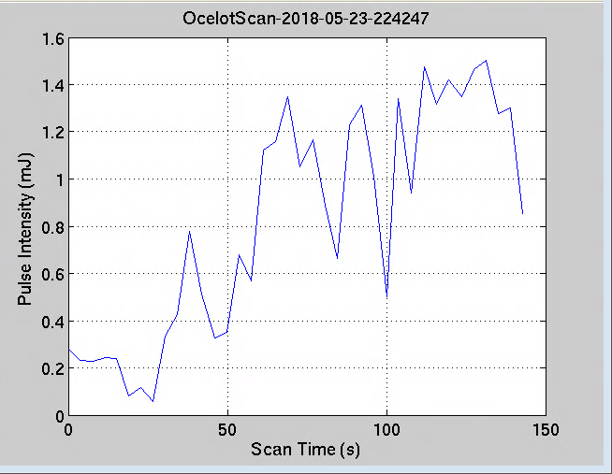
Ocelot Performance, May 2018
846 files in May (~9 per shift)
Mean scan time: 1.7 minutes
Mean scan gain: ☺

Slide 23
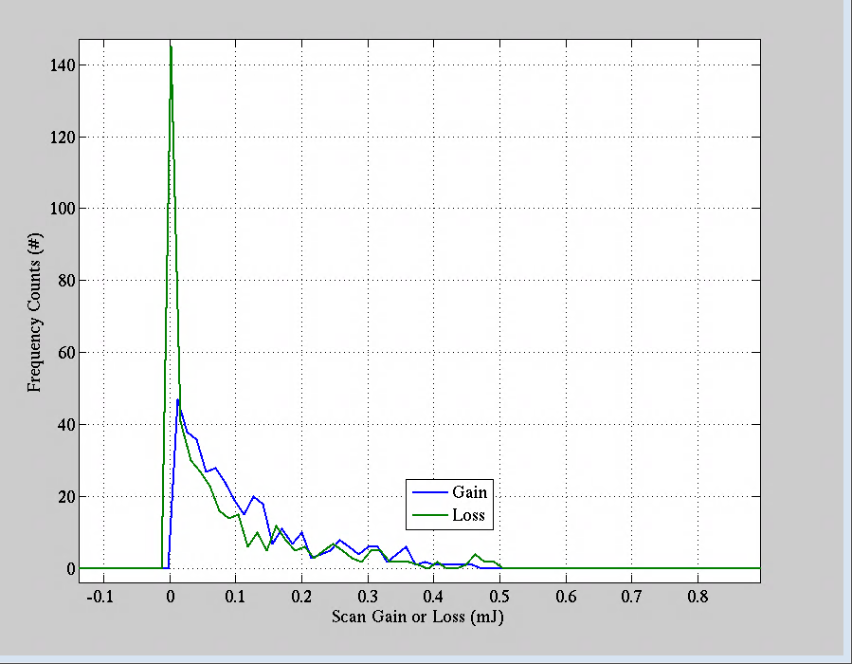
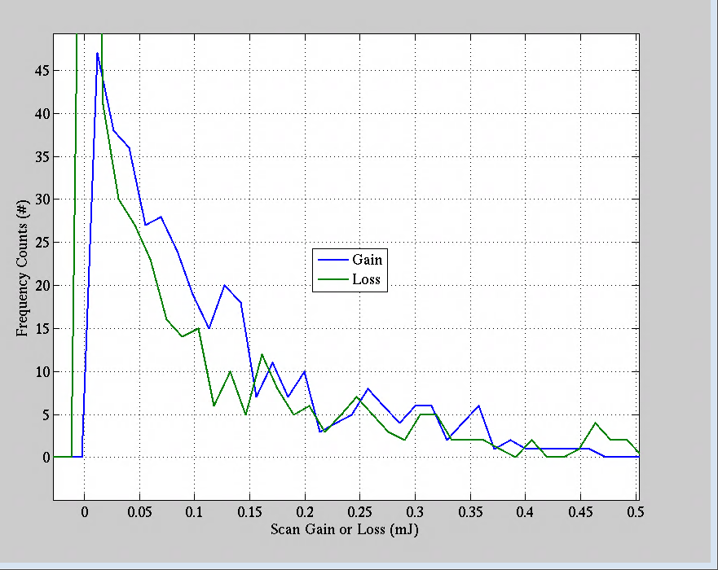
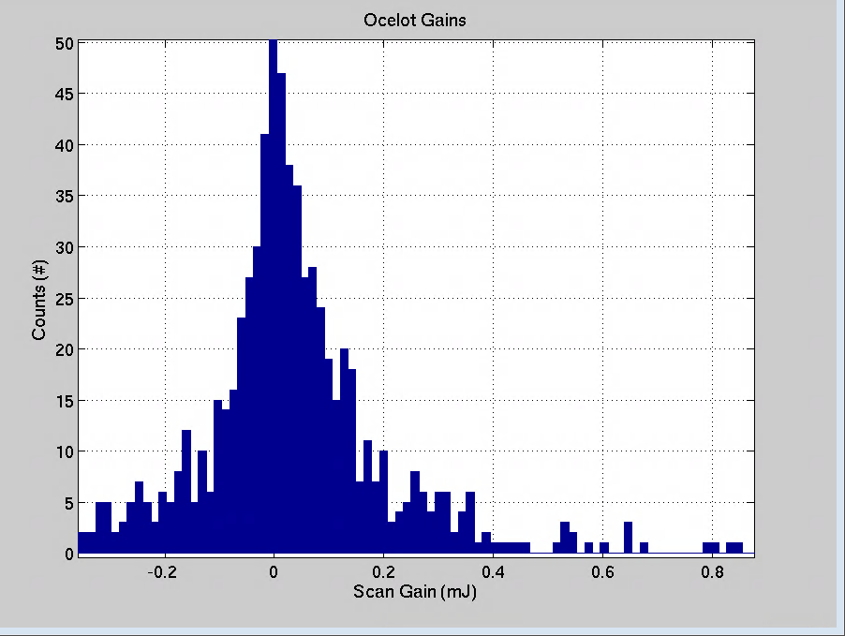
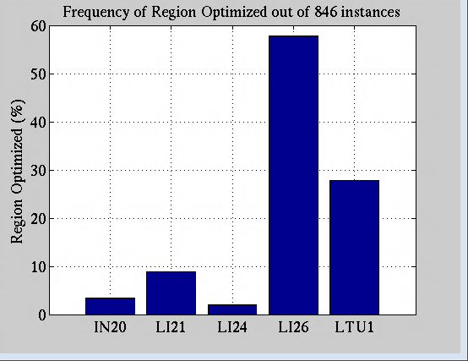
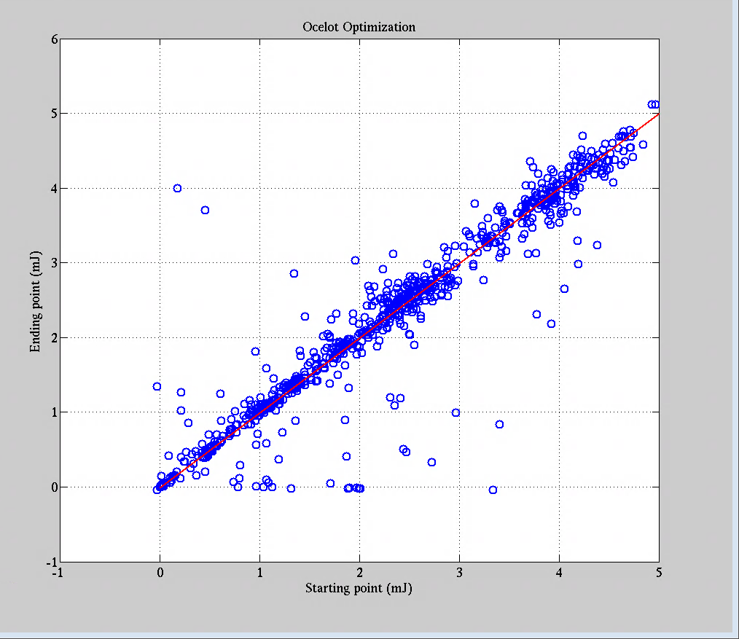
Ocelot Performance, May 2018, 846 Scans
Gain / (Gain+Loss) in 0.012 mJ to 0.2 mJ window is
59%

Slide 24
Neural Network + Extremum Seeking
Transition to Operations planned for end 2018
http://ipac2018.vrws.de/papers/thygbe1.pdf

Slide 25
LINAC Coherent Light Source - FEL

Slide 26
Catching Photosynthesis in the Act
“Photosynthesis is one of the most important chemical reactions on Earth, yet most aspects are not fundamentally understood. With the LCLS, researchers can directly observe the natural processes that convert the sun’s light into useable energy, with promising implications for America’s energy future.”

Slide 27
Facility for Advanced Accelerator Experimental Tests
FACET: Scientists have shown that a promising technique for accelerating electrons on waves of plasma is efficient enough to power a new generation of shorter, more economical accelerators. This could greatly expand their use in areas such as medicine, national security, industry and high-energy physics research.

Slide 28
Conclusion
There is a community interested in applying ML to accelerator challenges
ML techniques are beginning to be used at SLAC
At least one ML technique has been transitioned to operations at LCLS and SPEAR3

Slide 30
References
https://www6.slac.stanford.edu/news/2018-04-13-scientists-use-machine-learning-speed-discovery-metallic-glass.aspx
https://www.energy.gov/eere/amo/articles/artificial-intelligence-future-new-materials-discovery
https://conf.slac.stanford.edu/icfa-ml-2018/
https://cds.cern.ch/record/2305965/files/tupha204.pdf
https://cds.cern.ch/record/2309558/?ln=en
https://confluence.slac.stanford.edu/display/AI/AI+Seminar
http://accelconf.web.cern.ch/AccelConf/ipac2017/papers/wepab031.pdf
http://ucanalytics.com/blogs/bayes-theorem-monty-hall-problem/

