Slide 1
ARW 2019
Sheng Wang
Dongguan Branch, Institute of High Energy Physics, CAS
China Spallation Neutron Source

Slide 2
The distribution of large scientific facility
CSNS

Slide 3
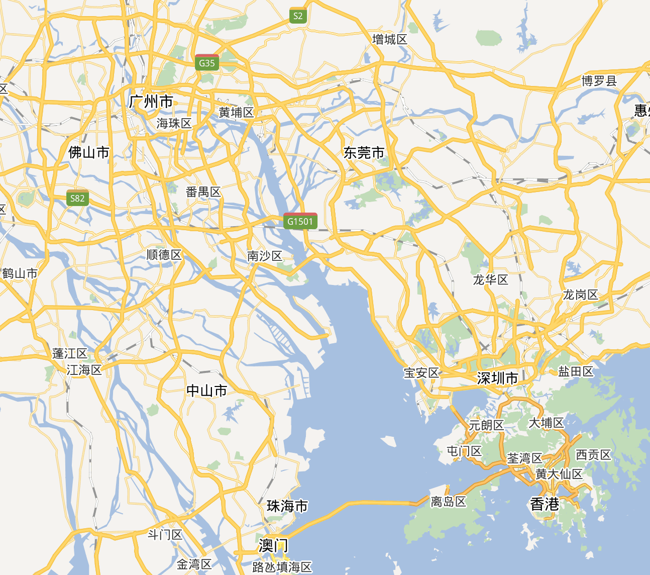
ARW 2019
Guangzhou
60km
Dongguan
CSNS
60km
Shenzhen
Hongkong

Slide 4
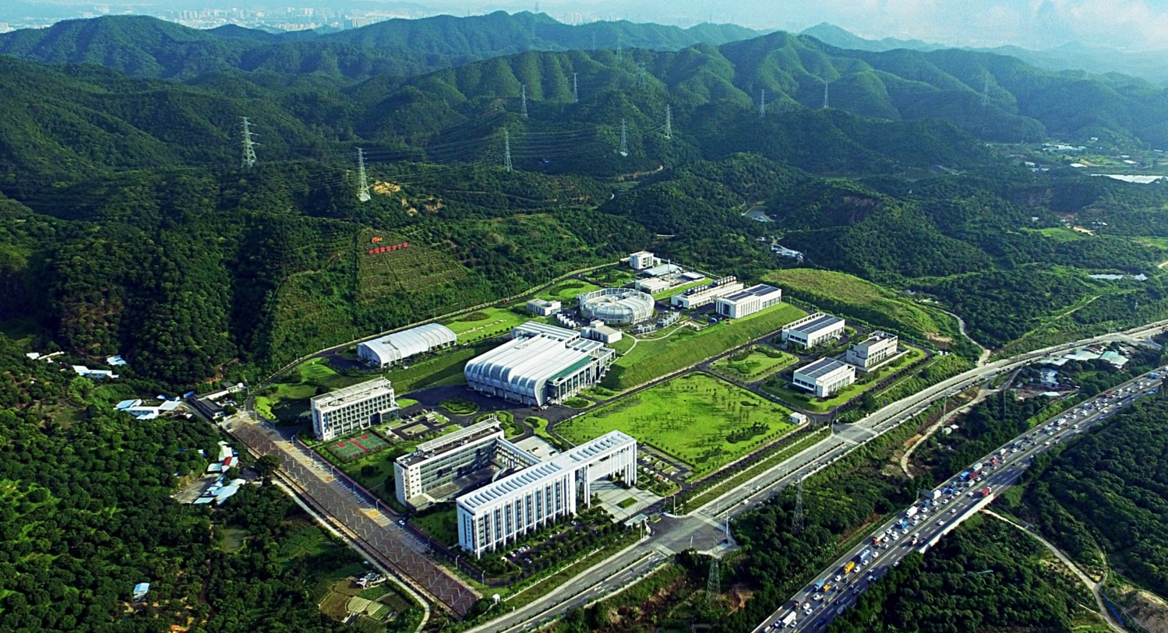
Bird-eye @ July, 2017

Slide 5
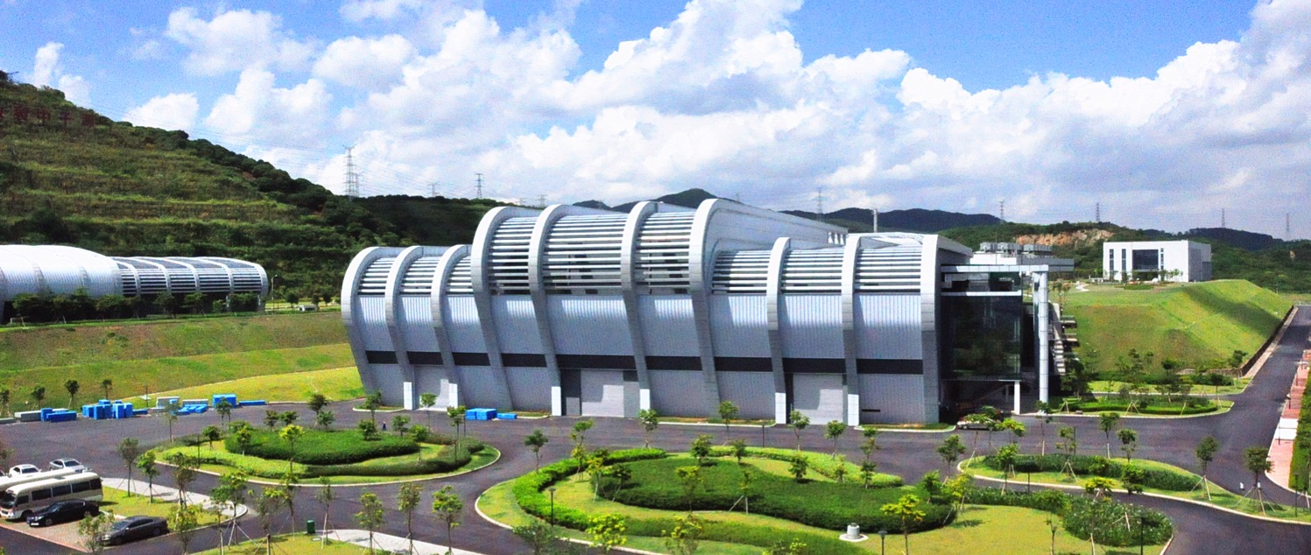
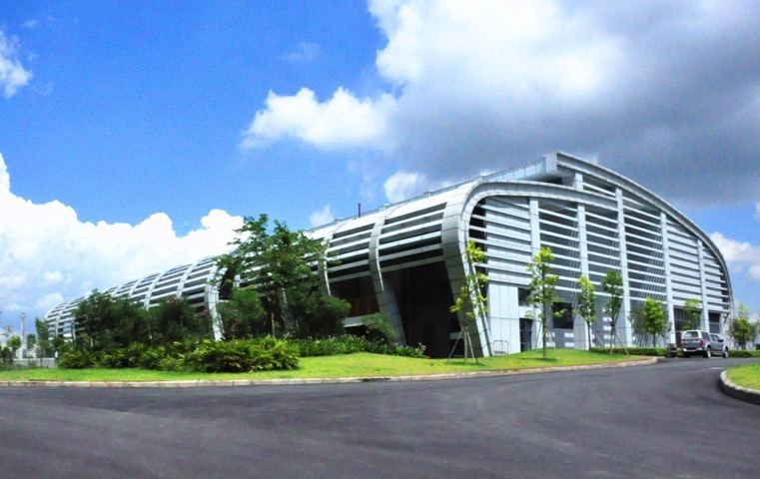
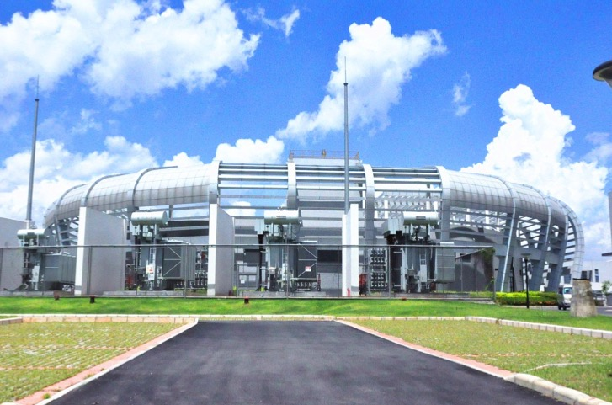
Target and experiment Hall
Linac service building
RCS service building

Slide 6
ARW 2019 Venue
Guangzhou
November 2019

Slide 7
Thank you！
See you next year in CHINA

Slide 8
Schedule
Date:
Suggested time interval
11-15Nov,2019

