Slide 1
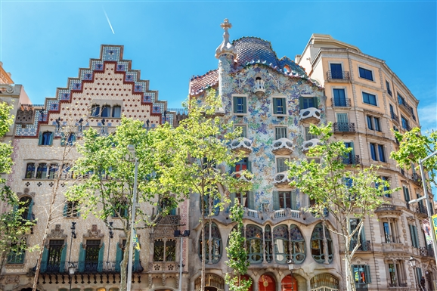
WAO’2020 LOCAL COMMITTEE REPORT
Welcome to WAO 2020 in Barcelona (Spain)

Slide 2
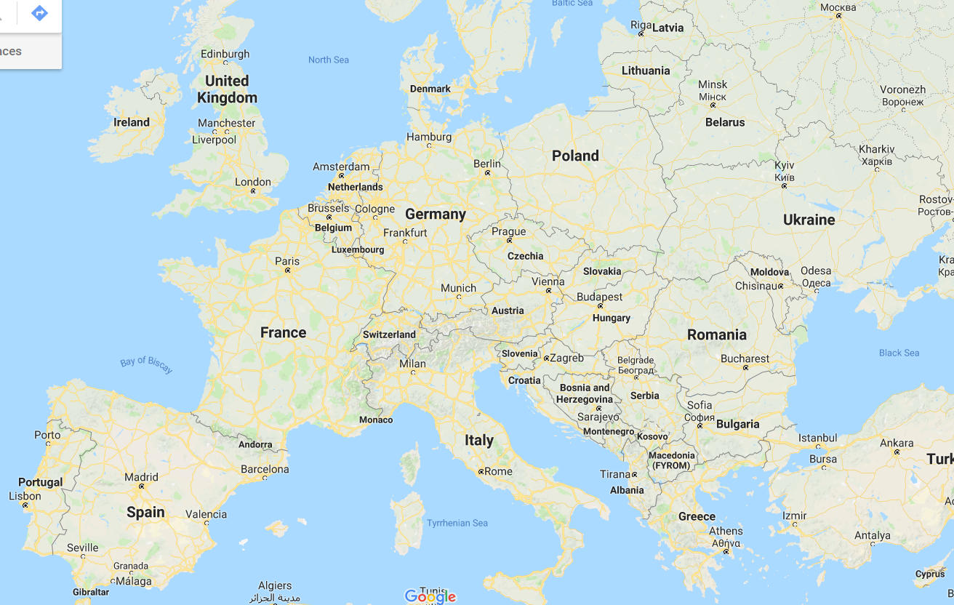
The city of Barcelona is situated on the Mediterranean coast.
It has 1.6M inhabitants and is the second city of Spain.

Slide 3
Hosted by
ALBA Synchrotron Light Source

Slide 4
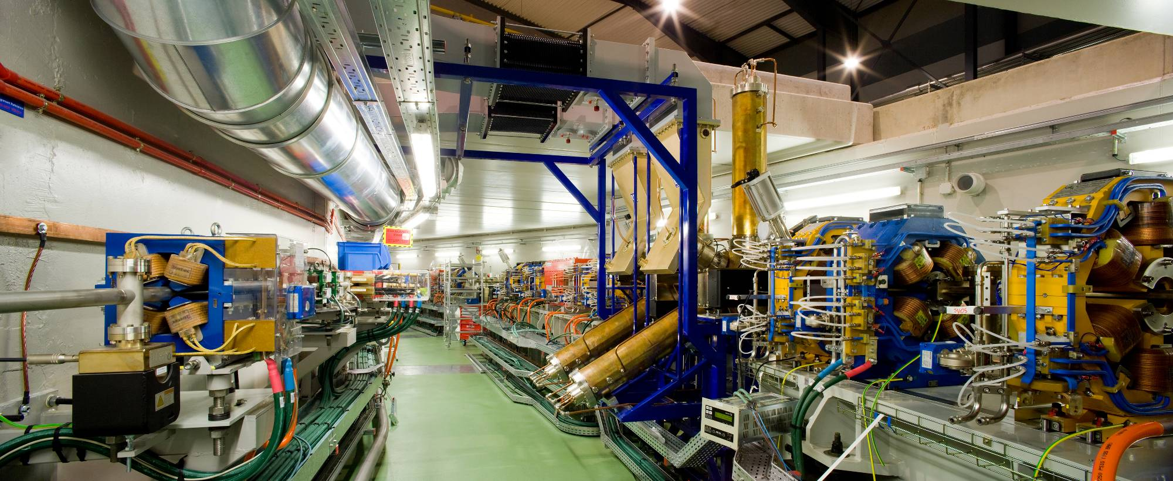
ALBA SYNCHROTRON
3 GeV electron storage ring
8 BL in operation
First users in 2012
Largest scientific installation in Spain

Slide 5
Proposed venue

Slide 6
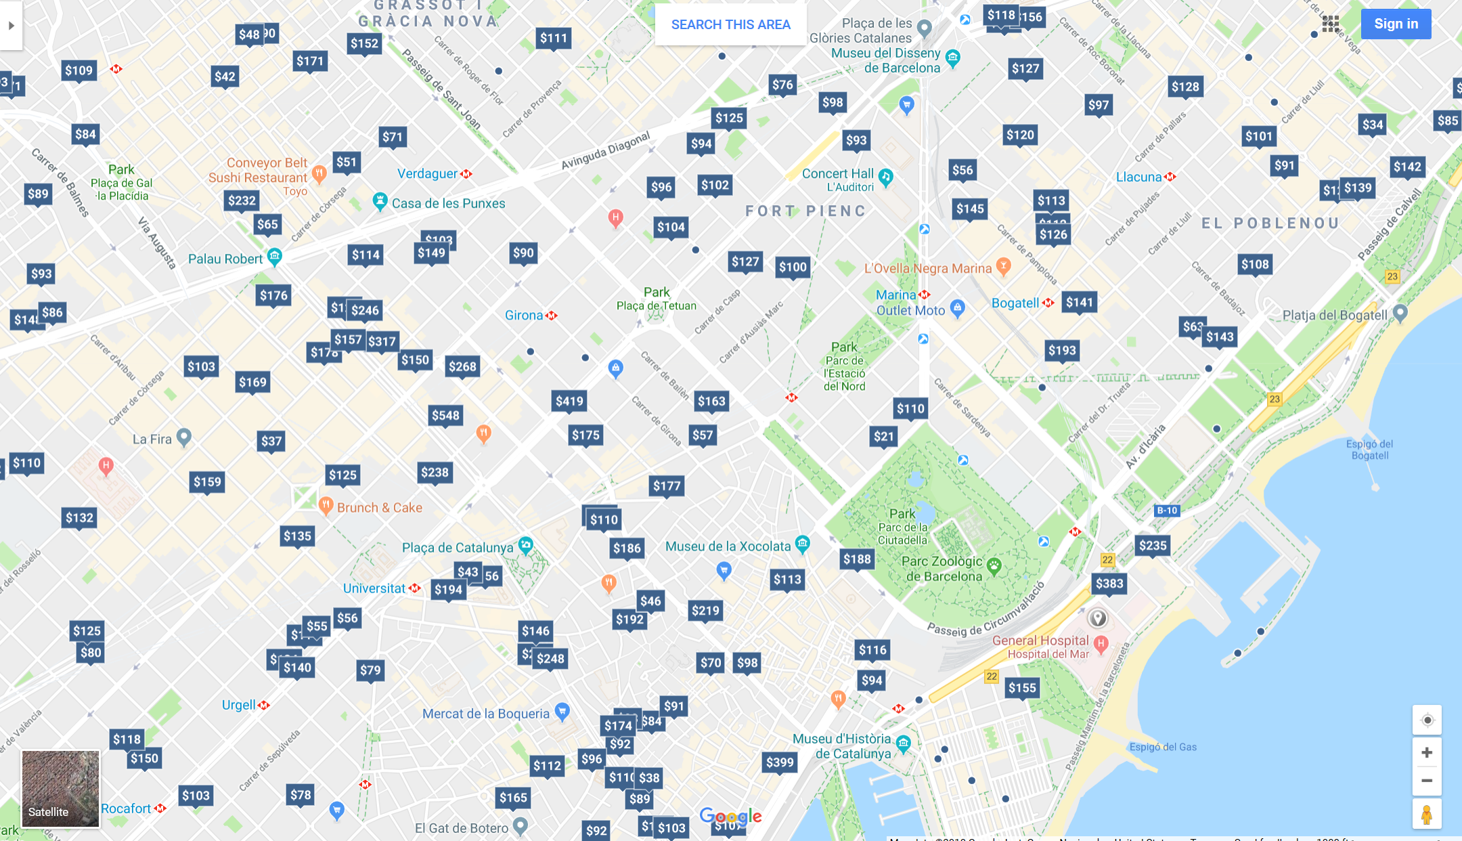
Accomodation
Barcelona offers more than 45000 hotel rooms
There is a price for each budget

Slide 7
Transportation
Barcelona can be reached by plane, train, road, ferry
BCN airport is 20 km from the city and well connected to it by public transportation and/or taxi
Proposed dates
October 2020

Slide 9
WAO’2020 LOCAL COMMITTEE REPORT
Welcome to WAO 2020 in Barcelona

