Slide 1
Survey on Operator Interfaces to Controls
Petra Schütt, Stephan Reimann

Slide 2
The survey
Survey on Operator Interfaces to Controls
  Was sent out to all registered participants of WAO18 end of July.
  Got answers from 21 institutes, for a total of 25 control rooms
  GSI Helmholtzzentrum für Schwerionenforschung GmbH
  SLAC
  SNS Spallation Neutron Source (SNS)
  ALBA ALBA synchrotron
  Fermilab
  Jefferson Lab
  Synchrotron Soleil
  NSCL Nat. Supercond. Cyclotron Laboratory at Michigan State Univ.
  Diamond Light Source
  Helmholtz-Zentrum Berlin
  TRIUMF TR13 Operations
  TRIUMF RIB Operations
  TRIUMF Driver Operations
  Heidelberg Ion Beam Therapie Centre
  Pohang Accelerator Laboratory
  Elettra-Sincrotrone Trieste
  Japan Synchrotron Radiation Research Institute (JASRI)
  DESY
  LANSCE Los Alamos Neutron Science Center
  KIT Karlsruhe Institute of Technology, KARA, FLUTE
  CERN
  S-DALINAC Institut für Kernphysik, TU Darmstadt
  BNL Brookhaven National Laboratory – Collider Accelerator Department
Raw data compiled into an Excel sheet, can be downloaded from workshop indigo site.
Some results to follow.

Slide 3
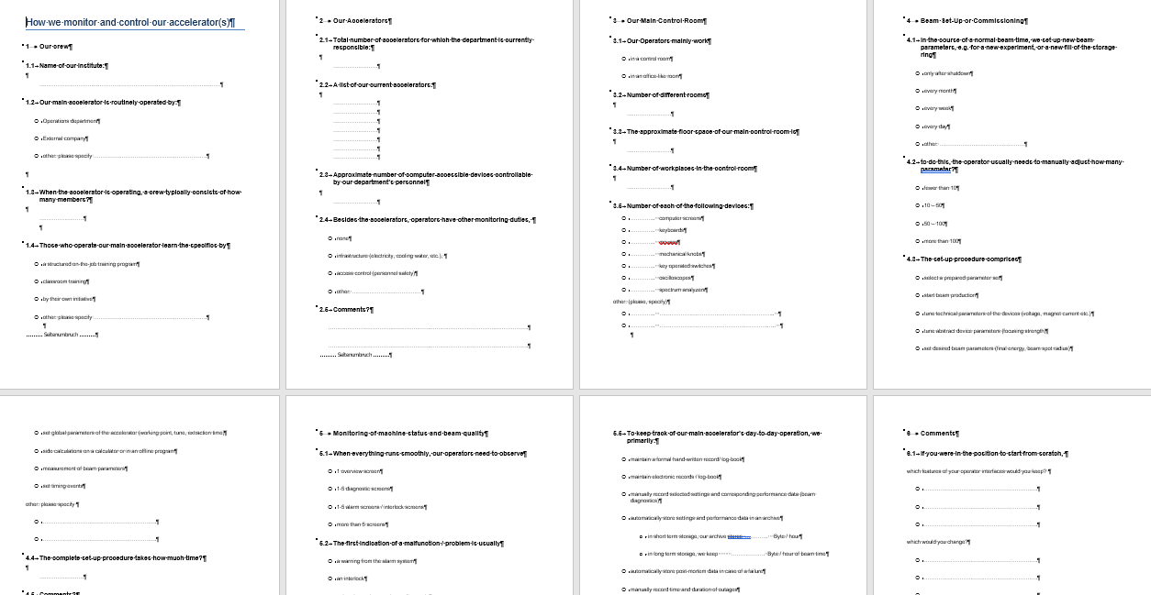
How we monitor and control our accelerator(s)

Slide 4
The Questions I
Our crew
  Name of our Institute:
  Our main accelerator is routinely operated by:
  When the accelerator is operating, a crew typically consists of how many members?
  Those who operate our main accelerator learn the specifics by
Our Accelerators
  Total number of accelerators for which the department is currently responsible:
  A list of our current accelerators:
  Approximate number of computer-accessible devices controllable by our department’s personnel
  Besides the accelerators, do operators have other monitoring duties?
Our Main Control Room
  Our Operators mainly work - in a control room / in an office-like room
  Number of different rooms
  The approximate floor space of our main control room is
  Number of workplaces in the control room
  Number of each of the following devices:

Slide 5
The Questions II
Beam Set-Up or Commissioning
  In the course of a normal beam time, we set up new beam parameters, e.g. for a new experiment, or a new fill of the storage ring how often?
  to do this, the operator usually needs to manually adjust how many parameter?
  The set-up procedure comprises …
  The complete set-up procedure takes how much time?
Monitoring of machine status and beam quality
  When everything runs smoothly, our operators need to observe how many screens?
  The first indication of a malfunction / problem is usually
  For quality assurance, we measure and document beam performance data (beam current, beam energy, emittance, etc.) (how often)
  This QA procedure interrupts beam time for experiments
  To keep track of our main accelerator’s day-to-day operation, we primarily:
If you were in the position to start from scratch,
  which features of your operator interfaces would you keep?
  which would you change?

Slide 6
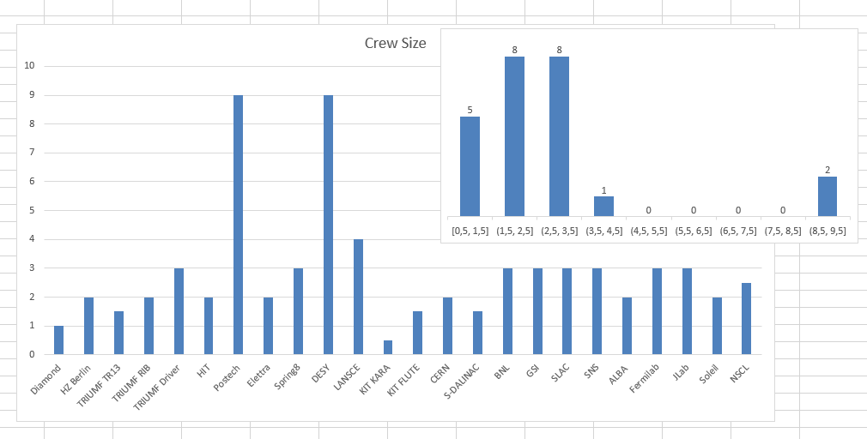
The Crew

Slide 7
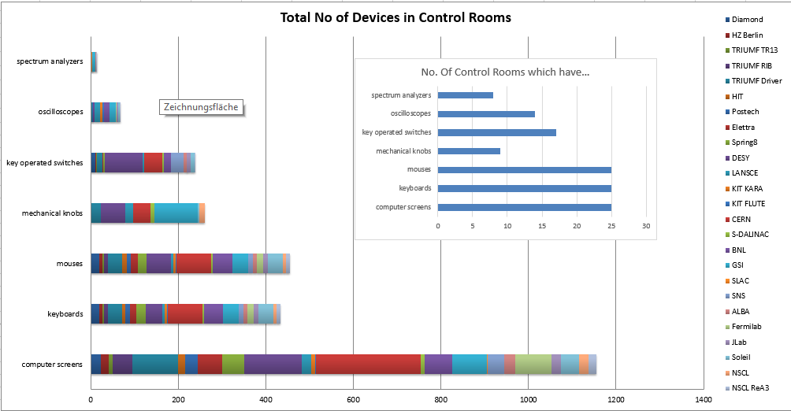
Main Control Room Equipment

Slide 8
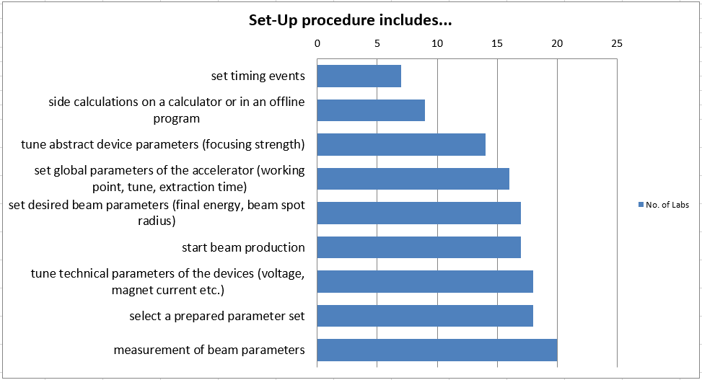
Set-up procedure

Slide 9
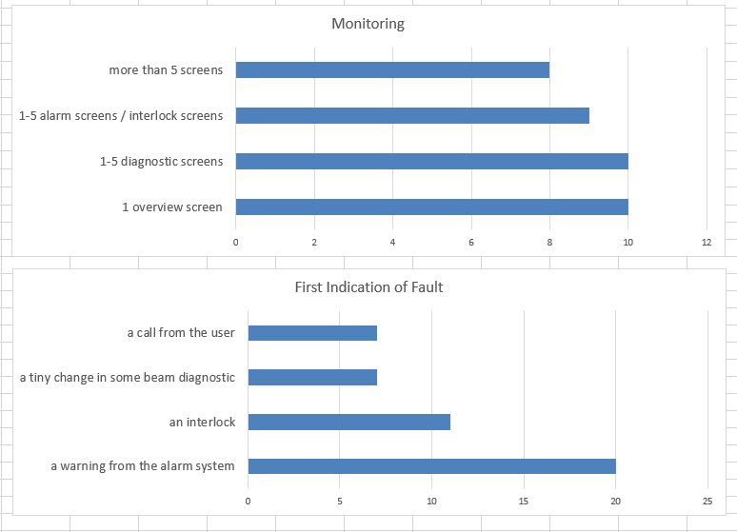
Monitoring

Slide 10
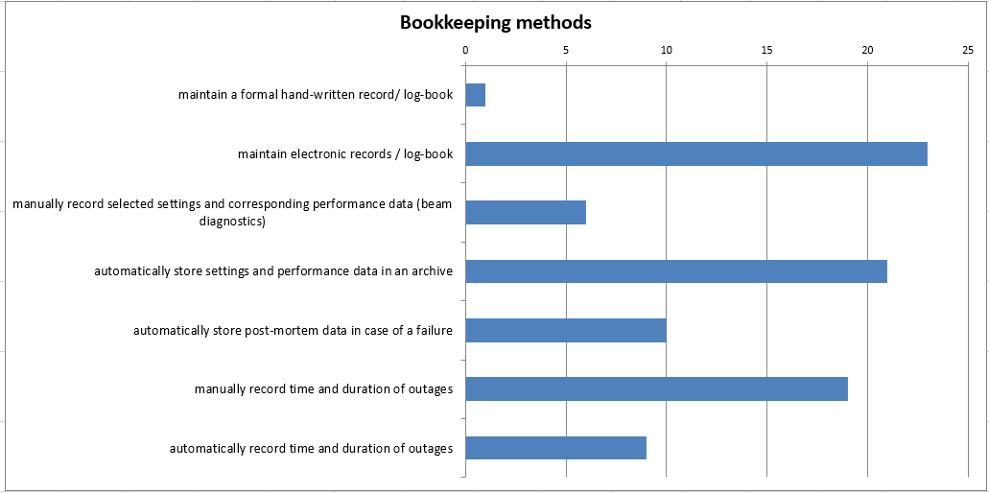
Bookkeeping

