Slide 1
Nonproliferation and National Security Department
Susan Pepper, Chair
Nonproliferation and National Security Department
January 16, 2018

Slide 2
Outline
History at BNL
Overview of NN Department
Ideas for future interaction between
Physics and NN

Slide 3
Definitions
Nonproliferation
Prevention of the increase of nuclear weapons
Horizontal or lateral – number of countries
Vertical – modernization or advancement
International Safeguards
Refers to nuclear safeguards conducted by the IAEA
The activities conducted by the IAEA to verify states’ commitments under the Nonproliferation Treaty
Requirement of nonnuclear weapons states under the NPT
Disarmament
Reduction of weapons
Requirement of nuclear weapons states under the NPT

Slide 4
History at BNL
Five decades of applied science for multiple U.S. agencies
Technical Support Organization
Formerly part of Nuclear Energy and Advanced Technology Departments
Significant part of BNL’s WFO/SPP (State, NRC, DHS, NNSA, DTRA, Intel Community, NASA, NIH)
International and domestic programs
Recognized contributor to U.S. policy
Connections to Physics/other BNL organizations

Slide 5
Nonproliferation and National Security Department
Susan E. Pepper, Chair
Donna Muscarella, Administrative Assistant
Nonproliferation and Radiation Detector R&D
Peter Vanier
International Safeguards Project Office
Ray Diaz
Safeguards Policy and Implementation
Katherine Bachner
Nonproliferation and Homeland Security Field Support
Biays Bowerman

Slide 6
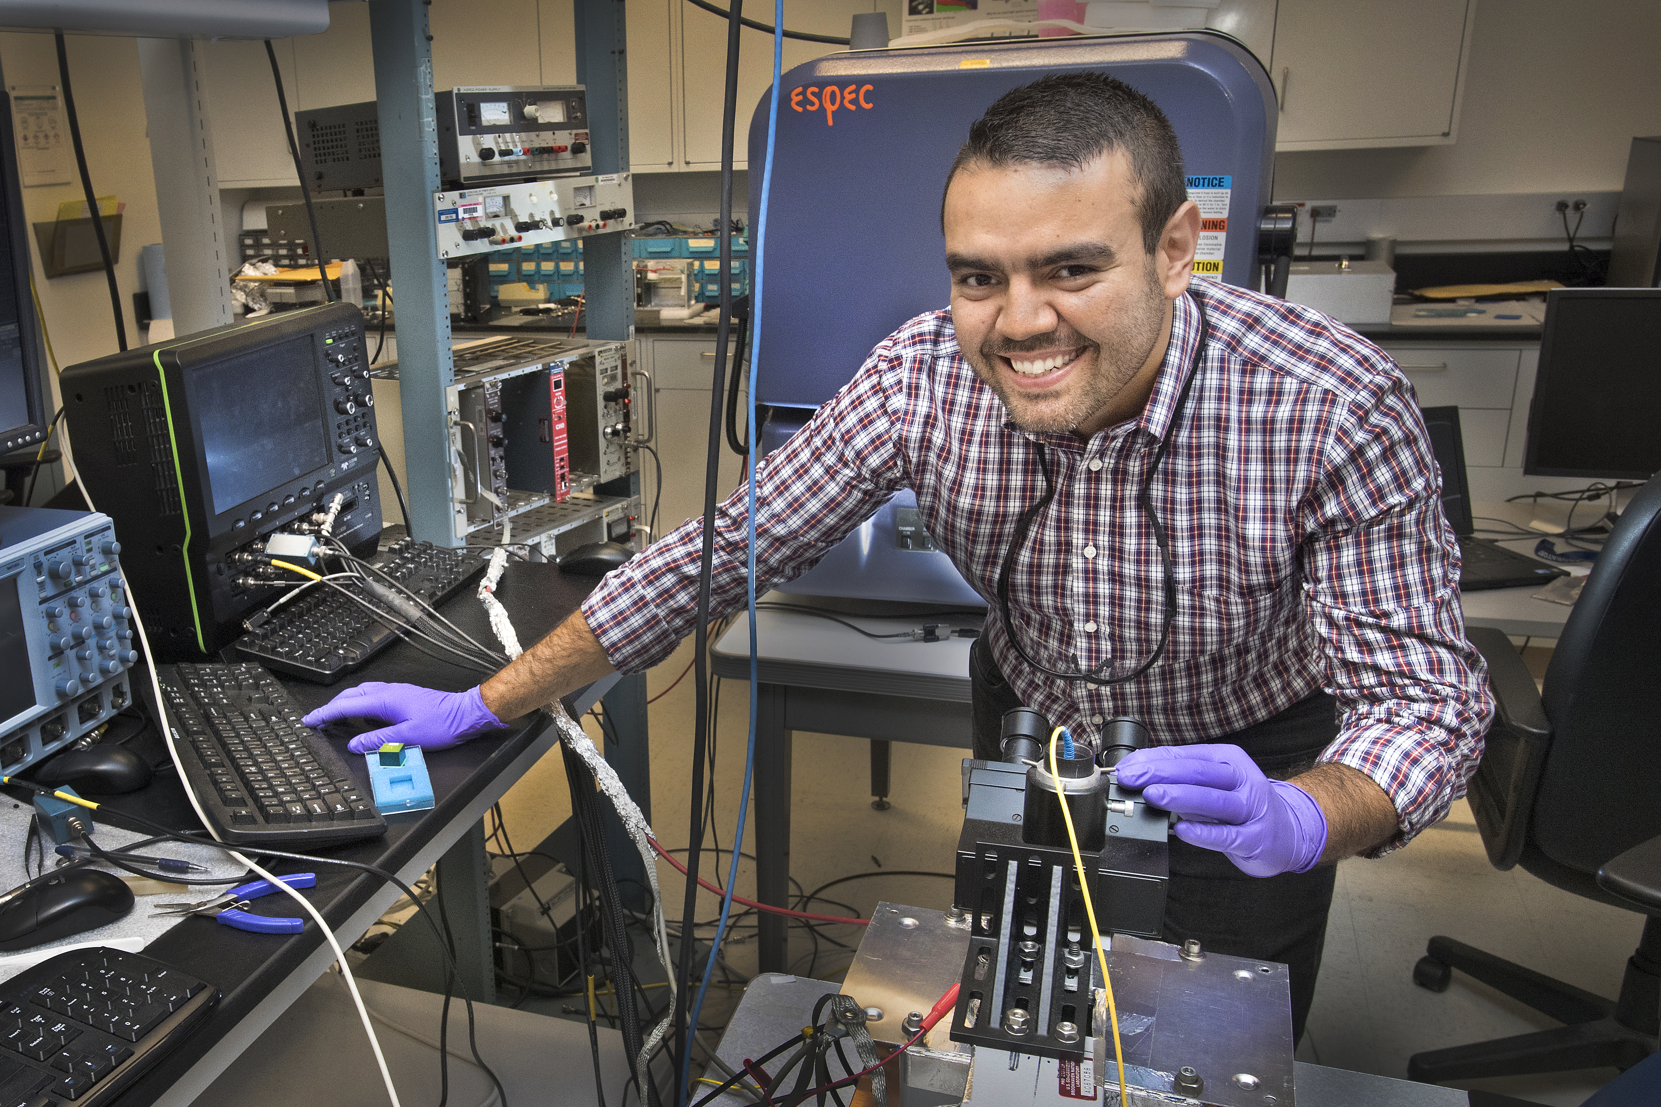
Radiation Detector R&D for Homeland Security and Nonproliferation
World class detector development capabilities
Crystal growth laboratory
Material assessment/characterization
Instrument design
Work in both gamma measurement and neutron imaging; scintillators and semi-conductors
Collaboration w/ Instrumentation Division
Industry partnerships
Crossover to other fields (e.g., medical scanning)

Slide 7
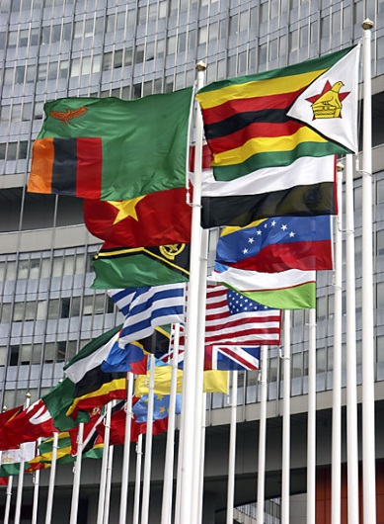
International Safeguards Project Office
Technical and administrative management of the U.S. Support Program to IAEA Safeguards
Presence on-site at BNL and in Vienna, Austria
Providing weapons inspectors with state-of-the-art instruments to improve their ability to detector diversion of nuclear materials and undeclared nuclear facilities
Network of national laboratory and private sector technology and technical service providers
Project management of instrument and integrated
systems development, training,
software and data systems
development, etc.
Recruitment of US citizens for positions
with the IAEA Department of
Safeguards

Slide 8
Safeguards Policy and Implementation
Nuclear security
Improved the control and accountancy of nuclear material in the former Soviet Union
Capacity building
Engagement with emerging nuclear states in the developing world to improve compliance with IAEA Safeguards commitments
Safeguards and nonproliferation policy studies
Training in international safeguards
For IAEA inspectors
For representatives of other member states
U.S. government agencies
Students/early career professionals

Slide 9
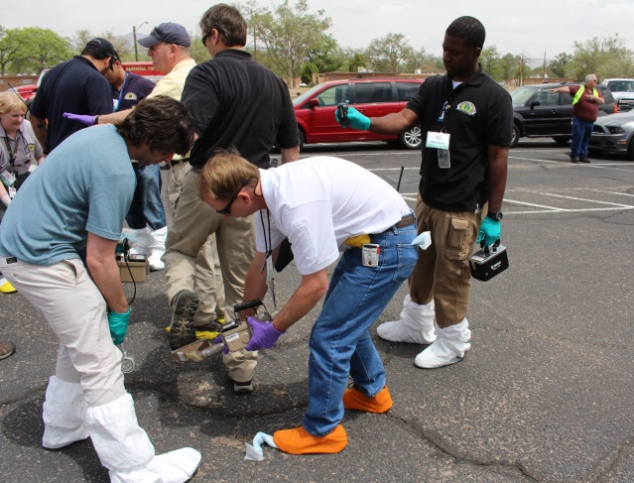
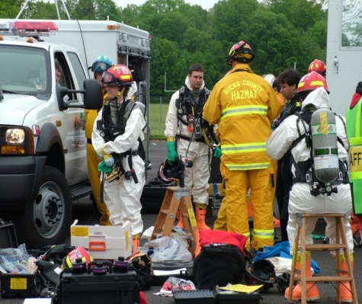
Nonproliferation and Homeland Security Field Support
Radiological Assistance Program (RAP) Region 1 (Northeast)
USAID Office of US Foreign Disaster Assistance (OFDA) Disaster Assistance Relief Team for radiological response
Developing Radiological Dispersion Device (RDD) response tactics
Testing and evaluating radiation detectors (handheld, backpack, and vehicle portal monitors)
Training local and regional first responders for nuclear/radiological emergencies
Chemical security training for developing countries
Cyber security

Slide 10
Thank You
`
Contact Information:
Biays Bowerman
Phone: 631-344-2946
Email: bowerman@bnl.gov

