Slide 1
Welcome

Slide 2
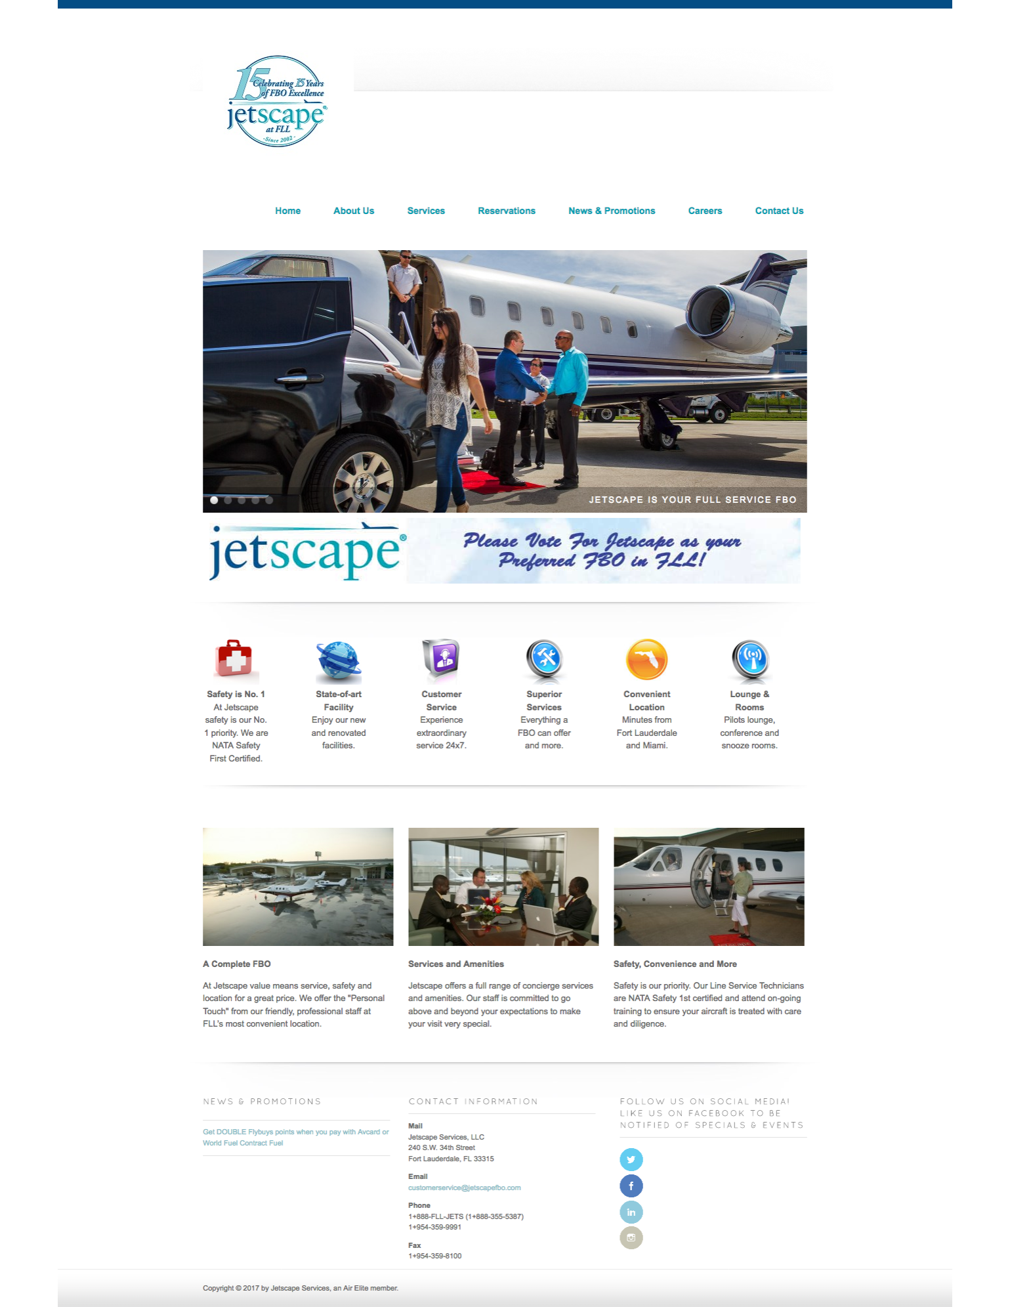
If you google JETSCAPE, here is the top entry:
At JETSCAPE, safety is our No.1 priority.

Slide 3
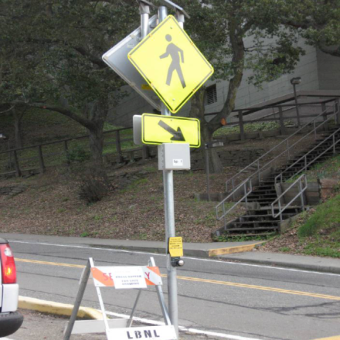
Traffic at the Lab
Traffic Safety
Speed limit is 15 mph
Follow traffic and parking signs
Obey all traffic control personnel and security officers
Bicyclists must wear helmets and obey traffic rules and signs
Pedestrian Safety
Stay on the sidewalk
Cross at crosswalks

Slide 4
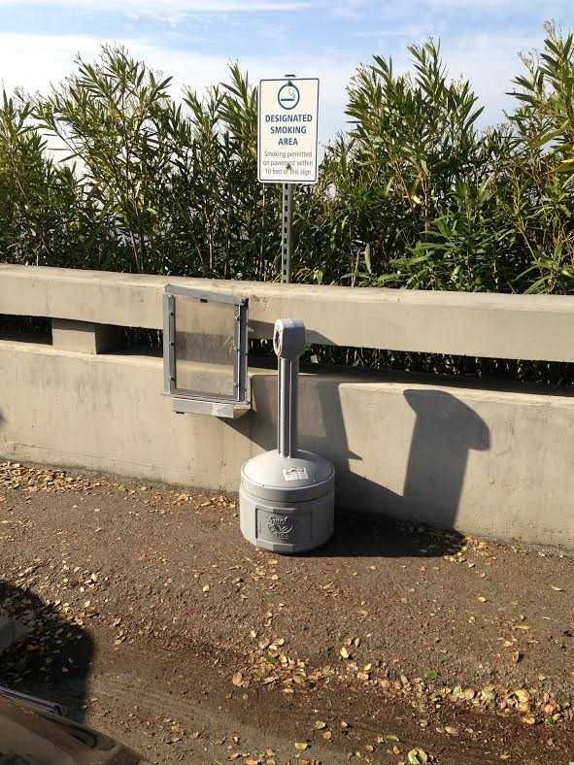
Smoking Policy
For those adults who choose to smoke, the Lab has provided ash cans in a few places throughout the site
Outside away from doors/windows
Away from dry brush
Use the ashcan

Slide 5
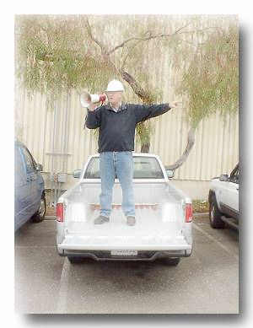
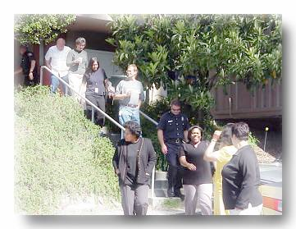
Earthquake Response
Drop down on the floor.
Cover under a sturdy desk, table or other furniture. In an auditorium, cover your head with your arms and get between rows of chairs.
Hold on and be prepared to move with the furniture
Evacuate to the assembly area (usually in parking lot).
Follow Directions from the building emergency team.

Slide 6
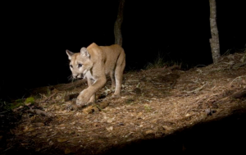
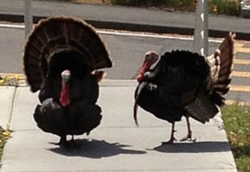
Wildlife at LBNL
LBNL is next to extensive parkland and mountain lions have been sighted here recently
Avoid hiking or jogging alone
Do not approach a lion. Give it a way to escape.
If you encounter a mountain lion, do not run; face the animal, make noise and try to look bigger by waving your arms; throw rocks or other objects.
Fight back if attacked. If a mountain lion attacks a person, immediately call 911.
Turkeys are generally harmless but they are wild and can behave unpredictably so keep your distance
Watch out for them when driving

Slide 7
Housekeeping Matters: wireless and slides
Wireless:
Network “lbnl-visitor”, no PW needed
eduroam also available
Speakers: please upload your talk to the Indico agenda prior to the start of your session
Slide wranglers: Aaron and Ron
All common presentation formats are supported but please verify fonts and animation on the presentation laptop in time to fix problems before the start of the session
Backup format is pdf

Slide 8
Housekeeping Matters: weekend transportation
No LBNL shuttle service on weekends
Saturday and Sunday:
Self-organize for transportation
Walking is do-able but hill is serious - give yourself enough time
Those of us who are local and have cars can meet at the hotel at an agreed-upon time (8:15 am?) to take some people
Others can take Uber/whatever and get reimbursed by JETSCAPE

Slide 9
Housekeeping Matters: meals
Wed-Fri lunch: at LBNL cafeteria (pay your own)
Friday banquet:
$50, you should have paid at registration
We will arrange rides/carpools on Friday at the start of the afternoon session
Dinner on other nights: on your own
Poskanzer restaurant guide: http://restguide.lbl.gov/
Saturday/Sunday sessions:
lunch will be brought in, $25 per person for both days collected Sat morning

Slide 10
Housekeeping Matters: other stuff
If you are receiving per diem support
Claim it from Wayne State following the meeting
See Abhijit for details
Open discussion on jet substructure and quenching:
Saturday during lunch, following the theory talks on substructure
Chaired by Joern
Everyone is welcome to present 1-2 slides. Joern will coordinate, see him for details.

Slide 11
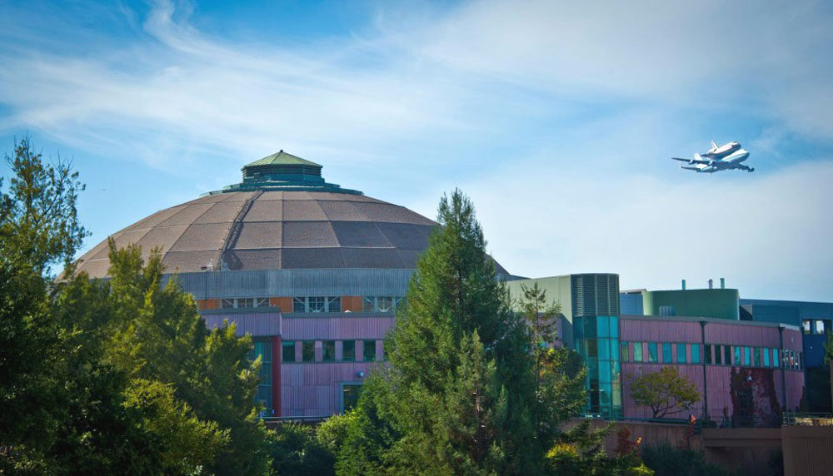
Enjoy the meeting!

