Slide 1
Computing on GPUs Loren Schwiebert Department of Computer Science Wayne State University loren@wayne.edu
Jetscape Winter School 2018

Slide 2
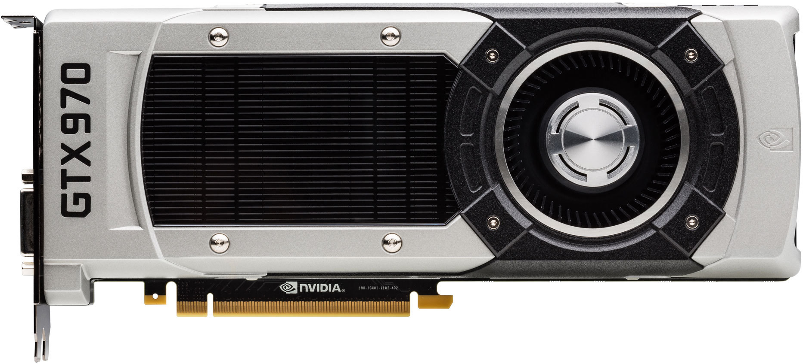
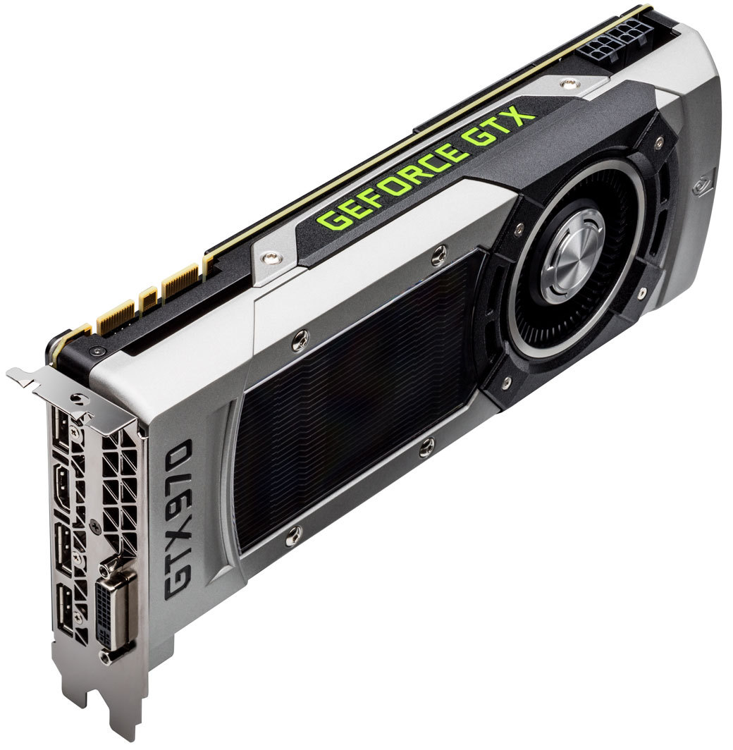
DESKTOP GPU – GTX 970
1664 Processor Cores
1050 MHz/1178 MHz Clock Rate
4 GB GDDR5 Memory
256-bit Memory Bus Width
224 GB/s Memory Bandwidth
List Price: $449 in Dec. 2017
13 Streaming Multiprocessors
Each has:
128 Processor Cores
32 Special Function Units
64 KB of Shared Memory
24 KB of L1 Cache
64K 32-bit registers
8 Instruction Issues/Cycle

Slide 3
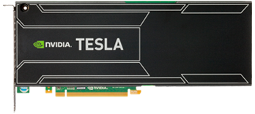
HIGH-END COMPUTE GPU – Kepler K40
2880 Processor Cores
745 MHz Clock Rate (+Boost)
12 GB DDR5
384-bit Memory Bus Width
288 GB/s Memory Bandwidth
List Price: $3400 in Dec. 2017
15 Streaming Multiprocessors
Each has:
192 Processor Cores
32 Special Function Units
48 KB of Shared Memory
16 KB of L1 Cache
64K 32-bit registers
8 Instruction Issues/Cycle

Slide 4
MEMORY CONFIGURATION

Slide 5
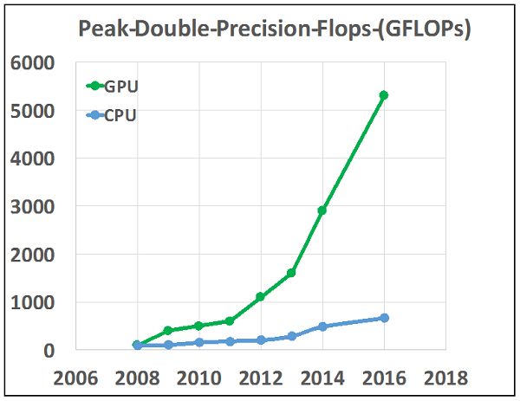
GPU VS. CPU FP PERFORMANCE

Slide 6
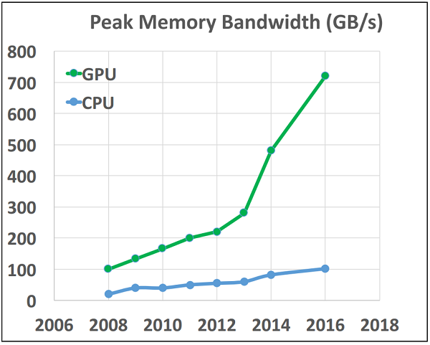
GPU VS. CPU MEMORY BANDWIDTH

Slide 7
GPU PROGRAMMING
CUDA: https://developer.nvidia.com/cuda-zone
Programming API.
NVIDIA GPUs only. Not an open standard.
Offers many advanced features.
OpenCL: https://www.khronos.org/opencl/
Open Standard.
Also supports other multicore and many-core architectures: AMD-ATI GPUs, Xeon Phi.
OpenACC: https://www.openacc.org/
Open Standard.
Programming based on directives: #pragma

Slide 8
GPU PROGRAMMING
A multi-threaded many-core model of computation
Threads are lightweight processes
Each thread solves part of the problem – data parallel apps
The threads can all run simultaneously – massively parallel
You can create millions of threads
A grid contains all the threads
The grid is divided into blocks
Each block has many threads
Each block runs independently
Blocks are assigned to streaming multiprocessors (SM)
Can have more than one block on the same SM
Run as many blocks simultaneously as possible
Threads are grouped into warps

Slide 9
THREAD MODEL
The Grid
Block 1 Warps
Block 2 Warps
Block 3 Warps
…
…
…
…
…
…
t0 t1 t2 … t31
t0 t1 t2 … t31
t0 t1 t2 … t31

Slide 10
WARP SCHEDULING EXAMPLE
Consider three separate instruction streams on one streaming multiprocessor: warp1, warp3, and warp8
OK, but why warps??
Warp | Current Instruction | Instruction State
Warp 1 | 42 | Ready to write result
Warp 3 | 95 | Computing
Warp 8 | 11 | Computing
…
Schedule
at time k+1
warp 8 instruction 11
t=k
warp 1 instruction 42
t=k+1
warp 3 instruction 95
t=k+2
. . .
. . .
warp 8 instruction 12
t=n>k
warp 3 instruction 96
t=n+1

Slide 11
IT’S NOT THIS

Slide 12
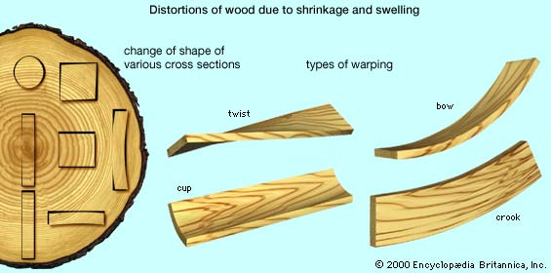
AND IT’S NOT THIS

Slide 13
IT’S THIS!

Slide 14
CUDA
Acronym for Common Unified Device Architecture
An API for General-Purpose GPU (GPGPU) Programming
Version 9.1 released in December 2017
Runs on Linux and Windows
Comes with Software Developer’s Kit – (Code examples)
Supports programming in C/C++ and Fortran
Supports a large subset of C++
Includes additional functionality
Debugging tools
Mathematical libraries
Image Processing libraries
Deep Learning libraries
Its Free – See https://developer.nvidia.com/cuda-downloads

Slide 15
CUDA PROGRAMMING
To call the GPU kernel, you call it like a function, but between the function name and the parameters, you enclose the number of blocks and number of threads per block in triple angle brackets <<< and >>>.
//The function call
Kernel<<<BlocksPerGrid, ThreadsPerBlock>>>(params);

Slide 16
NEED TO MAKE SURE THINGS ARE DONE IN THE RIGHT ORDER
__global__ void compute(int *d_in, int *d_out, int *d_sum) {
d_out[threadIdx.x] = 0;
for (i=0; i<SIZE/BLOCKSIZE; i++) {
int val = d_in[i*BLOCKSIZE + threadIdx.x];
d_out[threadIdx.x] +=
compare(val, 6);
}
}
If there are two steps that share variables, we have to make sure that the first is done before the second starts.
if (threadIdx.x == 0) {
for (i=0; i<BLOCKSIZE-1; i++)
*d_sum += d_out[i];
}
__threadfence();
This makes every thread in the block stop until all threads reach this point.

Slide 17
PERFORMANCE TIP #1
Premature optimization is the root of all evil – Donald Knuth
“Maximize” Simultaneous Threads on each SM
SM Resource Bottlenecks
Number of Registers
Number of Threads
Number of Blocks
Shared Memory
Compile-Time Directives
__launch_bounds__(Max Threads per Block, Min # Blocks)
Advanced Idea

Slide 18
PERFORMANCE TIP #2
Coalesced Memory Accesses
Global Memory Accesses are Expensive
Tens or hundreds of clock cycles
Can access up to 128 consecutive bytes in one memory operation
Combine reads/writes of threads to adjacent memory locations
Thread 0
Thread 1
…
Thread n-1
Option 1: Load elements
into shared memory
Option 2: Redistribute array elements

Slide 19
CODING CONSIDERATIONS
Single Codebase Approach
GPU Functionality Embedded in an Object-Oriented Framework
Interface should remain consistent
Multiple Parallel APIs could be supported
CUDA, OpenCL, OpenMP, OpenACC, etc.
#ifdef __NVCC__ … #endif
Gradual Implementation
Simple loops with many iterations
Compute intensive functions

Slide 20
SUMMARY
GPUs have a great deal of computing power
Software tools like CUDA, OpenCL, and OpenACC make GPUs easier to use for non-graphics apps
Performance depends on the GPU architecture
Data parallel applications
You have to think parallel
You often need different algorithms
At least, if you want to get good performance
Good performance is possible with some effort

Slide 21
THANKS!!!
For some of the Slides and Figures Courtesy of:
Mary Hall – University of Utah
NVIDIA Corporation Documentation

Slide 22
QUESTIONS??
Picture courtesy of Google Images

