Slide 1





Physics modeling challenges and approaches
LBNL, 1/6/2018
Shanshan Cao
Wayne State University

Slide 2
Outline
Part I: Multi-stage jet evolution
Part II: Jet-induced medium excitation
Part III: Jet substructure

Slide 3
Part I: Multi-stage jet evolution within JETSCAPE
SC et al., (JETSCAPE Collaboration), Phys. Rev. C96 (2017) 2, 024909
SC, A. Majumder, G.-Y. Qin and C. Shen, arXiv:1711.09053.

Slide 4
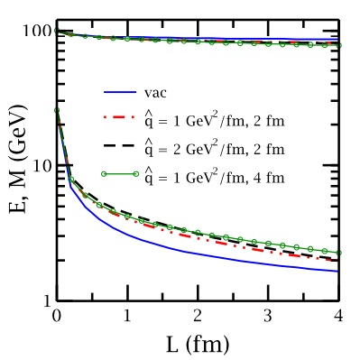
Multistage jet evolution in heavy-ion collisions
Stage 1: High Q and high E (DGLAP, higher-twist); lose Q faster than E [ Majumder and Putschke, PRC 93 (2016) ]
Stage 2: low Q and high E (Transport, higher-twist, AMY)
Stage 3: low Q and low E (near thermal) (strongly coupled approach)
However, one usually applies a single theory through all stages

Slide 5
Stage 1: high Q and high E
DGLAP evolution for parton fragmentation function at high Q:
Sudakov form factor ( probability of NO splitting in [ Q , Q_{max} ] ):
Splitting function:
[ higher-twist energy loss formalism: Guo and Wang (2000), Majumder (2012) ]
jet transport coefficient, due to elastic scattering
MATTER (The Modular All Twist Transverse-scattering Elastic-drag and Radiation) [Wayne: PRC 88, 014909, arXiv:1712.10055] -- a virtuality-ordered parton showers from initial Q_{max} to Q₀

Slide 6
Stage 2: low Q and high E
LBT or MARTINI (time-ordered transport model) simulates parton showers at (or below) Q₀ (with on-shell approximation)
LBT (Linear Boltzmann Transport) [LBL-CCNU: PRL 111 (2013) 062301, PRC 94 (2016) 014909, PLB 777 (2018) 255-259, PLB 777 (2018) 86-90]
Evolution of jet parton “1”:
Elastic Scattering rate:
Inelastic scattering rate (average gluon number per Δt):
Medium-induced gluon spectrum is taken from HT (same as MATTER)
Multiple gluon emission in Δt is allowed – Poisson distribution of <N_{g}>

Slide 7
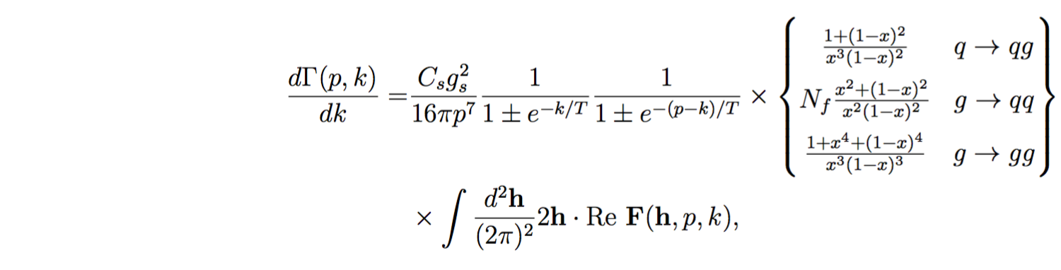
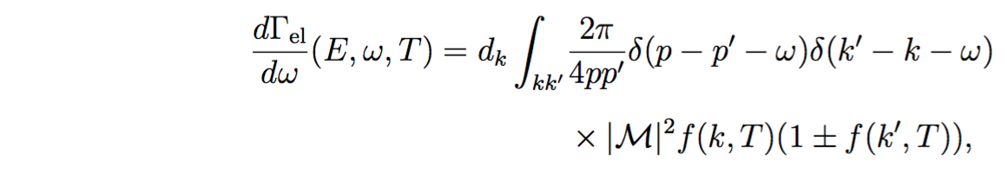
Stage 2: low Q and high E
MARTINI (Modular Algorithm for Relativistic Treatment of heavy IoN Interactions) [McGill: PRC 80 (2009) 054913, arXiv:0909.2037]
Energy loss mechanism in MARTINI is based on the AMY radiative formalism coupled with collisional energy loss
AMY formalism for 1->2 splittings where LPM effect is included:
F(h, p, k) [p – jet parton, k – emitted gluon, h = p × k] is the solution of an integral (Schwinger-Dyson) equation describing how |p − k; k⟩⟨p| evolves with t due to collisions and the energy difference between the two states.
Elastic scattering rate for 2->2 scattering process is included:
[S. Jeon and G. Moore PRC 71 (2005) 034901, S. Jeon NPA 830 (2009) 107 ]

Slide 8
Combining theories at high Q and low Q
MATTER (virtuality-ordered) evolves partons down to Q₀ and LBT or MARTINI (time-ordered) continues parton evolution at (or below) Q₀
Fixed Q₀ (both in vacuum and medium): 1, 2 or 3 GeV will be used and compared.
Dynamical Q₀ (virtuality gain from scattering with the medium):
Note: Dynamical Q₀ is only meaningful in a thermal medium, in vacuum, Q₀ = 1 GeV is applied
*
*
,

Slide 9
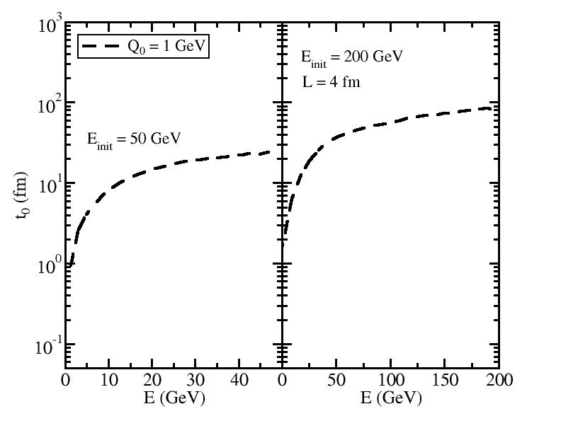
Separation time between MATTER and LBT/MARTINI
when a given parton hit Q₀ after multiple splittings
t₀ (vs. τ₀) is NOT small.

Slide 10
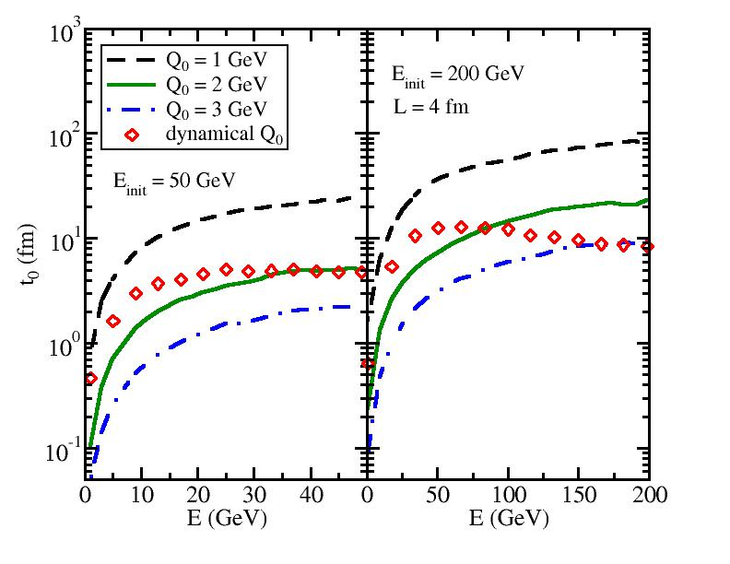
Separation time between MATTER and LBT/MARTINI
when a given parton hit Q₀ after multiple splittings
t₀ (vs. τ₀) is NOT small.
t₀ decreases if Q₀ increases or E_{init} decreases.

Slide 11
Separation time between MATTER and LBT/MARTINI
when a given parton hit Q₀ after multiple splittings
t₀ (vs. τ₀) is NOT small.
t₀ decreases if Q₀ increases or E_{init} decreases.
The dynamical Q₀ varies between 2 and 3 GeV for high E partons within quark jet with E_{init} between 50 and 200 GeV.
The dynamical Q₀ approaches 1 GeV for low E daughter partons.

Slide 12
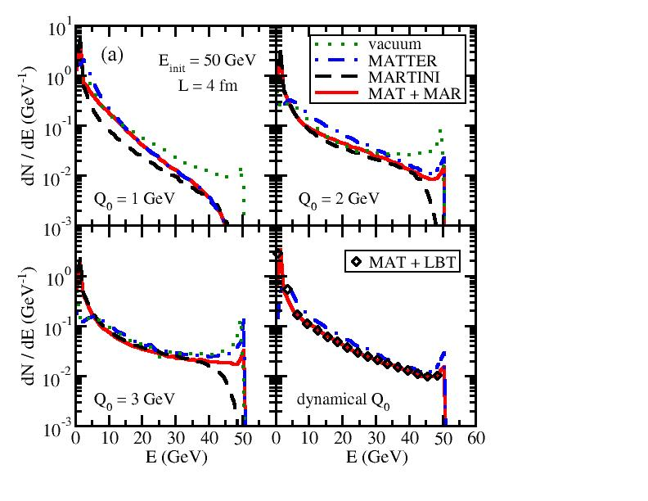
dN/dE of daughter partons (jet FF)
Energy distribution of final shower partons from a single quark with a fixed initial energy E_{init} through a brick with length L.
Four model setups:
Vacuum: Sudakov type of shower with vacuum P(z)
MATTER: Sudakov type of shower with vacuum + medium induced P(z)
LBT/MARTINI: Partons from vacuum shower evolve the entire 4 fm in LBT/MARTINI
MATTER+LBT/MARTINI: Combined scheme – partons evolve in MATTER up to t₀ and then in LBT/MARTINI till 4 fm

Slide 13
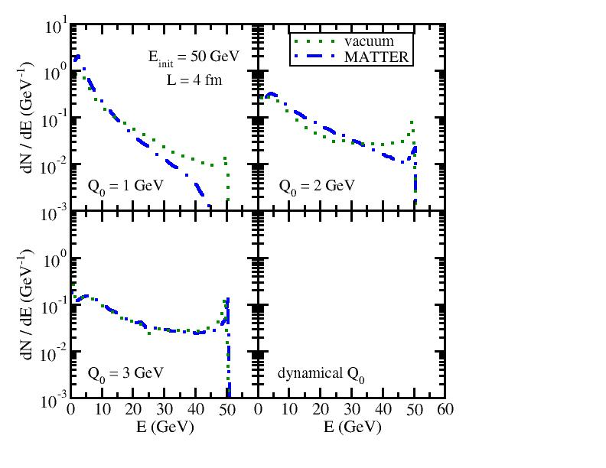
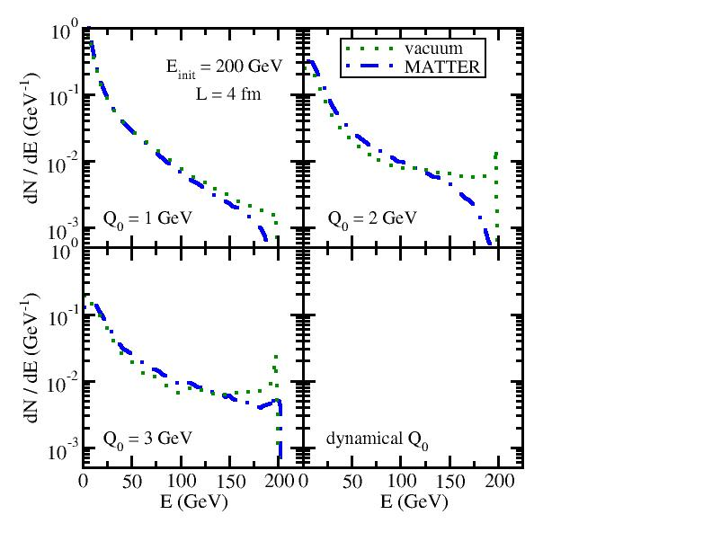
MATTER vs. vacuum shower
50 GeV jet
200 GeV jet
Energy loss in MATTER is stronger when Q₀ is smaller
Energy loss in MATTER disappears when (medium scale).
increases with the jet energy; MATTER evolution is more important to high energy partons than to low energy ones

Slide 14
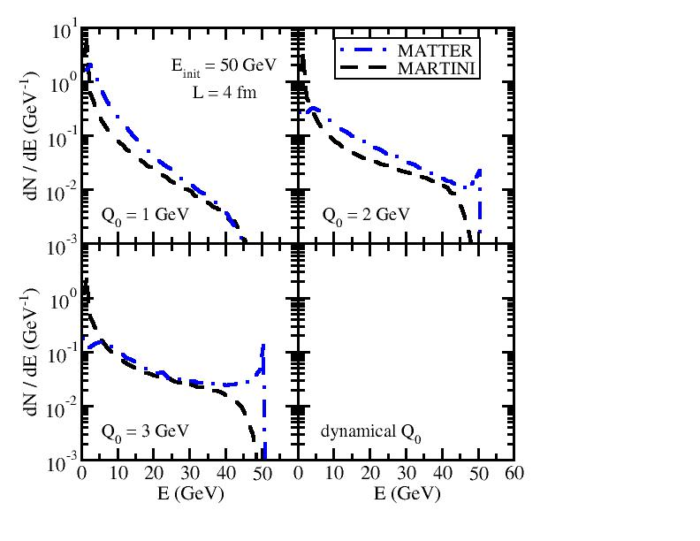
Pure MATTER vs. Pure LBT/MARTINI
On-shell time-ordered transport models are NOT constrained by any virtuality scale in the phase space ➔ energy loss in pure LBT/MARTINI evolution is stronger than that in pure MATTER

Slide 15
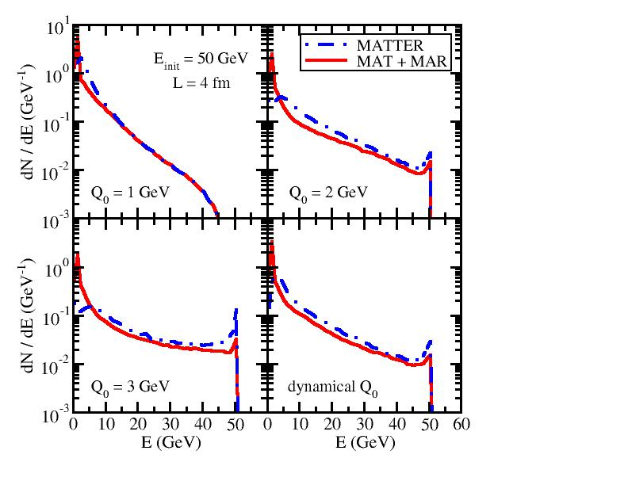
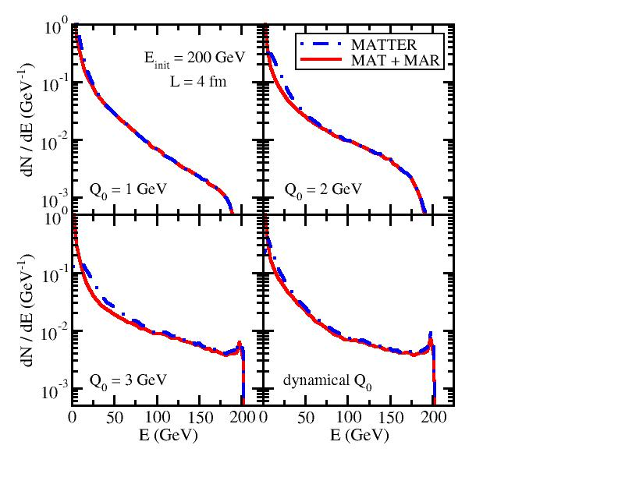
MATTER vs. LBT/MARTINI in combined approach
50 GeV jet
200 GeV jet
Recall: It takes longer time for high E partons to hit Q₀ in MATTER and leaves shorter time for the subsequent LBT/MARTINI.
Energy loss from LBT/MARTINI in MATTER + LBT/MARTINI is weak for high E partons, but becomes stronger for low E ones.

Slide 16
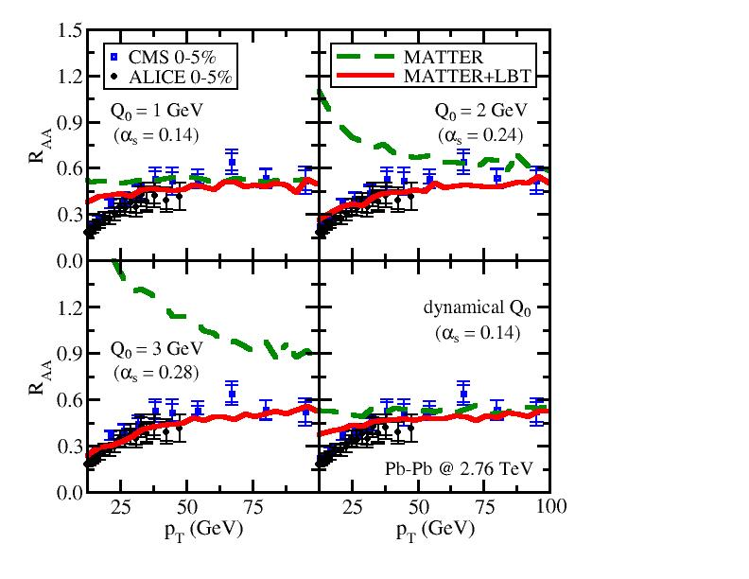
Nuclear modification of single hadrons
Dependence on Q₀ (central Pb-Pb @ 2.76 ATeV)
JETSCAPE
preliminary
Partons with larger E hit Q₀ later ➔ MATTER dominates high p_{T}, LBT low p_{T}
Larger Q₀ leads to shorter MATTER evolution ➔ LBT contribution is larger
Result from the dynamical Q₀ is close to fixed Q₀ = 1 GeV (average T is low)

Slide 17
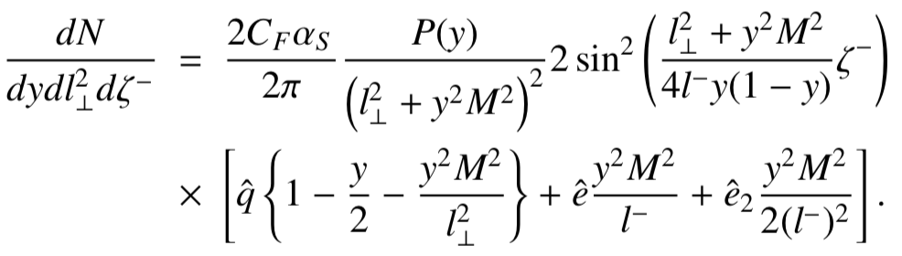
Multi-stage effects in heavy quark energy loss
SC, Majumder, Qin, Shen, arXiv: 1711.09053
^
For massless partons, q induced radiation dominates compared to e and e₂
For heavy quarks, at low scale Q ~ M, contribution from e and e₂ induced radiation is also important
^
^
^
^
^
Q < M, transport model with q + e + e₂; Q > M, DGLAP with q
Contributions from e and e₂ diminish at large p_{T}
e and e₂ decrease B meson R_{AA} and narrow the difference between D and B mesons
^
^
^
^
^
Zhang, Hou, Qin, PRC 94 (2016) 024916
Abir, Kaur, Majumder, PRD 90 (2014) 114026
Abir, Majumder, PRC 94 (2016) 054902
^
^

Slide 18
Part II: Jet-induced medium excitation
W. Chen, SC, T. Luo, L.-G. Pang and X.-N. Wang, PLB 777 (2018) 86-90.

Slide 19
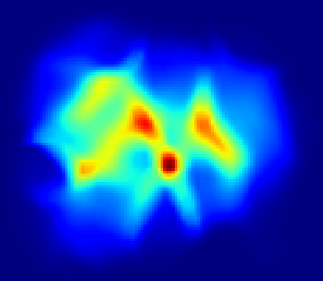
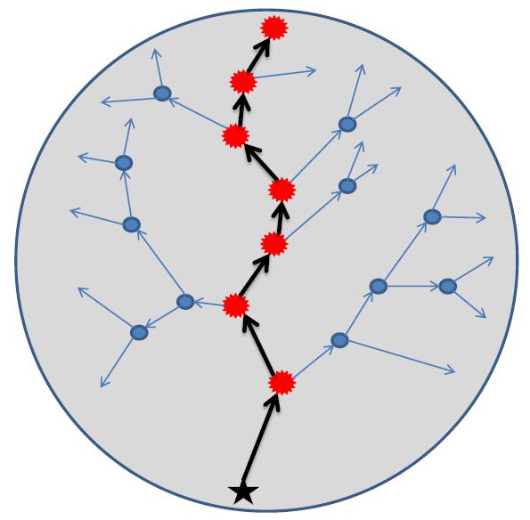
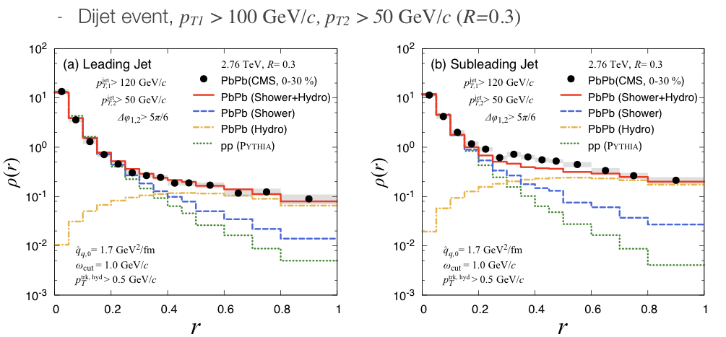
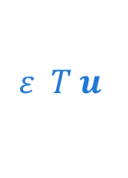
Beyond LBT (modification of medium background)
Linear approximation: only consider medium modification of jet
Jet-medium interaction also includes modification of the thermal background
Medium background
JET
$$ε T u$$
?
energy-momentum deposition from jets into medium as source terms
Tachibana, Chang, Qin, PRC 95 (2017) 4, 044909
Jet-induced medium excitation is important to jet shape at large r
Linear response treatment, not concurrent evolution of jet and hydro yet

Slide 20
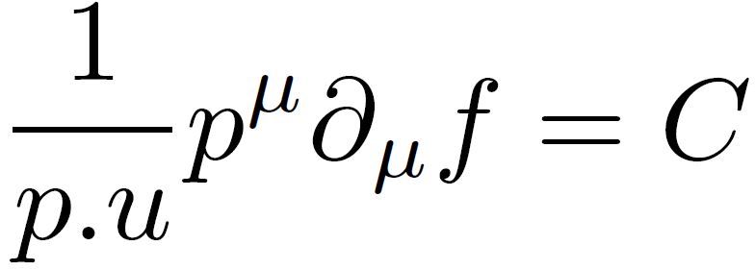
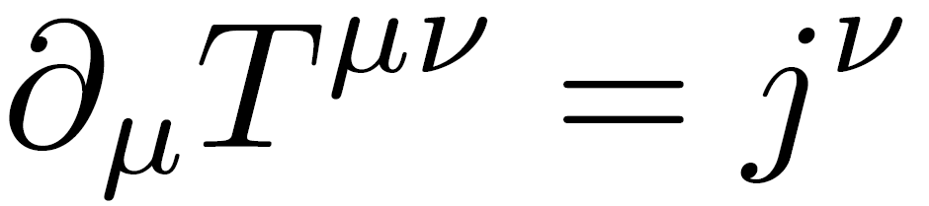
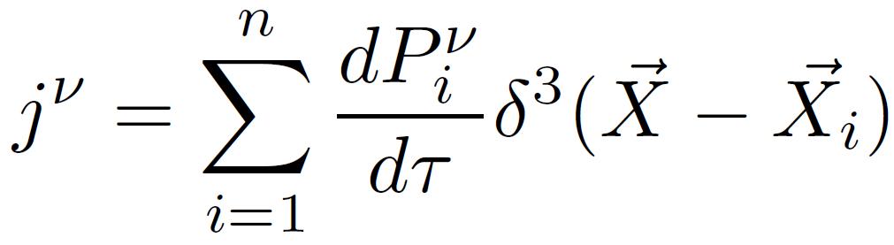
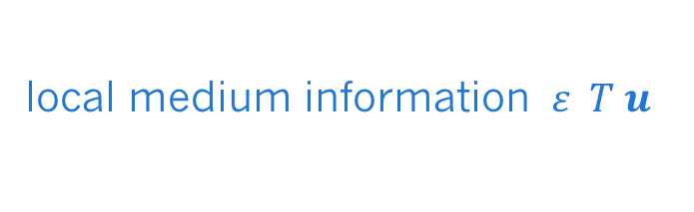
A coupled LBT and hydrodynamic model
Hydro
LBT
Soft
Hard
local medium information $ε T u$
jet partons and recoiled partons with E < E_{cut} (comoving frame) [positive] + back reaction [negative]
Source term
(soft partons in LBT)
Bottleneck of event-by-event calculation: hydrodynamic simulation of the bulk.
Notes:
Gaussian Width 0.6
Grid size x y 0.16 fm z 0.3
Tau step 0.02
6 min
No difference

Slide 21
CLVisc (3+1)D hydrodynamic model
Notes:
Gaussian Width 0.6
Grid size x y 0.16 fm z 0.3
Tau step 0.02
6 min
No difference

Slide 22
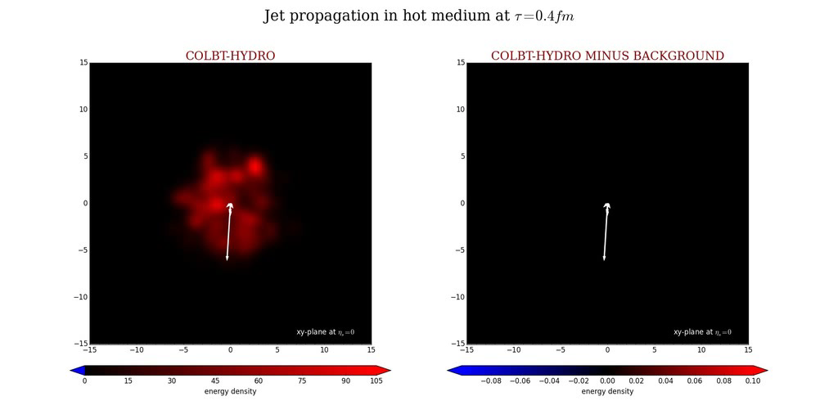
Gamma-jet evolution within CoLBT-hydro model

Slide 23
Medium modification of gamma-triggered hadron yields at RHIC
Suppression of hadrons at small ξ while enhancement at large ξ
With increasing photon p_{T}
Transition point from suppression to enhancement shifts to larger ξ
Transition point corresponds to the fixed p_{T} range
Soft hadrons from j.i.m.e. carry an average thermal energy that is independent of the jet energy
Details: Wei Chen’s talk tomorrow
Notes:
1.01 2.11
0.95 1.82
0.82 1.62
3

Slide 24
Novel topics to explore
Effects of the diffusion wake of one jet on the other jet – photon-jet vs. di-jet observables
Jet velocity dependence of medium excitation (medium response to light vs. heavy quark propagation) – heavy quark induced medium excitation may travel faster than heavy quark itself and affects its subsequent evolution

Slide 25
Part III: Jet substructures
N.-B. Chang, SC, G.-Y. Qin, arXiv: 1707.03767.

Slide 26
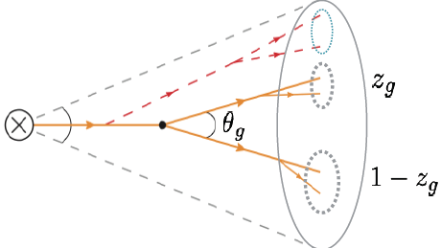
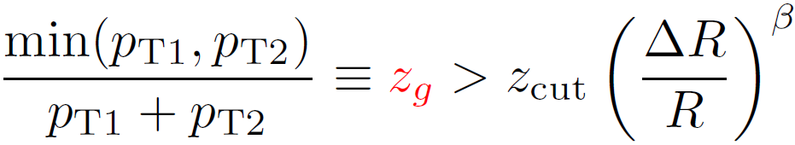
Soft drop jet grooming
Cluster anti-k_{T} jet with Cambridge/Aachen (CA) algorithm and then decluster the angular-ordered CA tree by dropping soft branches
Larkoski, Marzani, Thaler, Phys. Rev. D91,111501 (2015)
Soft Drop: JHEP 1405 (2014) 146
Allows a more direct measurement of the jet splitting function and its medium modification compared to R_{AA}, v₂ etc.
Notes:
The reason we study jet splitting function is that the jet splitting function can represent the parton splitting function to a great extent, whose modification can detect the medium induced radiation process directly. The way of CMS and STAR to study/measure the jet splitting function in softdrop jet grooming algorithm. In the way, An anti-kt jet is firstly re-clustered with CA algorithm, and then de-clustered by droping the softer branches until finding two subjets satisfying this relation. Here zg is the defined momentum sharing fraction of the groomed jets, whose distribution is jet splitting function. In measurement of CMS AND STAR, beta=0 , delta R=0.1 and z_cut=0.1 is chosen

Slide 27
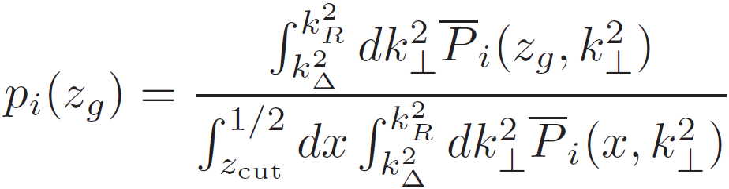
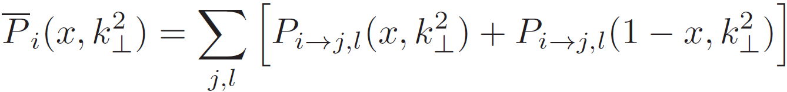
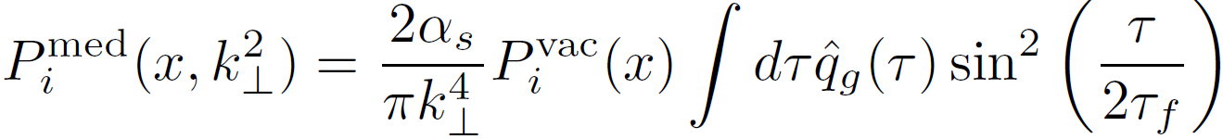
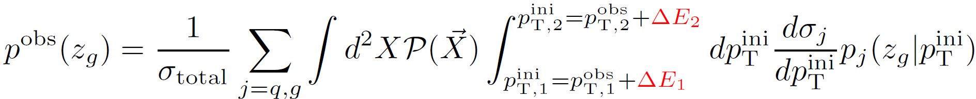
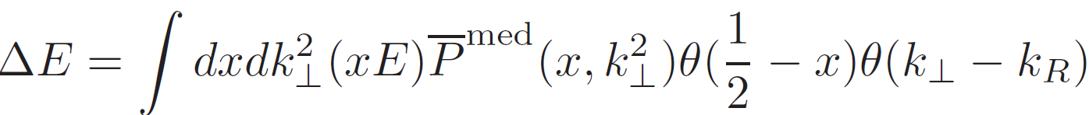
Framework of semi-analytical calculation
Larkoski, Marzani, Thaler, Phys. Rev. D91,111501 (2015);
Y.-T. Chien and I. Vitev arXiv:1608.07283
X.N. Wang and X.F. Guo,Nucl.Phys.A696,788(2001)
A. Majumder, Phys.Rev.D85,014023(2012)
Notes:
Then let’s see what’s the situation in theory. This is framework we calculate the jet splitting function. Jet splitting function can be defined by transverse momentum dependent parton splitting function in this way, where P bar need to be symmetrized (based on the normal parton splitting function) because zg is less than ½ by definiation.
In heavy-ion collisions/if the jet partons interact with the nuclear medium, the splitting function includes the contribution from both vacuum part and the medium induced part, and the medium induced part is taken from the higher-twist formalism, which is path dependence.
Finally, if we want to compare our theoretical results with the experimental data in a pT range, we need to average/convolute the jet splitting function at fixed jet pT with the cross section. And in heavy-ion collisions, we need to consider the energy loss of the jet. Here, we only consider the radiative energy loss out of the jet cone, and at first step we consider the two subjets lose energy coherently, which means energy loss reduce the total energy of their summation, but don’t change the momentum sharing fraction.

Slide 28
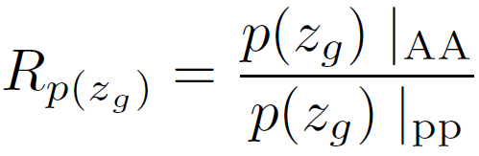
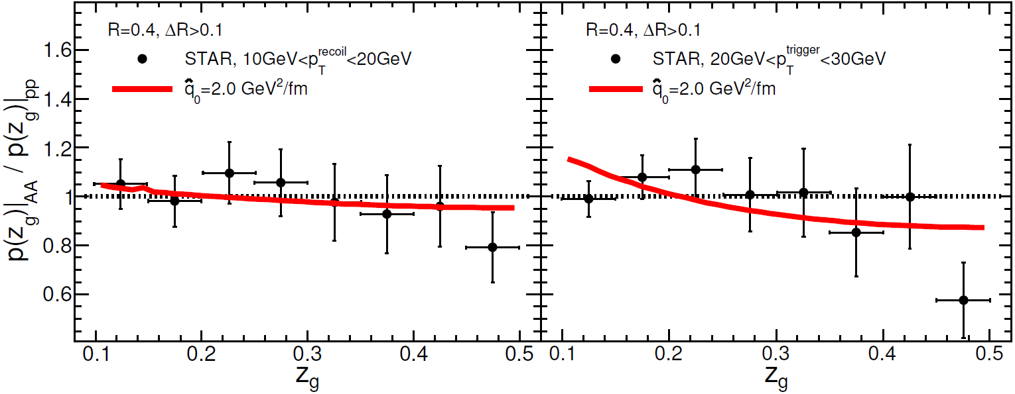
Non-monotonic p_{T} dependence of R_{p(zg)}
LHC
Significant nuclear modification at the LHC, but decreases with jet p_{T}
No apparent nuclear modification at RHIC
RHIC
Notes:
Here is our results at the LHC energy. Our theoretical results can describe the CMS data well and have same energy dependence of the nuclear modification. Results with qhat_0 is 4 GeV^2/fm can fit the data best. Then lets see the results at RHIC energy, see whether we can describe the STAR results.

Slide 29
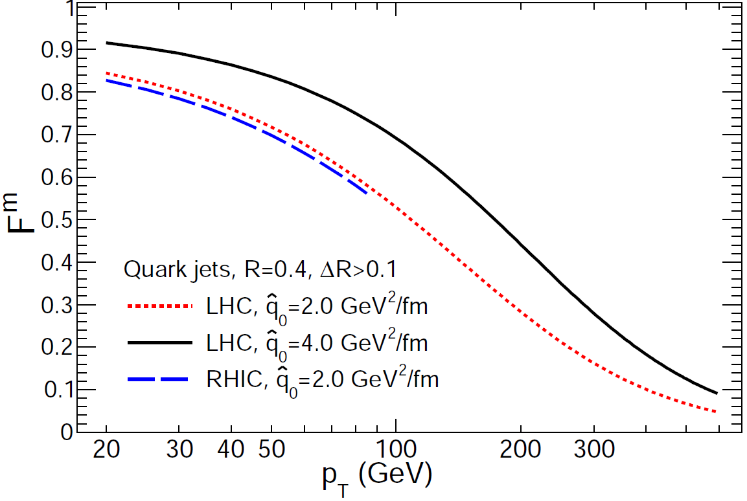
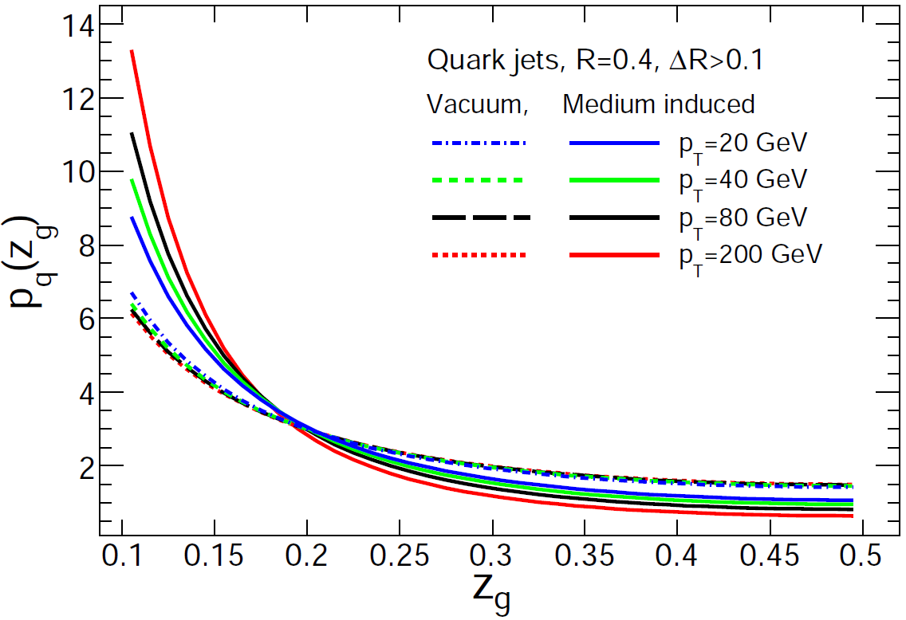
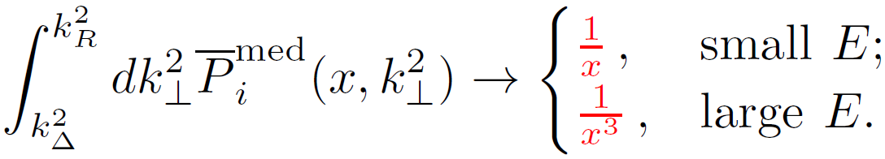
Sources of the non-monotonic behavior
The shape of med P is similar to vac at low p_{T}. Strong medium modification at low p_{T} cannot be reflected in the ratio of self-normalized P.
Medium contribution is suppressed at large p_{T} (p_{T} ∝k⟂ when θ is fixed)
The non-monotonic behavior is model dependent. Different energy loss models can be easily compared to each other within JETSCAPE.
Notes:
(The first reason of the non-monotonic behavior is )/( One factor cause the non-monotonic behavior is ) the medium induced parton splitting function from higher-twist formalism is suppressed by a factor of 1/k^2 compared to the vacuum parton splitting function.(note that k_\perp the the transverse momentum of radiated parton relative to the parent parton) For defined cone size R, k_\perp is proportional to the jet energy. So when jet energy/pT is large enough, the contribution from medium induced splitting function can be neglected. As shown in this plot the contribution fraction of the medium induced part decreases with increasing jet pT. This explain the observation by CMS collaboration, that the nuclear modification decreases with increasing jet pT.

Slide 30
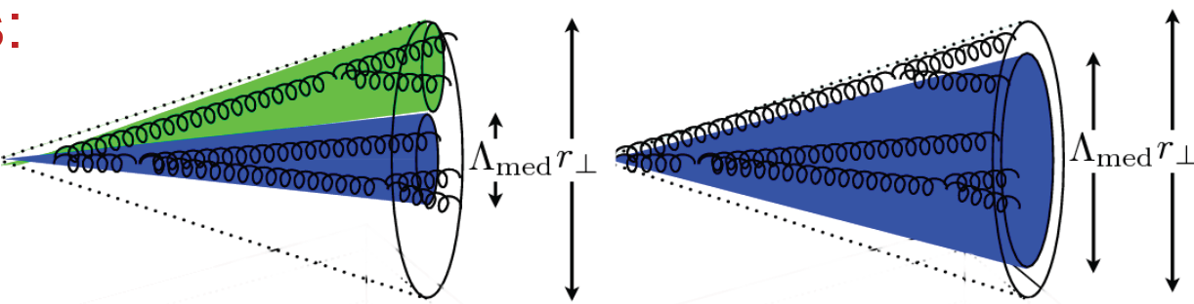
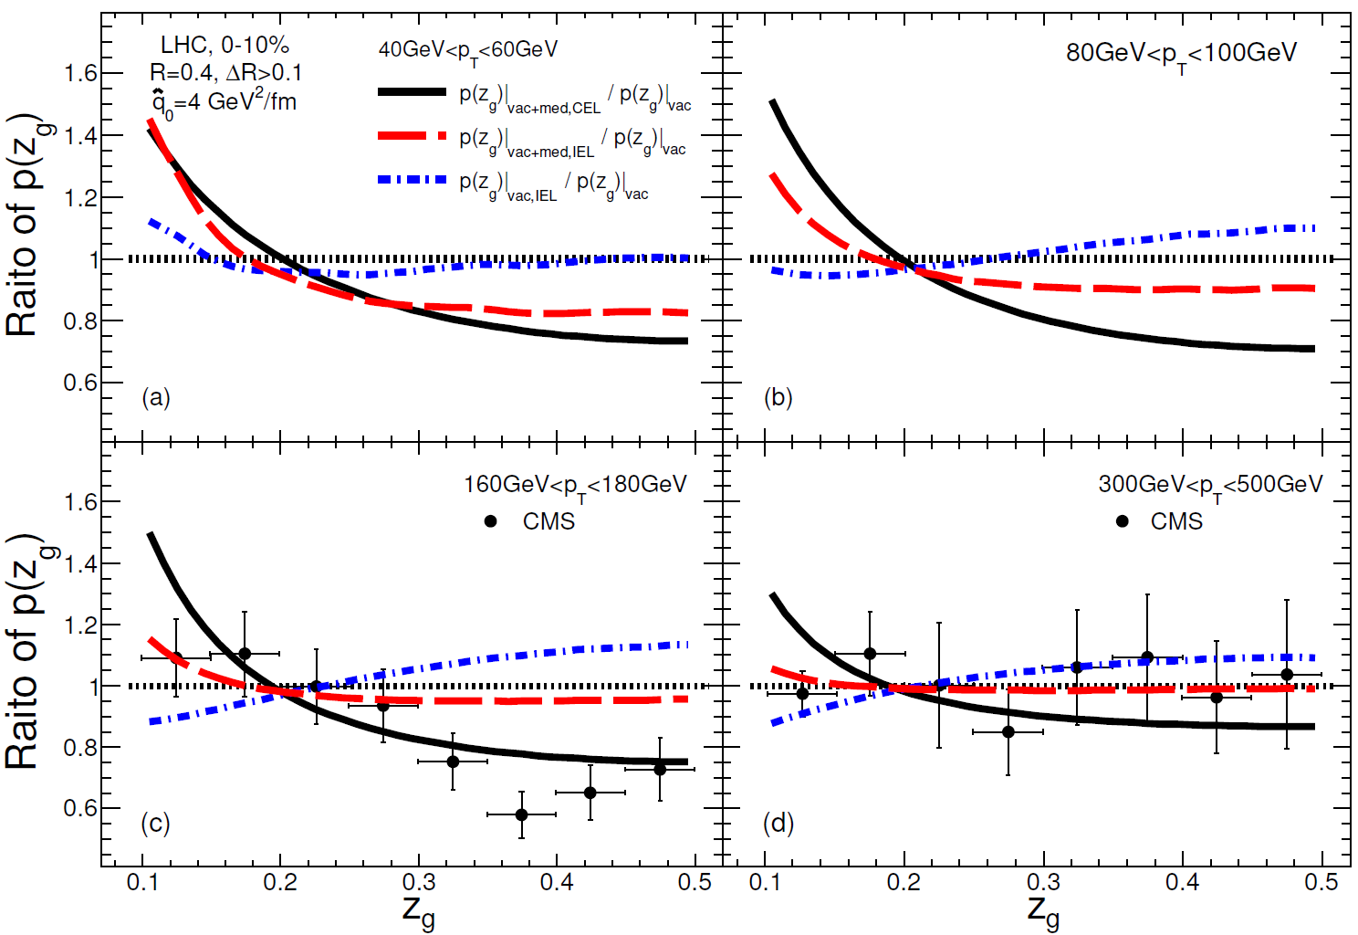
Coherent vs. incoherent energy loss of sub-jets
Incoherent (independent) energy loss of two sub-jets
coherent energy loss
Figure taken from Phys. Lett. B 725 (2013) 357–360
Data prefers coherent picture (black) than incoherent (red)
Coherent vs. incoherent picture is easier to be discussed with semi-analytical calculation, but is a great challenge to Monte-Carlo event generators (should be investigated by JETSCAPE)
Notes:
All former results are obtained under the assumption that the two subjets lose energy coherently. Actually, they can also lose energy incoherently, if they can resolved by the medium as two independent jets. Whether they are treat as/(regarded as) two independent jets depends on the relation of transverse separation of two subjets, the transverse wavelength of the subjets and the medium transverse resolution scale.
Note that the transverse wavelength of the subjets becomes smaller as parent jet energy increases, which means for fixed angle, subjets splitted from higher energy parent jet can be easier resoveld.(at least in vacuum)

Slide 31
Summary
Introduced a unified approach for multi-stage jet evolution (done by JETSCAPE Year 1)
Discussed formalisms for studying jet-induced medium excitation and their future application (under investigation by JETSCAPE Year 2 and 3)
Explored the non-monotonic p_{T} dependence of the nuclear modification of jet substructures and coherent vs. incoherent energy loss pictures (future challenges to JETSCAPE)
Thank you!

Slide 32
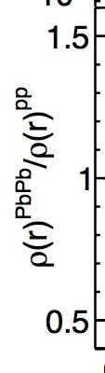
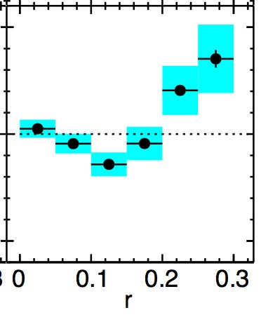
dE/dθ of daughter partons (jet shape)
In-medium evolution changes the jet shape – depletes energy in small cone and enhances energy in large cone.
LBT is more effective than MATTER in shifting energy distribution into larger angle since elastic scattering is included in LBT.
Interesting non-monotonic behavior at Q₀ = 1 GeV -- enhanced Sudakov type splitting at very small r and LBT scattering at large r. (Partly explain the jet shape measurement even with a brick.)

