Slide 1
JETSCAPE Framework Present and Future
K. Kauder

Slide 2
Outline
Working Session Recap
From 0.1 to 1.0
JETSCAPE 1.x
JETSCAPE 2.0
Concurrent running vs Parallelization

Slide 3
JETSCAPE 0.1 β
Installation
Prerequisites:
C++11 support (clang ≥ 3.3, gcc ≥ 4.8.1)
cmake v3, zlib
Download, unpack
Build in build directory
mkdir JETSCAPE-SCHOOL/build
cd JETSCAPE-SCHOOL/build
cmake ..
make

Slide 4
JETSCAPE 0.1 β
Installation
Extending the Framework
General:
Derive from appropriate base
Task-Based:
→ Override Init() and Exec()
using namespace Jetscape;
class Hello : public JetScapeTask {
virtual void Init() {
s=“Hello World”;
};
virtual void Exec(){
INFO << s;
};
protected:
string s;
// in wrapper:
#include<Hello.h>
…
auto hello=make_shared<Hello>();
jetscape->Add(hello);
…
jetscape->Init();
jetscape->Exec();
Can add new sources to src/CMakeLists.txt and parameters to xml file, but no existing code needs to be touched

Slide 5
JETSCAPE 0.1 β
Installation
Extending the Framework
Energy Loss:
Derive from appropriate base
class MyEloss
: public JetEnergyLossModule<MyEloss>
Can override Exec(), but it affects the whole event
E-Loss acts on every parton → Override DoEnergyLoss()

Slide 6
JETSCAPE 0.1 β
Installation
Extending the Framework
Energy Loss:
Derive from appropriate base
class MyEloss
: public JetEnergyLossModule<MyEloss>
How to access the local medium properties? Ask Hydro!
Signal+Slot: asynchronous, type-safe alternative to function pointer
Connection is made for you!
No existing code needs to be touched
E-Loss
Signal
Slot
Hydro
Signal
E-Loss
std::unique_ptr<FluidCellInfo> fluid_info;
GetHydroCellSignal(t, x, y, z, fluid_info);

Slide 7
JETSCAPE 0.1 β
Installation
Extending the Framework
Hydro:
Derive from appropriate base
class MyHydro : public FluidDynamics
Override Exec() → Calculate the entire hydro evolution
Override get_hydro_info() → Provides the Slot for E-Loss
Similar functionality for Initial State, Hadronization, etc.

Slide 8
JETSCAPE 0.1 β
Installation
Extending the Framework
Creating and using Output
Provided formats:
ASCII
gzipped ASCII
HepMC
auto writer=make_shared<JetScapeWriterAscii> (name);
// auto writer=make_shared<JetScapeWriterAsciiGZ> (name);
// auto writer=make_shared<JetScapeWriterAsciiHepMc> (name);
jetscape->Add(writer);
Or derive from appropriate base
class MyWriter : public JetScapeWriter

Slide 9
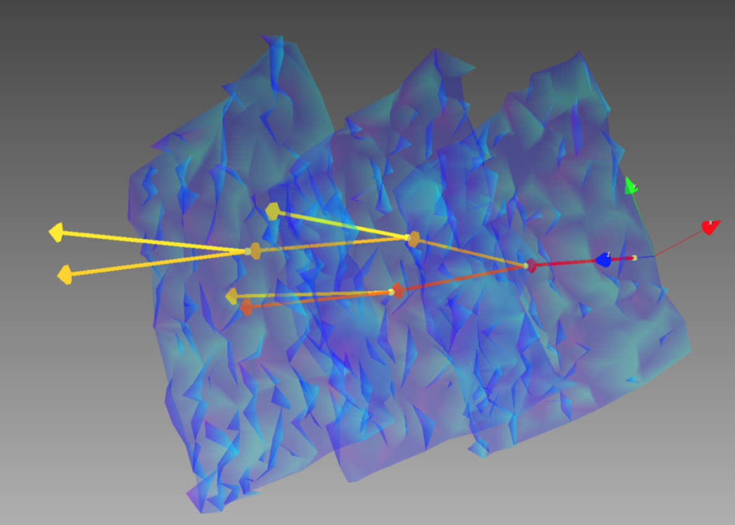
JETSCAPE 0.1 β
Installation
Extending the Framework
Creating and using Output
ASCII formats come with reader
Simple interface, returns JetScape particles or fastjet::PseudoJets
Recovers full shower graph
auto reader=make_shared<JetScapeReaderAscii>(name);
while (!reader->Finished()){
reader->Next();
auto showers=reader->GetPartonShowers();
vector<Partons> = showers[0]->GetFinalPartons();
vector<PseudoJet>
= showers[0]->GetFinalPartonsForFastJet();
}

Slide 10
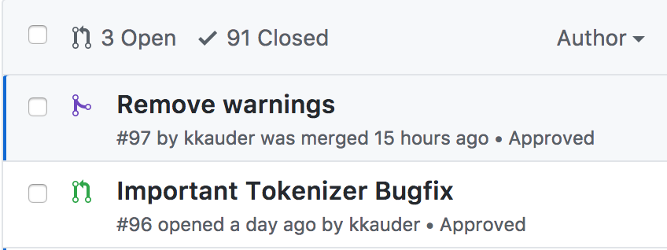
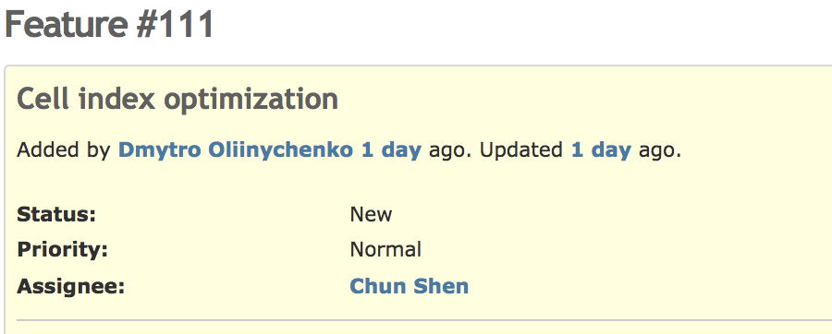
Working Sessions
Nothing can replace user feedback
Thanks to all participants!
Please stay in touch:
bugs.jetscape.org@gmail.com

Slide 11
From 0.1 to 1.0
A check in every box:
Trento (2+1)
MUSIC (2+1, 3+1) Brick, Gubser
PYTHIA8
MATTER, Martini, AdS/CFT, LBT
Cooper Frye
PYTHIA8
Declared Feature Freeze

Slide 12
Closing in on Release
Focus on
Bug fixes, conservative optimization
Extensive validation, parameter tuning
Documentation (Manual, Doxygen)
Structure cleanup, style unification, …

Slide 13
JETSCAPE 1.x++
Focus on Physics Modules
OSU pre-equilibrium
OSU hydro
Recombination
SMASH
NLO
…
Framework
Feature requests from contributors and users
Maintenance and incremental improvement
→ Expect stable production branch, major changes only in v2.0

Slide 14
Toward JETSCAPE 2.0
Sequential Running
Run entire hydro evolution
E-loss requests from memory
Concurrent Running
Run at the same time
Two-way communication at every time step
Full
Hydro
Full
Shower
Hydro
+ Recoil
Full
Shower
Hydro
+ Recoil
Possible (v1.y?)

Slide 15
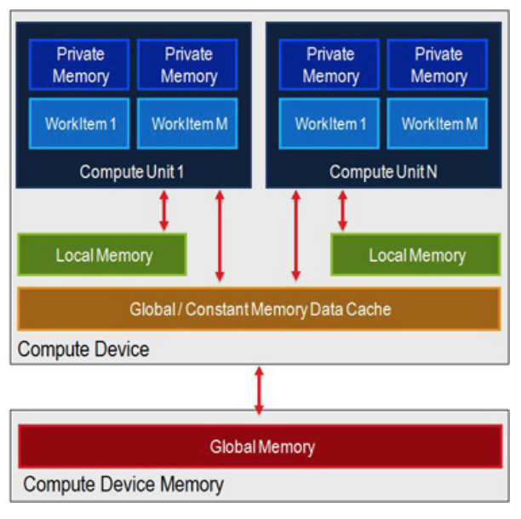
Concurrent Running
Important for Physics?
Not for single jet leading edge
What about the fringes?
What about forward di-jets, three-jets, multiple hard scatterings?
Technical Limitations
In memory:
2+1D MUSIC: O(100) MB
3+1D MUSIC: O(100) GB
Crucial to keep and use only what is needed

Slide 16
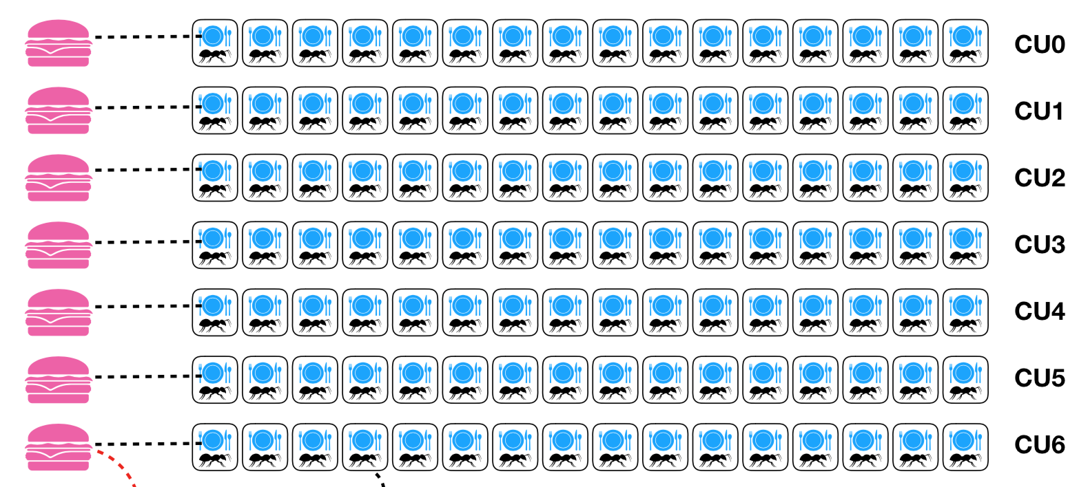
Parallelization
Necessary? Unequivocally YES
LongGang: Parallel processing on GPUS reduces time for a hydro event from tens of hours to a few minutes

Slide 17
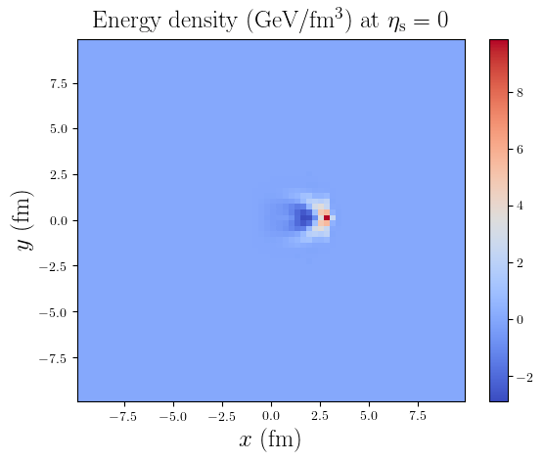
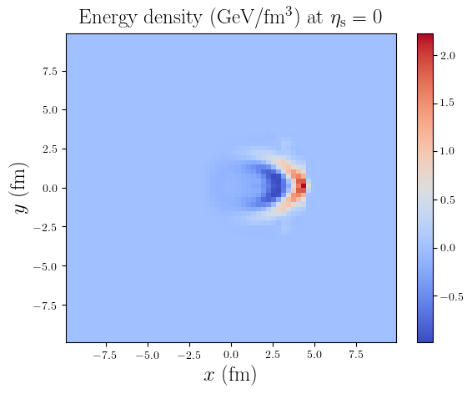
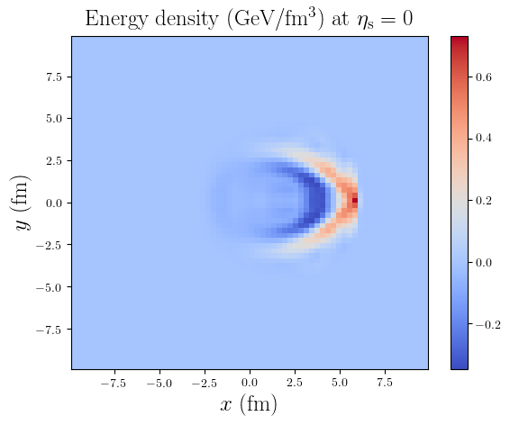
At the Framework Level?
Plots courtesy of Y. Tachibana
For illustration only
Seems natural!
But what is gained?
Hydro
Hydro
Hydro
t1
t2
t3
100 s
100 s
100 s
Σ = n * (100 s + x)
1 s
1 s
1 s
t1
t2
t3
Eloss
Eloss
Eloss

Slide 18
Sequential Tasks
Plots courtesy of Y. Tachibana
For illustration only
With these numbers, negligible gain
Hydro
Hydro
t1
t1
t2
100 s
Σ = n * (101 s + x’)
1 s
t0
t1
t2
Eloss
Eloss
Eloss

Slide 19
Considerations for v2.0
Concurrent Running is coming
Parallel computing is coming
Robust inter-task communication
Tools for intra-task parallelism
R&D for task parallelism if it becomes advantageous
How that can happen
Drastic Hydro speedup
Complex Eloss
Expensive tasks that can/must interface with Hydro, i.e. Particulization, Hadronization
New ideas

Slide 20
Summary
Very productive working session → Crucial feedback to iron out remaining bugs and stream-line the framework
Feature-frozen with physics module(s) at every step from Initial State through Hadronization → Full focus on first release of JETSCAPE 1.0
R&D for 2.0 is underway

