Slide 1





Physics modeling of jet Monte-Carlo
LBNL, 1/3/2018
Shanshan Cao
Wayne State University

Slide 2
Outline
Part I: Basics of Monte-Carlo Sampling
Part II: One example of jet Monte-Carlo (LBT model)
Part III: Multi-stage jet evolution within JETSCAPE

Slide 3
Part I: Basics of Monte-Carlo Sampling
Pythia Manual Chapter 4, JHEP 0605, 026 (2006)

Slide 4
Limits of semi-analytical calculation
Splitting function:
Number of emitted gluon:
Energy taken away from the quark:
E on the RHS does not change with parton evolution
Do not naturally include energy fluctuation, average energy loss only
Hard to include other fluctuations with the presence of medium
Monte Carlo methods are computational algorithms that rely on repeated random sampling based on probability distributions to obtain numerical results – naturally include quantum fluctuations in realistic physics processes and connect theories and experiments.
Use N_{g} (if N_{g} << 1, otherwise e^{-Ng}) as the probability of splitting
If a splittings happen, sample x using P(x) and take energy xE away from parent quark
Repeat the process to obtain numerical results of multiple splittings

Slide 5
MC Sampling: hit-or-miss method
If the maximum of f(x) ≤ f_{max} in the range where we want to sample x:
1. Select an x with even probability in the allowed range: x = x_{min}+R(x_{max}−x_{min});
2. Compare a (new) Rf_{max} with f(x);
if Rf_{max} ≤ f(x), accept x;
3. Otherwise repeat 1 and 2 until x is found.
f_{max}
Rf_{max}
x_{min}
x
x_{max}
Example: sample medium-induced gluon spectrum (x and k⏊) [used in LBT]
1. Calculate N_{g} within Δt at given E, T and t (record f_{max} when evaluating integral);
2. If emission happens sample x and k⏊ independently within physical ranges;
3. Compare a new Rf_{max} with f(x,k⏊), accept x and k⏊ if Rf_{max} ≤ f(x,k⏊);
4. Otherwise repeat 2 and 3 until x and k⏊ are found.

Slide 6
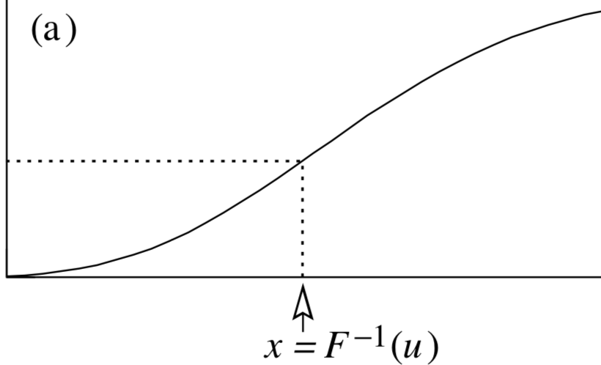
MC Sampling: inverse-primitive-fnc method
1. Find the primitive function of f(x):
2. Sample a random number u in [0, F(x_{max})] with RF(x_{max});
3. Solve x with the inverse function of F(x):
Efficient when the analytical solution of the inverse function exists. Still doable even it does not exist.
F(x_{max})
u = RF(x_{max})
x_{min}
x_{max}
Example: sample x from splitting function P(x) [used in MATTER]
1. Calculate the integrated splitting function (primitive function);
2. Sample a random number u in [0, F(x_{max})] with RF(x_{max});
3. Solve numerically (bisection method) --
(a) set x_{mid} = (x_{min}+x_{max})/2; (b) if F(x_{mid}) < u, set x_{min} = x_{mid}; if F(x_{mid}) > u, set x_{max} = x_{mid}; (c) Repeat (a) and (b) until |F(x_{mid})-u| < ε, and then x = x_{mid}.

Slide 7
MC Sampling: combined method
Assume the existence of a function g(x), with f(x) ≤ g(x) over the x range of interest. Here g(x) is picked to be a “simple” function, such that the primitive function G(x) and its inverse G⁻¹(x) are known.
Select an x according g(x) using the inverse primitive function method;
Compare a (new) Rg(x) with the ratio f(x); if Rg(x) ≤ f(x) accept x;
Otherwise repeat 1 and 2 until x is found.

Slide 8
Part II: An example of jet Monte Carlo linear Boltzmann transport model (LBT)
Y. He, T. Luo, X.-N. Wang and Y. Zhu, Phys. Rev. C91 (2015) 054908
SC, T. Luo, G.-Y. Qin and X.-N Wang, Phys. Rev. C94 (2016) 1, 014909
SC, T. Luo, G.-Y. Qin and X.-N. Wang, Phys. Lett. B777 (2018) 255-259
W. Chen, SC, T. Luo, L.-G. Pang, and X.-N. Wang, Phys. Lett. B777 (2018) 86-90

Slide 9
A linear Boltzmann transport model
Boltzmann equation for parton “1” distribution:
The collision term:
transition rate from p₁ to p₁-k
Elastic Scattering (2->2 process)
“Linear” in f₁ if the modification of medium by jet is neglected
microscopic cross section of 12->34

Slide 10
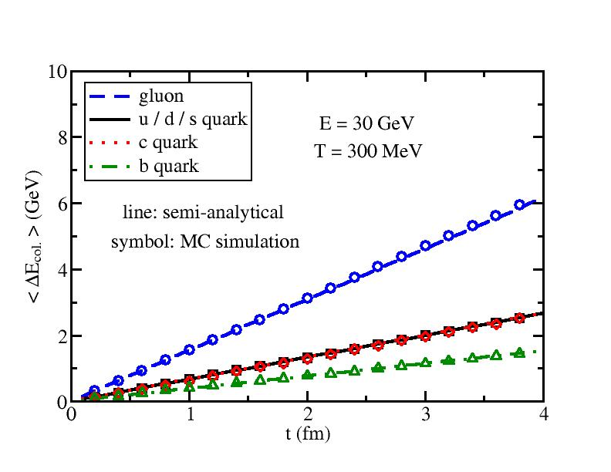
A linearized Boltzmann transport model
Scattering rate:
In model calculation:
1. Use total rate to determine the probability of elastic scattering
2. Use branching ratios to determine the scattering channel
3. Use the differential rate to sample the p space of the two outgoing partons
ΔE_{col.} from our MC simulation agrees with the semi-analytical result.

Slide 11
A linearized Boltzmann transport model
Inelastic Scattering (2->2+n process)
Average gluon number in Δt:
Spectrum of medium-induced gluon (higher-twist formalism):
[ Guo and Wang (2000), Majumder (2012); Zhang, Wang and Wang (2004) ]
of quark/gluon due to 2->2 scatterings
Splitting time of radiated gluon:
Splitting functions:
_
g->qq not included – slight effect on single hadron spectra

Slide 12
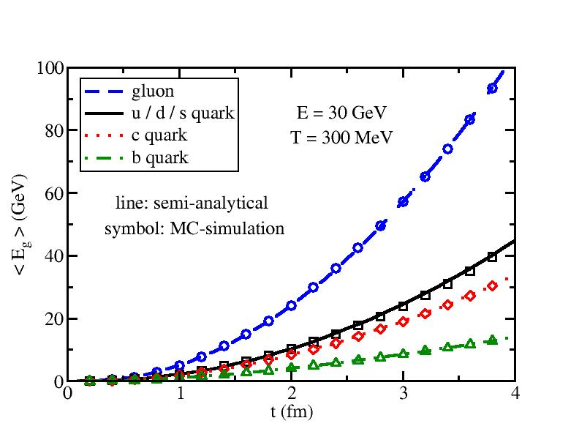
A linearized Boltzmann transport model
Number n of radiated gluons during Δt – Poisson distribution:
Probability of inelastic scattering during Δt:
In model calculation:
Calculate and thus
If gluon radiation happens, sample n from
Sample E and p of gluons using the differential spectrum
Assume 2->2 first and adjust E and p of the 2+n final partons together to guarantee E-p conservation of 2->2+n process
<E_{g}> from our MC simulation agrees with the semi-analytical result.

Slide 13
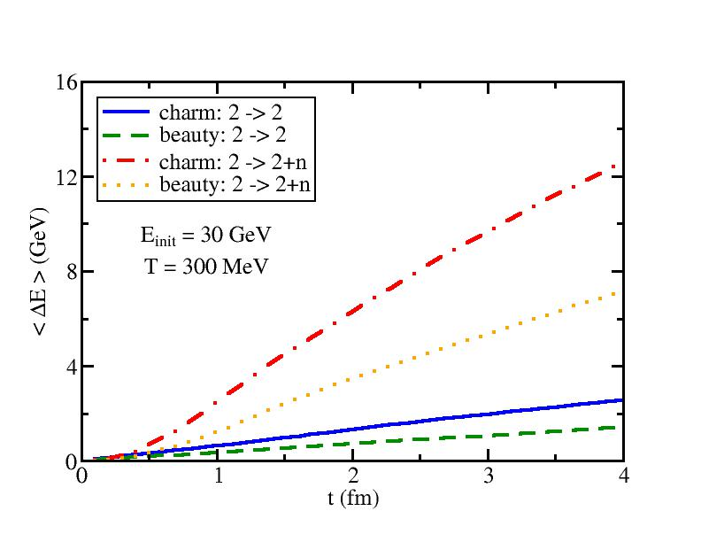
Elastic vs. inelastic energy loss
Divide scattering probability of jet parton into two regions:
Pure elastic scattering without radiated gluons:
Inelastic scattering:
Total probability:
In model calculation:
Use to determine whether the jet parton scatter with the thermal medium
If so, we then determine whether this scattering is pure elastic or inelastic
Simulate the 2->2 or 2->2+n process
HQ energy loss due to elastic and inelastic processes are comparable at early time, but is dominated by the inelastic process at large t.

Slide 14
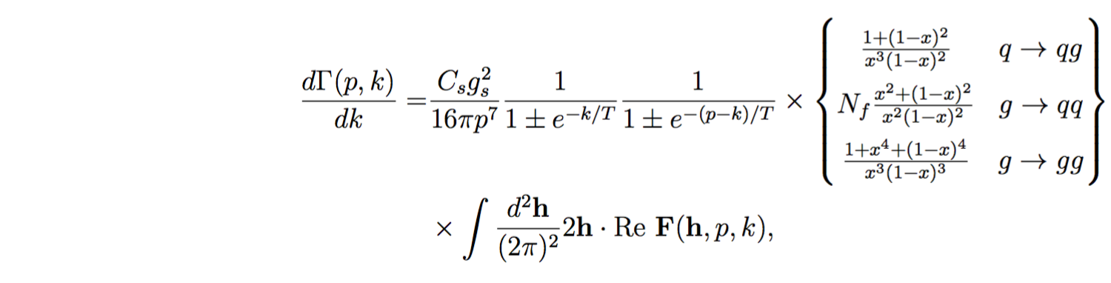
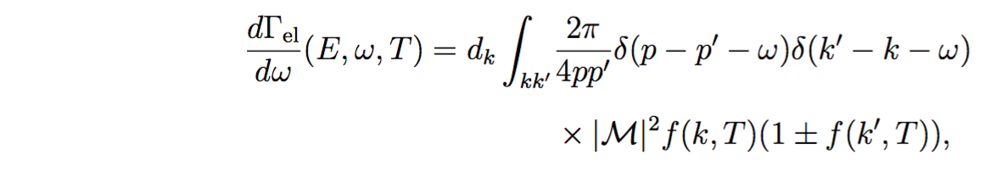
An alternative transport model in JETSCAPE
MARTINI (Modular Algorithm for Relativistic Treatment of heavy IoN Interactions) [McGill: PRC 80 (2009) 054913, arXiv:0909.2037]
Energy loss mechanism in MARTINI is based on the AMY radiative formalism coupled with collisional energy loss
AMY formalism for 1->2 splittings where LPM effect is included:
F(h, p, k) [p – jet parton, k – emitted gluon, h = p × k] is the solution of an integral (Schwinger-Dyson) equation describing how |p − k; k⟩⟨p| evolves with t due to collisions and the energy difference between the two states.
Elastic scattering rate for 2->2 scattering process is included:
[S. Jeon and G. Moore PRC 71 (2005) 034901, S. Jeon NPA 830 (2009) 107 ]

Slide 15
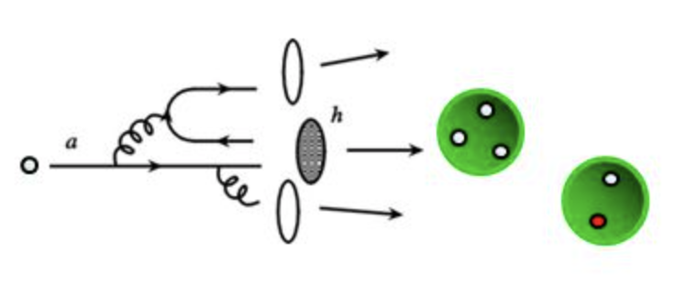
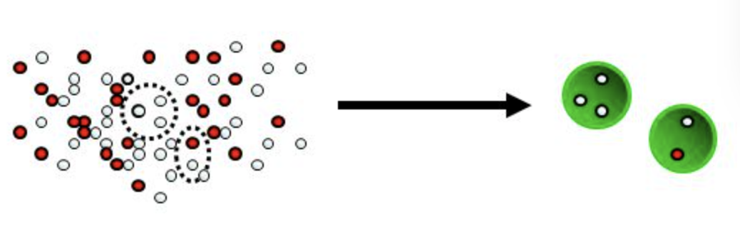
Hadronization
( Fragmentation + hard-thermal recombination )
Most high momentum quarks fragment into hadrons (one may use PYTHIA simulation) [fragmentation mechanism]
Most low momentum quarks combine with each other into hadrons [recombination (coalescence) mechanism]

Slide 16
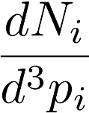


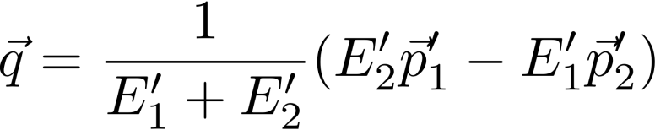
Example: hadronization of heavy quarks
Two-particle recombination for heavy meson formation:
Distribution of the i ^{th} kind of particle
Thermal light parton: thermal in the l.r.f of the QGP fluid cell
Heavy quark: the distribution at T_{c} after LBT evolution
Probability for two particles to combine
Variables on the R.H.S. are defined in the c.m. frame of the two-particle system.
Can be generalized to three-particle recombination (baryon)

Slide 17
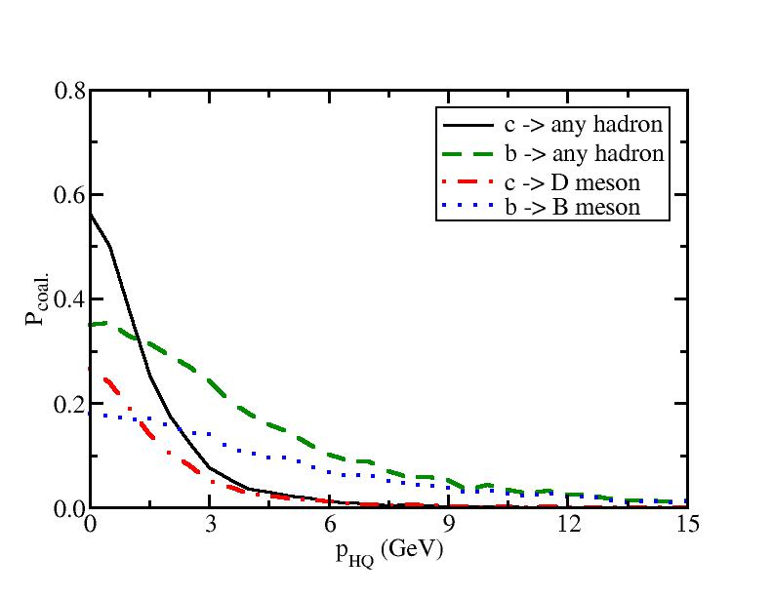
Hadronization of heavy quarks
Use f ^{W} to calculate P_{coal.}(p_{HQ}) for all channels (D/B Λ Σ Ξ Ω) at T_{c}
Three regions: recombination to D/B mesons, recombination to other hadrons, and fragmentation
In model calculation: in the l.r.f of the hadronization hypersurface, determine which region each HQ belongs to, and then use either recombination model or Pythia simulation to obtain D/B mesons
[ Details of recombination model: Rainer Fries’s talk on 1/7 ]

Slide 18
Framework overview
(Parton evolution inside the QGP)
Generation of QGP medium: viscous hydro from OSU (2+1 D) or LBL-CCNU (3+1 D) group
Initialization of hard partons: MC-Glauber for position space and pQCD calculation for momentum space (PDF: CTEQ5+EPS09)
Simulation of parton evolution: the Boltzmann transport model in the local rest frame of the medium
Hadronization: fragmentation + recombination model
outside the medium
(below T_{c}), converted into hadrons

Slide 19
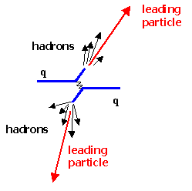
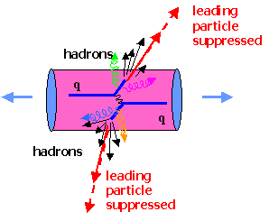
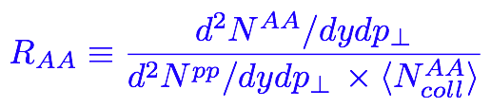
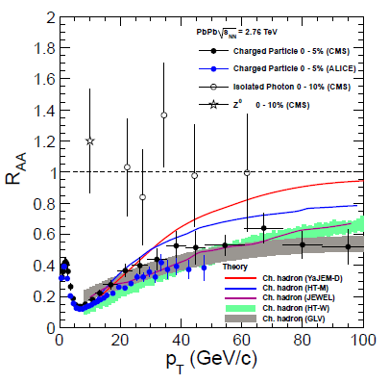
Nuclear modification of hard probes
p+p
A+A
Compare probes with and without medium modification and infer properties of the nuclear matter
1/N_{bin} d²N/d²p_{T}
energy loss shifts spectrum to left
p+p
medium absorption shifts spectrum downwards
A+A
p_{T}
Mueller et al., Ann. Rev. Nucl. Part. Sci. 62, 361 (2012)

Slide 20
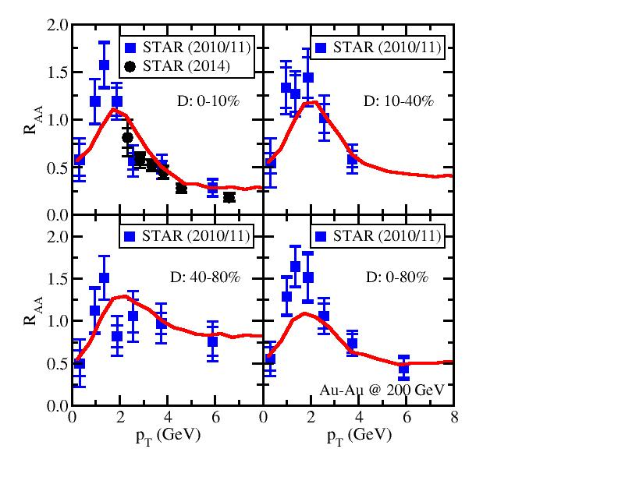
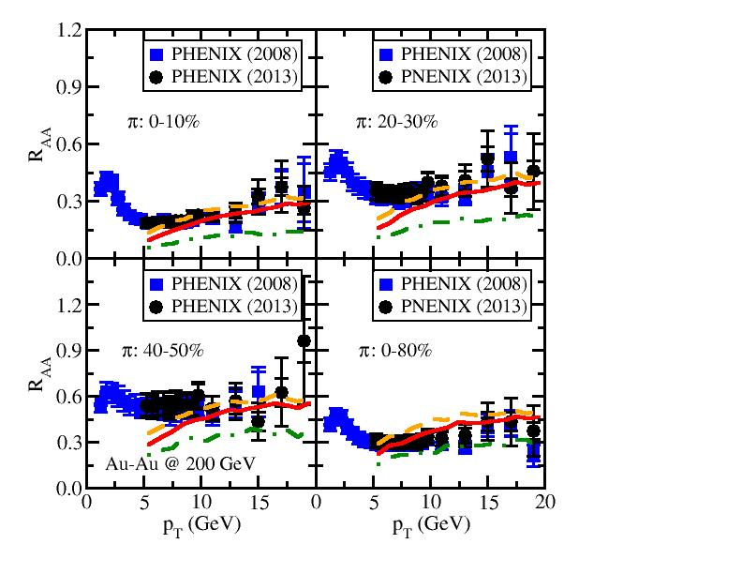
Simultaneous description of D and π R_{AA} in 200 GeV Au-Au collisions

Slide 21
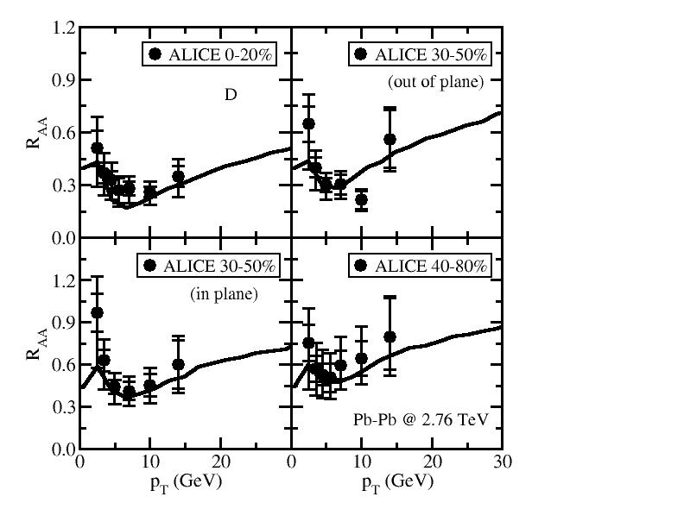
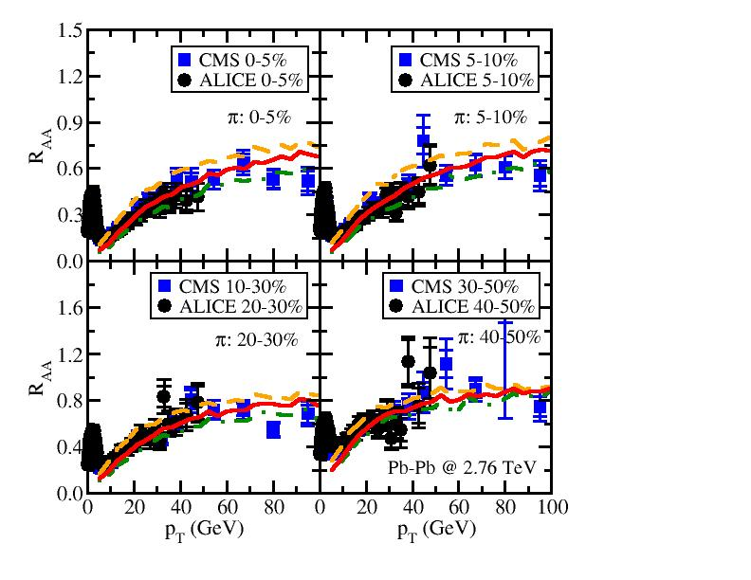
Simultaneous description of D and π R_{AA} in 2.76 TeV Pb-Pb collisions

Slide 22
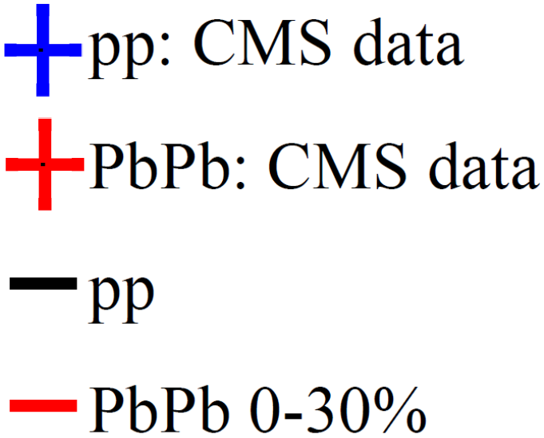
Other observables from LBT calculation
[ Wei Chen’s talk on 1/7 and Tan Luo’s talk on 1/7 ]
Nuclear modification of single jets
Nuclear modification of gamma-triggered hadron yields
Photon-jet asymmetry

Slide 23
Part III: Multi-stage jet evolution within JETSCAPE
SC et al., (JETSCAPE Collaboration), Phys. Rev. C96 (2017) 2, 024909
SC, A. Majumder, G.-Y. Qin and C. Shen, arXiv:1711.09053.

Slide 24
Quantum Effects
Particles in current transport models are usually on-shell
Quantum fluctuation allows particles to be off-shell (virtual)
within a finite splitting time
Partons produced in energetic collisions usually start with high virtuality (Q > 0) and then evolve back to shell after several splittings
Requires a unified approach combining theories at high and low Q
The JETSCAPE Collaboration
http://jetscape.wayne.edu
JESTCAPE paper Phys. Rev. C96 (2017) 2, 024909

Slide 25
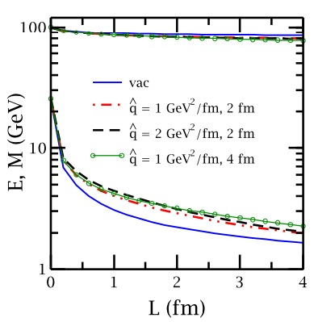
Multistage jet evolution in heavy-ion collisions
Stage 1: High Q and high E (DGLAP, higher-twist); lose Q faster than E [ Majumder and Putschke, PRC 93 (2016) ]
Stage 2: low Q and high E (Transport, higher-twist, AMY)
Stage 3: low Q and low E (near thermal) (strongly coupled approach)

Slide 26
Parton splitting at high Q
DGLAP evolution for parton fragmentation function at high Q:
Sudakov form factor ( probability of NO splitting in [ Q , Q_{max} ] ):
Splitting function:
[ higher-twist energy loss formalism: Guo and Wang (2000), Majumder (2012) ]
jet transport coefficient, due to elastic scattering

Slide 27
Parton splitting at high Q
MATTER (The Modular All Twist Transverse-scattering Elastic-drag and Radiation) [Wayne: PRC 88, 014909 (2013), arXiv:1712.10055)]
Monte-Carlo Implementation:
splitting happens above Q₀ (min. allowed virtuality)
no splitting above Q
splitting happens at (or below) scale Q
For a given splitting, the p⁺ fraction of the two daughter partons are determined by P(z), and p_{T} w.r.t. the parent parton is determined by the difference in invariant mass between the parent and daughters.
This Q also determines the new Q_{max} for the next splitting (iteration)
a virtuality-ordered parton showers from initial Q_{max} to Q₀

Slide 28
Combining theories at high Q and low Q
MATTER (virtuality-ordered) evolves partons down to Q₀ and LBT or MARTINI (time-ordered) continues parton evolution at (or below) Q₀
Fixed Q₀ (both in vacuum and medium): 1, 2 or 3 GeV will be used and compared.
Dynamical Q₀ (virtuality gain from scattering with the medium):
Note: Dynamical Q₀ is only meaningful in a thermal medium, in vacuum, Q₀ = 1 GeV is applied
*
*
,

Slide 29
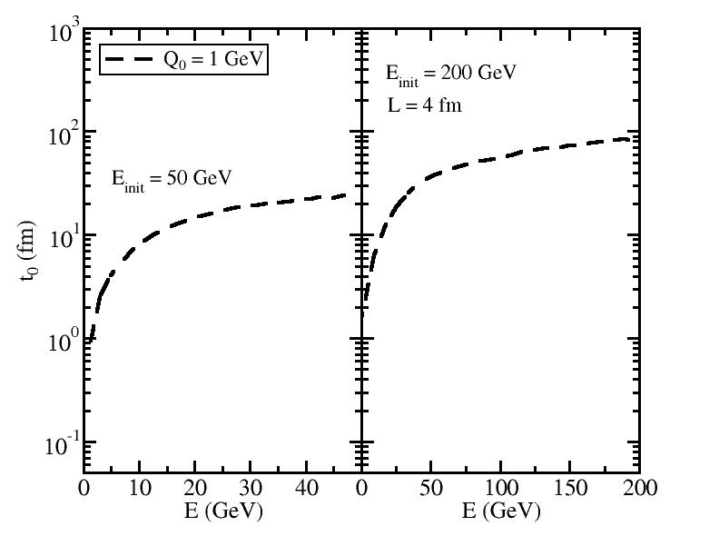
Separation time between MATTER and LBT/MARTINI
when a given parton hit Q₀ after multiple splittings
t₀ (vs. τ₀) is NOT small.

Slide 30
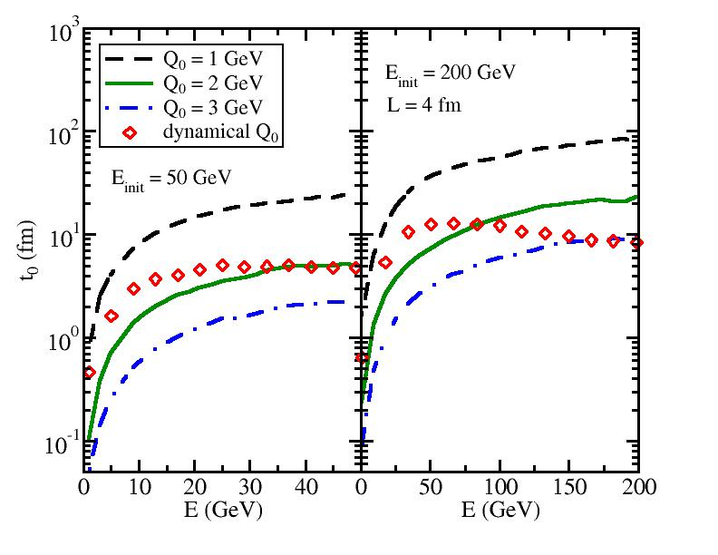
Separation time between MATTER and LBT/MARTINI
when a given parton hit Q₀ after multiple splittings
t₀ (vs. τ₀) is NOT small.
t₀ decreases if Q₀ increases or E_{init} decreases.

Slide 31
Separation time between MATTER and LBT/MARTINI
when a given parton hit Q₀ after multiple splittings
t₀ (vs. τ₀) is NOT small.
t₀ decreases if Q₀ increases or E_{init} decreases.
The dynamical Q₀ varies between 2 and 3 GeV for high E partons within quark jet with E_{init} between 50 and 200 GeV.
The dynamical Q₀ approaches 1 GeV for low E daughter partons.

Slide 32
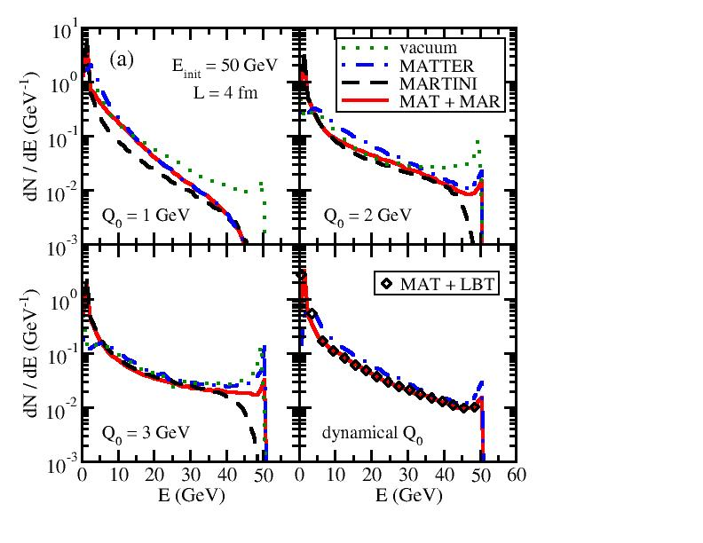
dN/dE of daughter partons (jet FF)
Energy distribution of final shower partons from a single quark with a fixed initial energy E_{init} through a brick with length L.
Four model setups:
Vacuum: Sudakov type of shower with vacuum P(z)
MATTER: Sudakov type of shower with vacuum + medium induced P(z)
LBT/MARTINI: Partons from vacuum shower evolve the entire 4 fm in LBT/MARTINI
MATTER+LBT/MARTINI: Combined scheme – partons evolve in MATTER up to t₀ and then in LBT/MARTINI till 4 fm

Slide 33
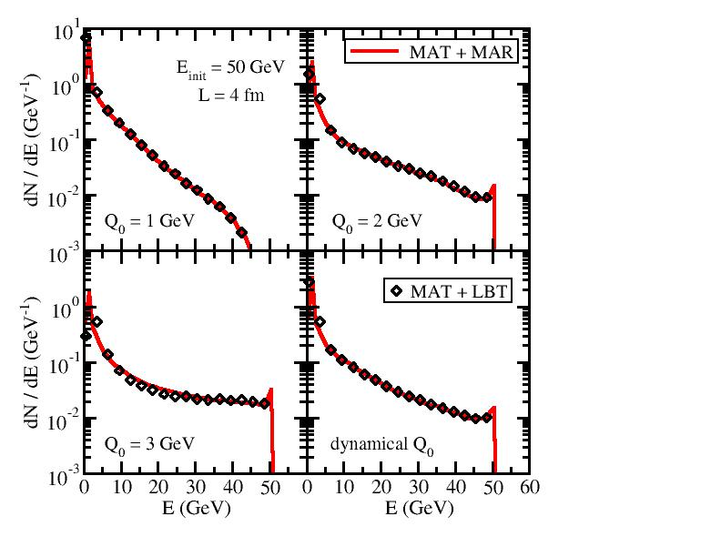
LBT vs. MARTINI
Final parton spectra from LBT and MARTINI are consistent with each other at the time comparable to the QGP lifetime.

Slide 34
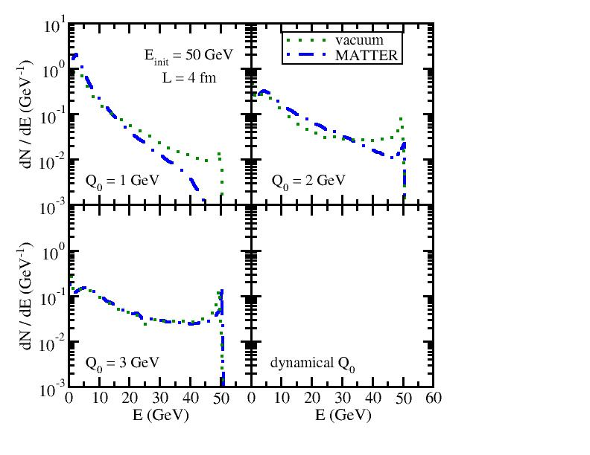
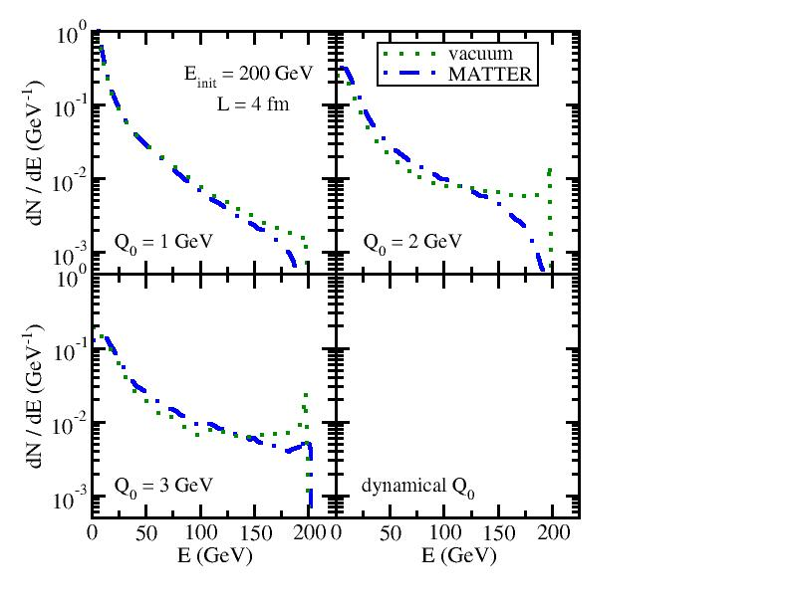
MATTER vs. vacuum shower
50 GeV jet
200 GeV jet
Energy loss in MATTER is stronger when Q₀ is smaller
Energy loss in MATTER disappears when (medium scale).
increases with the jet energy; MATTER evolution is more important to high energy partons than to low energy ones

Slide 35
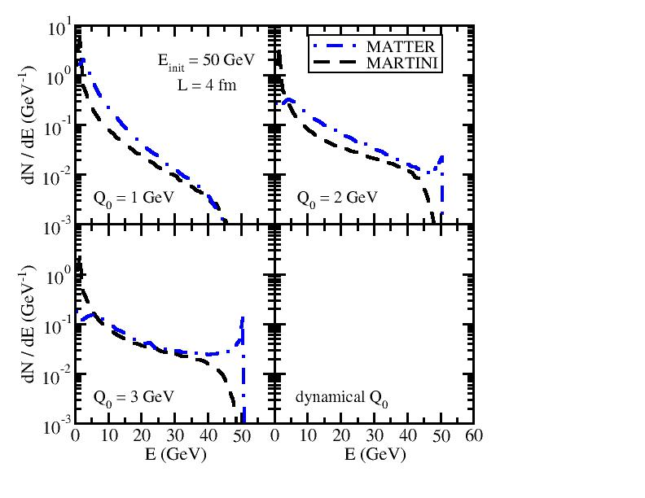
Pure MATTER vs. Pure LBT/MARTINI
On-shell time-ordered transport models are NOT constrained by any virtuality scale in the phase space ➔ energy loss in pure LBT/MARTINI evolution is stronger than that in pure MATTER

Slide 36
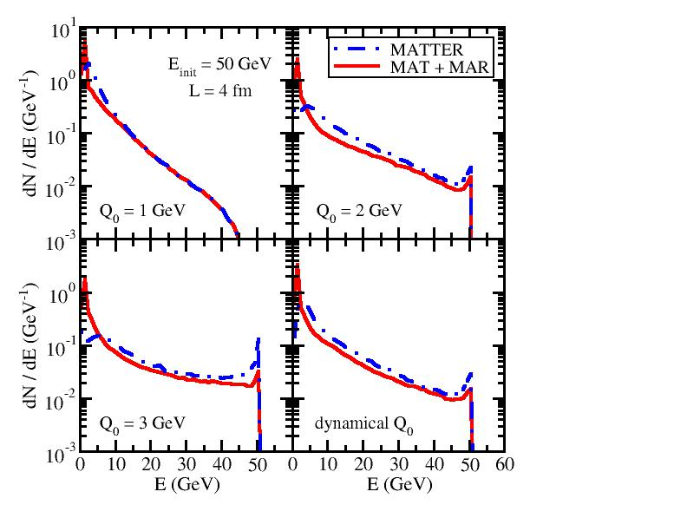
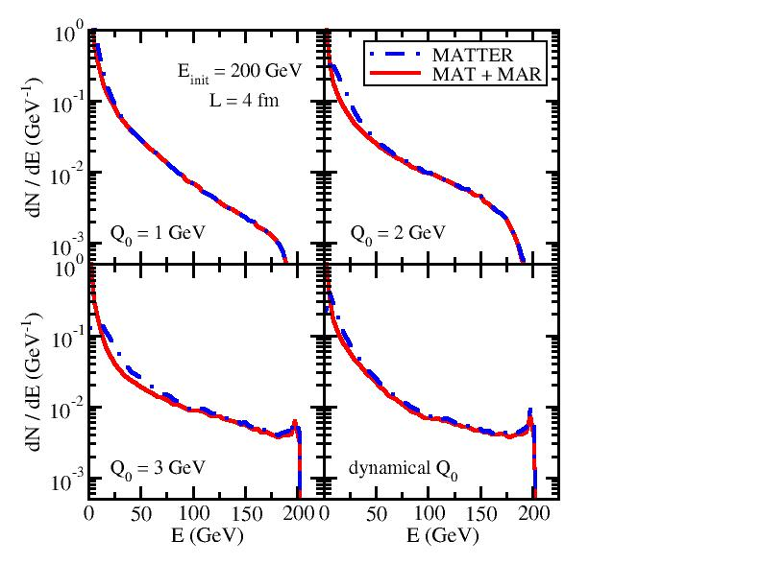
MATTER vs. LBT/MARTINI in combined approach
50 GeV jet
200 GeV jet
Recall: It takes longer time for high E partons to hit Q₀ in MATTER and leaves shorter time for the subsequent LBT/MARTINI.
Energy loss from LBT/MARTINI in MATTER + LBT/MARTINI is weak for high E partons, but becomes stronger for low E ones.

Slide 37
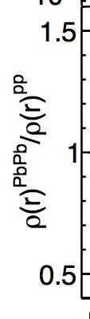
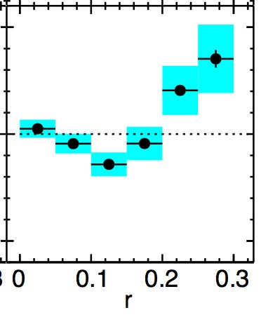
dE/dθ of daughter partons (jet shape)
In-medium evolution changes the jet shape – depletes energy in small cone and enhances energy in large cone.
LBT is more effective than MATTER in shifting energy distribution into larger angle since elastic scattering is included in LBT.
Interesting non-monotonic behavior at Q₀ = 1 GeV -- enhanced Sudakov type splitting at very small r and LBT scattering at large r. (Partly explain the jet shape measurement even with a brick.)

Slide 38
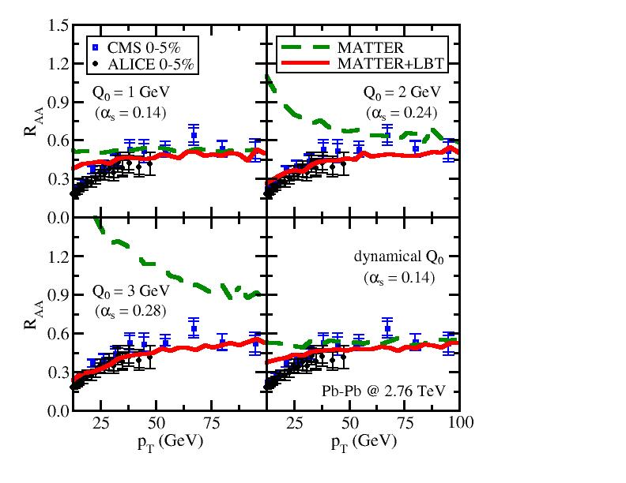
Nuclear modification of single hadrons
Dependence on Q₀ (central Pb-Pb @ 2.76 ATeV)
JETSCAPE
preliminary
Partons with larger E hit Q₀ later ➔ MATTER dominates high p_{T}, LBT low p_{T}
Larger Q₀ leads to shorter MATTER evolution ➔ LBT contribution is larger
Result from the dynamical Q₀ is close to fixed Q₀ = 1 GeV (average T is low)

Slide 39
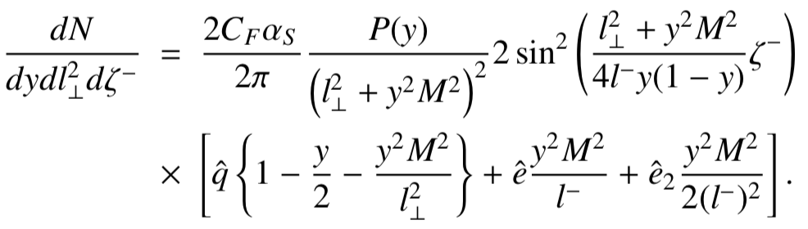
Multi-stage effects in heavy quark energy loss
SC, Majumder, Qin, Shen, arXiv: 1711.09053
^
For massless partons, q induced radiation dominates compared to e and e₂
For heavy quarks, at low scale Q ~ M, contribution from e and e₂ induced radiation is also important
^
^
^
^
^
Q < M, transport model with q + e + e₂; Q > M, DGLAP with q
Contributions from e and e₂ diminish at large p_{T}
e and e₂ decrease B meson R_{AA} and narrow the difference between D and B mesons
^
^
^
^
^
Zhang, Hou, Qin, PRC 94 (2016) 024916
Abir, Kaur, Majumder, PRD 90 (2014) 114026
Abir, Majumder, PRC 94 (2016) 054902
^
^

Slide 40
Summary
Reviewed basic techniques of Monte-Carlo sampling
Discussed in detail the construction of the linear Boltzmann transport model as an example of jet Monte-Carlo
Extended transport model to multi-stage jet evolution within JETSCAPE that covers different regions of phase space of jet partons
Thank you!

