Slide 1




A Hybrid Hadronization Model
JETSCAPE Workshop 2018
LBNL, Berkeley, January 7, 2018
Rainer Fries
Texas A&M University
Work in collaboration with
Kyongchol Han
Che Ming Ko
Michael Kordell

Slide 2
Overview
Introduction and motivation
The Hybrid Hadronization model
Including a medium
Matching to jet MCs and JETSCAPE

Slide 3
Hadronization Models
We propose a new kind of hadronization model: a hybrid of existing models.
  String fragmentation
  Quark recombination
Goal: extrapolate smoothly between successful vacuum phenomenology of string fragmentation and hadronization in a thermal environment. Focus on hadronization of parton showers/jets.
Original motivation: in-medium effects for jet hadronization in a medium.
  Hadron chemistry
  Momentum diffusion
More recently: modification of hadronization even in small systems?

Slide 4
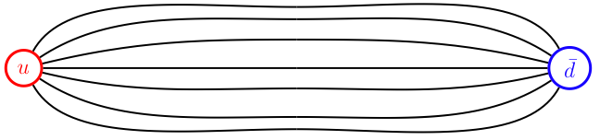
String Fragmentation
Color flux expelled from the QCD vacuum → color flux tubes → string-like behavior.
Lund string fragmentation picture
Successful phenomenology starting at PETRA, LEP, … → PYTHIA
Here: we will use default PYTHIA string fragmentation.

Slide 5


Hadronization!

Slide 6

Hadronization?

Slide 7
Quark Recombination
Densely populated phase space: Recombination of quarks into mesons and baryons?
Qualitatively similar to recombination in atomic physics.
Here: instantaneous recombination of constituent quark-like partons to stable hadrons and resonances.
Recombination models started in the 70s, were only successful in niches:
  Exclusive processes
  Leading particle effect
  Since 2000: heavy ion physics

Slide 8
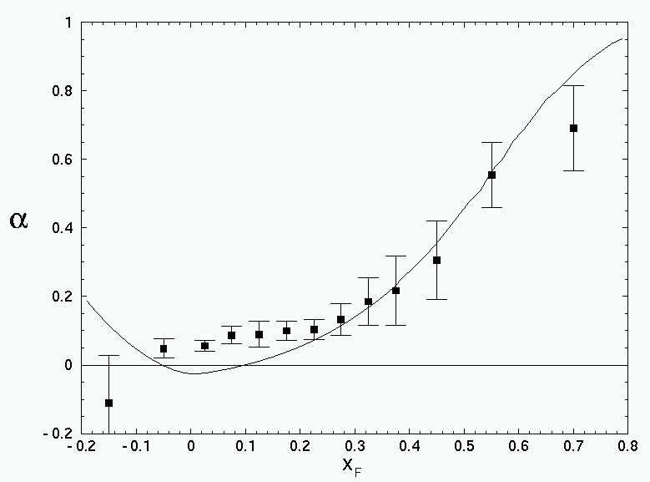
Quark Recombination
Exclusive processes: recombination of all beam partons:
Leading particle effect: recombination of produced partons with beam partons
Charm-strange correlations in heavy ion collisions: strangeness enhancement seen in D_{s}.
u
u
d

Slide 9
Input: Parton Shower
For illustration: single jet.
Perturbative parton showers evolved to a scale Q₀.
Decay gluons with remaining virtualities into quark-antiquark pairs.
Force gluon decay
Recombine
Remnant strings
String Decay

Slide 10
How Dense are Parton Showers?
Distance of quark-antiquark pairs in phase space is the deciding factor for the importance of recombination into mesons.
Distribution of pair distances in 100 GeV (PYTHIA) parton showers in phase space (in the pair center of mass frame)
“Our” PYTHIA jets: most of the jet is relatively dense in phase space.
  Space-time structure reconstructed from formation times.
Long tails exist (~ large z partons)
Test for other jet Monte Carlos? Perturbative evolution should not lead to dilute showers, otherwise non-perturbative effects are already dominant.
[K. Han, R.J.F., C. M. Ko, Phys. Rev. C 93, 045207 (2016) ]

Slide 11
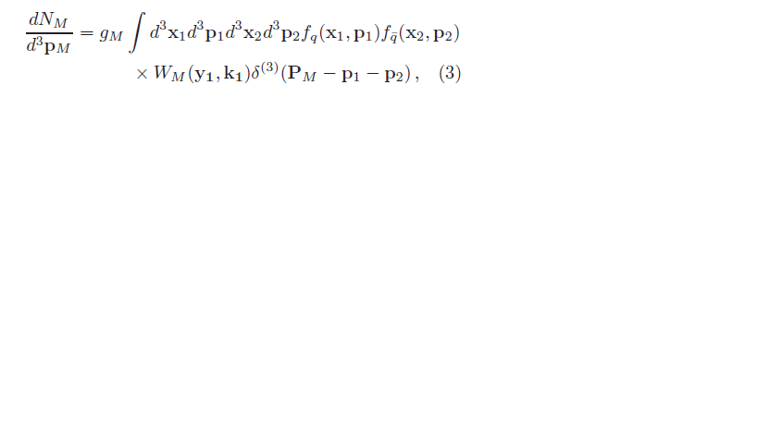
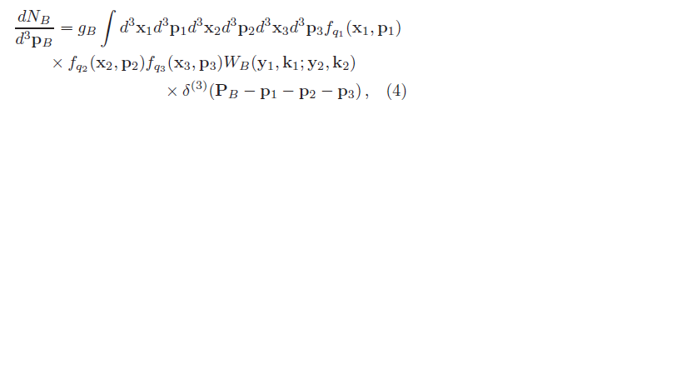
Recombination Step
Wigner function coalescence yield:
Can be turned into a formula for recombination probability (here meson)
  Evaluated at equal time in the pair or triplet rest frame.
  Throw dice to accept or reject a pair or triplet for recombination.
[RJF, V. Greco, P. Sorensen,
Ann. Rev. Nucl. Part. Sci. 58, 177 (2008)]

Slide 12


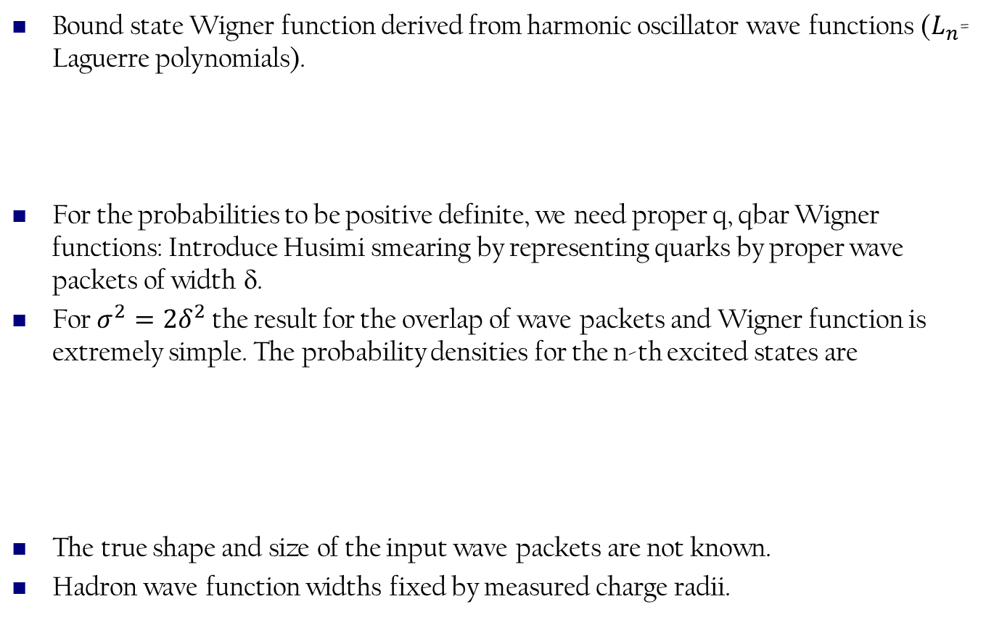
Recombination Step
Bound state Wigner function derived from harmonic oscillator wave functions ($L_{n}$= Laguerre polynomials).
For the probabilities to be positive definite, we need proper q, qbar Wigner functions: Introduce Husimi smearing by representing quarks by proper wave packets of width δ.
For $σ^{2}=2δ^{2}$ the result for the overlap of wave packets and Wigner function is extremely simple. The probability densities for the n-th excited states are
The true shape and size of the input wave packets are not known.
Hadron wave function widths fixed by measured charge radii.

Slide 13
Recombination Step
Monte Carlo implementation:
Evaluate recombination probability for q-qbar pairs and q (qbar) triplets.
Roll dice to decide if recombination happens.
Recombine into stable hadrons and resonances, let resonances decay
Force gluon decay
Recombine
Remnant strings
String Decay
[K. Han, R.J.F., C. M. Ko, Phys. Rev. C 93, 045207 (2016) ]

Slide 14
Remnant Strings
Naturally there are remnant quarks and antiquarks which have not found a recombination partner.
Why? No confinement in parton shower, quarks can get far away.
In reality: colored object needs to stay connected.
Connect partons with strings, return to PYTHIA for string fragmentation.
Force gluon decay
Recombine
Remnant strings
String Decay
[K. Han, R.J.F., C. M. Ko, Phys. Rev. C 93, 045207 (2016) ]

Slide 15
Remnant Strings
Check on recombination probability (100 GeV PYTHIA e+e- jets)
v2.0; 100 GeV jets

Slide 16
Results: Single Vacuum Jets
Longitudinal structure: dN/dz of stable particles compared to PYTHIA 6 string fragmentation (e+e-).
v2.0; 100 GeV jets

Slide 17
Results: Single Vacuum Jets
Transverse structure: dN/d²P_{T} of stable particles compared to PYTHIA 6 string fragmentation (e+e-).
Generally good agreement with pure string fragmentation.
No precision tuning to data.
v2.0; 100 GeV jets

Slide 18
Adding a Medium
Sample thermal partons.
Add thermal partons to the list of shower partons.
Apply same recombination MC procedure
  Allow shower-thermal (S-T) mesons, S-T-T + S-S-T baryons.
  Vetoing pure thermal hadrons for now.
Keep track of energy, momentum, quantum numbers removed from the thermal medium.

Slide 19
Adding a Medium
Jets in a medium: space-time picture is important.
All relevant partons have to be on the surface of the QGP or outside the QGP to hadronize.
Propagate all shower partons to the hadronization hypersurface, or make them part of the medium.
Hadronic/vacuum
T < T_{c}
QGP
T > T_{c}
Hadronization
T ~ T_{c}
Hadronic/vacuum
T < T_{c}
QGP
T > T_{c}
Hadronization
T ~ T_{c}

Slide 20
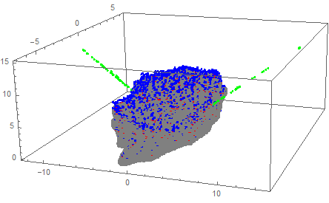
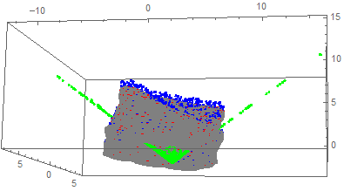
Jet + Medium
iEBE (Ohio State) event-by-event hydro with sampled thermal partons on the T=T_{c} hypersurface.
Plots: 500 PYTHIA (vacuum) showers emerging from the center embedded into an iEBE event
  blue = sampled thermal partons; green = shower; grey = hypersurface
t
t
y
x
x
y

Slide 21
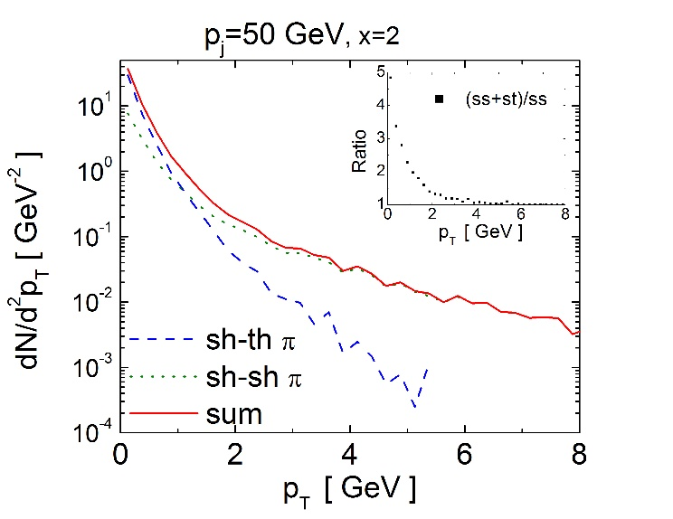
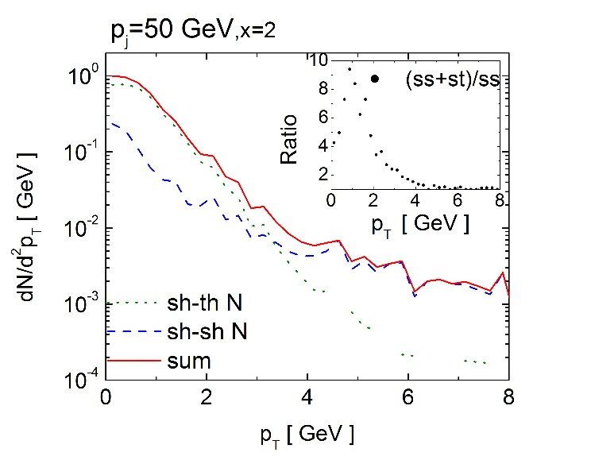
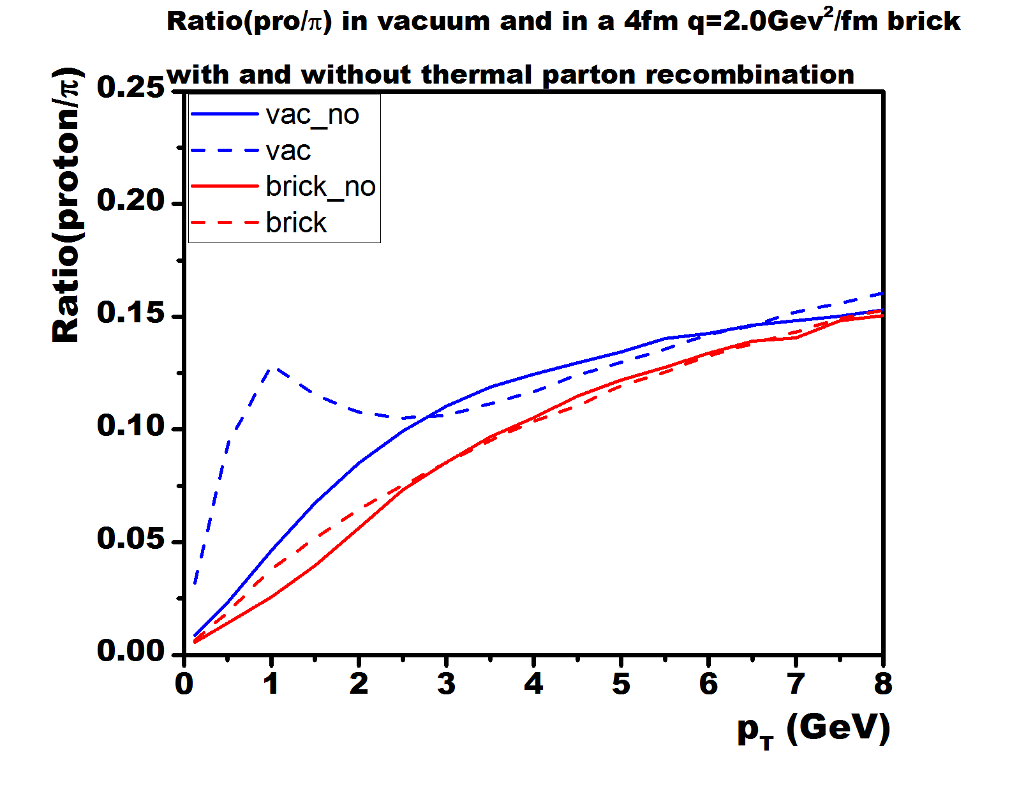
In-Medium Effects
Demonstration of baryon enhancement (iEbE + PYTHIA)
MATTER + brick (no flow)
v2.1

Slide 22
Code Details
v2.1: single jets, basic in-medium functionality: JET Collaboration
v2.2: current beta version
v3.0: JETSCAPE version (C++) under development
Input:
  Parton showers with color/string information.
  Sampled thermal partons (JETSCAPE functionality)
  Additional shower partons on the hypersurface.
Hadronization trigger: Q < Q₀, T< T_{c}
Abilities:
LBT+Hybrid
Hadronize | p+p | A+A
Parton showers | YES | YES
Parton-medium interaction | YES | YES
Medium/ underlying event | YES | ?

Slide 23
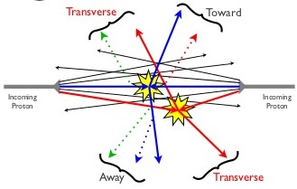
Underlying Events: p+p
Full p+p event: many strings, junctions, diquarks, …
Complexity requires instant “repair” of string objects that have lost partons to other hadronization channels.
Many possible channels to consider:
Start with well-defined string structure (e.g. PYTHIA), end with well-defined strings + hadrons: Strings → Strings’ + hadrons

Slide 24
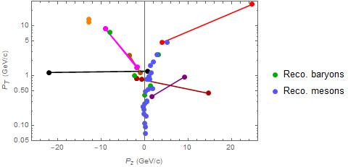
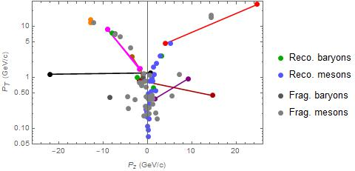
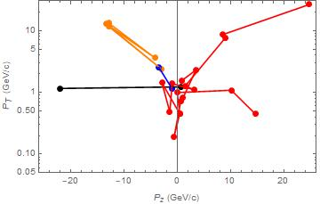
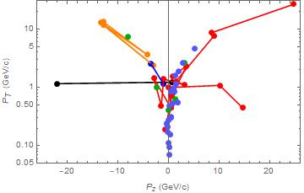
String-Recombination Interplay
200 GeV p+p event from PYTHIA, ~50 GeV momentum transfer.
J
J

Slide 25
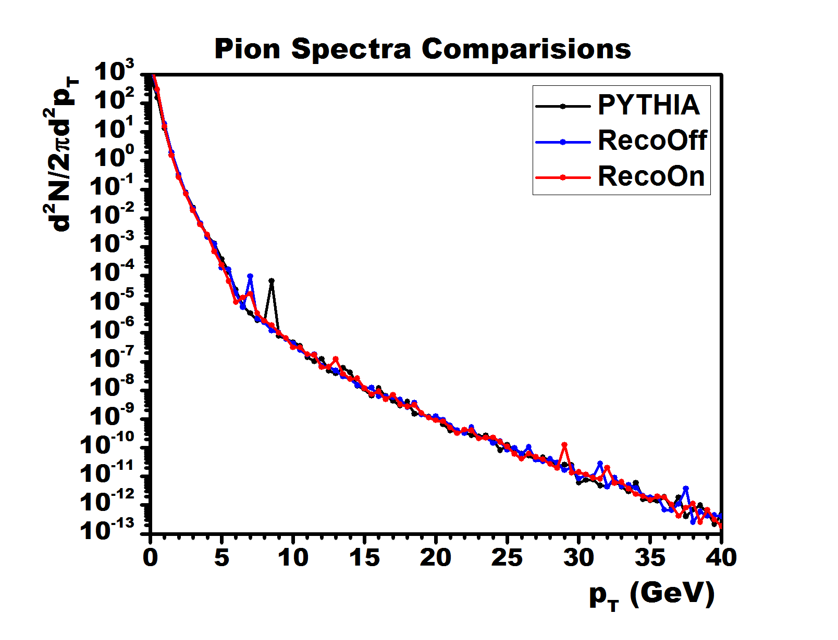
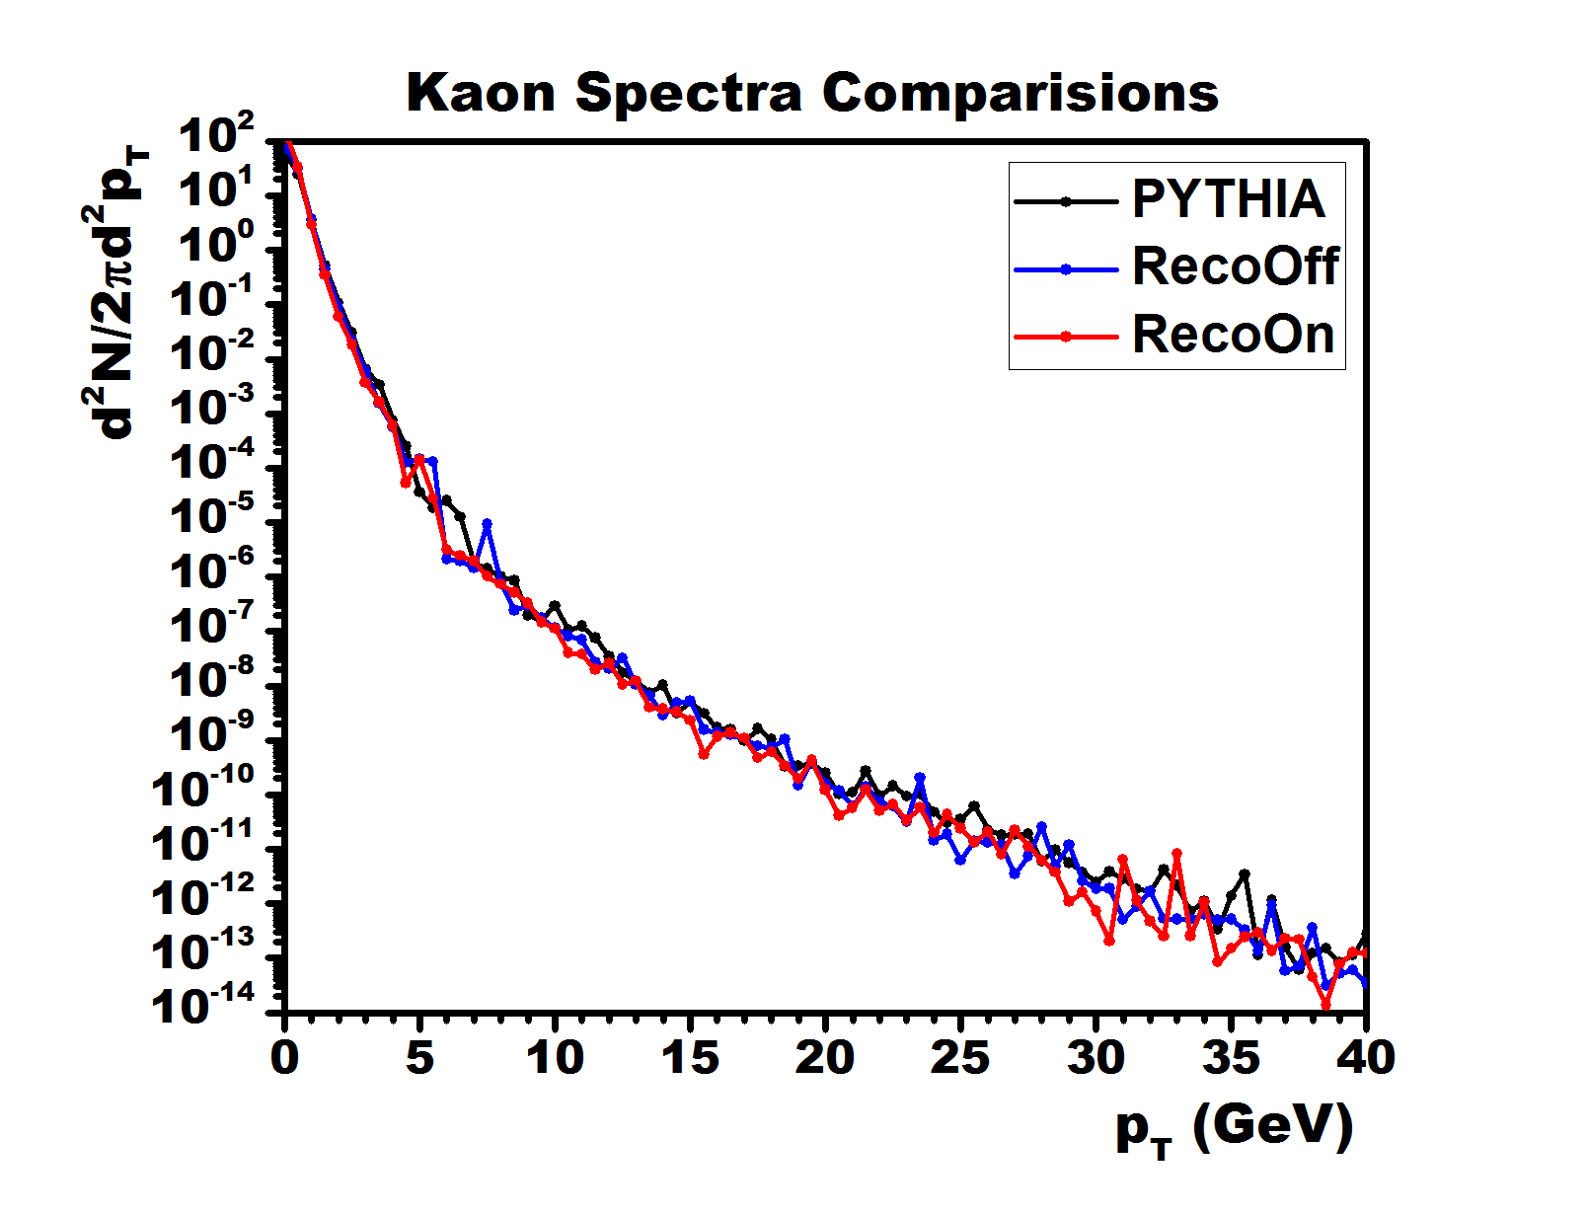
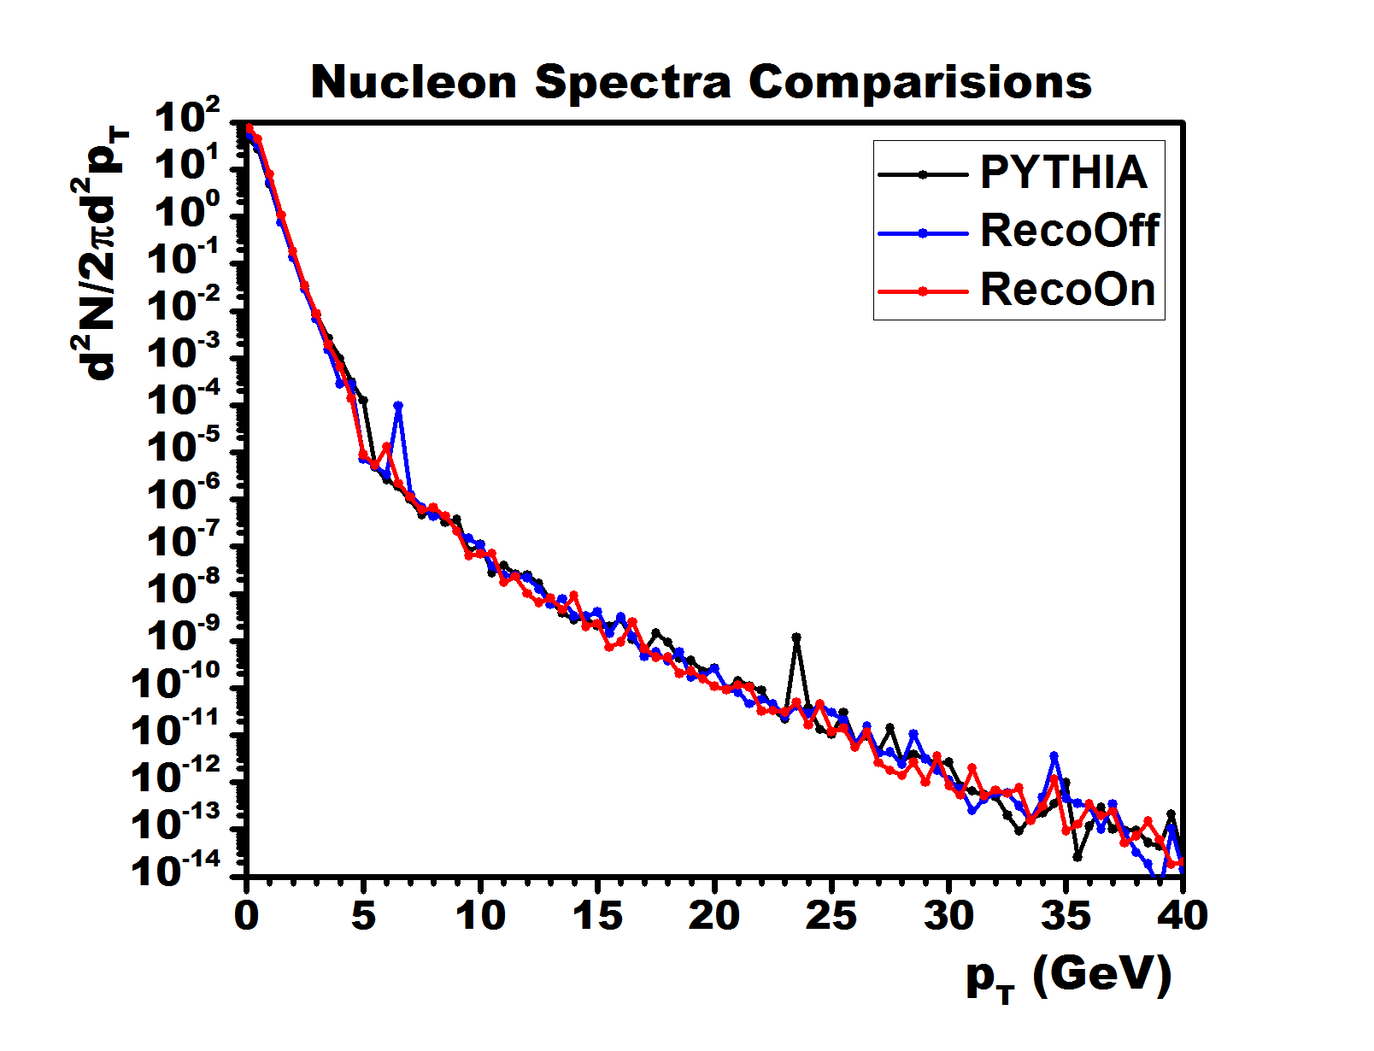
v2.2 Full p+p Events
3-way test:
  PYTHIA
  Hybrid hadronization reco=off
  Hybrid hadronization full
PYTHIA ~ benchmark.
More tests on the way.

Slide 26
Hybrid Hadronization in JETSCAPE
v3.0: Existing functionalities + many physics improvements:
credit: J. Putschke

Slide 27
Summary
We have developed an event-by-event hybrid hadronization module for jet Monte Carlos.
Quark recombination + string fragmentation.
Medium effects by sampling thermal partons on a hypersurface.
Upcoming version: hadronization with underlying events.
New v3.0 for the JETSCAPE framework: stay tuned.
Systematic studies of jet medium effects with in-medium jets ongoing.

Slide 28
Backup

Slide 29
Prepping Parton Showers
Example: Sample of 10⁶ PYTHIA parton showers with E_{jet} = 100 GeV.
dN/dz and dN/d²P_{T} before vs after gluon decay

Slide 30
Recombination Step
Parameters (harmonic oscillator WF case)

Slide 31
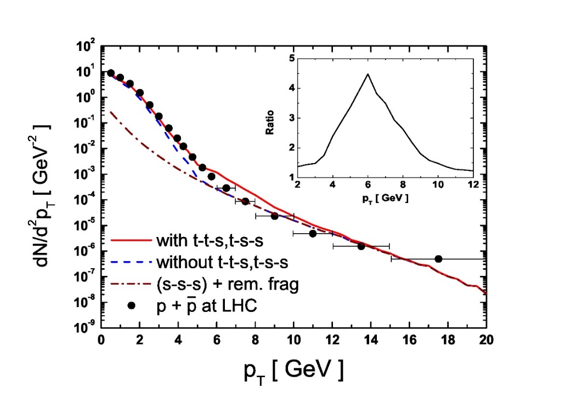
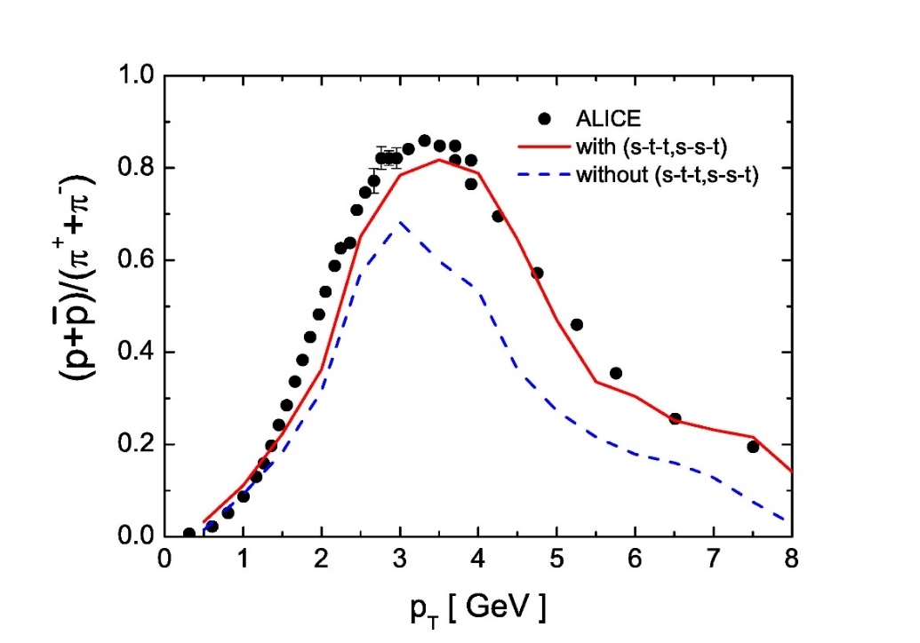

Towards a Full Picture
Some older results calculated using v1.0 and a blast wave medium reproduces experimental p/$$ ratio (jet, jet-medium and thermal medium itself included)
[K. Han, C.M. Ko]

Slide 32
Dirt Effects or Interesting Physics?
Hadronization is interesting in HI physics because
  it connects observables to deconfined partons
  probe-parton interactions at T_{c} (hadronization) = lim(T→T_{c}) probe-parton interactions at T> T_{c}
Theoretical control over the process?
But: wealth of new data, e.g.
  comparison of p+p, p+A and A+A
  new observables for jet substructure
…. with varying degree of sensitivity to hadronization.
[Jesse Thaler]
[A.J. Larkoski, S. Marzani, G. Soyez, J. Thaler: arxiv:1402.2657]

Slide 33
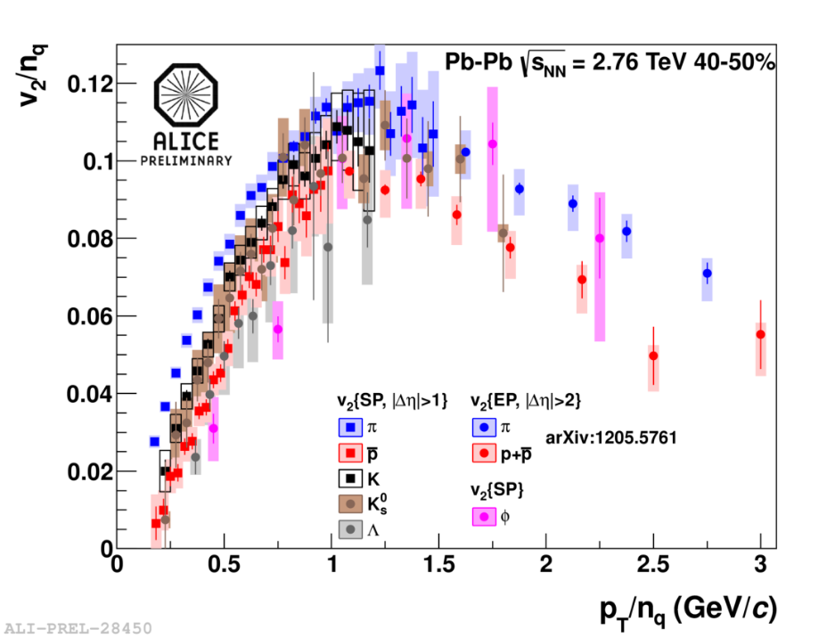
Elliptic Flow Scaling
At low and intermediate P_{T}: scaling with kinetic energy KE_{T} and valence quark number n_{q}.
Very good at RHIC, still good at LHC. Up to KE_{T}/n ~ 1.0…1.5 GeV.
Quark coalescence predicts n_{q}-scaling under certain assumptions:
A signature for deconfined quarks?

