Slide 1
Dataflow Architecture for Data-Intensive Science
Key emerging challenges
Summary of research direction
Much DOE-funded science will produce more data than can be analyzed without the deployment of better tools
Data production rates changing from GB to TB to PB on the time scale of a few years
Data production and analysis will occur at different locations
A generalized, deployable mechanism for data movement with long-term support
The requirement here is hardening, packaging, and long-term support for tools that are widely used throughout DOE/SC
Potential impact on software/systems
Potential impact on science communities
or DOE capabilities
If data movement is tractable, analysis of that data can proceed – if data movement is not tractable, analysis (and therefore science) will be constrained
Tools must be deployable and usable
Scientific productivity will be gated on data analysis in the future – data mobility, machine interfaces to data will be critical
DOE’s investment in facilities will be underutilized unless this is addressed
A small number of common solutions will meet the majority of needs
These solutions must be sustained such that they can be relied upon

Slide 2
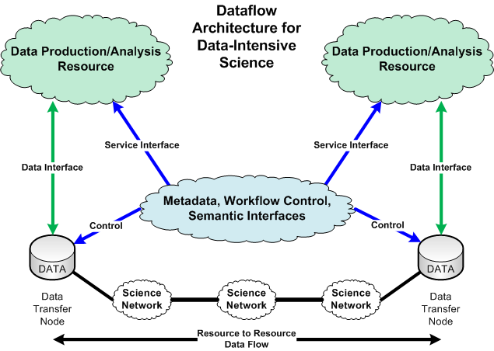

Slide 3
The Data Transfer Trifecta: The “Science DMZ” Model
Dedicated Systems for Data Transfer
Performance Testing & Measurement
Network Architecture
Data Transfer Node
High performance
Configured for data transfer
Proper tools
Science DMZ
Dedicated location for DTN
Easy to deploy - no need to redesign the whole network
Additional info: http://fasterdata.es.net/
perfSONAR
Enables fault isolation
Verify correct operation
Widely deployed in ESnet and other networks, as well as sites and facilities
Notes:
This is a bit different than the way a lot of folks do things
Many collaborations are beyond the point where the default system and network configurations will work for data transfer.
Several groups at the ALS are adopting these techniques.
You wouldn’t expect to be able to use a supercomputer without investing some time in figuring out how to drive it – the same goes for high-performance data transfers. Supercomputer centers have consultants to help you do that – so do networks (that’s us, the outreach group)

