Slide 1
Extreme-Scale Scientific Collaboration Workshop
December 6-7, 2011, Rockville, Maryland
Next-Generation Networks for Science Research
Program Update
Program Managers
Richard Carlson,
Thomas Ndousse-Fetter, PhD

Slide 2
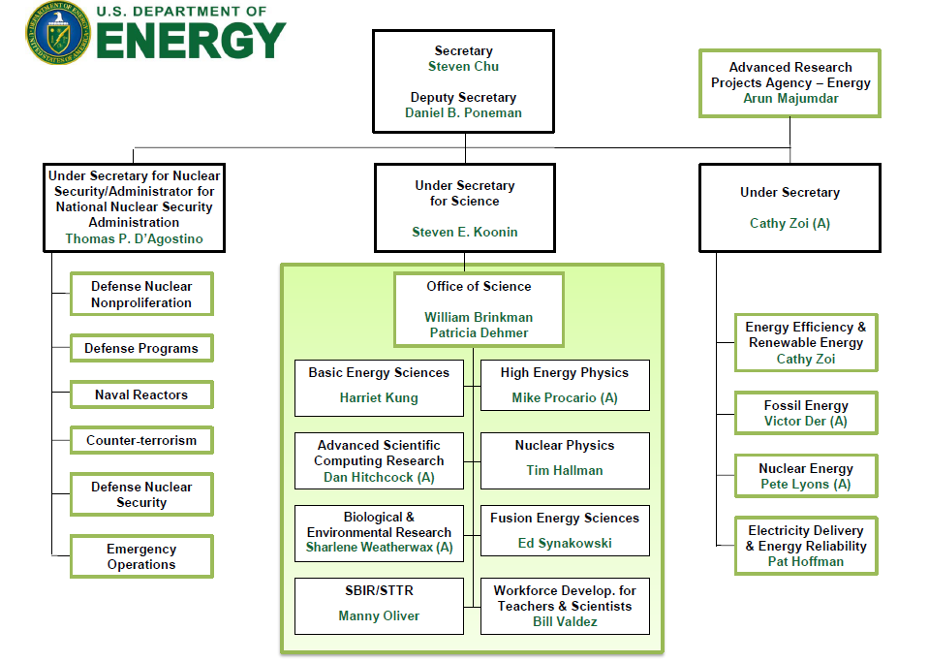
Where to find ASCR in DOE
2

Slide 3
ASCR Mission
The mission of the Advanced Scientific Computing Research (ASCR) program is to discover, develop, and deploy the computational and networking capabilities that enable researchers to analyze, model, simulate, and predict complex phenomena important to the Department of Energy.
A particular challenge of this program is fulfilling the science potential of emerging multi-core computing systems and other novel “extreme-scale” computing architectures, which will require significant modifications in today’s tools and techniques.
3

Slide 4
ASCR Programs
Research Division
Computer Science
Applied Math
SciDAC & SAPs
Next-Generation Networks
Career Awards
SBIR/STTR
Facilities Division
NERSC
ANL Leadership Computing Facility
ORNL Leadership Computing Facility
ESnet (Energy Sciences Network)
Note: ASCR Facilities are open Lab PIs, Academia, and to the industry through INCITE

Slide 5
Next-generation Networks for Science Program
Program Elements:
High-Performance Networks – Research and development of advanced network technologies unique to the DOE mission.
Scientific Collaboration – Research and development of HPC middleware and advanced scientific collaboration systems.
Program Goals
Provide effective access and sharing of multi-discipline effort, science instruments, computing resources, and scientific data.
Accelerate scientific discovery with secure and effective scientific collaboration technologies.
Enable researchers access to distributed scientific facilities and team efforts as local resources.
Facilitate multi-disciplinary research activities.

Slide 6
DOE Scientific Collaboration Environment
FRANCE
(ITER)
CERN
(LHC)
Pacific Northwest
National Laboratory
Idaho National
Laboratory
Ames Laboratory
Argonne National Laboratory
Brookhaven
National
Laboratory
Fermi
National
Accelerator
Laboratory
Lawrence
Berkeley National
Laboratory
Stanford
Linear
Accelerator
Center
Princeton
Plasma
Physics
Laboratory
Japan
Lawrence Livermore
National Laboratory
Thomas Jefferson National Accelerator Facility
China
General Atomics
Oak Ridge
National Laboratory
Institutions supported by SC
Major User Facilities
Sandia
National Laboratories
Los Alamos
National Laboratory
DOE Specific-Mission Laboratories
National
Renewable Energy Laboratory
DOE Program-Dedicated Laboratories
DOE Multiprogram Laboratories

Slide 7
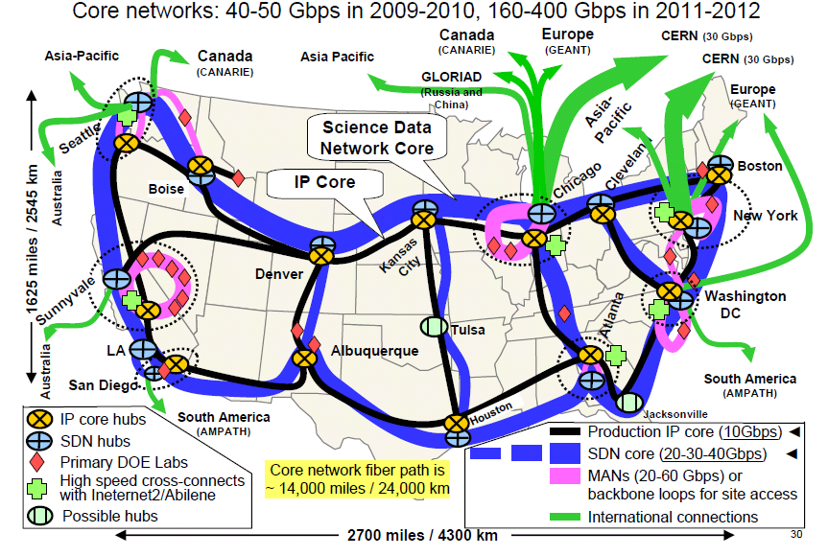
DOE Network R&D DOE’s ESnet Capability Projections

Slide 8
Major ASCR Priorities
Extreme Scale Science
Exascale Initiative
Co-Design Centers
SciDAC-3 Institutes and SAPs (Science Application Partnerships)
Extreme-Scale Data Management, Analytics, and Visualization
Goals:
To develop mathematical descriptions, models, methods and algorithms to enable scientists to accurately describe and understand the behavior of complex systems involving processes that span vastly different time and/or length scales.
To develop the underlying understanding and software to make effective use of computers at extreme scales.
To transform extreme-scale data from experiments and simulations into scientific insight.
To deliver cutting-edge computational and networking capabilities, enabling world-class researchers to extend the frontiers of science.
To provide networking and collaboration technologies that enable scientists worldwide to work together.

Slide 9
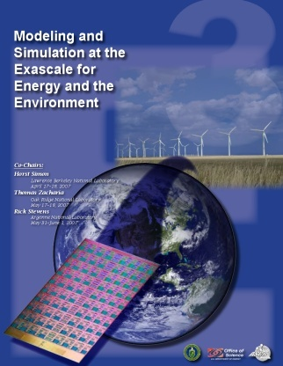
MISSION IMPERATIVES
Why Exascale -- (See Grand Challenge Workshop Reports)
http://science.energy.gov/ascr/news-and-resources/workshops-and-conferences/grand-challenges/
Town Hall Meetings April-June 2007
Scientific Grand Challenges Workshops November 2008 – October 2009
Climate Science (11/08),
High Energy Physics (12/08),
Nuclear Physics (1/09),
Fusion Energy (3/09),
Nuclear Energy (5/09) (with NE)
Biology (8/09),
Material Science and Chemistry (8/09),
National Security (10/09) (with NNSA)
Cross-cutting workshops
Architecture and Technology (12/09)
Architecture, Applied Mathematics and Computer Science (2/10)
Meetings with industry (8/09, 11/09)
External Panels
Trivelpiece Panel (1/10)
ASCAC Exascale Charge (FACA) (11/10)
“The key finding of the Panel is that there are compelling needs for exascale computing capability to support the DOE’s missions in energy, national security, fundamental sciences, and the environment. The DOE has the necessary assets to initiate a program that would accelerate the development of such capability to meet its own needs and by so doing benefit other national interests. Failure to initiate an exascale program could lead to a loss of U. S. competitiveness in several critical technologies.” Exascale Briefing -- 9.23.2011

Slide 10
Scientific Grand Challenge Workshops were held starting late 2008
Computer Science Program
Advanced Architectures and Critical Technologies for Exascale Computing (2010)
Scientific Data Management and Analysis at Extreme Scale (2010)
X-Stack-1: Software Stack for Extreme Scale Scientific Computing (2010)
X-Stack-2: Programming Challenges, Runtime Systems, and Tools (2012)
Applied Mathematic Program
Mathematics for Analysis of Petascale Data
Joint CS/Math Institutes
Advancing Uncertainty Quantification (UQ) in Modeling, Simulation, & Analysis of Complex Systems*
Scientific Discovery through Advanced Computing Program
Co-Design (
SciDAC-3 Institutes - ASCR
SciDAC-3 Institutes: Scientific Data Management & Vis – ASCR (2012)
SCiDAC-3 SAP: Fusion Energy Science – Scientific Application Partnerships (2012)
SCiDAC-3 SAP: High Energy Physics – HEP (2012)
SCiDAC-3 SAP: Nuclear Physics - NP
SCiDAC-3 SAP: Earth Systems Science – BER (2012)
SCiDAC-3 SAP: Material and Chemical Sciences – BES (2012)
Next-Generation Networks for Science Program
Terabit Networks for Extreme-Scale Science (2011)
ASCR –Wide
SBIR/STTR
Early Career Program

Slide 11
ASCR/SC SciDAC & Partnerships Activities
Co-Design Centers – (ASCR)
Center for Exascale Simulation of Advanced Reactors (ANL)
Center for Exascale Simulation of Combustion in Turbulence (SNL)
Exascale Co-Design Center for Materials in Extreme Environments (LANL)
SciDAC-3 Institutes – (ASCR)
FASTMath – Frameworks, Algorithms and Scalable Technologies for Mathematics (LLNL)
QUEST – Quantification of Uncertainty in Extreme Scale Computations (SNAL)
SUPER – Institute for Sustained Performance, Energy and Resilience (USC)
Data Institute - TBD
SciDAC -3 SC Application Partnerships – (SC program Office)
Fusion Energy Science: up to $6,600K annually for up to five years, focused on topics in Edge Plasma Physics, Multiscale Integrated Modeling, and Materials Science
High Energy Physics: up to $4,000K annually for up to three years, focused on topics in Cosmological Frontier, Lattice Gauge Theory QCD, and Accelerator Modeling and Simulation
Nuclear Physics: up to $4,000K annually for five years, focused on topics in Low- and Medium-Energy Nuclear Physics and Heavy Ion Collider Physics
Biological and Environmental Research: up to $6,500K annually for up to five years, focused on topics in dynamics of atmospheres, oceans, and ice sheets that support Earth System Modeling
Basic Energy Sciences: up to $6,000K annually for up to five years, focused on topics in theoretical chemistry and materials science, especially excited states of atoms and molecules and electron correlation in materials

Slide 12
ASCR Recent Workshops Relevant to Current Priorities
Scientific Collaborations for Extreme-Scale Science, December 6-7, 2011
Data and Communications in Basic Energy Sciences: Creating a Pathway for Scientific Discovery; October 24-25, 2011
DOE Exascale Workshop on Data Analysis, Management, and Visualization; February 22-23, 2011
2011 Workshop on Architectures I: Exascale and Beyond: Gaps in Research, Gaps in our Thinking; August 2-3, 2011
2011 Workshop on Architectures II: Exascale and Beyond: Configuring, Reasoning, Scaling; Sandia National Laboratories, Albuquerque, NM, August 8-10, 2011
Terabit Networks for Extreme-Scale Science, February 167-17, 2011
Architectures and Technology for Extreme-Scale Computing; December 8-1-, 2009

Slide 13
Looking Backward and Forward
Today - 2020
Extreme scale computing
Beyond petascale
Exascale computing
Exabytes data
Networking Environment
100 GbE
Terabits Networking
Extreme Scale Collaboration
Massive data
Streaming/steering
Multi-discipline
Co-design/development
Others – TBD
5-10 Years Ago
Computing Environment
Cluster computing
Terascale computing
Cloud computing
Petascale computing
Networking Environment
OC-12, OC-48
10 GigE
Middleware
GridFTP
Globus
Electronic Notebook
Grid/Cloud Computing
OSG
ESG
Fusion
Others
Persistent Issues
Software sustainability
Virtual organization persistence
Extensible and adaptable systems
Multi-domain security policies

Slide 14
Why Extreme-Scale Scientific Collaboration?
Mission Imperatives
Align the program activities with ASCR priorities and directions
Maintain leadership in HPC middleware and scientific collaborative technologies
Problem Scale
Massive data
Extreme-scale computing
Terabit networking
Multi-dimensional (multiple Institutions, disciplines, resources)
National and international
Complexities – Beyond Web-based Collaborative Technologies
Inter-discipline, intra-discipline
Real-Time (insitu, steering, streaming, just-in-time, etc.)
Cyber security policies
Standards

Slide 15
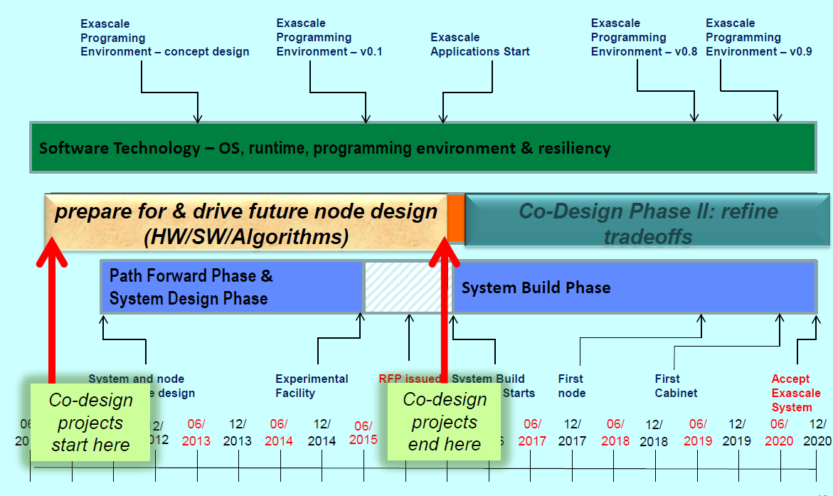
Extreme-Scale/Exascale
Reverse Timeline (Not an Exascale Plan)
1PF, 1PB, 100Gbps
500PF, 400PB, 400Gbps
1EF, 1EB, 1Tbps
5-10EF, 10EB, 5Tbps
Scientific Collab- Ver-0: Grids/Cloud
Scientific Collab- Ver-1
Scientific Collab- Ver-2
Scientific Collab- Ver-3
Scientific Collab- Ver-4
15

Slide 16
Additional Observations on Workshop Charge
Out-of-the box thinking – new directions (Short Term/Long Term)
Compelling case for scientific collaboration
Sound foundational/theoretical principles
Capabilities unique to the DOE science mission
Lessons learned in the last two decades
Office of Science programs as active stakeholders
Collaborative teams as virtual organization

Slide 17
Q&A

