Slide 1
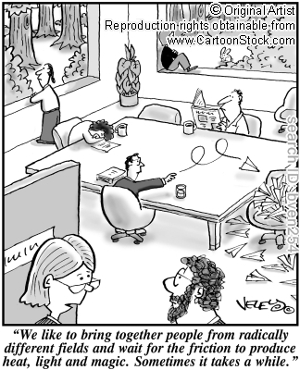
I have a dream
SCESS workshop
December 6, 2011
S. Klasky
H. Abbasi
“Any intelligent fool can make things bigger and more complex... It takes a touch of genius - and a lot of courage to move in the opposite direction” Einstein
Notes:
The dream is about easy collaboration. Please describe this.

Slide 2
Outline
The Dream
Thoughts on the reality of the dream
How to move forward from dream to reality
“To explain all nature is too difficult a task for any one man or even for any one age. 'Tis much better to do a little with certainty, & leave the rest for others that come after you, than to explain all things by conjecture without making sure of any thing.” Newton

Slide 3
The dream
I have a dream that one day our scientist will rise up and collaborate together in the true meaning of science: “We hold these truths to be self-evident, that all collaborators are treated equal.”
I have a dream that one day in the offices of DOE, the children of former computer scientists and the children of former physicists will be able to sit down at their ipads and seamlessly collaborate together.
I have a dream that one day even the researchers in impoverished universities, with poor network connectivity, sweltering with the lack of computing resources, will be transformed into an oasis of research and innovation.
I have a dream that all universities and labs will one day collaborate in a world where they will not be judged by their computer equipment and network connectivity but by the content of their innovation.
I have a dream today!
This is our hope, and this is the faith that I go back to Oak Ridge with.

Slide 4
From ideas to publications
The month in a life of a simulation scientist
We assume that the scientist (S1) has a code (C1) developed that runs on a large # of cores
S1 talks to performance engineering scientist (CS1) about the changes he/she will do to incorporate some new physics
S1 develops a new piece of physics and places this into C1. → takes a few weeks
CS1 works with S1 to make sure that this code runs at scale, and nothing slows down → takes a few weeks
Notes:
Place pictures.

Slide 5
From ideas to publications
The month in a life of a simulation scientist
In the meantime S1 works on new diagnostics along with his/her colleague (S2) to make sure that some new information will be evaluated. → weeks
S1 submits the simulation to the supercomputer and waits for the output
S1 works with S2 and another computer scientist (CS2) to make sure the data is coming out ok, and nothing is going wrong (energy conservation) while the run is occurring
S1 gets the output of data and then archives the data to HPSS.
S1 manually takes some of the output, and runs some data reduction routines to make smaller data

Slide 6
From ideas to publications
The month in a life of a simulation scientist
S1 moves the smaller data over to his/her local system
S1 analyzes the data, and usually sees that something is wrong the first time and iterates back to step 3 until the data looks right, and then runs a much longer simulation
S1 and S2 start collaborating and create new forms of synthetic diagnostics and analyze the data until it looks publishable
S1 and S2 work with an experimental scientist (E1) to get experimental data that they can validate against. They might need to have a face to face meeting, or several phone calls to look at the data, and talk about the type of experimental data they can get
E1 talks to some more experimental scientist (E2 – E4) to get a better feeling of the “best” data that S1/S2 can use for the validation study

Slide 7
From ideas to publications
The month in a life of a simulation scientist
E1 gives the data to S1, and they iterate on generating the new types of analytics
S1 gives some of the data to visualization person (V1) to visualize some of the results and show how the data is validated
S1 talks to more senior people (S3) to make sure results look interesting, and to E1 – E4
S1 starts writing a paper with everyone, but needs some more results, so they go back to step 6
They spend time visualizing and analyzing the data collaborative in a shared environment
Paper is produced, over several meetings and calls, and then submitted to publication

Slide 8
^{A month in a life for HEP} from LATBauerdick based on Jeff Porters contribution for NP
1. The large collaboration provides & maintains many tools & services needed by the experimental scientist (E1):
1. Identity management system for collaboration membership
2. Software framework for reading data files & unpacking the data into standard structures
3. Software repositories to archive and version code used in an analysis
4. Software management and deployment systems, including architecture/OS requirements
5. Analysis-­‐ready data and simulated detector response data to evaluate systematic corrections
6. Systems for locating relevant data and making that data accessible on available analysis facilities
7. Protected web-­‐based log area/tools and project-­‐specific email lists for managing information and communication

Slide 9
^{A month in a life for HEP} from LATBauerdick based on Jeff Porters contribution for NP
2. E1 works with a group of other collaboration scientists (E2), in the order of 5-10, often not all at the same institution, using computing resources distributed across several computing centers, and working with the collaboration’s physics working groups (PWG)
3. E1 explores an idea for a new analysis in one or more collaboration PWG. E1 selects or is steered to work within a specific PWG and presents a work plan at a PWG phone/video meeting providing: physics goals, analysis techniques to be used, code to be developed and data sets to be analyzed.
4. E1 develops the software (some new, but mostly put together from existing code examples and libraries) running over a small subset of pre-­‐staged/local data, sharing code and data sets with E2 & others, communicating via PWG email/news list to leverage PWG knowledge and procedures.
5. E1 develops or adapts a larger processing workflow (job-­‐submits, monitoring, post-­‐processing) using collaboration tools (job/data definitions), facility services (grid/batch/disk/tape) & some new + used user-­‐built ad-­‐hoc scripts.
6. E1 adds & maintains new software & data structures for the project, documents, obtains vetting from PWG, in a collaboration repository
7. E1 evaluates the ability to have fast, repeatable access to the data and opts to run an input-­‐data reduction pass, speeding up & simplifying analysis iterations.
8. E1 applies data reduction passes, duplicating data, adding new data structures, pulling data to a nearby facility. This often results in bypassing the collaboration catalog, raising data provenance issues. E1 modifies workflow from #5.
9. E1 now analyzes larger datasets to refine the analysis, working with E2 and discussing results in regular PWG phone/video meetings. E1’s iterations lead to new cross checks or features to be measured, with summaries saved in protected web-­‐based docs (mostly Twikis, CMS, blog).
10. E1 spends a month at the remote experiment site for shift duty & other work (still attending to the analysis, requiring remote access to the analysis environment) and is asked to use analysis to QA production of new analysis-­‐ready data & report by to production team.

Slide 10
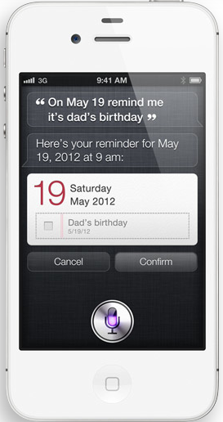
What do I really see
How do we make researchers want to work together?
  Make it easy
First things first:
  Get rid of the idea of files!!!!!
Need to know that when we collaborate we can’t always move data
How do I just run my code?
How do I just run “other’s” code?
How can I minimize the difficulties of using all of this software?
Siri: please move file /home/users/sklasky/T127.81.k=127.t=57.bp from sklasky@jaguar.ccs.ornl.gov to klasky@franklin.nersc.gov:/scratch/scratchdirs/k/klasky/xgc/test2 and compare it to the data from shku at shku@franklin.nersc.gov:/scratch/scratchdirs/s/shku/xgc1/out1/d3d.xgc1.k=127.t=57.u=87.h5 and use my analysis code on my laptop at ~/analysis/s.diag
Scott: I am moving the files ETA = 300 days 12 minutes and 2 seconds

Slide 11
A view from one team I work with
Edge gyrokinetic code
Neutral Code
Core
Core gyrokinetic code
Core MHD code
MHD stability analysis code
Transport Code
RF Code
Equilibrium Code
Synthetic Diagnostics
Performance Engineers
SDM
Visualization
Math
NSTX
DIII-D
CMOD
CMOD
JET
EAST
ITER

Slide 12
These are separate teams
Each team has its own independent mission
  Each team needs to independently collaborate with each other
    To develop code
    To develop science
Teams must be able to work efficiently with each other
  Must remove barriers that make it difficult for teams to work with each other
    Example: Schedule a calls with all of the collaborators
    Example: Who are the collaborators

Slide 13

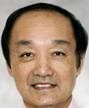

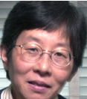




Science at the extreme scale
Siri: conference me with all of the collaborators who are available to discuss the results from our simulation of XGC for ITER from last week to validate against the closest experiment
Siri: please tell me who is using my analysis code and who has downloaded it
Scott here are the people who generated the results, shall I schedule a meeting at a time where everyone can attend the call?

Slide 14
Complexities
I believe that complexities can come from
  The problem (complex science/engineering)
  The codes and how they are
  Underlying disruptive infrastructure
  Coordination across codes and research teams
Service-Oriented Architectures have been used in the enterprise to deal with system/application complexity, rapidly changing requirements, evolving target platforms, and diverse teams
I believe that the data (both from in-transit and files) need to be self-describing
  Failures must NOT occur when some streams are missing

Slide 15
What is the dream?
Make it easy to collaborate by removing all of the barriers
  Data should be referenced, so researchers will get credit when their data is used
  Codes, (analysis, visualization) are referenced, and the history of the operations of the scientist are recorded in the streams of data (files) so that we know who did what
  Intents can be placed inside of data so that people learn from one-another
Data needs to be secure in places too to protect IP
  Understand who can see what, but remove the barriers from people

Slide 16
Intents
Concept I believe will ease some of the complexity
Metadata placed in streams which can be
  Hints on downstream processing
  What actors in the workflow should be run according to an expert
  Could be hints given by an expert
  Can contain semantic information of how the data should be processed
  How one might operate on the data in the future
Example: Intent for compression
  Place a simple workflow to perform an FFT to remove high frequency components from a signal, then reduce the data with a Gaussian filter, then compress it with ISABELA

Slide 17
More dreaming
I want to be able to run my simulation and couple that to many other services
I can learn that some of these need services I never thought of (without asking anyone else)
I can learn new information, and then publish the data and the paper

Slide 18
Somehow this looks complex

Slide 19
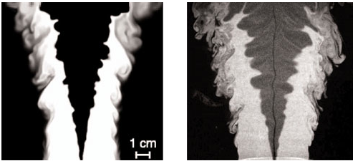
Need the Iphone-10s
Idea
  Just ask questions and then have the computer
    Run simulations if necessary
    Get data from other simulations
    Ask if it needs input data
    Learn how to reduce the data
    Learn how to present the data
    Change things on the fly
    Be able to access data and knowledge from collaborators to present results
Siri: Compare the results from my simulation with the closest lab experiments
Here are your results Scott
Image from J. Bell

Slide 20
What do I want to make collaboration easy
I don’t care about clouds, grids, HPC, exascale, but I do care about getting science done efficiently
Need to make it easy to
  Share data
  Share codes
  Give credit without knowing who did what to advance my science
  Use other codes and tools and technologies to develop more advanced codes
  Must be easier than RTFM
  System needs to decide what to be moved, how to move it, where is the information

Slide 21
But wait… I want more
Make it easy to code together
  SVN, GIT, …
  Ways to write code together
  Debug together
Collaboration should make it easier to visualize and interpret results together
  Write analysis code together even when people are far apart, and share the code with one-another (automatically plug the code into their software eco-system without any user intervention)

Slide 22
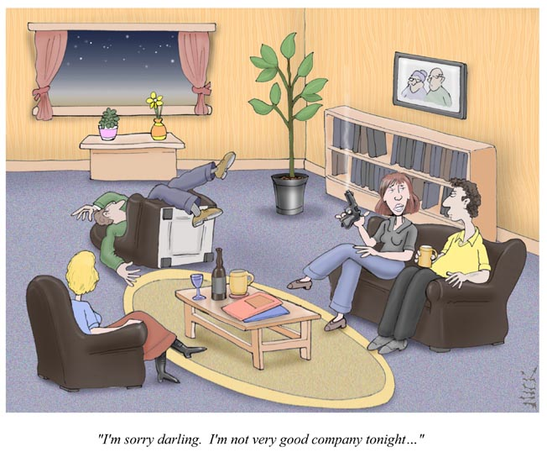
Need to deal with collaborations gone bad
bobheske.wordpress.com
I have had several incidents where “collaborators” become competitors
  Worry about IP being taken and not referenced
  Worry about data being used in the wrong context
  Without record of where the idea/data came from it makes people afraid to collaborate

Slide 23
Why now?
Science has gotten very complex
  Science teams are getting more complex
Experiments have gotten complex
  More diagnostics, larger teams, more complexities
Computing hardware has gotten complex
People often want to collaborate but find the technologies too limited, and fear the unknown

Slide 24
Issues to address
How do we break down the barriers so people are willing to trust each other?
How do we get away from a lifetime of thinking of files and a new generation which thinks of asking Siri questions?
How do we accurate record the history of data and then intention of people to learn from one another?
How do we help people collaborate even though they don’t realize they are collaborating?

Slide 25
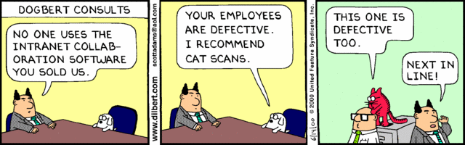
And what happens if we just build it
We have to plan how we build the collaboration environment or the cat will find us all defective

Slide 26
A breakdown of groups
Type/Condition | Large Simulations | Medium Simulations | Small Simulations | Large Experiments | Medium Experiments | Small experiments
Initial people accessing | <10 | >10<100 |  | >100 | >10<100
Final People accessing | <10 | >100 |  | >100 | >10<100
Common data to save | Vis, analysis, performance, code, monitoring | Vis, analysis, monitoring
Typical pains | Moving large data. Getting experimental data for Validation.
Tools to make life easier | Self-describing data. Workflow monitoring. Portals to share data
Complexity | small number of variables which have a large size Medium # of time steps | Large number of variables of a medium size Large # of time steps

Slide 27
Looking at Rectangles for collaborative activities
 | Combustion Sim | Fusion Sim | Supernova Sim | Climate Sim | LSST | BarBar | LHC | NSTX | SNS
Workflow
Visualization
Queries
Portals
I/O
Data Movement
Security
Monitoring/Steering
Performance data
Transparency of data
Need to prioritize activities for collaboration in each area

Slide 28
Summary
I believe the best form of collaboration is when I don’t have to talk to anyone to advance my science (besides Siri)
We need to enable large scale collaborations
  Facebook: to collaborate with social interactions
We need to make life EASY and use technology to simplify life, and build on each other to promote each other and advance our science
“If I have seen further it is only by standing on the shoulders of giants.” Newton

