Slide 1
Large scale simulations
Scott Klasky
David Bader
Ian Foster
Hasan Abbasi (Scribe)

Slide 2
Our difference
Users and developers are close to each other
Often the same
Co-development issues and data sharing
Lots of small groups developing components that are brought together
Large simulations are tied to the LCFs

Slide 3
The Issues
Tools
Integration
Workflows
Sociology/Culture of Collaboration

Slide 4
Tools
Robust tools
Sustainability in tools
Standardization
Cost
Usability
Scalability
Flexibility
Value proposition
Pain of Adoption/Usefulness
Notes:
Some tools are too powerful and don’t get adopted

Slide 5
Integration
Provenance capture
Standardization
Protect IP
Capture the processes that are repeated

Slide 6
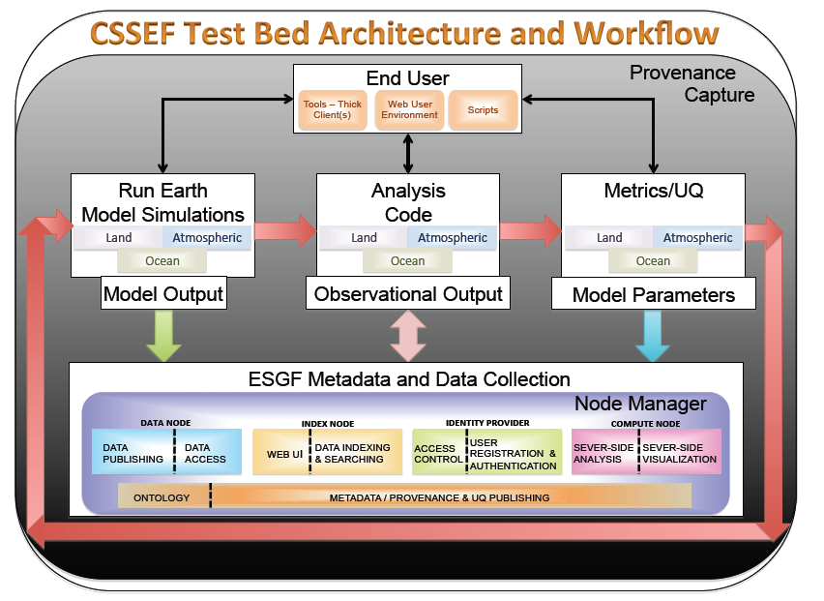
Workflows

Slide 7
Sociology/Culture of Collaboration
Trust issues
Security issues
Grassroots efforts
Reward mechanisms
Enforcement policies
Carrot and Stick

Slide 8
Participants
Scott Klasky (ORNL)
Hasan Abbasi (ORNL)
James Osborn (ANL)
Steve Gottlieb (Indiana)
Richard Bower (BU)
David Bader (LLNL)
Ian Foster (ANL)
Just observing ()
Jackie Chen (SNL)
Anshu Dubey (UC)
Robert Whitten (ORNL)
Bronson Messer (ORNL)
Bill Tang (PPPL)

