Slide 1
Breakout Technologies for Processing
Extreme-Scale Science Workshop
Tuesday
Dec 6, 2011

Slide 2
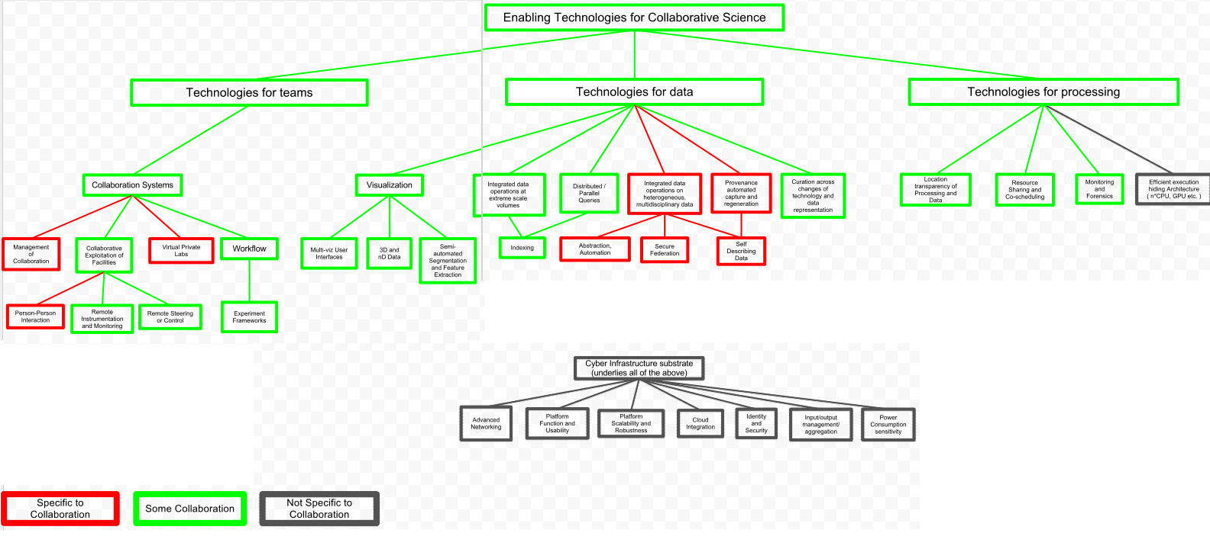
Our Piece of the Big Picture Technologies for processing
Things other than just moving data

Slide 3
Box 1: Location Transparency of Processing and Data
Federation of available data and computational resources that matches them dynamically and transparently
Cost and time are critical considerations how this happens under the covers
Also consider whether more efficient to move data to computation or move computation to data
Not classic batch moving of data then execution but rather the real-time need for data during execution
Codes flexible to run anywhere

Slide 4
Box 2: Resource Sharing and Co-scheduling
Resources can be shared between people or labs
Key problems involve policies of facilities and agreements between collaborators
Need to have expressed polices on all resources
Co-scheduling example:
Network, beam time and compute time synchronized thru reserved times
What happens if one goes down – charged for time on the other?
The Federation of data and resources again a solution

Slide 5
Box 3: Monitoring and Forensics
Monitoring both the resources and computation
Resources include beam lines, facilities, and computers
Resource status, availability, output results
Computation monitoring includes results to feedback to experiment
Real-time monitoring w/ transparent location
Monitoring can include both input and output
Debugging – how to get data (dumps) to location of the debugging tools
Particular example of transparent matching of data and comp
Pointed out that Federation requires this dynamic monitoring of resources

Slide 6
Box 4: Efficient execution hiding Architecture
Black color signifies it is not collaborative per se
Examples given in the diagram are multi-core and GPU based architectures
Codes may only be able to run on particular architectures
This topic relates to location transparency
Efficient choice for where to move data and or code so that computational efficiency is optimized.

Slide 7
Box N: Other areas missing from diagram?
Collaborative Programming Environment
Collaborative code development
Debugging
Performance evaluation
DSP computation
Initial reduction of data is it too little/too much

