Slide 1
Technologies for teams

Slide 2
DOE-SC’s vitally important 21st C research is performed on (at best) 20th C infrastructure
DOE investigators and facility users are all information workers, engaged in consuming and producing data. Yet:
Journal article is a primary information exchange method
The paper notebook is widely used to document research
The desktop drive is a primary data storage method
Most computational results cannot be reproduced
Email, telephone, airplane are primary collaboration tools
Security concerns are a frequent obstacle to collaboration
Much modeling and simulation is performed using spreadsheets and proprietary packages
Notes:
We should probably use + Knowledge Engineering components to motivate

Slide 3
Imagine a fully digital laboratory system designed to accelerate discovery to 21st Century speeds …
All data, code, and documents system-wide are accessible, discoverable, reusable, reproducible, computable, …
… and are linked by a distributed knowledge base that permits automated navigation of content and connections
Advanced software and computational processes are available on-demand and used routinely by every researcher
Collaboration occurs within spaces that people want to use even when they are not collaborating
Intrinsic and proactive security mechanisms encourage rather than discourage collaboration, while protecting against attacks
These capabilities are as intuitive, flexible, and collaborative as the best consumer software (Amazon, Apple, Google, …)

Slide 4
That beautiful figure …

Slide 6
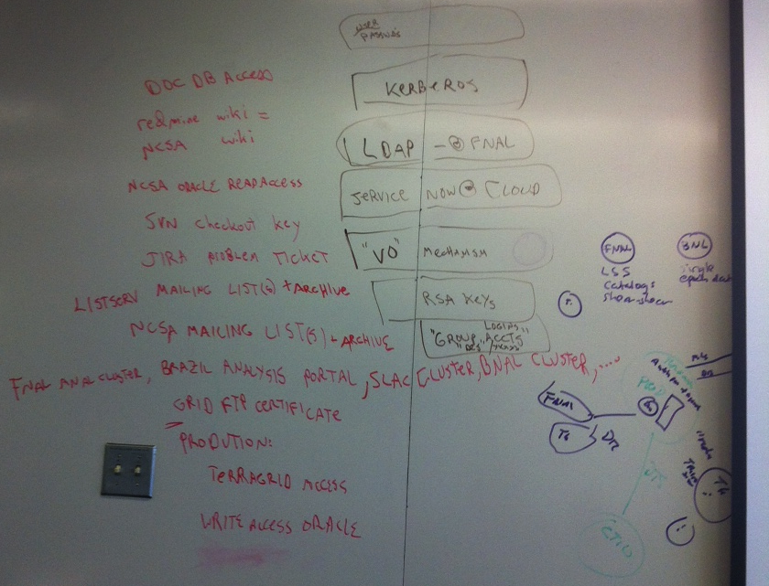
Some of the identities required for current Dark Energy Survey system
(Don Petravick)

Slide 7
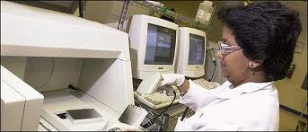
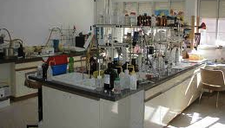
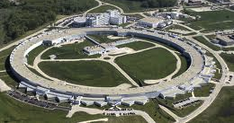
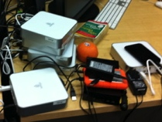
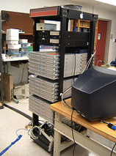

Research software as a service
(aka virtual private laboratories)
Provide as an outsourced service
  the hardware, software, and processes required for successful research
securely, efficiently, and cost-effectively

Slide 8
Research software as a service
Potential advantages
Powerful capabilities
Intuitive interfaces
Economies of scale
Professional operations
Elastic capacity
Easier collaboration
Optimization
Research challenges
Identification of processes
Design of key building blocks
Scalability to massive data
Human computer interface
Security
Integration of collaboration
Economic models
Success metrics
Accelerated discovery
Enhanced collaboration
Reduced costs

Slide 9
Those topics again
Management of collaboration
Collaborative exploitation of facilities
  Person-person interaction
  Remote instrumentation and monitoring
  Remote steering or control
Virtual private labs
Workflow
Identity and security

Slide 10
Notes from the discussion are in the “Notes” on this slide
Notes:
success metrics
-- accelerated discovery
-- enhanced collaboration
-- reduced costs
************************************************
The list of topics
Project management Scheduling, budget management, reporting, risk management
collaborative authoring, data repositories, communications, commodity solutions
****************************************
Management of collaboration :
-- adoption of best practices to step forward -- beyond that how do you go to the next step
-- investment upfront expecting to scale, or flexible design that scales as you need
--- component based approach to collaborative technology - good interoperability
-- whether ideas from industry applicable - self organizing collaboration groups, and
people in several collaborations at once - makes it different.
-- Different problem when you are involved in multiple collaborations that each have their own
standards. Link different technologies to provide a common interface ?
-- A set of higher level abstractions that are common -- differentiated visibility of the information
collaborative exploitation of facilities
How much is already in the industry
-- essential elements that are there for management of the collaboration, to take the framework
-- either framework is out there, you can see that it captured the elements for a cohesive
group to produce, or whether it cannot do so.
-- one can mesh together resources in a framework - how do you make such frameworks emerge
-- A few high level items that are useful
Collaborative exploitation of facilities
- person-person interaction
brainstorm, schedule, planning quite complex
wide variety, skype/ or unsolved
there is a larger problem (group dynamics is the bigger problem)
manage dynamics -- recognize that the interaction needs to happen so facilitating it is
a valid contribution to the project.
In terms of 10 year phase - is it a major challenge
sharing information - automatic ways of sharing meta-data ( searchable information)
- remote instrumentation monitoring (all capabilitities experiments or computations)
for both simulations and instruments, smaller scale, real time access
-- scope for collaboratories some communities have control rooms
-- there are different scales. Active issues for these communities.
-- running large scale simulation commonalities of interfaces -- in-situ
- remote steering
-- the point where it is feasible where the jitter from lack of capabilities
wouldn't let this happen.
-- downstream efforts that can be steered
-- experiments too -- people in different time zones contribute
- On demand /time critical data analysis (where does that fit)
virtual private labs
--- more of a technology delivery vehicle
-- important in creating dynamic workplaces for different communities collaborating
something more than a meeting less than a classical collaboration.
-- Not efficient if we have to deploy technolgy ourselves
-- notion of making it easy to pull together software important to a specific community
something that can encourage collaboration
-- expose some of the resources that external people can script your environment.
workflow -- experimental frameworks
-- a solution to a problem that is not well posed - range of problems to problems
-- discovery is not just simulation but also all these other steps
-- Capabilities in existing in workflow that are currently missing, workflows do not handle
dynamic challenges, share technologies -- a real time capability
-- concurrent activities, split into parts launch them separatly, workflow should be able
to capture that.
-- Lots of community need to capture what they are doing with their workflow
identity and security
--- can it be solved with research ?
-- every solution was blocked because the organization went with a different solution
-- job category -- a person who can connect a team to cyberinfrastructure needed by many
teams and no one wants to own them.

Slide 11
Extra slides

Slide 12
Priority Research Direction:
Secure Federation for Large-Scale Collaborative Science
Key emerging challenges
Summary of research direction
ASCR security technologies underpin science federation projects worldwide. But now we face:
More people: Collaborations larger, more
frequent, more fluid, span more institutions
More resources: Large and diverse data,
computers, sensors, mobile devices
More attacks: More, better connected, smarter,
better equipped adversaries
New technologies: Evolving commodity tech
Rethink security enforcement, intrusion
detection, incident response for team science:
Enable instant VOs, that provision secure
collaborative spaces in minutes not weeks
Leverage VOs as basis for security mechanisms
Take systems perspective on DOE-wide
security, integrating data and modeling
Address challenges of massively instrumented
and mobile environment
Potential impact on software/systems
Potential impact on science communities
or DOE capabilities
“Virtual private/team labs” via outsourced IT
provide delivery and enforcement vehicle;
require delivery and sustainability model
Data architectures and their security must be
rethought to enable secure but flexible
sharing
HPC analysis and modeling in support of
computer security → link to applied math
Intrinsic and proactive security mechanisms
encourage rather than discourage collaboration
Virtual private labs enable secure creation
and operation of outsourced research IT
By facilitating secure data sharing spanning
many modalities, enable transparent science
Deliver value to 26,000 DOE/SC researchers
and 27,000 facility users
Notes:
Reduce time required to create a VO from weeks to minutes
While also allowing for more powerful multi-modal collaborative spaces
And for more varied and flexible policies governing access, audit, etc.
Rethink security enforcement, intrusion detection, and incident response based on the needs of team science
We assert that the VO can provide a powerful organizing framework
Virtual private labs introduce new opportunities and challenges
The need for transparent science makes everything more difficult
Prepare for a massively instrumented and mobile environment involving many more devices
Leverage large-scale computation for analysis and simulation in support of computer security
, while protecting against attacks

Slide 13
Priority Research Direction:
High-Performance Distributed Data Management
Key emerging challenges
Summary of research direction
ASCR technologies have made reliable, efficient, secure data movement routine. But now we face:
Big pipes: 100 Gbps will soon be commonplace,
and 1 Tbps networks are on the horizon
Massive data: Data volumes and complexities
are growing faster than networks, computers
More demands: Data becomes central to
research progress; more sophisticated data
| management and sharing capabilities needed
A coordinated, multi-dimensional attack on big data and its place in the research ecosystem:
1) End-to-end, Tbps file system-to-file system,
with management of large-scale parallelism
2) Top-to-bottom, from problem to answer,
addressing need for services beyond movement
3) System-wide, with 1000s of 10+ Gbps users,
encompassing large-scale automation
Potential impact on software/systems
Potential impact on science communities
or DOE capabilities
Data services recognized as facility-supported
service: ubiquitous, secure, robust
Data services expand to encompass not just
movement but also storage, analysis,
indexing, sharing, annotation, …
Co-design of file systems, storage systems,
operating systems, data movement systems,
networks, applications
Data pipes never an unnecessary barrier to use
of DOE high-end facilities
Data reuse and pace of discovery both increase
by order of magnitude or more
DOE facilities are used more efficiently due to
more effective engagement of users with tasks
Number of facility users increases significantly
Notes:
Reduce time required to create a VO from weeks to minutes
While also allowing for more powerful multi-modal collaborative spaces
And for more varied and flexible policies governing access, audit, etc.
Rethink security enforcement, intrusion detection, and incident response based on the needs of team science
We assert that the VO can provide a powerful organizing framework
Virtual private labs introduce new opportunities and challenges
The need for transparent science makes everything more difficult
Prepare for a massively instrumented and mobile environment involving many more devices
Leverage large-scale computation for analysis and simulation in support of computer security
, while protecting against attacks

Slide 14
Priority Research Direction:
Virtual Private Labs for Extreme Science
Key emerging challenges
Summary of research direction
Increasingly complex science projects involving
large-scale collaboration, data, and workflows
require many tools from many sources
Individual projects can not feasibly assemble
these tools into a coherent and usable whole
Challenges exacerbated by security, data issues
Sustainability for the increasingly complex and
expensive software required for science success
Enable the creation of virtual private labs that
provide the resources and tools needed for
effective extreme-scale team science
Define platform that facilitates application
development, distribution, operation, and use
Address challenges inherent in massive data
and security
Do for extreme science what Apple IOS and
app store does for the consumer market
Potential impact on software/systems
Potential impact on science communities
or DOE capabilities
New type of facility required to support
outsourced collaborative science applications
New approach to developing and delivering
collaborative applications lowers costs of
producing, delivering, and using those apps
New security challenges relating to massive
outsourcing and collaboration
Need for co-design of data architecture and
collaboration architecture
Acceleration of on-ramp/off-ramp activities
around extreme-scale computing reduces time
to discovery and increases access to results
Dramatic improvement in quality of research
tools and access to computing resources
accelerates discovery across DOE in general
Notes:
Reduce time required to create a VO from weeks to minutes
While also allowing for more powerful multi-modal collaborative spaces
And for more varied and flexible policies governing access, audit, etc.
Rethink security enforcement, intrusion detection, and incident response based on the needs of team science
We assert that the VO can provide a powerful organizing framework
Virtual private labs introduce new opportunities and challenges
The need for transparent science makes everything more difficult
Prepare for a massively instrumented and mobile environment involving many more devices
Leverage large-scale computation for analysis and simulation in support of computer security
, while protecting against attacks

