Slide 1
Scientific Collaborations at Extreme-Scale -- 10-year Horizon --
ASCR-NGNS Workshop
Marriott Washington Center
Gaithersburg, MD
December 6-7, 2011
Walt Polansky
Advanced Scientific Computing Research, Office of Science

Slide 2
Science to Meet the Nation’s Challenges Today and into the 21st Century
The Frontiers of Science
Supporting research that led to over 100 Nobel Prizes during the past 6 decades—22 in the past decade alone
Providing 45% of Federal support of basic research in the physical sciences and key components of the Nation’s basic research in biology and computing
Supporting over 27,000 Ph.D.s, graduate students, undergraduates, engineers, and support staff at more than 300 institutions
21st Century Tools of Science
Providing the world’s largest collection of scientific user facilities to over 26,000 users each year
In 2021…
…what will the Frontiers of Science and Tools of Science look like ?
… where were the NGNS contributions ?

Slide 3
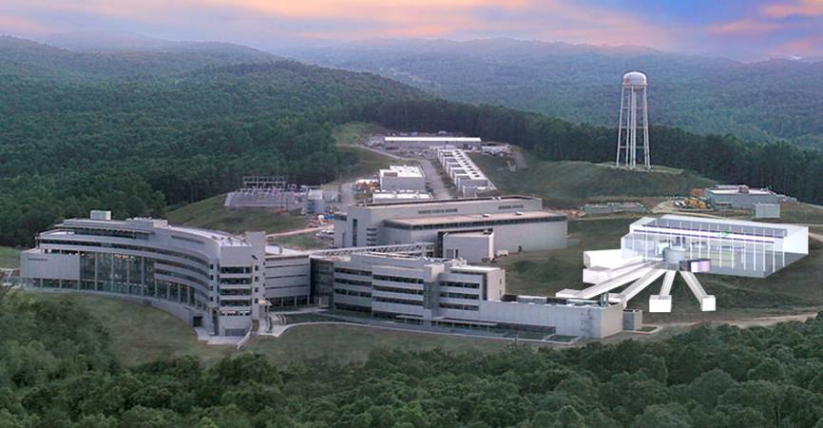
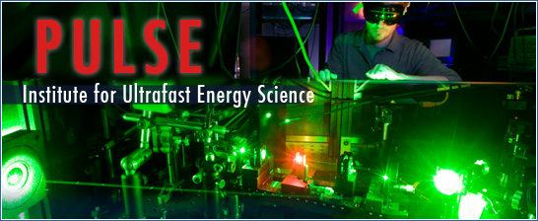
Support for Research and for Facilities
All Other
(Includes SCPD, S&S, …)
46 EFRCs ($100M), 2 Hubs ($60M), 3 BRCs ($75M) ~ 20% (each) of BES research and BER research.
Major Items of Equipment
(Includes ITER)
Office of Science
FY 2010 Budget
$4.904B
Facility Construction
Research
(About 1/3 of the research is sited at universities)
Facility Operations
Office of Science Program Briefing
3
Spallation Neutron Source shown with proposed 2nd target station

Slide 4
Breakdown of Users by Facility
Distribution by facility of ~26,000 users in FY 2010
Alcator
DIII-D
NSTX
ARM
SSRL
~26,000 users at the facilities in FY 2010:
~1/2 from universities;
~1/3 from labs;
~ 1/6 from industry, other agencies, and international entities.
JGI
EMSL
FES
ALS
40% of all users
ATLAS
Bio & Enviro
Facilities
HRIBF
TJNAF
Nuclear physics
facilities
APS
RHIC
Light Sources
B-Factory
High energy physics facilities
Tevatron
Neutron Sources
NSLS
ALCF
Computing
Facilities
Nano
Centers
OLCF
HFIR
Lujan
NERSC
SNS
NSRCs

Slide 5
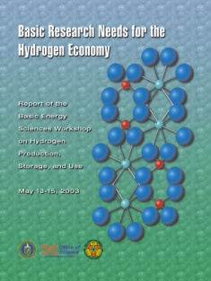
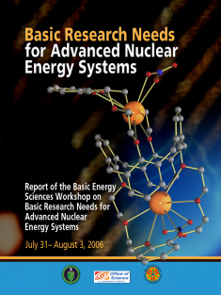
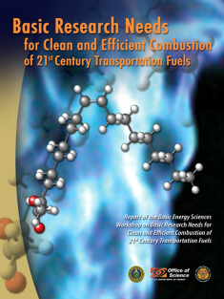
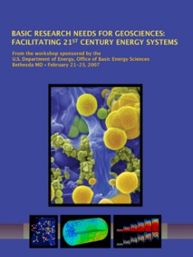
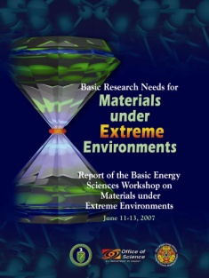
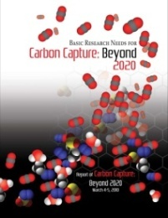
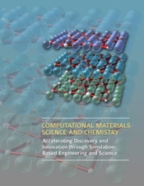
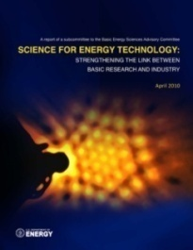
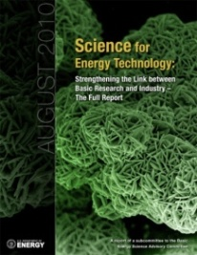
“Basic Research Needs” and Beyond
Notes:
CHARACTERISTICS OF A BASIC RESEARCH NEEDS WORKSHOP
Each workshop has three goals: (1) to summarize, prior to the workshop, the current state of technology and the associated R&D challenges in a Technology Perspectives Factual Document, which is used as a resource document for the basic research community at the workshop and well into the future; (2) to define a set of Proposed Research Directions that address the technology R&D challenges, the so-called technology show stoppers; and (3) to define a set of Science Grand Challenges that, if solved, might result in transformational changes in energy technologies.
The Basic Research Needs workshops must accomplish a great deal in a short time and their output must be authoritative, influential, and enduring. To accomplish the goals, the workshop planning, execution, and output stages are defined and structured. Ideally, each workshop report should serve as a reference document with a long shelf life. Additionally, the reports should be readily accessible. All reports are available on the BES website (http://www.sc.doe.gov/bes), usually within 60-75 days of the workshop.
The workshops are structured so that the participants learn about the status and challenges of a particular energy technology, generate proposed basic research directions to address short-term technology showstoppers, and articulate basic research grand challenges that might lead to transformational changes in energy technologies for the 21st century and beyond. The workshop reports that result from this process can help define the basic research agenda for a “decades-to-century” national energy agenda.
Workshop planning begins many months in advance and is performed by the workshop executive group, which is led by strong scientist chairs and co-chairs from academia and/or national laboratories. The executive group is made up of the workshop chair, co-chair(s), and panel leads. Participants come primarily from the scientific community and include the workshop chair(s), plenary speakers, panel leads, panelists, and writers. Each role is assigned tasks to complete before, during, and after the workshop. Technology experts serve as plenary speakers to provide applied perspectives to the scientific community.
A hallmark of the Basic Research Needs workshops is the production of the Technology Perspectives Factual Document. This feature describes the current status of technology development and is prepared prior to the workshop. It provides a common context and language for workshop discussions, it is used to educate workshop participants, and it becomes part of the workshop report. The Technology Perspectives Factual Document is written by technology experts from inside and outside DOE. If existing material is available (for example, technology roadmaps), it is included either explicitly or by reference. The Technology Perspectives Factual Document is not meant to provide the perspectives of the science community. Instead, science perspectives are garnered as an outcome of the workshop.
The outputs of the workshop are organized as (1) Panel Surveys describing the current state of science for each panel theme, (2) Priority Research Directions and Cross-Cutting Research Directions listed by each panel, (3) Science Grand Challenges outlined by all participants, and (4) Science and Technology Relationships Charts completed by the participants.
The result is a prioritization of the discovery-class and use-inspired basic research pertinent to energy technologies, obtained through a documented process. Often after the workshop, the chair and co-chair(s) and BES federal staff members participate in outreach activities to communicate the results of the workshop to the scientific community. Additionally, BES federal staff members brief other interested parties in the federal system, both inside and outside of DOE.

Slide 6
ASCR-BES Workshop https://www.orau.gov/dataworkshop2011/default1.htm
“Data and Communications in Basic Energy Sciences: Creating a Pathway for Scientific Discovery”
October 24-25, 2011 Bethesda, MD
Goals & Objectives
Identify and review the status, successes, and shortcomings of current data (including analysis and visualization) and communication pathways for scientific discovery in the basic energy sciences;
Ascertain the knowledge, methods and tools needed to mitigate present and projected data and communication shortcomings;
Consider opportunities and challenges related to data and communications with the combination of techniques (with different data streams) in single experiments;
Identify research areas in data and communications needed to underpin advances in the basic energy sciences in the next ten years;
Create the foundation for information exchanges and collaborations among ASCR and BES supported researchers, BES scientific user facilities and ASCR computing and networking facilities.
Co-Chairs
Peter Nugent, NERSC
J. Michael Simonson, SNS
Final Report- January 23, 2012

Slide 7
Big Data Planning -- A Broader context --
Other Agencies: Data Driven Science, Storage, Analysis, Simulation
NSF Task Force on Data and Visualization
Other Programs in DOE: LHC, RHIC, Climate Research, Leadership Computing…..
Interagency Working Group on Big Data
Competes Act 2010: Working Group on Public Access
Office of Science Working Group on Digital Data
Data Play a Key Role in Materials Genome
7

Slide 8
Data Capabilities & Needs
BES facilities have capability to produce TeraBytes of data per day from single beam lines
Examples: LCLS, SNS, Synchrotron Light Sources, e⁻ Microscopes
Increasing use of time resolved & tomographic studies
Increased need for analysis ‘on the fly’
Broad spectrum of BES data needs requires:
New level of understanding as a result of sophisticated applied mathematics and computer science techniques
New science that extracts the most from our (i.e. BES) facilities
Provided to workshop participants by BES
8

Slide 9
Break-out Sessions
Workflow management: Experiment to Science
Identifying and managing the data path from experiment to publication.
Theory and algorithms
Recognizing the need for new tools for computation at scale, supporting large data sets and realistic theoretical models.
Visualization and Analysis
Supporting near-real-time feedback for experiment optimization and new ways to extract and communicate critical information from large data sets.
Data Processing and Management
Outlining needs in computational and communication approaches and infrastructure needed to handle unprecedented data volume and information content.

Slide 10
Theory & Algorithms
Sustained support for interdisciplinary team consisting of domain scientists (theory and experiment), applied mathematicians, computer scientists working together to meet the theory/algorithm challenges for facilities’ data
Pilot studies
One team for each end station/facility
Inverse problems and solution algorithms (near term 1-3 years), but there is a need for long term R&D
Feature extraction, image analysis (near term 1-3 years), include model based constraint (longer term)
Combine multiple data sources and imaging techniques to provide more reliable solutions (mid-term 5 years)
Ab initio theory guided experiments for data triage/reduction (long term 5-10 years)
Computational endstation that couples virtual and real experiments (long term 5-10 years)
ASCR-BES Data Workshop Preliminary Findings

Slide 11
Enabling Transformative Science
Detector and source advancements will enable transformative science within BES facilities. Current systems are producing a tremendous amount of data. Future systems will overwhelm current analysis pipelines.
Integrate theory and analysis components seamlessly within experimental workflow.
Move analysis to closer to experiment.
Match data management access and capabilities with advancements in detectors & sources.
ASCR-BES Data Workshop Preliminary Findings

Slide 12
… components seamlessly within experimental workflow.
Integrate theory and analysis…
Coupled simulation and experiment
Theory guidance for experimental design
Analysis feedback to steer experiment
Common data formats
Common community toolsets for analysis and workflow
Apply ASCR’s investment in visualization and analysis tools (invest in adaptation specific to experiments)
ASCR-BES Data Workshop Preliminary Findings

Slide 13
Move analysis to closer to experiment
Real-time (in-situ), streaming analysis at beamline.
Local data reduction capabilities
0 suppression
Hierarchical filtering
Baseline and background subtraction
Live visualization of experiment
Improve the efficiency of the experiment
Increase data-quality
Improve off-line analysis
ASCR-BES Data Workshop Preliminary Findings

Slide 14
Match data management access and capabilities…
… with advancements in detectors & sources.
Remove the bottlenecks
Apply existing data transport and mobility toolsets
Apply forefront mathematical techniques to more efficiently extract science from the experiment.
Interoperability across different facilities/beamlines
Combine multiple data sets
Expandable
Incorporate legacy data
Integrated teams of engineers, scientists and computer scientists to solve these problems
ASCR-BES Data Workshop Preliminary Findings

Slide 15
Closing Thoughts…
… on developing model(s) for future scientific collaborations
Opportunities abound, but prioritization will be crucial
Scientific user community is diverse
Some users think there is no problem now, or in the future
Other users will ‘invent’ solutions to mitigate bottlenecks
Lack of widely accepted definitions or protocols for key topical NGNS areas, e.g. big data, analysis, fast networks, software toolkits, middleware, etc.
In general, users are very protective of their data
Many stakeholders must be engaged, including facility directors, SC program office(s)
Scientific User Facilities constitute long-term funding commitments; opportunities to increase research productivity might have a short-term window
Need a compelling story to initially garner and to sustain interest in a new research investment strategy

