Slide 1
BNL Institutional Cloud:
Status and Plans
SDCC Liaison Meeting
January 18, 2018
John Hover <jhover@bnl.gov>

Slide 2
Institutional Cloud
Openstack (Icehouse) instance; EC2 API enabled
120 compute nodes (16 cores, 32GB RAM, 2 to 5 TB disks).
Usable for data analysis/processing, prototyping, software testing.
Used by Biology group for custom Blast run using Ruby-based meta-Blast.
Ran for 2 months on ~40 nodes (~600 cores).
It is a complementary CSI/SDCC offering to the high-performance Institutional Cluster (w/ GPUs, high-speed parallel filesystem, high-speed interconnects.)
Hardware upgrades being considered for Spring 2018

Slide 3
Operational Modes (current)
Push-button single-user HTCondor, whole-node batch clusters
We have VM images for head node and worker nodes, customized at runtime.
You give us your public SSH key(s), and how many machines.
We create a batch cluster and send you the public hostname to SSH to.
You scp your input data to the head node, create condor submit files.
Run jobs…
You scp your output data back to your lab/systems.
Tell us to shut down workers until next run. Head node can stay running.
A project SDCC staff are collaborating on (co-PIs) will soon make this fully automated and more flexible. See: www.virtualclusters.org

Slide 4
Other Operational Modes
Direct EC2/Openstack client usage
If you already are familiar with Amazon EC2 or other clouds, and have VMs pre-configured, we give you credentials and you could upload/run VMs.
Docker (in the future)
We intend to support Docker in the next iteration of the resource.

Slide 5
Application Software
Without a mounted shared filesystem, software must be dealt with. Options...
Easily available dependencies (i.e. already in RPM form somewhere) can be added to your worker VM images (by us). If that’s all you use, you’re done.
We create RPMs for it and pre-install in VMs. (Done for three groups so far).
Software can now be installed to CVMFS, a read-only distributed software system. Repositories exist at BNL and on OSG for global use.
Send software with jobs, or job grabs software (e.g. via wrapper).
If total tarball size is less than ~50MB, no big deal.
Grab tarball(s) from web via wget.

Slide 6
Data
Head nodes have 5TB of local disk. Workers have minimum of 3TB.
So workloads under this scale can use Condor file transfer. No worse (or better) than a head-node shared filesystem.
Input data staged to head node, output needs to be retrieved from head node.
(Potentially) Swift (Amazon S3-equivalent) object store.
Upload/download data from anywhere (BNL, external)
Good bandwidth from VMs.
Other external storage, e.g. GridFTP.

Slide 7
Benefits of Cloud computing/virtual clusters
Total control over platform and software (OS versions, etc.)
Single user means simple, unshared batch setup.
You see what you have. No pre-emption or priorities. No other user's work can interfere.
Once a batch workflow has been ported to this mode, workloads can be easily run on Open Science Grid opportunistically, Amazon EC2, or other standard clusters (provided outbound network).
We can assist with porting workloads.
Ability to assign public IPs to nodes means:
Ideal for non-batch software development/service testing via setup/teardown.
Ideal for non-batch clustering environments,e.g. Spark (provided modest data size), JupyterHub
Nodes and data are typically reachable equivalently from both inside and outside BNL, so collaboration outside BNL may be easier.

Slide 8
Caveats and Limitations
This resource is repurposed hardware.
Virtual machines can crash/disappear. Any data/configuration/files not backed up by the user can be lost.
Data-intensive workloads may not be a good fit. Workload requiring significant node-to-node (MPI) communication may not fit.
Default HTCondor cluster does NOT have a shared filesystem.
Workloads/submit scripts/wrappers must be adapted to manage input and output.
Software needs to be natively installed, CVMFS, or sent with job.
Input data can be sent with the job from the head node using Condor directives.
Input data can be pulled from external source.
User must keep track of data movement.

Slide 9
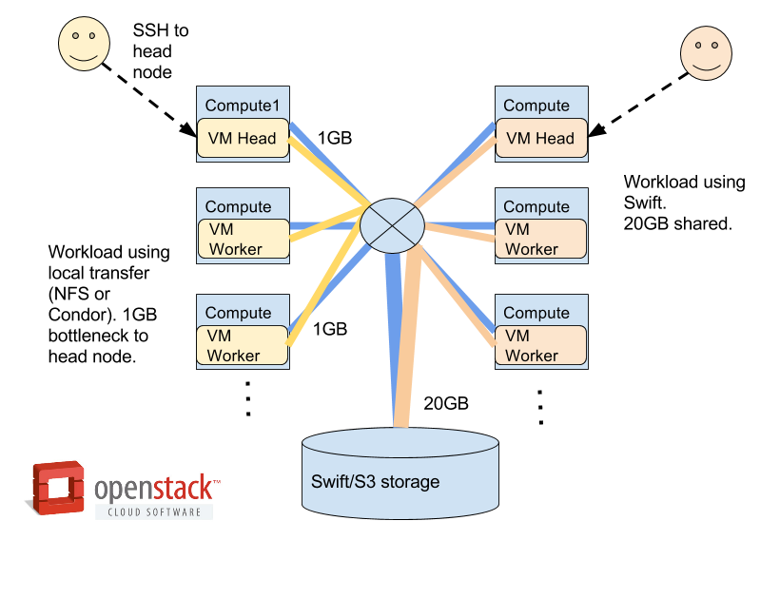
Bandwidth Considerations

Slide 10
Complementary possibility...
Establishment of a low-cost commodity HTCondor cluster is being discussed.
A generic, shared, general-purpose HTC cluster with shared filesystem.
Low performance relative to IC, KNL (Annie and Francis)
Built from hardware similar to Cloud.

Slide 11
Next steps...
If you're interested in Cloud, contact me (John).
We need to assess the workload for suitability.
We need to assess data access/transfer needs.
I have a questionnaire to help clarify workload properties and software requirements.
If only a physical cluster with shared FS will suit, tell us.
We should set up a separate meeting of all interested parties to discuss further. (Coordinate with Tony).
Timescale for both these platforms is Spring 2018.

Slide 12
More Info
In-depth discussion of workloads, virtual clusters, and Cloud operation:
https://docs.google.com/presentation/d/1wmDzKMXt1tGf8VP4a8RzBSS364Io6DfIVrtiwoeqjpE/edit?usp=sharing

