Slide 1
sPhenix Testing 1/29/18
C. Schultheiss, P. Rosas, Z. Altinbas
K. Yip, P. Orfin, B. Van Kuik
And a host of others.

Slide 2
Major Events
Lost Voltage Tap 11
Reconfigured Quench Detector
PS Compensation
Stable on Magnet, Large Current Error, Needs More Work.
Ramped to 500 Amps twice
First in steps at 0.5 Amps/sec
Fast Discharge occurred at 469 Amps
Ramped at 1.0 Amp/sec
Descended via Slow Discharge

Slide 3
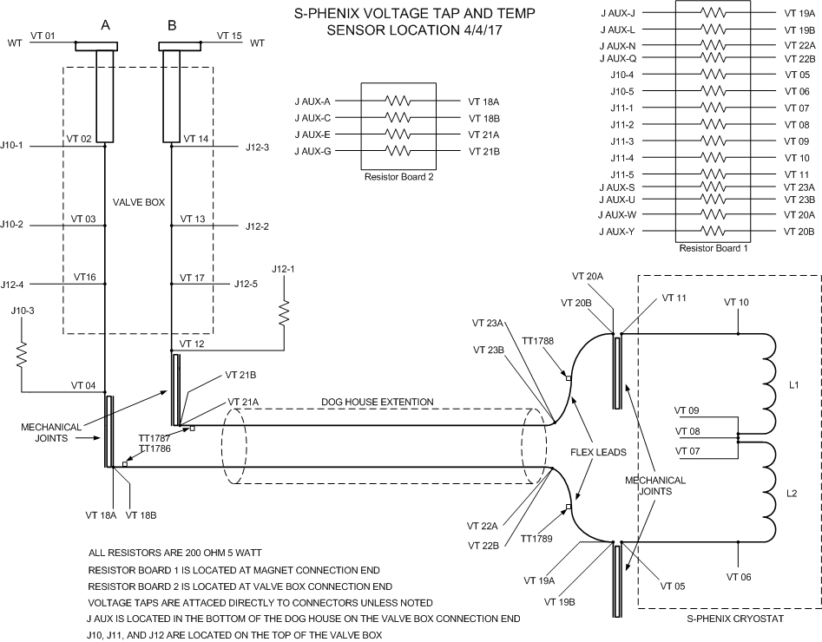
Voltage Taps

Slide 4
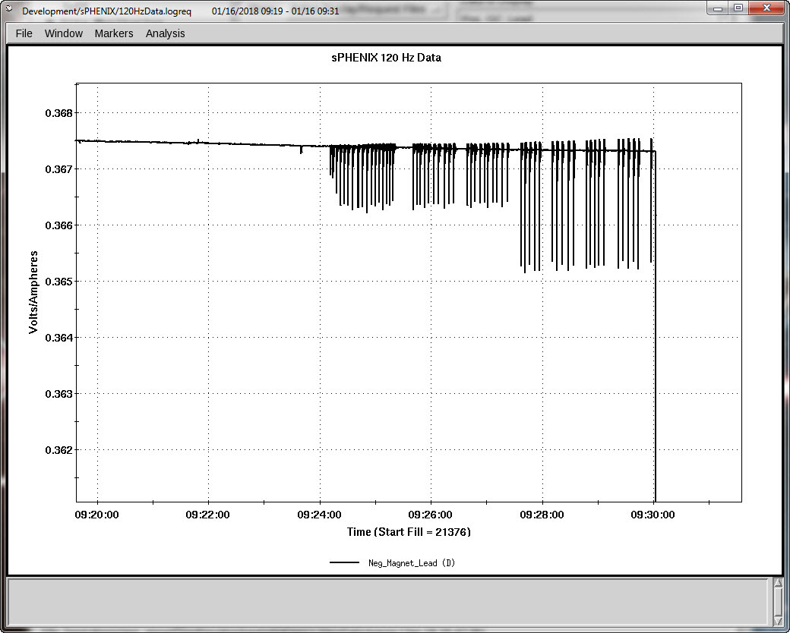
Voltage Tap VT11 Remakes Connection

Slide 5
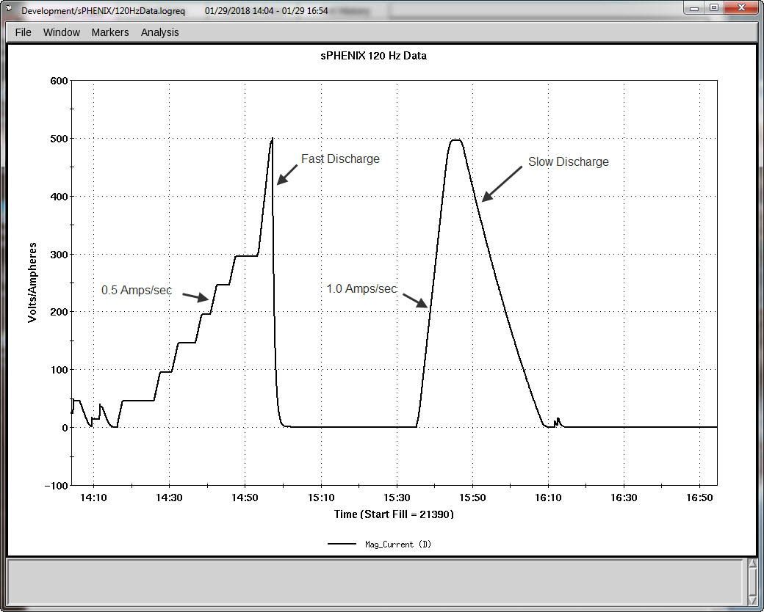
Ramps During Testing

Slide 6
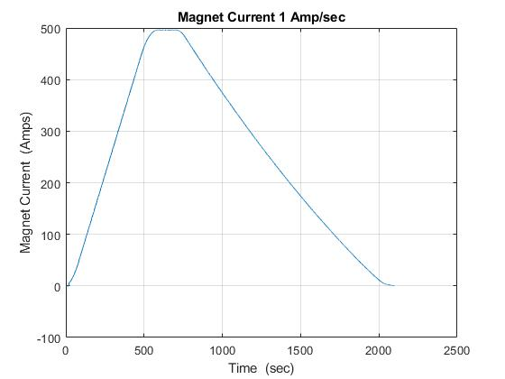
Ramp Used For Inductance Calculation

Slide 7
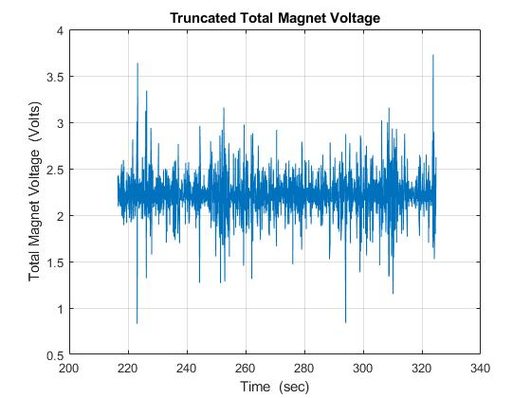
Magnet Voltage for Total Inductance Calculation

Slide 8
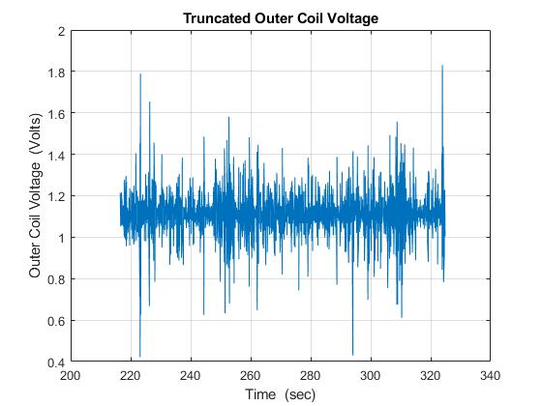
Magnet Voltage for Outer Coil Inductance Calculation

Slide 9
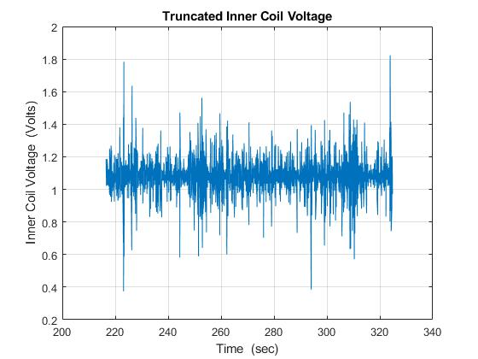
Magnet Voltage for Inner Coil Inductance Calculation

Slide 10
Inductance Calculation
Calculations from the 1 Amp/sec ramp
Total Inductance 2.215 H.
Outer Coil Inductance 1.112 H.
Inner Coil Inductance 1.081 H.
Delta from total -0.022 H. approx. -1%

Slide 11
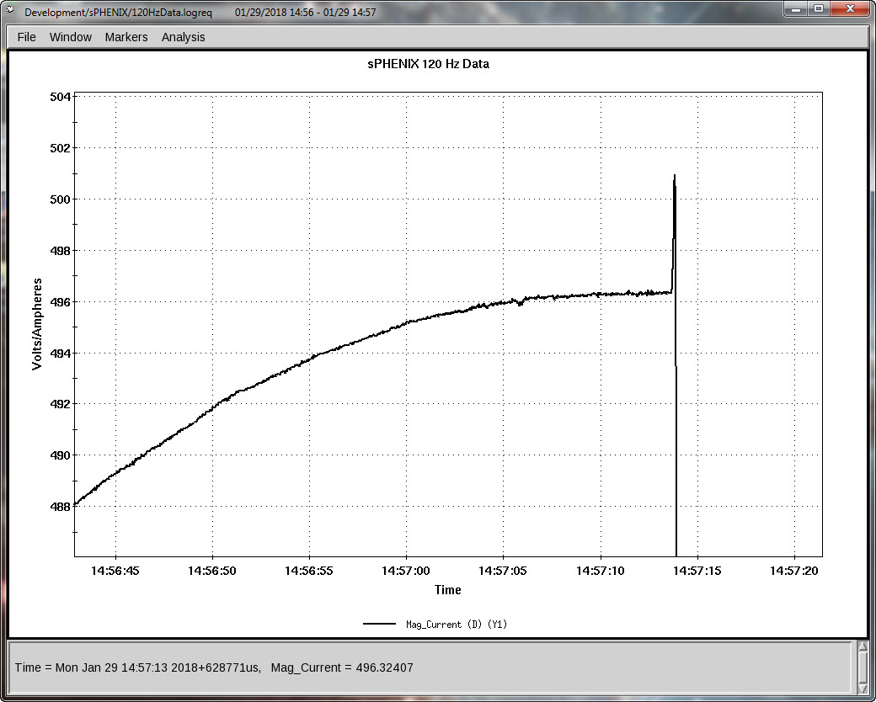
Fast Discharge Event

Slide 12
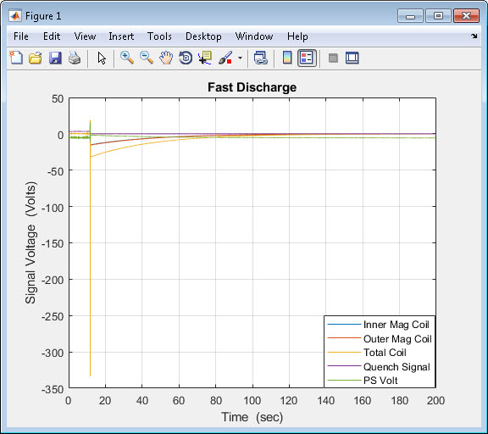
Fast Discharge Quench Detector Overview

Slide 13
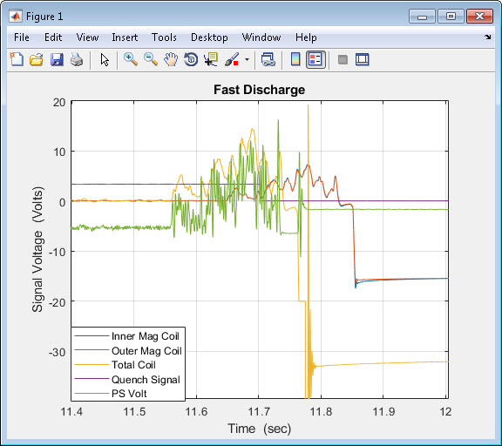
Fast Discharge Expanded View

Slide 14
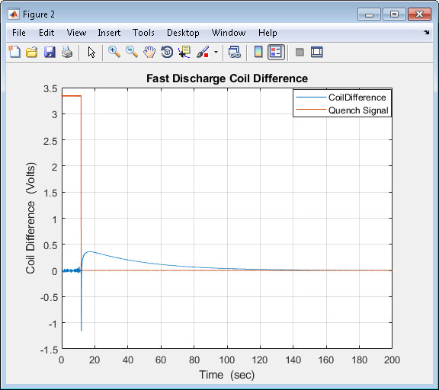
Calculated Coil Difference and Quench Signal

Slide 15
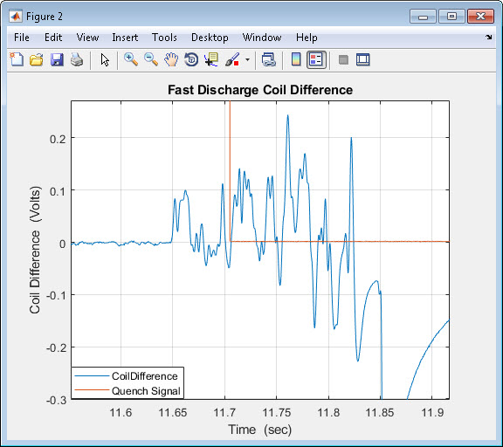
Calculated Coil Difference and Quench Signal Expanded View

Slide 16
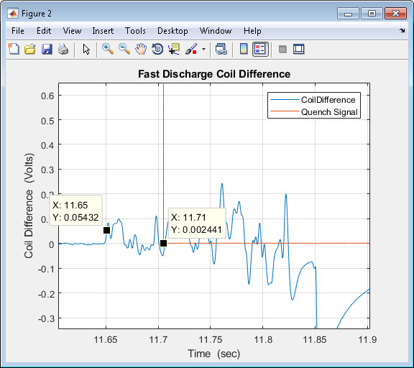
Quench Detector Response

Slide 17
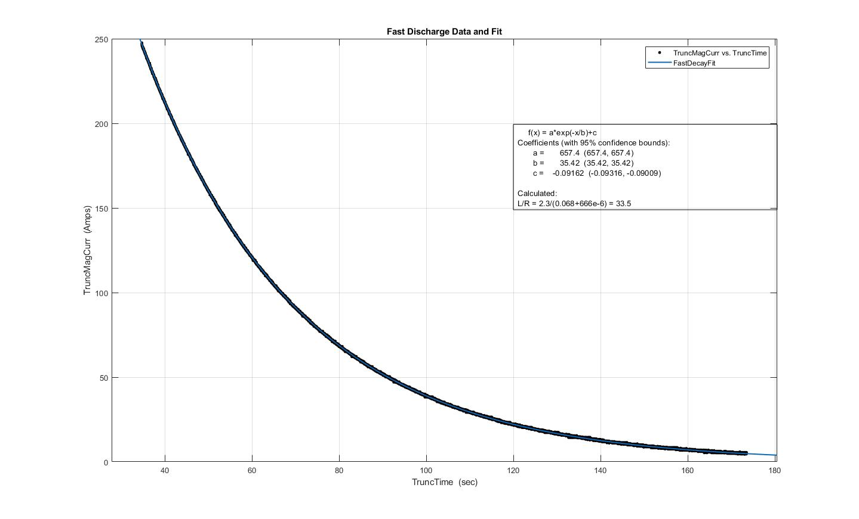
Fast Discharge Time Constant

Slide 18
Energy Extraction Resistor
Assume measured L and tau are correct, then R=L/tau and 2.215/35.42 = 0.0625; subtract cable R of 666 uOhms and Energy Dump Resistor is 0.0619 Ohms.

Slide 19
Conclusions
Fast Discharge caused by PS Voltage Upset
Low amplitude 286 Hz oscillation
Measured Inductances are reasonable, better estimates later with higher ramp rates.
Slow Discharge required about 1341 seconds.
Fast Discharge required about 200 seconds.

Slide 20
Issues
Issues still to be addressed:
PS Compensation
Difference between PS and Magnet Current
At Flattop
PS Current 775.71 Amps
Mag Current 496.24 Amps
Slope Error
Offset in PS Voltage
Appears to be -5.71 Volts
At 9:58:09
Mag Volt, PS Volt, Mag Curr, PS Curr are all zero
At 9:59:50
PS Volt jumps down to -5.71 Volts

Slide 21
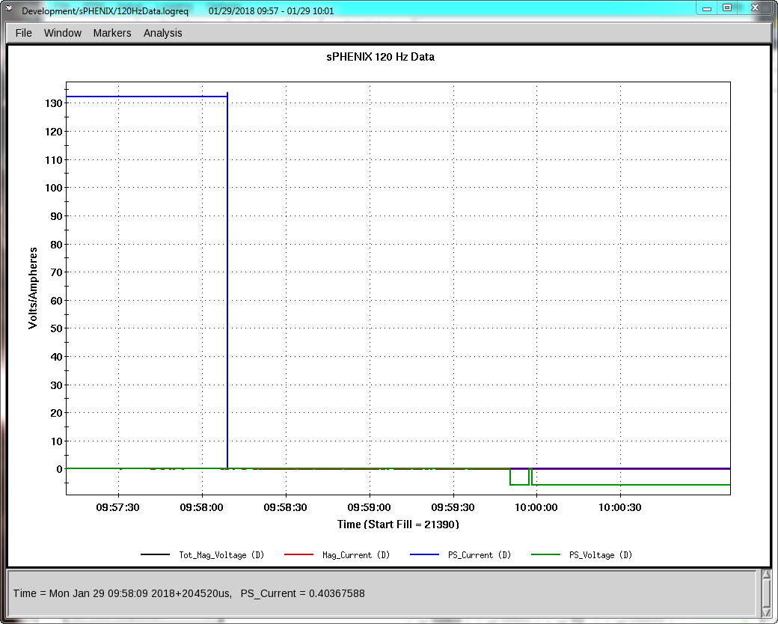
Offsets on Turn On

Slide 22
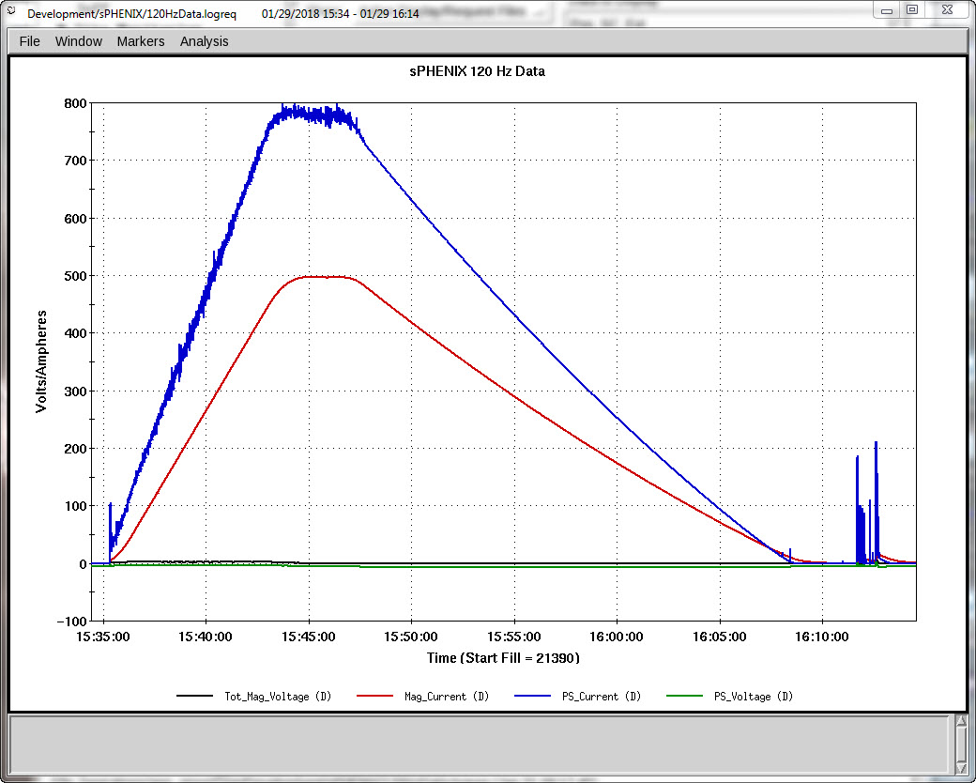
PS and Magnet Currents and Voltages

Slide 23
Issues (continued)
Time Displacement between Fast Logger Boards A and B
Outer Magnet Coil and Inner Magnet Coil on Logger Board A
Total Coil Voltage on Logger Board B
Board A lags Board B by about 80 ms

Slide 24
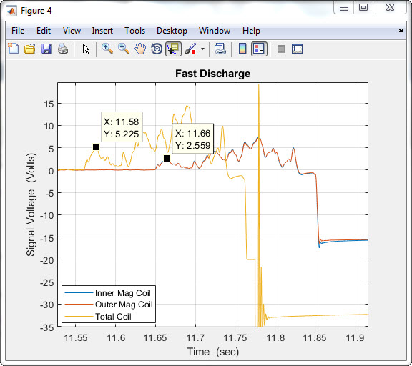
Logger Board Time Lag

