Slide 1
Agenda (https://indico.bnl.gov/conferenceDisplay.py?confId=4182)
Status/Plan :
We’ll try to run the test again on Thursday ~ 9 am ?
Carl Schultheiss’ analysis of Monday’s 500 A runs ( … fast discharge and slow discharge …)

Slide 2
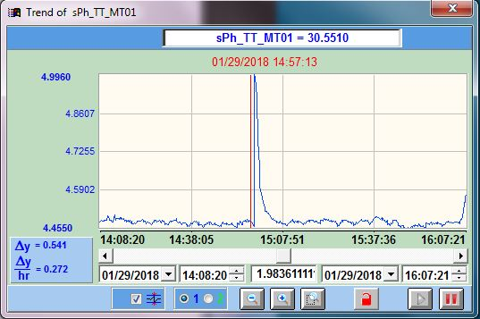
Fast Discharge ~14:57:13
A temperature jump of > 0.54 K on the coil temperature MT01 at ~495 A
According to Pasquale, at ~4600 A, non-superconducting @ Tcs=7.28 K.
conservatively ⇒ΔT allowed ~2.78K (from 4.5 K) without turning non-superconducting
If heat ∝ I², I > 1123.1 A would likely reach 2.78 K temperature jump.

