Slide 1
Probing collectivity in pPb collisions using heavy quarks with CMS detector
Zhenyu Chen (Rice University)
BNL Seminar, March 2018

Slide 2
Probing collectivity in pPb collisions using
D⁰ meson with CMS detector
CMS-PAS-HIN-17-003
Zhenyu Chen (Rice University)
BNL Seminar, March 2018

Slide 3

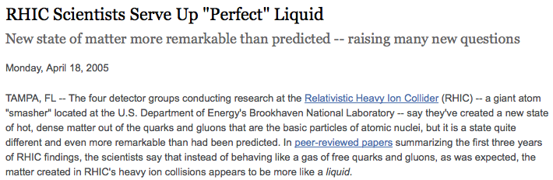
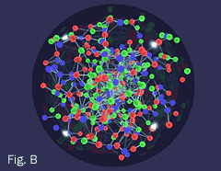
A bit of history
(2005)
Discovery of a strongly coupled QGP

Slide 4
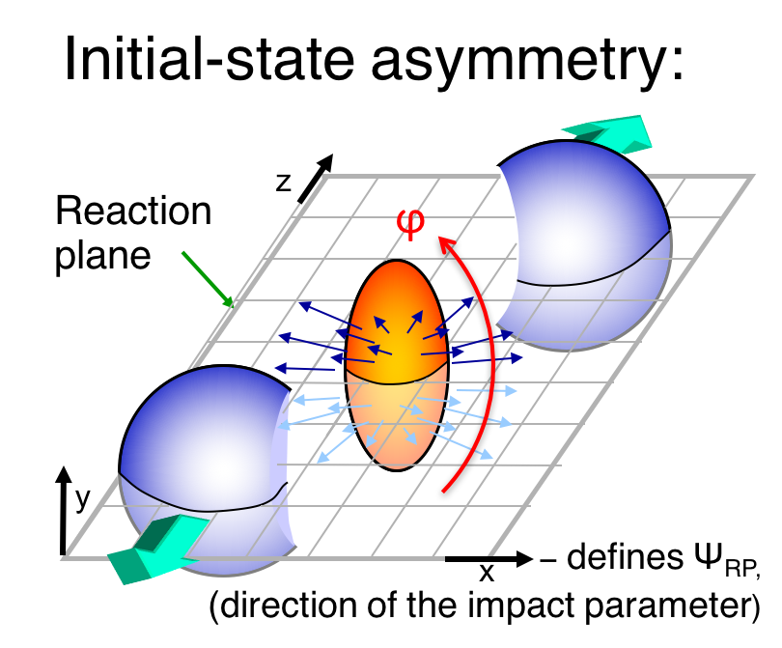
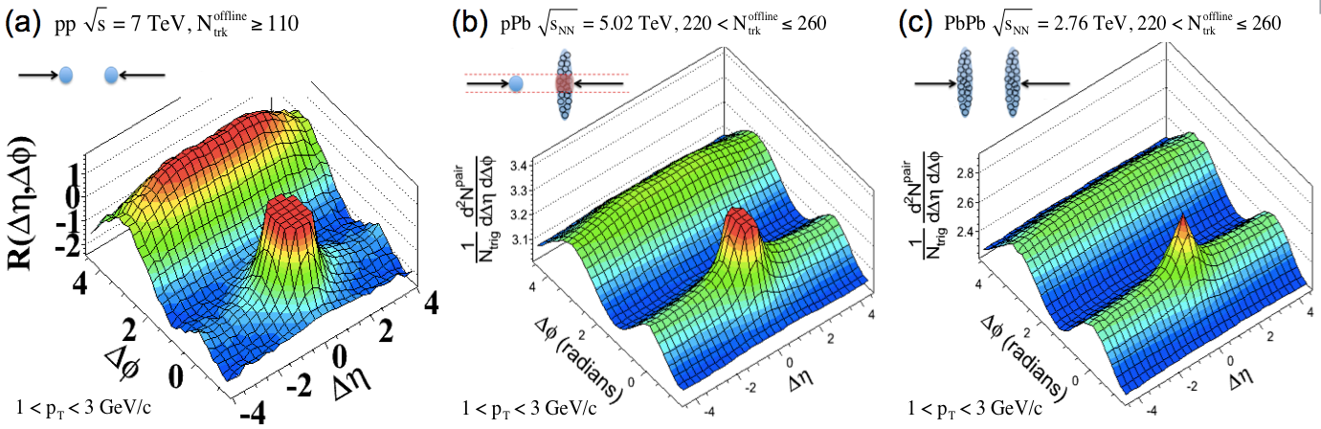
The long range “Ridge”
CMS
“Ridge”
PLB 724 (2013) 213
Hydrodynamic expansion of QGP in AA collisions

Slide 5
Omnipresent “Ridge”
“Ridge”
“Ridge”
Add something here to demonstrate the expansion, probably from Wei’s talk
“Ridge”
JHEP 09 (2010) 091
PLB 724 (2013) 213
PLB 724 (2013) 213
What is the origin of the long range “Ridge” in small system?
A small droplet of QGP? Other QCD effect (CGC)?

Slide 6
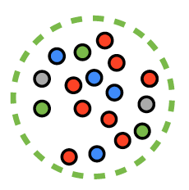
How small a QGP fluid can be?
Hydrodynamic applies when:
(mean free path)
~ 1/(g⁴T)
AA
L~10 fm

Slide 7

How small a QGP fluid can be?
Hydrodynamic applies when:
(mean free path)
~ 1/(g⁴T)
AA
Too small and dilute?
pp
L~1 fm
L~10 fm

Slide 8

How small a QGP fluid can be?
Hydrodynamic applies when:
(mean free path)
~ 1/(g⁴T)
AA
Small but dense!?
T↑
pp
L~1 fm
L~10 fm

Slide 9
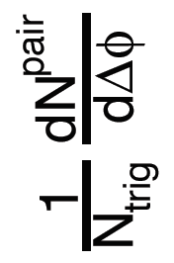
Quantify the “Ridge”
“Flow” analysis
Initial Geometry
ε2
+
ε3
+
ε4
+...
=
cos2Δϕ
cos3Δϕ
cos4Δϕ

Slide 10
Similar “Flow”
Universal trend in v_{n}
PRL 120.092301

Slide 11
Similar “Flow”
Universal trend in v_{n}
PRL 120.092301
Key question: Collectivity?

Slide 12

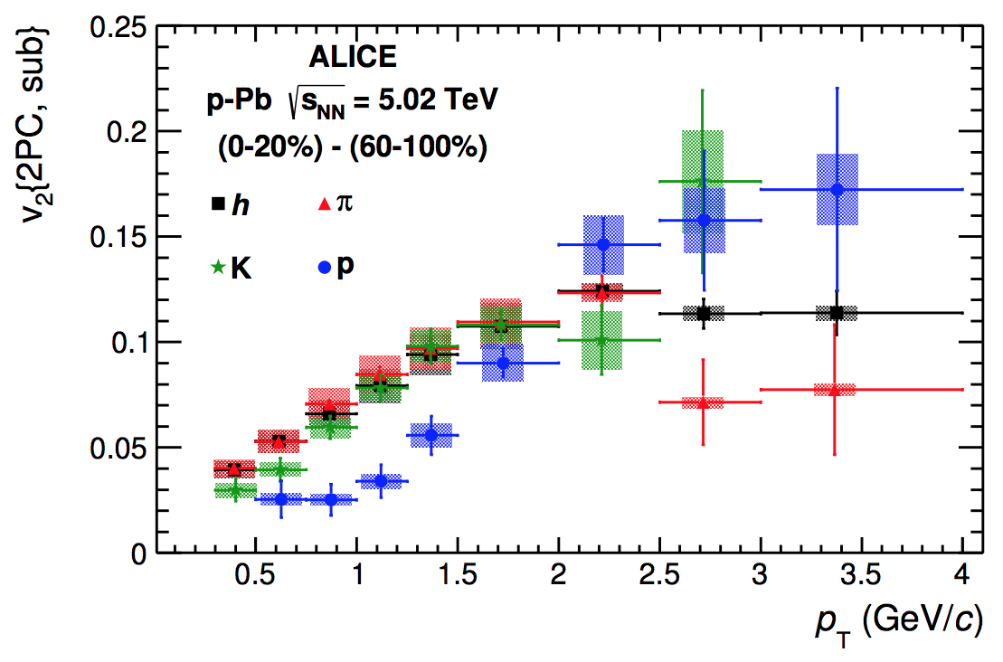
Collectivity in small systems
PLB 742 (2015) 200
PLB 726 (2013) 164

Slide 13
Collectivity in small systems
PLB 742 (2015) 200
PLB 726 (2013) 164
Mass ordering of v2
Common velocity field
Collective phenomena

Slide 14
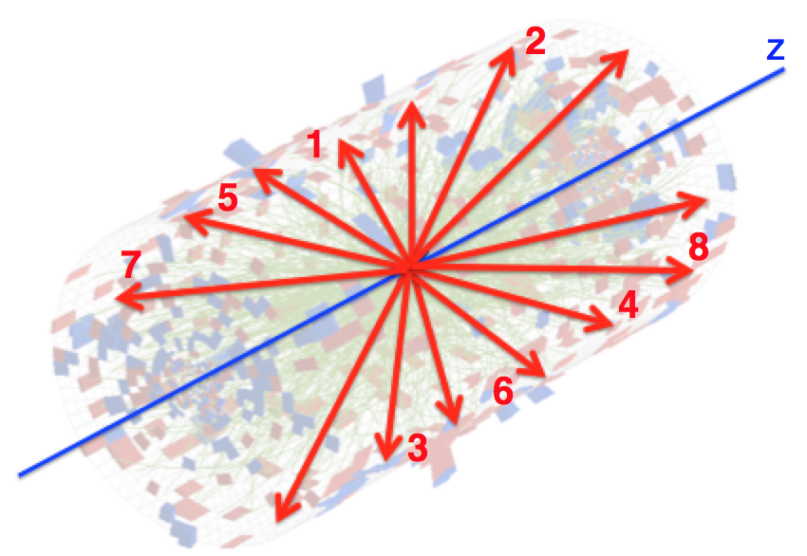
Collectivity in small systems
PRL 115.012301
(cumulants)
v₂{4} ≈ v₂{6} ≈ v₂{8} ≈ … ≈ v₂{∞}
Direct evidence of collectivity

Slide 15
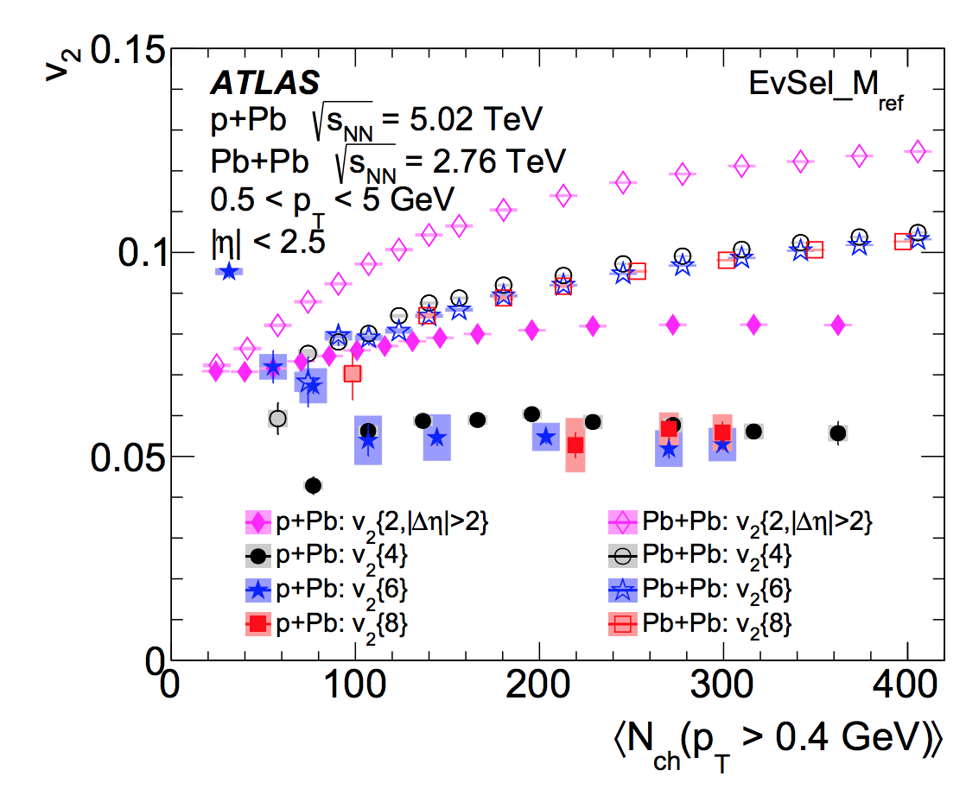
Collectivity in small systems
EPJC 77 (2017) 428
v₂{4} ≈ v₂{6} ≈ v₂{8} ≈ … ≈ v₂{∞}
Direct evidence of collectivity

Slide 16
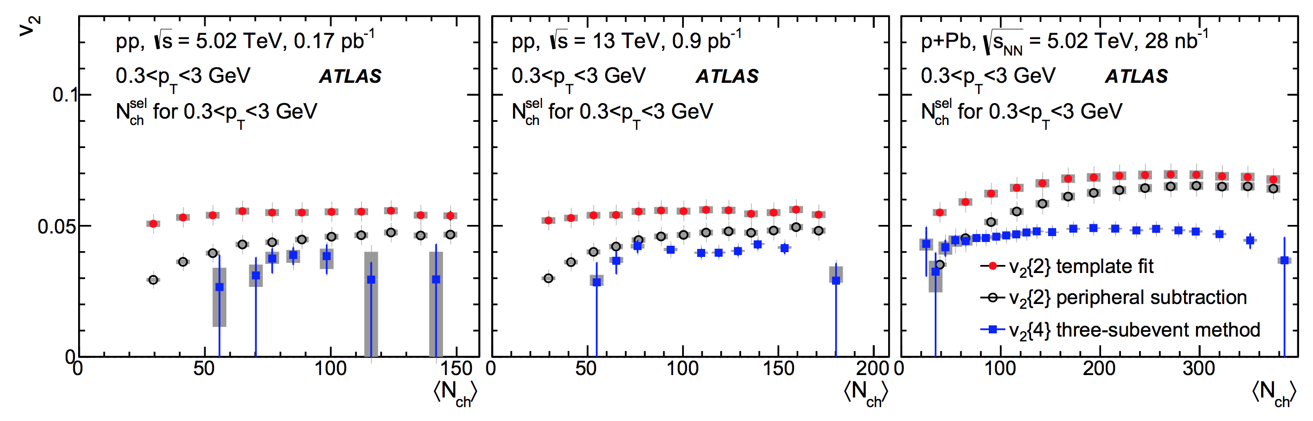
Collectivity in small systems
EPJC 77 (2017) 428
PRC 97 (2018) 024904
v₂{4} ≈ v₂{6} ≈ v₂{8} ≈ … ≈ v₂{∞}
Direct evidence of collectivity

Slide 17
An emerging paradigm

Slide 18
An emerging paradigm
Collectivity confirmed in small systems.

Slide 19
An emerging paradigm
Collectivity confirmed in small systems. But QGP?

Slide 20
Hydrodynamic in AA collision
PRC 89 (2014) 044906
Very successful in describing data

Slide 21
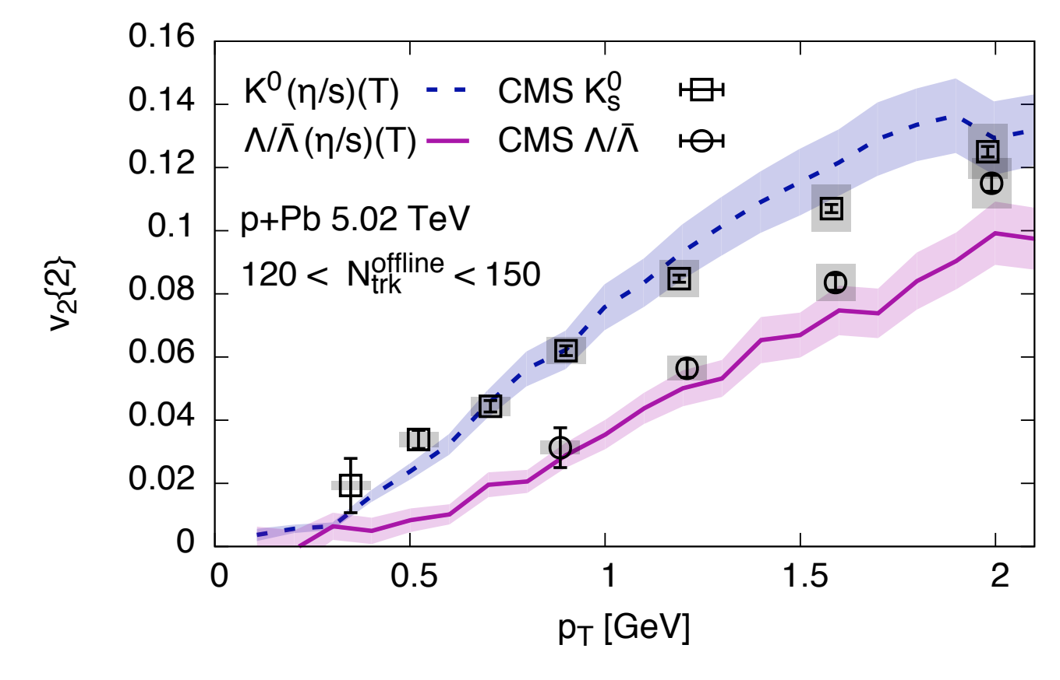
Hydrodynamic in pPb
PLB 772 (2017) 681
Good agreement between data and model

Slide 22
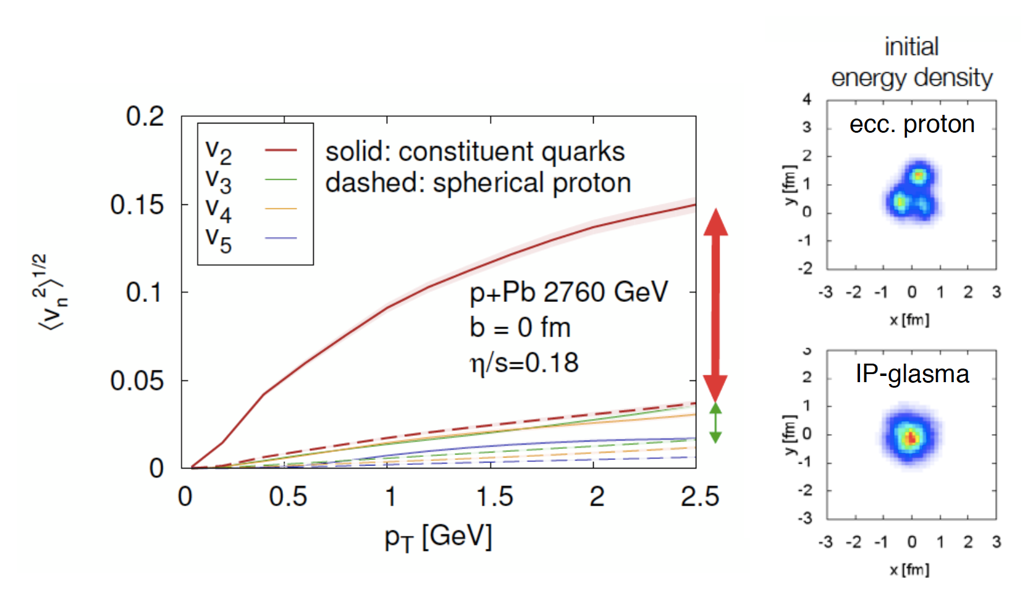
Hydrodynamic in pPb
Most recent calculation:
PLB 772 (2017) 681
PRL 113 (2014) 102301
PLB 772 (2017) 681
B.Schenke
Good agreement between data and model
Extremely sensitive to initial conditions

Slide 23
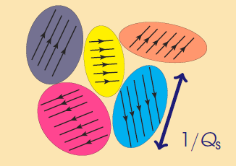
Color Glass Condensate
Before the collision,
“Momentum Domains”
Or Color Electric Fields
Lappi, Schenke, Schlichting, Venugopalan
Non-Geometry related
No later-stage interactions as for Hydro
JHEP 01 (2016) 061

Slide 24
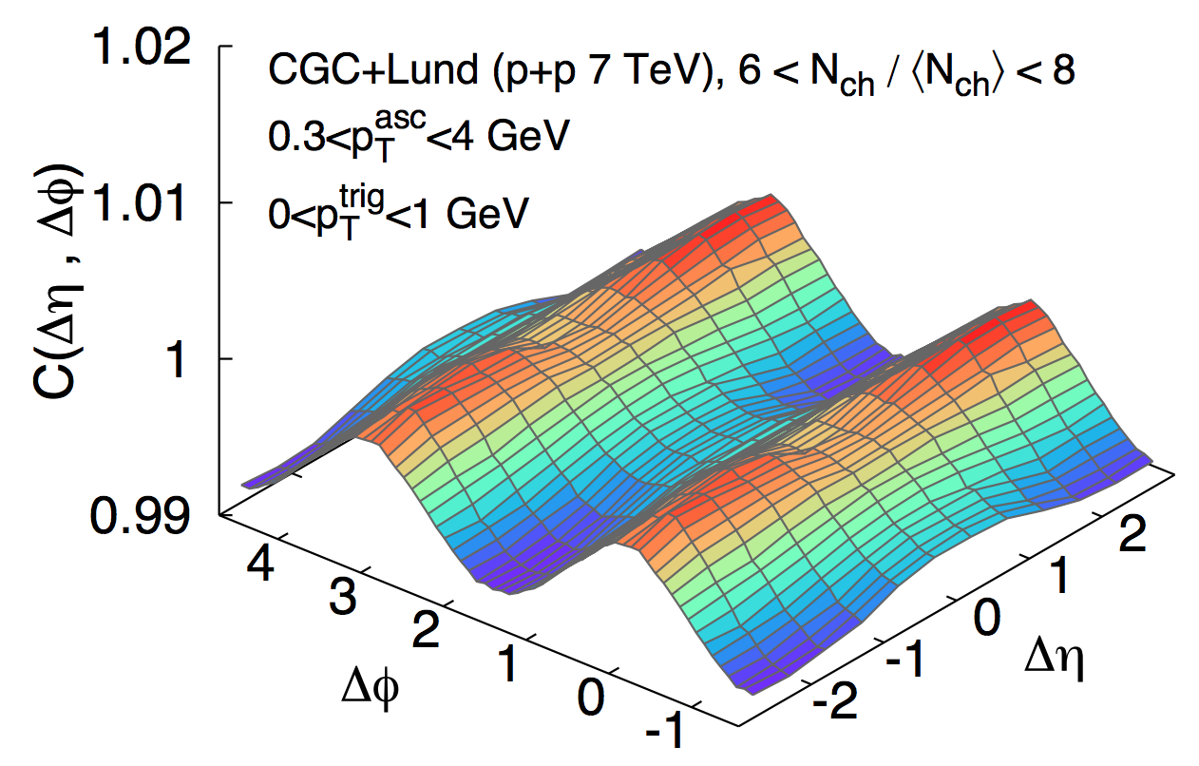
Color Glass Condensate
CGC models confronting data
PRL.117.162301

Slide 25
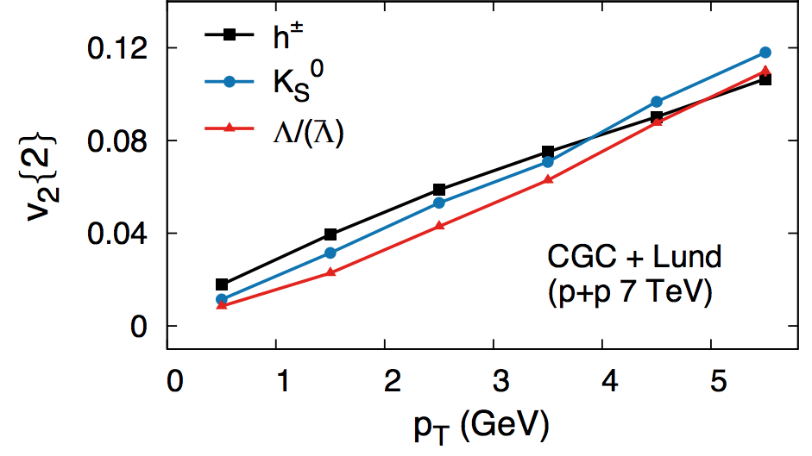
Color Glass Condensate
CGC models confronting data
PRL.117.162301
PRL.117.162301

Slide 26
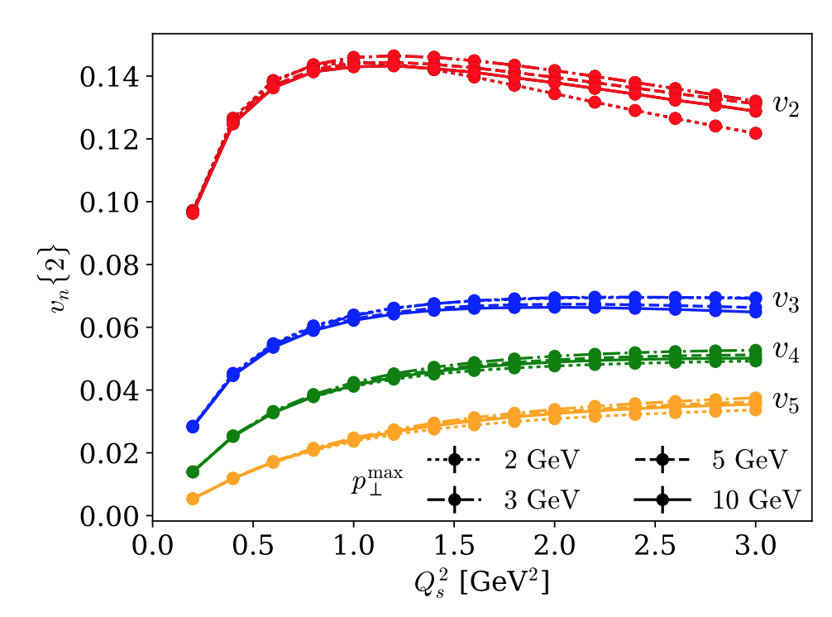
Color Glass Condensate
CGC models confronting data
PRL.120.042002

Slide 27
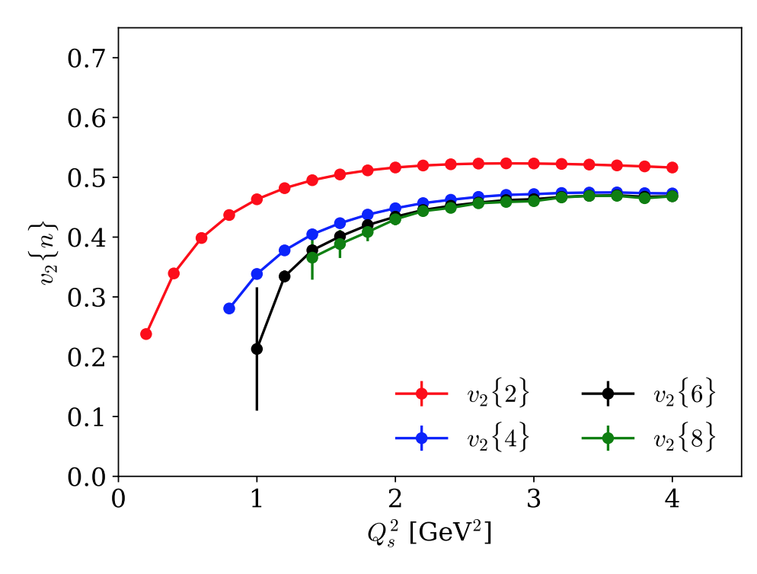
Color Glass Condensate
CGC models confronting data
PRL.120.042002
PRL.120.042002
Quantitative comparison not yet settled…

Slide 28
What’s next

Slide 29
What’s next
What’s missing in the QGP picture?

Slide 30
What’s next
What’s missing in the QGP picture?
Parton-medium interactions

Slide 31
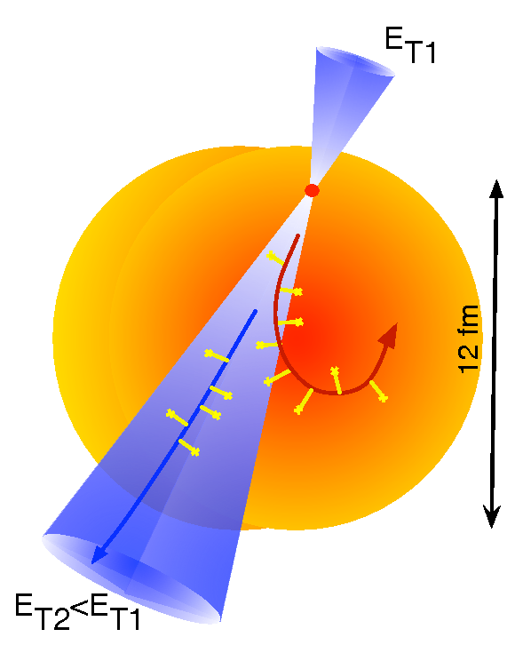
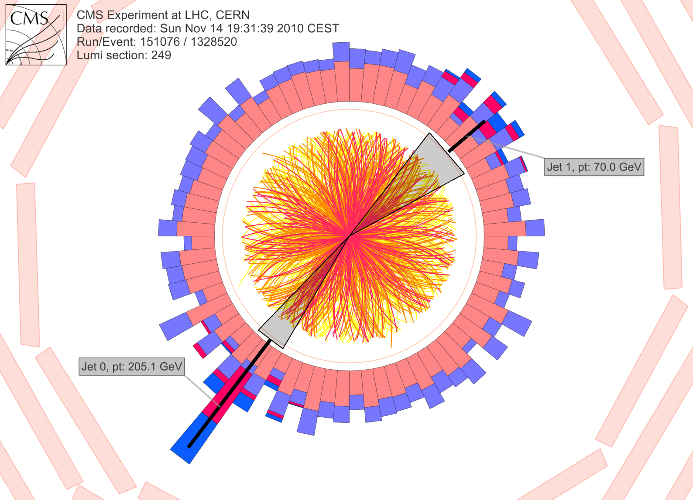
What’s next
What’s missing in the QGP picture?
Parton-medium interactions
Significant jet quenching in
AA collisions

Slide 32
What’s next
What’s missing in the QGP picture?
Parton-medium interactions
Significant jet quenching in
AA collisions
So far not observed in
small systems

Slide 33
What’s next
What’s missing in the QGP picture?
Parton-medium interactions
Significant jet quenching in
AA collisions
So far not observed in
small systems
Heavy Flavor quark serve
as external probe

Slide 34
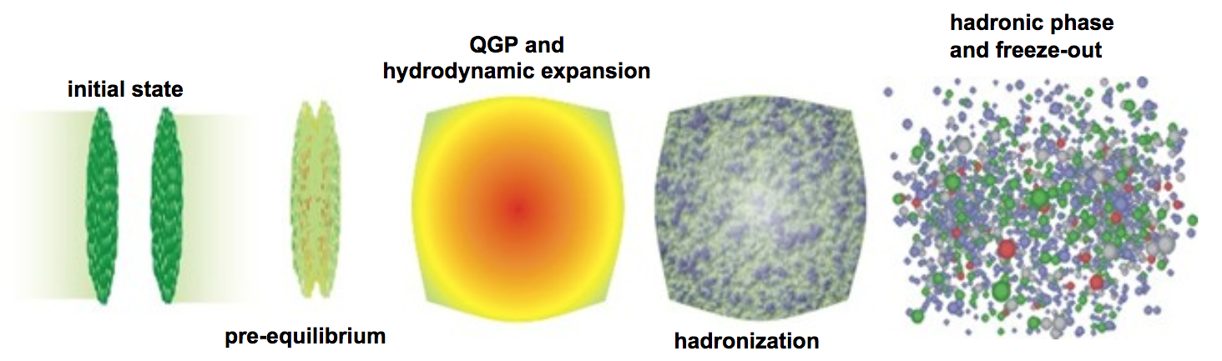
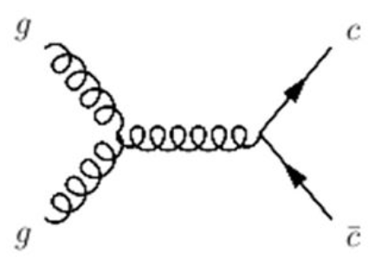
Heavy Flavor as external probe

Slide 35
Heavy Flavor as external probe
u
D⁰
c
Charm quark expected to flow!!

Slide 36
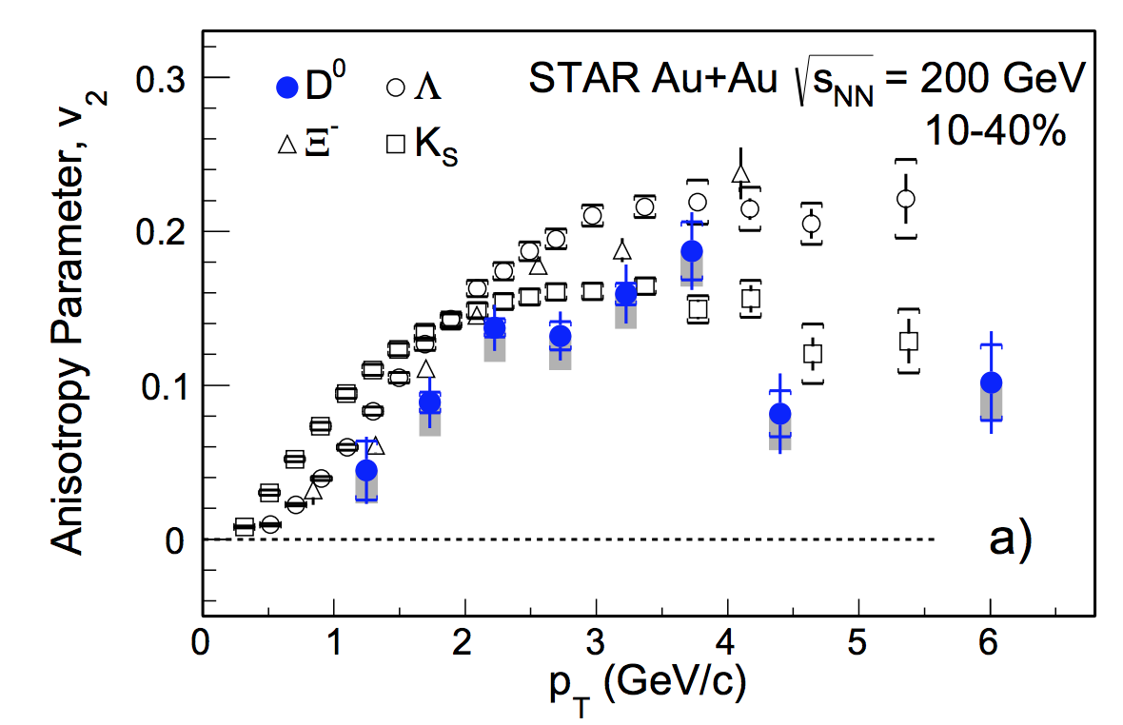
Heavy Flavor as external probe
PRL.118.212301
Significant interaction between HF and QGP in AA

Slide 37
Heavy Flavor as external probe
arxiv.1708.03497
PRL.118.212301
Significant interaction between HF and QGP in AA

Slide 38
Heavy Flavor as external probe
arxiv.1708.03497
PRL.118.212301
Significant interaction between HF and QGP in AA
Do we see the same in small systems?

Slide 39
D⁰ reconstruction in pPb
D⁰ -> Kπ (BR = 3.88+0.05%)

Slide 40
D⁰ reconstruction in pPb
D⁰ -> Kπ (BR = 3.88+0.05%); large amount of data needed!!

Slide 41
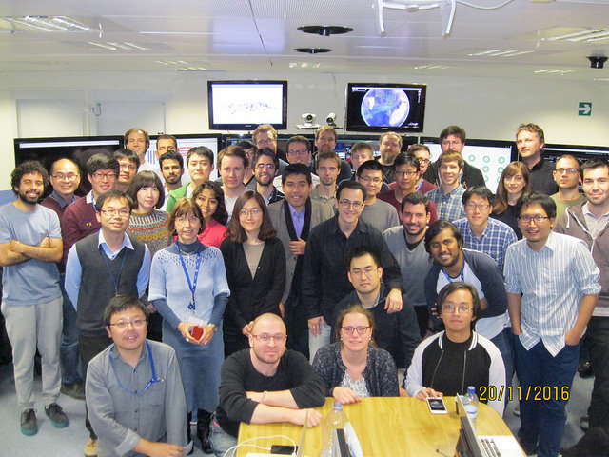
D⁰ reconstruction in pPb
D⁰ -> Kπ (BR = 3.88+0.05%); large amount of data needed!!
Heavy ion people are “monsters”
– CMS DAQ shifter

Slide 42
D⁰ reconstruction in pPb
D⁰ -> Kπ (BR = 3.88+0.05%); large amount of data needed!!
2016 pPb 8.16 TeV
HighMultiplicity
(Ntrk > 185): 550 M
MinimumBias: 7 B
“Monsters” are happy
– CMS HI group

Slide 43
D⁰ reconstruction in pPb
D⁰ -> Kπ (BR = 3.88+0.05%); large amount of data needed!!
2016 pPb 8.16 TeV
HighMultiplicity
(Ntrk > 185): 550 M
MinimumBias: 7 B

Slide 44
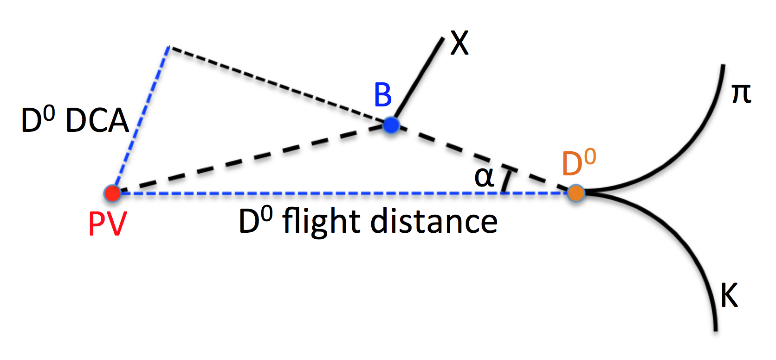
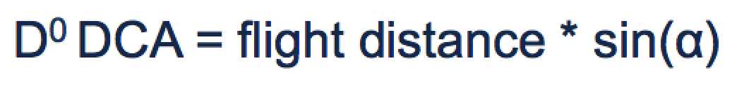
Non-prompt D⁰ fraction
D⁰ DCA distinguish prompt and non-prompt

Slide 45
Non-prompt D⁰ fraction
D⁰ DCA distinguish prompt and non-prompt

Slide 46
Non-prompt D⁰ fraction
D⁰ DCA distinguish prompt and non-prompt

Slide 47
D⁰ correlation with charged hadron
N_{trk}^{offline} < 35
185 < N_{trk}^{offline} < 250
|M_{inv}- M_{D0}| < 0.4 GeV

Slide 48
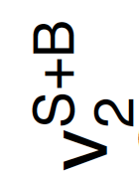
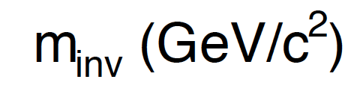
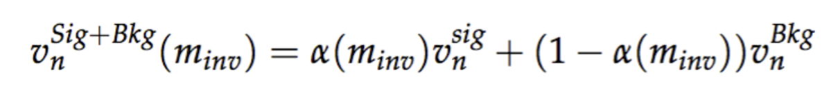
D⁰ signal v₂ extraction

Slide 49
D⁰ signal v₂ extraction

Slide 50
Strange and charm hadron v₂
CMS-PAS-HIN-17-003
Mass ordering at low p_{T}

Slide 51
Strange and charm hadron v₂
CMS-PAS-HIN-17-003
Mass ordering at low p_{T}, hold for multi-strange hadrons

Slide 52
Strange and charm hadron v₂
CMS-PAS-HIN-17-003
Significant v₂ signal, follow mass ordering at low p_{T}
D⁰ share the common velocity field

Slide 53
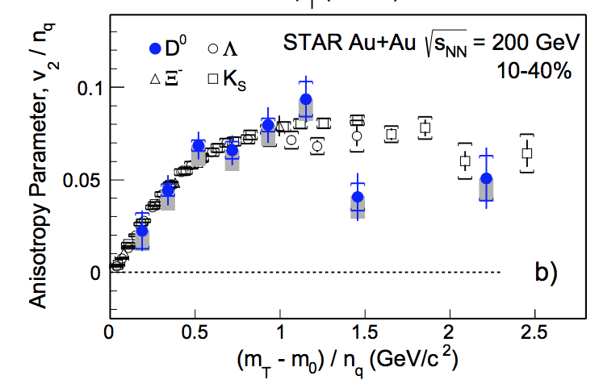
Number of constituent quark scaling
Flowing medium at some stage consists of constituent quarks

Slide 54
Number of constituent quark scaling
CMS-PAS-HIN-17-003
NCQ scaling holds for strange hadrons.

Slide 55
Number of constituent quark scaling
CMS-PAS-HIN-17-003
NCQ scaling holds for strange hadrons. Except Ω? How about ϕ?

Slide 56
Number of constituent quark scaling
CMS-PAS-HIN-17-003
NCQ scaling holds for strange hadrons. Except Ω? How about ϕ?
D⁰ results significantly lower

Slide 57

Number of constituent quark scaling
CMS-PAS-HIN-17-003
pPb
PbPb
NCQ scaling holds for strange hadrons. Except Ω? How about ϕ?
D⁰ results significantly lower
Different than observation in PbPb

Slide 58
Number of constituent quark scaling
CMS-PAS-HIN-17-003
pPb
PbPb
In hydro-QGP picture:
Charm quark shows less collectivity in pPb
Due to small system size and different mean free path?
Look forward to see interpretation in CGC picture

Slide 59
Summary
New results of D⁰ meson flow in high-multiplicity pPb
Indication of charm quark – medium interaction observed
Weaker collective behavior for charm than for light quarks
Different than large system
CMS-PAS-HIN-17-003

Slide 60
Outlook
Confirmation of charm collectivity with multi-particle correlation

Slide 61
Outlook
Confirmation of charm collectivity with multi-particle correlation
J/ψ (hidden charm) flow

Slide 62
Outlook
Confirmation of charm collectivity with multi-particle correlation
J/ψ (hidden charm) flow
Naïve extrapolation to J/ψ upper limit:
v₂(J/ψ) / 2 = v₂(D⁰) – v₂(K⁰_{S}) / 2
v₂(c) = v₂(c+u) – v₂(u)

Slide 63
Outlook
Confirmation of charm collectivity with multi-particle correlation
J/ψ (hidden charm) flow
Naïve extrapolation to J/ψ upper limit:
v₂(J/ψ) / 2 = v₂(D⁰) – v₂(K⁰_{S}) / 2
v₂(c) = v₂(c+u) – v₂(u)

Slide 64
Outlook
Confirmation of charm collectivity with multi-particle correlation
J/ψ (hidden charm) flow – Stay tuned
Naïve extrapolation to J/ψ upper limit:
v₂(J/ψ) / 2 = v₂(D⁰) – v₂(K⁰_{S}) / 2
v₂(c) = v₂(c+u) – v₂(u)

Slide 65
Back up

Slide 66
Back up

Slide 67
Back up

