Slide 1

Frank in ATLAS
Frank E. Page Memorial Symposium
Brookhaven National Laboratory
May 2, 2018
Peter Loch
Department of Physics
University of Arizona
Notes:
When I was asked to speak at this symposium, I felt very honored. But then I realized that the majority of Frank’s contribution to jet reconstruction and calibration in the ATLAS experiment at the LHC is characterized by what seems to be rather low level work, with little potential for recognition and famous publications. And there was nothing obvious to highlight, it seems. This seems to be a little unusual for a well-recognized theorist.
We were all aware at that time (the early 2000’s) we needed all the help we could get – most of us were very busy still building, testing and commissioning detectors, and designing a reconstruction and simulation software framework. We had little time to think about new approaches for jet calibration, even though rough ideas and plans were around. So any offer to help was very welcomed. And we sensed quickly that Frank’s motivation to get involved was driven by his interest in SUSY – he understood the need for well-measured jets and particles emerging in the long decay chains of these models.
With some respect it took me until the preparation of this presentation that I realized that Frank’s implementations, while not directly used anymore since some time, laid the foundation of the success story in experimental jet reconstruction in ATLAS. It is therefore more than appropriate to reflect on his work in this domain one more time, and with some respect let his work shame us experimentalists again, one more time.
Frank’s most important contributions are a bit technical – sorry – and, in addition, restricted to internal ATLAS use – per experiment policy. I hope the brief selection I show today, which cannot be more than a snapshot anyway , gives you some insight into the importance of his work for ATLAS.

Slide 2

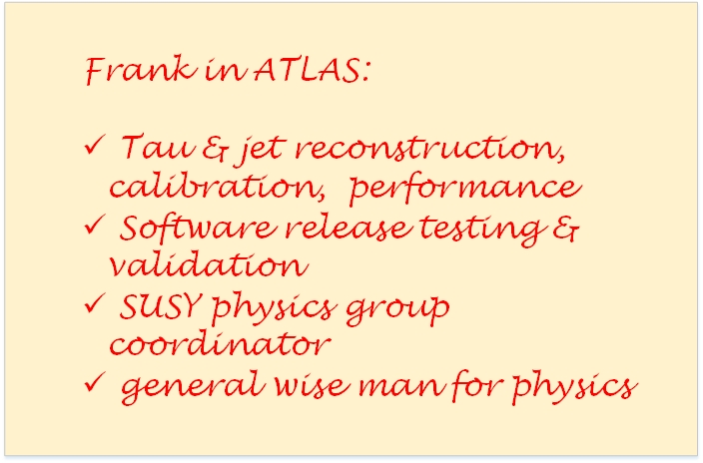
Notes:
Frank contributed to several domains in ATLAS, from signal reconstruction and software validation to physics analysis. Here is a brief list of these domains. My remarks today are focused on the jet reconstruction and calibration, as here we had the most overlap in terms of activity and interest.

Slide 3
March 7, 2002
…the first contribution involving Frank in the electronic ATLAS archive !
Notes:
The very first trace of Frank in the electronic archive of ATLAS is from March 7, 2002. While I am pretty sure he contributed already earlier, this is the very first presentation that I found. While not yet working with jets, the content slide gives us a good summary of his contribution style:

Slide 4
physics motivation
Notes:
It indicate the physics motivation – Frank’s beloved SUSY.

Slide 5
detector employment & signal use
Notes:
In addition, it is no surprise today to find his name associated with the optimization of detector signals for the best possible physics performance at the time – which more recently has gained a lot of momentum in ATLAS with the somewhat refined implementation of particle flow, where calorimeter signals are combined with reconstructed charged tracks;

Slide 6
Software testing & validation
Notes:
Testing new software and software releases – one of his favorites, as I recall; with one release he discovered that the sum of all constituent energies in a reconstructed jet exceeded the total energy content of the universe, and helped today’s speaker to learn a lot about a certain programming language and the need for initial values for all variables in the code;

Slide 7
Collaboration with
experimentalists
Notes:
Collaboration with experimentalists – not restricted to the same institute, but always effective and productive – even though we sometimes had a hard time to listen to him … while he most certainly was much more patient with us experimentalists. The only times I saw him displaying any impatience were when it comes to computers, they were never fast enough.

Slide 8
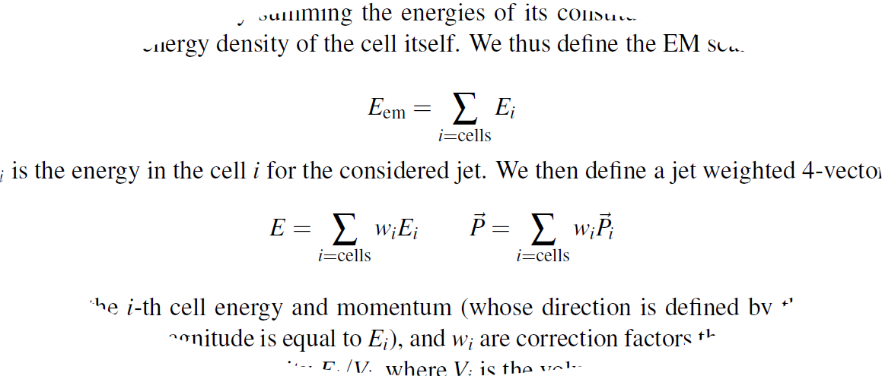
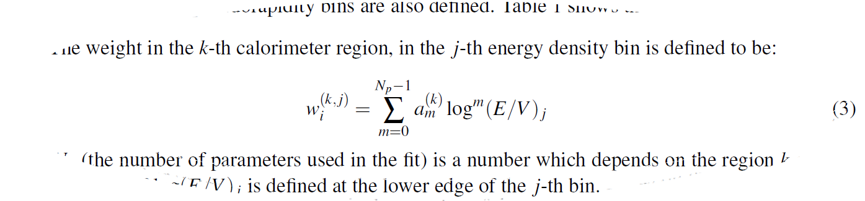
arXiv:0901.0512
Notes:
Frank most important impact in the early days of ATLAS was the development of a calorimeter cell signal weighting scheme addressing the differences in the calorimeter response between electromagnetic and hadronic interacting particles. This subject led to the most intense collaboration between him and myself, as I was one of the authors of the principal weighting scheme in the H1 experiment at HERA in the late 1980’s. He picked up from where we had to stop and adapted the scheme to jet reconstruction in a calorimeter operated at a hadron collider.
While the formula on top, which captures the basic reconstruction of the jet four-momentum, seems to be trivial, the determination of the weights is far from. Frank set up a completely new and much more stable numerical system to repeatedly determine these numbers for various jet algorithms and changing detector conditions.

Slide 9
Now used for local hadronic calibration of calorimeter cell clusters
arXiv:0901.0512
Notes:
And the principal approach lives on. It is not applied to the signals from calorimeter cells in jets anymore, as jets are now built from clusters of cells. Cell signal weighting is now applied in the context of these clusters. Yet, Frank took part in this transition and adapted his scheme for these clusters as well. It laid the foundation for the extensive jet and physics studies published in the famous yellow reports on the estimated performance of ATLAS in 2008.

Slide 10
Same functional form now used with different kinematic variables for overall smooth jet energy calibration functions in given bins of phase space!
arXiv:0901.0512
Notes:
The parametrization of the weights is original Frank. We still use the power sum of logarithms approach in today’s jet calibration in ATLAS to calculate calibration functions now applied to jets rather than cells. Again a seemingly straight forward ansatz but like most effective methods, somebody has to come up with it first.

Slide 11
And it worked very well, too!
arXiv:0901.0512
Notes:
Frank’s calibration worked very well for jets in several different final states in terms of jet signal linearity, jet signal uniformity, and jet energy resolution – all of which are important experimental aspects. He predicted that we can meet the required precision levels of order 1%. This certainly motivated and challenged us at the same time, as this kind of precision has not been reached before, at least not for all final states in collider experiments. Frank was certain we can get there once data arrived, and he understood early on that his method in its original implementation would show limitations once we get into higher luminosity regimes at the LHC. Nevertheless, his work laid the foundation for basically every jet calibration that followed.

Slide 12
Data arrived in 2010… and Frank changed focus!
Eur.Phys.J. C73 (2013) no.3, 2304
Notes:
And once physics data arrived in 2010, Frank shifted his focus on the validation of the initially applied jet calibration, which has largely been derived from simulations, with experimental data.

Slide 13
Data arrived in 2010… and Frank changed focus!
How to validate simulation derived jet calibrations with data?
Notes:
He focused on exploiting the idea of two very different measurements of the jet transverse momentum.

Slide 14
Data arrived in 2010… and Frank changed focus!
Eur.Phys.J. C73 (2013) no.3, 2304
How to validate simulation derived jet calibrations with data?
Notes:
One is rather complete from the ATLAS calorimeter, and one is based only on reconstructed charged particles from the inner detector.

Slide 15
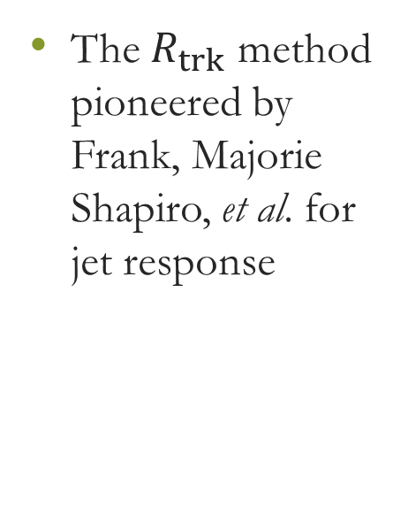
Data arrived in 2010… and Frank changed focus!
Eur.Phys.J. C73 (2013) no.3, 2304
The $R_{trk}$ method pioneered by Frank, Majorie Shapiro, et al. for jet response
Notes:
Together with mainly US collaborators including Majorie Shapiro from LBNL and Ariel Schwartzman from SLAC, among many others, Frank developed a method which relates the ratio of the transverse momentum of a jet measured with the ATLAS calorimeter to the transverse momentum carried by reconstructed tracks associated with this jet in data to the same ratio in simulations – a double ratio approach.

Slide 16
Eur.Phys.J. C73 (2013) no.3, 2304
Notes:
It worked very well for the transverse momentum in 2010. This approach is now standard procedure for all jet substructure measurements and jet mass calibration validation.

Slide 17
Recent contributions
Jet substructure for highly boosted jets – how to tag a possible 2(3)-prong decay inside the jet?
“Skinny jets” and cell-based jet mass – challenging structural measurements …
Notes:
Frank got interested in the question of how to measure a decay structure inside a jet when the decaying particle is significantly boosted? This is a tremendous experimental challenge due to the limitations in angular resolution in particular in the calorimeter.

Slide 18
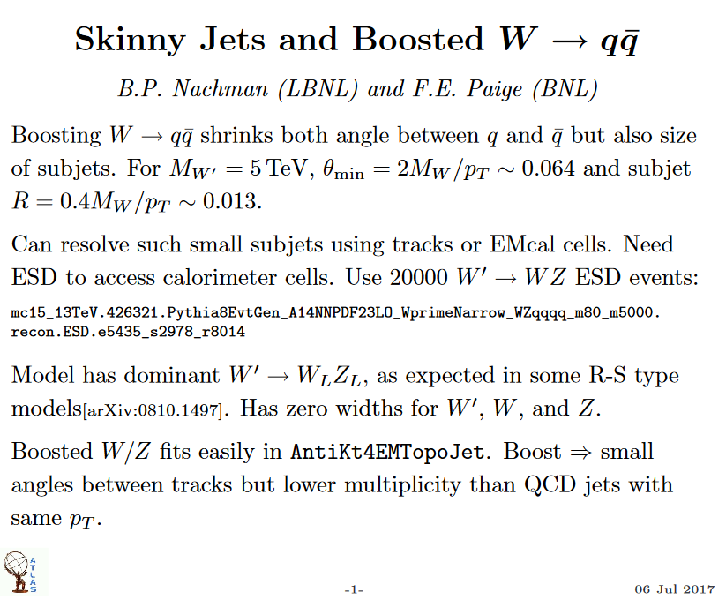
One of Frank’s final contributions…
Notes:
Unfortunately we do not have public results yet, but there is quite some activity in the study of observables that Frank helped to define – with his latest contribution from July 6, 2017

Slide 19
One of Frank’s final contributions…
EMBARGOED!
July
6, 2017
Notes:
Let me conclude with some more personal remarks. I believe with Frank’s passing we lost not only a very well recognized physicist with significant contributions to several theoretical and experimental topics, but also one of the last gentlemen in our field. Frank was a patient listener, and he always found time to talk to me and others – I made it quite a rule to visit him on every one of my frequent visits to the lab in my days as US ATLAS software coordinator. I will always remember the morning at CERN when I accidently met him for breakfast and he explained mSugra to me. While I may have forgotten details of the model, I enjoyed one of my most pleasant hours with physics, and a highly appreciated break in my otherwise very busy day.
I think I can say that the jet performance community within ATLAS – and therefore all of ATLAS – lost a very important and productive collaborator who a bit unexpectedly advanced experimental techniques for the long term operations at the LHC.
Rest in peace, Frank!

