Slide 1


Archival Storage at
Overview
Feb 15th, 2018

Slide 2
What is HPSS?
High Performance Storage System
High Performance Storage System (HPSS) is a flexible, scalable, policy-based Hierarchical Storage Management product developed by IBM in collaboration with various DOE National Labs. It provides scalable hierarchical storage management (HSM), archive, and file system services using cluster, LAN and SAN technologies to aggregate the capacity and performance of many computers, disks, disk systems, tape drives and tape libraries.
http://www.hpss-collaboration.org/index.shtml
https://en.wikipedia.org/wiki/High_Performance_Storage_System#Architecture

Slide 3

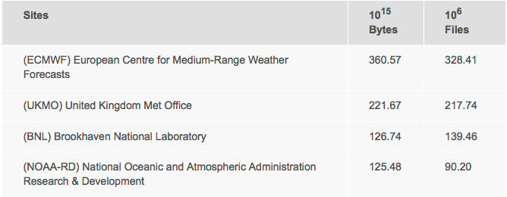
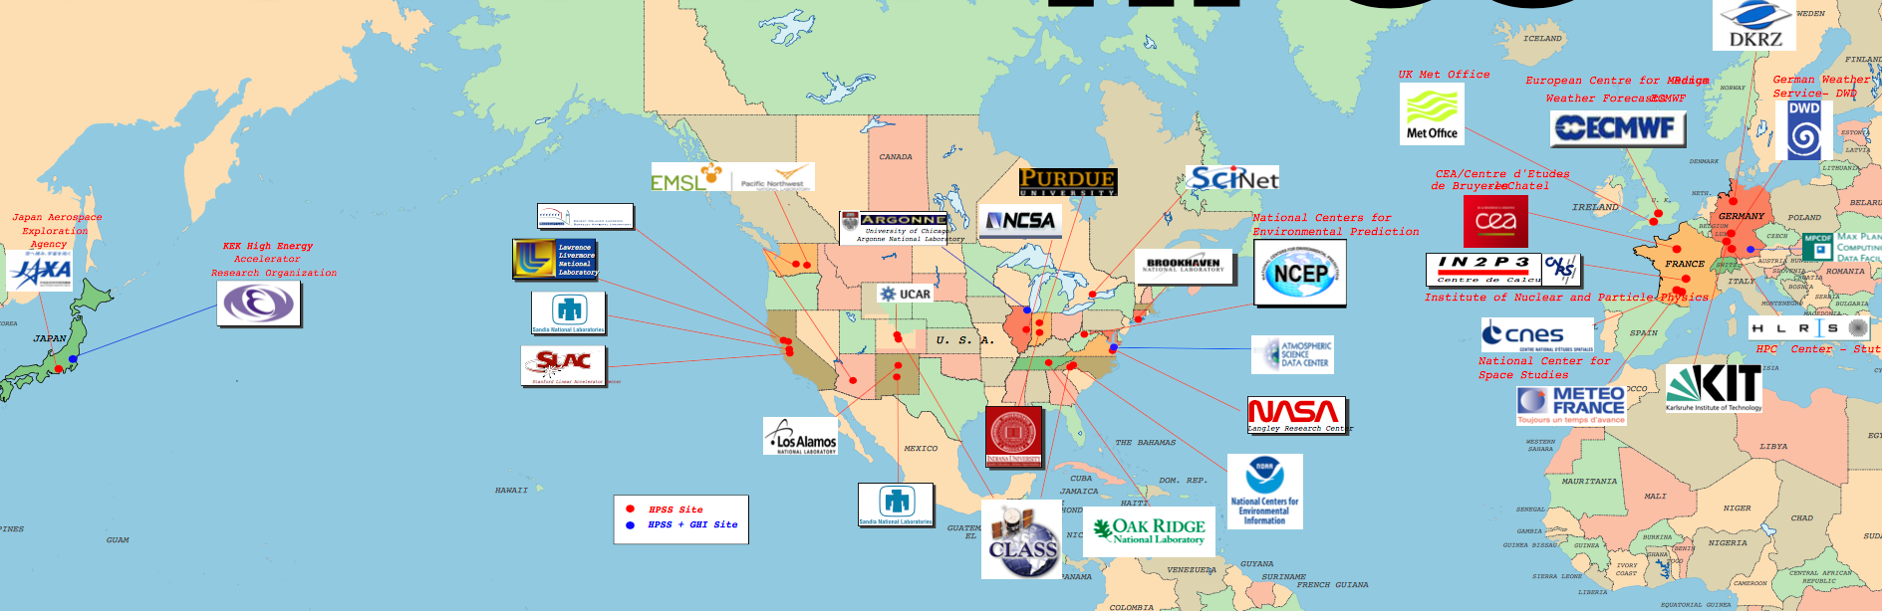
We are the largest HPSS site in US,
3rd in the world.
HPSS Users
United Kingdom
United Kingdom
United States
United States
http://www.hpss-collaboration.org/customersT.shtml

Slide 4
Archival Storage
  Provides permanent data storage for all RHIC experiment
    STAR, PHENIX,PHOBOS and BRAHMS
    RAW and DST
    User Data (No Personal data, no PII allowed)
  Archival storage for C-AD Operational Logger Data
  Serves as LHC ATLAS Tier-1 for the US
    Secondary data storage for fraction of data (~23%).
  Serves as Belle-2 Tier-1 (New)

Slide 5

  Scientific Data
    Exponential Growth
    Preserve for decades
    Non-compressible
Retention Policy
Current practice is to retain the
data, and the ability to retrieve
them indefinitely.

Slide 6
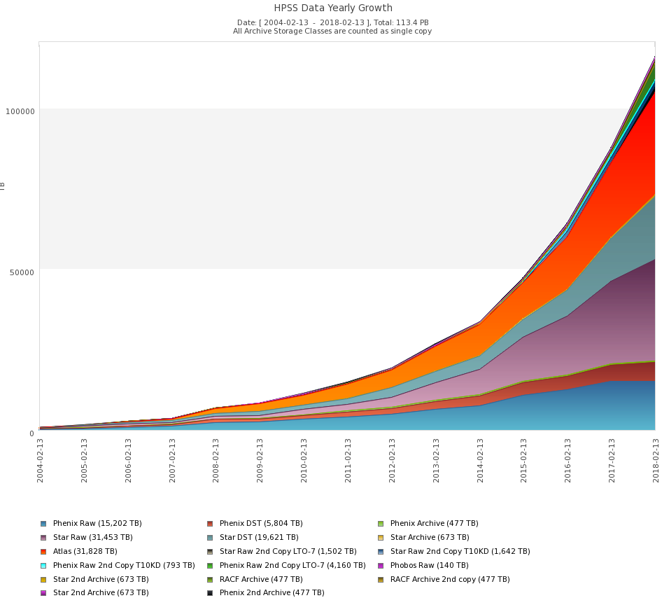
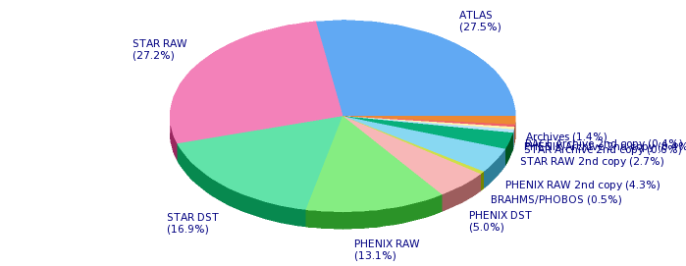
Archived Data (Tape)
~113.4 PB
30 PB ATLAS
2004-2
2018-2

Slide 7
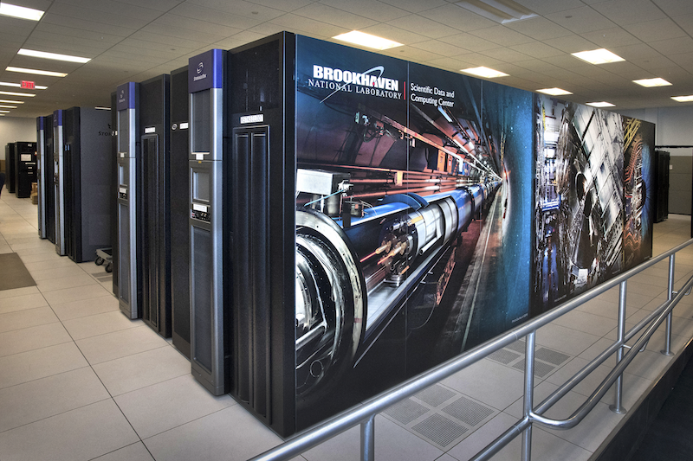
Mass Storage
TAPE
  9 x Oracle SL8500 (most of them are 10,088 slots)
  Latest Drive Technology: LTO-7 (6TB, 300 MB/s)
  Older drives and medias: LTO-4,5,6 and T10K-D
  Currently 113+ PB on 60K tape cartridges
  Use HPSS to manage our tape storage

Slide 8
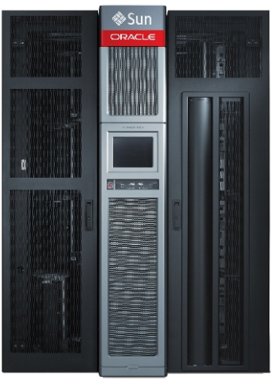

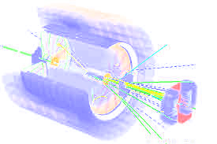



High Throughput Data Archiving
RHIC Experiment data directly go to tape storage (primary)
RHIC detectors:
Disk cache
STAR
Detector
PHENIX
Detector
Notes:
8
8

Slide 9
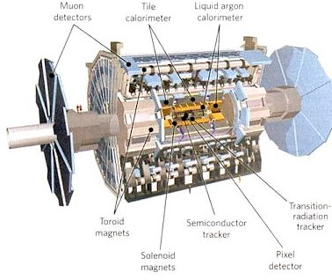
High Throughput Data Archiving
ATLAS Experiment data goes to dCache and then send to tape storage.
Disk cache
dCache
Notes:
9
9

Slide 10

High Throughput Data Archiving
Retrieving data on demand
dCache
CRS
Data Carousel
BNLBox
Disk cache
Data processing
Notes:
10
10

Slide 11

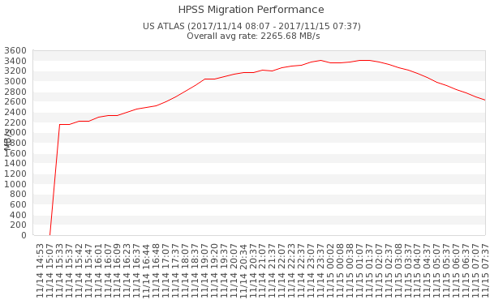
Tape Storage – Archive Performance
2.8 GB/s
ATLAS 2017
Data Taking
Tape write peak: 3.4 GB/s
Tape write avg: 2.8 GB/s
Sample: Nov 14, 2017

Slide 12
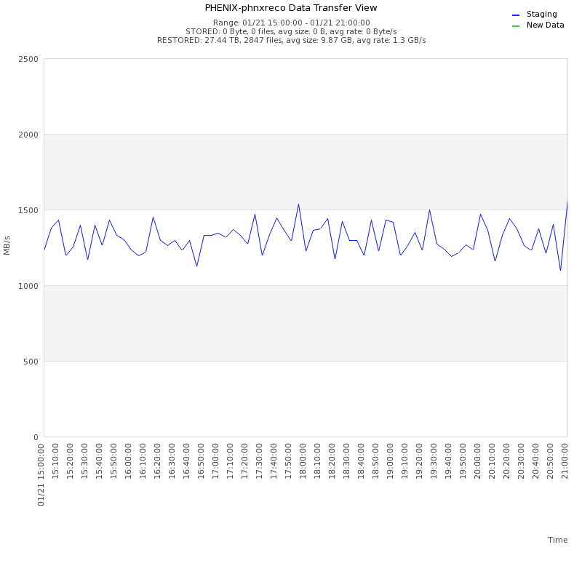

Tape Storage – Recall Performance
PHENIX
Restored 406 TB from LTO-5 Media
Sample: Jan 18 - 22
42,196 files requested
Average file size: 10 GB
Destination disk limit: <1.5 GB/s
Need to adjust staging drives, to keep @ <1.5 GB/s
15:00 – 21:00 sample: 1.3 GB/s
LTO-5 max speed: 140 MB/s
1.3 / 10 Drives = 132 MB/s/drive
All overheads included
(mount/dismount, seek … )

Slide 13
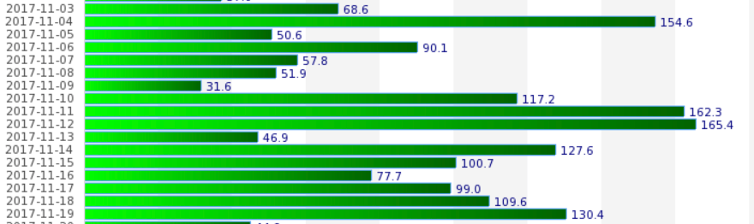
High Throughput Data Archiving
ATLAS
Max Archive: 165.4 TB/day
Max Recall: 200 TB/day

Slide 14
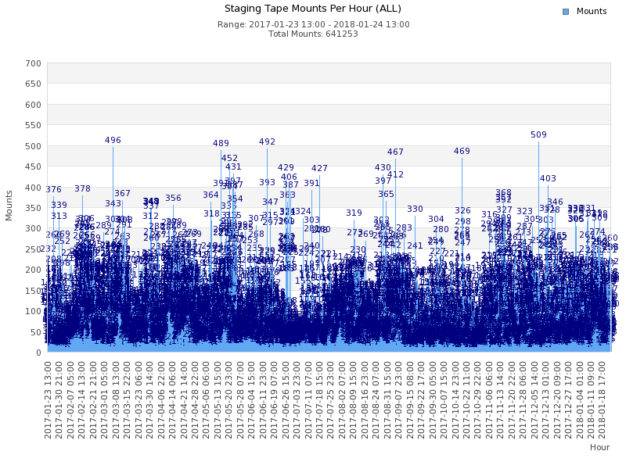
High Throughput Data Archiving
24x7 Data Access
Hourly tape mounts in 2017

Slide 15
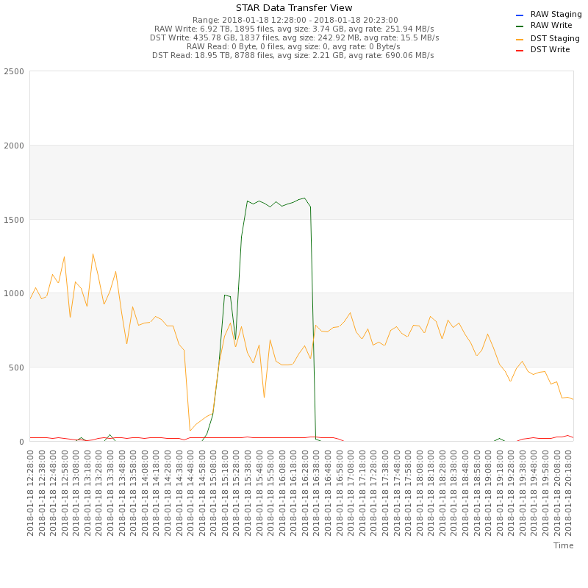
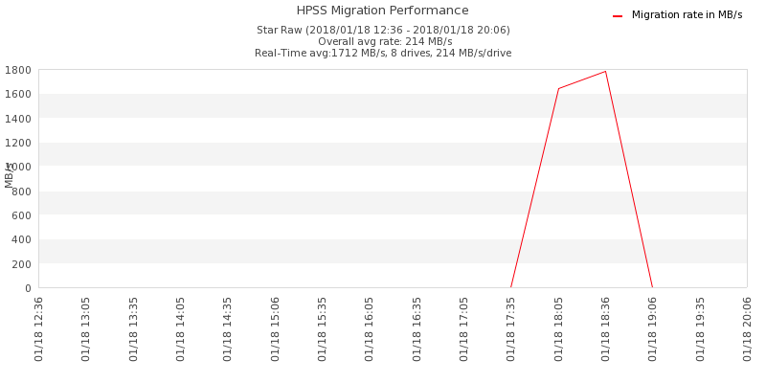
RHIC Run 18 Mock Data Challenge
Expect same data throughput and volume like 2017
The 1.5 hours MDC test went successfully.
Demonstrated full production service: data taking and normal staging at the same time.
Data injection stayed sustain at 1.6 GB/s for ~1.5 hours. Received ~7 TB in total, 1895 files, average file size 3.7 GB.
LTO-7 max speed: 300 MB/s
Migration was able to do average 1.7 GB/s, or 214 MB/s/drive; also took ~1.5 hours to complete.

Slide 16
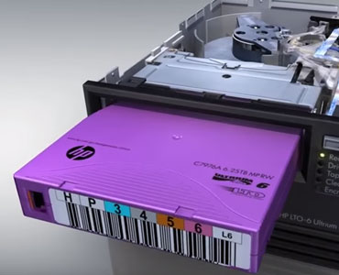

Tape Storage - Usage
Tape Usages
In 2017
Archived to tape:
  19,412,702 files – Average 53,185 files/day
  20.8 PB – Average 58.4 TB / day
20.8 PB
Restored from tape:
  11,693,141 files - Average 32,036 files/day,
  24.8 PB - Average 69.5 TB/day
24.8 PB

Slide 17
Capacity
Tape Capacity
Over 32,000 slots available
LTO-7: 6 TB, 194 PB
LTO-8: 12 TB, 388 PB
After 2020
LTO-9: 24 TB

Slide 18
Conclusions
Conclusions
We have implemented an active tape-storage data archive currently holding 100+ PB of scientific data and serving scientists from multiple collaborations worldwide
The archive and the underlying tape storage complex are managed in a very efficient way by a suite of in-house developed optimization and monitoring tools
The data archive volume can grow virtually unlimited, with the addition of relevant tape storage resources (media, libraries and tape drives)
Tape is still the leader in cost per GB and power efficiency. The implementation concept is based on the most cost-effective and energy efficient (green) memory model available today
Notes:
18
18

Slide 19

Technology Meeting?
We can have further discussion if necessary…
Why use Tape?
  Reliability, life expectancy, cost…
  Advantages and Disadvantages
In-house tape storage VS Cloud
The future of archival storages
dyu@bnl.gov
Notes:
19
19

Slide 20


