Slide 1
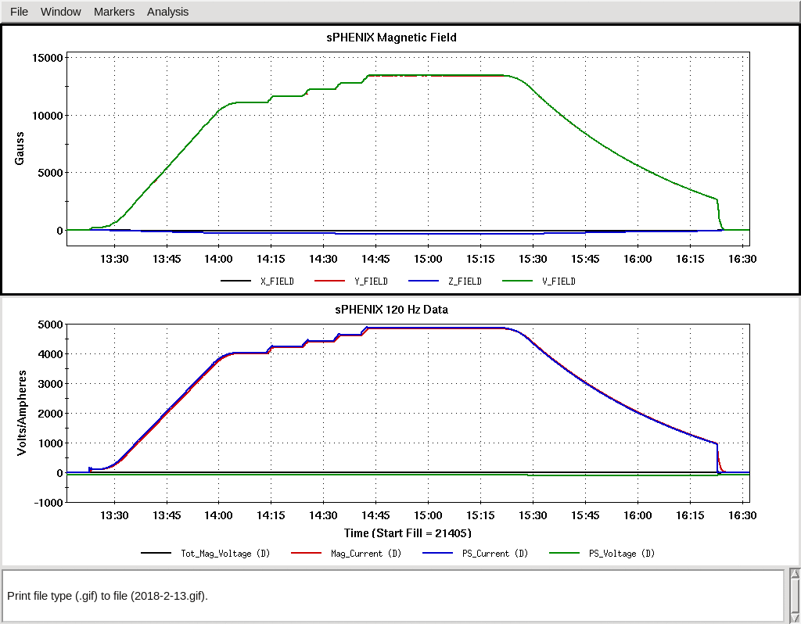
Meeting page: https://indico.bnl.gov/conferenceDisplay.py?confId=4273
Status/Plan :
We reached ~4830 A yesterday (with 2A/s).
What’s next ? To stay at
4600 or 4830 A for a longer
period … and then tried a
fast discharge at the end ?
And then tried again on another day after the fast discharge ?

Slide 2
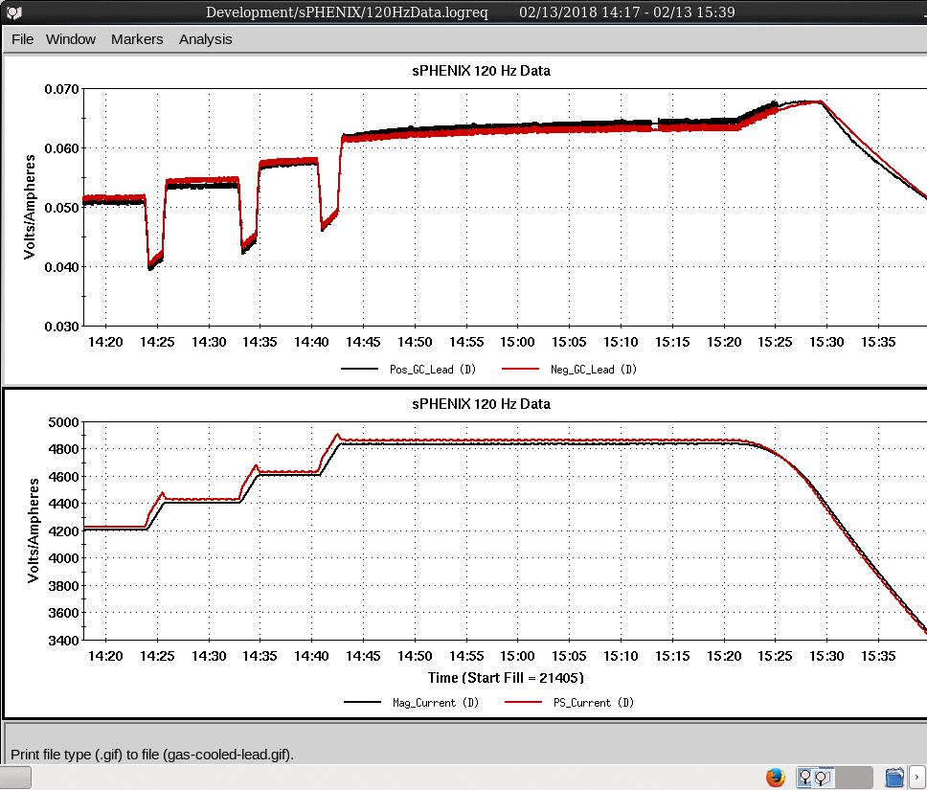
We probably want to watch the gas-cooled lead and flow rate a bit …

