Slide 1
Meeting page: https://indico.bnl.gov/conferenceDisplay.py?confId=4307
Making sense of Strain Gauges (a little analysis)
Now, as the High Field Test is over, there are things we need to think about …
Keeping vacuum at least until the Magnet is warmed up … but do we keep on vacuuming after that ?
Do we want to loosen the jack ?
⇒ Carl Schultheiss’ slides
Remember to purchase better flow controller at the Current Leads that can deal with lower pressure.
Do we want to think about fixing VT10/VT11 ?

Slide 2
Trying to make sense of strain gauge …
On Feb. 5, soon after the intentional fast discharge at 2000 A. Most strain gauges were screwed ( volt/resistance close to 0 ) as there was a short developed.
This was not the first time (and each time it could be a different channel). Per Paul’s suggestion, we switched to just measuring the resistance across the strain gauge (2-wire), without using the constant current source to measure voltage/resistance (4-wire).
We unplugged the current (flow) wires to avoid the short.
But in this method, we’re sensitive to the cable/wire resistance between strain gauge and the readout. I actually asked Winston to put a hack (subtracting a 7.5 Ω for all connections) to make the strain measured not too big.
In any case, our thinking was that since we’re interested in the change of strain between 0 A to top current, we only care about its relative change during the ramp, assuming the temperature fluctuation during the ramp was minimal.

Slide 4
Stress = strain × Young’s modulus in the linear-elastic region
Young’s modulus ~ 200 GPa or ~29007 ksi for Inconel 718
Yield ~1.1 GPa and Tensile Strength (Ultimate) ~ 1.375 GPa
Force ~ stress × σ (Tie-Rod)
typically σ (Tie-Rod) ~ 200 mm² from BaBar documents
Anything that I wrote below can easily have 10% uncertainty.
Feb. 5, 2018 (when we still had the 4-wire implementation --- more precise/absolute) : ramping to 2000 A
~Biggest change @ strain-gauge 19 (TS21)
See picture (next page)
-0.00003 → 0.00005 ~0.00008 ⇒ stress ~16 MPa

Slide 5
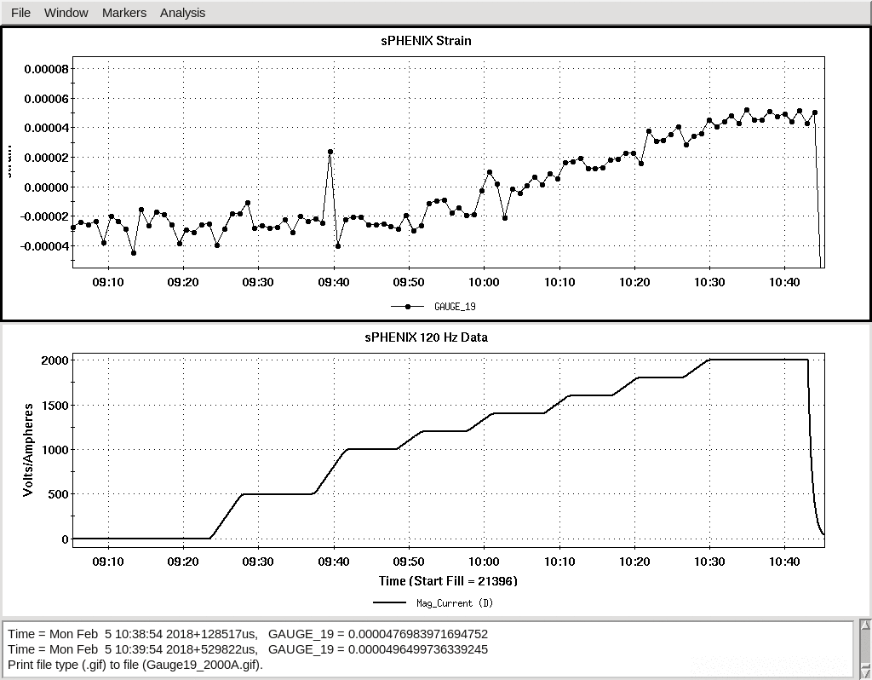
Feb. 5: TS21 (more precise with constant current source)
Magnet Current

Slide 6
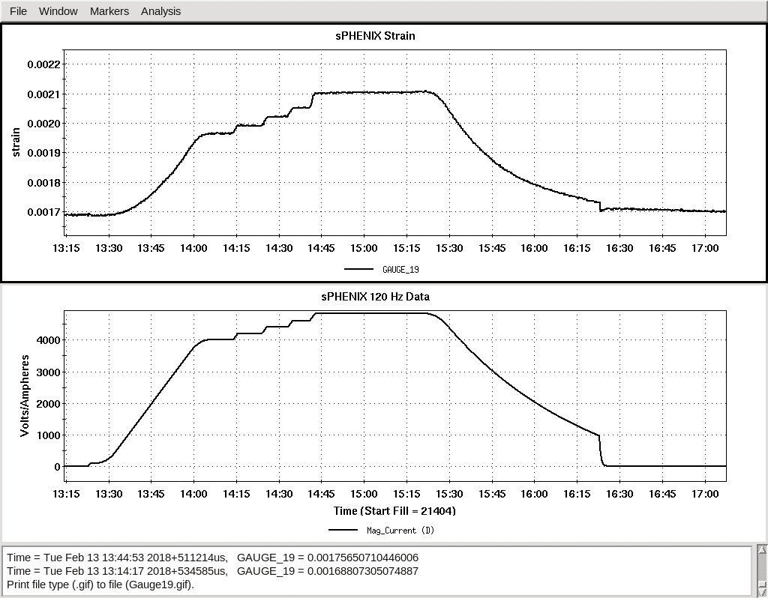
Feb. 13, 2018 (when we only had the 2-wire implementation to measure the resistance --- less precise and only good for relative measurement) : ramping to 4830 A
`
Feb. 13: TS21 (only good for relative measurement)
Magnet Current

Slide 7
Feb. 13, 2018 (only good for relative measurements) :
TS21: 0.0016876 → 0.0021046 ⇒ change of ~0.00042 ⇒ stress ~83 MPa
At 2000A : 0.0016876 → 0.0017602 ⇒ change of ~0.000073
which is not too different from ~0.00008 measured on Feb. 5, 2018.
Force ∝ stress and Force ∝ I² -------- *
0.00042(±10%) / 0.000073(±10%) ~ 5.75 ± 0.81
(4830 A/2000 A)² ~ 5.83
The above-mentioned relations (*) are verified ☺
TS21 is axial.
How about radial ? For a good example, ⇒ TS08 (See next page)

Slide 8
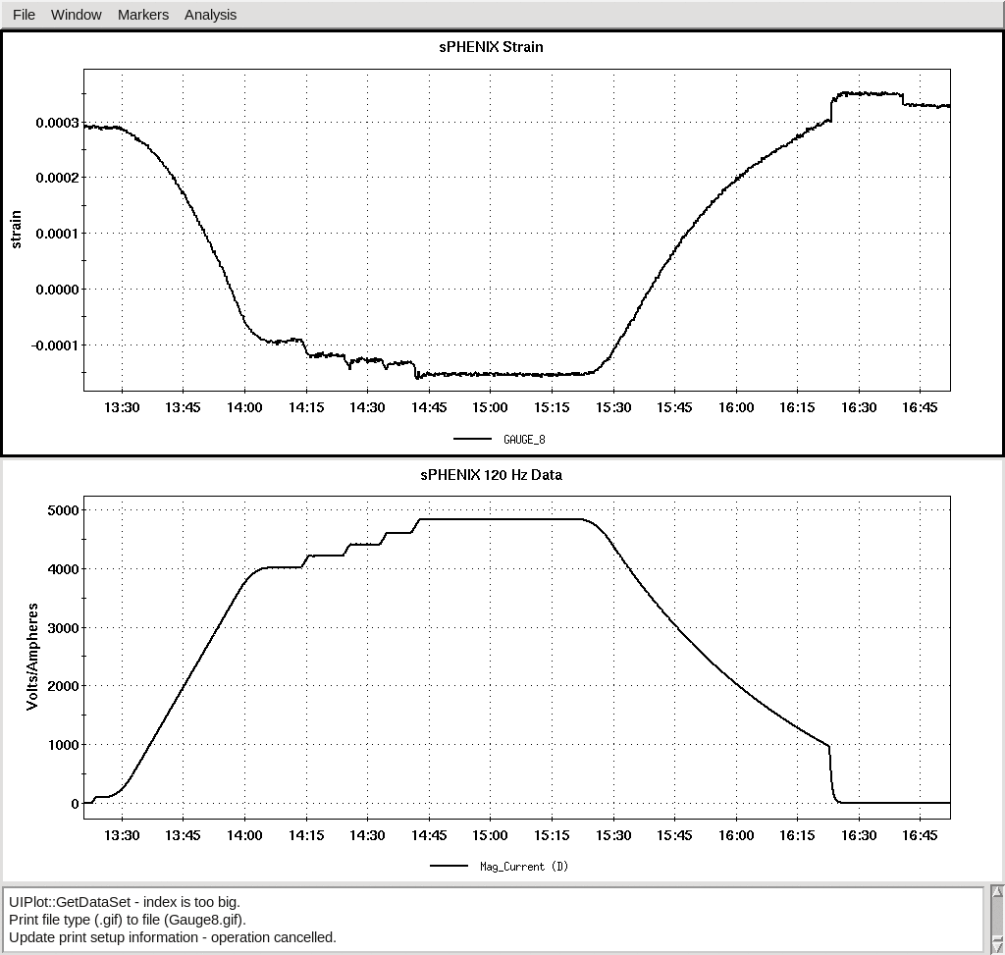
Also on Feb. 13, 2018, similarly for TS08
TS08: 0.000290 → −0.000155 ⇒ change of ~0.000445 ⇒ ~89 MPa
TS08 (only good for relative measurement)
Magnet Current

