Slide 1
Simulation tools
and eRHIC detector geometry
for EIC VMP studies
Alexander Kiselev
“GPD studies with exclusive mesons at EIC” Workshop
Stony Brook University June,4-6 2018

Slide 2
Outline
BeAST main detector geometry and modeling tools
eRHIC Interaction Region (IR) modeling environment ...
... and a couple of selected results
Outlook

Slide 3
EicRoot framework in one slide
Interface to GEANT, ROOT, …
FairBase
PandaRoot
FopiRoot
“Ideal” track finder,
Interface to GenFit
…
TPC R&D stuff, …
EicRoot
CbmRoot
eic-smear
MC generated evts import
Fast smearing codes
RICH stuff
solenoid
modeling
IR design
configuration

Slide 4
Available functionality
Flexible MC event import
Various generator ASCII output files (MILOU, PYTHIA, ...), binary formats: (TPythia, ...)
Vertex smearing, kinematics adjustment (22mrad crossing angle), ...
Modular geometry
Reasonably good track reconstruction ...
... and much less functional calorimetry codes
Several advances in the IR description
Main detector and forward-acceptance detectors are treated at once
Recoil proton goes to B0 silicon tracker or to the RPs
Scattered electron (& say π⁺π⁻ pair) - to the main detector

Slide 5
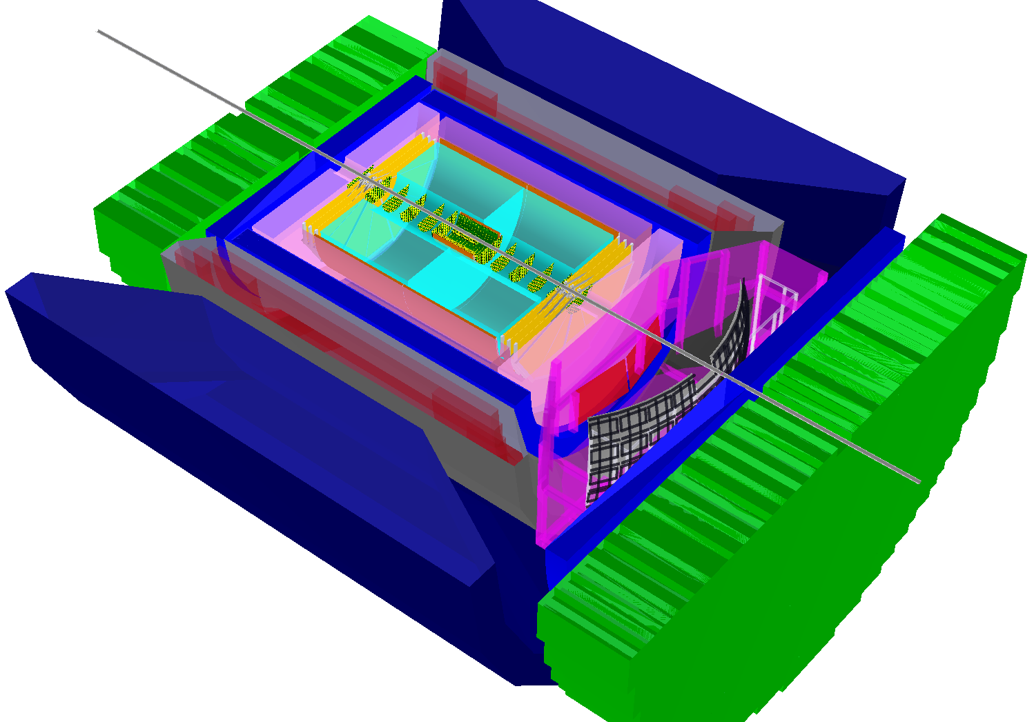
BeAST model detector in EicRoot
-3.5 < η < 3.5: Tracking & e/m Calorimetry (hermetic coverage)
hadronic calorimeters
e/m calorimeters
RICH detectors
up to 9.0m
Momentum resolution
hadrons
electrons
silicon trackers
TPC
GEM trackers
Micromegas barrels
3T solenoid cryostat
magnet yoke
An update incorporating IR vacuum system design is in progress

Slide 6
Simulation usage options
1) Download & compile EicRoot from scratch
2) Download pre-packaged EicRoot Docker container
simulation
digitization
reconstruction
PID; assembly
-> MC points
-> Hits
-> Tracks, clusters
-> Events
3) Wait until “EIC Sandbox” framework grand-unification environment is set up
-> first version as early as June this year?
4) Use EIC smearing generator package (eic-smear) instead?

Slide 7
EIC smearing generator
“Smearer” defines some element of performance
+ acceptance
Built-in standard smearers provided with eic-smear
Users can define own smearers using inheritance
Smearer
“Detector”
NOT a “physical detector”:
represents the overall performance in measuring a quantity.
Smearer
Apply all smearers to an MC event
Yield smeared event
Optionally recalculate derived values e.g x, Q²
Smearer
Smearer
Smearer
Think of it as a parametric filter, which acts on imported MC events

Slide 8
EIC smearing generator
Easy to install & use
No external dependencies other than ROOT
ASCII generator file import is readily available
The main idea: once detector acceptance regions and resolutions of kinematic variables are determined via complete GEANT simulation & subsequent reconstruction (by somebody else), for rough basic estimates it may suffice to use a collection of “parameterized detectors” rather than running the full simulations

Slide 9
EIC smearing generator
MC generator
ASCII output
Tree code:
Build ROOT tree containing events
Smearer:
Perform fast detector smearing
PYTHIA
DPMJet
Large number
of EIC Monte
Carlo generators
with standard
ASCII format
PEPSI
Milou
gmc_trans
Rapgap
LEPTO
Djangoh
NB: both event import and smearing functionality is supported in EicRoot

Slide 10
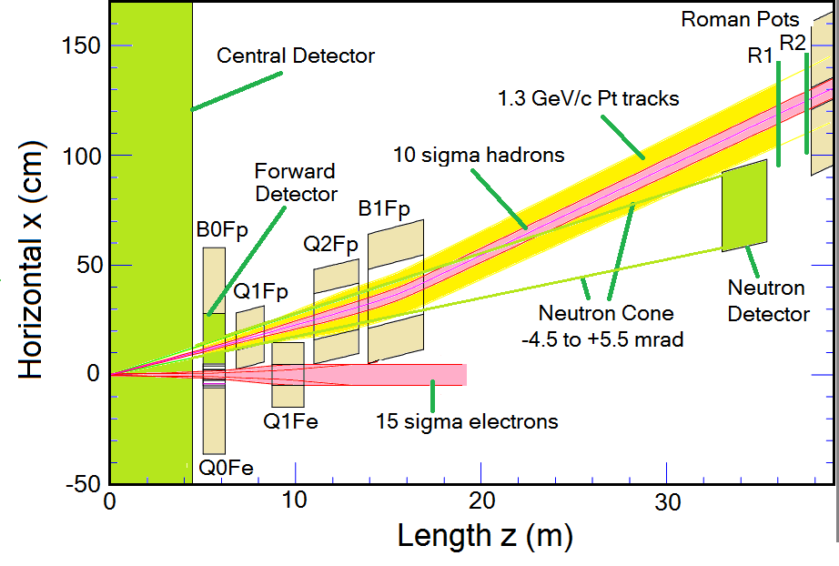
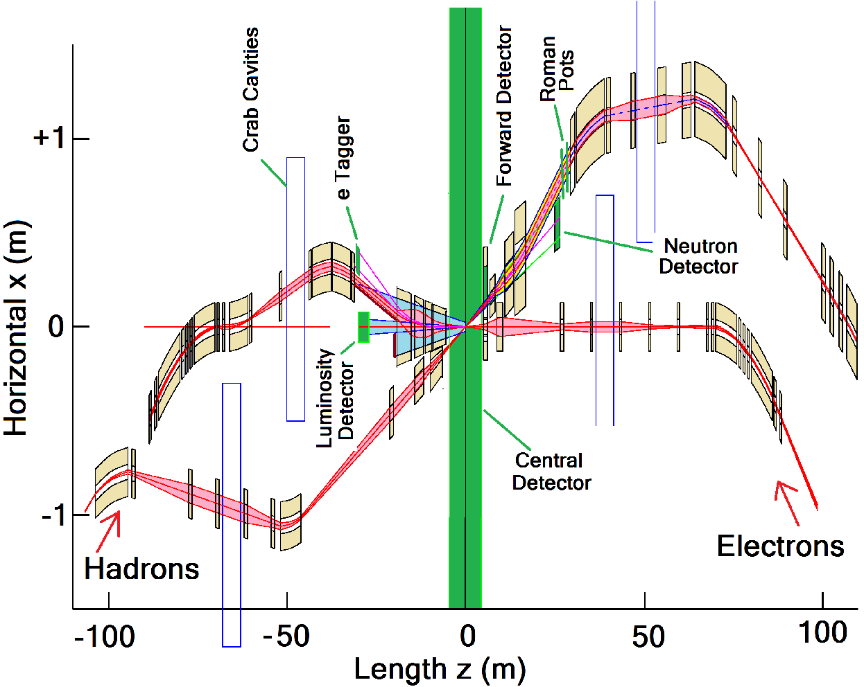
eRHIC IR hadron-going direction
Back to the full GEANT simulations
Will focus on B0 magnet, RPs & ZDC

Slide 11
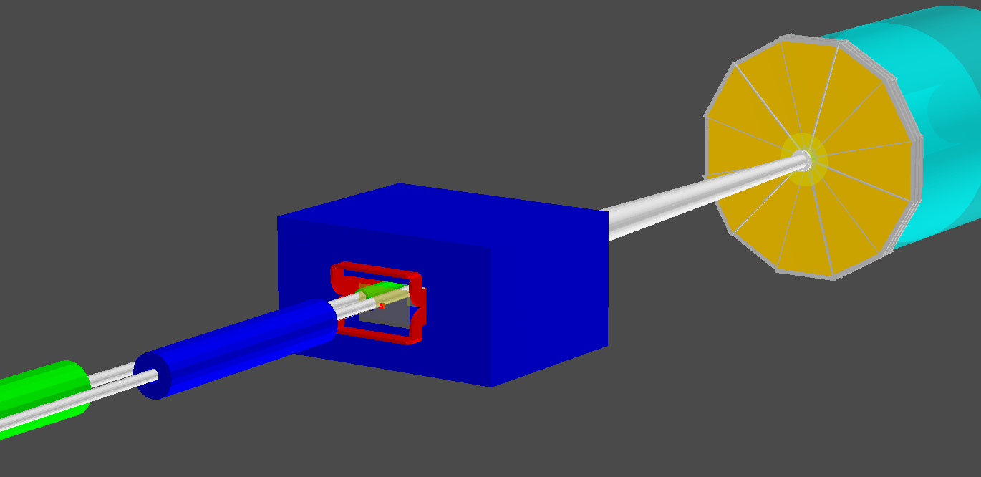
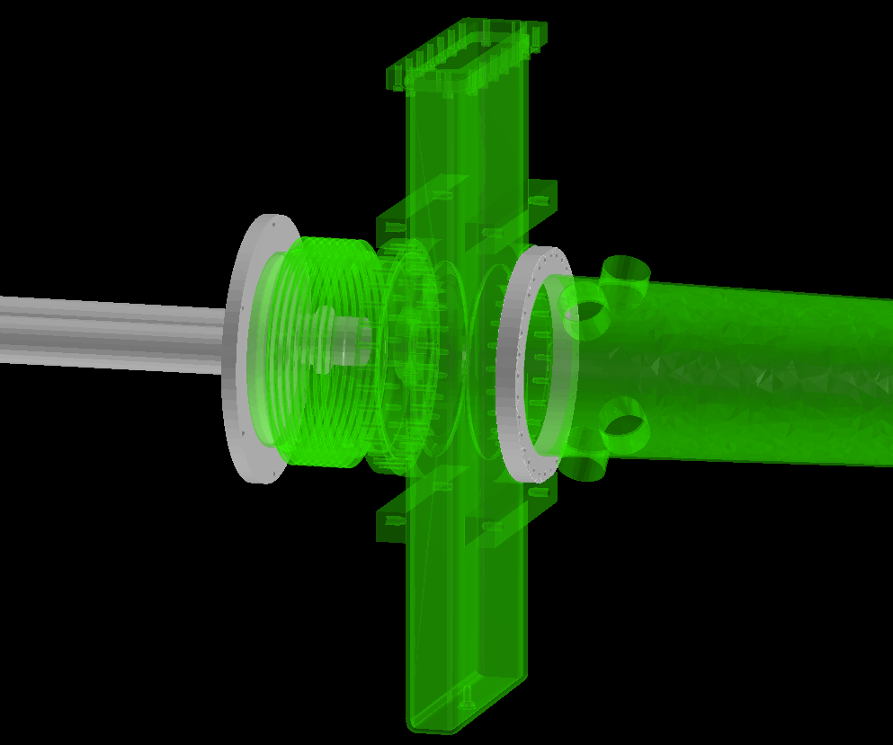
eRHIC IR simulation environment
Pump stand “ghost” volume
B0
e
Main tracker
Q2E
Q1H
B0 Si tracker
ROOT event display
p
Beam line element apertures and magnetic fields (.madx files)
Vacuum system engineering drawings (ground CAD .stp import)
Either boolean decomposition or STL->tetrahedrons dump or just a “ghost” shape
B0 large-acceptance dipole design (COMSOL .mphtxt import)

Slide 12
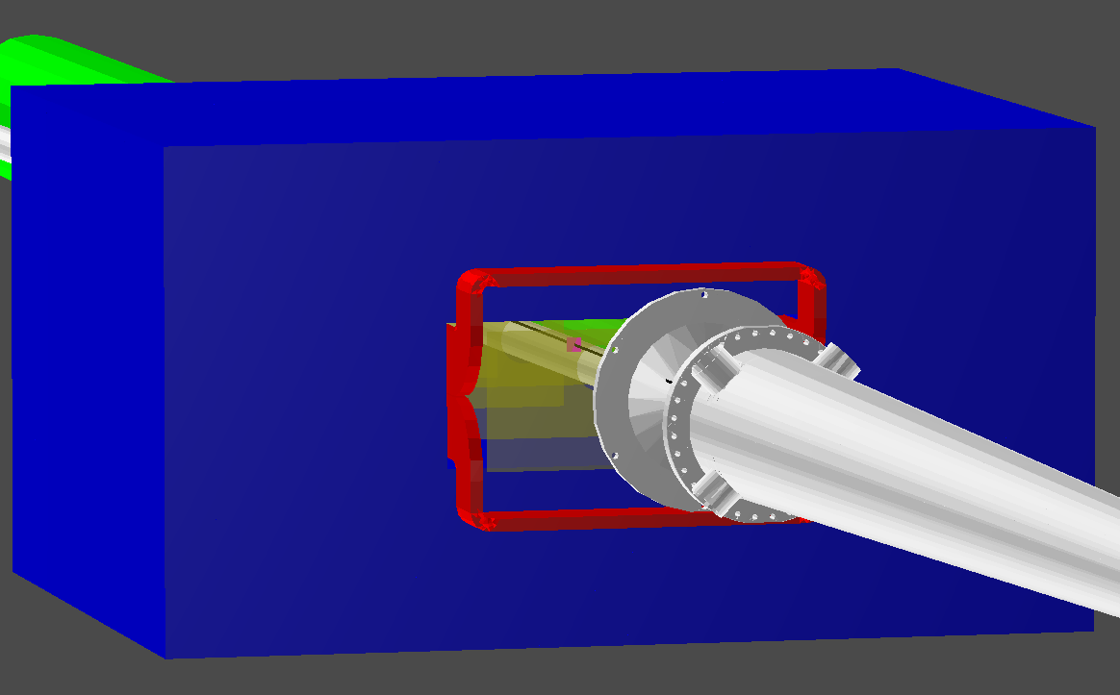
P_{t} acceptance for DVCS protons
275 x 18 GeV
Plots: HD (high divergence) case
~10σ away from beam line
Q2E
RP
20mrad vacuum pipe
B0 Si tracker
100 x 10 GeV
p
first quad aperture & beam pipe
B0
vacuum chamber exit window
41 x 5 GeV
Gap between RP and B0 will be further optimized
Low-P_{t} part can be filled in with HA-running
vacuum system ~20mrad cone
B0
achieve at least 0.3 GeV < p_{t} < 1.3 GeV range

Slide 13
Angular acceptance for charged tracks
~[ 0 .. 5] mrad: Roman Pots
~[ 5 .. 7] mrad: “gray zone”
~[ 7 .. 20] mrad: B0 forward large-acceptance spectrometer
~[20 .. 50] mrad: “gray zone”
From ~50 mrad or so (η ~ 3.5): main tracker

Slide 14
P_{t} resolution for recoil protons
B0 magnet [100 GeV/c beam energy @ p_{t} ~ 1.3 GeV/c (worst case)]
(~1.3T field, ~1.2m long; 4 Si stations with ~20μm resolution; Kalman fllter)
~30 MeV/c without IP vertex constraint
~15 MeV/c with reasonable assumptions about beam envelope size at the IP
Roman Pots [275 GeV/c beam energy]
(2 stations ~30m from IP, 20cm apart, ~20μm resolution; matrix transport)
~20 MeV/c at φ ~ 0 degrees (recoil in horizontal plane)
~10 MeV/c at φ ~ 90 degrees (recoil in vertical plane)
NB: these estimates do not include beam divergence at the IP

Slide 15
Angular acceptance for neutrons
B2A
ZDC
NB: here particles generated flat in θ
ZDC is handled as a “black hole” volume
Q3E
p
4mrad
B1
e
Q2H
ACCEPTED
Q2E
Q1H
B0
NB: space for ZDC needs to be increased for better hadronic shower containment
Main tracker
Achieve the 4 mrad acceptance requirement

Slide 16
Summary & Outlook
Main detector geometry and IR geometry bits a pieces (basic vacuum chamber blocks, quad & dipole volumes, simplified magnetic fields, etc) can be imported in a full GEANT environment and used at once ...
... otherwise smearing generator fast simulation tool is available
Recently the GEANT codes were used for eRHIC IR design validation
Eventually: use unique source of geometry & other input info for
Physics simulations
Detector performance benchmarks
Beam-gas machine background studies
Synchrotron background studies
Neutron flux and radiation dose estimates

