Slide 1



Quantum Chaos and Eigenstate Thermalization
Anatoli Polkovnikov, BU
L. D’Alessio Exa Corp.
M. Bukov BU
O. Howell BU
D. Huse Princeton
Y. Kafri Technion
M. Kolodrubetz UT Dallas
M. Rigol PennState
L. Santos Yeshiva
D. Sels BU
P. Weinberg BU
Quantum Entanglement at Collider Energies
Stony Brook, 09/10/2018

Slide 2



Details:
(2016)

Slide 3
Classical chaotic systems
Regular vs. chaotic motion: like beauty. When we see it we recognize it.
No mathematically rigorous definition of chaos.
Standard practical definition:
Divergent trajectories.

Slide 4
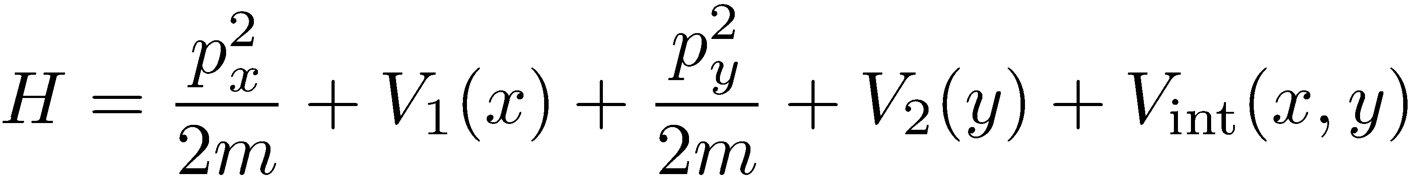
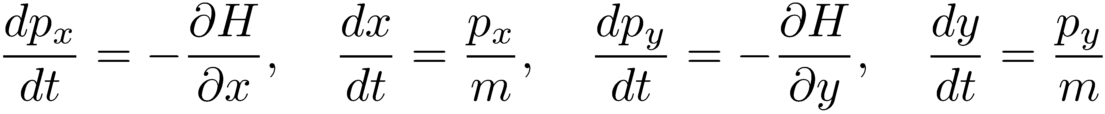
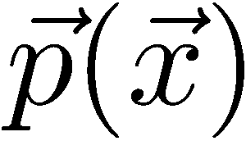
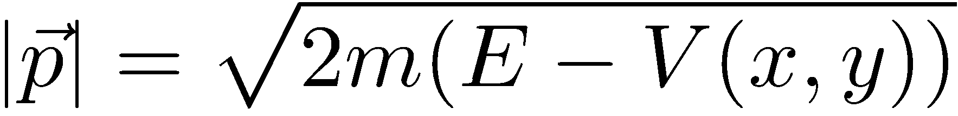
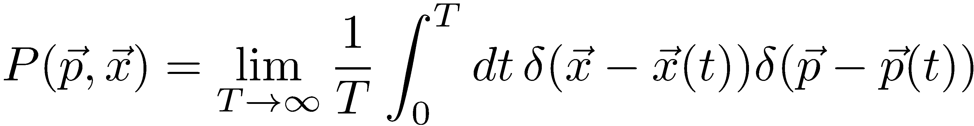
Chaos, ergodicity and determinism in classical systems
Two interacting particles (one particle in 2D)
No continuous symmetries (only energy is conserved)
Can define unique trajectories for a given initial condition
From energy conservation can not uniquely define
Can only define
What is the stationary probability distribution?

Slide 5
Chaos lead to ergodicity. No general proof, but a simple argument
For a given initial condition the energy is fixed
In the absence of conservation laws stationary distribution = microcanonical distribution. So chaotic motion must be ergodic.
Nature is a bit more creative. This story is overly simplistic, it ignores possibility of emergent conservation laws.

Slide 6
Example: Kapitza pendulum (motivated byparticle accelerators, 1951)
High frequency expansion: effective (Floquet) Hamiltonian
New emergent (quasi)energy conservation law preventing chaos at high frequencies

Slide 7
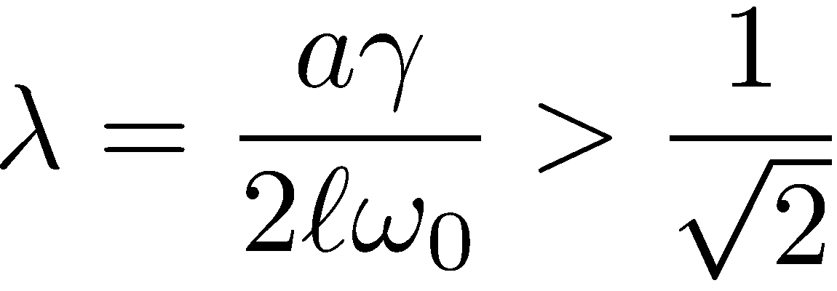
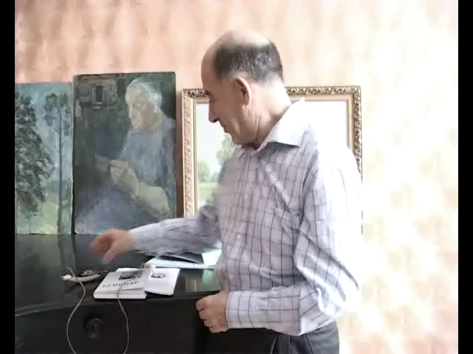
Stable inverted equilibrium for
V. Arnold (using KAM theorem: effective description is stable at sufficiently high frequencies). Chaos does not occur immediately.

Slide 8
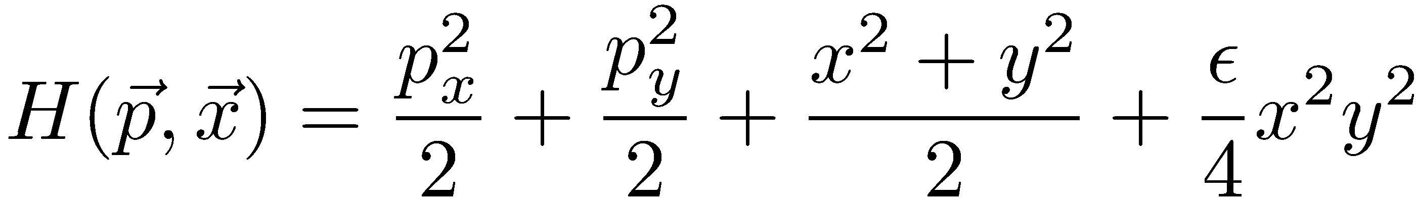
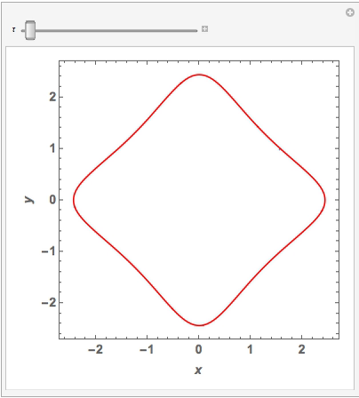
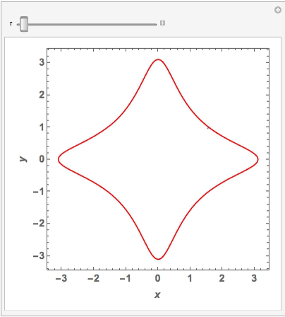
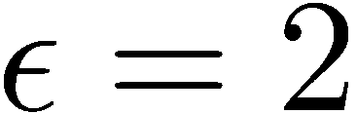
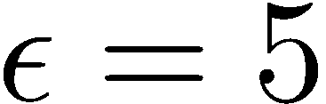
A specific two-dimensional system (animations with help of P. Weinberg, BU)
Initial conditions:
Stable (nonergodic) motion
Chaotic (ergodic) motion

Slide 9
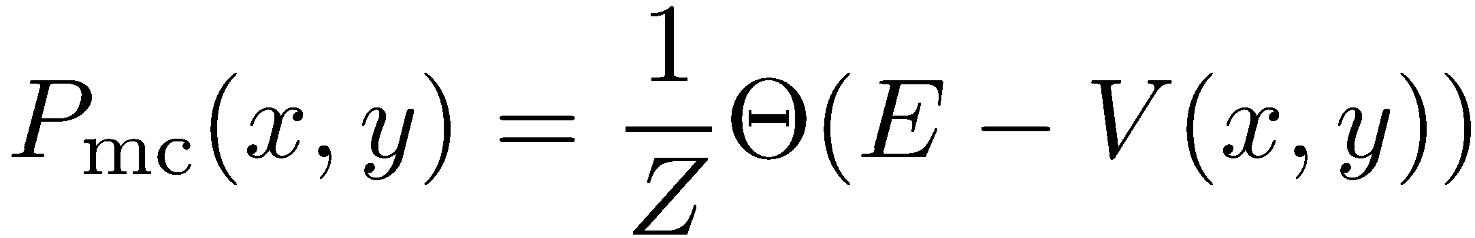
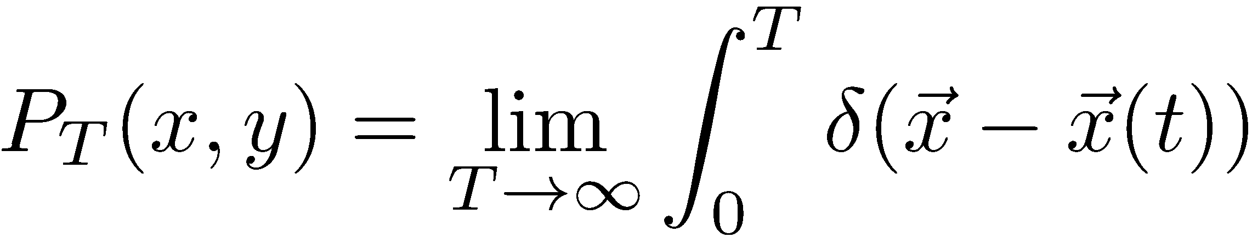
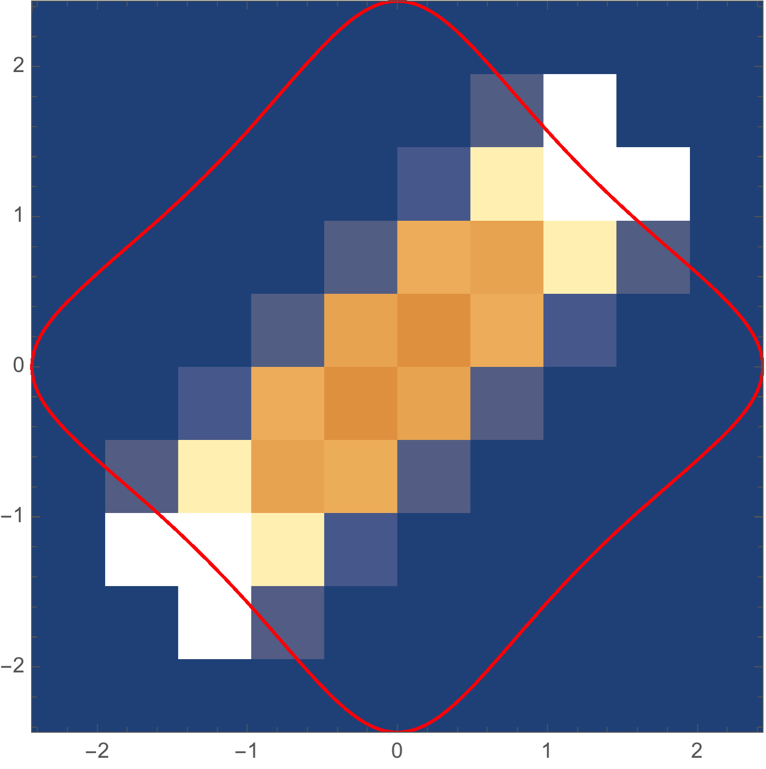
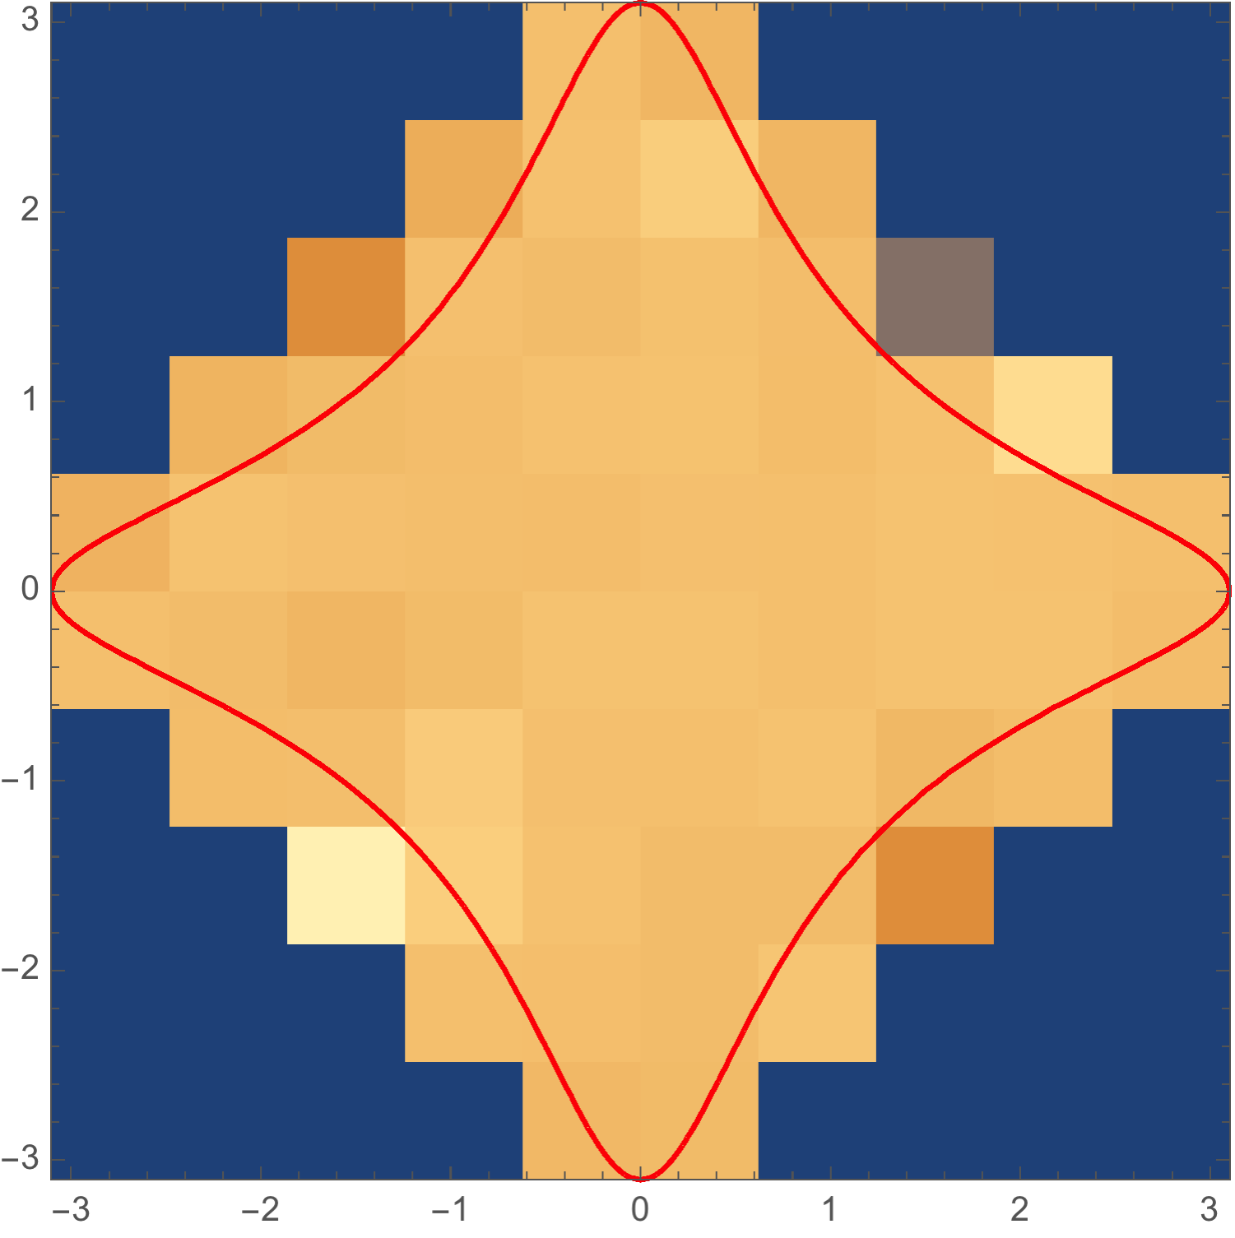
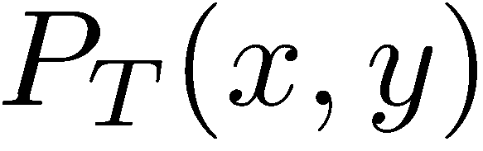
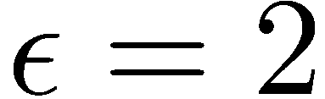
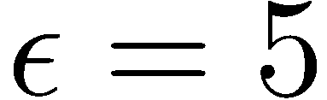
Chaos and ergodicity.
Very simple microcanonical coordinate distribution in 2D
In two (and more) dimensions chaos leads to ergodic behavior for strong enough integrability breaking

Slide 10
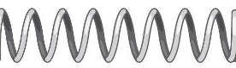
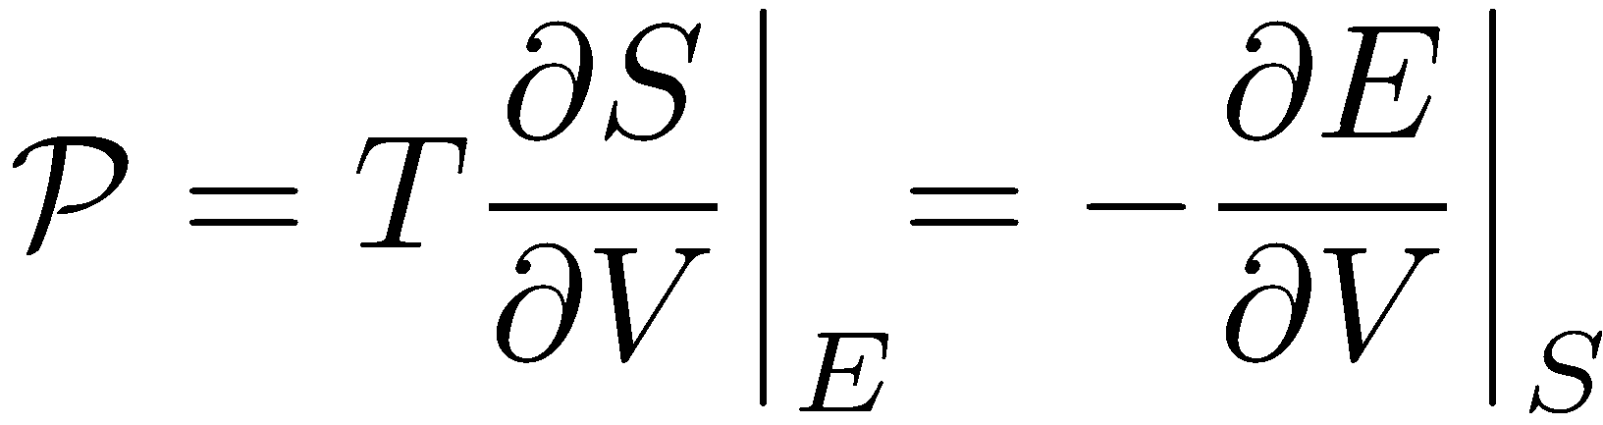
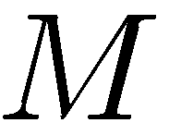
From Chaos Back to Determinism, Emergent Macroscopic Dynamics
Generalized (entropic) forces: related to available phase space volume (rely on ergodicity)
Most forces we observe in nature are entropic
Friction, mass renormalization, hydrodynamic forces – all deterministic forces emergent from assumption of local equilibrium coming from ergodicity and hence chaos. Chaos helps macroscopic determinism.
Chaos leads to probabilistic determinism, processes develop along most probably directions. Only has limited predictive power of macroscopic behavior.

Slide 11
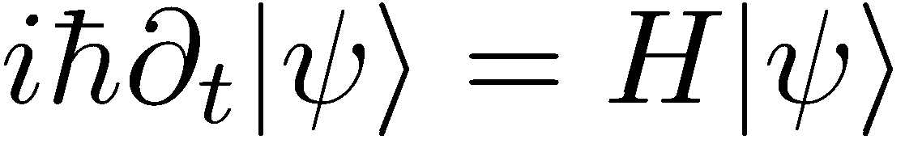
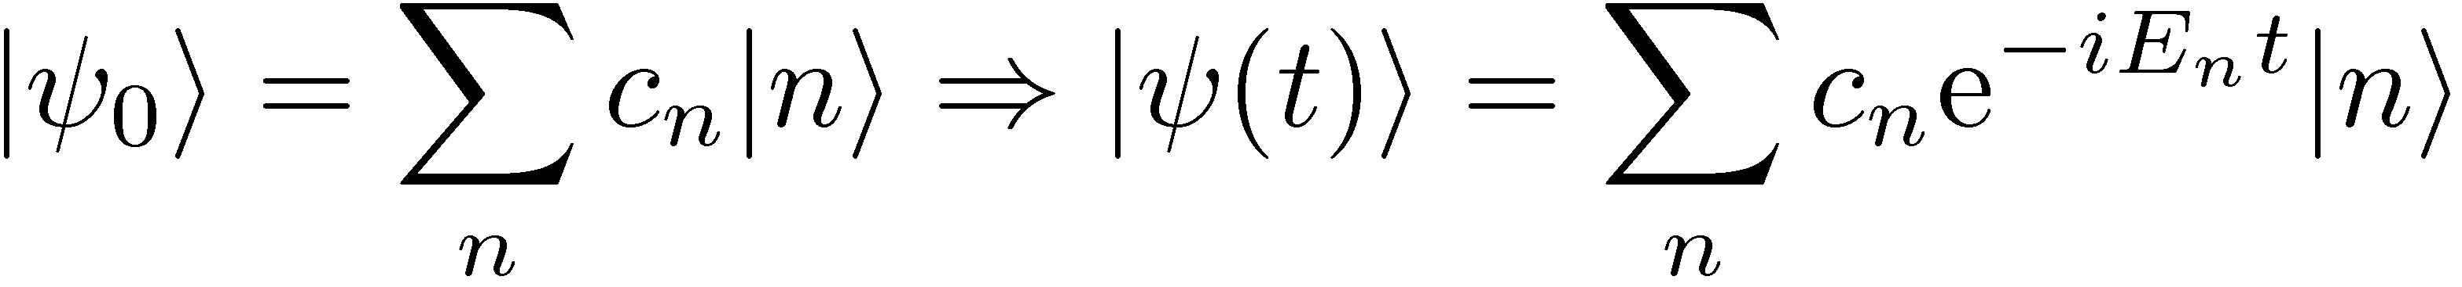
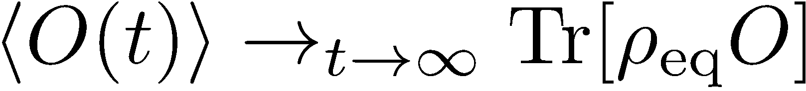
Quantum systems. Linear equations of motion no chaos?
Linear equations of motion like harmonic chains are non-chaotic. Any solution is a superposition of normal modes (eigenstates).
Constant Hamiltonian: time evolution is a simple-dephasing
Look into expectation value of some observable O at time t.
Thermalization must be built in to the structure of Eigenstates and revealed through observables (von Neuman, 1929; Wigner 1955, Mazur, 1968; Berry 1977, Deutsch 1992, Srednicki, 1994; Rigol et. al. 2008, …)
The limit is understood as at long times at almost all times. In a way in quantum language thermalization is prebuilt in the system. Time evolution is just dephasing.

Slide 12
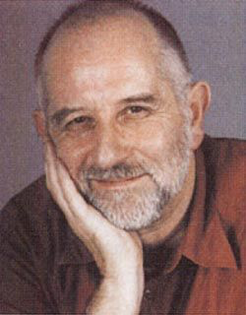
Stationary states in quantum mechanics. What is the classical limit?
Very important question. One dimensional (Integrable) systems: WKB
Quantum stationary state Classical time averaged trajectory over an orbit
Integrable (special):
Nice orbit, nice classical limit
Nonintegrable (generic):
Chaotic orbit, nasty classical limit.
Berry conjecture 1977: Wigner function (analogue of probability distribution P(x,p)) for quantum eigenstates in the classical limit approaches, after infinitesimal smearing, the microcanonical distribution.

Slide 13
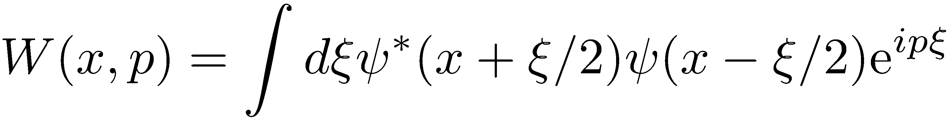
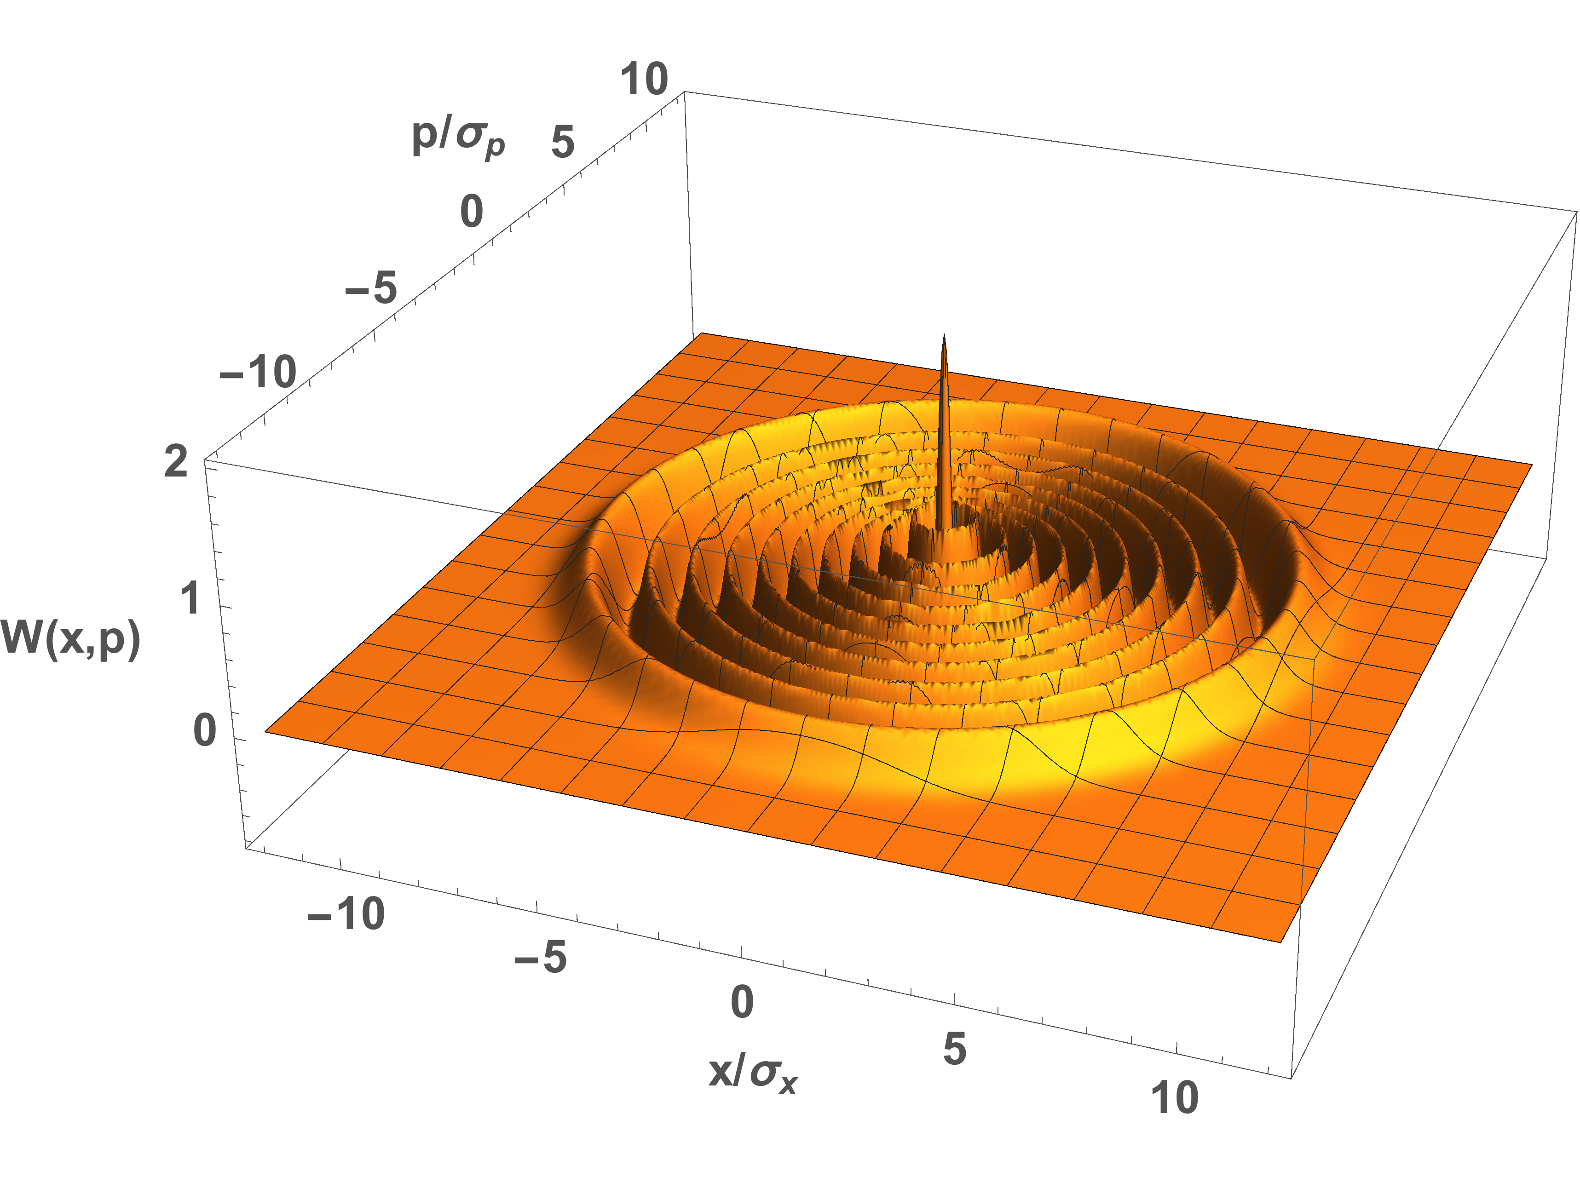
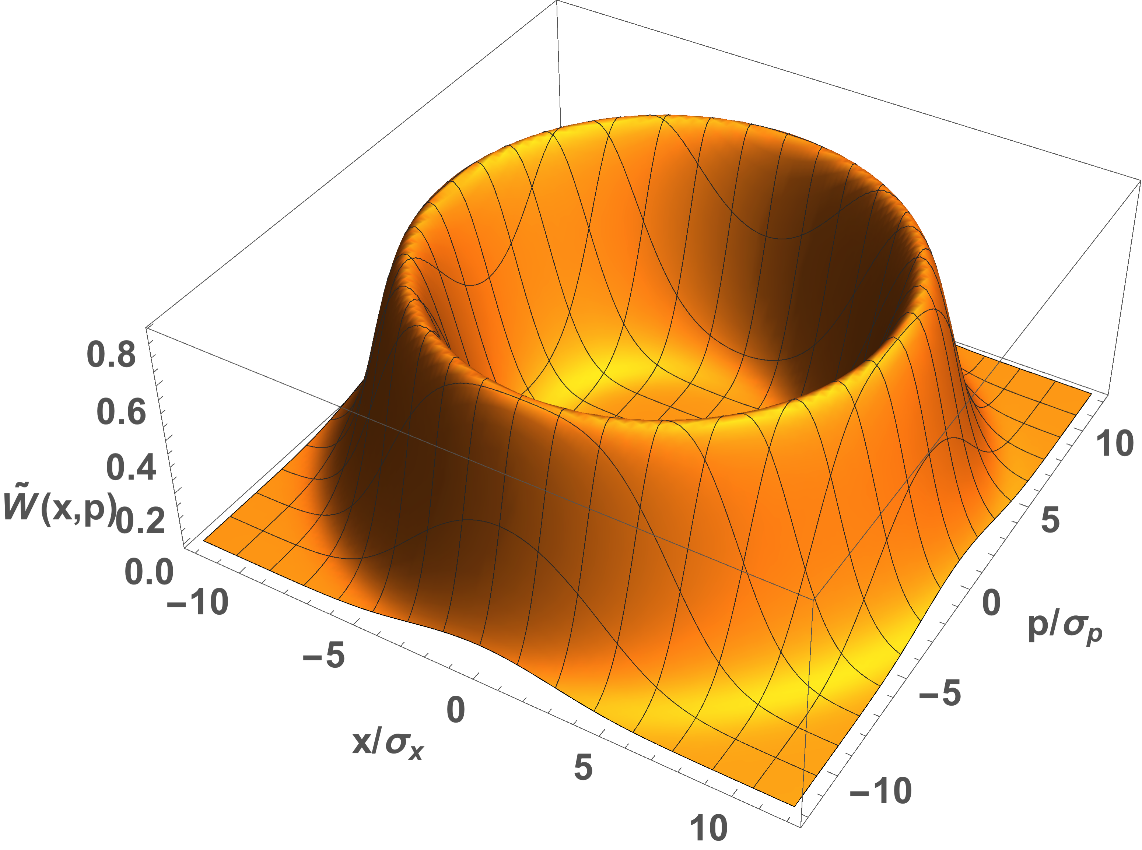
Berry’s conjecture in 1D systems (trivial)
Example: 1D Harmonic oscillator
Wigner function for n=20
Wigner function convolved with a narrow Gaussian Kernel
(2D chaotic systems – hard to visualize, but can be checked numerically)

Slide 14
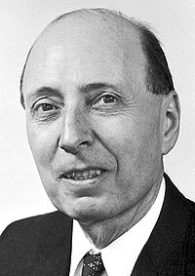
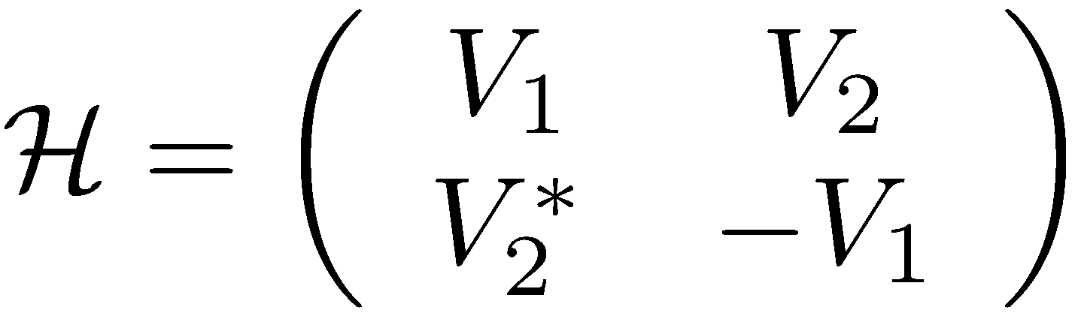
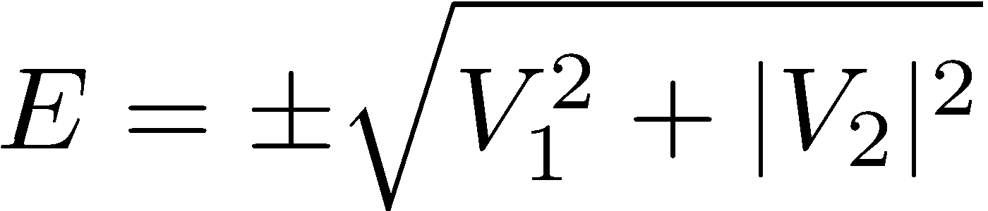
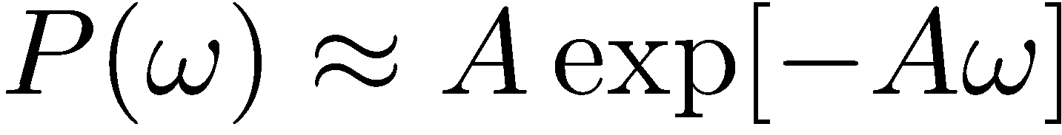
E. Wigner (1955) thinking not about thermalization but spectral functions of complex nuclei formulated what is now known Random Matrix Theory
Essential ingredient: level repulsion (small probability of energy levels to be too close to each other)
Wigner-Dyson statistics (Wigner surmize)
Random energy levels (random diagonal matrix): Poisson statistics.

Slide 15
Two powerful conjectures about energy levels in single-particle systems
Non-chaotic “generic systems” (energy is some of contributions from extensive number of symmetry sectors: expect Poisson statistics (Berry-Tabor conjecture, 1977)
(Bohigas, Giannoni, Schmit) BGS conjecture (1984): random matrix statistics in chaotic generic systems
Examples:
Incommensurate
rectangular box
Sinai Billiard. O. Bohigas et. al. 1984
Another chaotic billiard by Sinai.
Z. Rudnik, 2008
Z. Rudnik, 2008

Slide 16
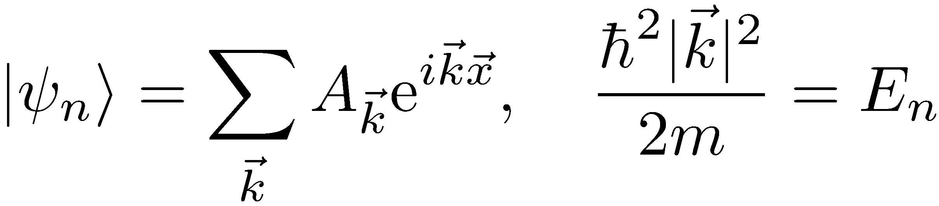
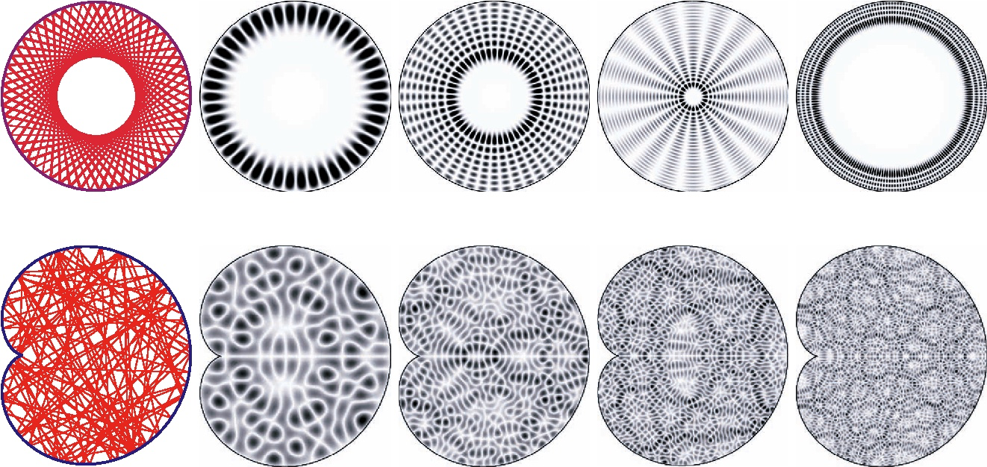
Berry’s conjecture follows from BGS conjecture (RMT) if we assume that eigenstates are random superpositions of plane waves
Eigenstates is integrable vs. chaotic billiard. Very similar pictures from random superpositions of plane waves (taken from A. Backer, Quantum Chaos in Billiards, 2007)

Slide 17
Many-body quantum systems. Standard tool to check chaos.
Integrable (in a compliated way) bosonic(L. Santos and M. Rigol, 2010)
The onset of chaos coincides with the onset of thermalization defined through the observables.
Interacting spin-chain with a single impurity
(A. Gubin and L. Santos, 2012)
Randomness is intrinsic to quantum systems, not obviously tied to locality of observables

Slide 18
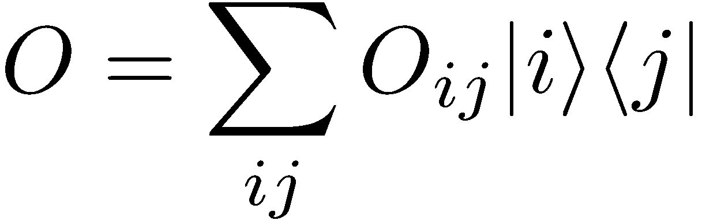
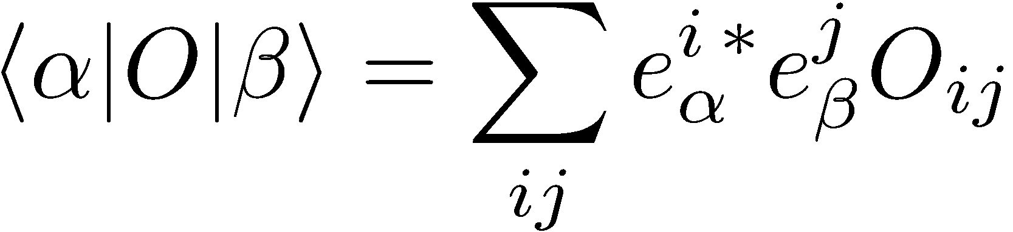
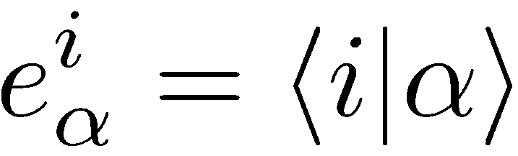
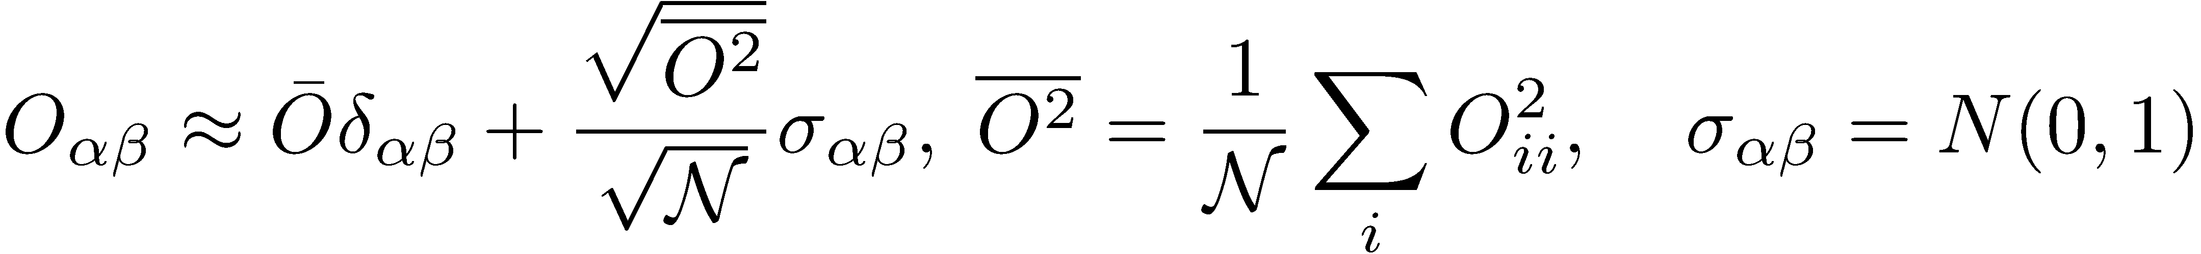
Implications of RMT to observables
In some, say Fock, basis
RMT:
Combine together
RMT strongly constraints the structure of matrix elements of physical observables.

Slide 19
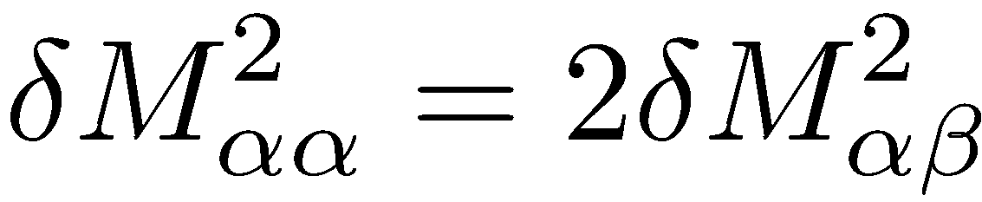
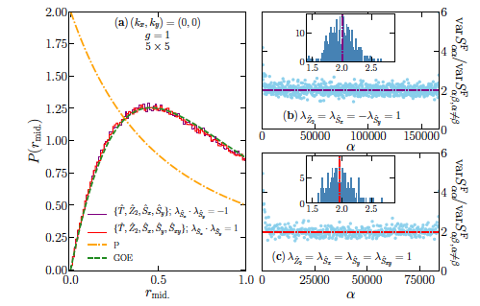
More accurately for real random matrices
Follows from Wick’s theorem
Chaos analysis in 2D transverse field Ising model (R. Mondaini, M. Rigol 2017).
Related earlier results in a 1D chain: A. Dymarsky and H. Liu 2015
Left: level spacing statistics
Right: ratio of variances of diagonal and off-diagonal matrix elements of

Slide 20

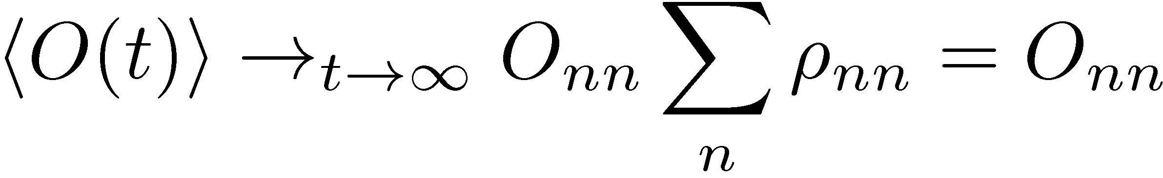
Interacting many particle systems.
Eigenstate Thermalization Hypothesis
J. Deutsch (1992), M. Srednicki (1994, 1996), M. Rigol, V. Dun’ko, M. Olshanii (2008)
Expectation values of observables
All eigenstates within a narrow energy shell are statistically the same (random vectors in a huge-dimensional Hilbert space).
Expectation values of all local observables between eigenstates are exponentially close to each other
M. Srednicki
General ETH ansatz (direct generalization of the RMT)

Slide 21
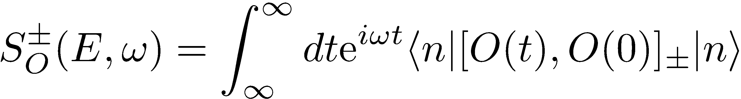
Meaning of the function f(ω)
Follows from a simple two-line calculation after substituting ETH ansatz into non-equal time correlation functions and inverting the relation
Temperature appears through the density of states (no Gibbs distribution is assumed).
We connect non-equal time-correlation functions with off-diagonal matrix elements.

Slide 22
Many-body eigenstates are destroyed by exponentially small perturbations
Define Shannon information entropy for an eigenstate m and project to states of a deformed Hamiltonian
Corollary: removing just a single particle projects to exponentially many eigenstates, i.e. leads to thermalization (from the ETH review).

Slide 23
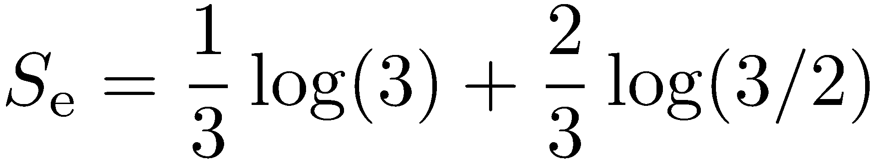
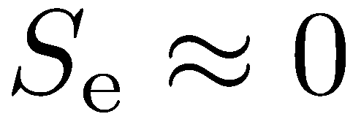
ETH and entanglement (delocalization)
ETH implies that entanglement entropy = thermal entropy (local density matrix is maximally chaotic).

Slide 24

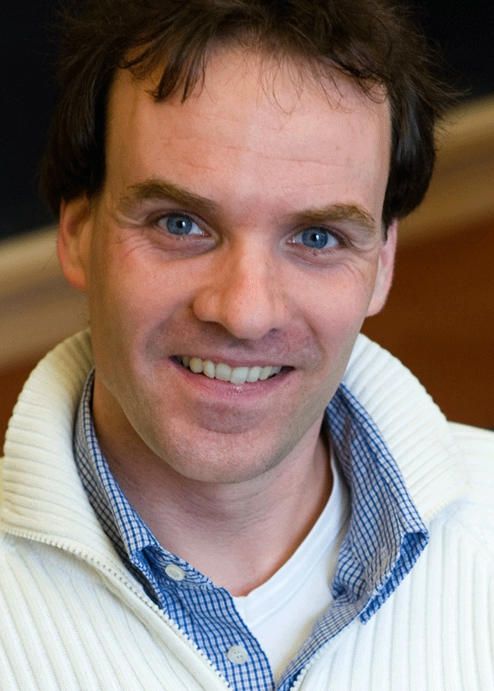

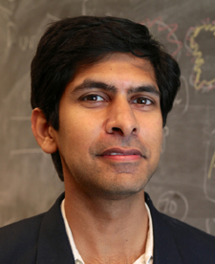
Experiments: M. Greiner group (Harvard)
Up to L_{A}=L/2 entanglement entropy = thermal entropy
Numerics: J. Garrison and T. Grover, 2015;
Analytics based on ETH and RMT: N. Lashakri, A. Dymarsky, H. Liu 2017,
Canonical typicality: S. Sugiura et. al. 2017
Experiment: A. Kaufman et. al., Science 2016
Measured entanglement (Renyi) entropy for a system of 6 interacting bosons on 6 lattice sites

Slide 25

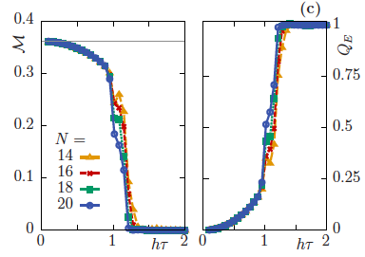
New developments (back to KAM in quantum systems).
Kicked non-ergodic Ising model (M. Heyl, P. Hauke, P. Zoller, 2018)
Long time Heating
Long time magnetization
Very sharp ergodic-nonergodic crossover as a function of the driving period. Related results (T. Prosen 1998, L. D’Alessio, A.P. 2013, A. Das et. al. 2018,…). Another example – many-body localization transition (D. Basko, I. Aleiner, B. Altshuler 2005 + many works).

Slide 26

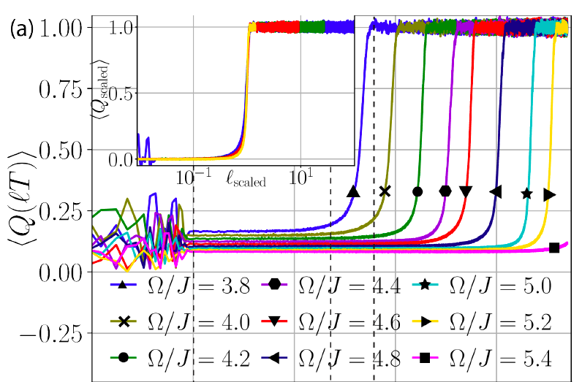

Prethermalization (J. Berges, J. Schmiedmayer, many others…).
Classical periodically driven spin chain (O. Howell, et. al. 2018)
Related results:
S. Notarnicola et. al. (2018)
A. Rajak et. al. (2018)
Number of periods

Slide 27
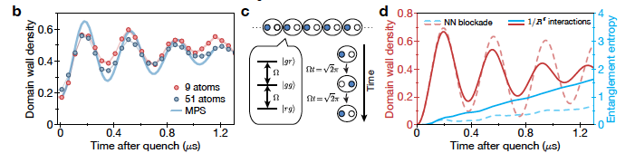
Long non-thermalizing oscillations in a system of Rydberg atoms in the middle of the spectrum (Quantum Scars), H. Bernien, …M. Lukin 2017
Theoretical explanations:
Special eigenstates in the middle of the spectrum: (C. Turner et. al. 2018), related findings (N. J. Robinson, A. James, R. Konin, 2018).
Proximity of the model to a nontrivial integrable one (V. Khemani, A. Chandran, C. Laumann, 2018)
Can create and enhance these oscillations in other models (S. Sugiura, A. Dymarsky, D. Sels, A.P. in progress)

Slide 28






ETH (normal typicality) and thermodynamics for single eigenstates
Fluctuation theorems (Bochkov, Kuzovlev, Jarzynski, Crooks)
Initial stationary state + time reversability:
Eigenstate thermalization hypothesis: microscopic probabilities are essentially (independent on m,n)
Bochkov, Kuzovlev, 1979, Evans, Searles 1994, Crooks 1998, Tasaki 2000, Kurchan 2000
Integrate Crooks’ equality get
Jarzynski equality, 1997
Fluctuation theorems can be proven in two lines for Gibbs states. ETH extends the proof to arbitrary stationary states.

Slide 29

Open systems (A can be a single spin or macroscopic)
B
A
Time reversal symmetry implies microscopic detailed balance:
Sum over eigenstates of B. Use ETH for the system B.
Detailed balance follows from the Crooks equality for the two systems and ETH for the system B.

Slide 30

New developments: scrambling and OTOC (out of time order correlations)
Define (one can use arbitrary operators instead of momentum)
A. Larkin and Yu. N. Ovchinnikov (1969), A. Kitaev (2014), J. Maldacena, S. H. Shenker, and D. Stanford (2016), many others
Measurements through echo: M. Garttner, … J. J. Bollinger, and A. M. Rey (2017)
Semi-classical limit
Averaging is done over the initial conditions (Wigner function)
Near classical limit C(t) exponentially grows with the Lyapunov exponent
Similar exponential sensitivity and OTOC appear in Echo dynamics (B. Fine 2014, M. Schmitt S. Kehrein 2017 + A.P. 2018)

Slide 31
Quantum Kicked Rotor
(2017)
Quantum (orange circles) and semiclassical (green line) exponents perfectly match. Exponential grows of OTOC indicates classical chaos in this model.
Similar results for SYK model (M. Schmitt, D. Sels, A. P., S. Kehrein 2018 also T. Scaffidi, E. Altman 2017)
Many interesting developments but so far no clear relation to ETH.

Slide 32
Summary
Quantum chaos is encoded in the structure of eigenstates through a very simple Random-Matrix type Gaussian ansatz
Can easily recover all thermodynamic relations from this ansatz for individual eigenstates.
Ergodic - non-ergodic transitions. Evidence for a many-particle KAM theorem in quantum systems (MBL, Floquet).
Many other open questions

Slide 33





Another spectacular example of the RMS: zeros of the Riemann-zeta function
p are the prime numbers
Partition function of non-interacting bosons with dispersion relation and inverse temperature
Hugh Montgomery
Freeman Dyson
Spacing between zeros of the zeta-function (Fisher zeros) follow RMS statistics.
Fascinating connections between prime numbers, random matrices, chaos and ergodicity.
Spacing distribution for a billion zeroes of the Riemann zeta function, and the corresponding prediction from random matrix theory. (Source: Andrew Odlyzko, Contemp. Math. 2001), Montgomery 1972.

