Slide 1


Hadronization studies at Belle and Belle II
Anselm Vossen
Entanglement 2018
Notes:
8:18

Slide 2
Outline
Disclaimer: No research program on entanglement yet, this talk is mostly to point to opportunities and solicit input
Motivation for hadronic physics at e+e-
Belle Experiment and KEK
Recent results and work in progress on hadronization of light quarks at Belle
  Focus on single- and di-hadron cross-sections
  →Connections to entanglement: Final state entropy, thermal behavior of sub-phase spaces (e.g. p_{T})
Belle II at SuperKEKB

Slide 3
Why e⁺e⁻?
P_{h１}
Clean!
Low density (no thermal behavior expected)
Study of hadronization and global event properties
Drawback:
  Low multiplicities event-by-event studies more challenging
  BUT: very high luminosity, can select high multiplicity events
e⁺
quark
e⁻
antiquark
P_{h２}

Slide 4
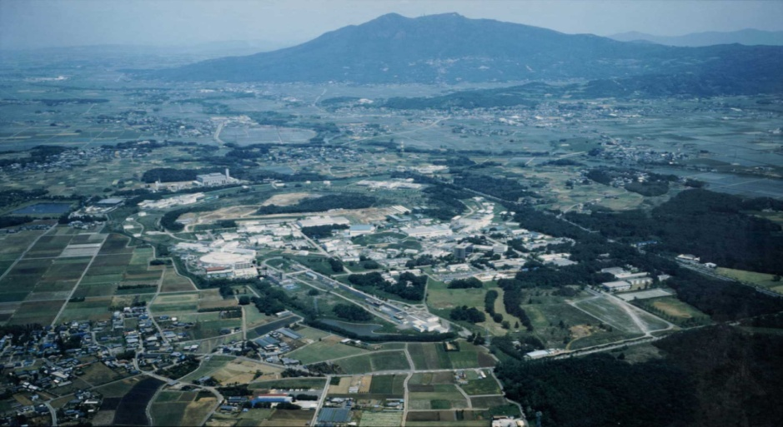
Belle (II) detector
KEKB
4/18

Slide 5
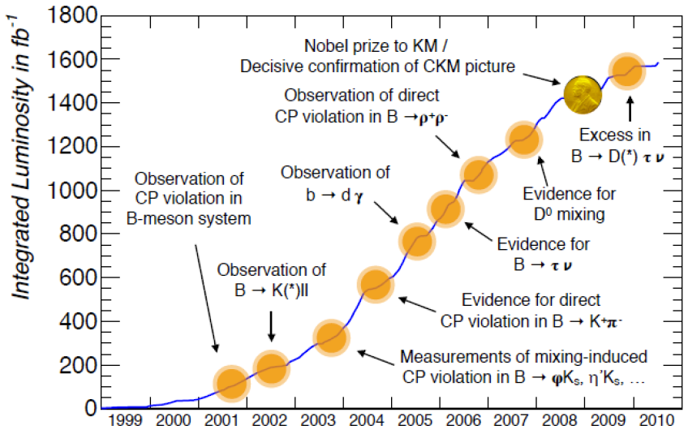
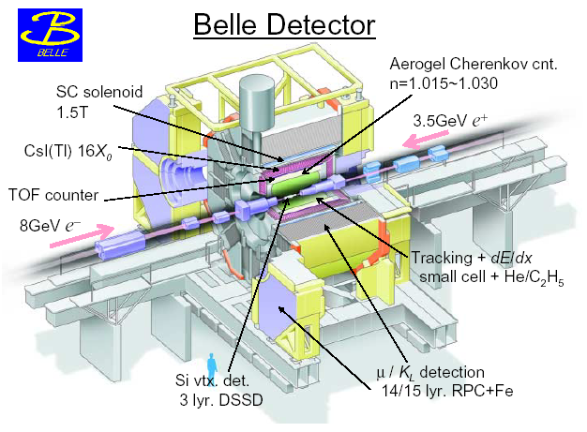
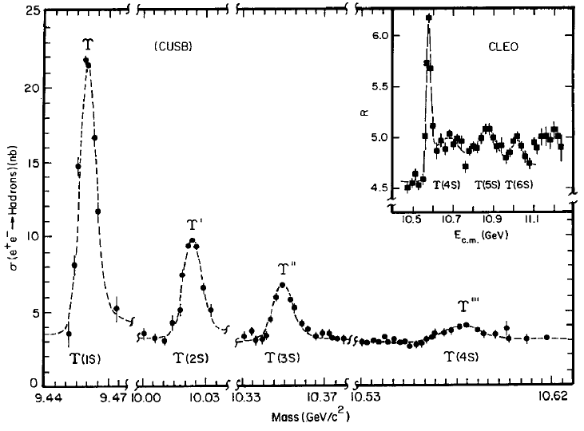
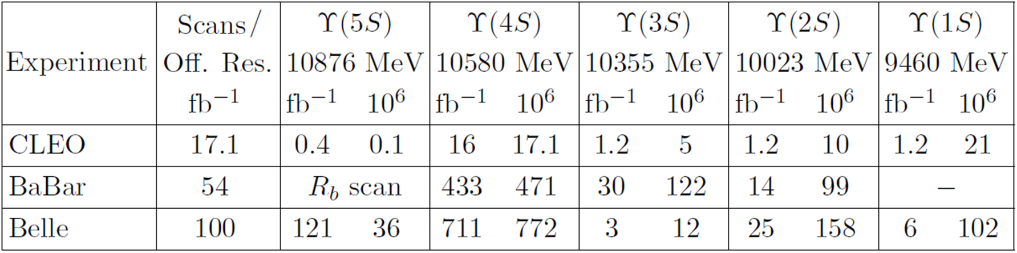
Belle Experiment (1999 - 2010)
Belle/KEKB (KEK) and BaBar/PEP-II (SLAC)
+About 4x10⁶ events per fb in continuum

Slide 6
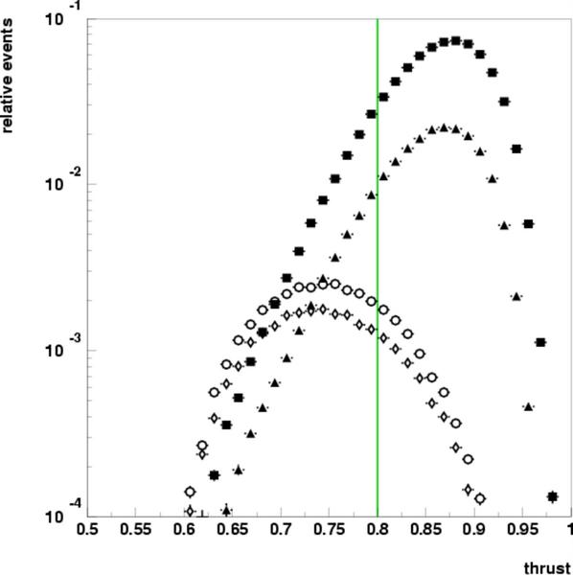
Lots of data off resonance, easy to remove resonance background
e⁺e⁻→qq̅, q∈uds
4s
“off”
e⁺e⁻→cc̅
small B contribution (<1%) in high thrust sample
>75% of X-section continuum under
ϒ (4S) resonance
~100 fb⁻¹ ➔ ~1000 fb⁻¹
0.5 0.8 1.0
Notes:
6
6

Slide 7
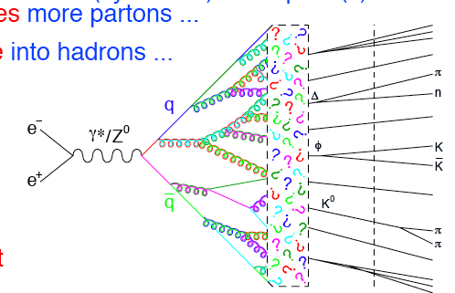
Factorized picture of e+e- →Fragmentation functions
Field, Feynman (1977): Fragmentation functions encode the information on how partons produced in hard-scattering processes are turned into an observed colorless hadronic bound final-state [PRD 15 (1977) 2590]
Detector
ElectroWeak
pQCD
Decays
Earlier machines (including LEP) focused on observables like jet structure
High statistics/PID + progress in SIDIS →B-factory program focuses on fragmentation functions (and spectroscopy)

Slide 8
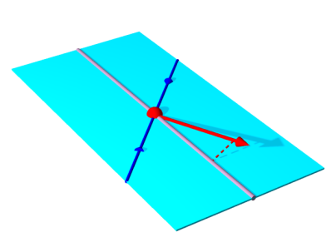
Spin Averaged FFs from X-section Measurements for charged pion, kaons and protons

Slide 9
From yields to cross-sections
Hadron yields undergo a number of corrections
  Particle (mis) identification [e. g., not every identified pion was a pion]
  smearing unfolding [e.g., measured and true momentum might differ]
  non-qq processes [e.g., two-photon processes, Υ-> BB, …]
  4𝝿” correction [selection criteria and limited geometric acceptance]
  QED radiation [initial-state radiation (ISR)]
  optional: weak-decay removal (e.g., “prompt fragmentation”)
Collins asymmetries also corrected for false asymmetries and maybe for qq-axis (mis)reconstruction
partially different approaches in different experiments/analyses

Slide 10
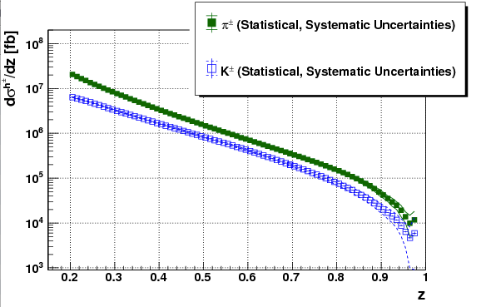
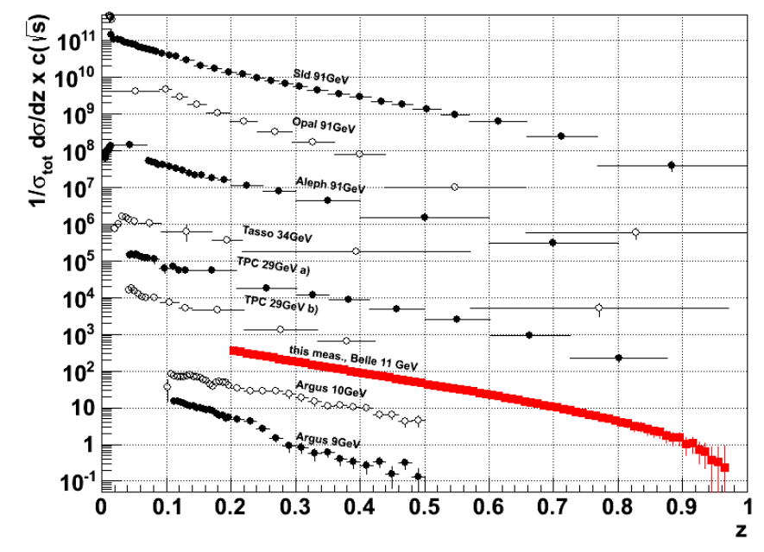
Cross sections for single hadrons
π compared to
World data
Phys.Rev. D92 (2015) no.9, 092007
Phys. Rev. Lett. 111, 062002 (2013)

Slide 11
Comparison to MC
Agreement with Belle MC reasonable with the exception of high z K/p

Slide 12
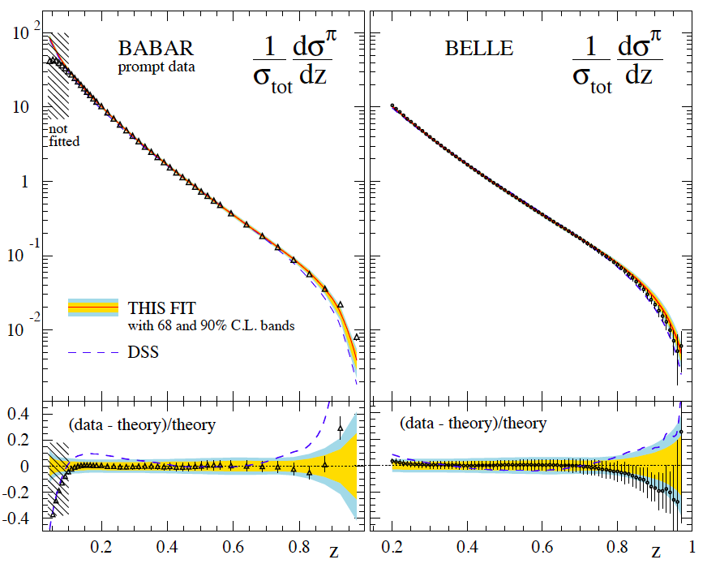
DSS(E,H-P) Fit
pQCD fit at NLO
Good agreement between Belle and BaBar however, there seems to be a trend away from the fit for the Belle data at high z
Low z data from BaBar also agrees with Modified Leading Log predictions

Slide 13
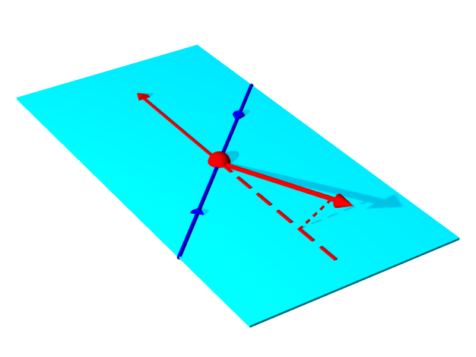
Transverese momentum dependence
Two different defininitons
  Vs thrust direction
  Relative in back-to-back hadrons (related: q_{T}, relative transv. momentum of γ*)

Slide 14
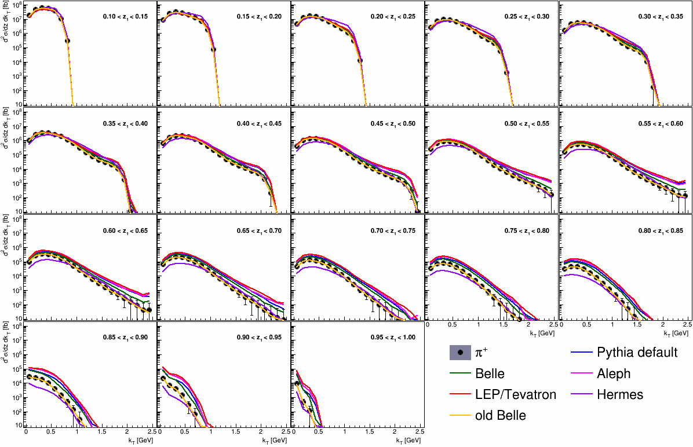
MC example of k_{T} sensitivities

Slide 15
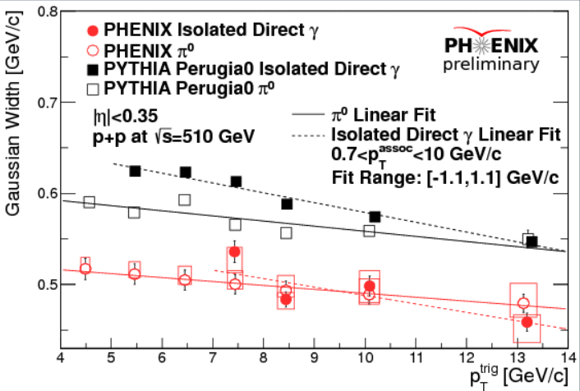
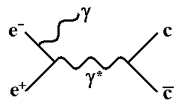
Connection to color entanglement?
PRD 81, 094006 (2010)
0.125< z₁,z₂ < 0.15,
Color entanglement might lead to factorization breaking
p_{T} ‘narrowing’ observed at RHIC, at variance with pQCD but in good agreement with Pythia
At Belle can study transverse momentum distribution as a function of Q² using ISR

Slide 16
Production of Charmed and non charmed baryons as a test of fragmentation models
Ξ⁻, Ξ(1530), Ω⁻ Σ_{c}, Ω_{c}, Ξ_{c} not shown

Slide 17
Mass Dependence confirms diquark model

Slide 18
Production of hadron pairs
From Phys.Rev. D92 (2015) no.9, 092007 and Phys.Rev. D96 (2017) no.3, 032005

Slide 19
Topology: same hemisphere vs opposite hemispheres

Slide 20
Cross-section compared to MC

Slide 21
Decomposition according to Pythia

Slide 22
Results Systematics Dominated
Low z: Dominated by PID uncertainties
Belle II prospects: Improved PID, higher statistics to improve uncertainties on PID
High z: Dominated by ISR uncertainties
Belle II prospects: better understanding of ISR radiation with better statistics
Seidl et. al. Phys.Rev. D96 (2017) no.3, 032005
m [GeV]

Slide 23
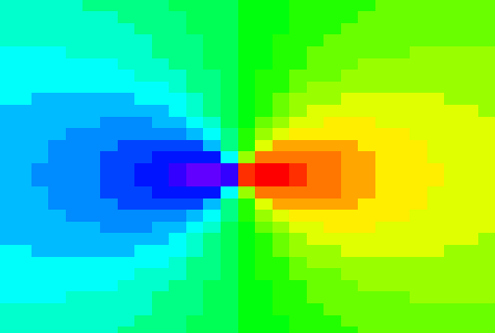
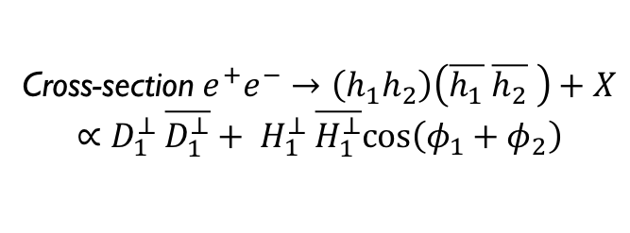
CORRELATION MEASUREMENTS IN E+E-
J. Collins, Nucl. Phys. B396, (1993) 161
ϕ₂
π⁺
z₂
q₂
π⁻
q₁
ϕ₁
q
quark-2
spin
quark-1
spin
z₁
z_{1,2} relative pion pair
momenta
Cross-section $e^{+}e^{−}→\left(h_{1}h_{2}\right)\left(\overline{h_{1}} \overline{h_{2}} \right)+X$
$$∝D_{1}^{⊥} \overline{D_{1}^{⊥}}+ H_{1}^{⊥} \overline{H_{1}^{⊥}}cos\left(φ_{1}+φ_{2}\right)$$
Access spin dependence and p_{T} dependence (convolution or in jet) without PDF complication
Made possible by B-factory luminosities

Slide 24
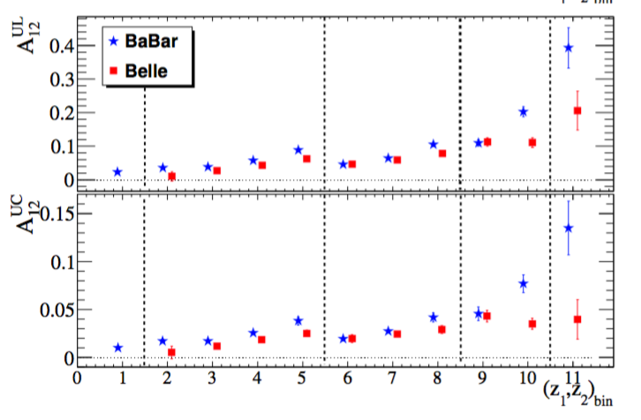
    Collins Effect vs (z1,z2): comparisons
Unlike/Likesign
Ratios to cancel
acceptance effects
Unlike:
fav*fav+dis*dis
Like:
fav*dis
0.3< z₂< 0.5
0.5< z₂< 0.7
0.15< z₂< 0.2
0.2< z₂< 0.3
EPJA, 52, 1-15 (2016)
First non-zero independent measurement of the Collins effect for pion pairs in e⁺e⁻ annihilation by Belle Collaboration @ √s ∼ 10.6 GeV (PRL 111,062002(2008), PRD 88,032011(2013)) leads to first extraction of transversity (Phys.Rev. D75 (2007) 054032 ) from SIDIS and e+e-
  Confirmed by BaBar @ √s ∼ 10.6 GeV (PRD 90,052003 (2014); PRD 92,111101(R)(2015) for KK and Kπ)
  Measured at BESIII @ √s = 3.65 GeV (PRL 116,42001(2016))

Slide 25
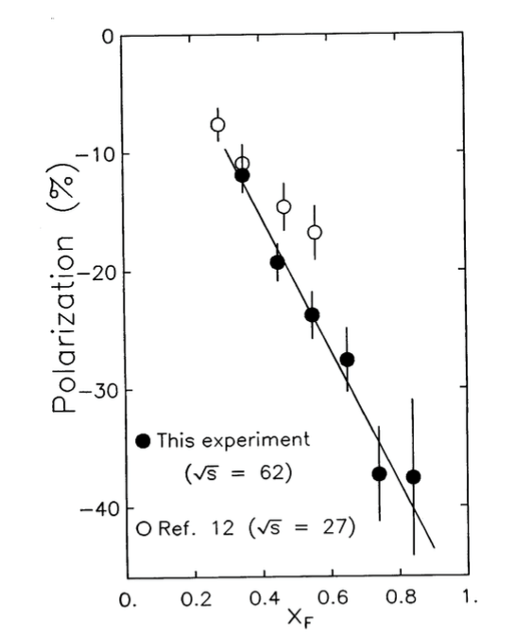
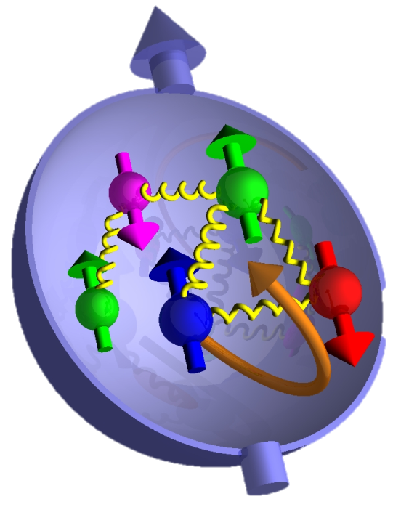
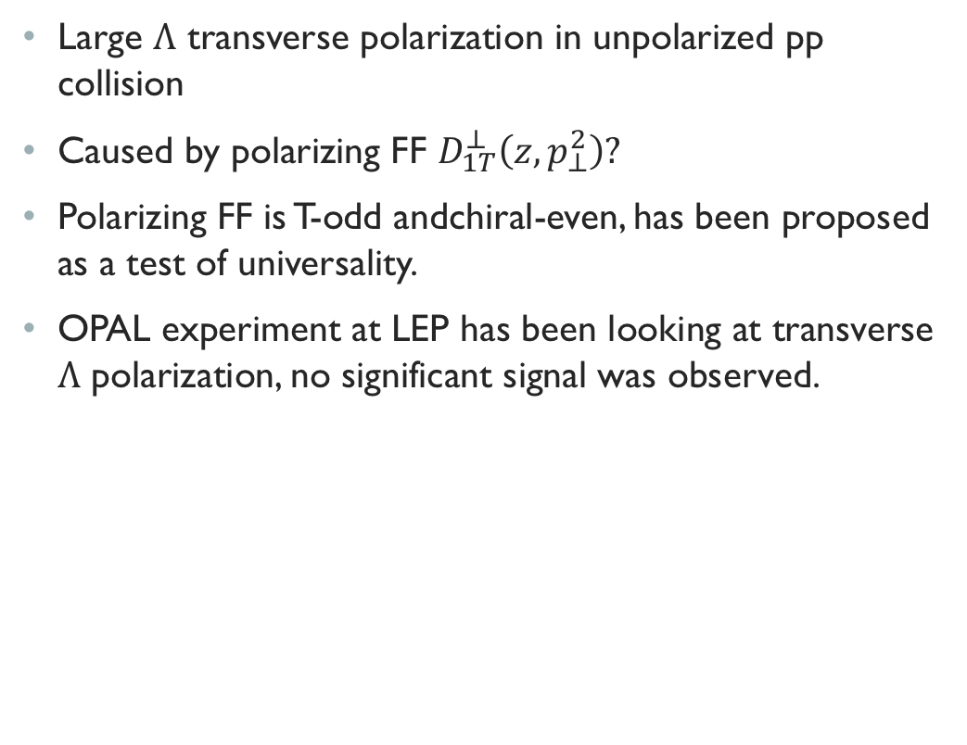

Polarized Hyperon Production
Large $Λ$ transverse polarization in unpolarized pp collision
Caused by polarizing FF $D_{1T}^{⊥}\left(z,p_{⊥}^{2}\right)?$
Polarizing FF is T-odd andchiral-even, has been proposed as a test of universality.
OPAL experiment at LEP has been looking at transverse $Λ$ polarization, no significant signal was observed.
PRL36, 1113 (1976); PRL41, 607 (1978)
$$p+p→Λ^{↑}+X$$
PRL105,202001（2010）
Fermilab
ISR data
(Phys.Lett. B185 (1987) 209)
Eur. Phys. J. C2, 49 (1998)
$$x_{F}=p_{L}/\max_{}{p_{L}\sim _{LO}x_{1}−x_{2}\sim _{forward}x_{1}}$$
p_{T}
q

Slide 26
First observation of transverse Λ polarization in e+e-

Slide 27
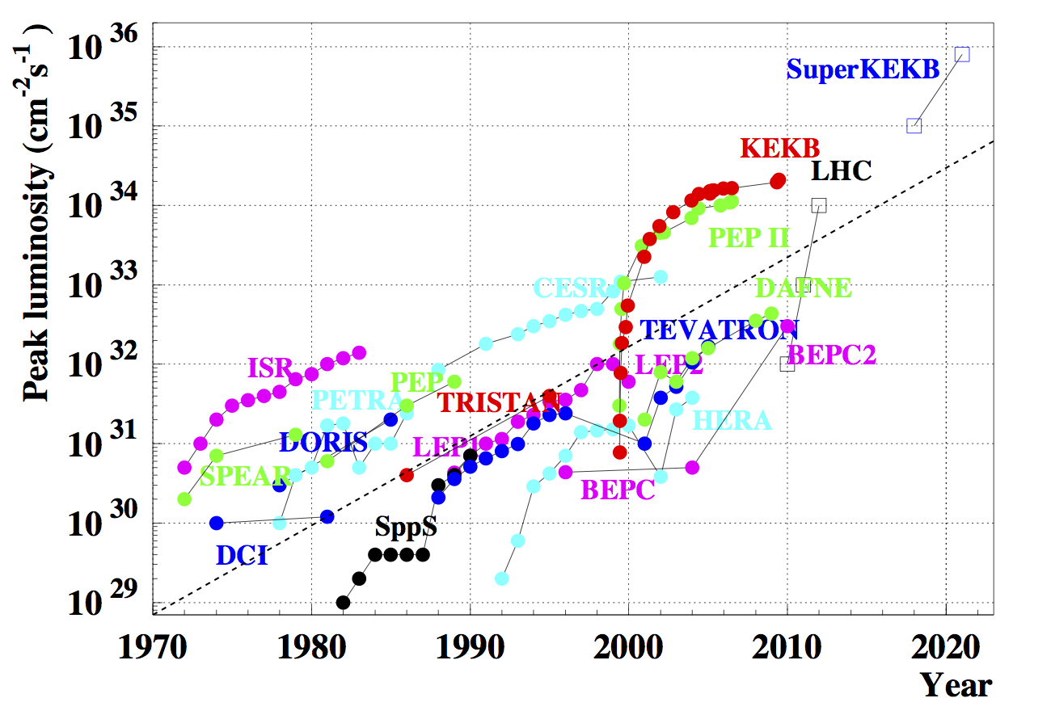
Luminosity history of e+e- (and pp) machines

Slide 28
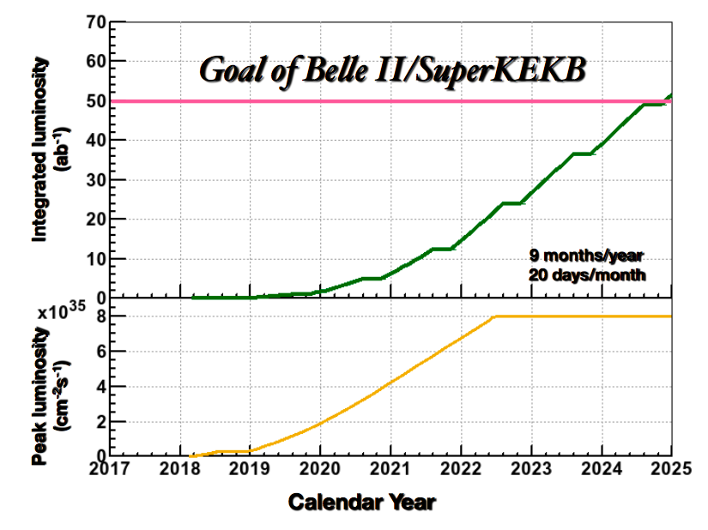
Current Status and Schedule
Phase 1 (complete)
  Accelerator commissioning
Phase 2 (just concluded)
  First collisions (20±20 fb⁻¹)
  Partial detector
  Background study
  Physics possible
Phase 3 (“Run 1”, early 2019)
  Nominal Belle II start
Ultimate goal: 50 ab⁻¹

Slide 29
Cut view of Belle II Detector
K_{L} and muon detector:
Resistive Plate Counter (barrel outer layers)
Scintillator + WLSF + MPPC (end-caps, inner 2 barrel layers)
EM Calorimeter:
CsI(Tl), waveform sampling
Pure CsI for end-caps
Particle Identification:
Time-of-Propagation counter (barrel)
Prox. focusing Aerogel RICH (fwd)
electron (7GeV)
Beryllium beam pipe
2cm diameter
Vertex Detector:
2 layers DEPFET + 4 layers DSSD
positron (4GeV)
Central Drift Chamber
He(50%):C2H6(50%), Small cells, long lever arm, fast electronics
Readout (TRG, DAQ):
Max. 30kHz L1 trigger ~100% efficient for hadronic events.
1MB(PXD)+100kB(others) per event
g over 30GB/sec to record
Offline computing:
Distributed over the world via GRID

Slide 30
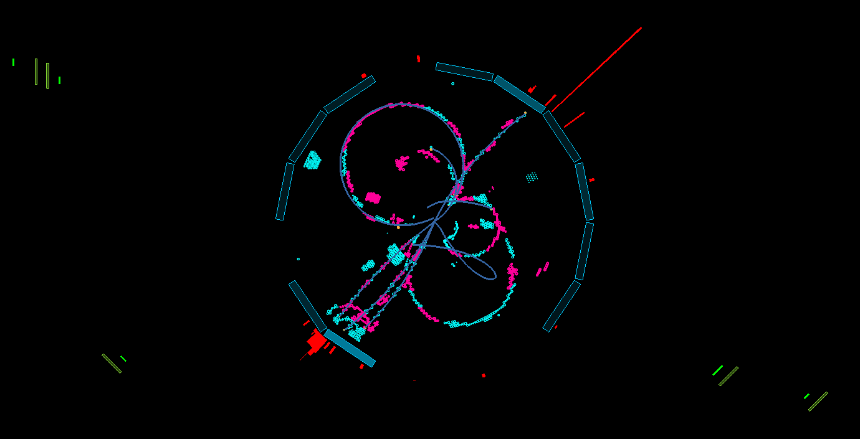
26 April 2018 00:38 GMT+09:00: First Collisions
MuID
EMCal
CDC
ToP
beamview

Slide 31
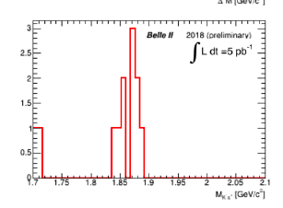
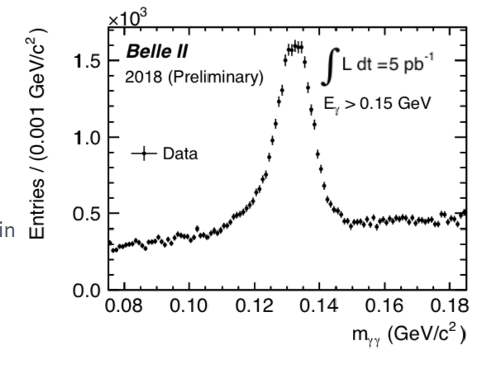
First bumps
D→Kπ
π⁰→γγ
K_{S} →π π

Slide 32
Conclusion
B-factories provide world record statistics to study e+e- annihilation final states
Rich physics program on fragmentation function studies already exists
Extension to entanglement studies would be very interesting

Slide 34
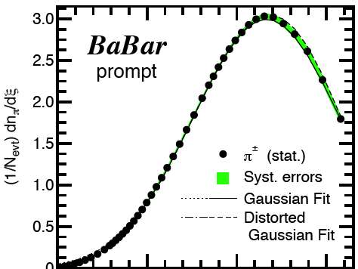
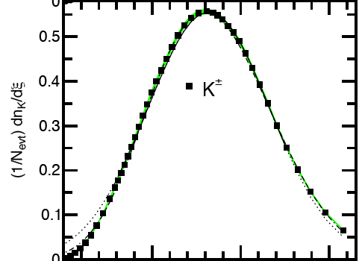
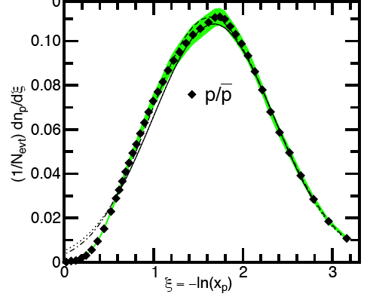
Test of MLLA and Loc. Parton-Hadron Duality
Test of QCD prediction
Modified Leading Logarithm Approximation (MLLA) with Local Parton-Hadron Duality (LPHD) ansatz: ==> a Gaussian function should provide a good description of these spectra
==> the peak position ξ* should decrease exponentially with increasing hadron mass at a given E_{cm}
==> should increase logarithmically with E_{cm} for a given hadron type
BABAR
Preliminary
BABAR
Preliminary
BABAR
Preliminary
Fit the spectra with a (distorted) Gaussian function ==> reasonable description of the data
ξ*_{π} is higher than ξ*_{K} in agreement with the predicted drop, but ξ*_{p} is not lower than ξ*_{K}
Similar behavior observed at higher energies
Material from I. Garzia, QCD Evolution 2013

Slide 35
Invariant mass distribution Compared to MC
m [GeV]

Slide 36
Ratio to MC

Slide 37
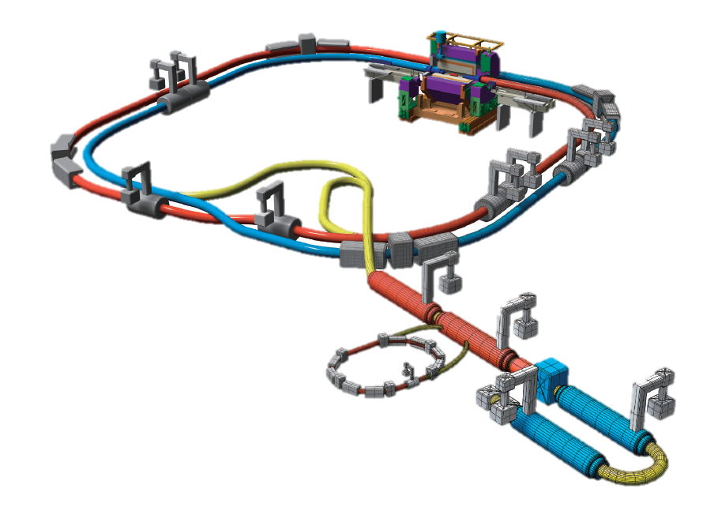
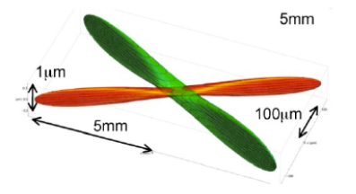
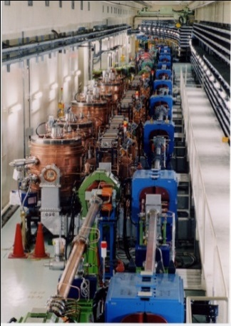

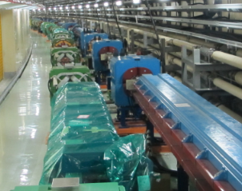

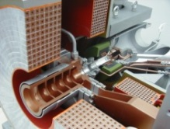
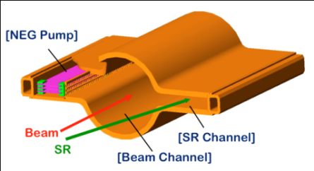
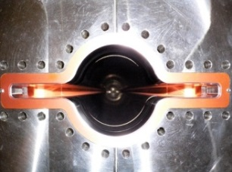
KEKB →SuperKEKB: Deliver Instantaneous Luminosity x 40
Belle II
New superconducting final focusing quads (QCS) near the IP
e⁺ 4GeV 3.6 A
`
e⁻ 7GeV 2.6 A
New IR
Nano beam collision
(~2x KEKB)
SuperKEKB
Target: L = 8x10³⁵/cm²/s
Replace short dipoles with longer ones (LER)
Reinforce RF systems for higher beam current
Positron source
New positron target / capture section
Redesign the lattices of HER & LER to squeeze the emittance
Damping ring (new)
TiN-coated beam pipe with antechambers
Cu for wigglers and Al alloy for the rest
@1.1 GeV
To inject low emittance positrons
Low emittance gun
To inject low emittance electrons

Slide 38
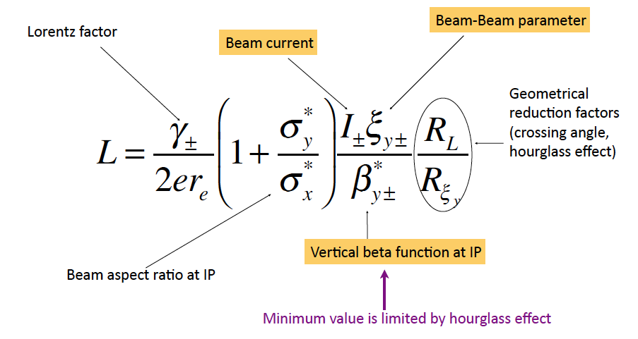
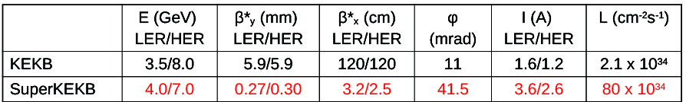
Accelerator Design: Nano Beam Scheme
Invented by Pantaleo Raimondi for SuperB
ξ_{y} ∝ √(β_{y}*/ε_{y})

Slide 39
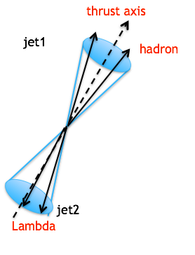
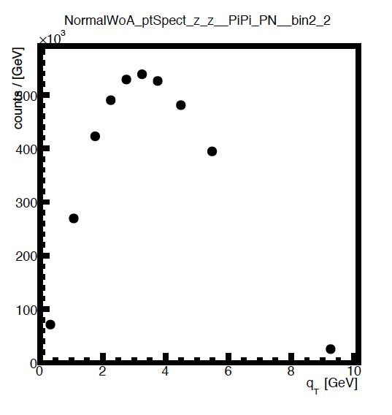
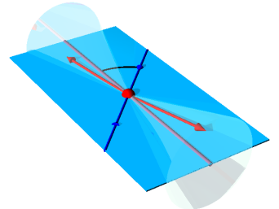
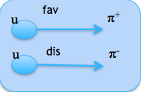

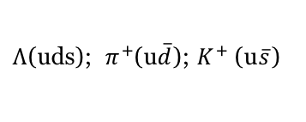

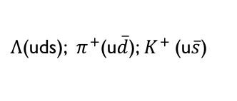
Observables in Λ Restframe
$\hat{n}$ is perpendicular to the $Λ$ production plane.
$Λ$ production plane
thrust axis
$Λ$(uds); $π^{+}$(u$\overline{d}$); $K^{+}$(u$\overline{s}$)
Self-analyzing decay leads to polarization dependent distribution
where $α$ is the decay parameter: $α_{+}$=0.642$±$ 0.013 for $Λ$ and
$α_{−}$=-0.71 $±$0.08 for $\overline{Λ}$ (PDG).
T$he p_{t}$ is measured as the transverse momentum of $Λ$ relative to the thrust axis

Slide 40
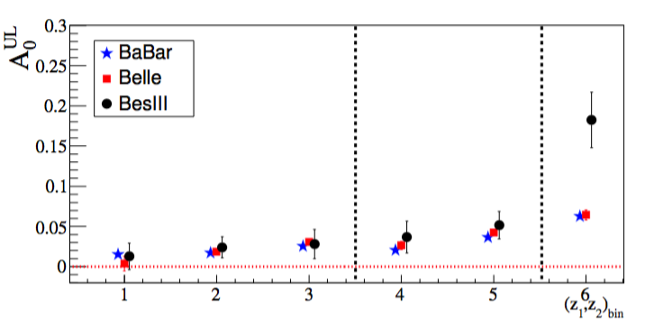
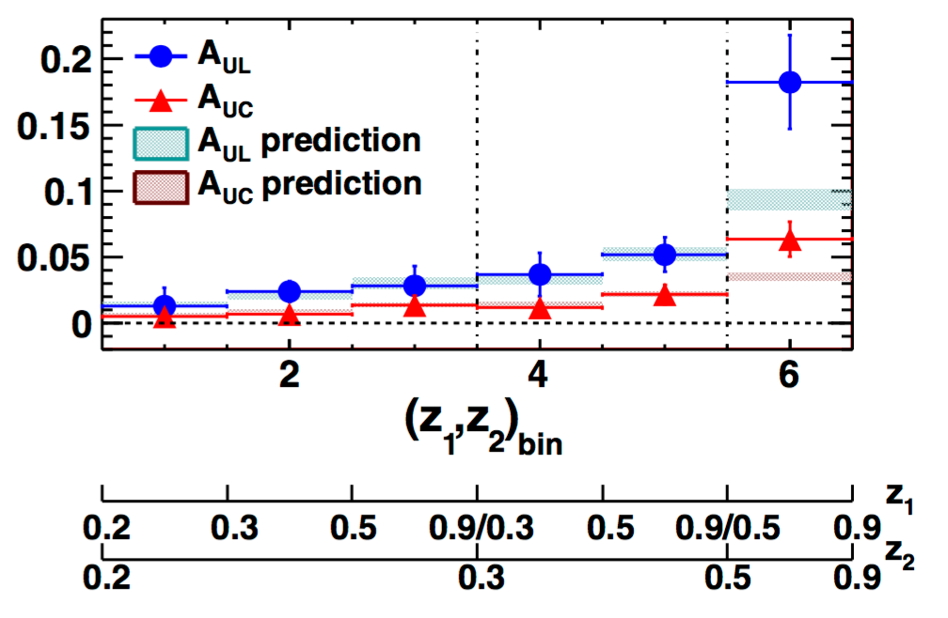
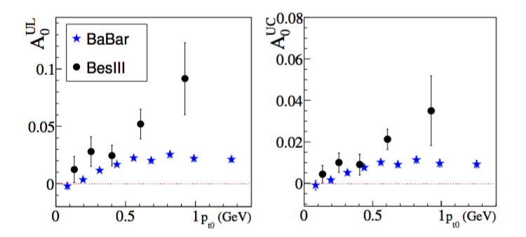
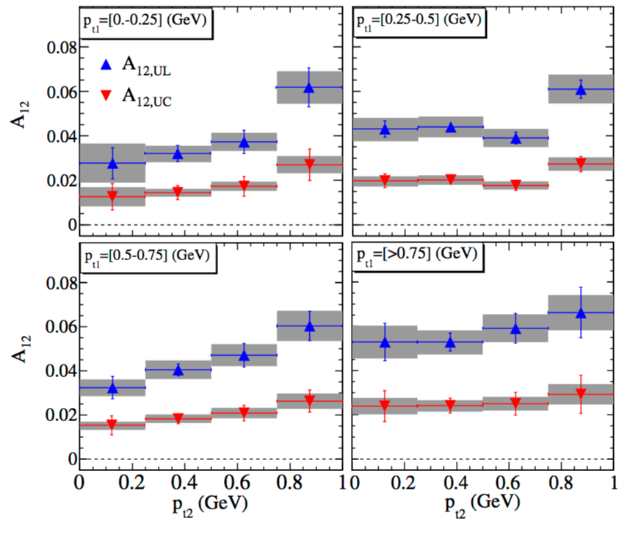
    Collins Effect vs (z1,z2): comparisons
Unlike/Likesign
Ratios to cancel
acceptance effects
Unlike:
fav*fav+dis*dis
Like:
fav*dis
0.3< z₂< 0.5
0.5< z₂< 0.7
0.15< z₂< 0.2
0.2< z₂< 0.3
EPJA, 52, 1-15 (2016)
First non-zero independent measurement of the Collins effect for pion pairs in e⁺e⁻ annihilation by Belle Collaboration @ √s ∼ 10.6 GeV (PRL 111,062002(2008), PRD 88,032011(2013)) leads to first extraction of transversity (Phys.Rev. D75 (2007) 054032 ) from SIDIS and e+e-
  Confirmed by BaBar @ √s ∼ 10.6 GeV (PRD 90,052003 (2014); PRD 92,111101(R)(2015) for KK and Kπ)
  Measured at BESIII @ √s = 3.65 GeV (PRL 116,42001(2016))

