Slide 1





Towards simulating quantum field theories
with photons and atoms
Eden Figueroa

Slide 2
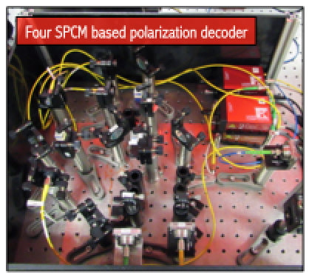
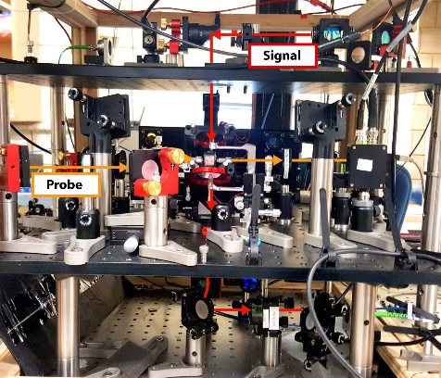
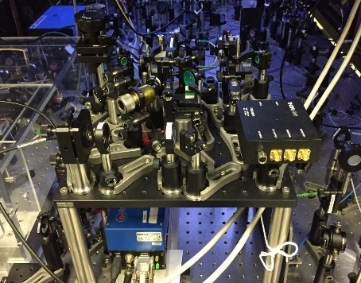
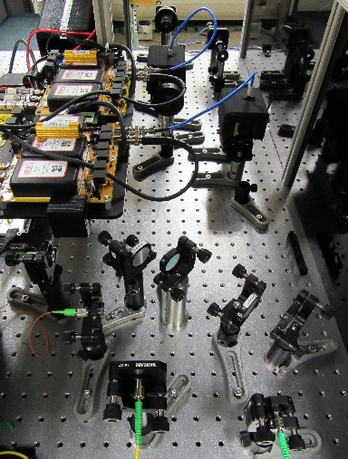
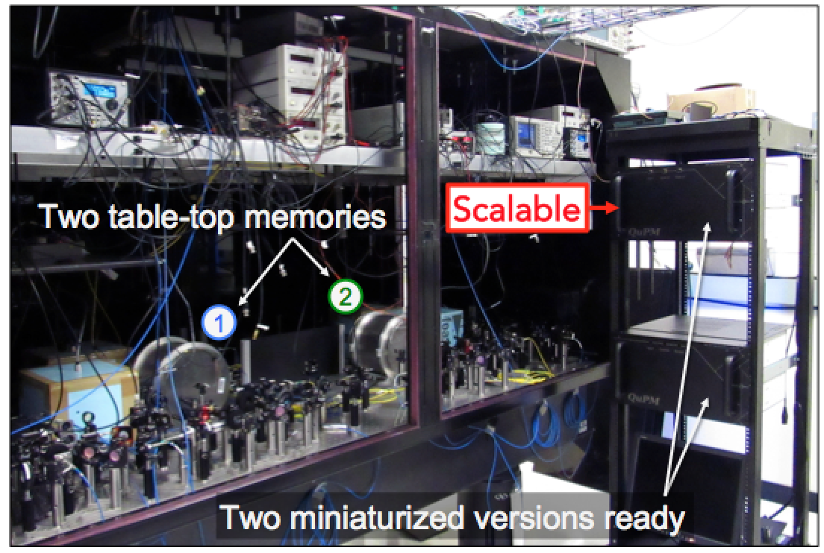
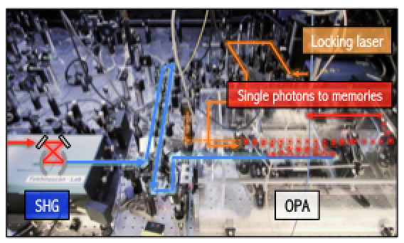
Stony Brook room temperature quantum network
Quantum processing units
Cavity QED gate
RT phase gate
>15 interconnected
quantum devices
Photon Sources
Bell measurements
Ancilla qubits
Homodyne detectors
Measurement stations
Entangled photons
Network of quantum memories
arXiv:1808.07015 (2018)
PR App. 8, 064013 (2017)
PR App. 8, 034023 (2017)

Slide 3
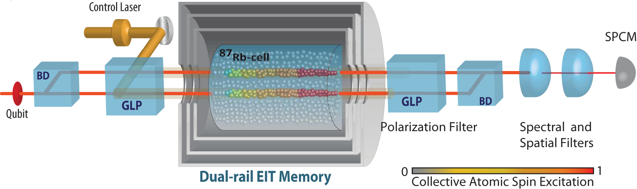
Outline
Analog quantum simulators with light.
Photon-photon interaction experiments.
Scaling the size of the simulators.

Slide 4
I. Analog quantum simulators

Slide 5
Feyman’s quantum simulation dream

Slide 6
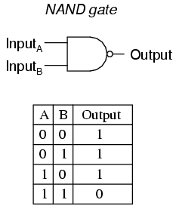
Tailoring Hamiltonians with arrays of atoms
-Classically, computers are constructed of Boolean logic gates. For each gate, its input bit(s) determines the output bit.
-Implementing this in reality requires some platform (Transistors) that responds to the input bit(s) and changes the output accordingly.
- Optimizing control of quantum matter systems to engineer their interactions to resemble different physical systems.
Notes:
Task is to build quantum analogue of classical systems

Slide 7

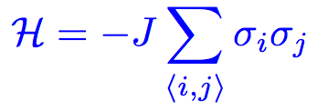
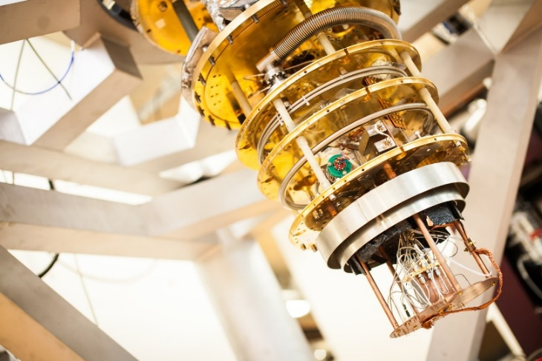
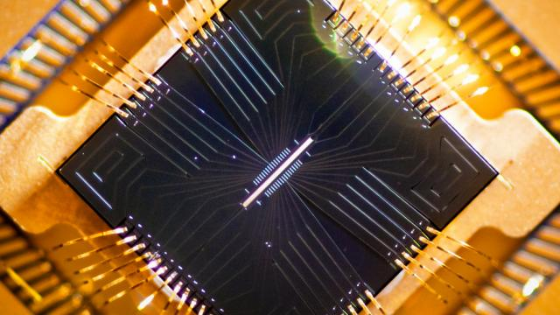





Ising Quantum simulators
Individual quantum systems (nodes) combine to serve as building blocks of a quantum communication network
An example of a quantum system is the quantum memories we have developed.
First RT Quantum Memory surpassing all the classical limits.
Superconducting Quantum Simulators
Trapped Ions Quantum Simulators
Interactions among neighbors (NR)
Operation at 2K
Solves particular problems

Slide 8
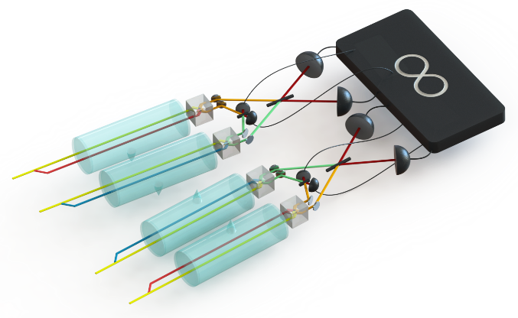
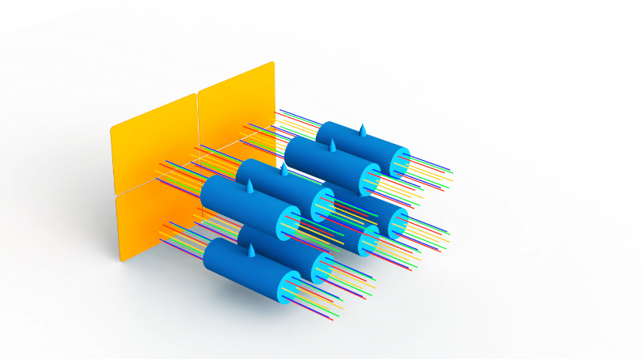
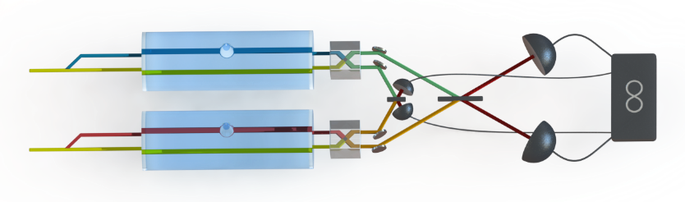
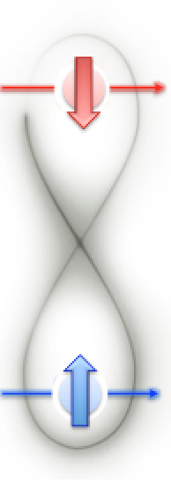
Next evolution: Programable light based quantum computer
Many-device entanglement.
Room temperature operation.
Programable.
Individual quantum systems (nodes) combine to serve as building blocks of a quantum communication network
An example of a quantum system is the quantum memories we have developed.
First RT Quantum Memory surpassing all the classical limits.
Quantum buffer
and measurement
stations
Quantum
Processing
Unit
Deterministic
Entanglement
Sources
Quantum memories for light qubits.
Photon-photon logic gates for qubits.
Solve quantum mechanical problems.

Slide 9
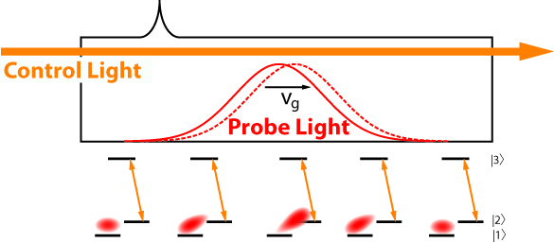
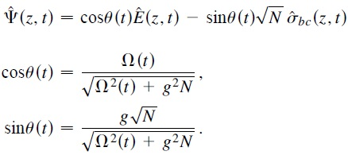

Photon propagation under EIT conditions
PHY 690
|3>
|2>
|1>

Slide 10
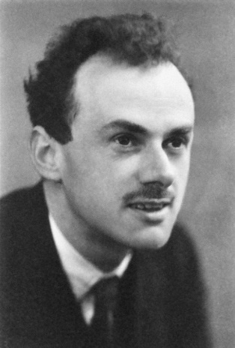
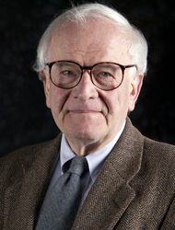
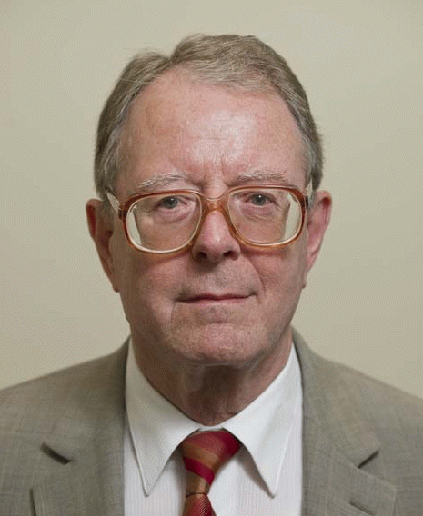
Interesting Quantum Simulation model: Dirac equation
- The Dirac equation merges quantum mechanics with special relativity.
- The Jackiw-Rebbi model describes a Dirac field coupled to a soliton field.
- A kink in the soliton yields a topologically protected zero-energy mode.
- Leads to charge fractionalization.

Slide 11
How to build a quantum simulator using dark state polaritons?
EIT setup
Multiple EIT systems
Spinor of light setup
PRL 105, 173603 (2010).

Slide 12
Dirac dynamics using spinor of light
Spinor of light:
The spinor obeys a Dirac-like equation:
PRL 105, 173603 (2010).
Scientific Reports 4, 6110 (2014).

Slide 13
Creating spinors of light experimentally
arXiv:1711.09346

Slide 14
Quantum simulation of Dirac spinor dynamics
“Realizing JR would require beams of relativistic particles interacting with Fermi quantum fields. This realization of the same physics requires only diode lasers and a cell of Rb atoms.”
arXiv:1711.09346

Slide 15
II. Photon-photon interaction experiments.

Slide 16
Photon-photon gate systems
Scientific Reports 5, 16581 (2015).
arXiv:1803.07012

Slide 17
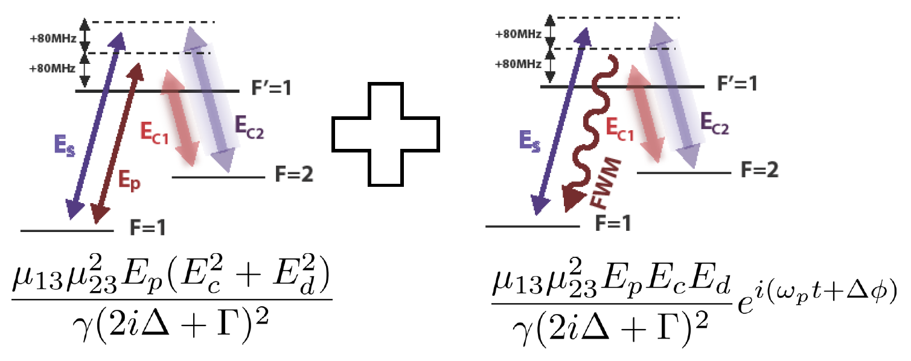
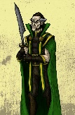
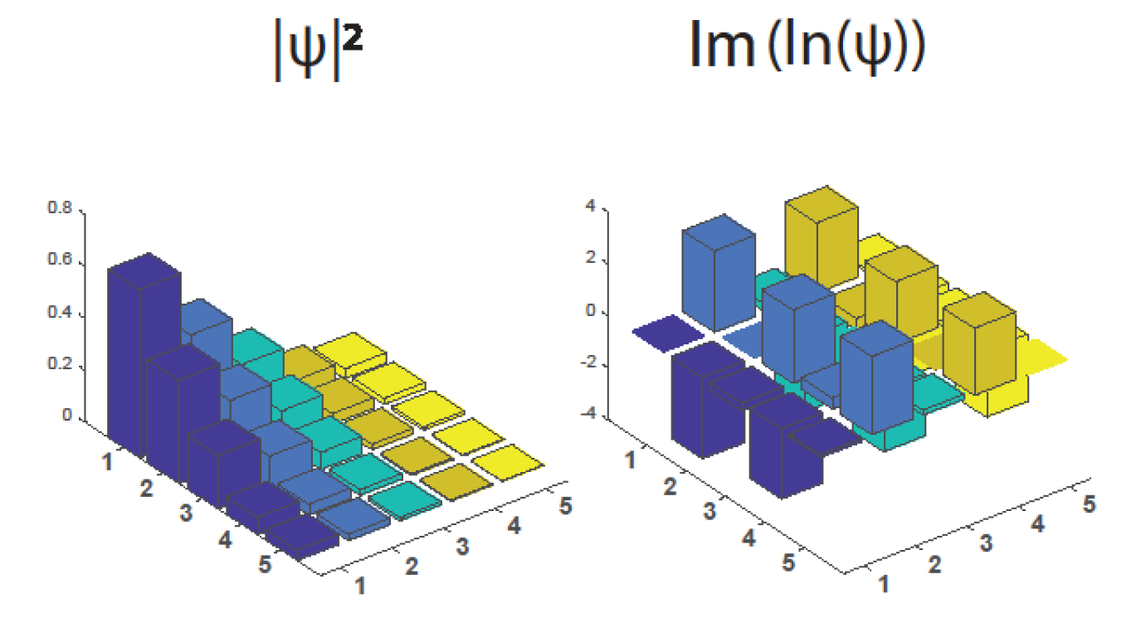
Reconstruction of wave-functions
Control
fields
Single- photon level pulses for
probe and signal
Density matrix
reconstruction
Wave function characterization
arXiv:1803.07012

Slide 18
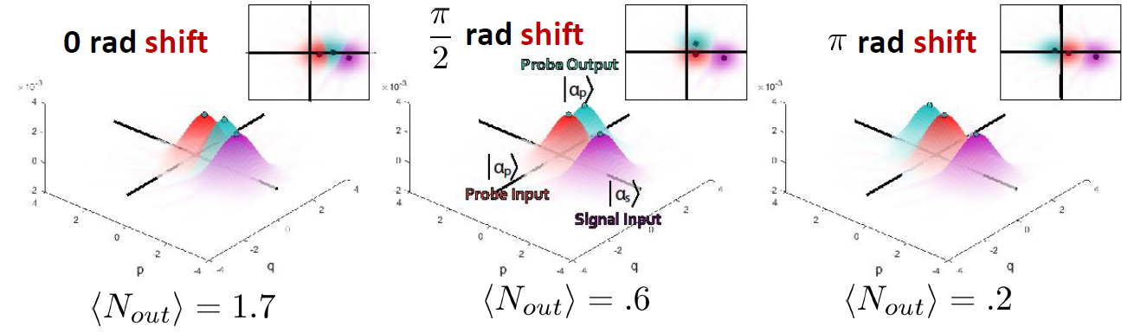
Pi-phase shifts in single photon fields mediated by few-photons
Triggered pi phase shifts
High transmission (~80%)
High-Fidelity (~90%)
Room-Temperature
arXiv:1803.07012

Slide 19
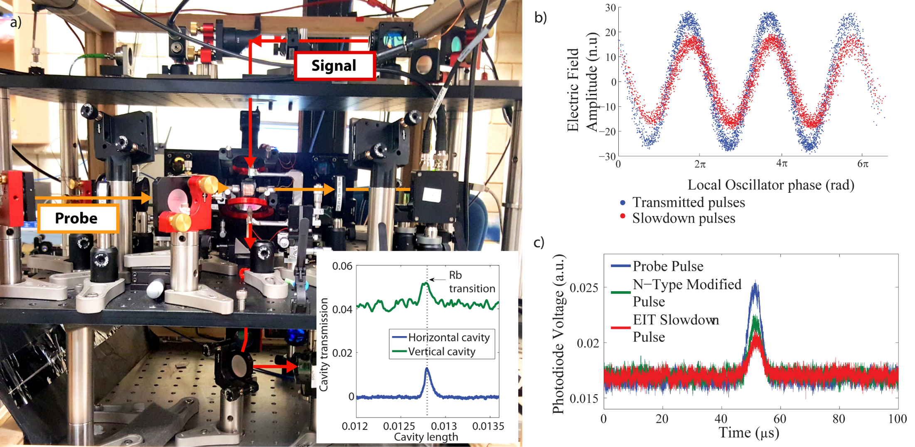
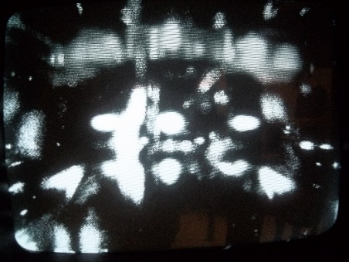
Implementation of a crossed cavity QED/EIT system
Current Status:
- Construction of cavities in a multi-layer system
- Observation of magneto-optical trapping and characterization of atomic cloud
- Observation of coupling between atoms and the two cavities.

Slide 20
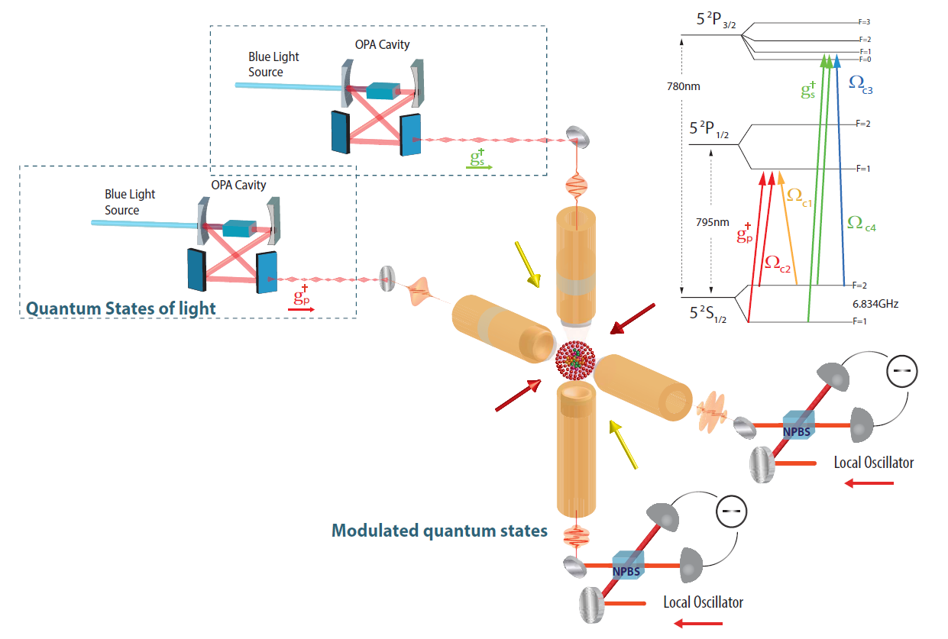
Outlook: Quantum simulation with quantized light fields

Slide 21
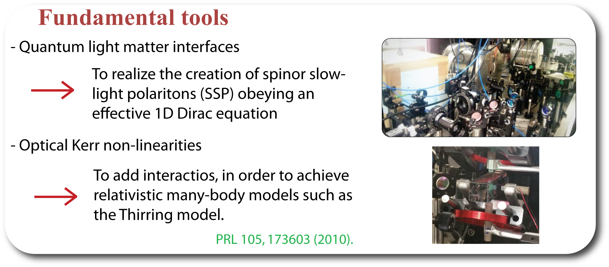
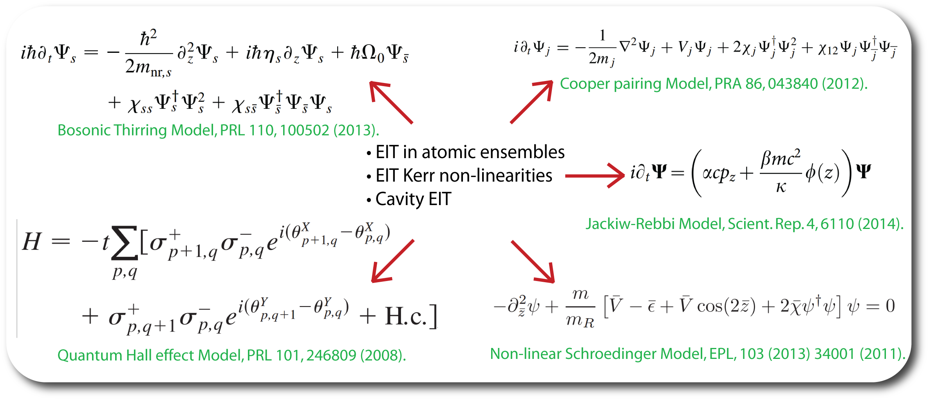
Road map for a DSP-based quantum simulator

Slide 22
Scaling the number of qubits

Slide 23
Entanglement imaging (SBU/BNL)
Individual quantum systems (nodes) combine to serve as building blocks of a quantum communication network
An example of a quantum system is the quantum memories we have developed.
First RT Quantum Memory surpassing all the classical limits.
TimePix camera with
intensifier.
Single photon level
detection in time and
space.
Entanglement pictures.
arXiv:1808.06720 (2018).

Slide 24
Entanglement characterization (SBU/BNL)
Individual quantum systems (nodes) combine to serve as building blocks of a quantum communication network
An example of a quantum system is the quantum memories we have developed.
First RT Quantum Memory surpassing all the classical limits.
Entanglement characterization.
Bell inequality violation.
81 simultaneous entanglement measurements.
arXiv:1808.06720 (2018).

Slide 25
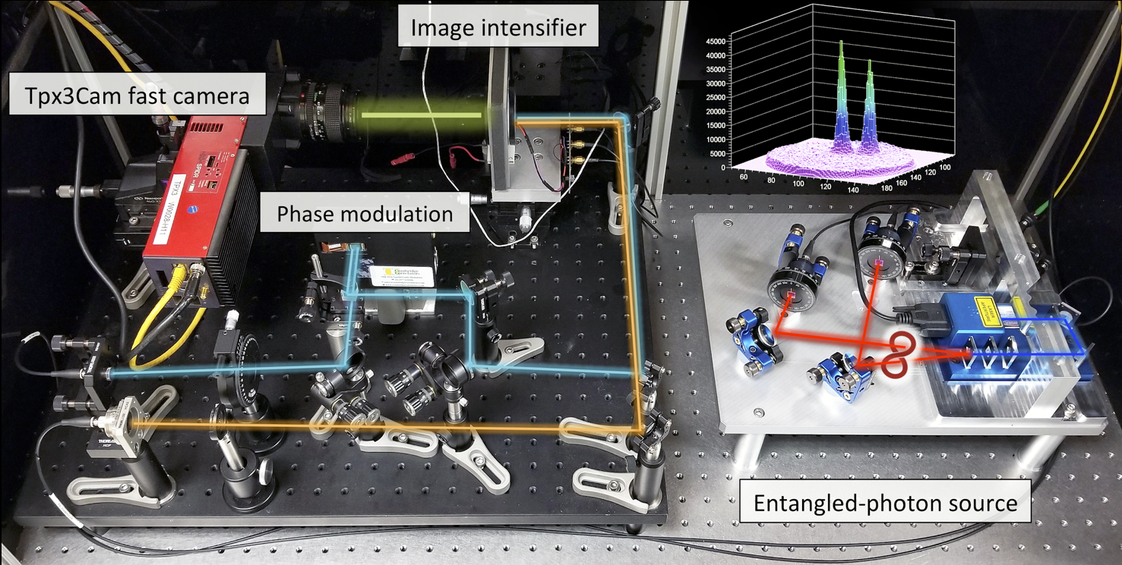
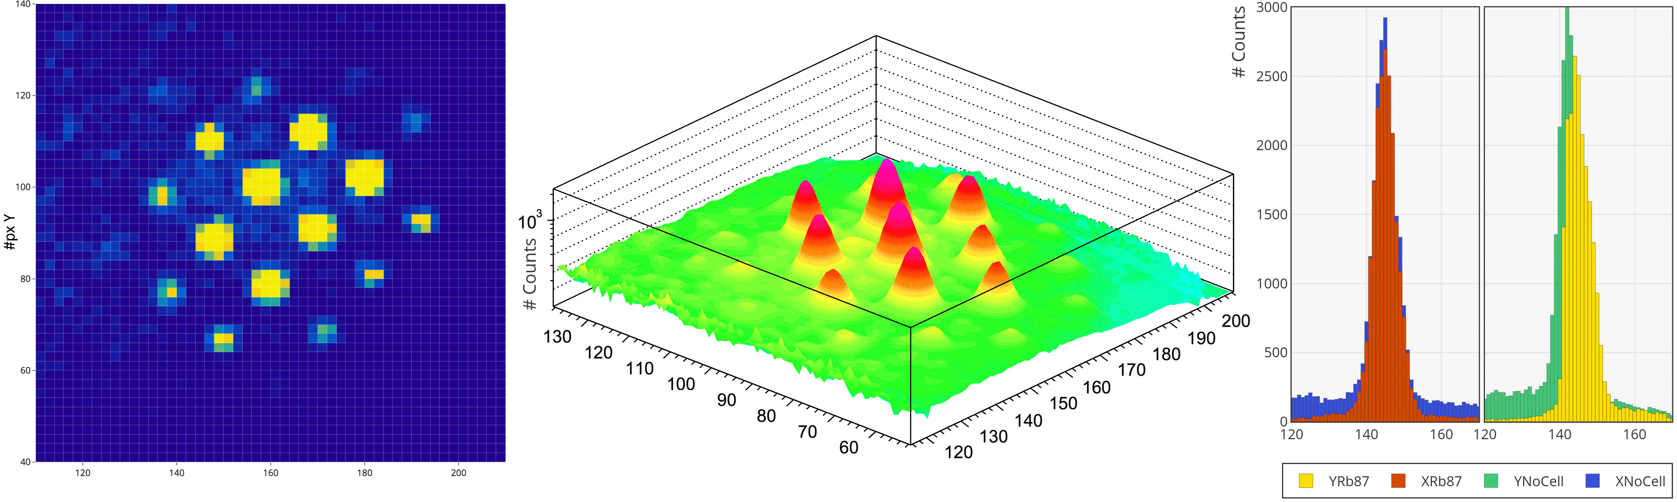
Scaling and multiplexing: a quantum grid (SBU/BNL)
TimePix camera with
intensifier.
Single photon level
detection in time and
space.
16-rail system created.
Rubidium interaction.
Individual quantum systems (nodes) combine to serve as building blocks of a quantum communication network
An example of a quantum system is the quantum memories we have developed.
First RT Quantum Memory surpassing all the classical limits.

Slide 26
Interaction with entangled photons from quantum dots (SBU/KTH)
Individual quantum systems (nodes) combine to serve as building blocks of a quantum communication network
An example of a quantum system is the quantum memories we have developed.
First RT Quantum Memory surpassing all the classical limits.
- Quantum dot photons tuned to the Rubidium D1 line (795nm)
arXiv:1808.05921 (2018).

Slide 27
Electromagnetically Induced Transparency with quantum dot photons (SBU/KTH)
Individual quantum systems (nodes) combine to serve as building blocks of a quantum communication network
An example of a quantum system is the quantum memories we have developed.
First RT Quantum Memory surpassing all the classical limits.
- New dynamics of fast photons interacting with atoms on resonance.
- Control-field-induced transparency for fast photons.
arXiv:1808.05921 (2018).

Slide 28
Outlook: A light-based quantum computer
- Quantum simulation of a sea of entangled relativistic particles.
Many qubits
characterization
Individual quantum systems (nodes) combine to serve as building blocks of a quantum communication network
An example of a quantum system is the quantum memories we have developed.
First RT Quantum Memory surpassing all the classical limits.
Photon-photon
cross-talk
Entanglement
interaction
- One-way quantum
computing with clusters of entangled photons.
Qubit grids

Slide 29
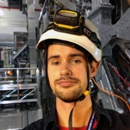
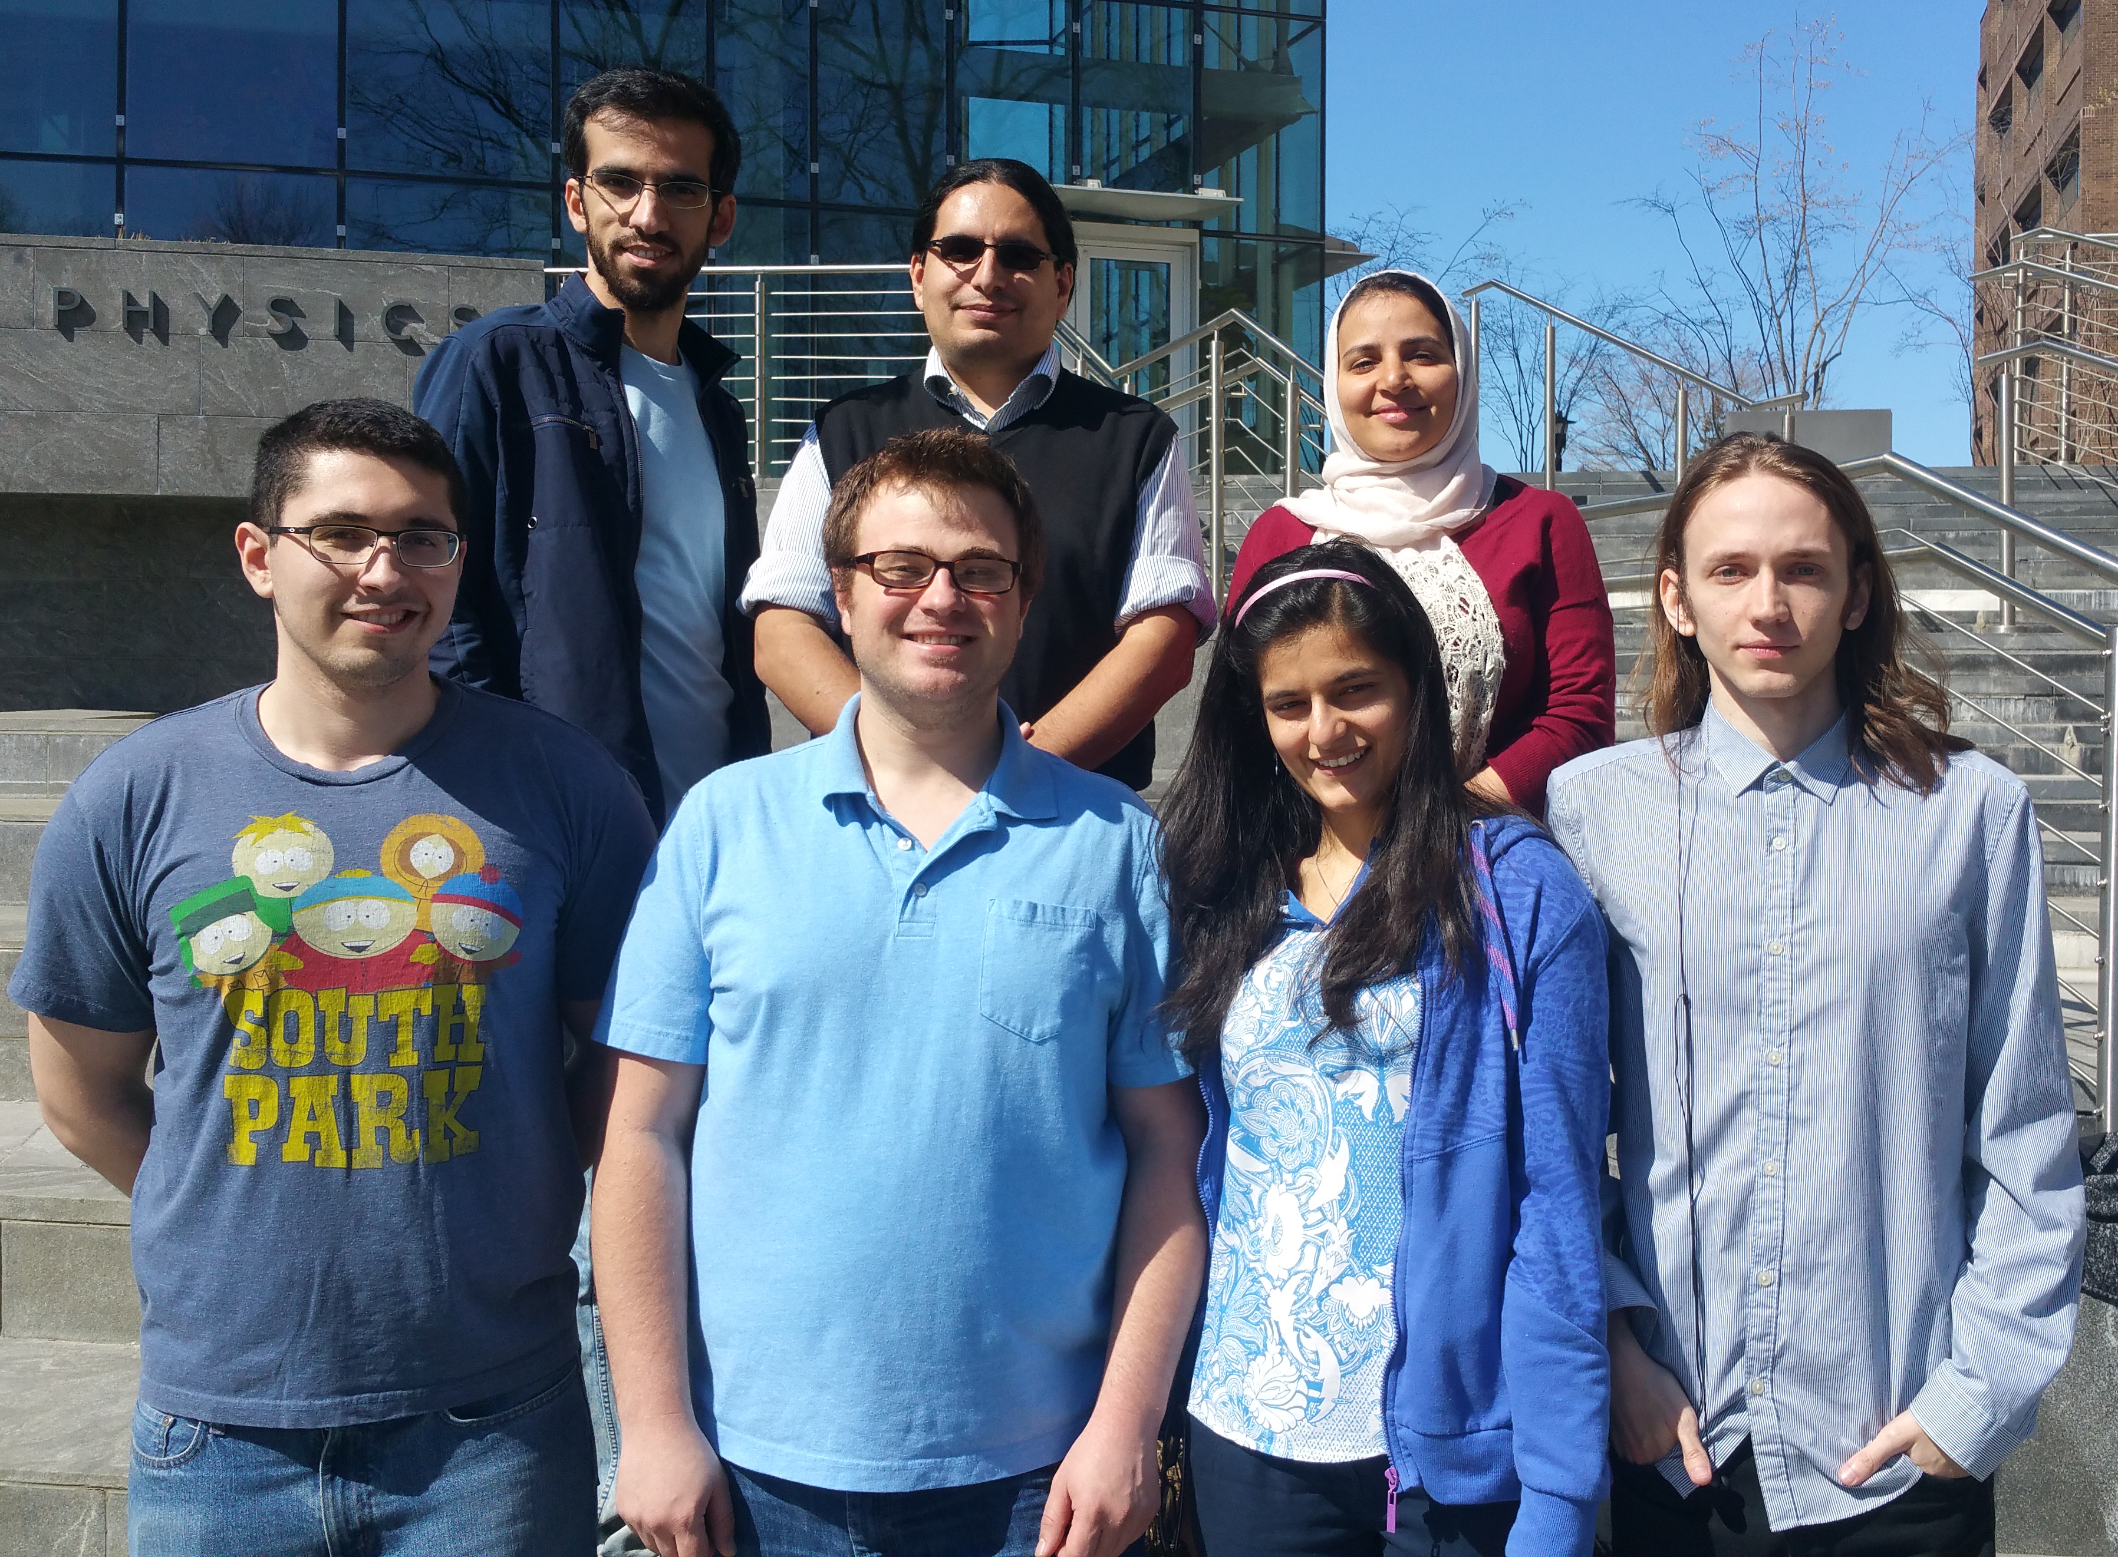
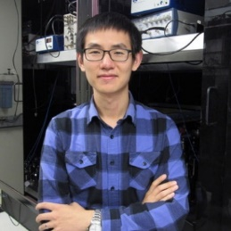
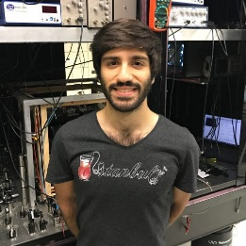
Take-home ideas
Small summary.
  Quantum simulation with light and atoms.
  Phase switching operations triggered by a few photons.
  Interaction with entangled photons.
  Grids with many light-qubits coming soon.
Principal Investigator:
Prof. Eden Figueroa (MEX)
Graduate projects:
Mehdi Namazi (IRN)
Bertus Jordaan (SAF)
Steven Sagona (USA)
Christopher Ianzano (USA)
Sonali Gera (IND)
Mael Flament (FRA)
Guodong Cui (CHN)
Samet Demircan (TRK)
Youngshin Kim (KOR)
qit.physics.sunysb.edu eden.figueroa@stonybrook.edu

