Slide 1
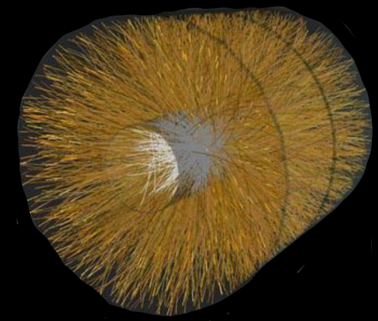
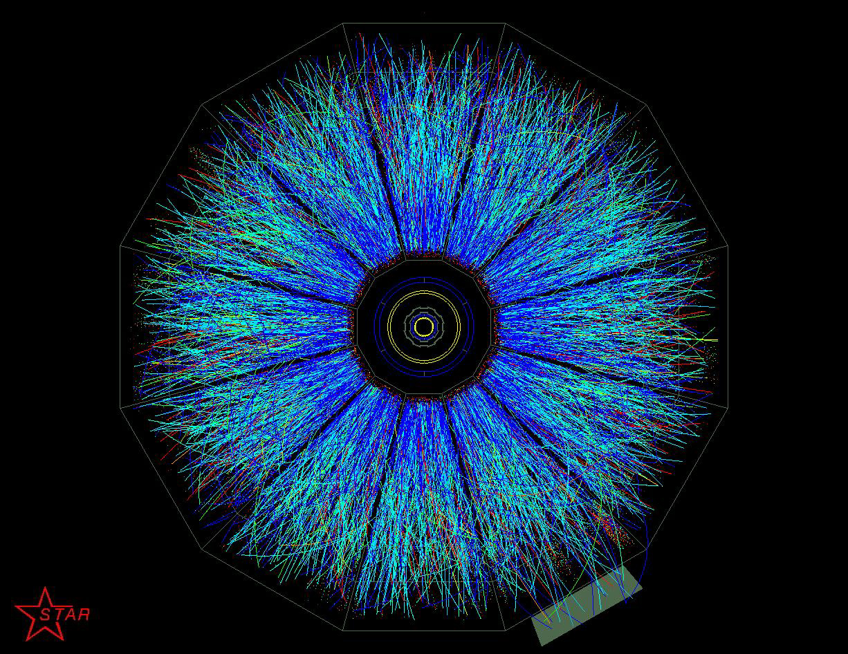
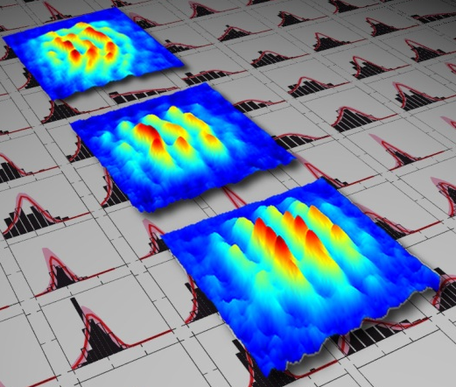
Universality far from equilibrium
and entanglement entropy
J. Berges
Heidelberg University
ALICE/CERN
Oberthaler Labs
Schmiedmayer Labs
Quantum Entanglement at Hadron Colliders, Stony Brook, September 2018
BNL

Slide 2
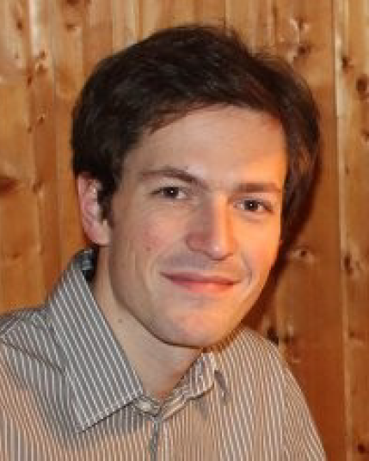

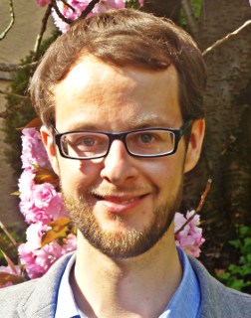
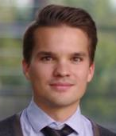
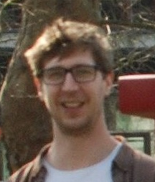
Content based on
• Thermal excitation spectrum from entanglement in an expanding quantum string, J.B., S. Flörchinger, R. Venugopalan, PLB778 (2018) 442; JHEP 1804 (2018) 145
& M. Heinrich, L. Kuhn, in preparation
→ see also talk by Stefan Flörchinger
• Prescaling in the nonequilibrium quark gluon plasma,
A. Mazeliauskas, J.B., to be published
• Observation of universal quantum dynamics far from equilibrium,
M. Prüfer et al, (Oberthaler Lab) arXiv:1805.11881, Nature (to appear)
• Observation of universal dynamics in an isolated one-dimensional Bose gas far from equilibrium, S. Erne et al, (Schmiedmayer Lab) arXiv:1805.12310

Slide 3
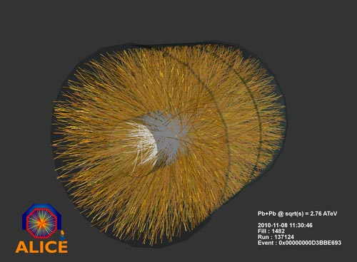

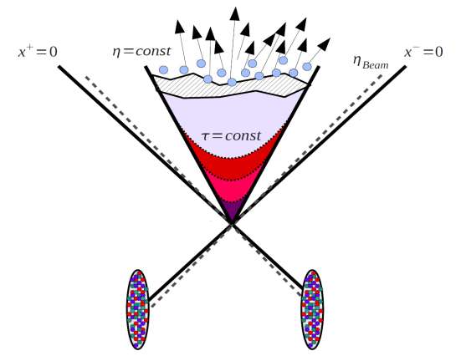
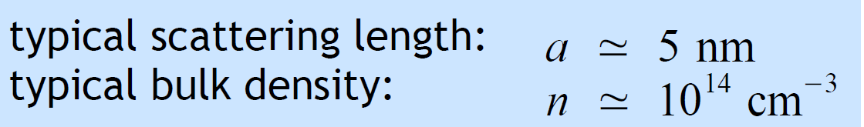



Far from equilibrium systems
Heavy-ion collisions in the high-energy limit
Dilute Bose gases
far from equilibrium
Oberthaler Labs
’Color Glass Condensate’:
Lappi, McLerran, Venugopalan,…
’Bose-Einstein condensation’:
Cornell, Ketterle, Wieman
( )
gauge coupling:
diluteness:
saturation
scale
coherence length⁻¹:
Far-from-equilibrium condition: over-occupation
→ Equilibration process starting from large gauge (scalar) fields s ( / )

Slide 4
Effective loss & entanglement entropy production
Characteristic stages for loss of details about initial conditions and parameters (longitudinal expanding λϕ⁴):
Coherent field:
Fluctuations/distribution:
early time
intermediate time
late time
Strong
coherent
fields
Nonthermal
fixed point
Approach to
(local) equilibrium
Instability
Prescaling
proper time τ
entanglement
across horizon
particle
production
far-from-equilibrium
hydodynamics
self-similar
scaling
⇒ thermal
fluctuations:
universal
distribution f_{S}
universal
exponents
α , β , γ

Slide 5
Early times: entanglement across particle horizon
• Entanglement entropy of Gaussian state in region A:
determined by matrix of correlation functions
J.B., Floerchinger, Venugopalan,
arXiv:1707.05338, 1712.09362
,
• Entanglement entropy for observable/causal rapidity interval Δη at proper time τ
Massive fields at early time ( ):
`Hubble‘ expansion rate dominates over masses/interactions (conformal)
→`collisionless´ entropy contribution

Slide 6
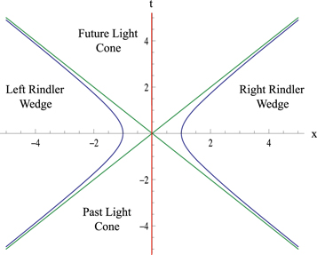
Thermal initial excitation spectrum from entanglement
• Entanglement entropy for rapidity interval Δη at proper time τ in 1+1 D:
free bosons (λ=0) of mass M
free fermions (g=0) of mass m
cf. also Holzhey, Larsen, Wilczek (1994); Calabrese, Cardy (2004); Casini, Huerta (2009)
⇒ extensive entropy in Δη ! (independent of coherent φ at very early times)
• Reduced density operator with early time-dependent temperature
time
space
• Compare Hawking-Unruh temperature in Rindler wedge:

Slide 7
Instabilities and role of interactions
• Linearized fluctuation equation (1+1 D):
Oscillator analogue (parametric
resonance):
`dilution
damping´
`redshift´
enhancement of fluctuations from parametric amplification
with Stefan Floerchinger, Michael Heinrich, Lara Kuhn

Slide 8
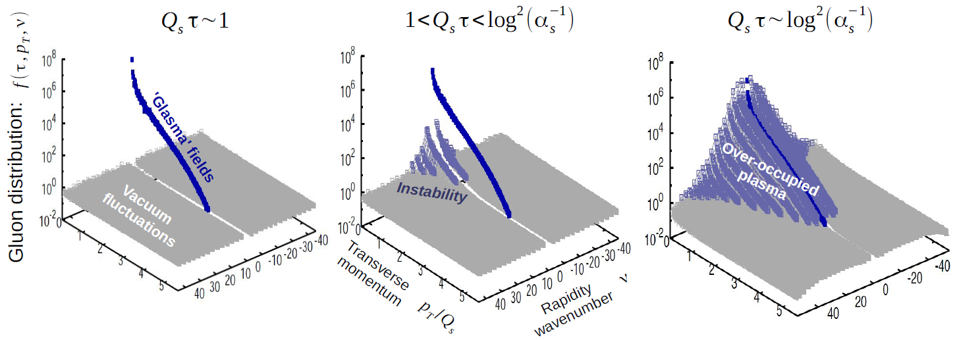
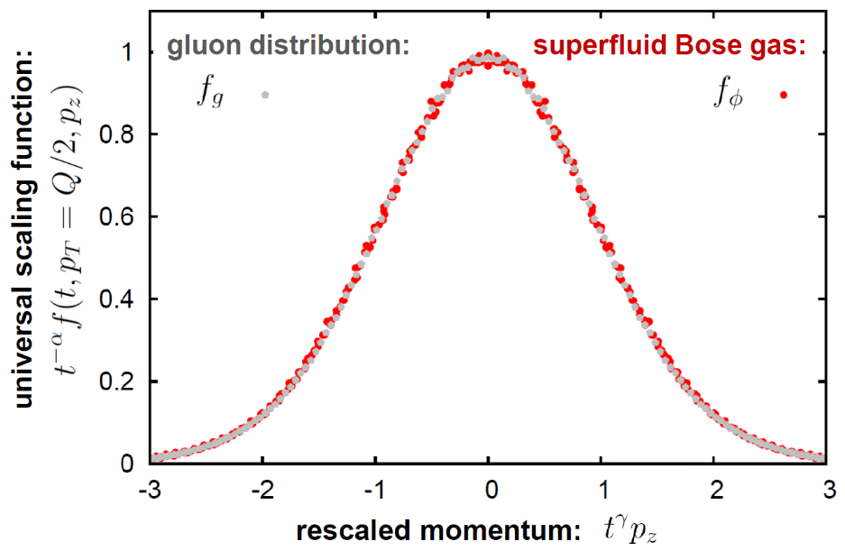

Intermediate times: universality far from equilibrium
Equilibration process for the quark gluon plasma in the high-energy limit (3+1 D):
strong color
fields
plasma
instabilities
nonthermal
fixed point
low-occupancy
regime
local thermal
equilibrium
particle production
universality
scalars‘ distribution:
gluon distribution
τ
τ
(real-time lattice simulations, read-out in ‘Coulomb gauge‘)
τ
J.B., Schenke, Schlichting,
Venugopalan, NPA931 (2014) 348
J.B., Boguslavski, Schlichting,
Venugopalan, PRL 114 (2015) 061601

Slide 9
Self-similar scaling at a nonthermal fixed point
Here: QCD effective kinetic theory
Arnold, Moor, Yaffe, JHEP 01 (2003) 030
with Aleksas Mazeliauskas
gluon, quark
distribution
elastic
scatterings
particle number
changing processes
Self-similar scaling:
universal exponents
universal fixed-point distribution
details about initial conditions and system parameters become irrelevant
• only elastic processes in small-angle approximation:
• first stage of `bottom-up´* thermalization emerges as a consequence of the attractor
*Baier et al (BMSS), PLB 502 (2001) 51
Lattice: J.B., Boguslavski, Schlichting, Venugopalan,
PRD 89 (2014) 074011; ibid. 114007

Slide 10
Prescaling and the emergence of universality
Prescaling:
with Aleksas Mazeliauskas
non-universal time-dependent exponents
universal fixed-point distribution
rapid establishment of fixed-point distribution with time-dependent exponents
→ prescaling
scaling→
→ prescaling
scaling→
units of Q

Slide 11
(Pre)scaling
Scaling
Prescaling
units of Q

Slide 12
Far-from-equilibrium hydrodynamics
Analyze moments of the distribution function:
&
which probe different momentum regimes
Prescaling:
⇒ dynamics described by 3 slow-varying exponents ⇔ 3 hydrodynamic moments:
Set of hydrodynamic equations in prescaling regime, e.g. for conformal case ( ):

Slide 13
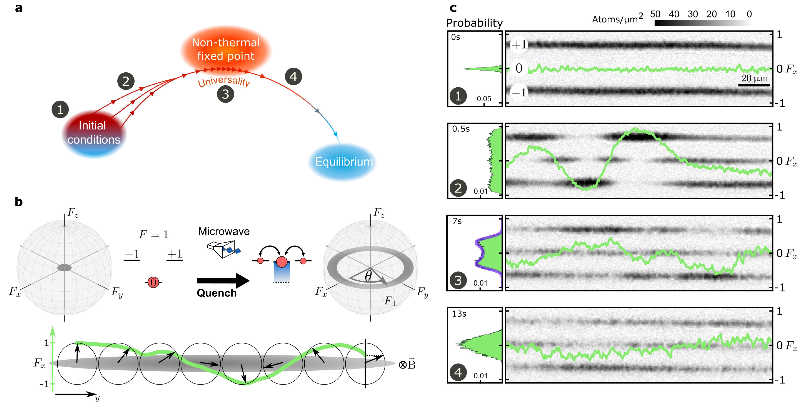
Observing universal dynamics with ultracold atoms
⁸⁷Rb BEC in a quasi 1D optical trap:
Spin-1 BEC (F=1 hyperfine state with magnetic sublevels m_{F} = 0, ±1), no expansion!
Prüfer et al, arXiv:1805.11881, Nature (to appear); see also Erne et al, (Schmiedmayer Lab) arXiv:1805.12310

Slide 14
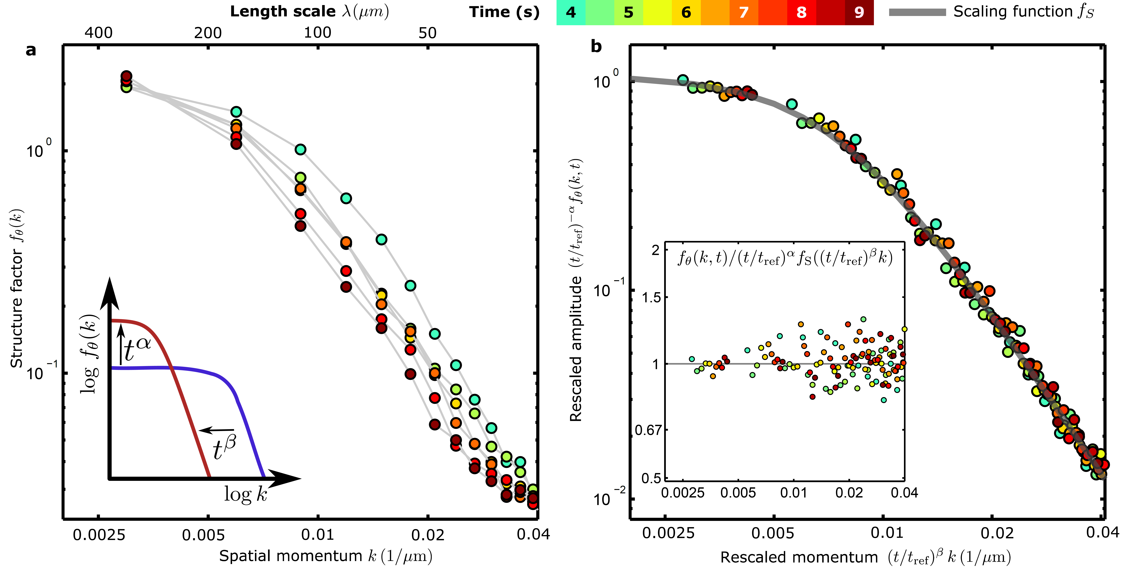
Self-similar dynamics after nonequilibrium instability
Scaling exponents and nonthermal fixed-point distribution:
,
α = 0.33±0.08
β = 0.54±0.06
Prüfer et al, arXiv:1805.11881, Nature (to appear)

Slide 15
Conclusions & Outlook
Characteristic stages for effective loss & (entanglement) entropy production:
• Initial thermal-like fluctuations from entanglement across horizon
→ collisionless at early times with subsequent parametric amplification
• Prescaling and far-from-equilibrium hydrodynamics
universal scaling distribution, non-universal time-dependent exponents
• Nonthermal fixed points: universality classes far from equilibrium
→ unexpected quantitative links between different nonequilibrium systems
Outlook: sonic horizon physics and (pre)scaling in cold atoms with expansion
detecting and quantifying entanglement
cf. talk by Philipp Hauke
higher-order correlation functions
cf. talk by Jörg Schmiedmayer

Slide 16
Supplementary material

Slide 17
Dynamical emergence of conserved quantity
⇒

Slide 18
Universal scaling & insensitivity to initial details
Schmiedmayer labs
87Rb on an atom chip
Distribution after quench in 1D:
Different 1D universality class?
Erne, Bücker, Gasenzer, Berges, Schmiedmayer

Slide 19
Gluon distribution function
units of Q

Slide 20
Quark (pre)scaling
units of Q

Slide 21
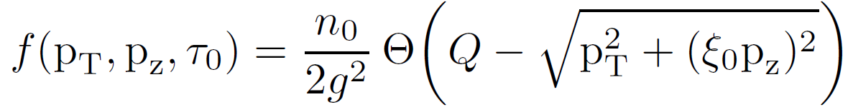
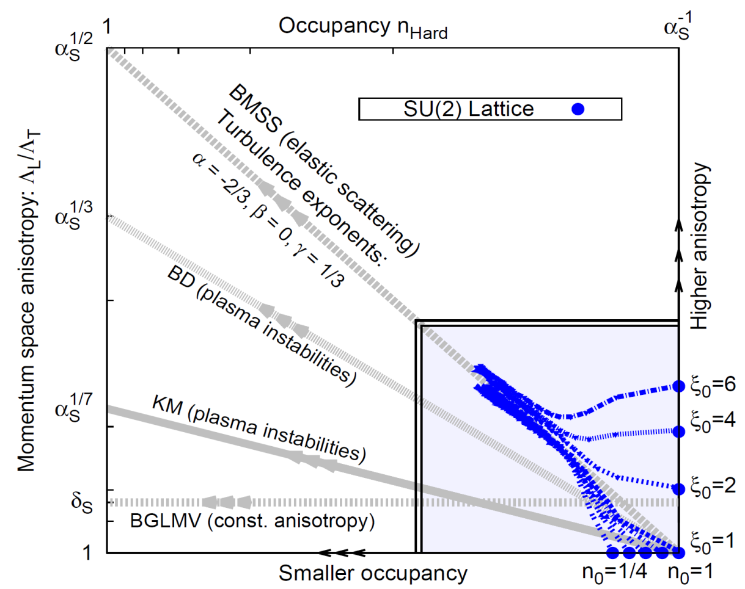
Nonthermal fixed point in QCD
Attractor in the `anisotropy-occupancy plane´
Lattice data
Scaling exponents:
(256²×4096)
(`bottom up´ scenario)
Berges, Boguslavski, Schlichting, Venugopalan,
PRD 89 (2014) 074011; ibid. 114007
BMSS: Baier, Muller,
Schiff, Son (2001)
BD: Bodecker (2005)
KM: Kurkela, Moore (2011)
BGLMV: Blaizot et al. (2012)

Slide 22
Long-distance behavior: Wilson loop scaling
Wilson loop (gauge invariant, no expansion):
Time
Space-Time
Wilson Loop
Space
Space-Space
Wilson Loop
Space
Universal self-similar scaling:
Berges, Mace, Schlichting, PRL 118 (2017) 192005
Mace, Schlichting, Venugopalan, PRD 93 (2016) 074036

Slide 23
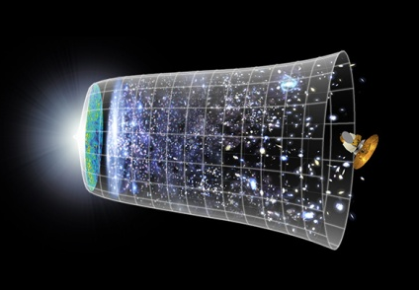


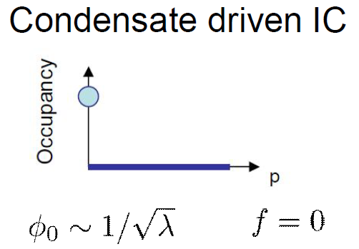
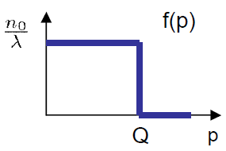




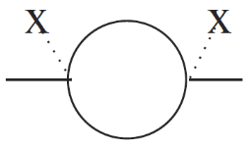
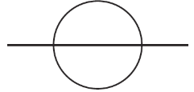
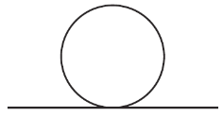
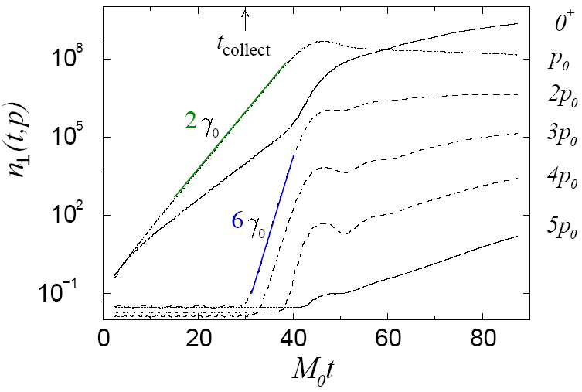
Early universe preheating: Nonequilibrium instability
Schematic scalar inflaton evolution at early times:
Large initial field →
growth of occupation number
→ over-occupation
instability
(parametric resonance)
N-component field with λ/(4!N) (Φ_{a}Φ_{a})²:
instability
over-occupation
→ dynamical power counting (2PI)
primary instability
…
f
f~1/λ^{1/2}
f~1/λ^{3/2}
f~1/λ
time
‘Occupancy‘
secondaries
Berges, Serreau, PRL 91 (2003) 111601
Cold atoms: Zache et al, PRA 95 (2017) 063629
time

Slide 24
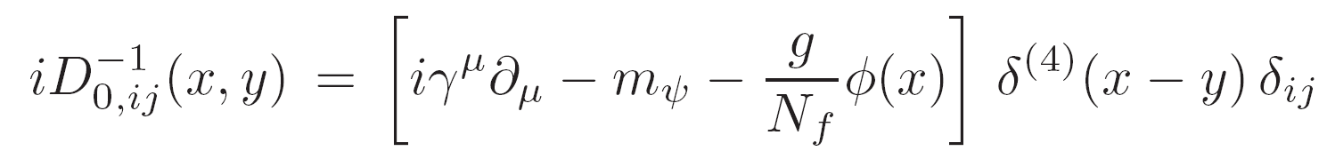
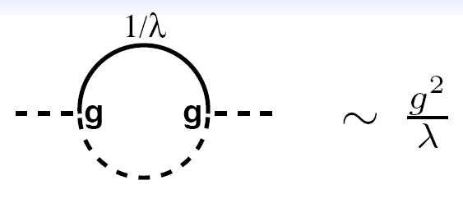
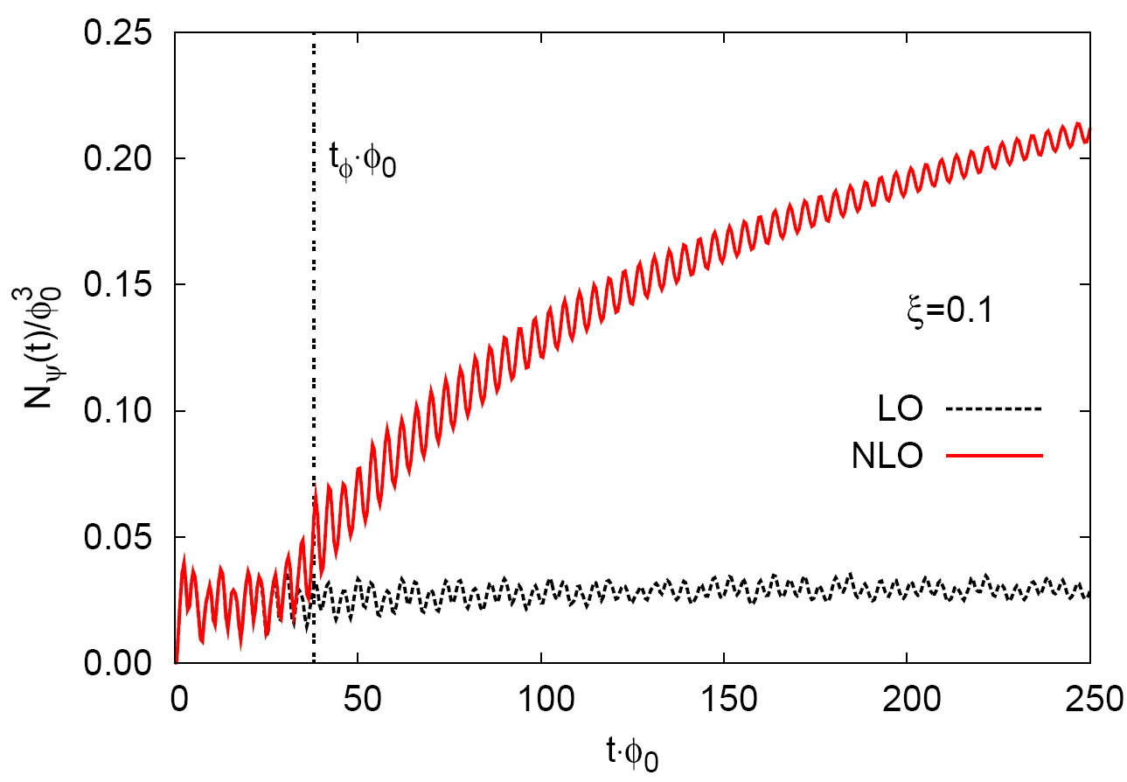
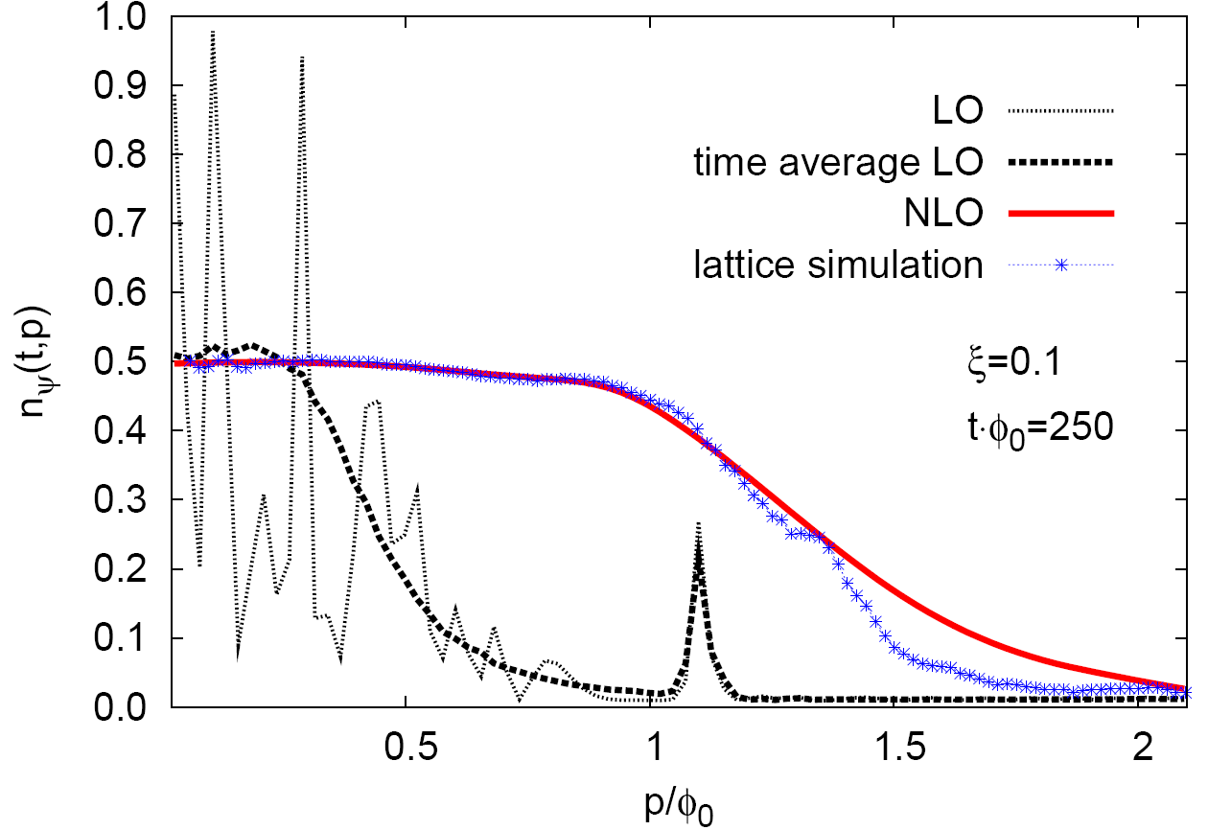
Fermions: strongly enhanced quantum effects
Semi-classical (LO):
t
Boson
g
NLO:
over-occupied
bosons act as
‘quantum magnifiers‘
Fermion
instability
over-occupied bosons
Check against lattice simulation:
Semi-classical ( )
Total number of fermions
quantum correction
Semi-classical
Time
Berges, Gelfand, Pruschke, PRL 107 (2011) 061301; Hebenstreit, Berges, Gelfand, PRL 111 (2013) 201601
Gelfand, Hebenstreit, Berges, PRD 93 (2016) 085001; scaling: Tanji, Venugopalan, PRD 95 (2017) 094009

Slide 25
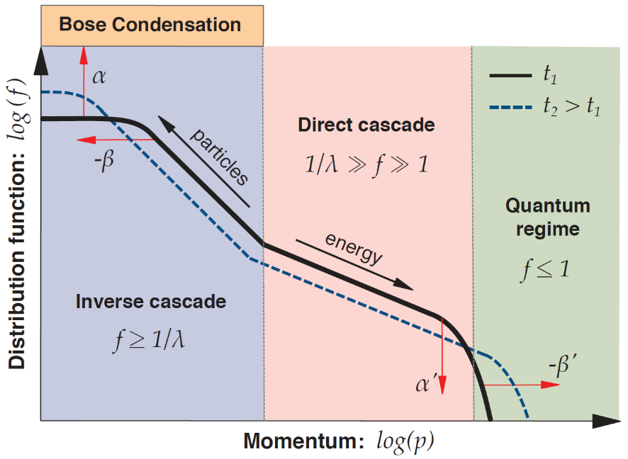
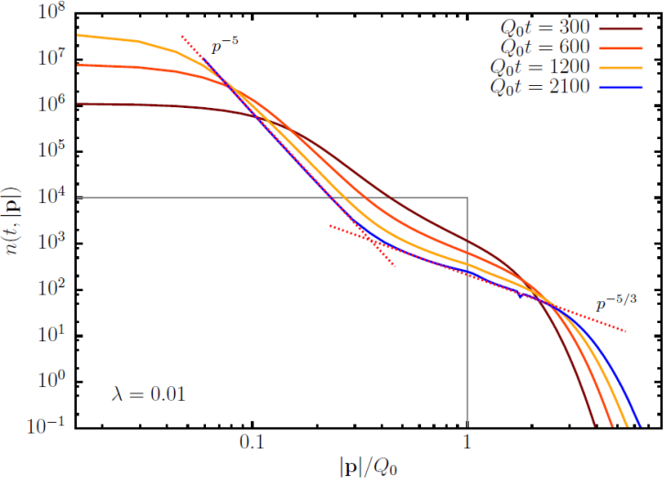
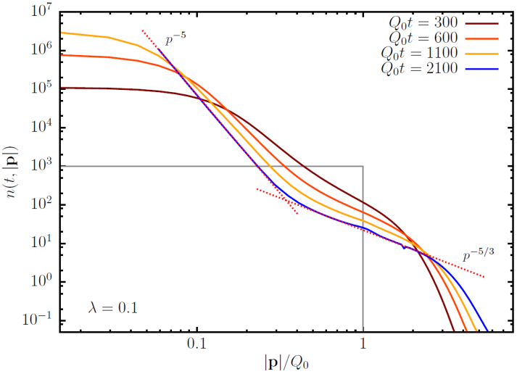
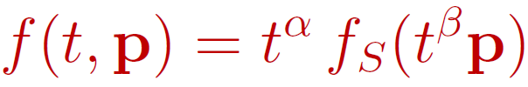
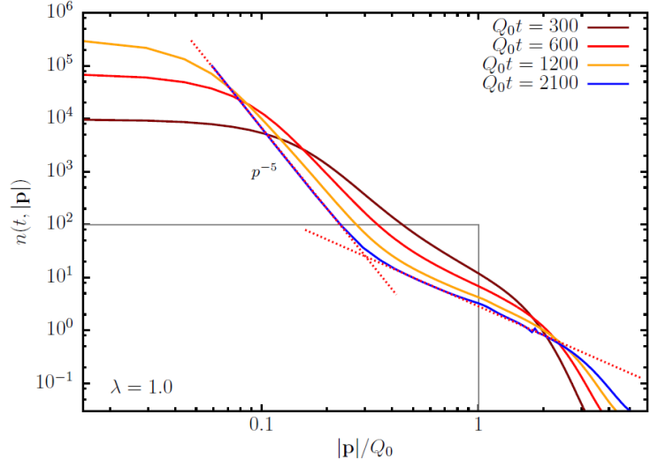
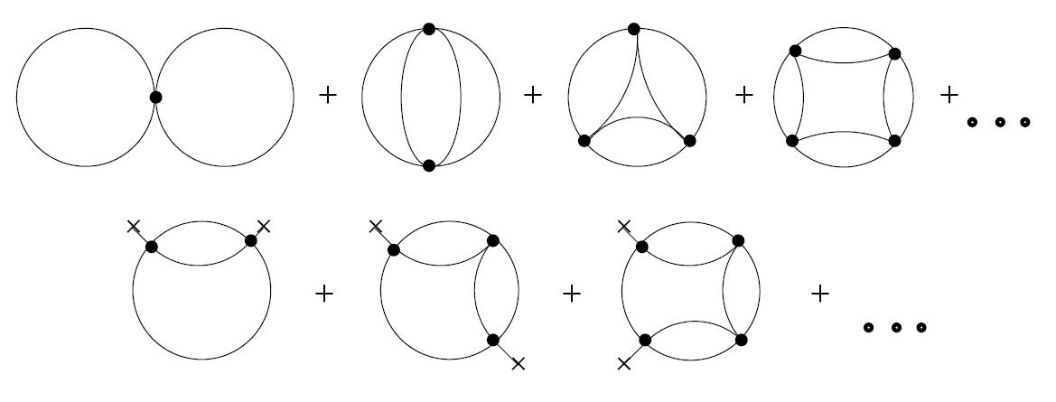
Subsequent scaling regime: dual cascade
UV → weak wave turbulence: Micha, Tkachev, …
& IR: Berges, Rothkopf, Schmidt, Hoffmeister, Sexty;
Gasenzer, Scheppach, Novak, Schole, Erne, Schmidt,
Karl; Ewerz, Samberg; Piñeiro Orioli, Boguslavski …
Low
occupancy
regime
Bosons
(N = 4)
f
λ= 0.01
IR scaling exponents:
NLO 1/N:
λ= 0.1
λ= 1
Universal behavior for wide range of couplings!
anomalous dimension
Piñeiro Orioli, Boguslavski, Berges, PRD 92 (2015) 025041; Berges, Wallisch, PRD 95 (2017) 036056

Slide 26

Self-similar dynamics: infrared scaling
,
Piñeiro Orioli, Boguslavski, Berges,
PRD 92 (2015) 025041
d = 3
lattice simulation

Slide 27
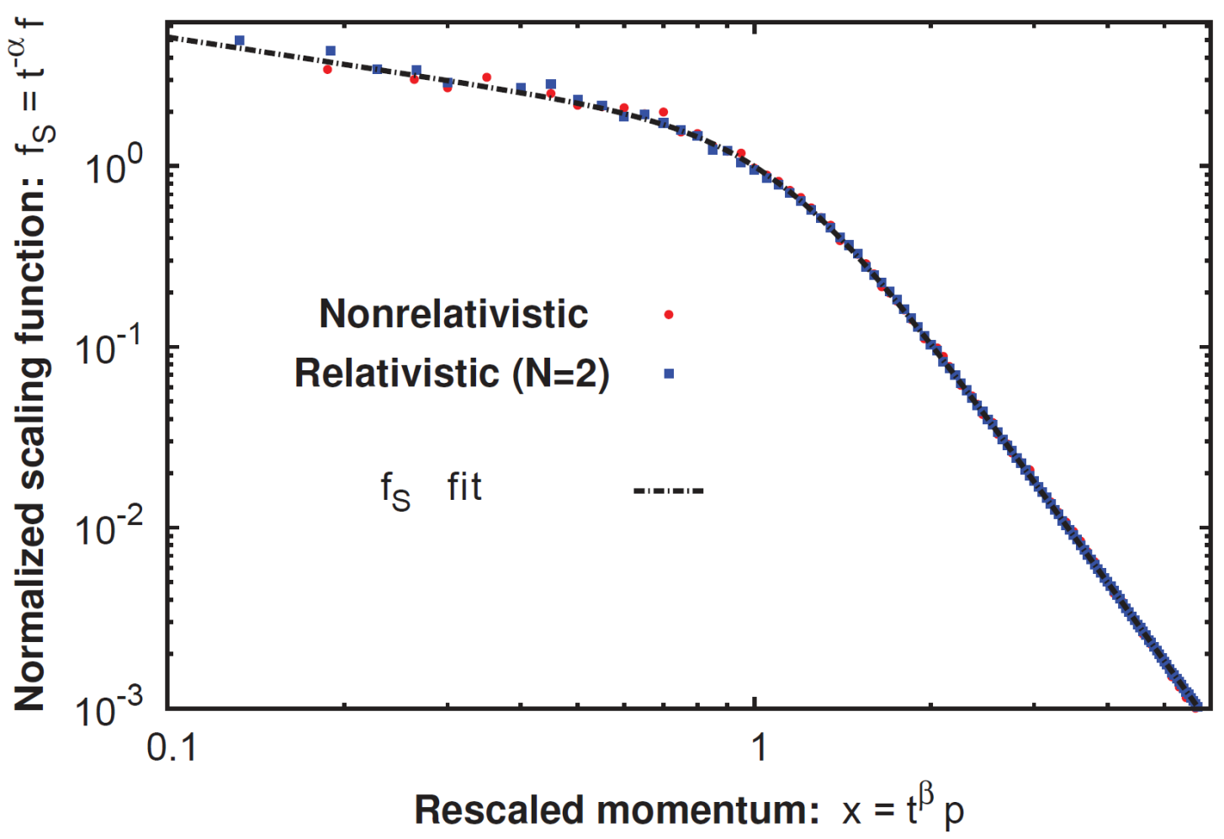
Universality far from equilibrium
Piñeiro Orioli, Boguslavski, Berges,
PRD 92 (2015) 025041; Moore, PRD93 (2016) 065043; Walz, Boguslavski, Berges arXiv:1710.11146; Chantesana, Piñeiro Orioli, Gasenzer, arXiv:1801.09490
(insensitive to value of finite N)
lattice simulation
ξ
Same universality class (nonthermal infrared fixed point)
for non-relativistic Bose gas and relativistic Inflaton
27

Slide 28
Non-relativistic infrared dynamics: phase fluctuations
density
phase
Universal scaling function for phase fluctuations:
Asier Piñeiro Orioli
Comparison: density vs. phase fluctuations
phase
density
cf. also Mikheev, Schmied, Gasenzer

Slide 29






Transport towards infrared
⇒
Time-independent scaling function:
Scaling exponents α and β determine rate and direction of transport:
⇒
e.g. α > 0, β > 0: transport towards lower momentum scales

Slide 30
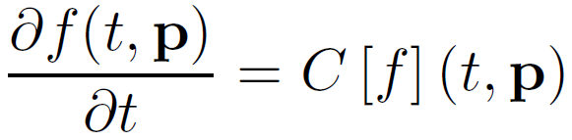
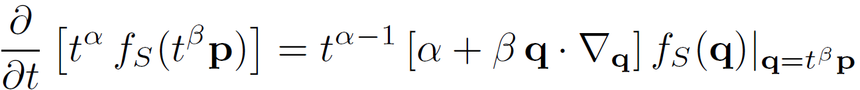

Nonthermal fixed points: a kinetic theory primer
`collision integral´
Use
Time-independent fixed point equation:
+ scaling relation:

Slide 31
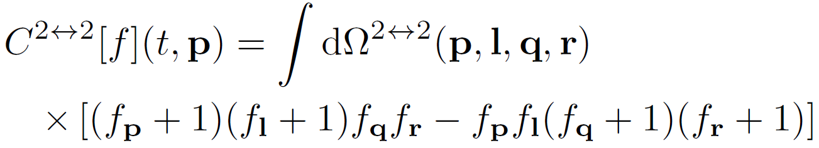
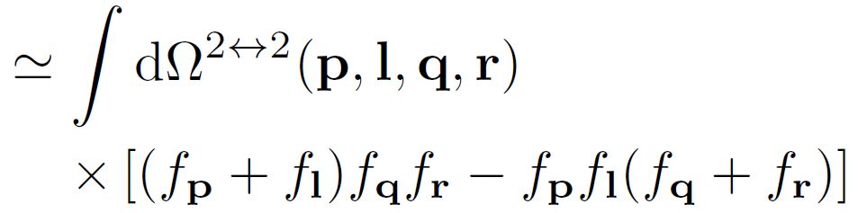

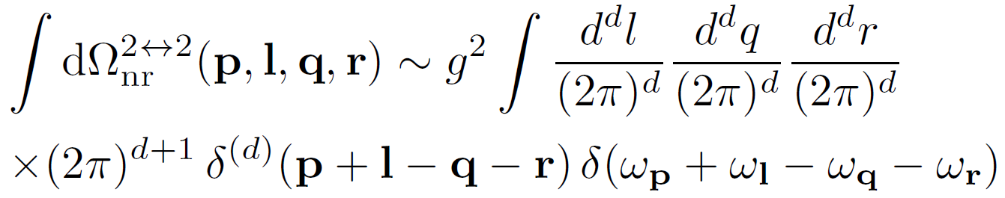
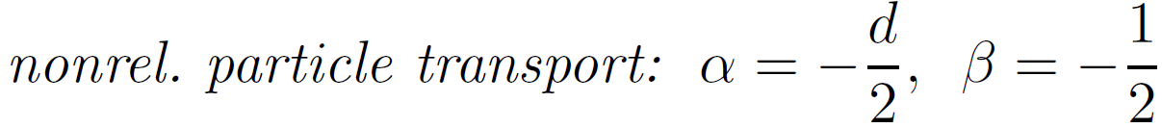
Perturbative estimate
Using:
for (free) quadratic dispersion gives:
⇒
Negative perturbative exponents do not account for inverse particle cascade!

Slide 32
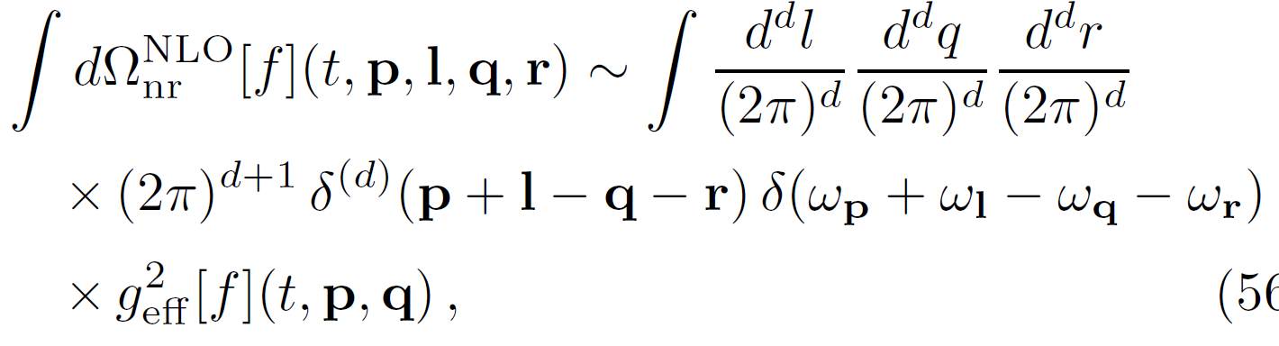
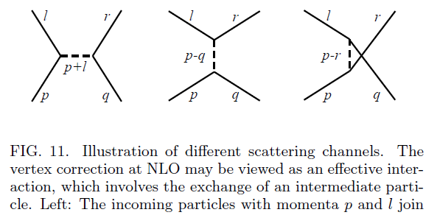
Beyond perturbation theory: large-N expansion to NLO

Slide 33
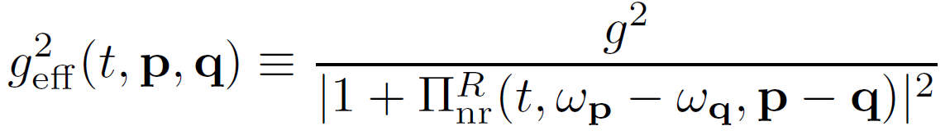
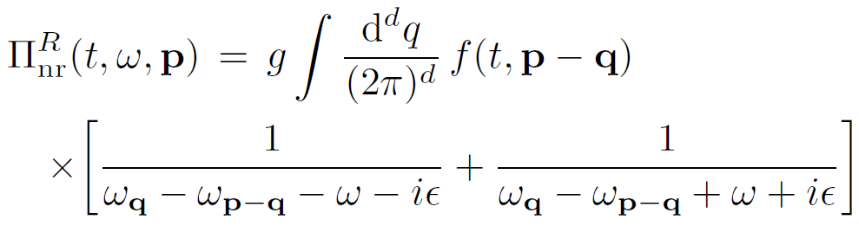


Effective interaction vertex at NLO 1/N
one-loop retarded self-energy:
scaling behavior:
,
in the infrared:
⇒

Slide 34


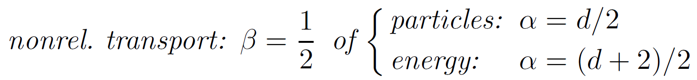
Scaling solution at NLO 1/N
gives scaling relation:
⇒
+ number conservation ( ):
Positive nonperturbative
exponents describe
inverse cascade!
Piñeiro Orioli, Boguslavski, Berges,
PRD 92 (2015) 025041
Walz, Boguslavski, Berges,
ariv:1710.11146

