Slide 1
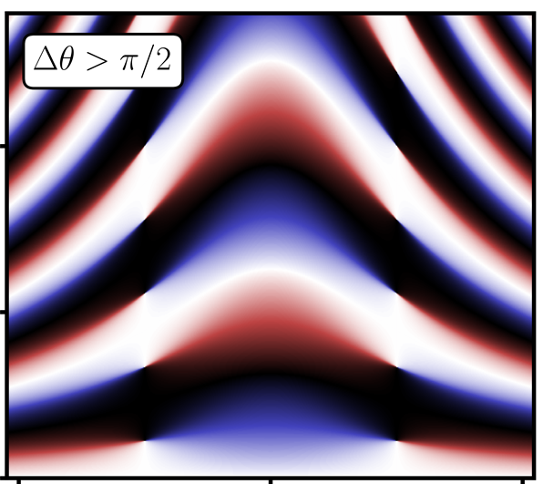
Towards quantum simulating gauge theories:
Dynamical topological quantum phase transitions
Philipp Hauke
Heidelberg University
Stony Brook, Sept. 12 2018
Zache, Mueller, Schneider, Jendrzejewski, Berges, Hauke, arXiv:1808.07885

Slide 2
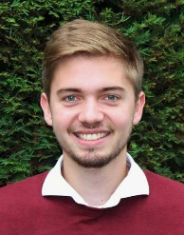
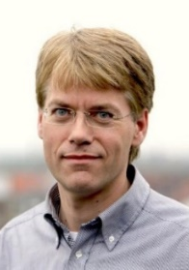
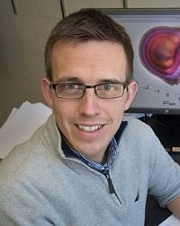
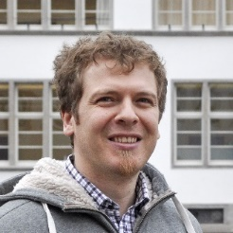
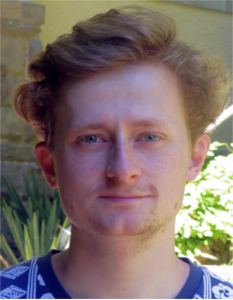
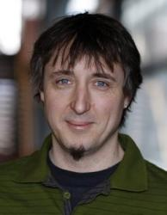
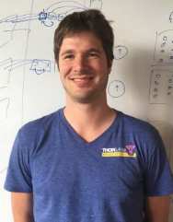
Collaborators
Heidelberg
Brookhaven
Bern
Theory
Torsten
Zache
Jan
Schneider
Jürgen
Berges
Niklas Müller
Florian
Hebenstreit
Experiment
Markus
Oberthaler
Fred
Jendrzejewski
Innsbruck
Theory
Experiment
Christine Muschik, Markus Heyl, Marcello Dalmonte, Peter Zoller
Esteban Martinez, Philipp Schindler, Daniel Nigg, Alexander Erhard,
Thomas Monz, Rainer Blatt

Slide 3
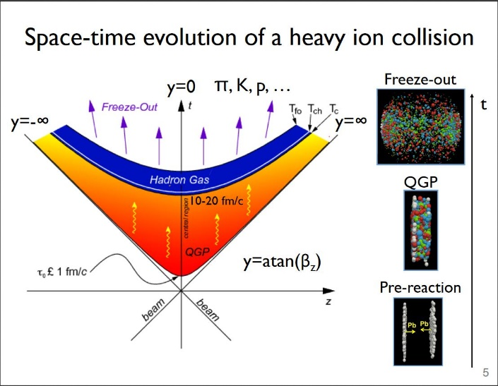
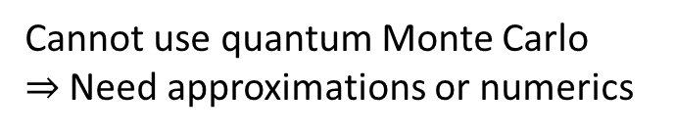
We would like to understand out-of-equilibrium dynamics of quantum systems.
Wei Li’s talk
on Monday
Entanglement is a challenge for that.
Cannot use quantum Monte Carlo
$⇒$ Need approximations or numerics

Slide 4
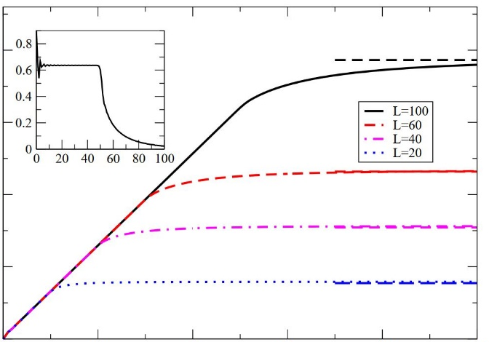

Powerful method: Tensor networks
Complexity scales exponentially with entanglement
Entanglement typically grows linearly with time
Calabrese, Cardy, J. Stat. Mech. 2005
ent. entropy
time

Slide 5
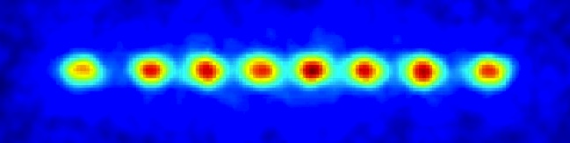
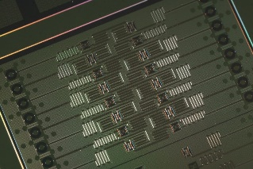
Remedy (Feynman, Lloyd): “Quantum simulation”
Use engineered quantum devices to study quantum dynamics
see talks A. Bazavov, E. Figueroa, C. Muschik, M. Savage, J. Schmiedmayer, E. Zohar
Optical lattices
Trapped ions
Superconducting qubits
Quantum dots, Photons, . . .

Slide 6




First proof of principle experiments exist (QED in 1+1D)
Martinez, Muschik, Schindler, Nigg,
Erhard, Heyl, Hauke, Dalmonte,
Monz, Zoller, Blatt, Nature 2016
See also talk, M. Savage
map to spin system with
long-range interactions
design efficient algorithm
for quantum computer
$$e^{−}$$
$$e^{+}$$
$$e^{−}$$
$$e^{+}$$
time

Slide 7


First proof of principle experiments exist (QED in 1+1D)
Martinez, Muschik, Schindler, Nigg,
Erhard, Heyl, Hauke, Dalmonte,
Monz, Zoller, Blatt, Nature 2016
See also talk, M. Savage
particle
number
th+exp with decoherence
theory without decoherence
time
$$tm\sim 2$$
Proposal for optical lattices
20 lattice sites realistic
Coherence times up to $tm\sim 2$
Zache, Hebenstreit, Jendrzejewski, Oberthaler, Berges, Hauke, Quantum Sci. Tech. 2018
Many more works in groups
Cirac, Lewenstein, Reznik, Savage, Solano, Tagliacozzo, Wiese, Zoller, . . .

Slide 8


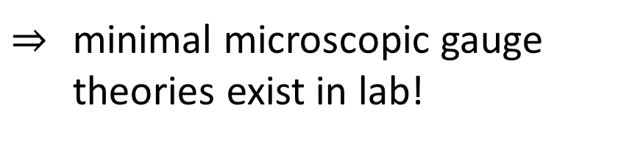
$⇒$ minimal microscopic gauge
theories exist in lab!
But currently attainable time scales short, system sizes small
$$tm\sim 2$$
$4−20$ sites

Slide 9
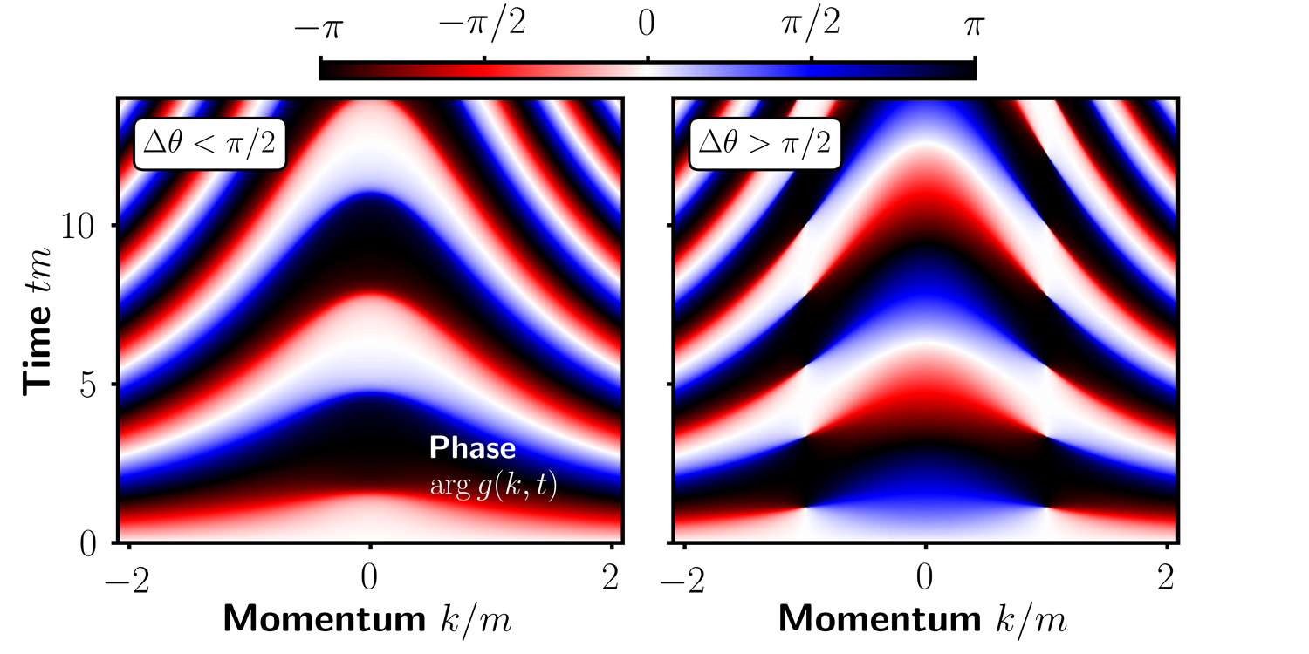


Challenge:
What relevant phenomena can
be done in the lab right now ?
$$tm\sim 2$$
momentum $km$

Slide 10
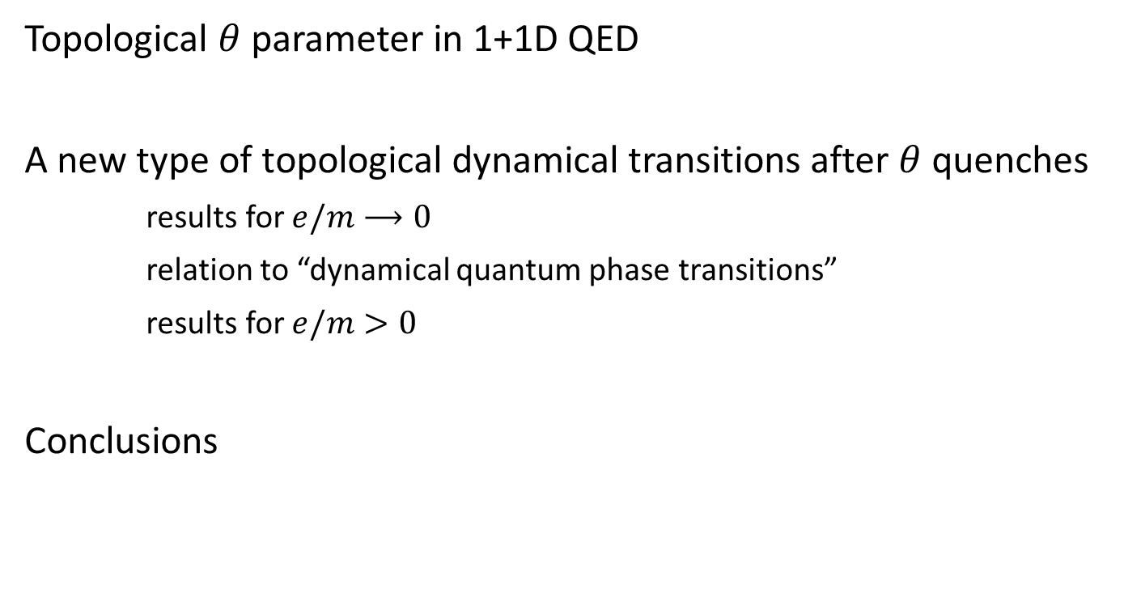
Outline
Topological $θ$ parameter in 1+1D QED
A new type of topological dynamical transitions after $θ$ quenches
results for $e/m⟶0$
relation to “dynamical quantum phase transitions”
results for $e/m>0$
Conclusions

Slide 11
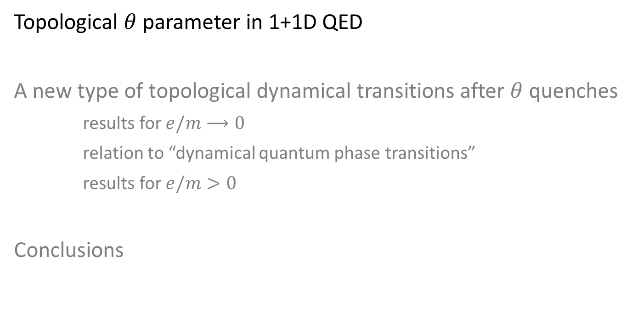
Outline
Topological $θ$ parameter in 1+1D QED
A new type of topological dynamical transitions after $θ$ quenches
results for $e/m⟶0$
relation to “dynamical quantum phase transitions”
results for $e/m>0$
Conclusions

Slide 12
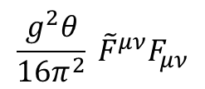


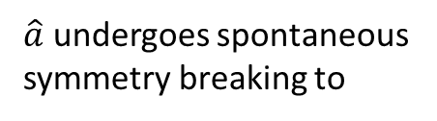
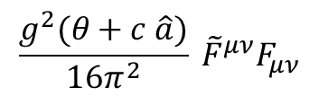

Motivation to study $θ$ parameter
Topological structure of 3+1D QCD allows for additional term in action
$$\frac{g^{2}θ}{16π^{2}} {\tilde{F}}^{μν}F_{μν}$$
Violates CP
But experiments find $θ<{10}^{−9}$
(no CP violation observed)
Possible explanation: axion field
$$\frac{g^{2}(θ+c \hat{a})}{16π^{2}} {\tilde{F}}^{μν}F_{μν}$$
Weinberg, PRL 1978, Wilczek, PRL 1978
Peccei, Quinn, PRL 1977
$\hat{a}$ undergoes spontaneous
symmetry breaking to
$$θ^{eff}=0$$
Axion has not yet been observed!

Slide 13
Very complicated.
$⇒$ consider $θ$ as an externally adjustable parameter
$⇒$ simpler model accessible to current quantum simulators?

Slide 14

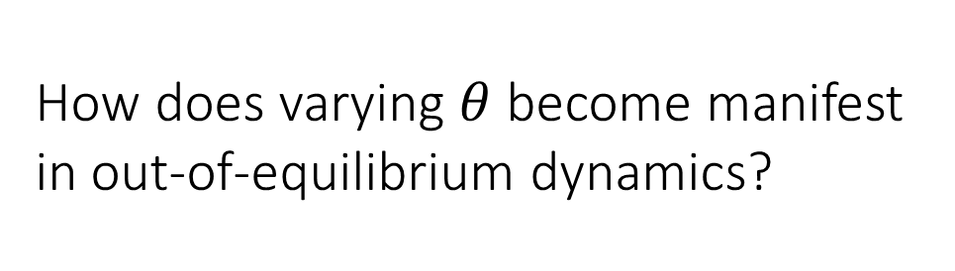


Paradigmatic toy model: 1+1D QED with $θ$ term
$$H_{QED}=\int{dx \left[\left(\overline{ψ}\left(x\right) iγ_{1}D_{x} ψ\left(x\right)+h.c.\right) + m\overline{ψ}\left(x\right)ψ\left(x\right)+ \frac{1}{2}{E\left(x\right)}^{2}+\frac{e θ}{2π} E(x)]\right]}$$
kinetic energy of fermions
rest mass
electric
field
energy
$θ$ term
spinor ($e^{−},e^{+}$)
How does varying $θ$ become manifest
in out-of-equilibrium dynamics?

Slide 15
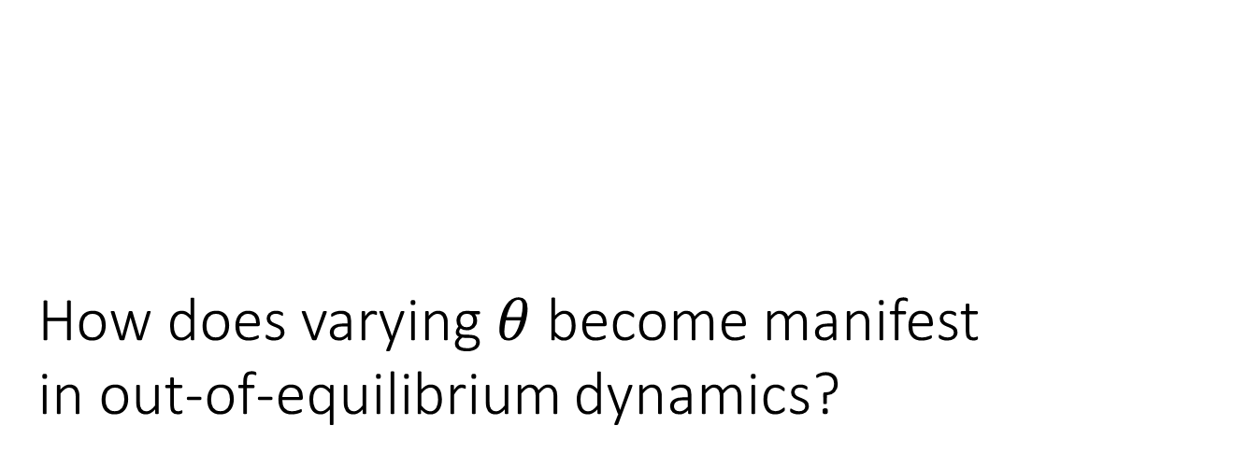
How does varying $θ$ become manifest in out-of-equilibrium dynamics?

Slide 16


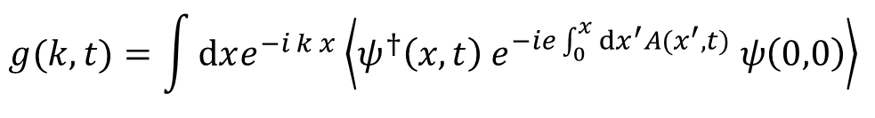

Our study: out-of-equilibrium dynamics after a quantum quench of the $θ$angle
Zache, Mueller, Schneider, Jendrzejewski, Berges, Hauke, arXiv:1808.07885
initial state
$$θ$$
abrupt change
“quench”
dynamics
$$θ′$$
Main observable: single-particle propagator
$$g(k,t)=\int{dxe^{−i k x}\left\langle ψ^{†}\left(x,t\right) e^{−ie\int_{0}^{x}{dx^{′}A(x^{′},t)}} ψ\left(0,0\right)\right\rangle }$$

Slide 17
Outline
Topological $θ$ parameter in 1+1D QED
A new type of topological dynamical transitions after $θ$ quenches
results for $e/m⟶0$
relation to “dynamical quantum phase transitions”
results for $e/m>0$
Conclusions

Slide 18
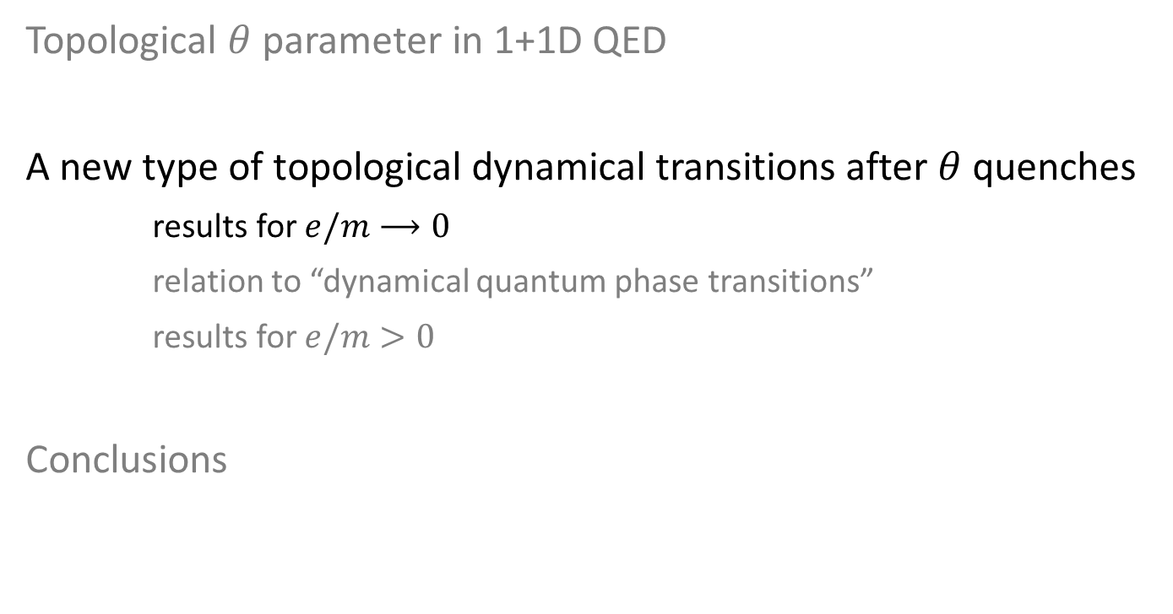
Outline
Topological $θ$ parameter in 1+1D QED
A new type of topological dynamical transitions after $θ$ quenches
results for $e/m⟶0$
relation to “dynamical quantum phase transitions”
results for $e/m>0$
Conclusions

Slide 19















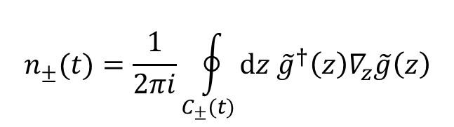




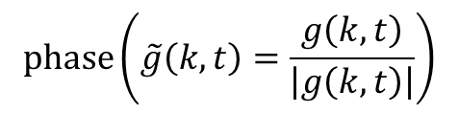



Results for weak coupling $\frac{e}{m}→0$
$$phase\left(\tilde{g}\left(k,t\right)=\frac{g\left(k,t\right)}{\left|g\left(k,t\right)\right|}\right)$$
$$π$$
$$Δθ<π/2$$
$$Δθ>π/2$$
$$10$$
time $tm$
$$0$$
Vortices
Appear!
$$5$$
$$−π$$
$$C_{+}(t)$$
$$0$$
$$−2$$
$$0$$
$$2$$
$$−2$$
$$0$$
$$2$$
$$∞$$
momentum $k/m$
momentum $k/m$
New dynamical topological invariant
$$n_{±}(t)=\frac{1}{2πi}\oint_{C_{±}(t)}{dz {\tilde{g}}^{†}\left(z\right)∇_{z}\tilde{g}\left(z\right)}$$
$$ν=n_{+}−n_{−}$$
$\hat{=}$ # vortices

Slide 20
Results for weak coupling $\frac{e}{m}→0$
$$phase\left(\tilde{g}\left(k,t\right)=\frac{g\left(k,t\right)}{\left|g\left(k,t\right)\right|}\right)$$
$$π$$
$$Δθ<π/2$$
$$Δθ>π/2$$
$$10$$
Vortices
Appear!
time $tm$
$$0$$
$$5$$
$$−π$$
$$C_{+}(t)$$
$$0$$
$$−2$$
$$0$$
$$2$$
$$−2$$
$$0$$
$$2$$
$$∞$$
momentum $k/m$
momentum $k/m$
New dynamical topological invariant
$$n_{±}(t)=\frac{1}{2πi}\oint_{C_{±}(t)}{dz {\tilde{g}}^{†}\left(z\right)∇_{z}\tilde{g}\left(z\right)}$$
$$ν=n_{+}−n_{−}$$
$\hat{=}$ # vortices

Slide 21
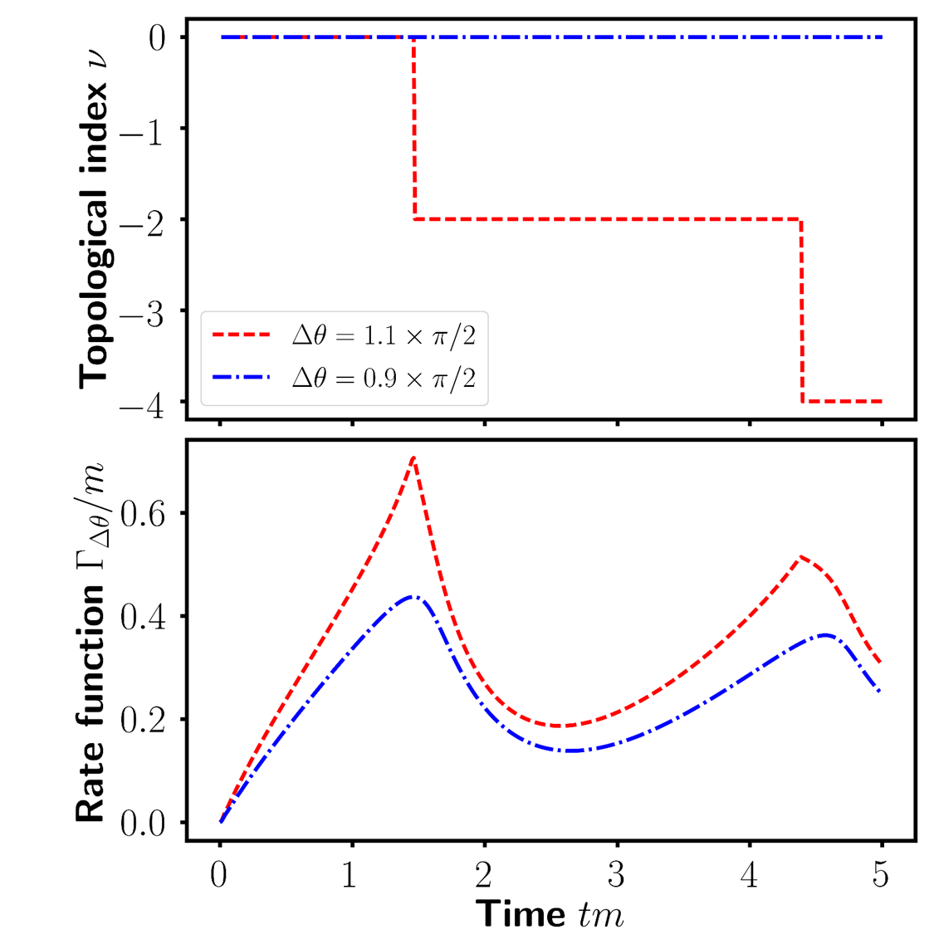


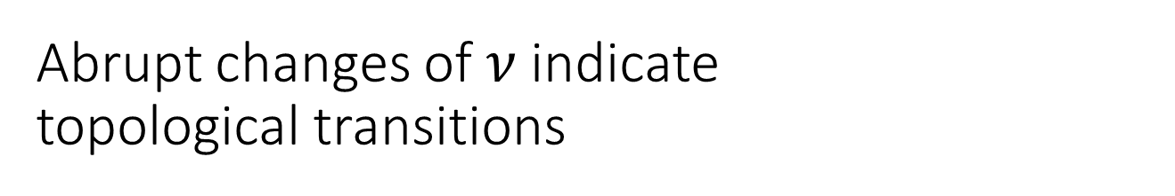








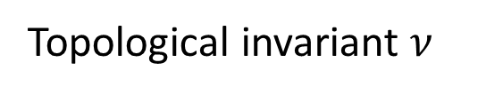


Abrupt changes of $ν$indicate topological transitions
Topological invariant $ν$
$$0$$
$$Δθ<π/2$$
$$−2$$
$$Δθ>π/2$$
$$−4$$
time $tm$
$$0$$
$$1$$
$$2$$
$$3$$
$$4$$
$$5$$

Slide 22
What type of transition is this?

Slide 23
Outline
Topological $θ$ parameter in 1+1D QED
A new type of topological dynamical transitions after $θ$ quenches
results for $e/m⟶0$
relation to “dynamical quantum phase transitions”
results for $e/m>0$
Conclusions

Slide 24
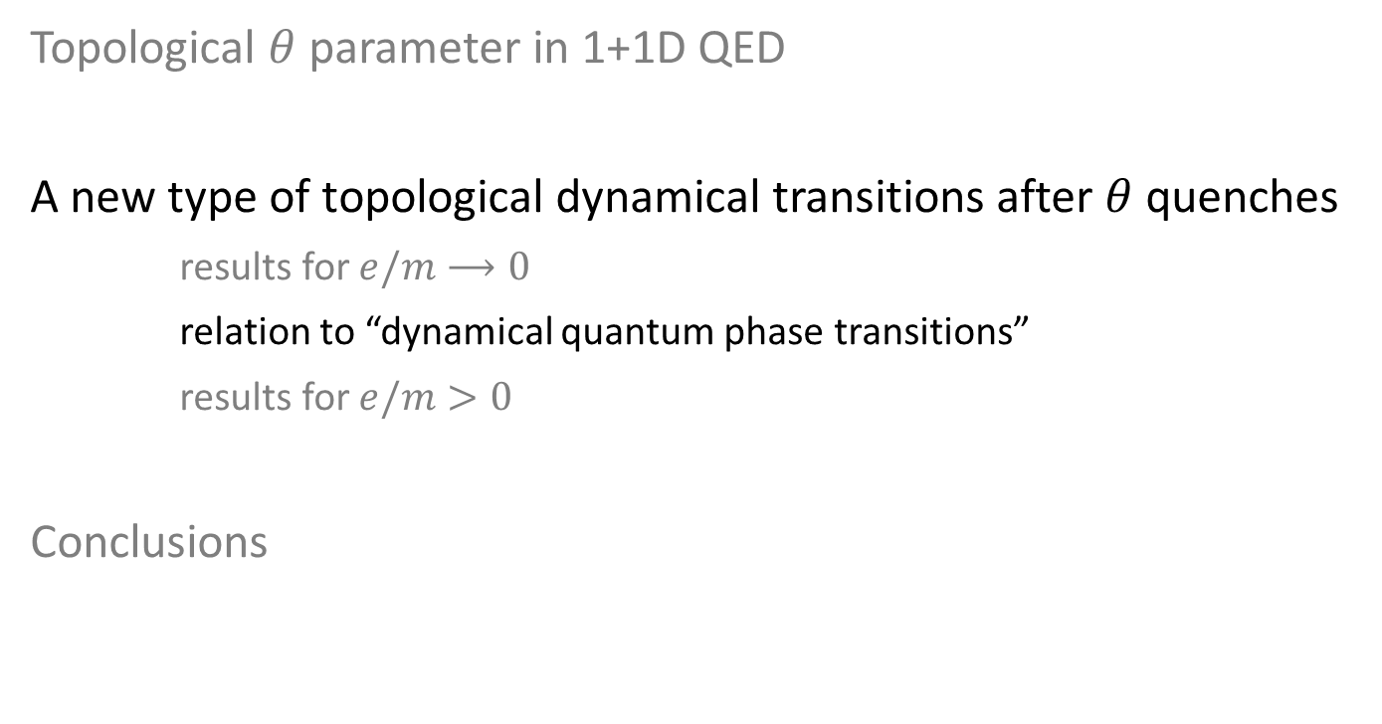
Outline
Topological $θ$ parameter in 1+1D QED
A new type of topological dynamical transitions after $θ$ quenches
results for $e/m⟶0$
relation to “dynamical quantum phase transitions”
results for $e/m>0$
Conclusions

Slide 25

“Dynamical quantum phase transition” (DQPT)
(as known from condensed-matter models)
First paper: Heyl, Polkovnikov, Kehrein, PRL 2013
Loschmidt amplitude
$$ℒ\left(t\right)=\left\langle vac\left(θ\right)| e^{−i H_{θ^{′}} t} |vac\left(θ\right)\right\rangle$$
Definition: DQPT = non-analyticity in $ℒ\left(t\right)$
Features of DQPTs
Signals breakdown in perturbative treatments
Scaling behavior
Robustness against perturbations
Features in entanglement
Jurcevic, Shen, Hauke, Maier, Brydges,
Hempel, Lanyon, Heyl, Blatt, Roos, PRL 2017
Gong, Ueda, arXiv 2017

Slide 26
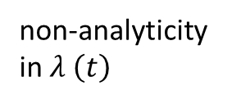

Features of entanglement in DQPTs
Jurcevic, Shen, Hauke, Maier, Brydges,
Hempel, Lanyon, Heyl, Blatt, Roos, PRL 2017
Long-range Ising model with transverse field
$λ\left(t\right)=−\frac{1}{V}log\left|ℒ\left(t\right)\right|$
non-analyticity
in $λ \left(t\right)$
time
ent.
entropy
squeezing

Slide 27
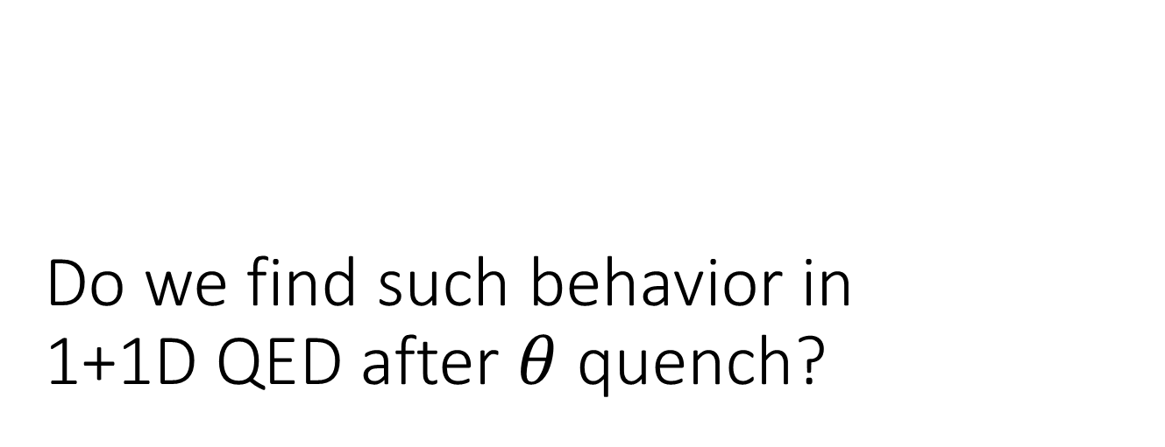
Do we find such behavior in
1+1D QED after $θ$ quench?

Slide 28


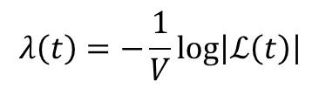









First observation of DQPT in gauge theory
see also Huang, Banerjee, Heyl, arXiv:1808.07874
$$λ\left(t\right)=−\frac{1}{V}log\left|ℒ\left(t\right)\right|$$
non-analyticity
$$0.6$$
$$Δθ>π/2$$
$$Δθ<π/2$$
$$0$$
$$0$$
$$1$$
$$2$$
$$3$$
$$4$$
$$5$$
time $tm$

Slide 29











Dynamical topological quantum phase transition
$$λ\left(t\right)=−\frac{1}{V}log\left|ℒ\left(t\right)\right|$$
non-analyticity
$$0.6$$
$$Δθ>π/2$$
$$Δθ<π/2$$
$$0$$
$$0$$
$$1$$
$$2$$
$$3$$
$$4$$
$$5$$
time $tm$
Topological invariant $ν$
$$0$$
$$−2$$
$$−4$$
$$0$$
$$1$$
$$2$$
$$3$$
$$4$$
$$5$$
time $tm$

Slide 30
Outline
Topological $θ$ parameter in 1+1D QED
A new type of topological dynamical transitions after $θ$ quenches
results for $e/m⟶0$
relation to “dynamical quantum phase transitions”
results for $e/m>0$
Conclusions

Slide 31
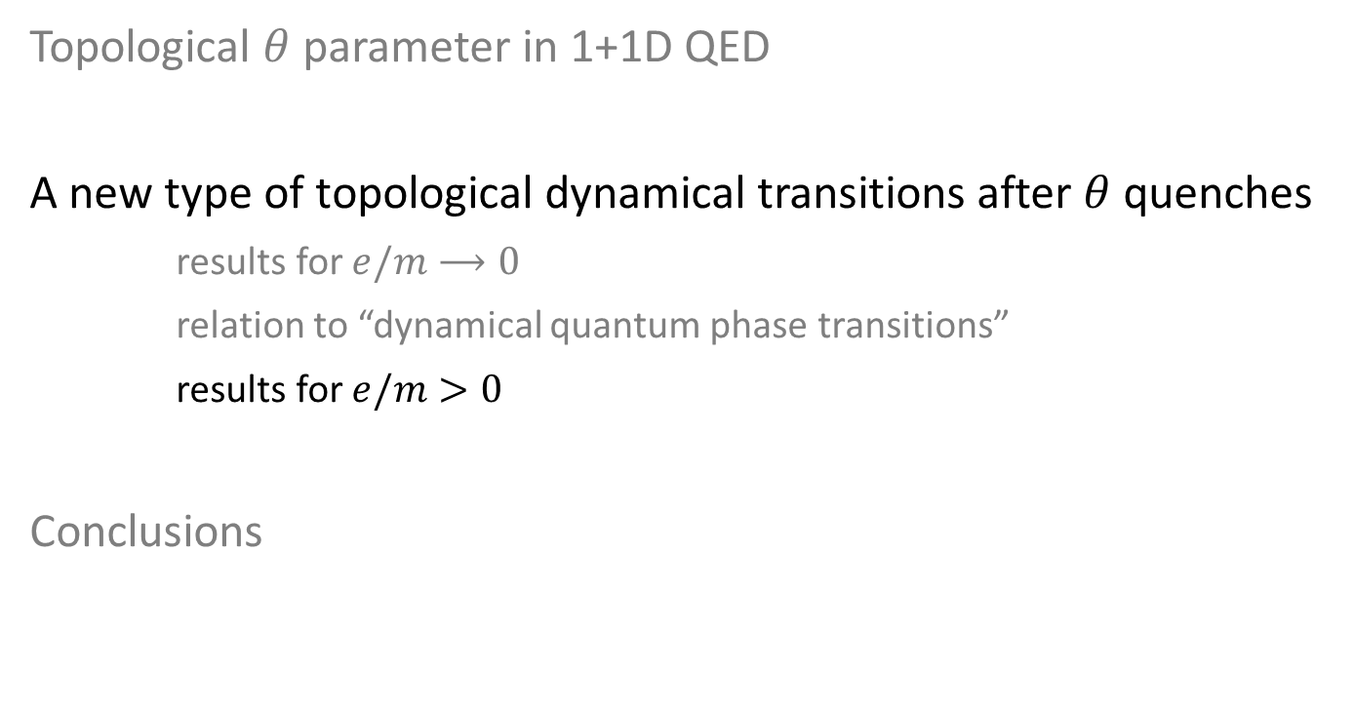
Outline
Topological $θ$ parameter in 1+1D QED
A new type of topological dynamical transitions after $θ$ quenches
results for $e/m⟶0$
relation to “dynamical quantum phase transitions”
results for $e/m>0$
Conclusions

Slide 32

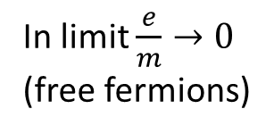


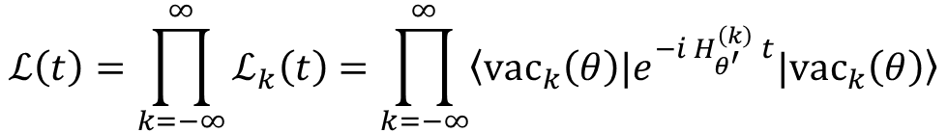
In non-interacting lattice theories,
DQPT as topological transition was known
Loschmidt amplitude
$$ℒ\left(t\right)=\left\langle vac\left(θ\right)| e^{−i H_{θ^{′}} t} |vac\left(θ\right)\right\rangle$$
In limit $\frac{e}{m}→0$
(free fermions)
$$ℒ\left(t\right)=\prod_{k=−∞}^{∞}{ℒ_{k}\left(t\right)}=\prod_{k=−∞}^{∞}{\left\langle {vac}_{k}\left(θ\right)\right.|e^{−i H_{θ^{′}}^{\left(k\right)} t}|\left.{vac}_{k}\left(θ\right)\right\rangle }$$
Previous prescription
$$ℒ_{k}\left(t\right)=\left|ℒ_{k}\left(t\right)\right|e^{−i φ_{dyn}\left(k\right) t} e^{−i φ_{geom}\left(k\right) t}$$
Heyl, Budich, PRB 2017
trivial
interesting
Experiments:
Tian et al., Xu et al., arXiv 2018
$$Δθ<π/2$$
$$Δθ>π/2$$

Slide 33
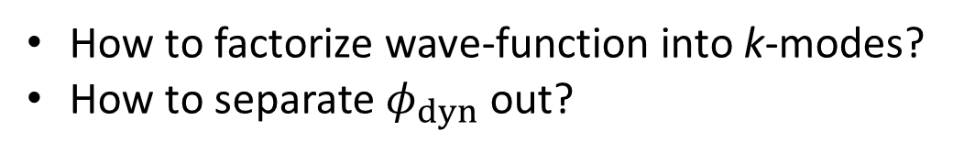
In non-interacting lattice theories,
DQPT as topological transition was known
Loschmidt amplitude
$$ℒ\left(t\right)=\left\langle vac\left(θ\right)| e^{−i H_{θ^{′}} t} |vac\left(θ\right)\right\rangle$$
In limit $\frac{e}{m}→0$
(free fermions)
$$ℒ\left(t\right)=\prod_{k=−∞}^{∞}{ℒ_{k}\left(t\right)}=\prod_{k=−∞}^{∞}{\left\langle {vac}_{k}\left(θ\right)\right.|e^{−i H_{θ^{′}}^{\left(k\right)} t}|\left.{vac}_{k}\left(θ\right)\right\rangle }$$
Previous prescription
$$ℒ_{k}\left(t\right)=\left|ℒ_{k}\left(t\right)\right|e^{−i φ_{dyn}\left(k\right) t} e^{−i φ_{geom}\left(k\right) t}$$
Heyl, Budich, PRB 2017
trivial
interesting
Experiments:
Tian et al., Xu et al., arXiv 2018
How to generalize to interacting system?
How to factorize wave-function into k-modes?
How to separate $φ_{dyn}$ out?

Slide 34
In non-interacting lattice theories,
DQPT as topological transition was known
Loschmidt amplitude
$$ℒ\left(t\right)=\left\langle vac\left(θ\right)| e^{−i H_{θ^{′}} t} |vac\left(θ\right)\right\rangle$$
In limit $\frac{e}{m}→0$
(free fermions)
$$ℒ\left(t\right)=\prod_{k=−∞}^{∞}{ℒ_{k}\left(t\right)}=\prod_{k=−∞}^{∞}{\left\langle {vac}_{k}\left(θ\right)\right.|e^{−i H_{θ^{′}}^{\left(k\right)} t}|\left.{vac}_{k}\left(θ\right)\right\rangle }$$
Previous prescription
$$ℒ_{k}\left(t\right)=\left|ℒ_{k}\left(t\right)\right|e^{−i φ_{dyn}\left(k\right) t} e^{−i φ_{geom}\left(k\right) t}$$
Heyl, Budich, PRB 2017
trivial
interesting
Experiments:
Tian et al., Xu et al., arXiv 2018
How to generalize to interacting system?
How to factorize wave-function into k-modes?
How to separate $φ_{dyn}$ out?

Slide 35
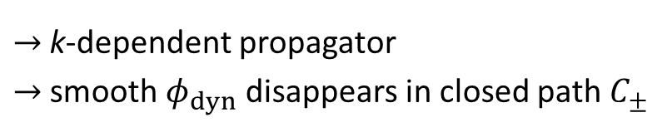


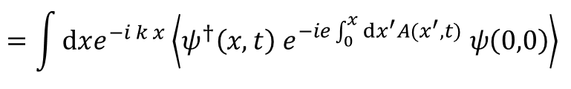

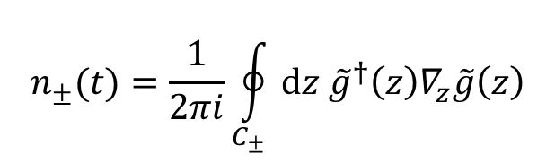

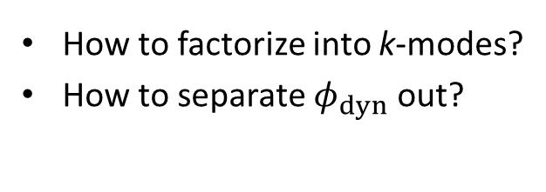

Generalization to interacting system
Previous prescription
$$ℒ_{k}\left(t\right)=\left|ℒ_{k}\left(t\right)\right|e^{−i φ_{dyn}\left(k\right) t} e^{−i φ_{geom}\left(k\right) t}$$
trivial
interesting
How to generalize to interacting system?
How to factorize into k-modes?
How to separate $φ_{dyn}$ out?
$→$ k-dependent propagator
$→$ smooth $φ_{dyn}$ disappears in closed path $C_{±}$
At $\frac{e}{m}→0$:
$$ℒ_{k}\left(t\right)=$$
$$g(k,t)$$
$$=\int{dxe^{−i k x}\left\langle ψ^{†}\left(x,t\right) e^{−ie\int_{0}^{x}{dx^{′}A(x^{′},t)}} ψ\left(0,0\right)\right\rangle }$$
$$n_{±}(t)=\frac{1}{2πi}\oint_{C_{±}}{dz {\tilde{g}}^{†}\left(z\right)∇_{z}\tilde{g}\left(z\right)}$$
Resembles interacting
equilibrium topological
invariants, e.g.,
Gurarie, PRB 2011
time $tm$
Is immediately generalizable
to interacting system!
momentum $k/m$

Slide 36

So what happens under coupling $\frac{e}{m}>0$ ?

Slide 37
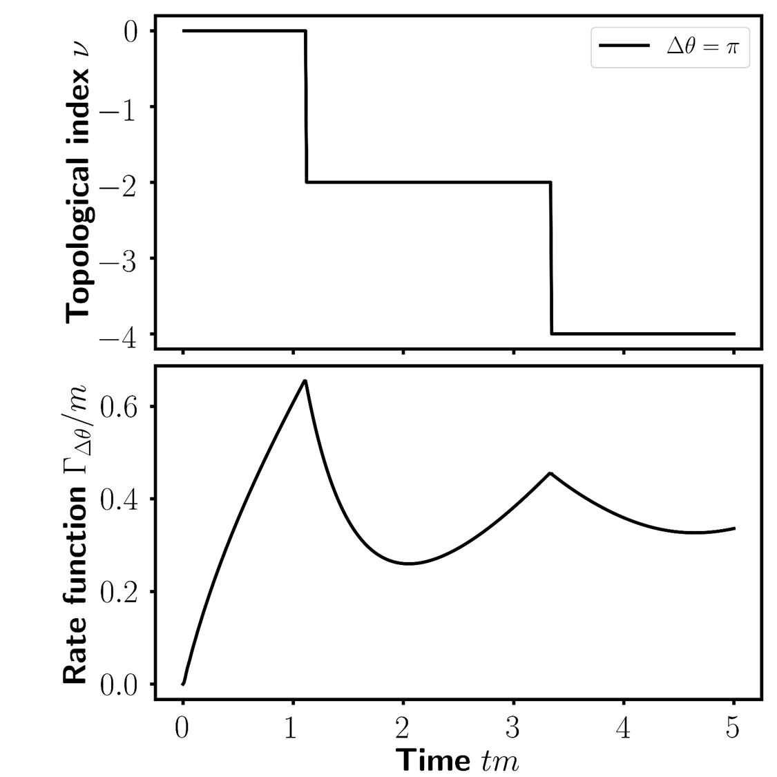































Numerically exact lattice calculations
(exact diagonalization, 8-24 sites)
$$V=∞, a=0$$
$$0$$
$$1$$
$$2$$
$$3$$
$$4$$
$$tm$$
$$0$$
$$1$$
$$2$$
$$3$$
$$4$$
$$tm$$
Topological invariant $ν$
$λ\left(t\right)=−\frac{1}{V}log\left|ℒ\left(t\right)\right|$
$$2$$
$$2$$
$$tm$$
$$tm$$
$$1$$
$$1$$
$$0$$
$$0$$
$$0$$
$$1$$
$$2$$
$$0$$
$$1$$
$$2$$
coupling $e/m$
coupling $e/m$

Slide 38
Outline
Topological $θ$ parameter in 1+1D QED
A new type of topological dynamical transitions after $θ$ quenches
results for $e/m⟶0$
relation to “dynamical quantum phase transitions”
results for $e/m>0$
Conclusions

Slide 39
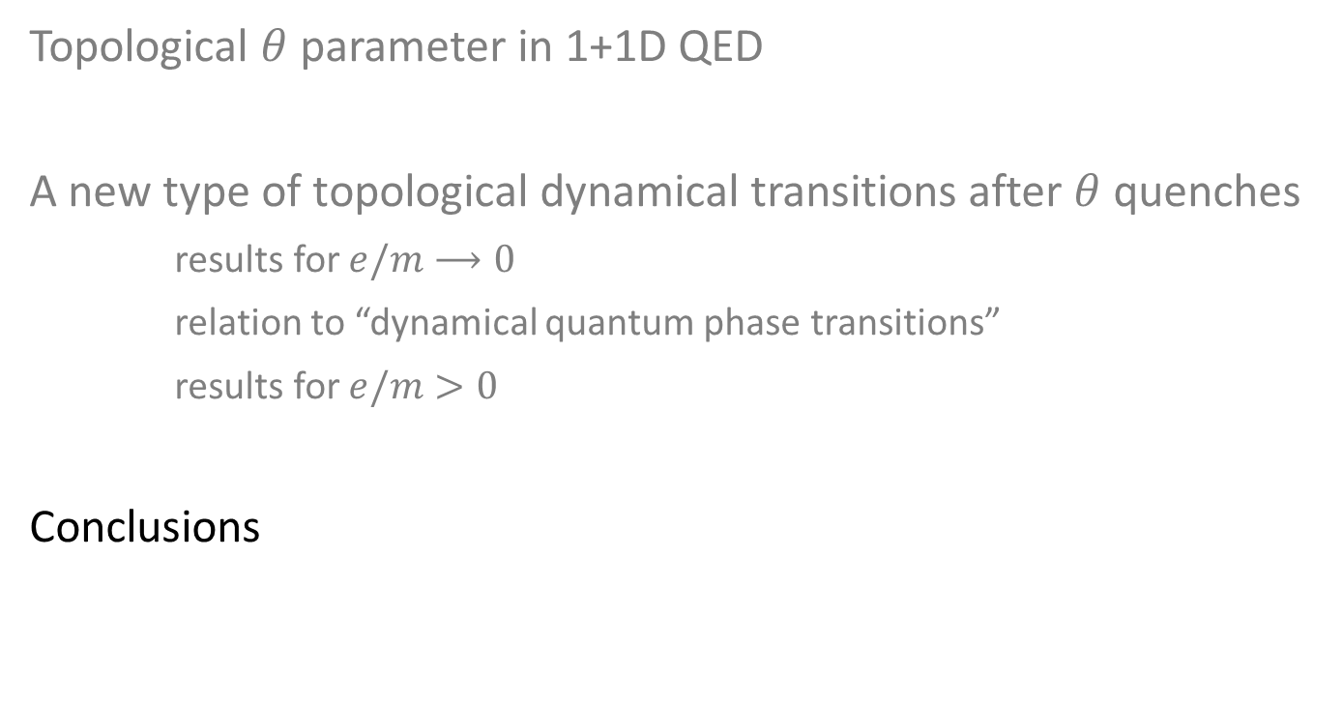
Outline
Topological $θ$ parameter in 1+1D QED
A new type of topological dynamical transitions after $θ$ quenches
results for $e/m⟶0$
relation to “dynamical quantum phase transitions”
results for $e/m>0$
Conclusions

Slide 40














Conclusions
Found a new (?) topological transition in dynamics of lattice gauge theory
Related to dynamical QPT
Generalized to interacting theories
Can be observed in near future quantum simulators
  Minimum requirement: 8 sites $→$ feasible
  $tm\sim 2$ $→$ there already
$$2$$
$$tm$$
$$1$$
Thank you!
$$0$$
$$0$$
$$1$$
$$2$$
$$0$$
$$1$$
$$2$$
coupling $e/m$
Zache, Mueller, Schneider, Jendrzejewski, Berges, Hauke, arXiv:1808.07885
$$tm\sim 2$$

Slide 41


Open questions
Any connection to sphalerons ?
Dependence on equilibrium topological sectors ?
Physical consequences of momentum-
time vortex in propagator ?
Relation to entanglement ?
Jurcevic, Shen, Hauke, Maier, Brydges, Hempel, Lanyon, Heyl, Blatt, Roos, PRL 2017
Gong, Ueda, arXiv 2017
time $tm$
momentum $k/m$
Thank you!
Zache, Mueller, Schneider, Jendrzejewski, Berges, Hauke, arXiv:1808.07885

Slide 42
Constant progress
Proposal to observe Schwinger effect in optical lattices
Zache, Hebenstreit, Jendrzejewski, Oberthaler, Berges, Hauke, Quantum Sci. Tech. 2018
Many more works in groups
Cirac, Lewenstein, Reznik, Savage, Solano, Tagliacozzo, Wiese, Zoller, Zohar, . . .

Slide 43
Constant progress
Proposal to observe Schwinger effect in optical lattices
Zache, Hebenstreit, Jendrzejewski, Oberthaler, Berges, Hauke, Quantum Sci. Tech. 2018
Many more works in groups
Cirac, Lewenstein, Reznik, Savage, Solano, Tagliacozzo, Wiese, Zoller, Zohar, . . .

Slide 44

Constant progress
Proposal to observe Schwinger effect in optical lattices
Zache, Hebenstreit, Jendrzejewski, Oberthaler, Berges, Hauke, Quantum Sci. Tech. 2018
20 fermionic lattice sites realistic
Coherence times just sufficient ($tm\sim 2$)
Many more works in groups
Cirac, Lewenstein, Reznik, Savage, Solano, Tagliacozzo, Wiese, Zoller, Zohar, . . .

Slide 45


Paradigmatic toy model: 1+1D QED with $θ$ term
$$H_{QED}=\int{dx \left[\left(\overline{ψ}\left(x\right) iγ_{1}D_{x} ψ\left(x\right)+h.c.\right) + m\overline{ψ}\left(x\right)ψ\left(x\right)+ \frac{1}{2}{E\left(x\right)}^{2}+\frac{e θ}{2π} E(x)]\right]}$$
kinetic energy of fermions
rest mass
spinor ($e^{−},e^{+}$)
energy
$$2m$$
filled
Dirac sea
momentum

Slide 46


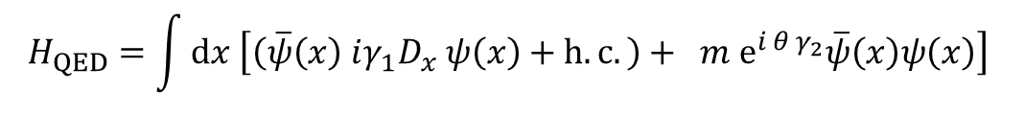




Changing $θ$ has physical consequences
Example: surface states
See, e.g., Shen, Shan, and Lu, SPIN 2011
$$H_{QED}=\int{dx \left[\left(\overline{ψ}\left(x\right) iγ_{1}D_{x} ψ\left(x\right)+h.c.\right)+ m e^{i θ γ_{2}}\overline{ψ}\left(x\right)ψ\left(x\right)\right]}$$
surface
state
$$2m$$
$$2|m|$$
$$m>0$$
$$m<0$$
$$x$$
Analogous to, e.g., Su-Schrieffer-Heeger model in condensed matter

Slide 47























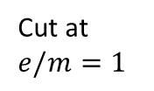
















Numerically exact lattice calculations
(exact diagonalization, 8-24 sites)
$$V=∞, a=0$$
From equal-
time correlator
$$0$$
$$1$$
$$2$$
$$3$$
$$4$$
$$tm$$
$$0$$
$$1$$
$$2$$
$$3$$
$$4$$
$$tm$$
$λ\left(t\right)$
From $|g\left(k,t\right)|$
Topological invariant $ν$
$λ\left(t\right)=−\frac{1}{V}log\left|ℒ\left(t\right)\right|$
$$2$$
$$2$$
$$2$$
$$tm$$
$$tm$$
$$tm$$
$$1$$
$$1$$
$$1$$
Cut at
$e/m=1$
$$0$$
$$0$$
$$0$$
$$0$$
$$1$$
$$2$$
$$0$$
$$1$$
$$2$$
$$0$$
$$1$$
coupling $e/m$
coupling $e/m$
rate functions

