Slide 1

Low-x from String at eIC
SBU-18’

Slide 2
Outline
Quantum string in
Thermodynamical entropy
Entanglement entropy
Low-x xg, xq, xq↑

Slide 3
Ladder vs String

Slide 4
String as Ladders at Strong Coupling

Slide 5
Maldacena Coulomb

Slide 6
Eikonal

Slide 7
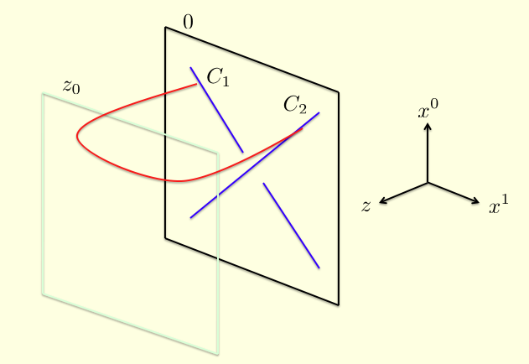
Picture in

Slide 8
Holographic Rules

Slide 9
Conformal String
Basar-Kharzeev-Yee-Zahed 12

Slide 10
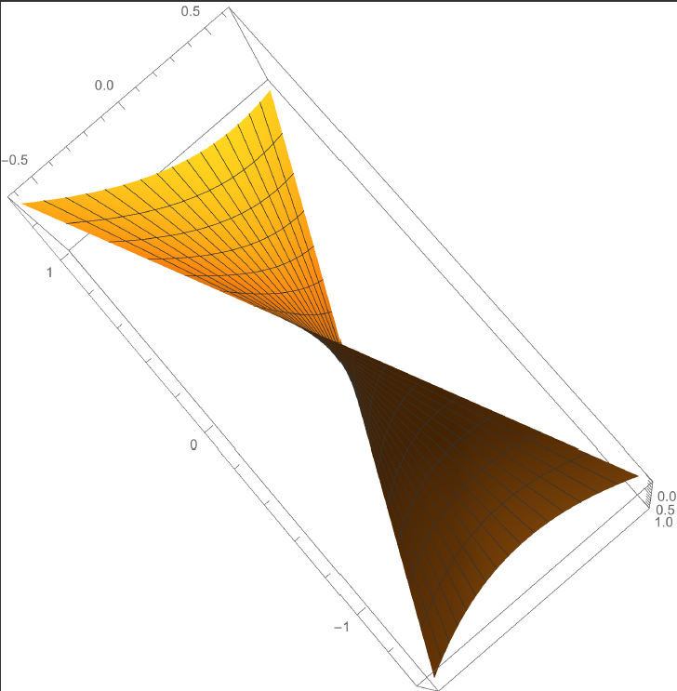
Hyperbolic surface

Slide 11
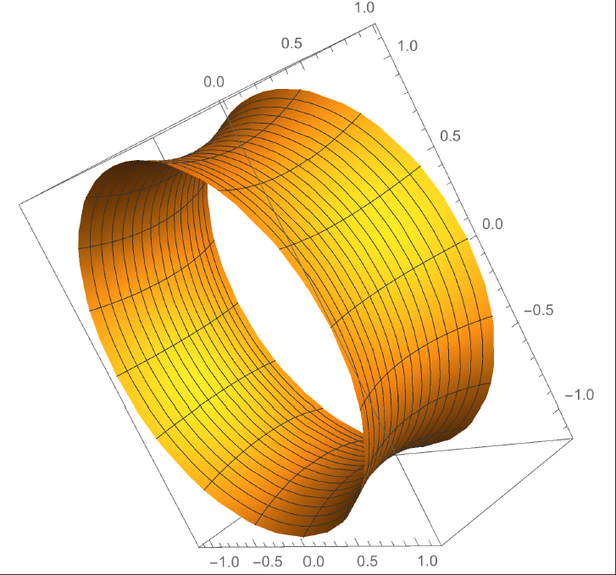
Instanton surface

Slide 12
Instanton contd.

Slide 13
Pomeron

Slide 14
Gribov Diffusion

Slide 15
Thermodynamical Entropy

Slide 16
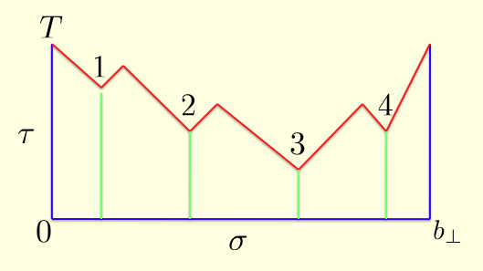
More Entropy through String Breaking

Slide 17
Transverse fluctuations

Slide 18
Entangled Density Matrix

Slide 19
Entanglement Matrix

Slide 20
Entanglement (Von-Neuman) Entropy

Slide 21
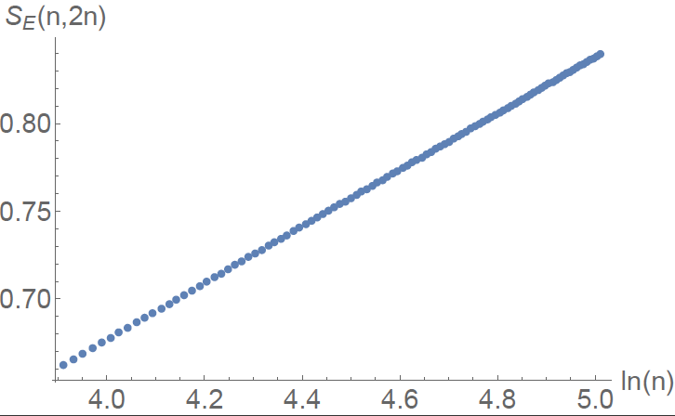
Entanglement Entropy

Slide 22
Black-hole-like

Slide 23
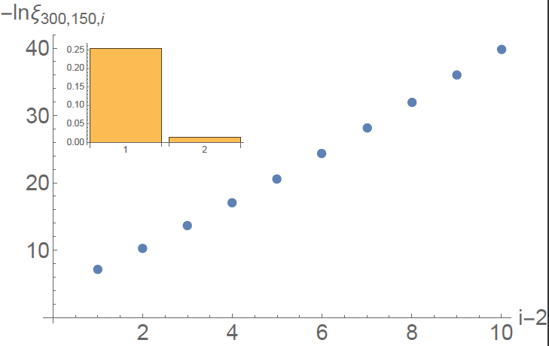
Eigenvalues

Slide 24
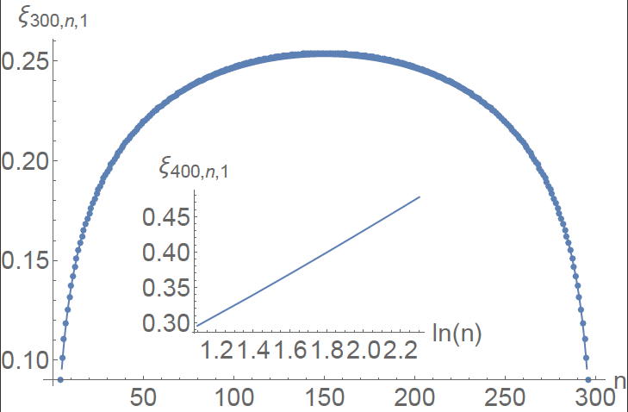
Wee-Quanta

Slide 25
Cascade Equation

Slide 26
Distribution of wee quanta at low-x

Slide 27
Sea quarks low-x

Slide 28
Sea Modified Regge Trajectory

Slide 29
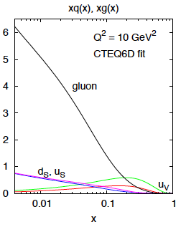
Unpolarized wee quanta at low-x

Slide 30
Polarized Wee-Quanta

Slide 31
Outlook
For eN see K. Mamo+ IZ 18’

