Slide 1

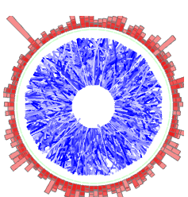

Jet Substructure Measurements with STAR
Kolja Kauder
Probing Quark-Gluon Matter with Jets - 2018, BNL

Slide 2

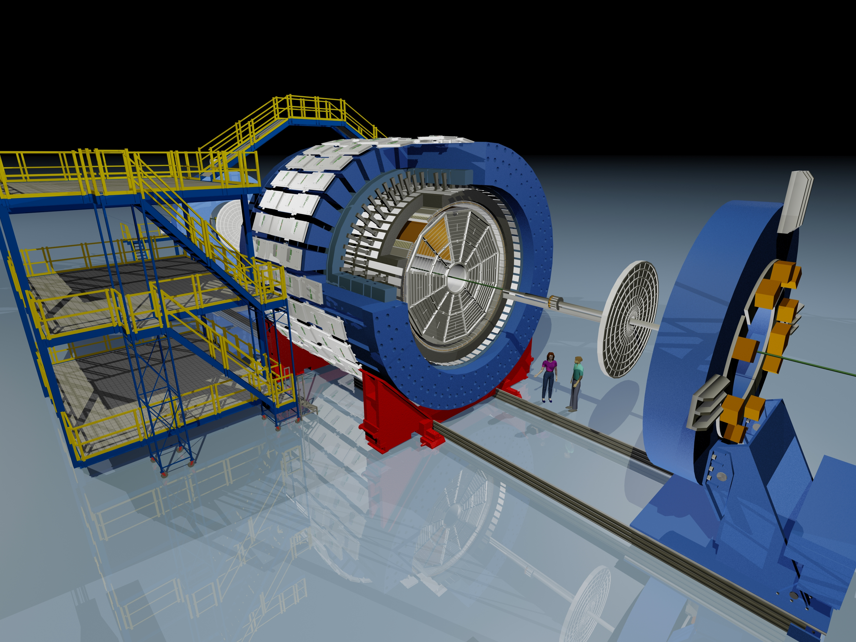
The Solenoidal Tracker at RHIC
BEMC
TPC
Additional Capabilities:
Particle ID:
Charged (TPC dE/dx, TOF)
γ identification (BSMD)
Heavy flavor (HFT)
Many collision systems small and large
Muons (MTD)
Event Plane (EPD)
…
TOF
Core Systems for Jets:
2π x|η|< 1 acceptance:
charged particles (TPC)
neutral particles (BEMC)

Slide 3
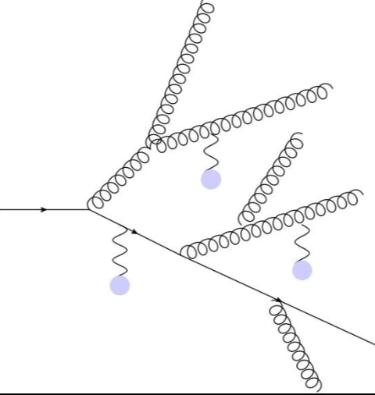
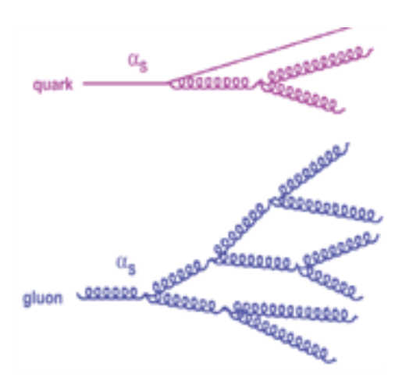
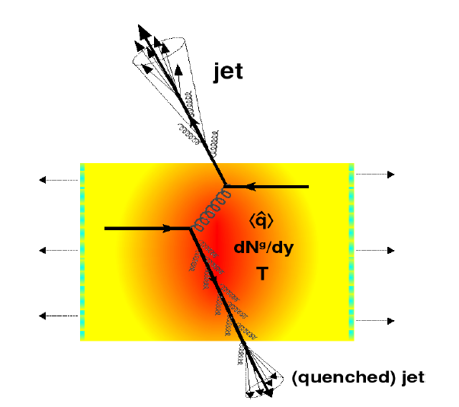
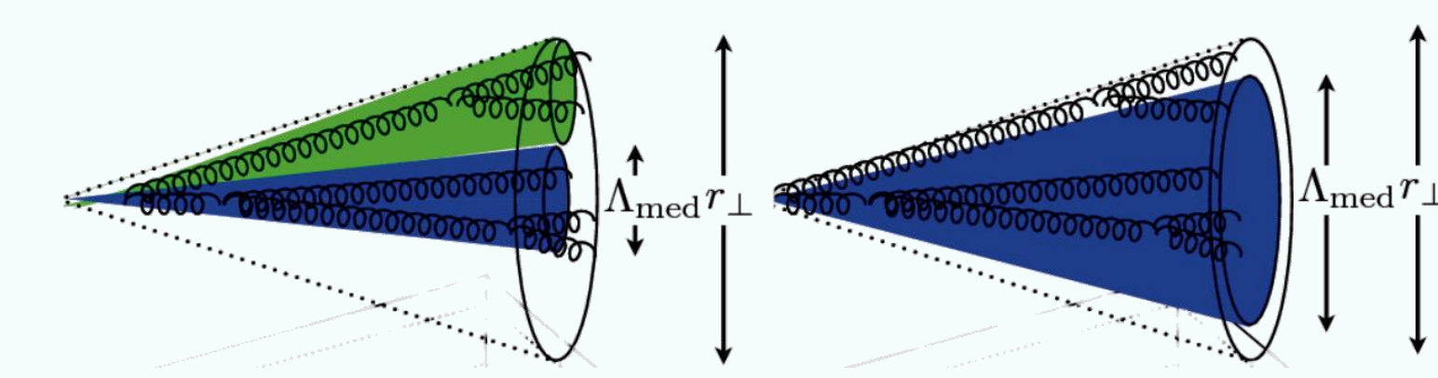
Jets and Jet Substructure in HIC
Traditional Questions: Energy Flow
How much energy is (left) in the jet?
And where did it go?
Substructure: Focus on Shower
Where did energy flow inside the jet?
Is the shower modified?
Quark vs. gluon jet?
Splitting kernel?
De-coherent vs coherent E-loss?

Slide 4
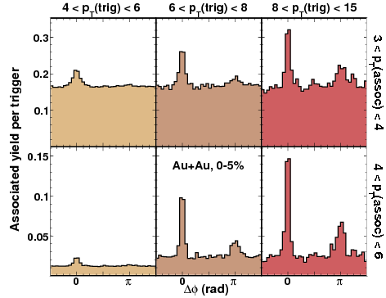
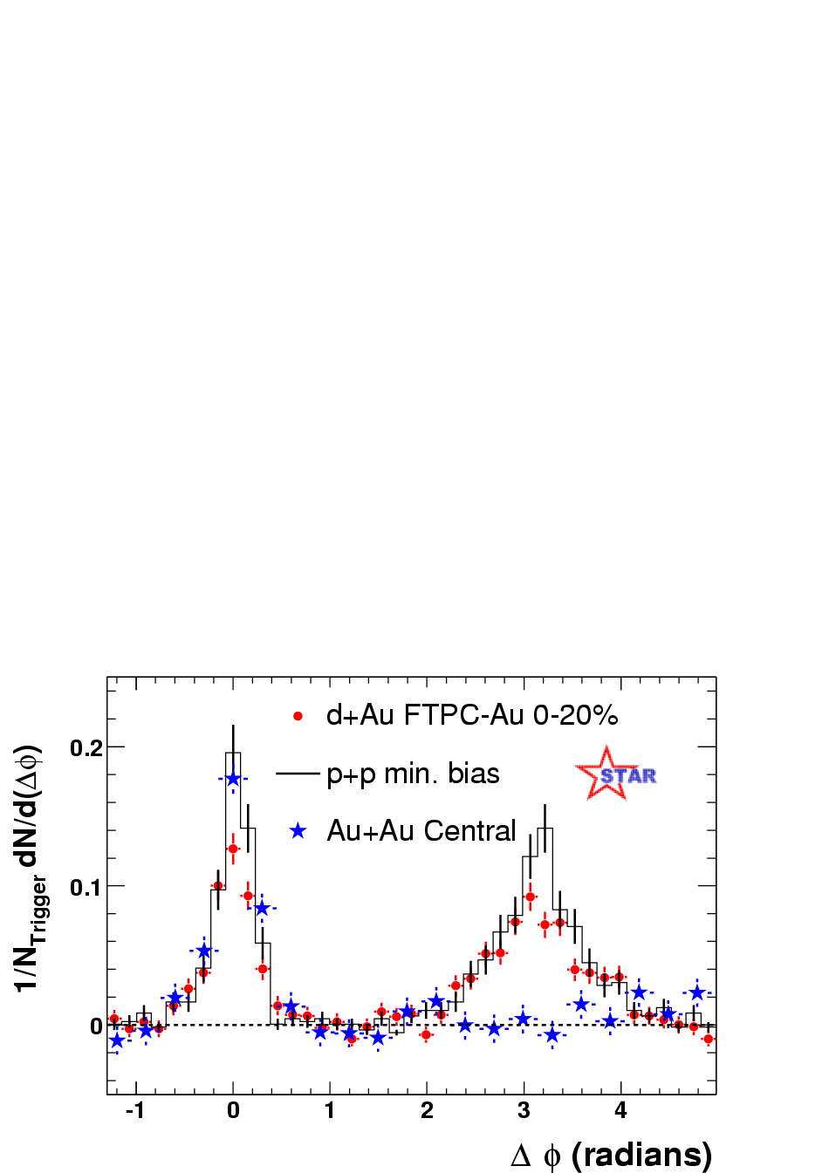
“Jet” “Substructure”
STAR, PRL 97 (2006) 162301
Narrow, vacuum-like Dijets
STAR, PLB751 (2015) 233-240
π trigger
Non-π trigger
STAR, PRL 91 (2003) 072304
Narrow, vacuum-like Near-Side
Broadened, softened Away-Side
Broader NS for non-π triggers
could access quark/glue difference

Slide 5
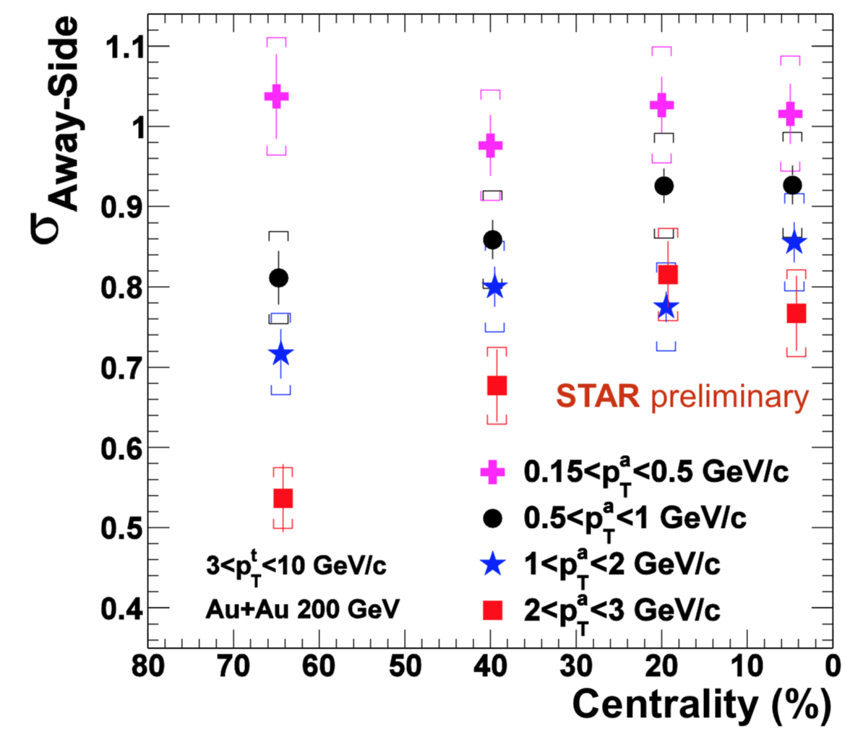
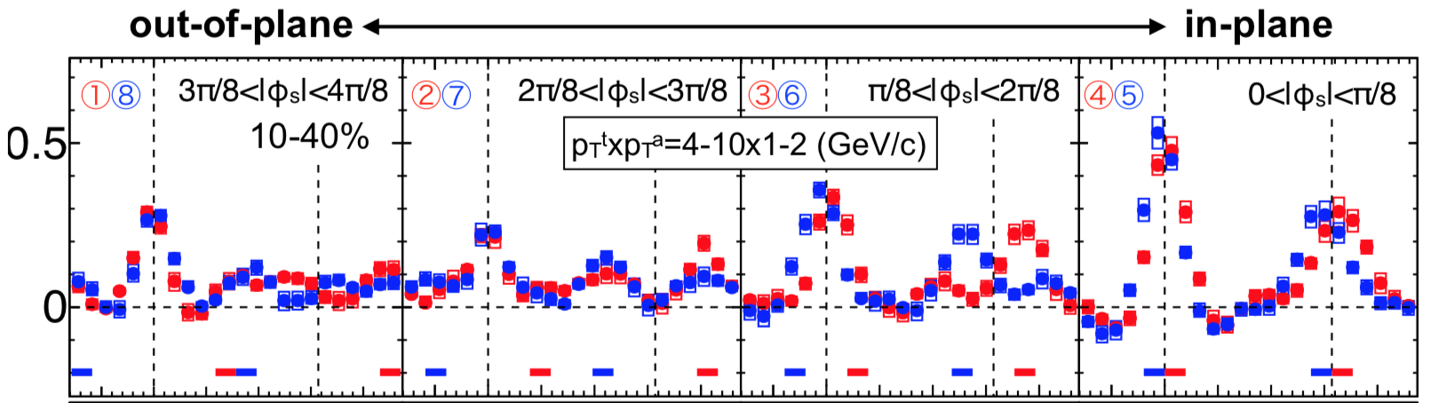
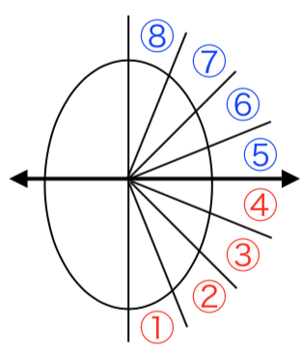
Recent Di-hadron Results
Kun Jiang, QM2018
Ryo Aoyama, QM2018
Away-Side broadening after flow subtraction
Strong AS deformation as a function of Event Plane (and Shape)
Di-hadron correlations offer great insights into jet substructure
- but here we will focus on reconstructed jets

Slide 6
Jet Reconstruction
Sequential Clustering:
Calculate a distance d_{ij} between two particles and a beam distance d_{iB} for all particles.
Find smallest of all d_{ij}, d_{iB}
If it’s a d_{ij}, recombine particles i and j. If it’s a d_{iB}, call particle i a jet
Repeat from step 2 until no particles are left
Resulting clusters are jets.
Operational definition. No unambiguous jet definition exists!
Advantages:
Minimize sensitivity to hadronization:
IR-safe and collinear-safe algorithm and instrumentation
Measure energy flow: connect to dynamics of partons
Comparison to QCD calculations beyond event generators
De-facto standard. For substructure:
also provides cluster history

Slide 7
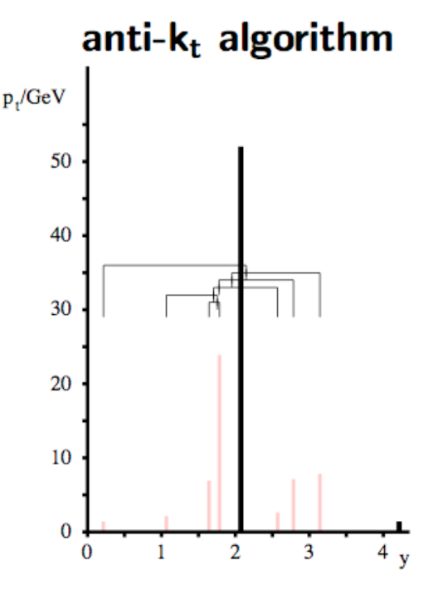
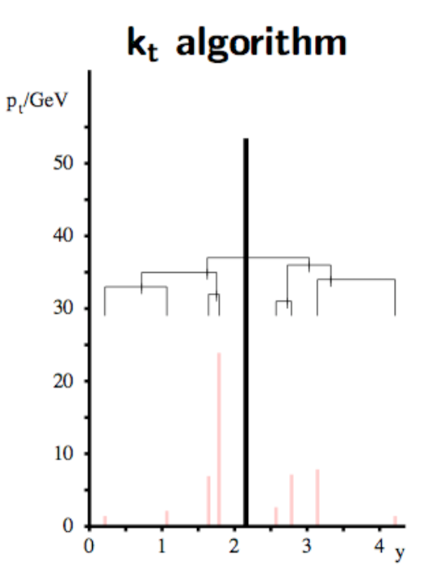
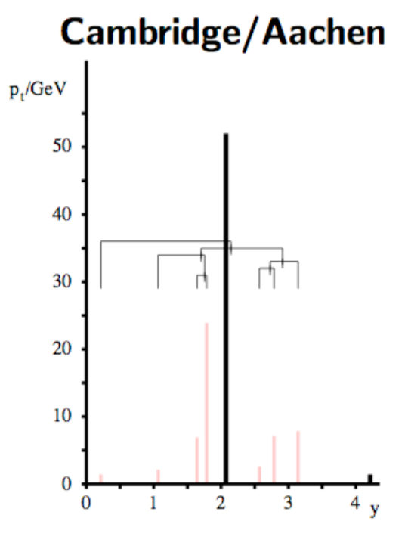
Distance Measures
d_{ij} = f(p_{T,i}, p_{T,j}) ( Δy² + Δφ²) / R²
f = min ( 1/p_{T,i}², 1/p_{T,j}² )
merge to hardest
seed on “real” jets
circular leading jets
f = min ( p_{T,i}², p_{T,j}² )
merge to softest
good characterization of “background” jets
f = 1
merge to closest
angular ordering
→ relevant later!
M. Cacciari , HP ‘16

Slide 8
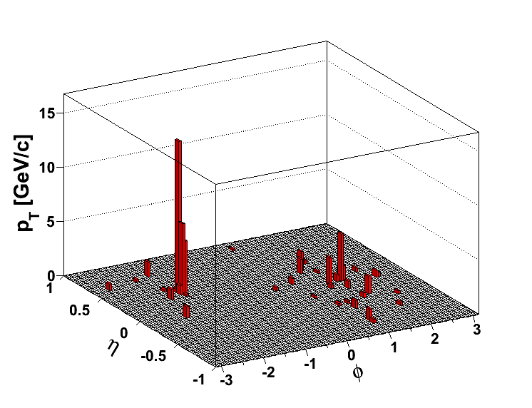
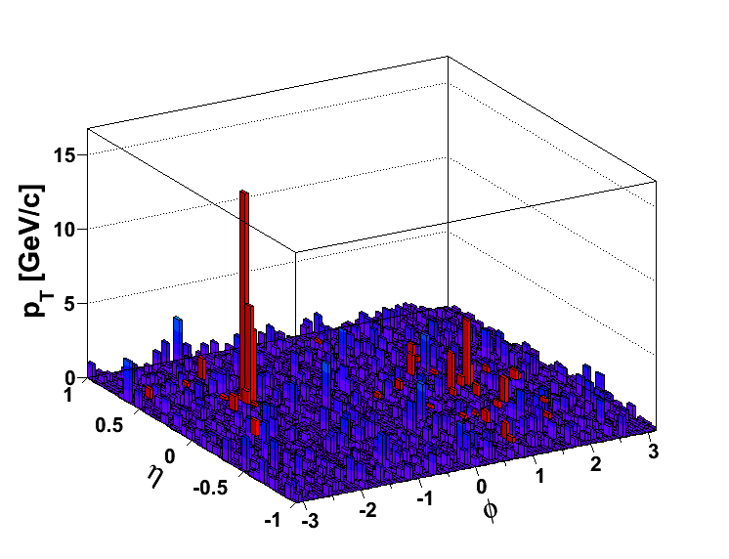
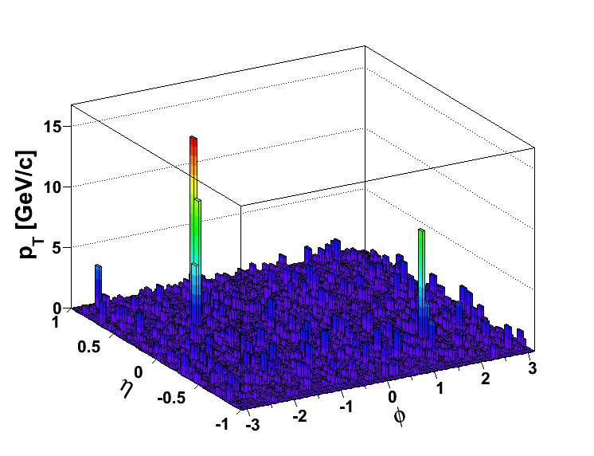
Jets in Heavy Ions
Pedestal Subtraction:
Area-based:
Substructure: Some observables sensitive to soft, large angle radiation → exploring alternatives (e.g. constituent subtraction)
p+p @200 GeV
Fluctuations:
Response from
Embedding:
Compare at detector level
Or unfold to particle level
… if possible
p+p @ Au+Au
Central Au+Au

Slide 9
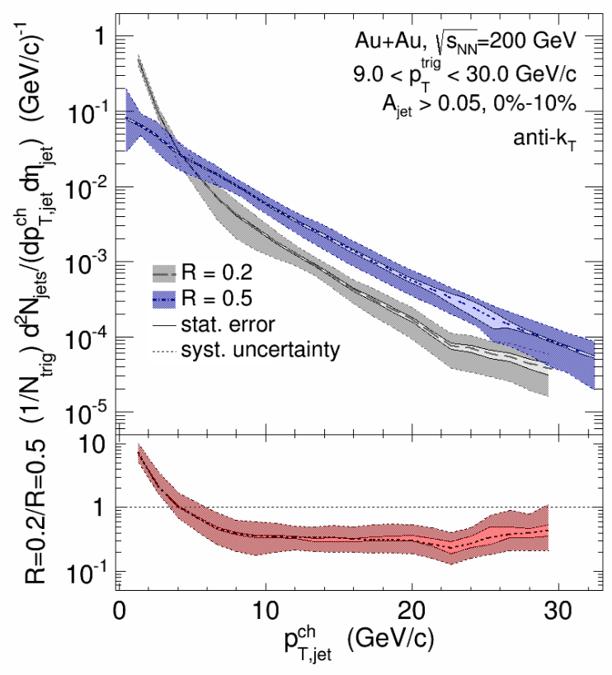
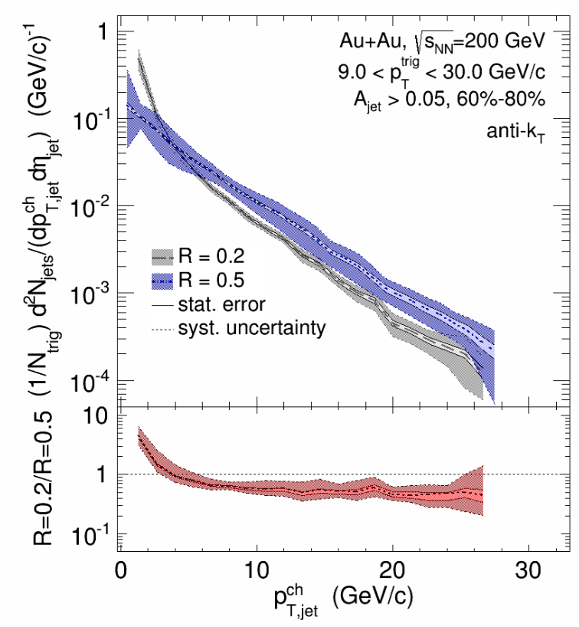
Hadron+Jet “Substructure” (Shape)
0-10%
R=0.2 vs. R=0.5
60-80%
NB: STAR/ALICE
approach to jet shape,
ALICE, PLB 722, 262 (2013)
Compare and contrast to:
CMS, PLB 730, 243 (2014)
ATLAS, EPJC77, 379 (2017)
Medium-induced broadening between R=0.2 and R=0.5
STAR, PRC 96 (2017) 24905

Slide 10
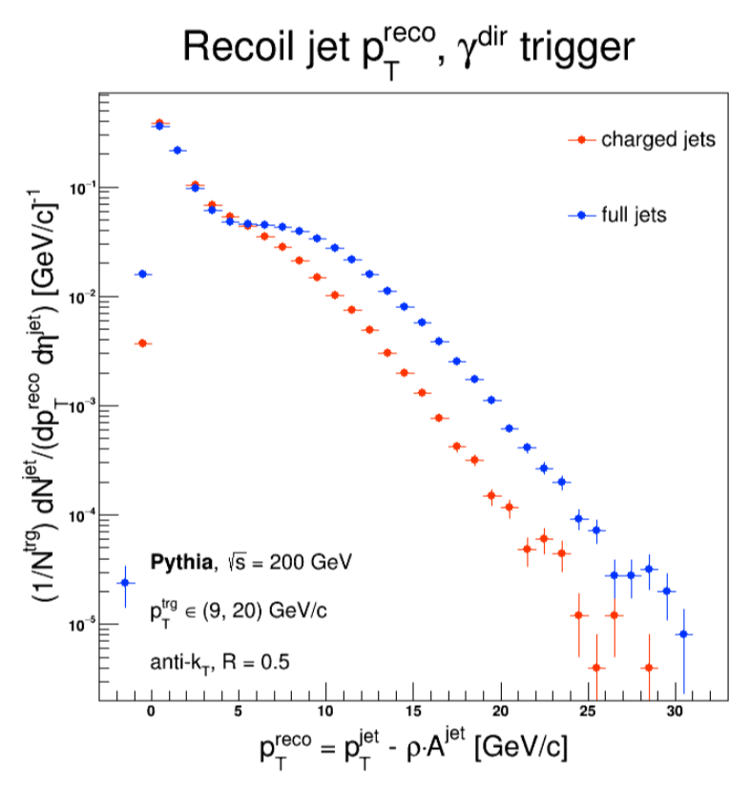
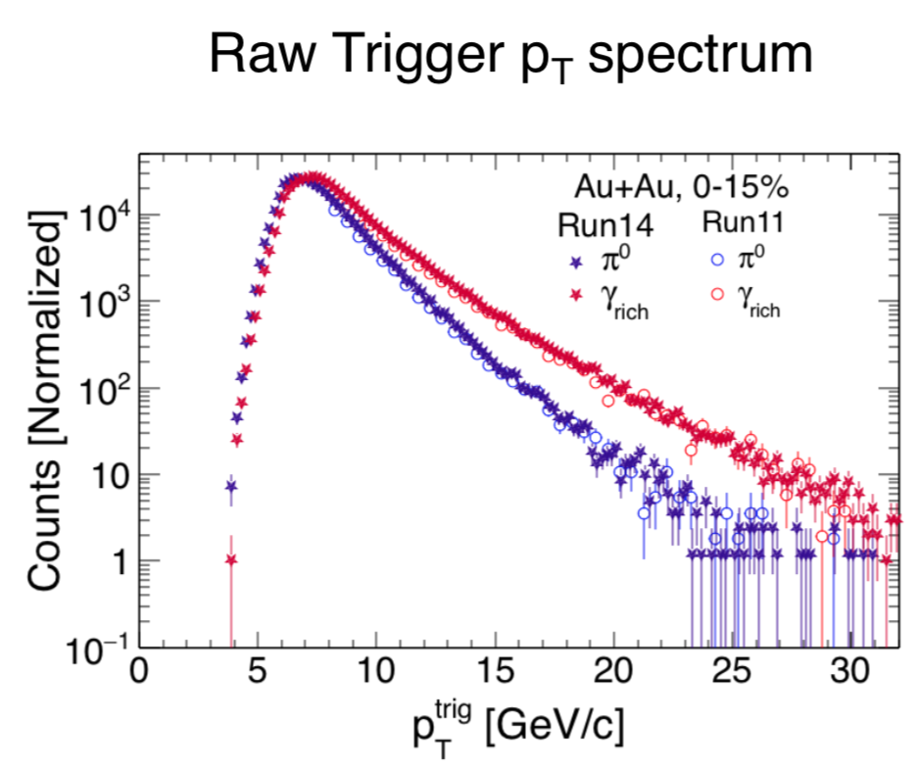
Outlook: γ+Jet
Repeating this analysis with the “golden probe” – stay tuned

Slide 11
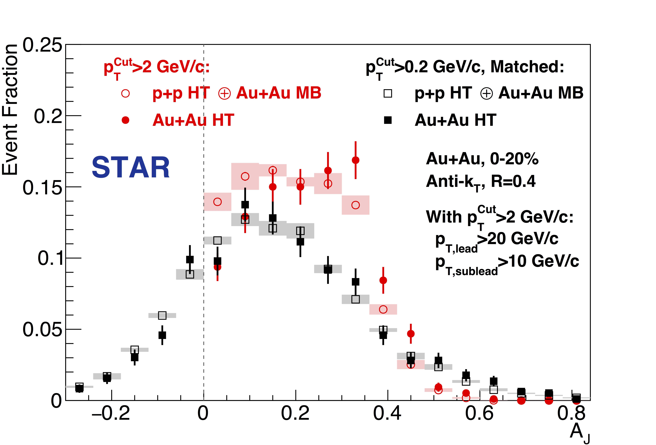
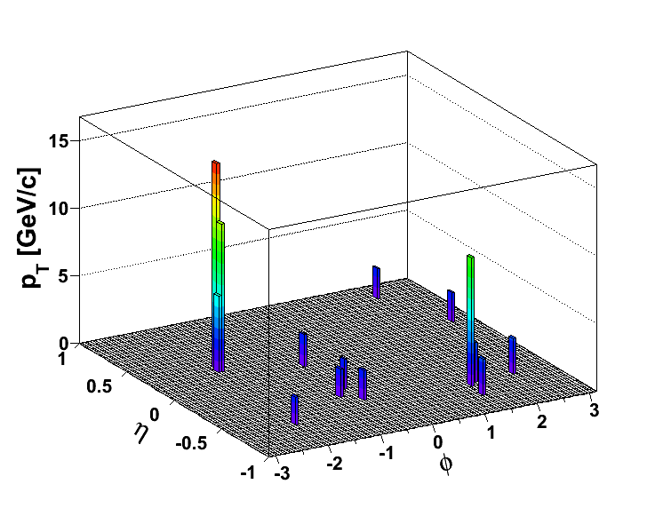
Jet-by-Jet with hard cores
pT^{Lead}>20 GeV/c
pT^{SubLead}>10 GeV/c
|Δφ-π|<0.4
STAR PRL 119, 062301 (2014)
pT^{Cut}=2 GeV/c
Match
Rerun jet-finding
on same events
Imbalance in “hard cores” restored
in matched di-jets for R=0.4
pT^{Cut}=0.2 GeV/c

Slide 12
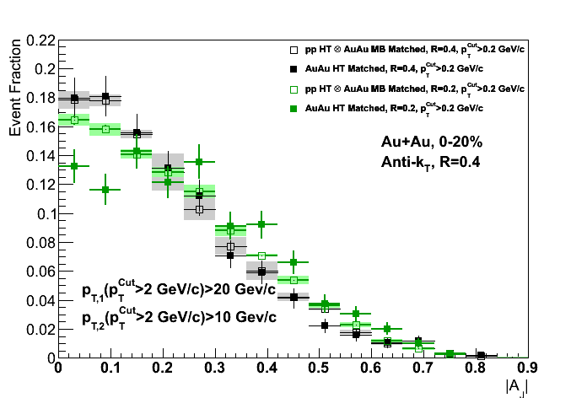
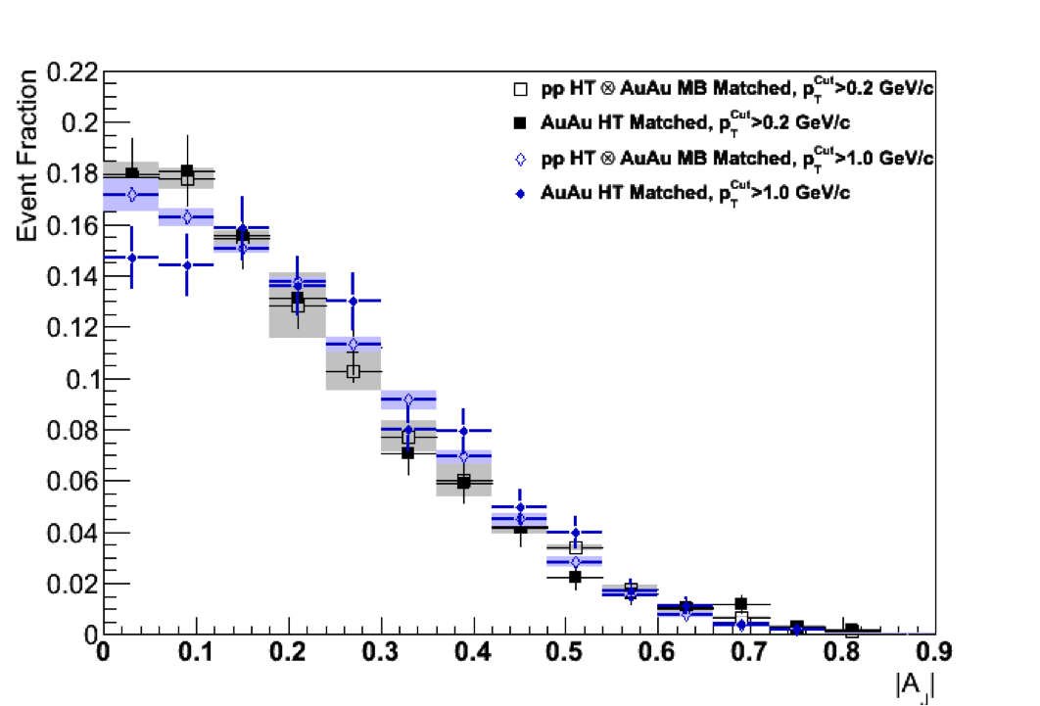

Angular and Spectral “Substructure”
R=0.2
R=0.4
R=0.4
Matched to
Matched to
p_{T}^{Cut} > 0.2 GeV/c
p_{T}^{Cut} > 2 GeV/c
p_{T}^{Cut} > 1 GeV/c
Preliminary
Differential analysis:
Balance not recovered in smaller cone, or harder constituents
Preliminary

Slide 13
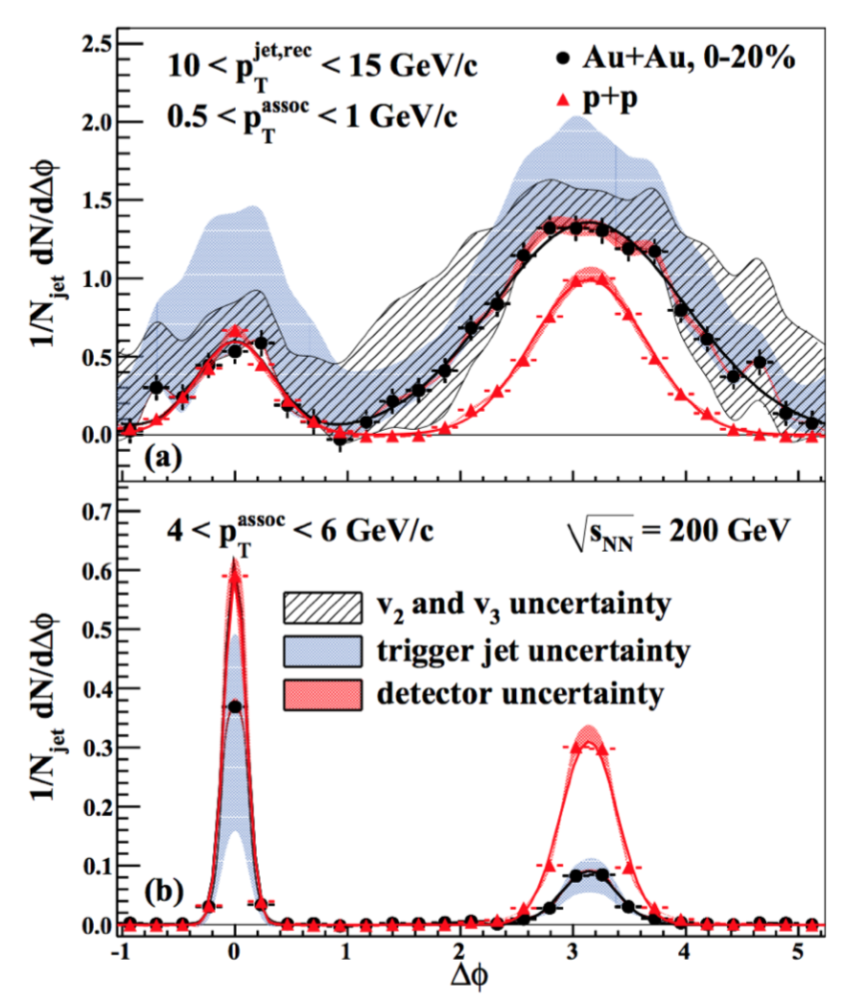
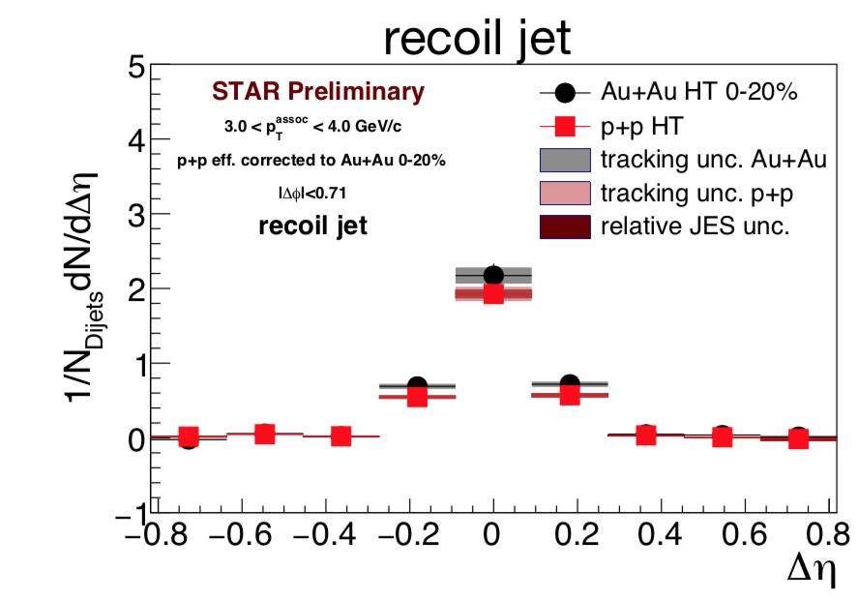
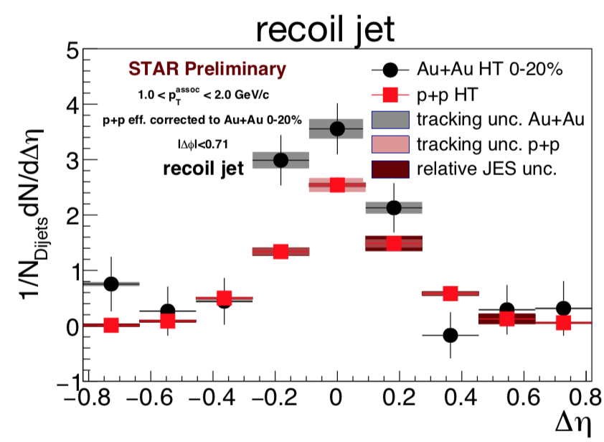
(Di)Jet+Hadron “Substructure”
Now want to focus on jet-by-jet, pQCD style, IRC-safe substructure observables
- but don’t dismiss correlations and
traditional shapes

Slide 14
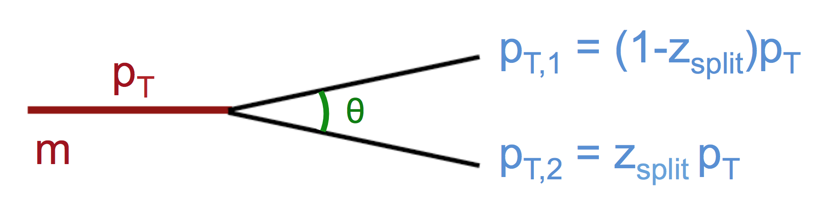
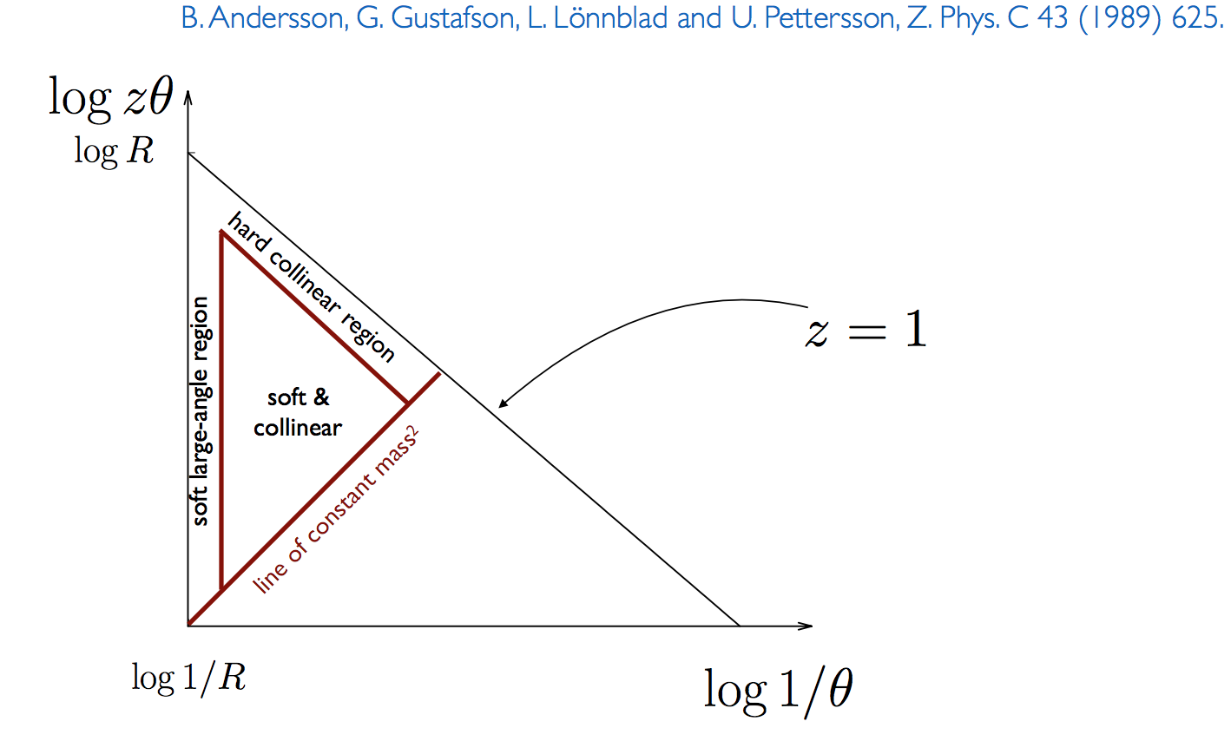
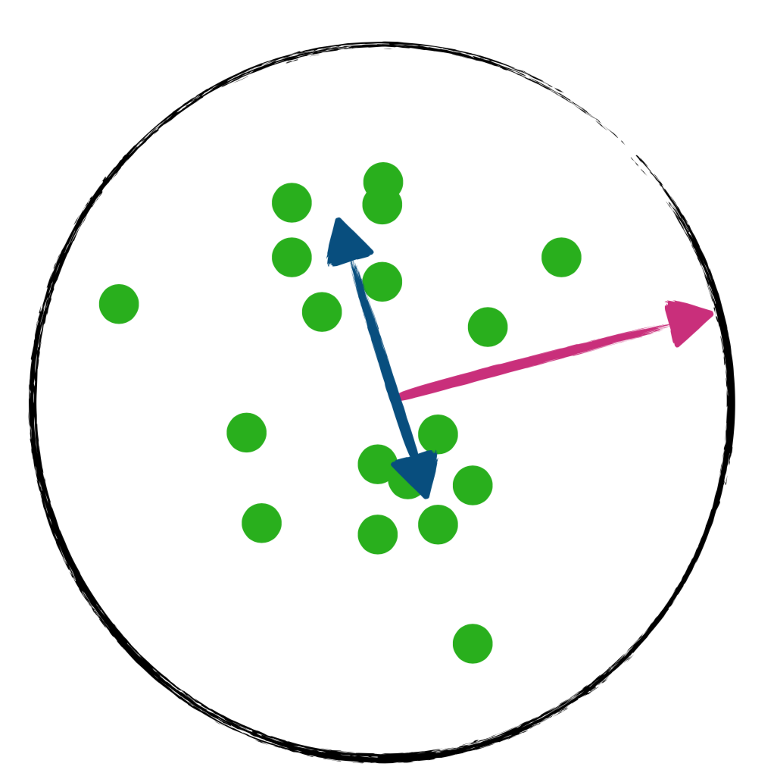
Jet Substructure
Cartoon by M. Verweij
Lund Diagram:
B. Anderson et al., Z Phys C 43, 625 (1989)
Two scales for incoming parton: m, p_{T}
Two scales for the split: z, θ
Program: Characterize with experimentally robust observables
Cartoon by R. Kunnawalkam Elayavalli

Slide 15
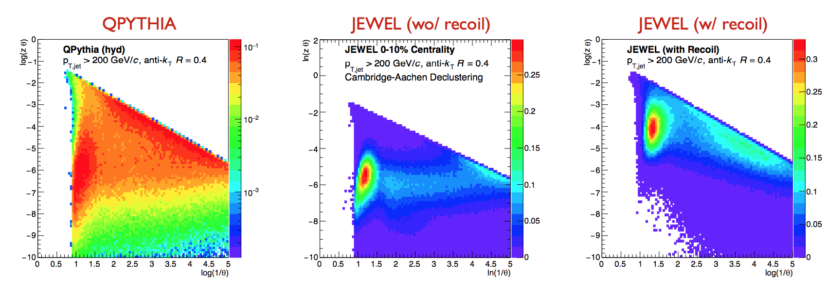
Tantalizing MC Results
Promise of strong model disambiguation
Let’s assemble ingredients
MC Study by K. Tywoniuk et al.
Details: JETSCAPE Winter School 2018

Slide 16
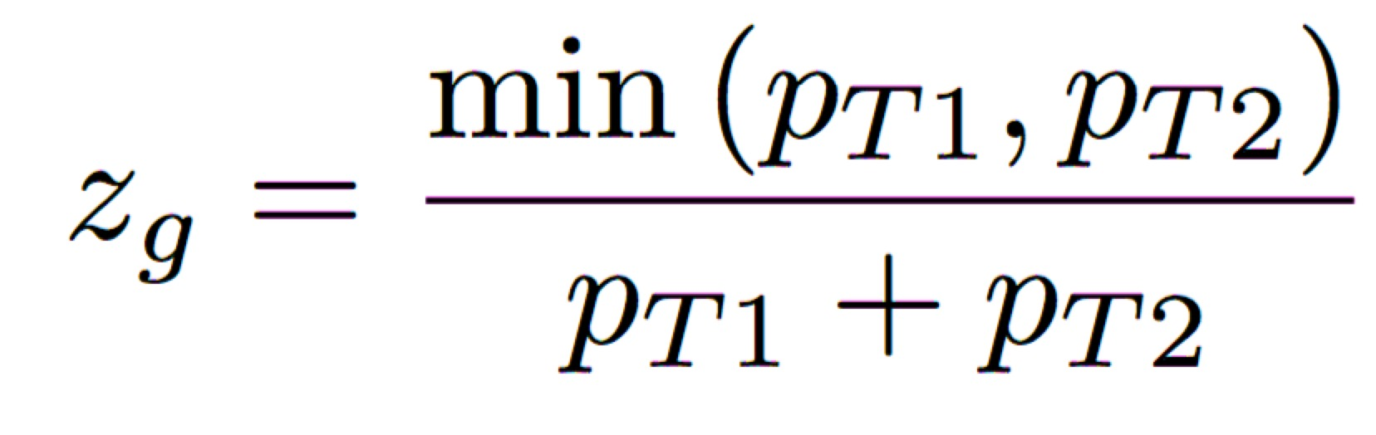
Groomed Momentum Sharing z_{g}
Soft Drop: Remove wide angle soft radiation
With β=0 and Cambridge/Aachen:
“Groomed Momentum Sharing”
Relative z of the softer prong
In vacuum:
~ independent of α_{s}
~ independent of p_{T} (in UV limit)
~ independent of quark/gluon jet
Connection to fundamental QCD
P_{i}: AP splitting functions
J. Thaler
ALICE Jet Workshop (2015)
Larkoski et al.,
PRD 91, 111501 (2015)

Slide 17
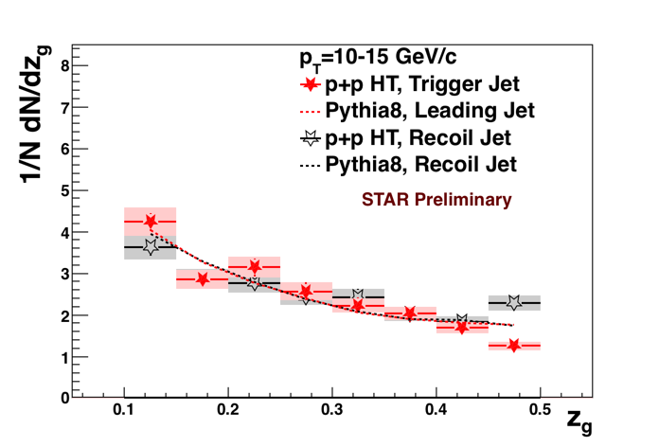
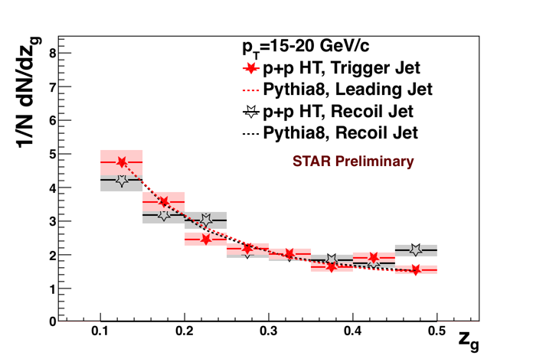
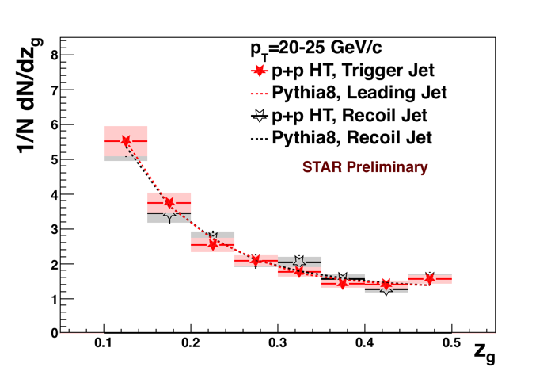
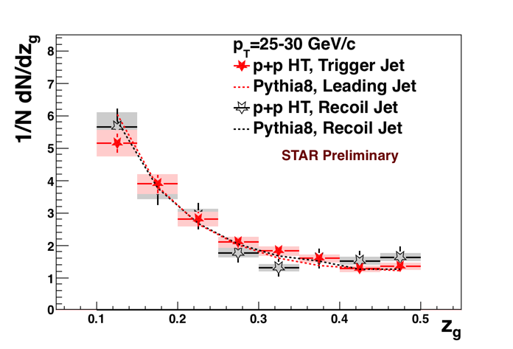
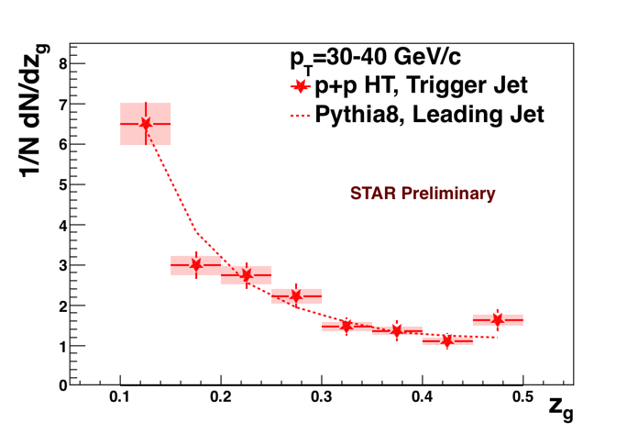
Particle Level z_{g} in p+p
Bin-by-bin corrected
KK, HP16, QM17
Mild p_{T} dependence above ~20 GeV/c
Well described by Pythia
Upcoming:
Larger data set + unfolding → z_{g} up to 50+ GeV/c

Slide 18
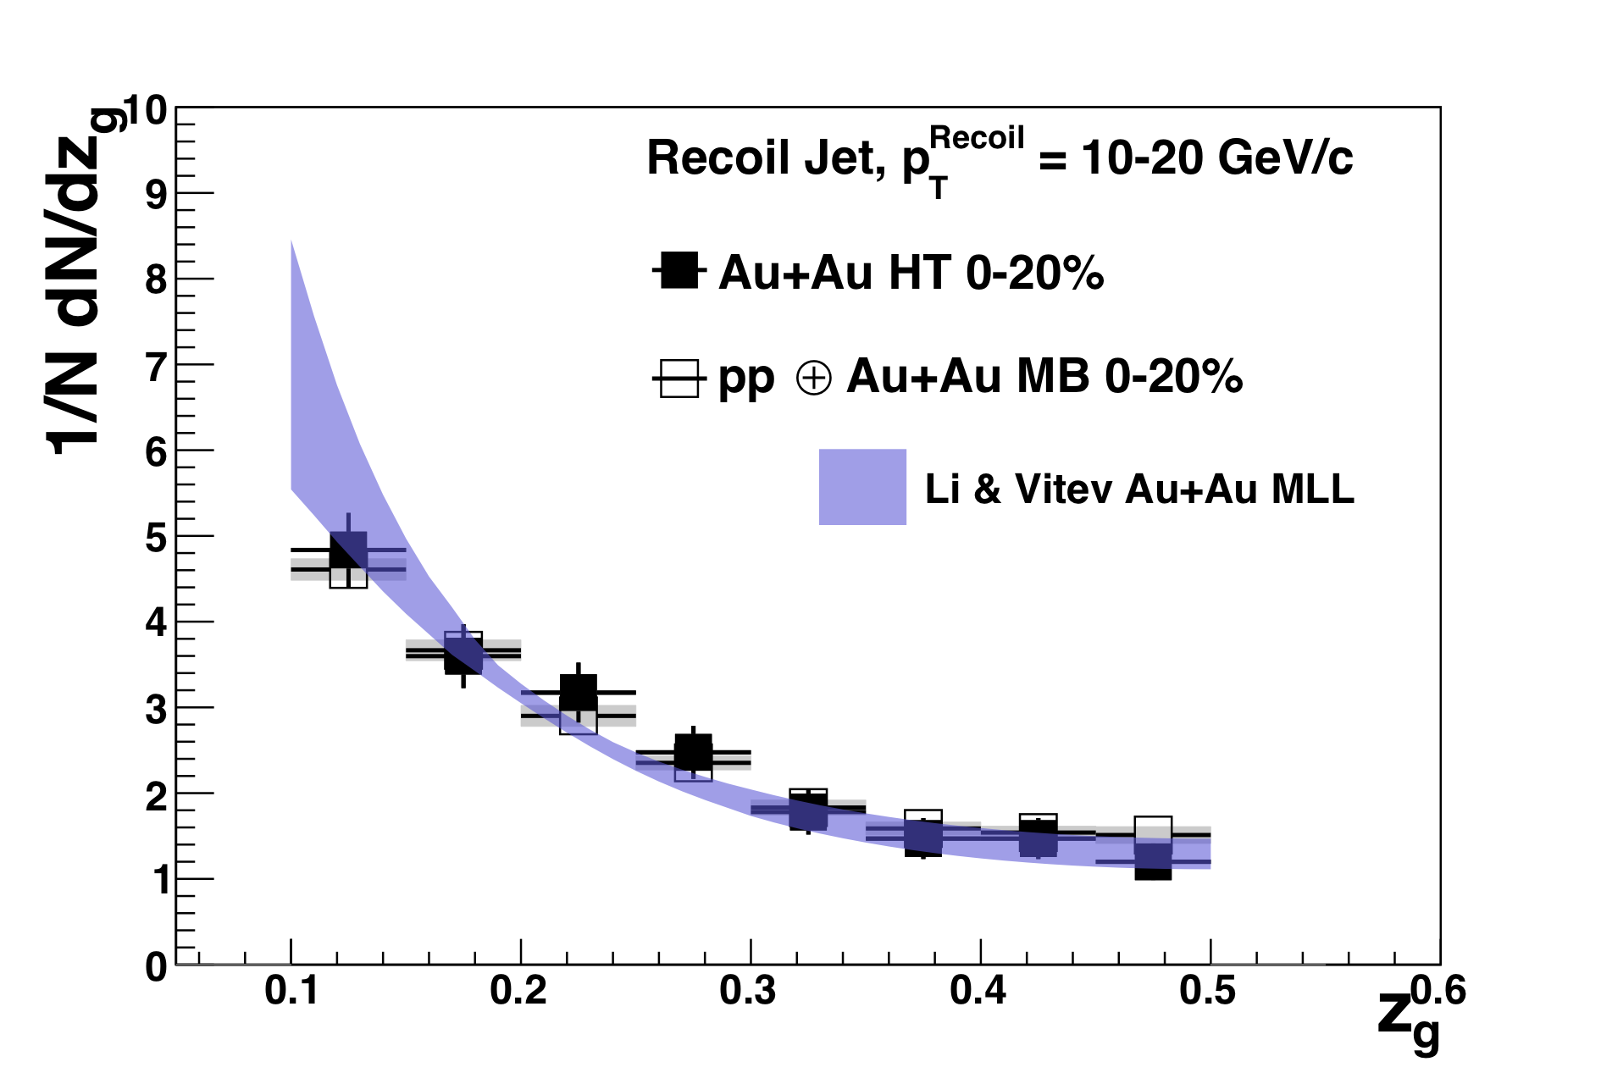
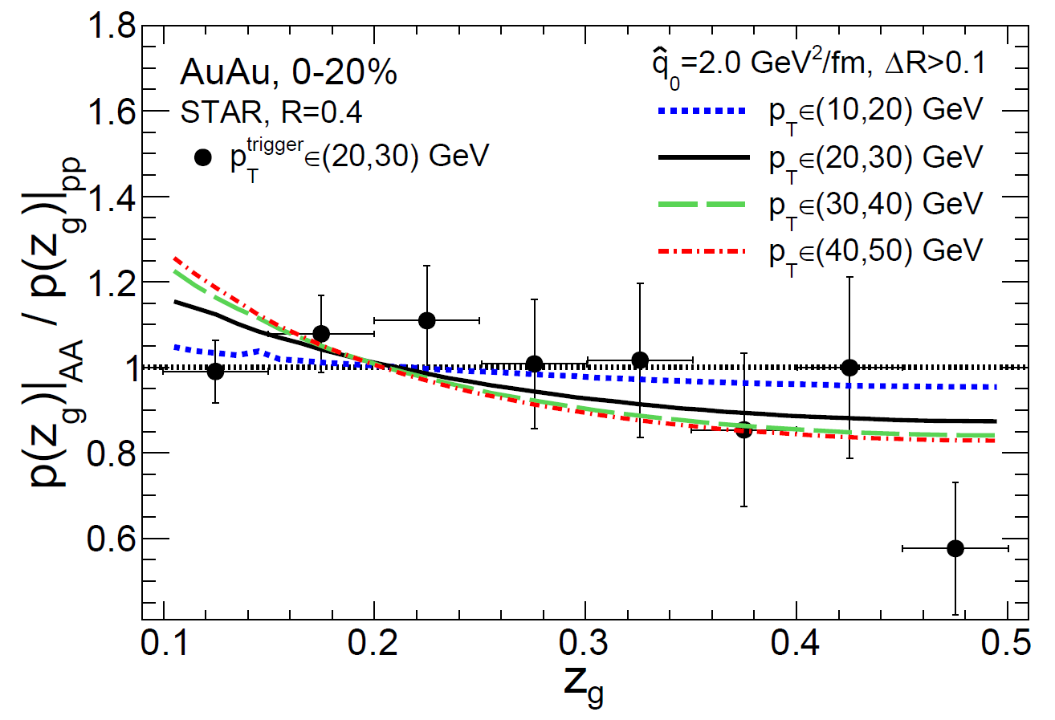
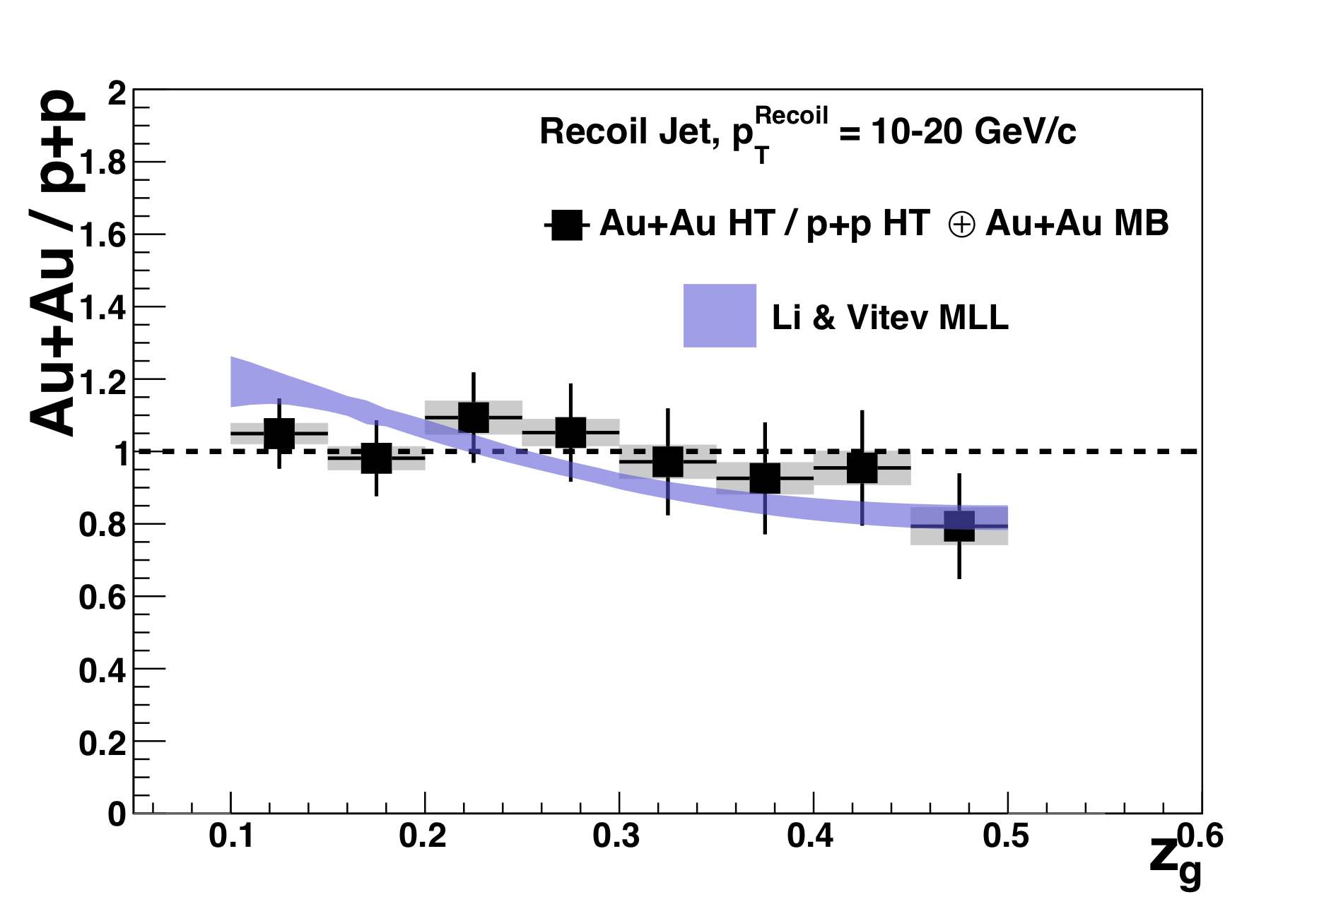
Jet Substructure: z_{g} in Hard Core Jets
KK, HP16, QM17
No significant modification on trigger and recoil side of hard-core dijets
Theoretical models capture this well
More statistics: Test downward slope
Li & Vitev
arXiv: 1801.0008
Modelers: Be mindful of cuts and detector effects
Ning-Bo Chang et al. QM18

Slide 19
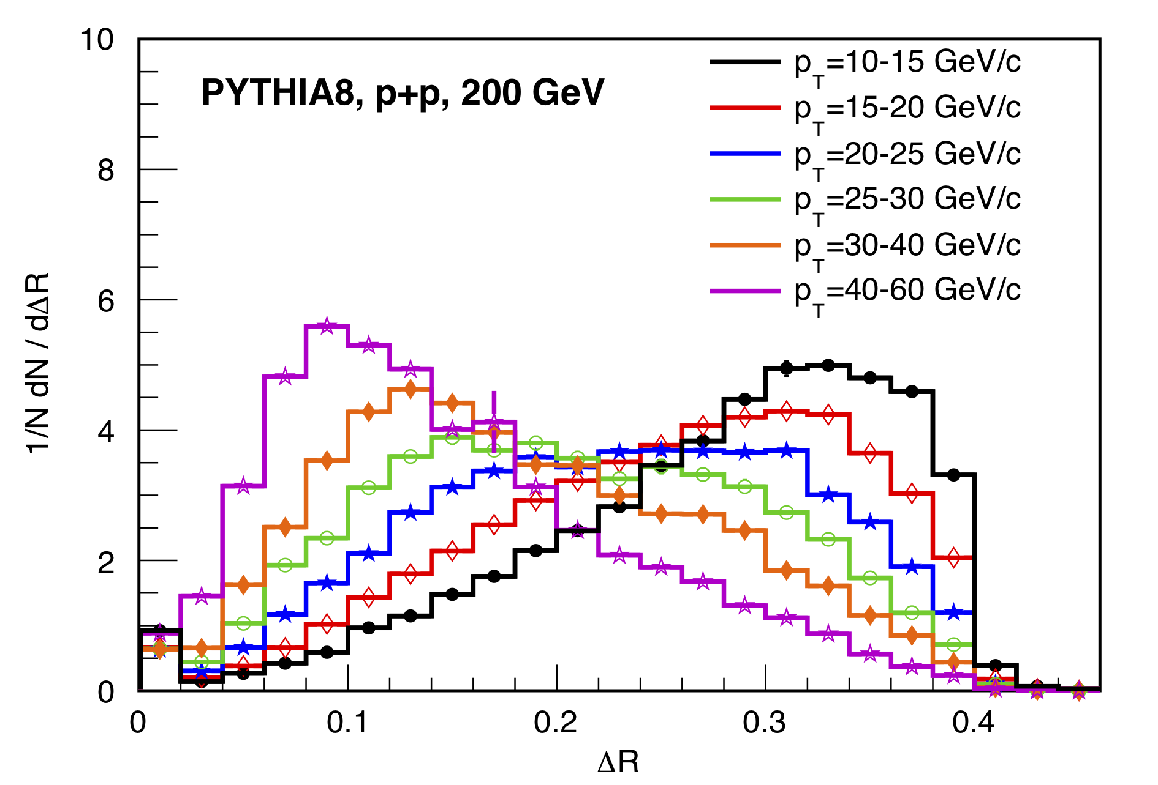
Groomed jet radius r_{g}
aka r_{g}, R_{g}, ΔR
LHC jets
live here
STAR BEMC (but tracking is dominant)
Expected narrowing with p_{T}
Good resolution in RHIC’s kinematic range
CMS constraint
Plays to RHIC’s strengths
What about HI background?

Slide 20
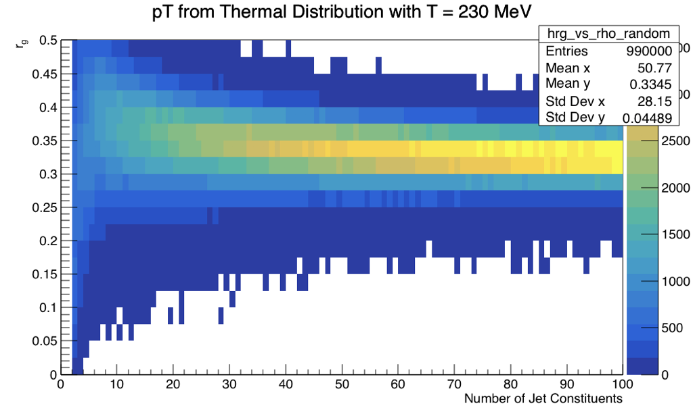
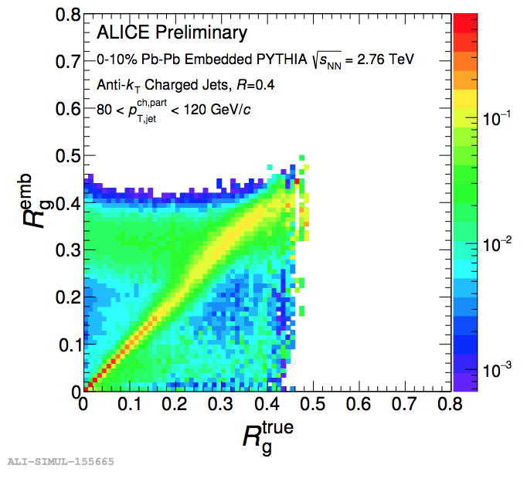
r_{g} in a Thermal Background
R. Kunnawalkam Elayavalli
ALICE< Harry Andrews, QM ‘18
ALICE, 80<p_{T}<120
Effect potentially more severe
in STAR’s kinematic range
Toy background creates a peak purely determined by jet parameters
With signal present, significant structures remain – difficult to disentangle w/o truth info
SoftDrop’s biggest strengths are intimately tied to Cambridge/Aachen,
because C/A follows angular ordering – but HI background is not angular ordered

Slide 21
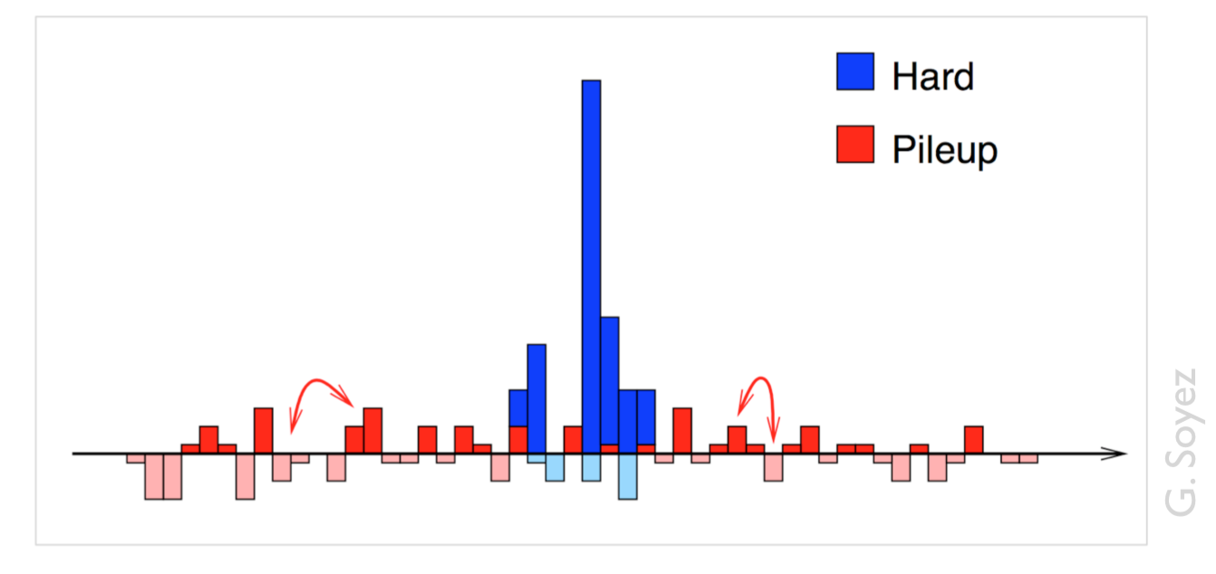
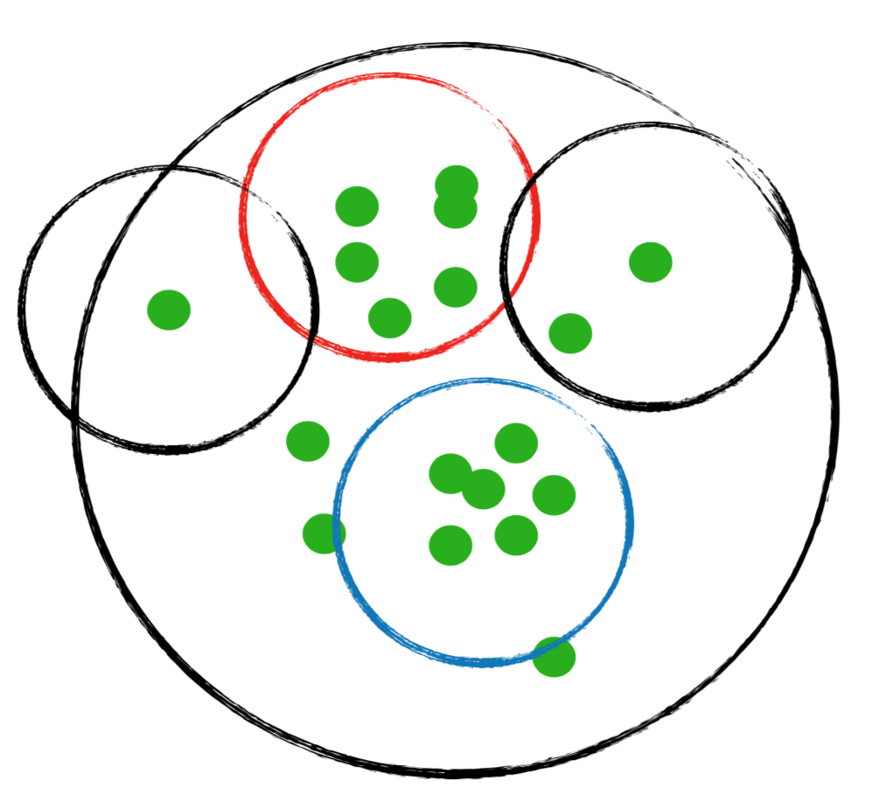
Mitigation/Alternatives
Possible mitigation options
Increase z_{cut}
Introduce additional cuts
Alternatives to C/A?
More sophisticated background subtraction (e.g. constituent subtraction)?
“Generic experimental characterisation of jets in HI collisions, even in the absence of universally valid theoretical descriptions, can and should be a priority” - M. Cacciari , HP ‘16
Possible alternatives to characterize angular scale:
Jet mass (in the works), girth, …
Small subjets (in the works)
Cartoon by
R. Kunnawalkam Elayavalli
M. Cacciari , HP ‘16

Slide 22
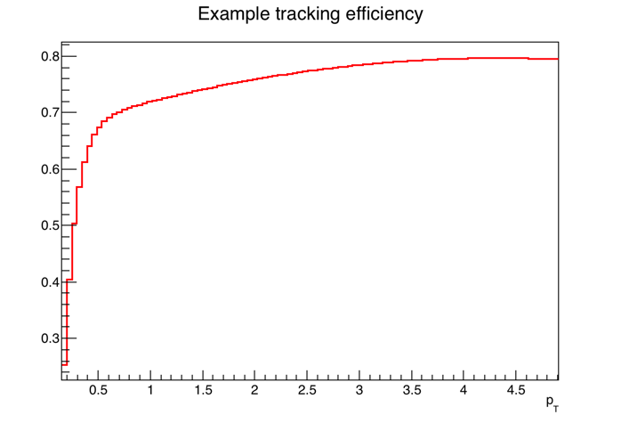
Challenges in Unfolding
Substructure: z, θ, E, two jets,…
→ dimensionality grows → need to carefully factorize
What is the truth level?
→ Hard-core, trigger cuts etc. done at detector level
→ Inclusive measurements may not be possible
… or desirable (e.g. jet geometry engineering)
3) vacuum != medium jets
Possible solutions:
Detector Level comparison (ratios help)
Rethink response construction
Bracket response using multiple models
m, r_{g}
p_{T}, z_{g}
1.0
Quenching

Slide 23
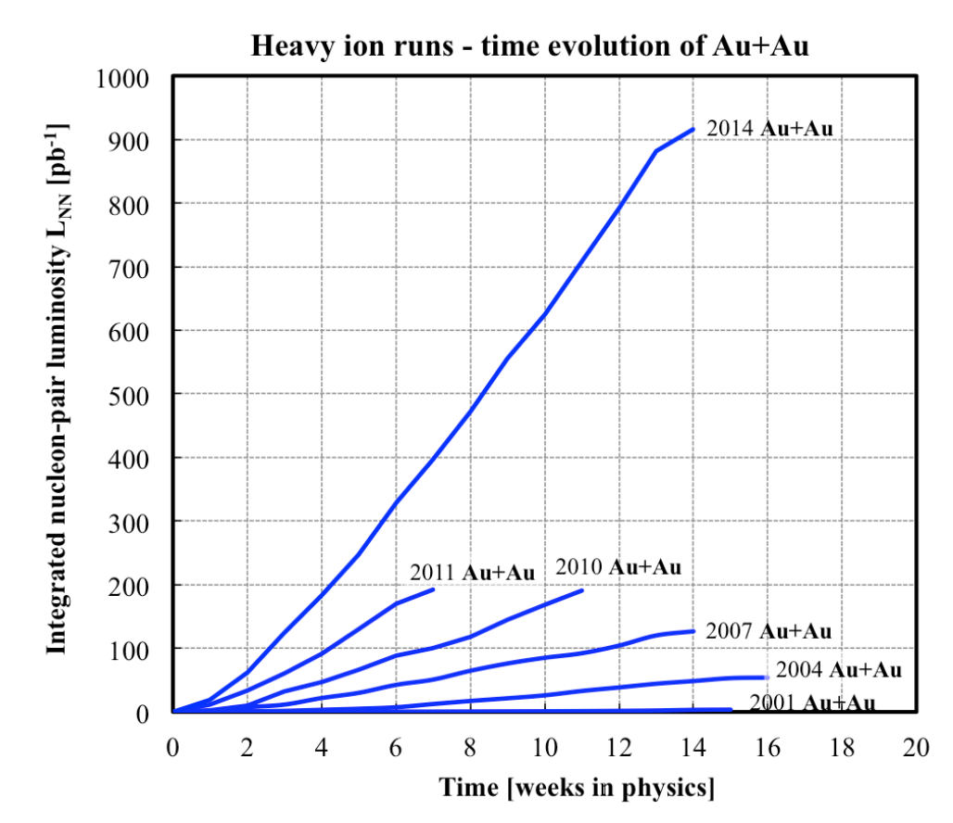
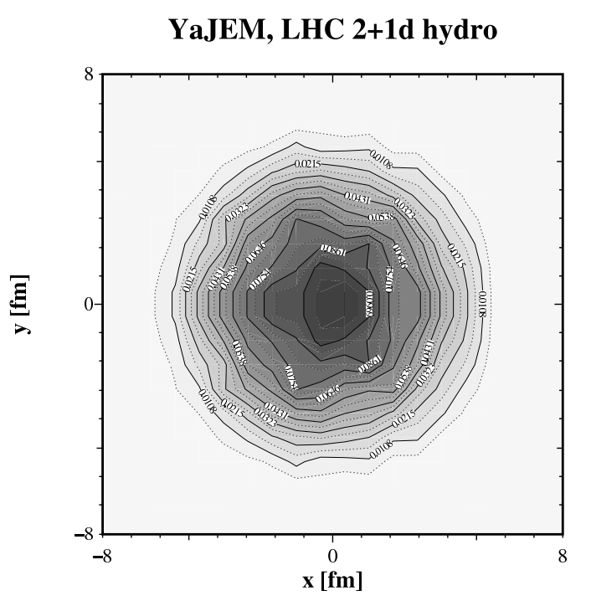
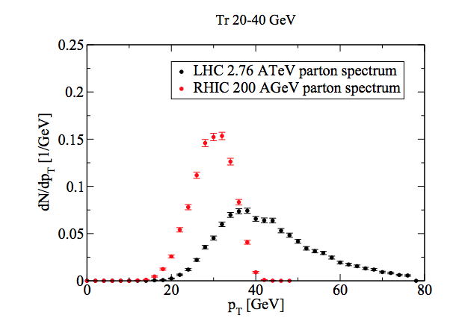


Summary
STAR and RHIC offer unique strengths and capabilities for jet and jet substructure studies
An ambitious program of traditional,
1st , and 2nd generation observables
is well underway
  Book your ticket to Aix-les-Bains!
Jet Geometry
Engineering
Tight parton--jet
correspondence
Sensitivity to
substructure
Flexibility and
Luminosity

Slide 24
BACKUP

Slide 25


Unique RHIC Strengths
R=0.4,
p_{T}^{Cut}>2 GeV/c
LHC Imbalanced Dijets
120 GeV gluon jet
T. Renk, PRC 88, 044905 (2013)
RHIC Jet-h
Recoil p_{T} off a 20-40 GeV trigger
Steeply falling spectrum
→ Good correlation between
jet and original energy!
LHC: Larger energy loss at early times
→ more diffusion
→ larger angles
YaJEM, T. Renk
arXiv:1212.0646, PRC 87, 024905 (2013),
PRC 85, 064908 (2012), PRC 87, 024905 (2013)
Path Length Control?

Slide 26

A+A: Geometries and Strategies
YaJEM: T. Renk arXiv:1212.0646,
PRC 85, 064908 (2012),
PRC 87, 024905 (2013)
RHIC
LHC Dijets
hadron
ideal jet
~ direct _{γ}
jet
w/ cuts
dijet
Selecting a hard scatter:
High-p_{T} hadron
High-p_{T} direct photon
Jet, with cuts
LHC: Geometry ~unaffected
Exploit bias at RHIC for Jet Geometry Engineering
Analyze the recoil
Correlation
Semi-inclusive jets
→ maximum path length
Jet, with cuts
→ shorter path length?

Slide 27




Large Angle Scattering off the QGP?
JHEP 1305 (2013) 031
Δφ
Discrete scattering centers or effectively continuous medium?
Scattering probability can give us
important information about coupling
→ strongly/weakly coupled QGP
→ quasiparticles?
“Weak”
multiple scattering
“Strong”
Continuous E-loss

Slide 28




h-Triggered Recoil Jets
arXiv:1702.01108
Raw
R=0.3
Unfolded
Recoil jets
azimuthal distribution
h^{+/-}-triggered charged recoil jets:
→ I_{CP} shows strong suppression
(~0.2-0.3 for R=0.3)
New limit on large-angle Molière scattering in central Au+Au

Slide 29


Di-Jet Imbalance
R=0.2
R=0.2 vs. R=0.4
R=0.4
p+p balance no longer recovered
Energy shifted outward, yet remains inside 0.4
Leading or sub-leading jet? A_{J} can’t answer
arXiv:1609.03878

Slide 30



Contrast to LHC
HP ‘16
Trigger
Recoil
STAR Biased Di-Jets: No z_{g} modification found
Possible Reasons:
Split as measured with z_{g} occurs outside the medium?
  Or before formation?
Splitting function not affected by medium interactions?
Other explanations?
BOOST ’16
HIN-16-006
CMS Inclusive Jets:
Significant modification in central Pb+Pb
below 250 GeV/c

Slide 31






RHIC and the LHC
Larger Q², new probes (Z, W, …) in “similar”QGP
→ Stronger model constraints
Qualitative differences?

Slide 32


Slide 33


