Slide 1



BNL, July 22-25, 2018
Workshop on Probing quark-gluon matter with jets
LBT model for jet transport and the unavoidable effect of medium response
Xin-Nian Wang
CCNU/LBNL
In collaboration with S. Cao, W. Chen, Y. He, T. Luo, LG Pang

Slide 2
Jet quenching in heavy-ion collisions
Parton energy loss leads to
jet suppression
Jet 1
q
q
Energy deposition leads to
medium excitation
Jet 2
A-A collision
Notes:
Jet quenching originally was proposed as a signal of the the formation and high density matter in heavy-ion collisions.

Slide 3
Jet energy and background subtraction
Jet energy as defined in the jet reconstruction algorithm
Uncorrelated background should be subtracted
Jet-induced medium response is correlated with jet: not background
Some of the energy lost by leading partons remain inside jet-cone

Slide 4
LBT: Linear Boltzmann Transport
Induced radiation
pQCD elastic and radiative processes (high-twist)
Transport of medium recoil partons ( and back-reaction)
3+1D hydro bulk evolution
jet parton
Back-reaction
recoil parton
Li, Liu, Ma, XNW and Zhu, PRL 106 （2010） 012301
XNW and Zhu, PRL 111 (2013) 062301; He, Luo, XNW & Zhu, PRC91 (2015) 054908;
Notes:
f_i(p_i)=\frac{1}{e^{p_i\cdot u/T}\pm 1} (i=2,4)
f_i(p)=(2\pi)^3\delta^3(\vec p_i-\vec p_0)\delta^3(\vec x-\vec x_0-t\vec v_i) [i=1,3]
\frac{dN_g}{dzd^2k_\perp dt}=\frac{2\alpha_s N_c}{\pi k_\perp^4} P(z)
(\hat p\cdot u) \hat q \sin^2(\frac{t-t_0}{2\tau_f})

Slide 5
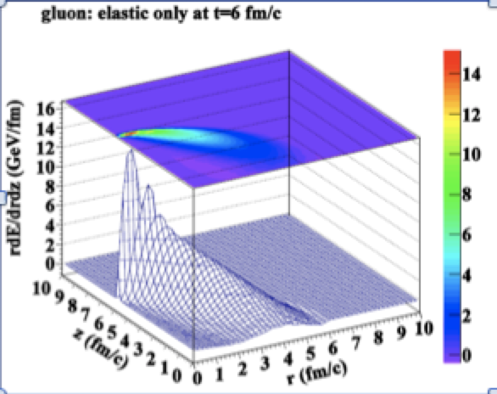
LBT: Jet-induced medium response
Energy distr. of medium response
Parton distr. from elastic scattering
He, Luo, XNW & Zhu, PRC91 (2015) 054908;
Notes:
f_i(p_i)=\frac{1}{e^{p_i\cdot u/T}\pm 1} (i=2,4)
f_i(p)=(2\pi)^3\delta^3(\vec p_i-\vec p_0)\delta^3(\vec x-\vec x_0-t\vec v_i) [i=1,3]
\frac{dN_g}{dzd^2k_\perp dt}=\frac{2\alpha_s N_c}{\pi k_\perp^4} P(z)
(\hat p\cdot u) \hat q \sin^2(\frac{t-t_0}{2\tau_f})

Slide 6
CoLBT-hydro
(Coupled Linear Boltzmann Transport hydro)
LBT for energetic partons (jet shower and recoil)
Hydrodynamic model for bulk and soft partons: CLVisc
CLVisc: (3+1)D viscous hydro parallelized on GPU using OpenCL
Chen, Cao, Luo, Pang & XNW, PLB777(2018)86
Notes:
\partial_\mu T^{\mu\nu}(x) = j^\nu (x)
\delta f(p,x) \ll f(p,x)
j^\nu(x) = \sum_i p^\nu_i \delta^{(4)}(x-x_i) \theta(p^0_{cut}-p\cdot u)
j^\nu(x) = \sum_a\int \frac{d^3p}{(2\pi)^3}\frac{p^\nu}{p^0}f_a(p)\theta(p\cdot u - p^0_{cut})
p\cdot \partial f(p) =- C(p) \;\;\; p\cdot u > p_{cut}^0

Slide 7

γ-jet propagation within CoLBT-hydro
Notes:
\partial_\mu T^{\mu\nu}(x) = j^\nu (x)
\delta f(p,x) \ll f(p,x)
j^\nu(x) = \sum_i p^\nu_i \delta^{(4)}(x-x_i) \theta(p^0_{cut}-p\cdot u)
j^\nu(x) = \sum_a\int \frac{d^3p}{(2\pi)^3}\frac{p^\nu}{p^0}f_a(p)\theta(p\cdot u - p^0_{cut})
p\cdot \partial f(p) =- C(p) \;\;\; p\cdot u > p_{cut}^0

Slide 8
Light and heavy quark hadron suppression
AuAu@200 GeV
PbPb@2760 GeV
PbPb@5020 GeV
Cao, Luo, Qin & XNW, PRC94 (2016) 014909

Slide 9
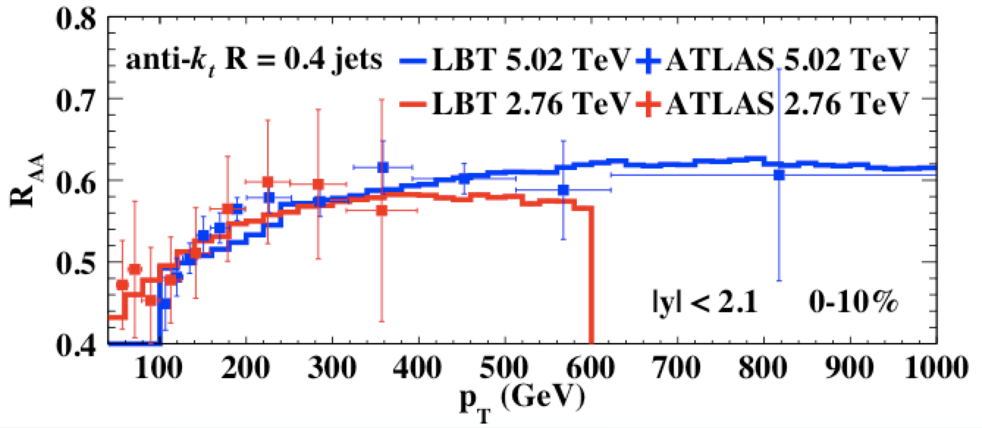
Single jet suppression at LHC
preliminary
He, Cao, Luo & XNW to be published
Weak pT dependence: initial jet spectra and pT dependence of energy loss ΔE
Week energy dependence: increase of jet energy loss and the slope of initial spectra

Slide 10
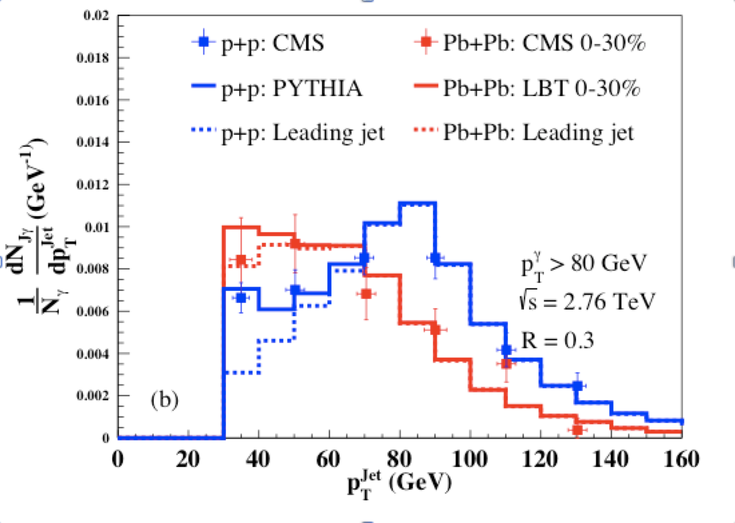
Jet energy loss and γ(Z⁰)-jet asymmetry
Luo, Cao, He & XNW, PLB782(18)707
Zhang, Luo, XNW, Zhang, arXiv:1804.11041
Notes:
v_2^{jet}=\frac{\langle v_2^{soft} \cos(2[\phi^{jet}-\Psi_2])\rangle}{\sqrt{\langle(v_2^{soft})^2\rangle}}

Slide 11
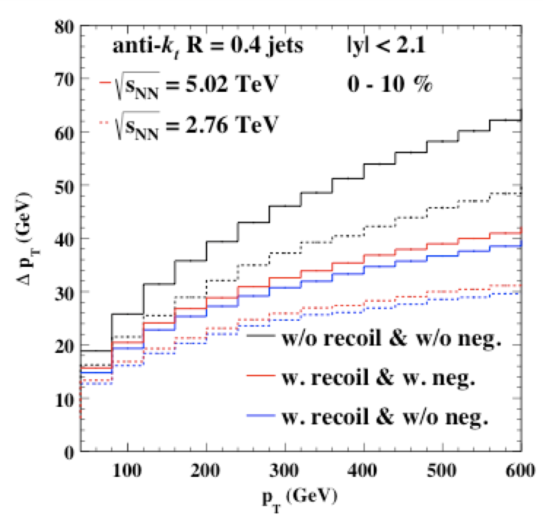
Medium response reduces jet energy loss
Recoil partons within the jet
cone reduce the net jet energy loss
Diffusion wake (backreaction)
reduces the thermal
background, if taken into
account, increase the net jet
Energy loss with given cone-size
Depend on jet cone-size R
Sensitive to radial flow
Can be estimated from elastic
Scattering: PRC96(2017)034903

Slide 12
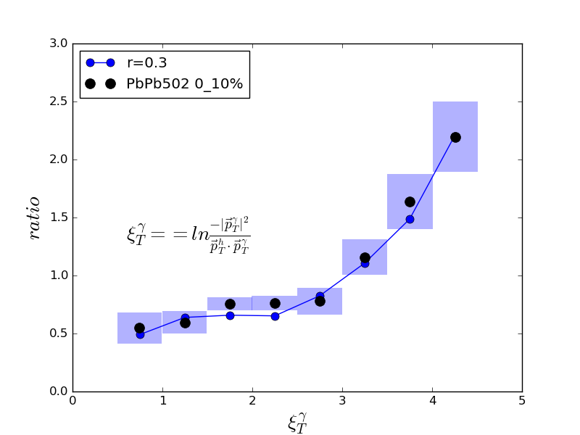
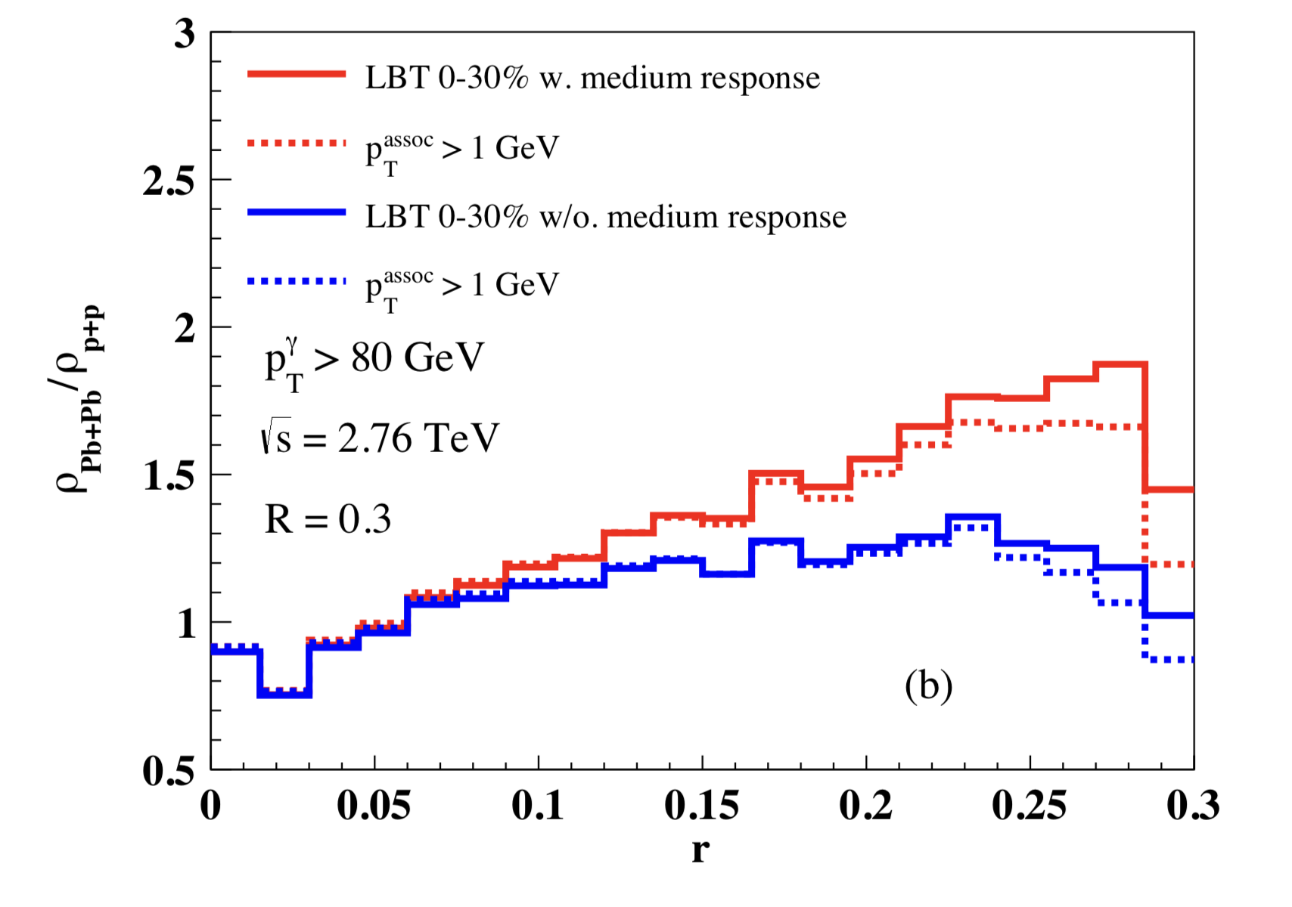
Effect of medium response
Enhancement of Frag Function
at small z
Enhancement of jet shape
at larger r
Preliminary
CMS
With recoil
w/o recoil
Luo, Cao, He & XNW, arXiv:1803.06785

Slide 13
Enhancement of soft hadrons
Chen, Cao, Luo, Pang, XNW,PLB777(2018)86
Onset of soft hadron
enhancement is at
fixed pT ~ 2 GeV

Slide 14
Azimuthal distribution of soft hadrons from medium response in γ-jet
Broadening of jet peak
Depletion of the background
In the γ direction
Chen, Cao, Luo, Pang, XNW,
PLB777(2018)86

Slide 15
The flavor of medium response
ALICE
γ-jet p/π
Bulk p/π
Enhancement of p/pi in bulk medium
Dominance of medium response of
soft hadron inside jet pT<2 GeV
p/pi, K/pi ratios resemble to bulk

Slide 16
Summary on medium response
Suppression of high pT hadrons caused by energy loss of leading partons, not medium response
Jet (with R) energy loss influenced by both transport shower partons & medium response
Medium response leads to modification of jet shape, jet frag function, hadron flavor modification
Diffusion wake → depletion of hadron in the gamma-direction

Slide 17
Data-driven extraction of jet energy loss
Extraction of qhat is model dependent
Extraction of jet energy loss is mostly
model independent
JET Collaboration: Phys.Rev. C90 (2014) 1, 014909

Slide 18
Jet cross section in p+p and A+A
Kang, Ringer & Vitev, PLB769(2017)242
Medium modified jet function and jet energy loss distribution:
Medium modified jet production cross section
p_{T}(p_{Tc}) → jet p_{T} in vaccum
Notes:
\frac{d\sigma_{\rm jet}}{dp_Td\eta}=\sum_{a,b,c} d\sigma_{ab}^c \otimes J_c(p_T,p_{Tc},R)
\frac{d\sigma_{\rm jet}}{dp_Td\eta}=\sum_{a,b,c} f_a\otimes f_b\otimes H_{ab}^c \otimes J_c(p_T,p_{Tc},R)
\widetilde J_c(p_T,p_{Tc},R, {\bf r}, {\bf b})=\int d\Delta p_T w_c(\Delta p_T, p_T, R, {\bf r}, {\bf b}, \phi) J_c(p_T+\Delta p_T,p_{Tc},R)
W^{c}_{\rm AA}(\Delta p_T, p_T, R)=\frac{\int d^2r d^2b t_A(r) t_A(|{\bf b}-{\bf r}|) \frac{d\phi}{2\pi}
w_c(\Delta p_T, p_T, R, {\bf r},{\bf b},\phi)}{\int d^2r d^2b t_A(r) t_A(|{\bf b}-{\bf r}|)}.
\frac{d\sigma_{\rm jet}^{\rm AA}}{dp_Tdy}=\int d\Delta p_T \sum_{a,b,c}W^{c}_{\rm AA}(\Delta p_T, p_T+\Delta p_T, R)d\sigma_{ab}^c\otimes J_c(p_T+\Delta p_T,p_{Tc},R)

Slide 19
Data-driven extraction of jet energy loss
LBT simulations
Flavor averaged jet energy loss distribution
Notes:
\frac{d\sigma_{\rm jet}^{\rm AA}}{dp_Tdy}=\int d\Delta p_T W_{\rm AA}(\Delta p_T, p_T+\Delta p_T, R)\frac{d\sigma_{\rm pp}}{dp_Tdy}|_{p_T=p_T+\Delta p_T}
W_{\rm AA}(\Delta p_T, p_T, R)\approx W_{\rm AA}(\Delta p_T/\langle \Delta p_T \rangle, R)

Slide 20
Bayesian analysis of experimental data
200K samplings
Markov chain Monte Carlo
to sample parameters based
on uniform prior distributions
Notes:
W_{AA}(\Delta p_T, p_T, R)
\sigma_{\rm jet}^{AA}(p_T)
\sigma_{\rm jet}^{pp}(p_T)
\langle \Delta p_T\rangle=b p_T^c \log(p_T)
W_{AA}(x)=\frac{\alpha^\alpha}{\Gamma(\alpha)}x^{\alpha-1} e^{-\alpha x}
x=\frac{\Delta p_T}{\langle \Delta p_T\rangle}

Slide 21
Jet energy loss: single inclusive jet

Slide 22
Jet energy loss: γ+ jet

Slide 23
Summary on extraction of jet energy loss
Using factorized pQCD jet cross section, A+A jet cross section can be obtained from p+p cross section with an energy loss distribution
Using Bayesian method, one can extract jet energy loss distribution and average jet energy loss from experimental data on jet cross section in p+p and A+A collisions

Slide 26
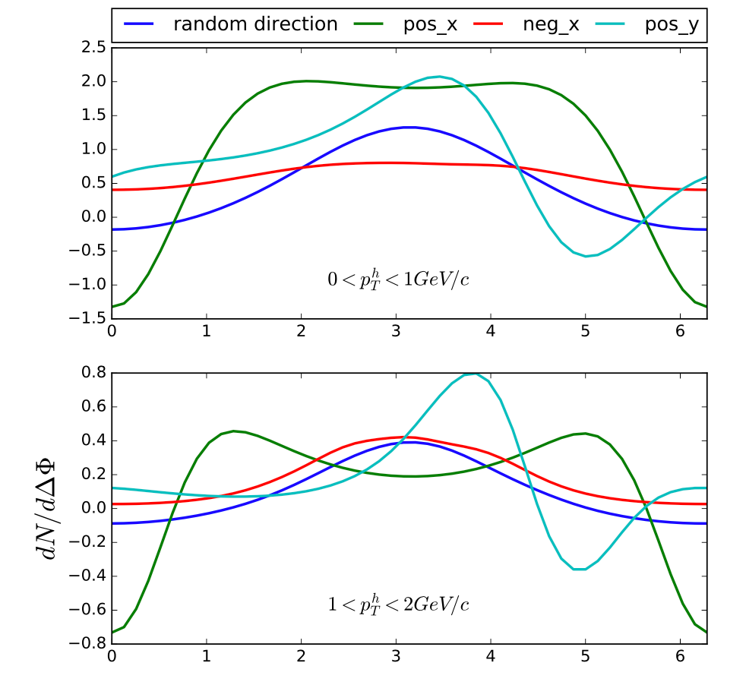
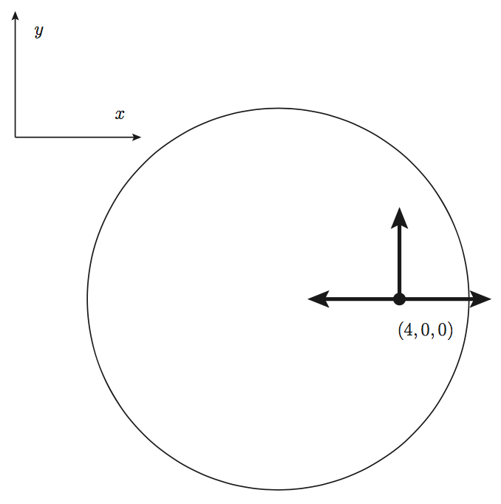
Wide angle distribution of soft hadrons
ΔΦ

Slide 27
Energy dependence of jet spectra

Slide 28
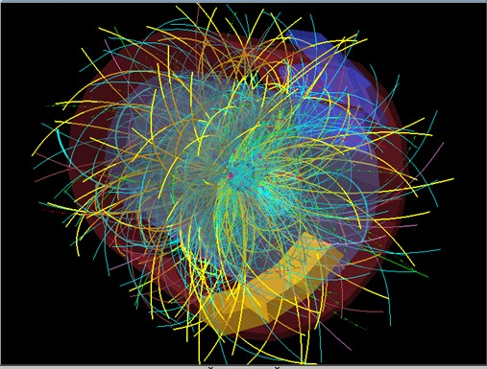
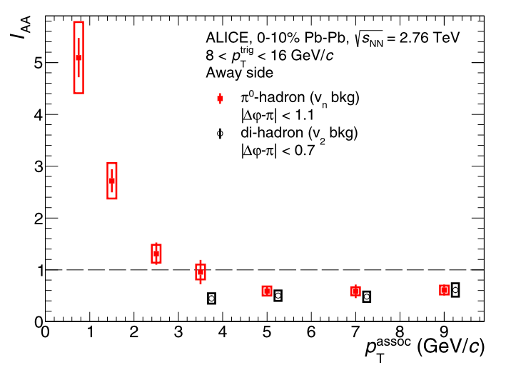
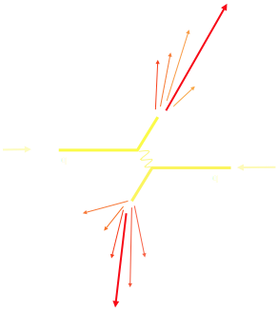
Jet Quenching phenomena at LHC
Pedestal&flow subtracted
Notes:
RHIC experiments marked a milestone for jet quenching, from a theoretical concept to a reality.

Slide 29
Jet transport coefficient
JET Collaboration: Phys.Rev. C90 (2014) 1, 014909

Slide 30
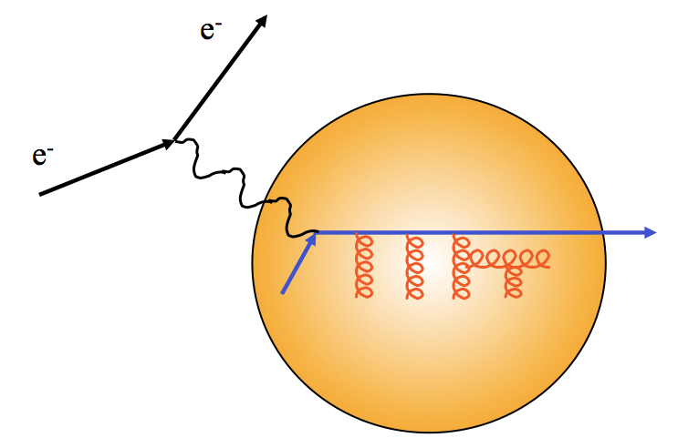
Hard probes of medium properties
TMD gluon distribution or
Jet transport coefficient q
Yuanyuan Zhang, et al 2018
Notes:
\frac{dN}{d\ell_T^2dz}=2\pi\frac{C_2C_A}{d_A}P(z)\int dy \rho(y)\int \frac{d^2q_T}{(2\pi)^2}\phi(x_D,q_T) \\
\times\frac{2 \vec q_T \cdot \vec \ell_T}{q_T^2\ell_T^2(\vec \ell_T - \vec q_T)^2}\left[1-\cos[(x_L+\frac{x_D}{1-z})p^+y^-]\right]
x_L=\frac{\ell_T^2}{2p^+q^-z(1-z)}
x_D=\frac{q_T^2-2\vec q_T\cdot \vec \ell_T}{2p^+q^-z}

Slide 31
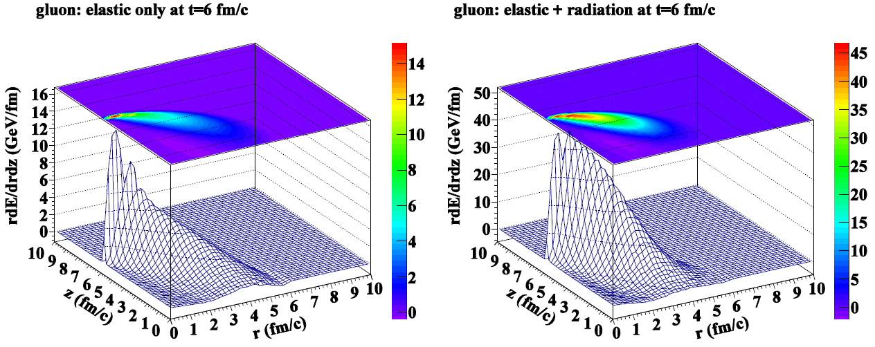
Linear Boltzmann Transport (LBT)
pQCD elastic and radiative processes (high-twist)
Transport of medium recoil partons
3+1D hydro bulk evolution
Li, Liu, Ma, XNW & Zhu, PRL 106 (2011)012301
XNW & Zhu, PRL 111 (2013), 062301
He, Luo, XNW & Zhu, PRC91 (2015) 054908;

Slide 32
Energy dependence of jet spectra

Slide 33
Gamma-jet profile
Pb+Pb @ 2.76 TeV
p+p @ 2.76 TeV

