Slide 1
Welcome and Announcements

Slide 2
Questions or Concerns?
Contact the Workshop Organizers:
Curt Hovater (hovater@jlab.org)
Kevin Smith (ksmith@bnl.gov)
Anna Petway (petway@bnl.gov)
Christine Meyer (cmeyer@bnl.gov)

Slide 3
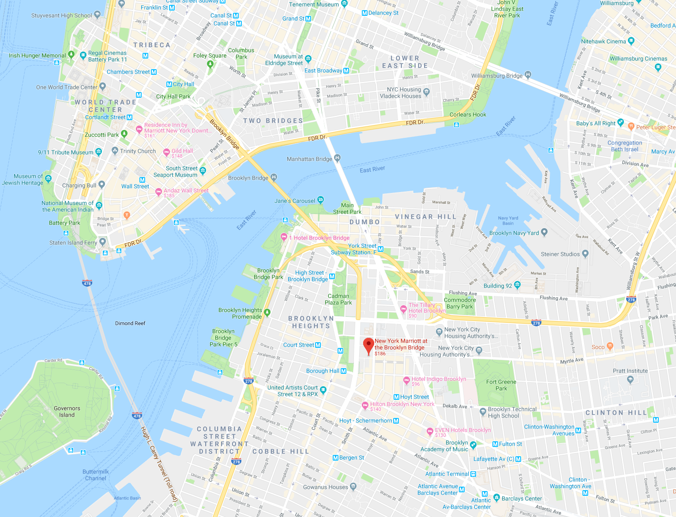
Where you are – one small corner of NYC.
Very easy to walk across the iconic Brooklyn Bridge.

Slide 4
Where you are – one small corner of NYC.
Very easy to walk across the iconic Brooklyn Bridge.
Beautiful views when the weather cooperates.
If you choose to walk across the bridge, be aware that bicycle riders defend their designated lanes with a combination of bells, distinct New York idioms and the specific application of momentum and inertia.
Get out in the evening (and hopefully this weekend) and wander around NYC.
Subways will get you almost anywhere, but can be confusing for newcomers.
Taxis, Uber and Lyft are easier.

Slide 5
In the Beginning …
There was the First Microphonics Workshop
Fermilab, October 2015
https://indico.fnal.gov/event/10555/
Jeremiah Holzbauer, Yuriy Pischalnikov, Warren Schappert

Slide 6
The Basics:
Workshop sessions are all held in this room (Dumbo – Navy Yard). There are no parallel sessions.
Attendees are “on their own” for breakfast, lunch and dinner. We want attendees to socialize.
There are two 30 minute coffee breaks each day. They are long to encourage conversation and interaction - develop topics for Q & A.
There are Day 2 “Open Q & A” sessions. Feel free to suggest a topic for discussion.

Slide 7
The Workshop Motivation and Goals:
Bring together a diverse group of experts spanning the key disciplines critical to the design and operation of SRF cavities and cryomodules.
Provide a basis for understanding the technologies and constraints which drive critical engineering decisions – and which illustrate the importance of a tightly integrated, cross discipline effort that starts at the earliest practical point in a project.
Identify the key microphonic and detuning issues experienced in facilities currently operation, and lessons learned which can inform the design and installation of those under construction and being proposed.
Present the latest developments with the overall goal of producing quiet cryomodules, addressing noise via techniques ranging from simple passive methods to advanced active compensation techniques.

Slide 8
The Workshop Motivation and Goals:
To this end, we encourage:
Active participation from all.
Everyone has something to contribute.
Everyone has something to learn.
Open, honest (and civil) discussions of real experiences.
Exchange of ideas and experiences within the sessions and outside of them.
The workshop will be what we all make it.

Slide 9
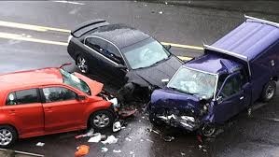
All Roads Lead to Resonance Control …
Accelerator Physics
Cryo Engineering
LLRF Controls
Mechanical Engineering

Slide 10
Workshops Do Not Emerge from the Vacuum
Many teleconferences with the program committee:
Mariusz Grecki, Curt Hovater, Yuriy Pischalnikov, Alex Ratti, Kevin Smith
Thank you to our sponsors!
PI and Phytron – please visit their tables just outside the conference room.
A special thank you to the Session 1 speakers for helping to develop the opening session (via still more teleconferences) and putting in the work to produce the presentations.
More thanks to the session conveners for agreeing to the thankless task of keeping the presenters on time (and under budget).
And of course thanks to the behind the scenes players who make the workshop happen.
Anna Petway, Bryan Callaghan, Christine Meyer, Christina Blas-Cruz

Slide 11
Welcome to New York
&
Welcome to Brooklyn!

