Slide 1
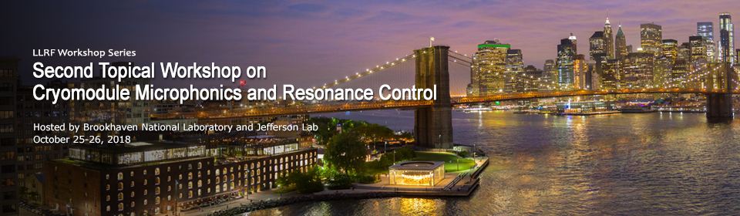
Summary Close Out

Slide 2
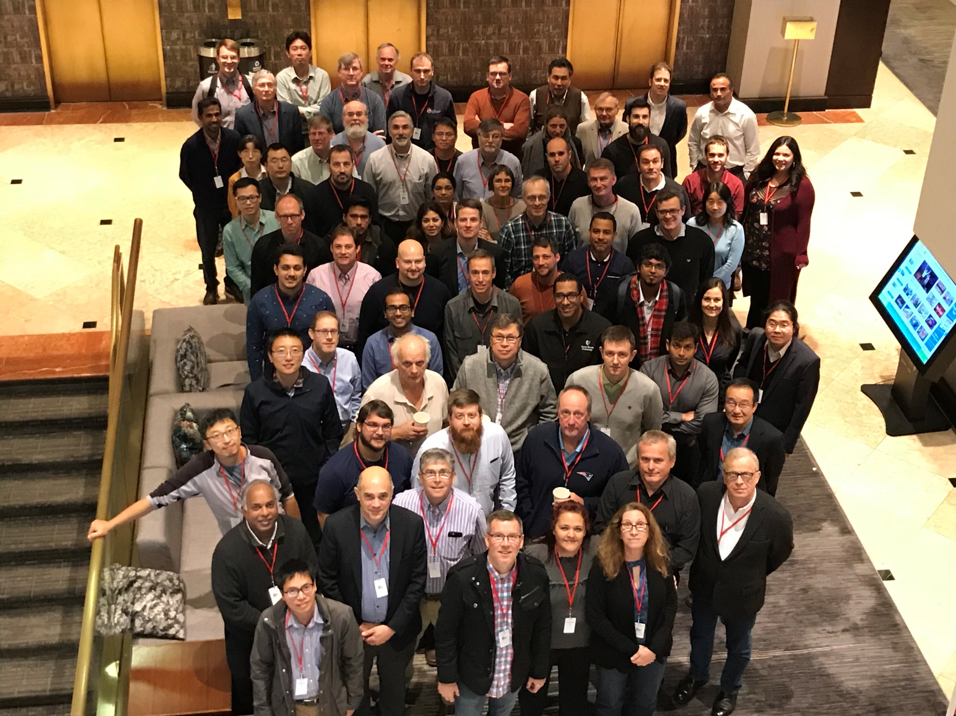

Slide 3
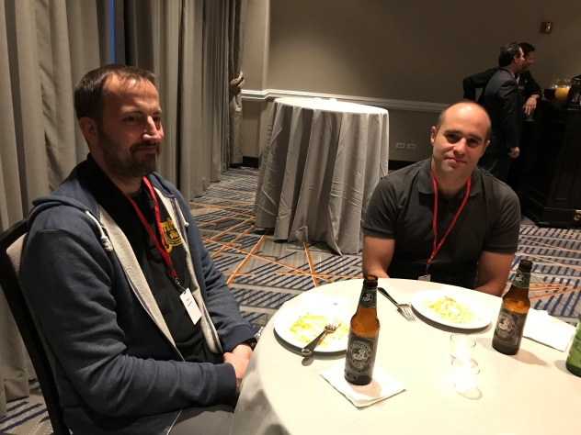
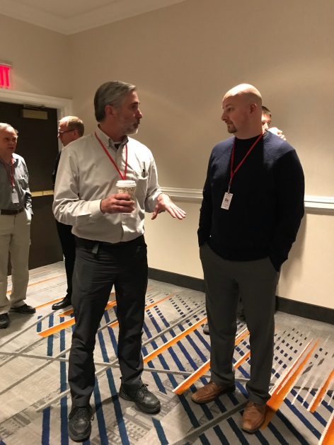
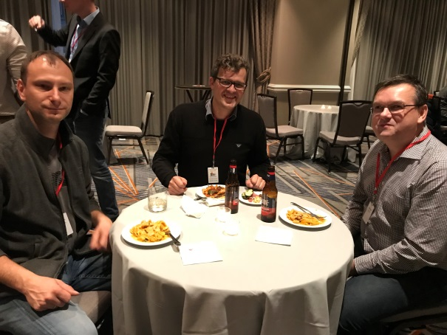
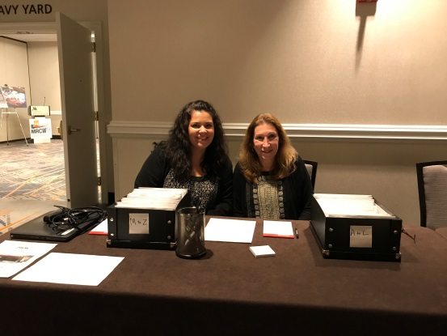
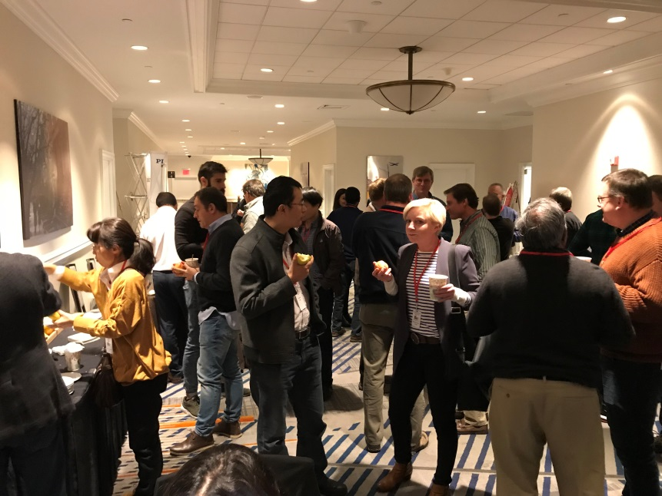
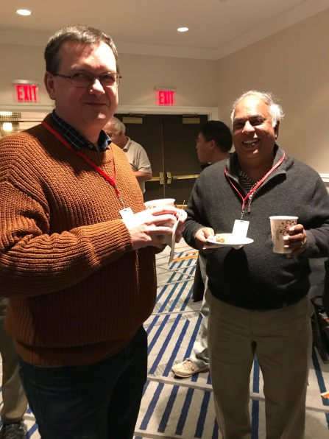
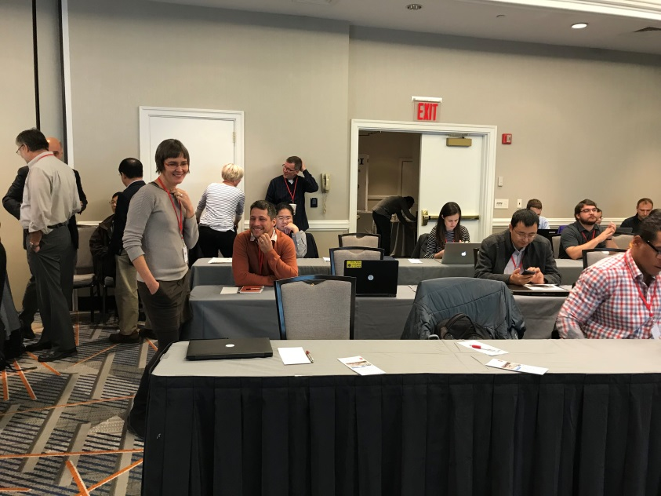
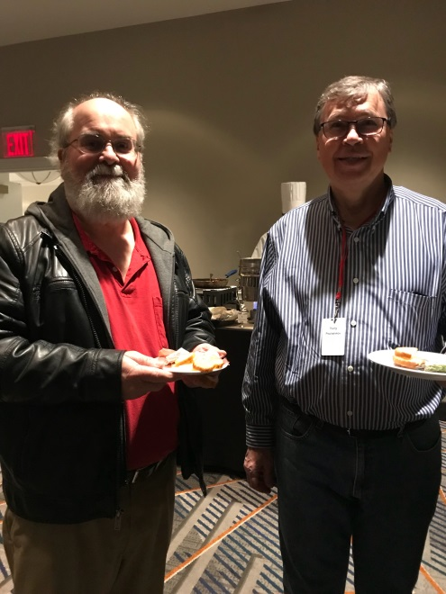
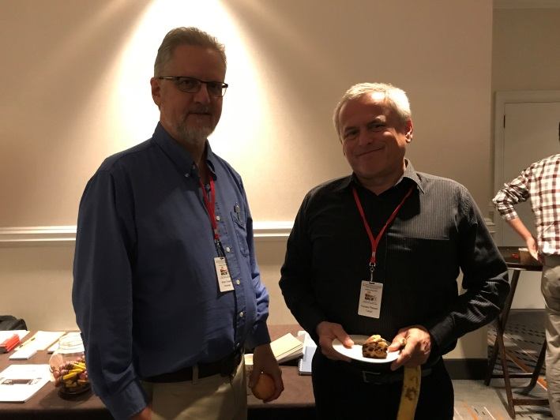
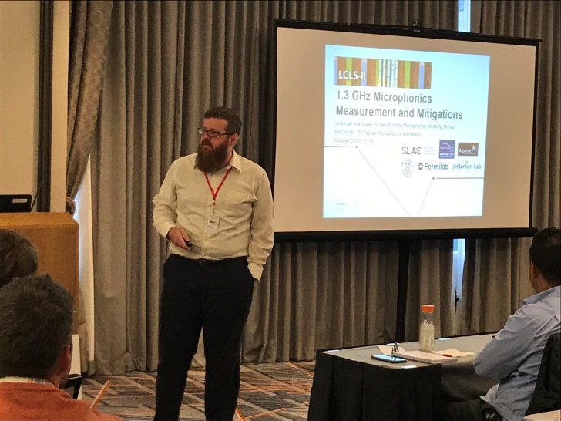

Slide 4
Some Statistics
Over 70 Attendees from over 20 institutions
33 Presentations from 16 Institutions
Two Industrial Sponsors
  PI and Phytron!!

Slide 6
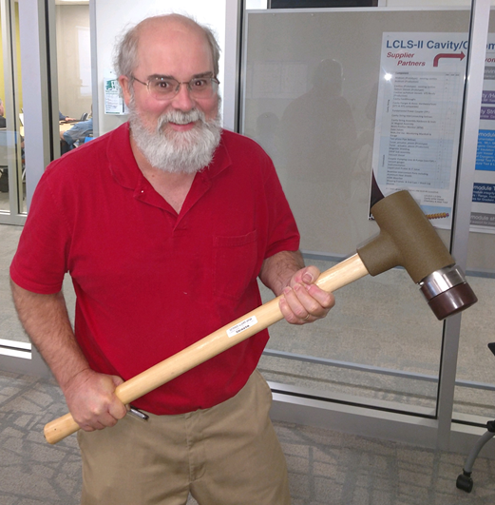
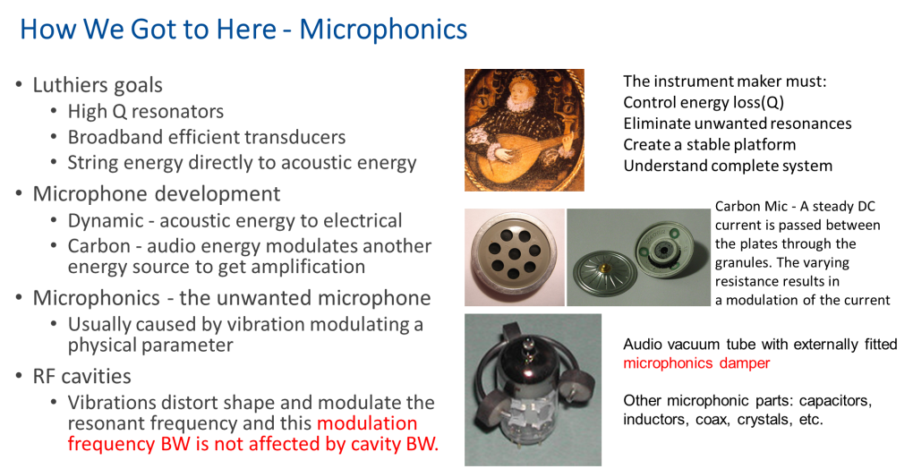
Session Highlights

Slide 7
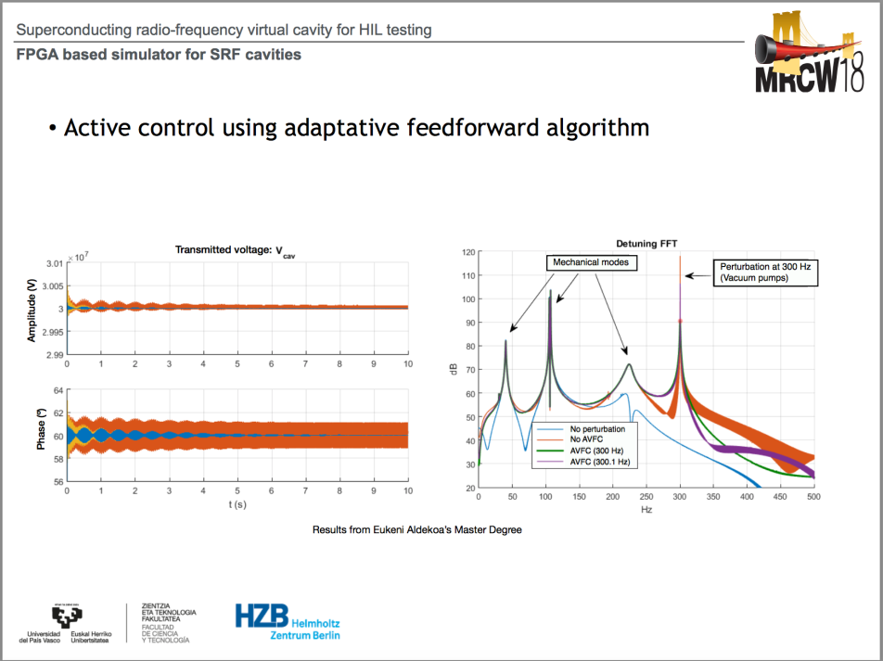
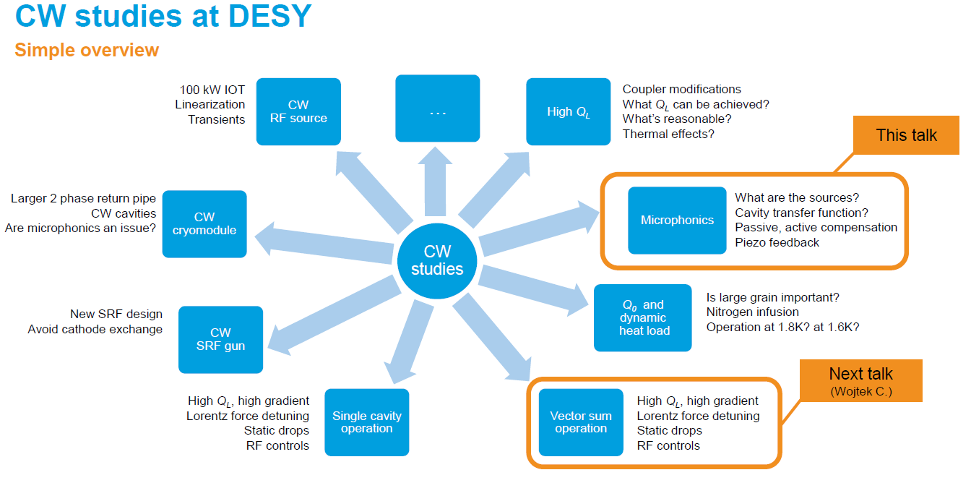
Session Highlights

Slide 8
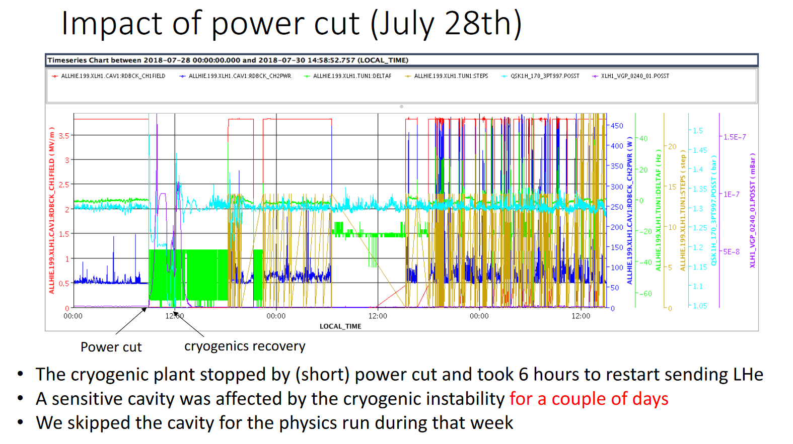
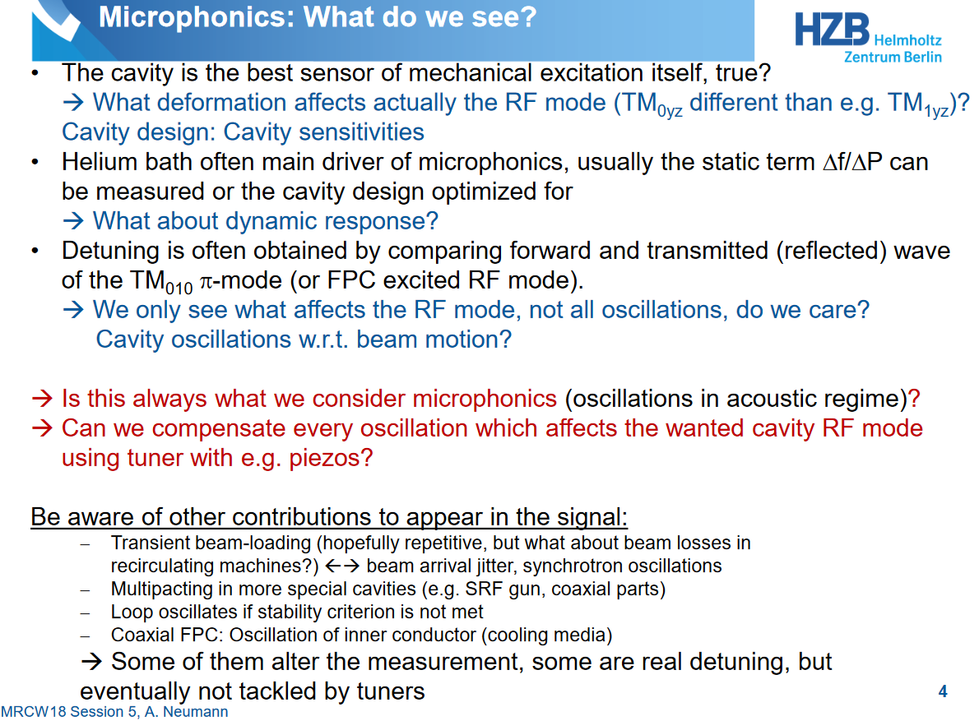
Session Highlights

Slide 9
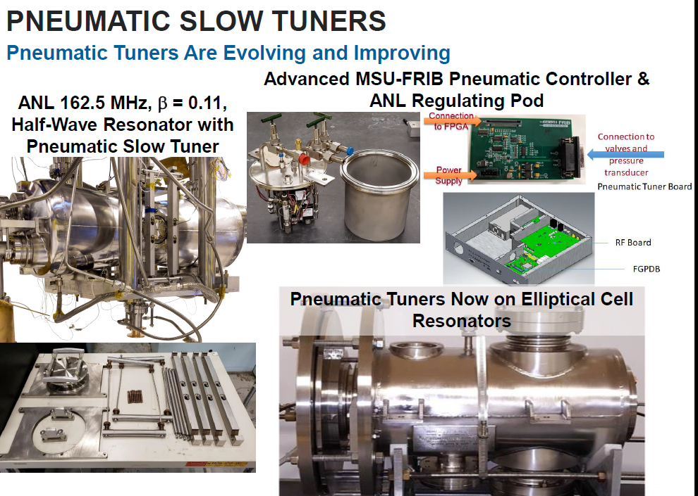
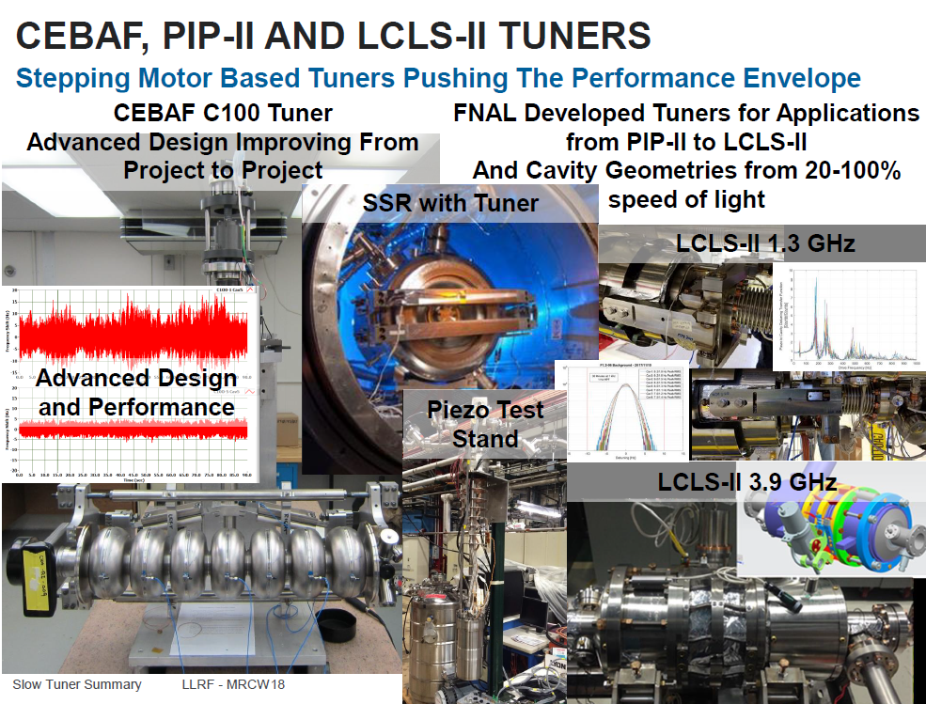
Session Highlights

Slide 10

The Workshop Motivation and Goals:
Bring together a diverse group of experts spanning the key disciplines critical to the design and operation of SRF cavities and cryomodules.
Provide a basis for understanding the technologies and constraints which drive critical engineering decisions – and which illustrate the importance of a tightly integrated, cross discipline effort that starts at the earliest practical point in a project.
Identify the key microphonic and detuning issues experienced in facilities currently operation, and lessons learned which can inform the design and installation of those under construction and being proposed.
Present the latest developments with the overall goal of producing quiet cryomodules, addressing noise via techniques ranging from simple passive methods to advanced active compensation techniques.

Slide 11


All Roads Lead to Resonance Control …
Accelerator Physics
Cryo Engineering
LLRF Controls
Mechanical Engineering

Slide 12
How did we do?
What’s Next?

Slide 13
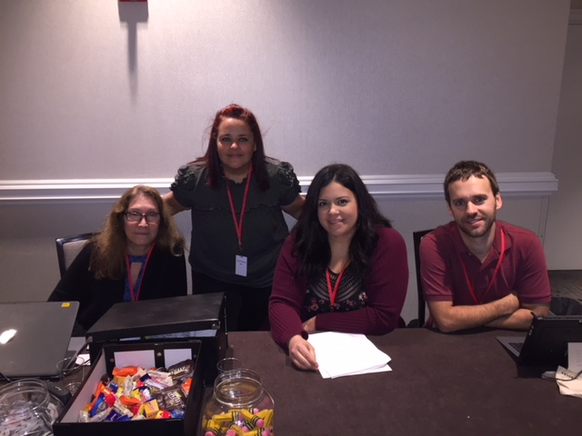

Thanks Again
To the program committee:
  Mariusz Grecki, Curt Hovater, Yuriy Pishalnikov, Alex Ratti, Kevin Smith
Thank you to our sponsors/Industrial Partners.
  PI and Phytron – please visit their tables just outside the conference room.
Thanks to the session conveners for agreeing to the thankless task of keeping the presenters on time
Special Thanks to the behind the scenes players who made the workshop happen.
  Anna Petway, Bryan Callaghan, Christine Meyer, Christina Blas-Cruz

