Slide 1
Microphonics and Resonance Control From the RF Perspective
(and from an amateur Luthier’s perspective)
Brian Chase, Josh Einstein-Curtis, Philip Varghese
Second Topical Workshop on Microphonics, Brooklyn NY 2018

Slide 2
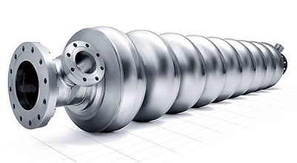
The cavity transfer function in Laplace domain
The cavity transfer function
in Laplace domain
“R over Q”
A bandpass response centered at
cavity resonance frequency
- Is what gets modulated by microphonics and LFD
cavity coupling → loaded Q

Slide 3



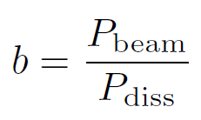

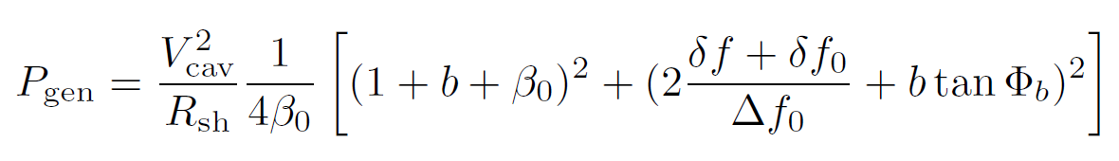
Microphonics maths
Cavity unloaded bandwidth
Static detuning, optimized for no reflected power
Optimal coupling coefficient for minimal Pfwd*
where
Optimal coupling
Minimal Pfwd
(assuming optimal coupling)
* Merminga, Delayen, “On the optimization of Qext under heavy beam loading and in the presence of microphonics”, CEBAF TN-96-022, 1996

Slide 4
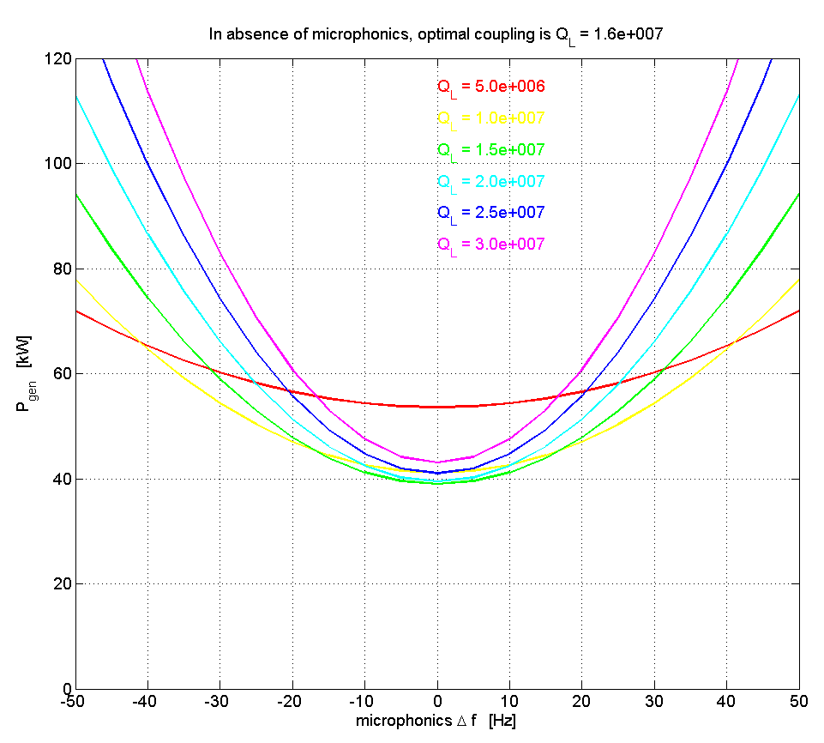
Power requirements dependence on microphonics
f₀ = 650 MHz
R/Q = 638
Q₀ = 12.70x10⁹
Vcav = 19.9 MV
Plot shows the power required as a function of microphonic detuning for different values of Q_{L}
The power spec for an Solid State amp may increase by 50% due to microphonics

Slide 5
Sources of Mechanical Distortions in SRF Cavities
Lorentz force – biggest pulsed issue
  ~Gradient squared
External vibration
  Rotating equipment; vacuum pumps, fans, compressors
  Road vibration
Cryogenic liquid and gas turbulent flow - CW
  Thermal Acoustic Oscillations
  Leaking valves
Noise term from tuner motor and piezo drive
Adjacent cavity coupled vibrations
Power coupler antennas can also vibrate
-These terms modulated the dimensions of the cavity at the nano-meter scale which modulates the resonance frequency of the cavity
- Note that the modulation of the cavity resonance frequency does not take energy out of the vibrations, leaving high Q mechanical resonance

Slide 6
Problems caused by microphonics for RF field regulation
Cavity detuning caused phase and amplitude errors which can cause gradient field errors
  High gain feedback loops can control this pretty well
  Detuning also reduces phase margin for the control loop and increases noise
Detuning budgets require more RF power overhead which is expensive due to:
  increased amplifier power requirements
  Larger RF distribution, cooling, conventional power, floor space and electric costs
  Higher coupler power ratings
The total cost to the project and to operations can be quite alarming

Slide 7
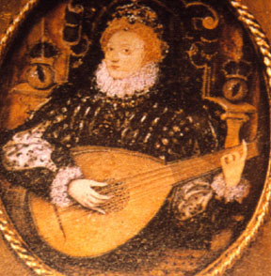
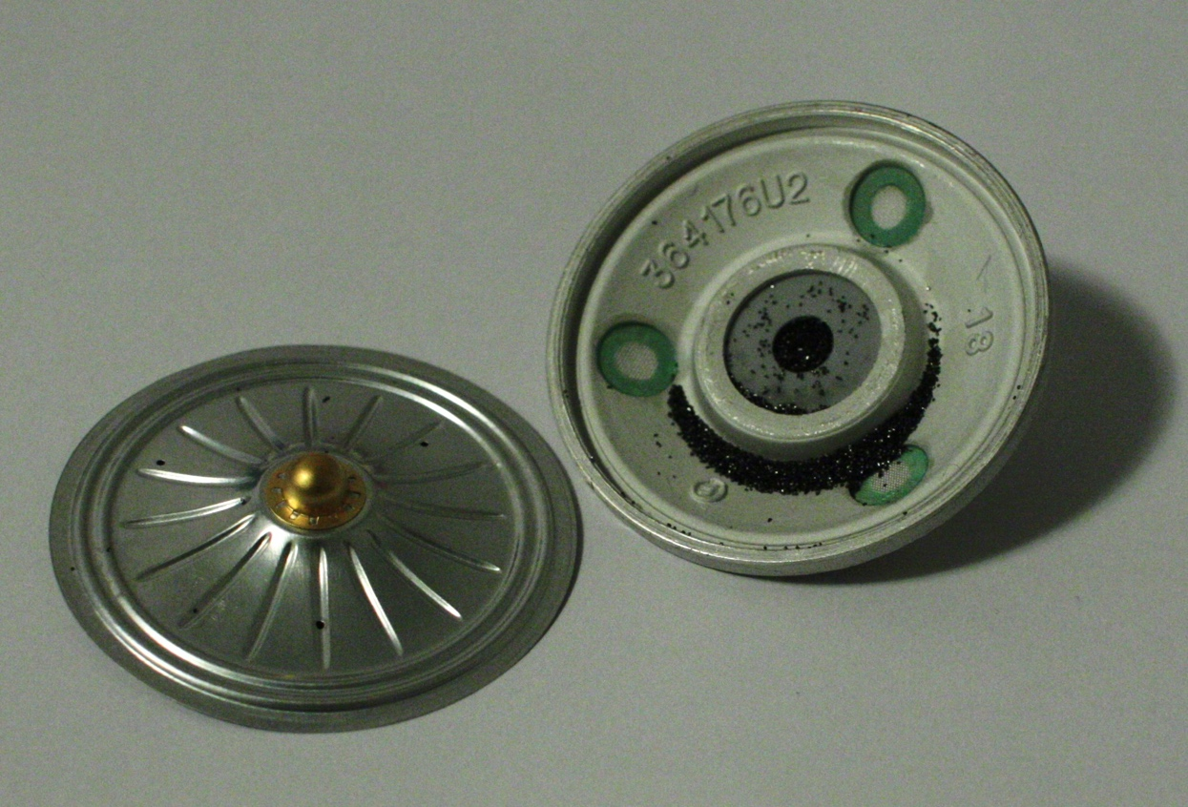
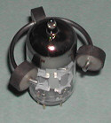
How We Got to Here - Microphonics
Luthiers goals
  High Q resonators
  Broadband efficient transducers
  String energy directly to acoustic energy
Microphone development
  Dynamic - acoustic energy to electrical
  Carbon - audio energy modulates another energy source to get amplification
Microphonics - the unwanted microphone
  Usually caused by vibration modulating a physical parameter
RF cavities
  Vibrations distort shape and modulate the resonant frequency and this modulation frequency BW is not affected by cavity BW.
The instrument maker must:
Control energy loss(Q)
Eliminate unwanted resonances
Create a stable platform
Understand complete system
Carbon Mic - A steady DC current is passed between the plates through the granules. The varying resistance results in a modulation of the current
Audio vacuum tube with externally fitted microphonics damper
Other microphonic parts: capacitors, inductors, coax, crystals, etc.

Slide 8
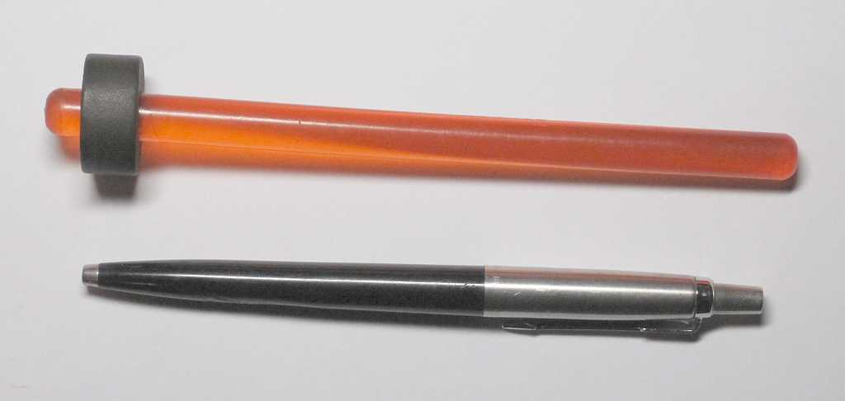
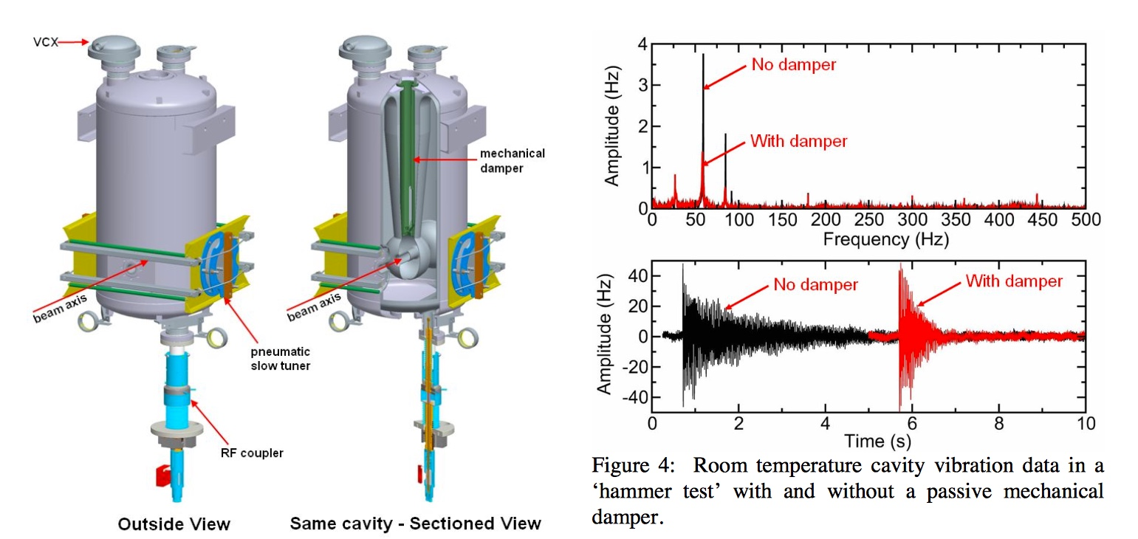
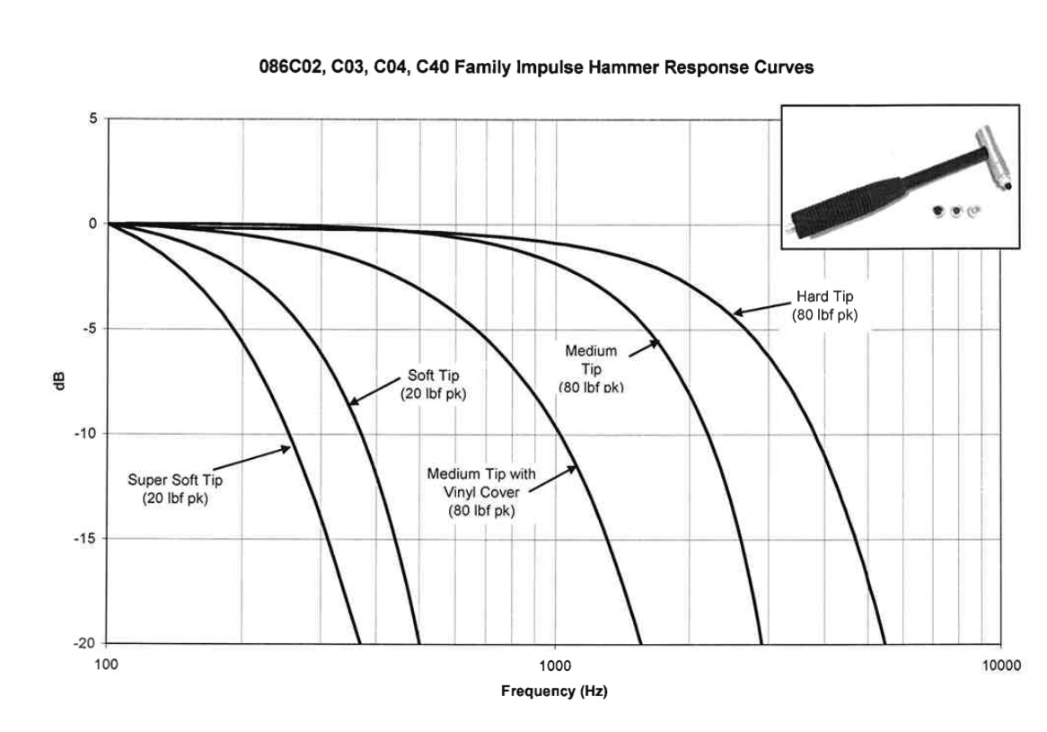
Microphonic Diagnostic Tools
Valve (tube) hammer
M. Kelly, MICROPHONICS IN THE ATLAS UPGRADE CRYOMODULE
Impulse response from hammer test
-And yes, these cavities ring like a guitar with similar frequencies and decay times
Instrumented hammer for external excitation

Slide 9
Analysis of a device containing 6 high Q resonators
The next slide shows a device that has 6 resonators that are highly coupled mechanically
  Yet, by careful choice of resonant frequencies, these resonators have very low energy coupling between them
The device has a very refined human interface allowing the user to:
  rapidly excite and modulate the resonant frequencies
  Chose harmonic content (shown in video)
  Damp resonant amplitude when desire

Slide 10
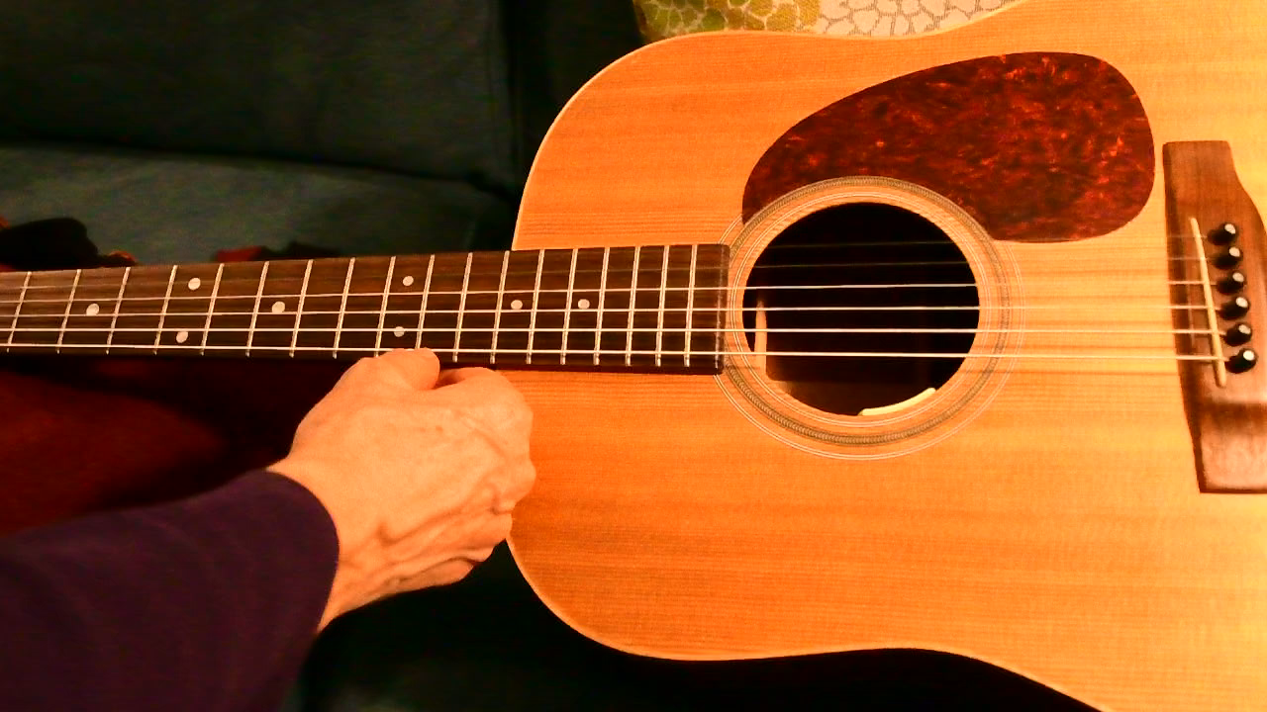
1st and 2nd Harmonics
60 Hz strobe, E string retuned

Slide 11
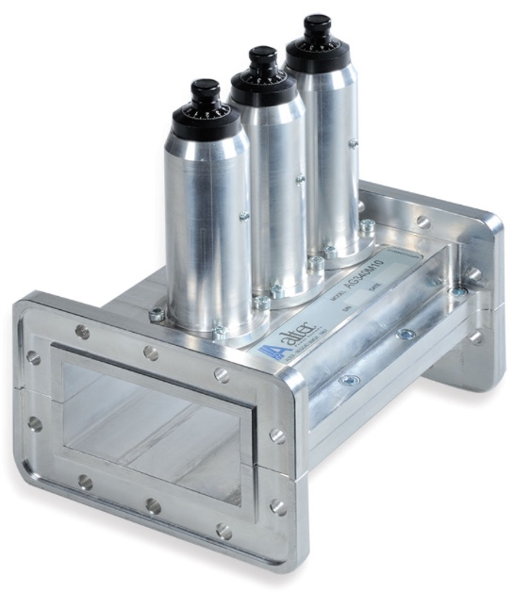
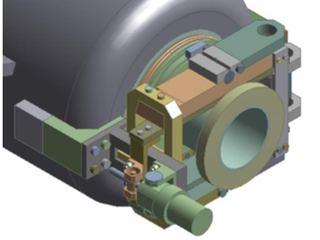
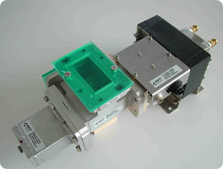
Control and Tuning of Cavity Resonant Frequency
Resonance control is part of every almost cavity RF system
  Copper cavities heat up and change frequency, sometime dramatically
  Synchrotrons often change frequency and cavities must track sometimes in the GHz/s rate
  SRF cavities have much higher loaded Qs and are thin walled which creates much higher sensitivity to microphonics and Lorentz Force Detuning
  Tuning may be accomplished by changing the cavity dimensions by temperature or force, internal tuning slugs, or external RF tuners (mechanical or ferrite stubs)
650 MHz Tuner
Ferrite fast tuner AFT Microwave
3-stub tuner

Slide 12
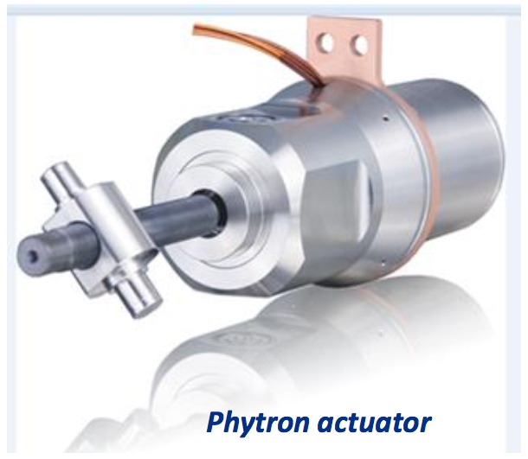
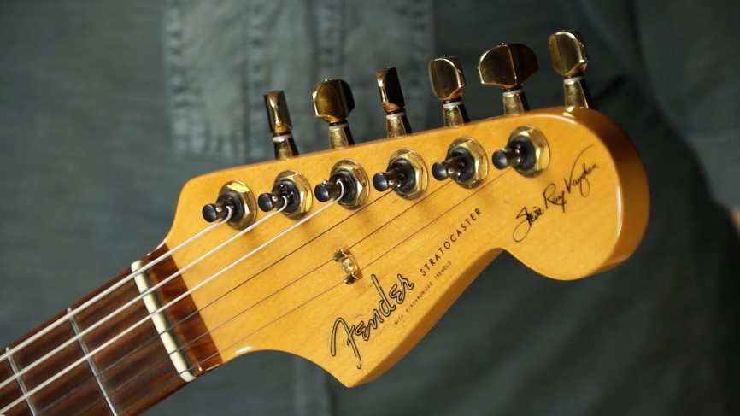
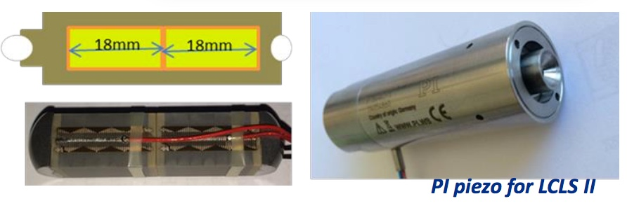
Tuners for two types of mechanical systems with similar Qs and bandwidths
Slow tuners
Work over a large frequency range
Once on frequency they are only
used to correct slow drifts
Note the mode dampers for the B and E strings
Fast tuners
Used for fast dynamic resonance frequency modulation to compensate for microphonics or Lorentz Force Detuning
Stratocaster Wammy bar

Slide 13
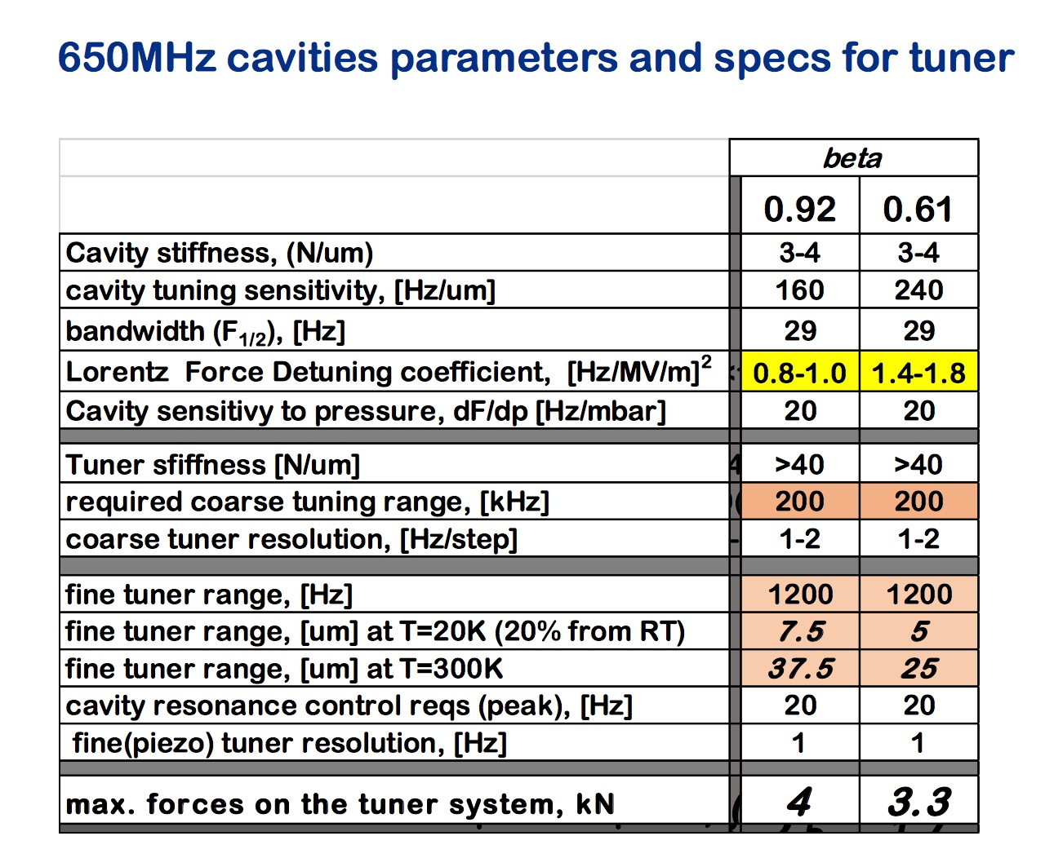
Tuner Requirements and Design
Tuners are primarily designed for static or low bandwidth frequency control and are amazingly good at the PPB level
Design is for single axis (longitudinal) control
On many designs, the tuner couples to significantly to transverse modes and to modes in other cavities in the cryomodule (almost exact resonant frequencies)
A single actuator can only control one dimension in a three dimension motion space making it impossible to damp some vibrations

Slide 14
Tuner showing very good low frequency properties – 300 Hz sweep using piezos
Barely seen are 2nd , 3rd and 4th harmonics – Good Linearity
A good 1300 MHz cavity may be held to 2 Hz r.m.s.
If we shot an arrow the 1147 km from Chicago to New York, 2 parts in 1,300,000,000 means we are missing the bulls eye by only 1.7 mm
The cavity and tuners are apparently good time invariant linear systems

Slide 15
Control of a cavity’s resonant frequency using direct feedback
→ Use the classic “plant-controller” approach
Controller
Plant (cavity)
+
X(s)
Err(s)
Y(s)
Desired tuning
+
K(s)
H(s)
_
Piezo drive
Historical poor results with this approach
What is wrong?
Feedback
G(s)
Solve close loop transfer function

Slide 16
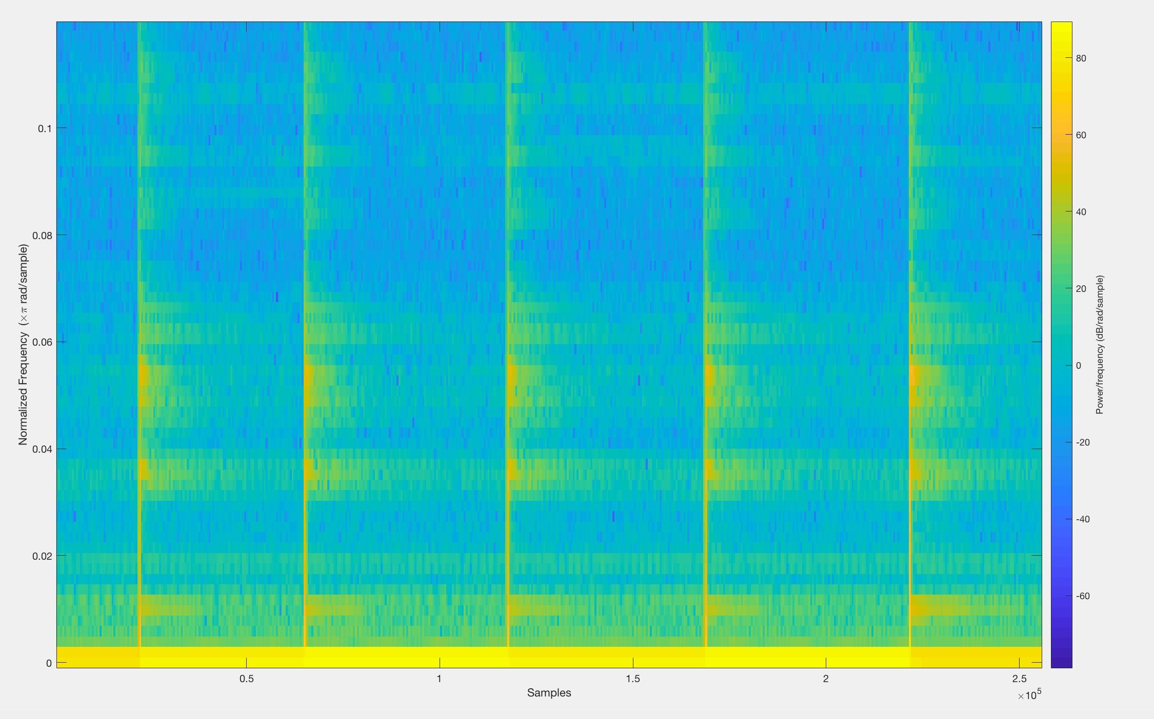

Internal Hammer Impulse Response - Piezo steps every 5 sec
LCLS-II cryomodule 0,25,50,25,50,0 volt steps Cavity 2 10/12, 2018
A first easy test is just to step the piezo voltage and plot the spectrogram in response
Many transverse vibration modes are being excited and they persist for a long time.
While interesting, this is not what the control engineer is hoping to see
Does visual spectrogram or audio track give more insight?

Slide 17
Stepper Motor - short moves about every 5 seconds
•This is a large disturbance that excites many modes
-Cavity is unlikely to stay in GDR mode
- May take out other cavities as well
•Future study: slower rotation speed combined with micro-stepping may reduce the level of excitation

Slide 18
Spectrogram of stepped gradient – 5 steps of 2 MV/m, 5 to 15 MV/m
Nothing going on in the spectrogram or in the audio track
Why?
  Here the cavity bandwidth comes into play as the 16 Hz, half BW limits the higher frequency components of LFD, so the mechanical modes are not excited
  LFD and piezo transfer functions are different
Higher power cavities with wider RF bandwidth can and do excite mechanical modes in pulsed machines

Slide 19
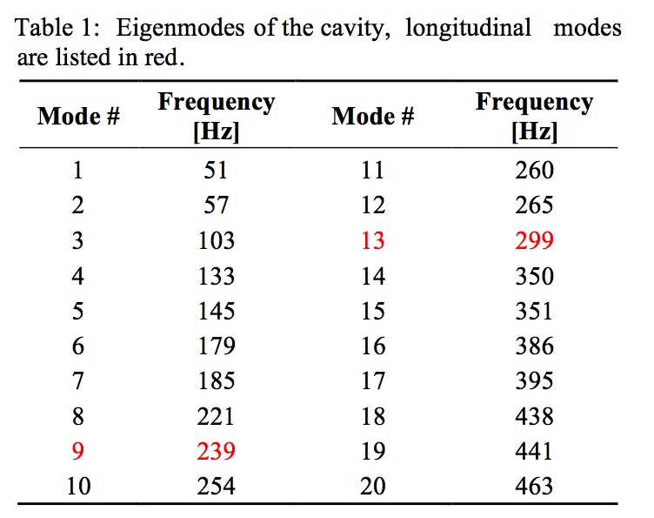
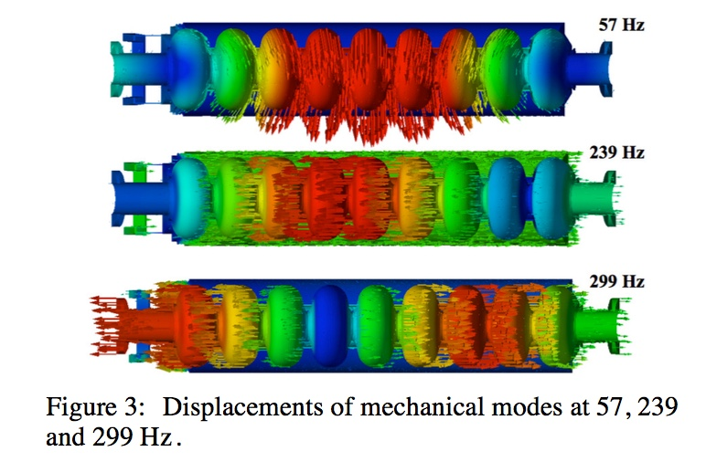
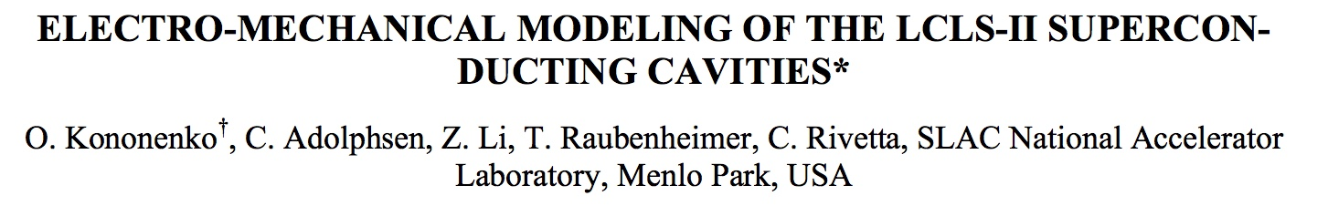
Electo-Mechanical Modeling

Slide 20
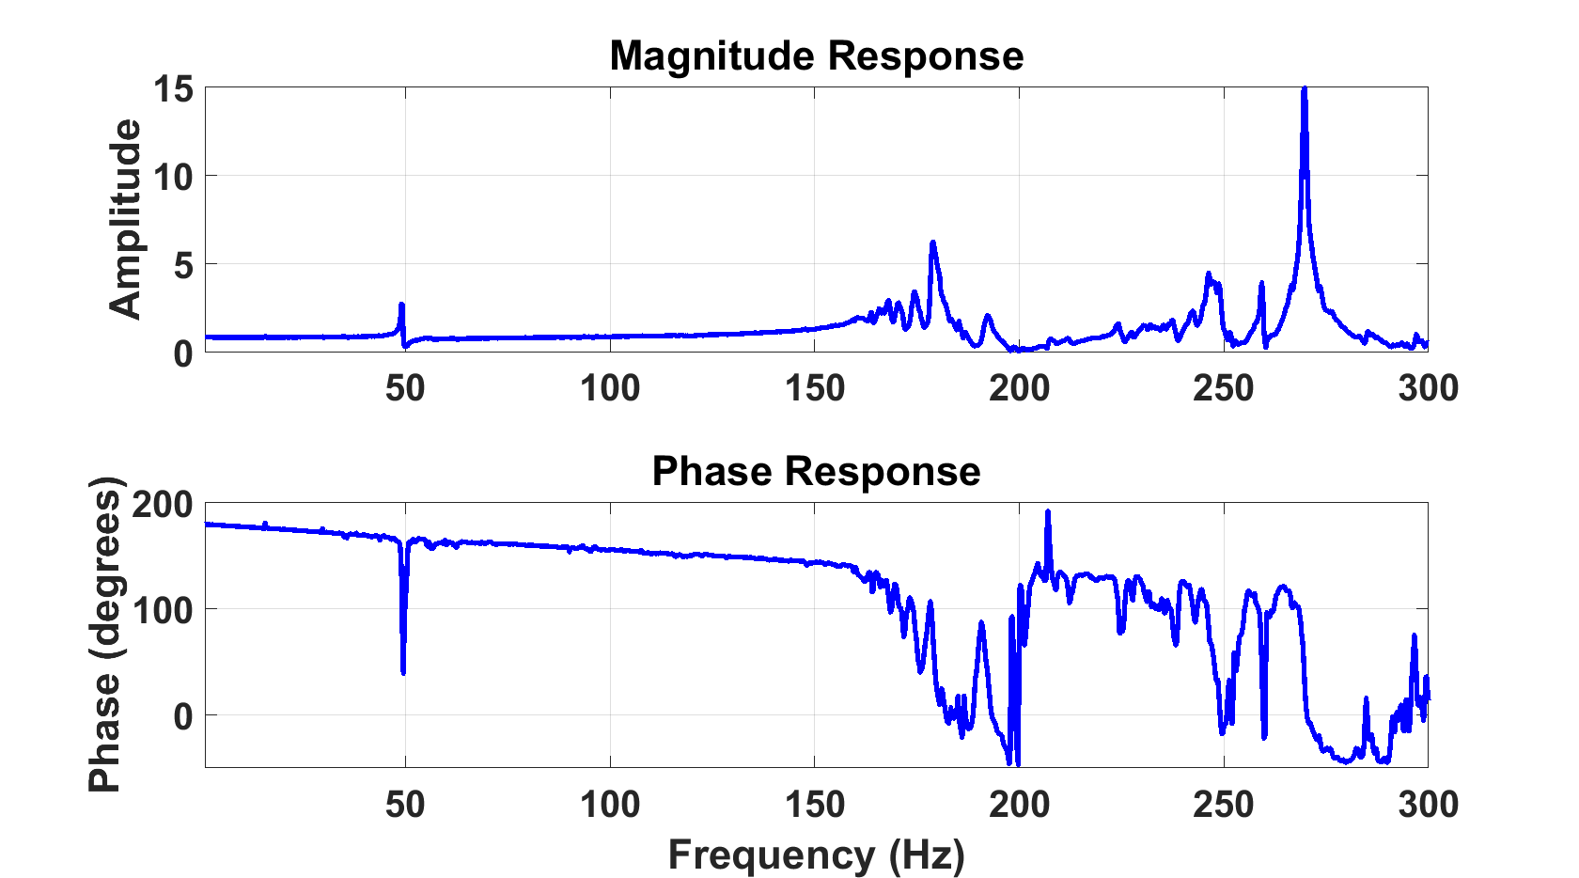
Transfer Function 0.25 Hz steps, 4 sec DAQ per point, 5 sec dwell
Longitudinal modes
Extremely well behaved out to 175 Hz
Transverse modes
0.66 millisecond group delay probably from DAQ

Slide 21
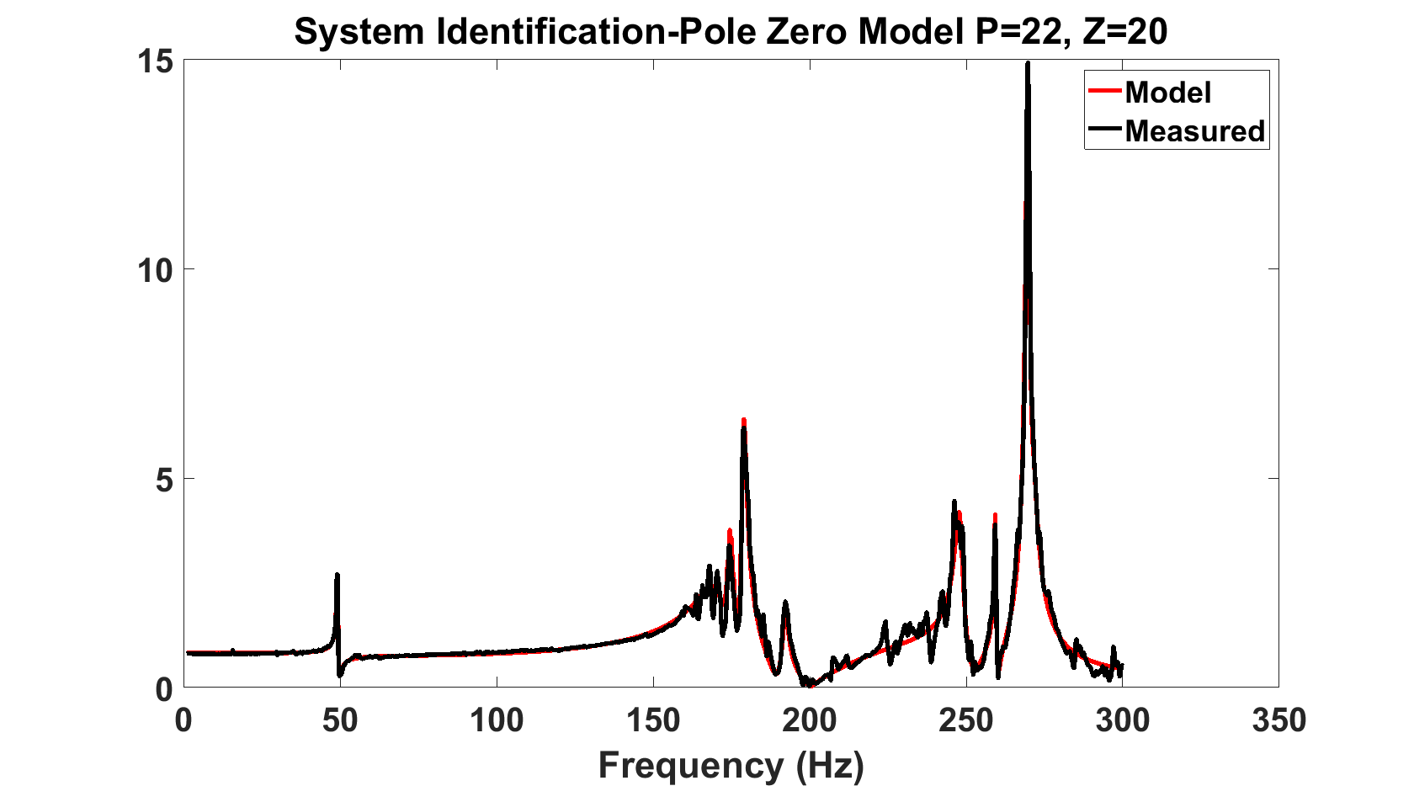
System Identification using Matlab with a very good fit
Is the system controllable?
See Philip Varghese’s talk later today

Slide 22
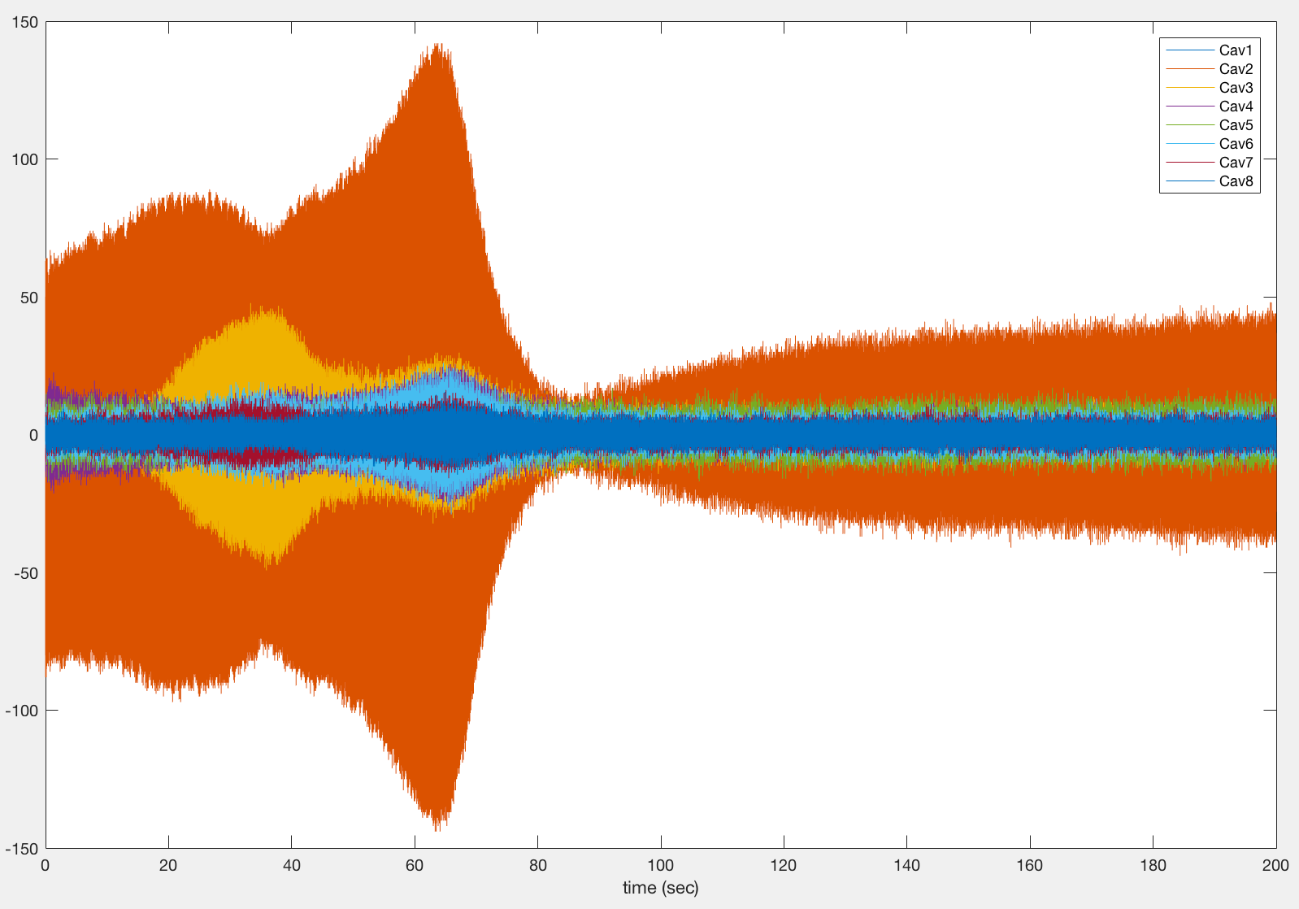
FFT of Frequency Sweep 49 to 54 Hz of Cavity 2’s Piezo – 1st Transverse Harmonic
D
A)Gain sum of longitudinal
+ transverse response
B) Phases add between modes
lowers vector sum
C)Resonance of cavity 3
D) Transverse resonance
Q~125 at 50.6 Hz
3dB BW ~ 0.4 Hz
E) More phase change in transverse mode with drop in amplitude creates null
F) Dominated by longitudinal and higher frequency transverse response
Time Domain
Frequency sweep on cav2
200 seconds, all cavities response
A
B
C
F
E

Slide 23
FFT of Frequency Sweep 260 to 278 Hz of Cavity of Cavity 2’s Piezo, 0.5 V sin excitation
.05 Hz steps – 1st Longitudinal Harmonic
B
A) Coupled resonance of other cavities?
B) Longitudinal fundamental mode
Q~245, BW~1.1 Hz
C) Parasitic coupling of the other cavities
-17 dB crosstalk
Time domain
A
Does it make sense to try to control with the piezo above the longitudinal 1st harmonic?
C

Slide 24
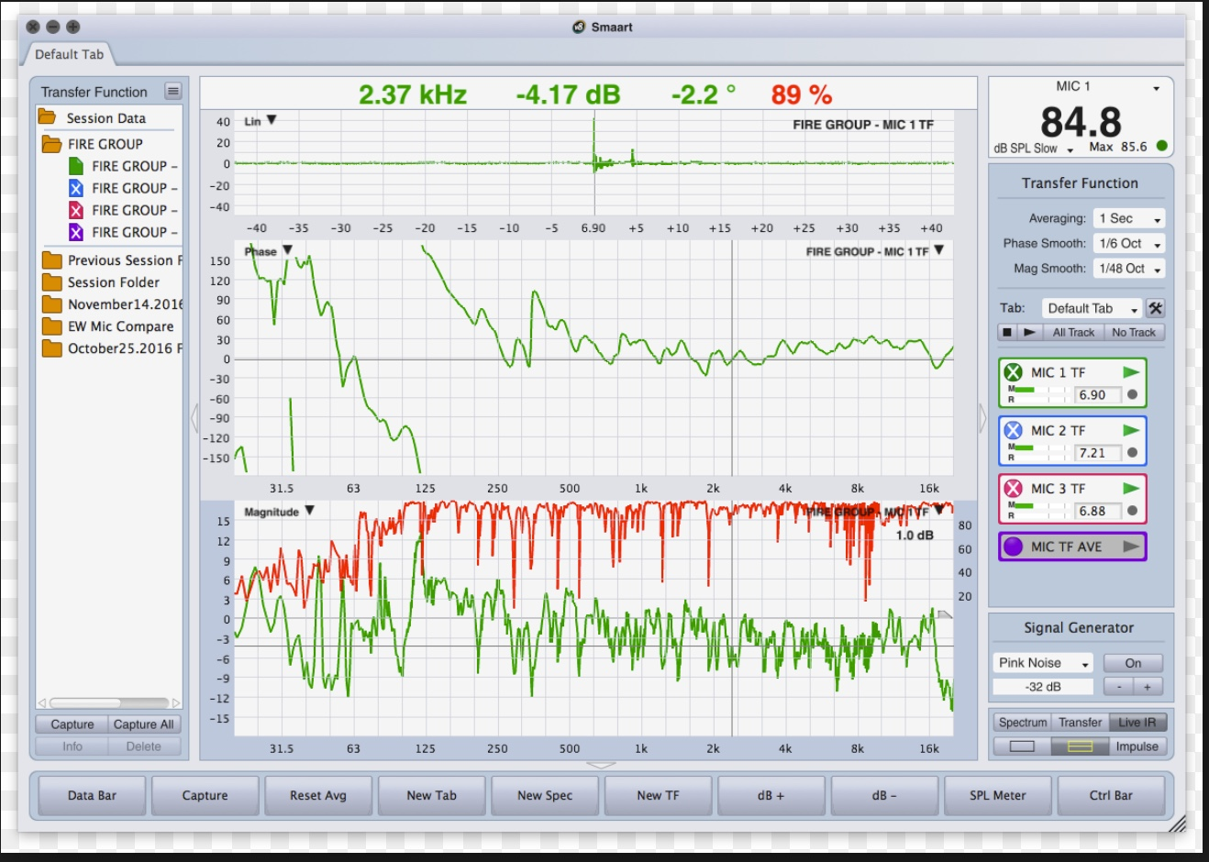
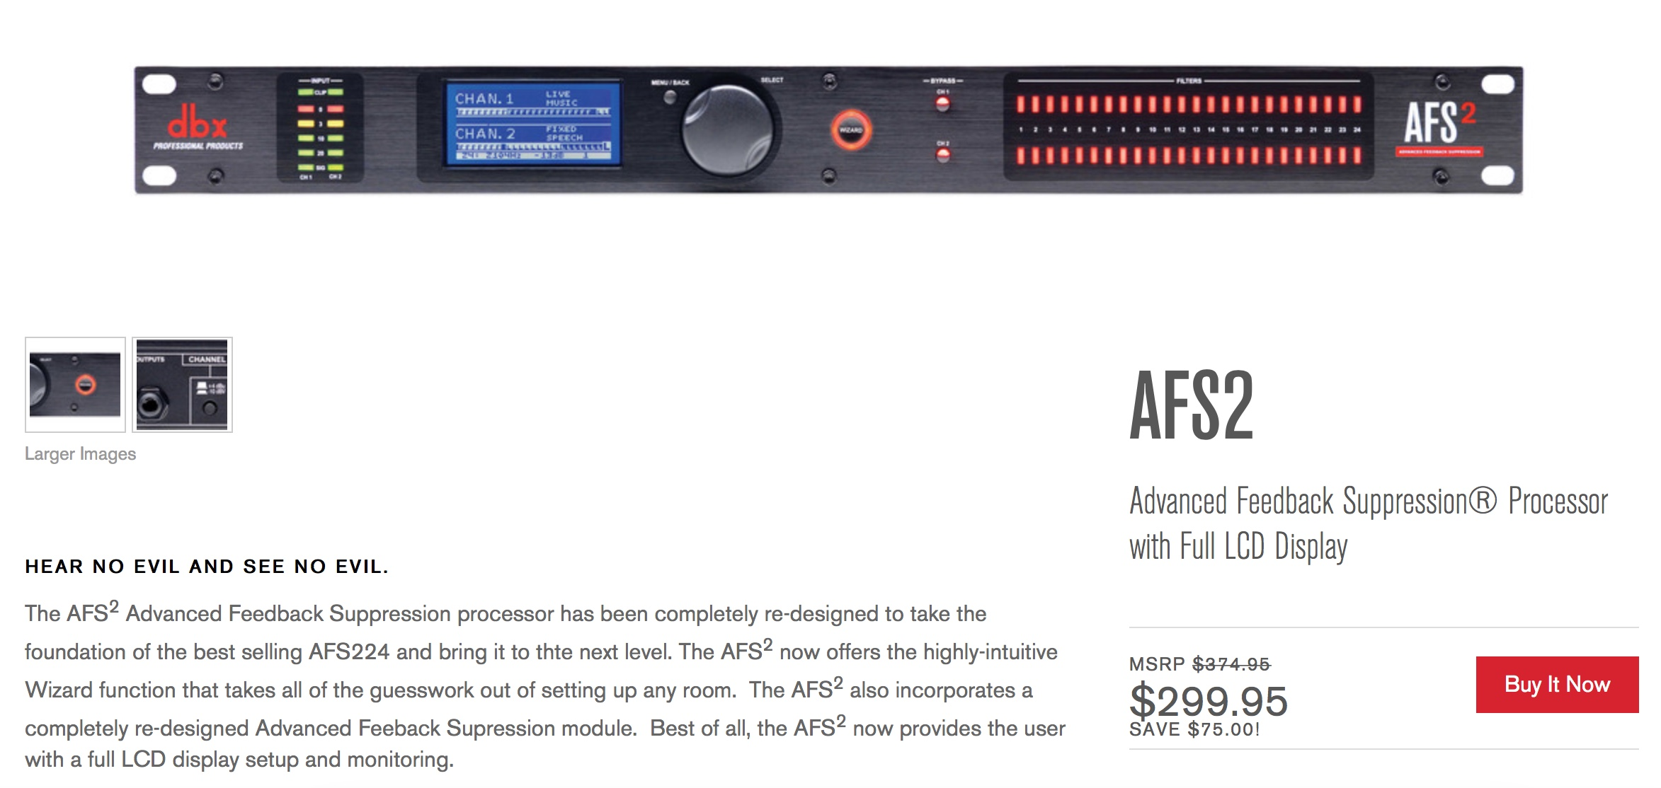
Live sound mixing – same issues
Live sound mixing deals with:
  High Q resonances
  Multipath responses
  Feedback paths that are easy to make unstable
The solution is subtractive EQ with notch filters
There are many commercial
solutions that can plug and play
This dbx unit is completely automated
It slowly increases system gain, detects ringing and places a narrow notch filter at that frequency.
It then repeats the process to add up to 24 filters with Qs to 1/80th octave.
10s of years of programing effort.
Cornell is using the same approach with good success

Slide 25
The magic of notch filters
Notch Filter Frequency Response
To maintain both gain and phase margin for stable gain you must reduce the gain of high Q resonances in the transfer function
High Q notch filters do this while not impacting the phase response outside of a narrow frequency range
Note: Use IIR filters as FIRs have group delay at all frequencies

Slide 26
Simulation of a closed loop response of piezo with one high Q resonance at 50 Hz - 1 notch filter compensation
Open loop response to 100 Hz chirp
PID loop control of plant with one high Q resonance at 50 Hz. This is compensated with one high Q notch filter allowing for high gain (Kp=100, Ki= 628)
Closed loop response: Y scale/1000

Slide 27
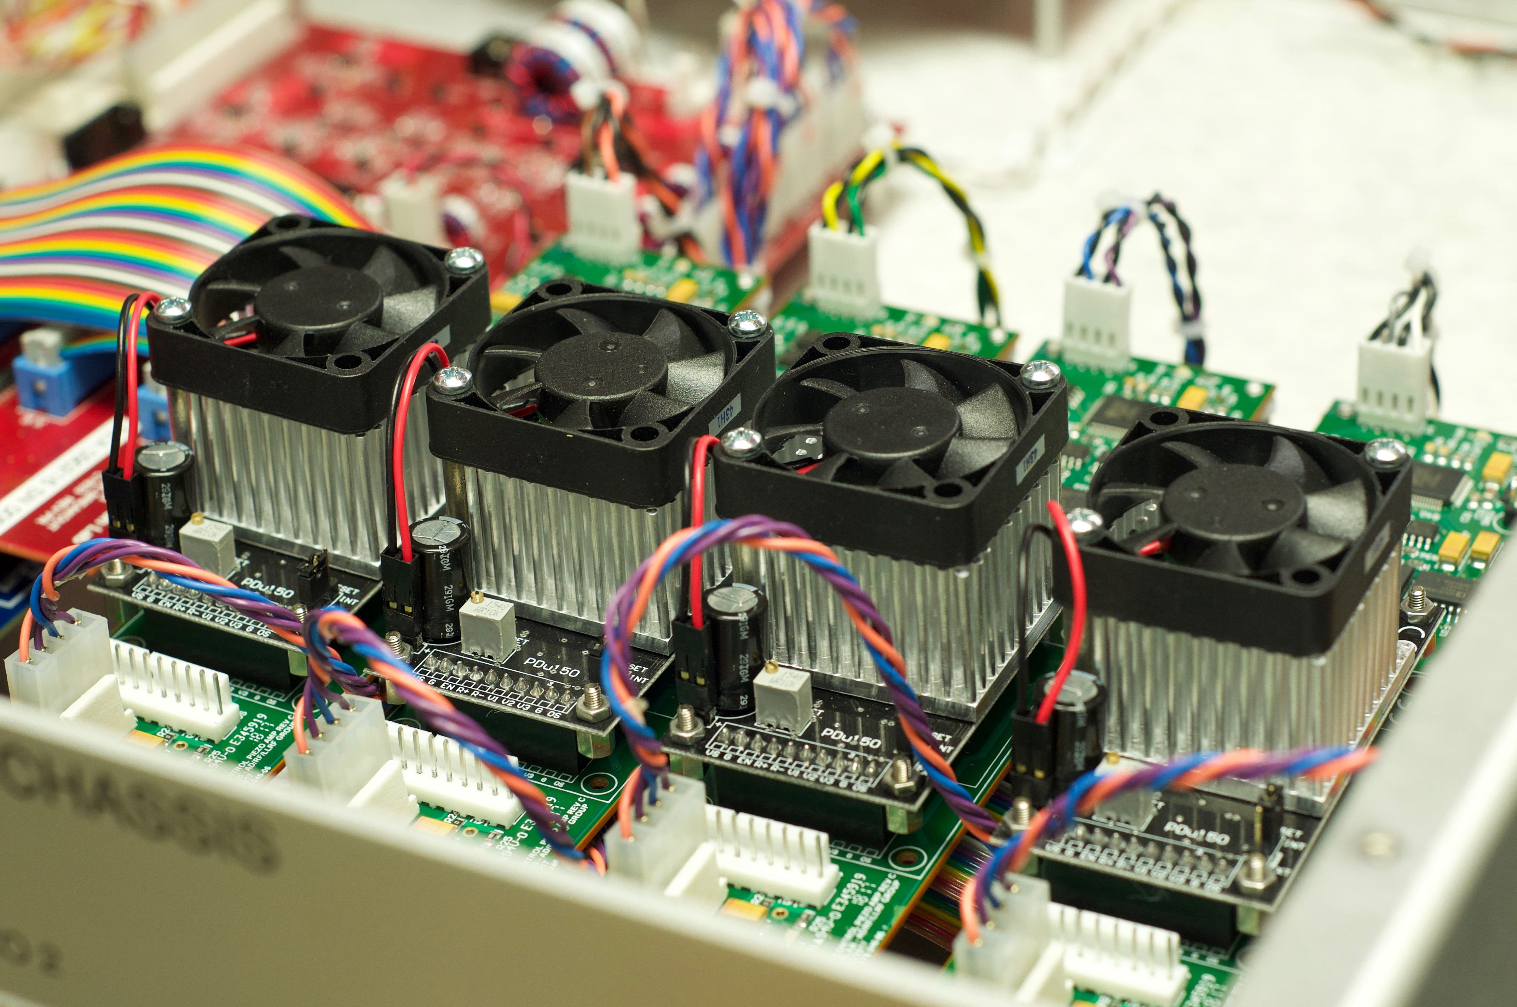
Important Design Considerations for Piezo Amplifiers
Low noise – high Q modes are very sensitive to noise
Self limiting average power to piezos
Limited dV/dt so the piezo can’t chatter
Enough BW to cover requirements but maybe not a whole lot more
Differential drive to the piezo
  Provides common mode rejection
  Cuts each leg voltage to ground in half
Split amplifiers for redundant drive in case of piezo short and possible scaled drive
Good diagnostics
  Drive program, Drive Voltage, Output Voltage, Output Current for each amplifier
  Front panel differential IO for transfer function and drive monitoring
PDu150 - 26 uV RMS (1 uF load, 0.03 Hz to 1 MHz)

Slide 28
Discussion topics on moving forward
  Set up teams early in the design process with active compensation goals in the requirements
Stiffen cavities, particularly in transverse modes
  Support cavities with wire brushes?
Increased resonance frequencies create more usable control bandwidth
Design in a frequency spread between cavities in a cryomodule
Reduced mechanical coupling between cavities by design
  Damping is difficult at 2K, but it is an important goal!
  Explore tuner designs that cover three motion axis
  Treat cavities and cryomodules as the acoustic instruments that they are
  Model and test at each design stage

Slide 29
Thank you!

