Slide 1
Microphonics and Resonance Control from the Cryo-Mechanical Perspective
Based on the TTF-XFEL experience
Kay Jensch
Brooklyn, 25th October 2018

Slide 2
Summary
Subheading, optional
01 Introduction
Microphonics VS vibrations
Vibrations in TTF (TESLA Technology Facility, e.g. FLASH,…..)
02 Main sources of microphonics
Mechanical design
Cryogenic
Vacuum
RF
03 Conclusions

Slide 3
Introduction

Slide 4
Microphonics or vibrations?
Subheading, optional
Is there any difference?
In the cryo and mechanical world we call them mainly vibrations
Wider range of amplitude
Looking mainly at low frequencies -> up to 100 Hz
Consider also very low frequency (<1 Hz)

Slide 5
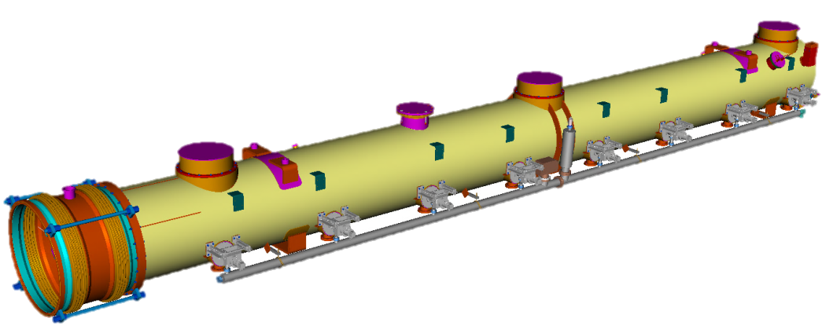
Vibrations in the TTF cryomodule design
Where did we cross them?
TTF based accelerators @ DESY
FLASH (7 cryomodules, different design stages)
XFEL (97 cryomodules, final “evolution” of the TTF design)
Impact of vibrations
Not a primary issue for the RF control
  Pulsed machine, main detuning effect from Lorenz Force
At the early stage of the design (first FLASH modules)
  Stability concerns at the quadrupole -> possible alignment issue
  Possible effect of cryo-operation conditions
For the XFEL 1.3 km machine
  Concerns on the stability of the new hanging supports
→ see Serena later today

Slide 6
Main sources of vibrations

Slide 7
Main sources of vibrations
In an accelerator environment
Environment
Ground vibrations
Surroundings -> highways, traffic, construction sites,….
Mechanical design
Resonances of subcomponents
Support system
Connections to the environment
Cryogenics
Valves
Cryoplants
Vacuum
Pumps
Clean rooms
RF sources
Cooling system

Slide 8
Environment

Slide 9
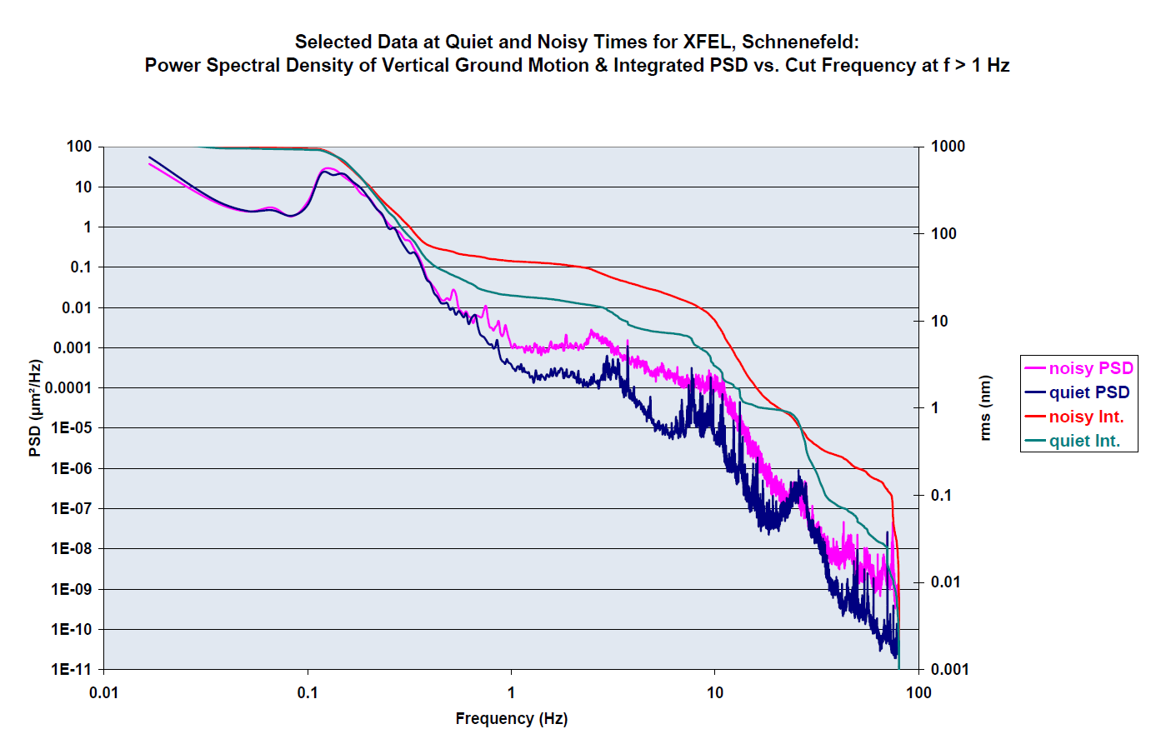
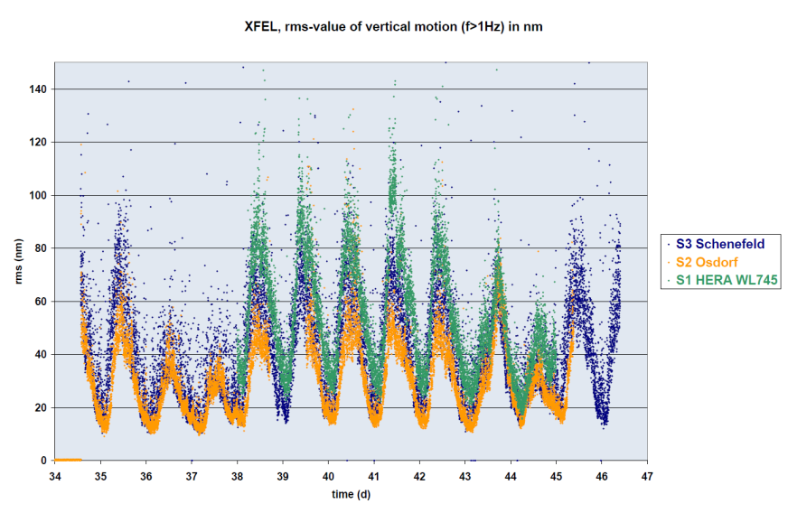
The environment
From the vibration point of view
Ground vibration
Can’t be change, once the site is chosen
Not constant, mainly daily fluctuations
Surroundings and occasional events
Highways, railroads, big cities, constructions
Earthquakes
Mitigation possible?
E.g. LCLS and ILC (Japan) build on one tectonic plate

Slide 10
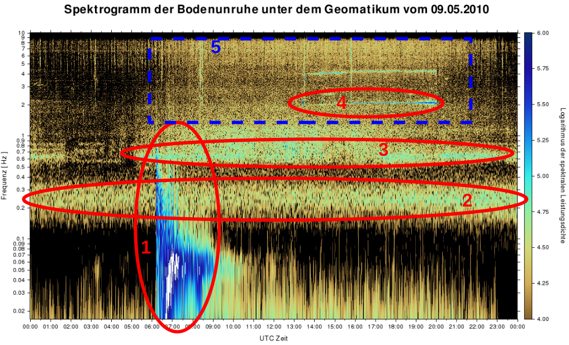
Examples
(Sonntag)
Picture from N. Meyners
5. Human made
(vertical Subway)
4. Concert (120bpm)
3. Building
(stimulated by technic?)
Sebastian Heimann
10sec
2. Ocean Waves (4sec)
1. earthquake
20sec
50sec
Von Sebastian Heimann, Institut für Geophysik; Universität Hamburg

Slide 11
Mechanical design

Slide 12
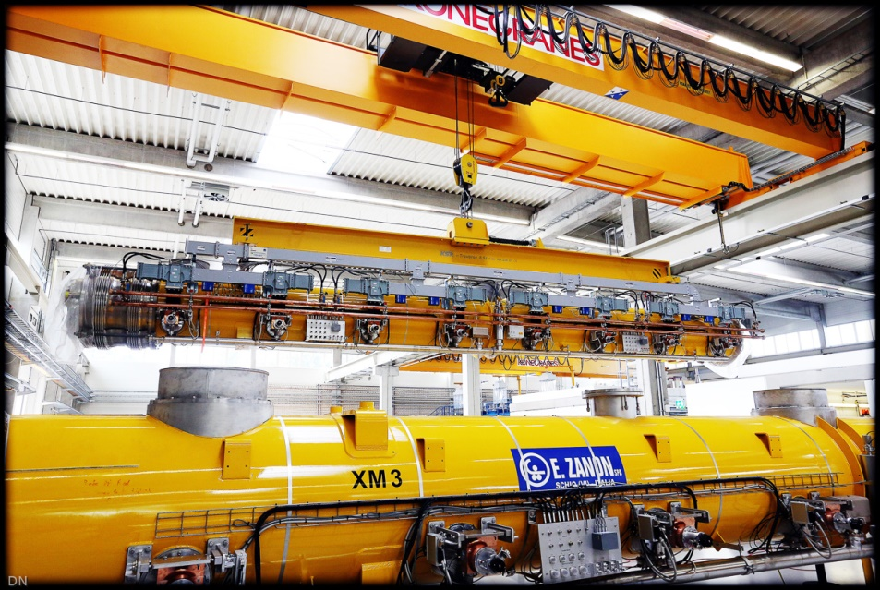
A foreword: why do we need cryomodules?
Mechanically support the cavity string, allowing thermal shrinkage of parts
from 300 K to 2 K without introducing stresses during cool down and warm up
Guarantee the cavity string alignment with a precision less than 0.5 mm
Supply the cavity string with 2 K liquid helium
Thermally isolate the cavity string at 2K from the 300 K environment
Bring high power RF to the cavity string (coupler)

Slide 13
1. Mechanical design
From the vibration point of view
Sources of vibrations
Resonances of subcomponents
  Reduction -> e.g. optimize design with modal analysis
  Limitation -> cavity design optimized for performances, no much play
Position of the support “feet” and brackets
  Reduction -> e.g. move the components
  Limitation -> design to minimize movement of inner components (quadrupole/BPM)
Cavity supports
  Reduction -> e.g. make them as stiff as possible
  Limitation -> alignment requirements special for warm/cold
Module to module connection
  Reduction -> e.g. reduce coupling of vibration between consecutive components
  Limitation -> more complicated cryo destribution (e.g. valves, boxes, …..)

Slide 14
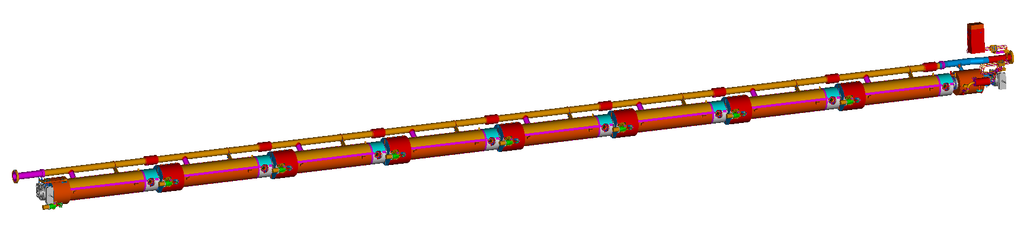
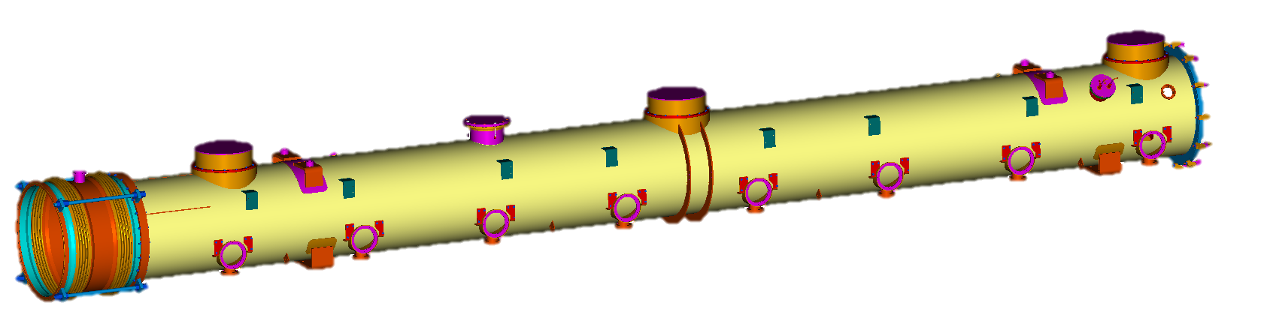
1. Support of the cavity string
Cold Mass: includes all service pipes and the cavity string support structurs
Cavity-String: 8 SCRF cavities (with helium tank, 2 phase line, tuner with piezos,…, 1 quadrupole and 8 RF-cold couplers
Vacuum Vessel: Cold Mass with Cavity-String and on the outside 8 RF-warm couplers and the whole wave guide system

Slide 15
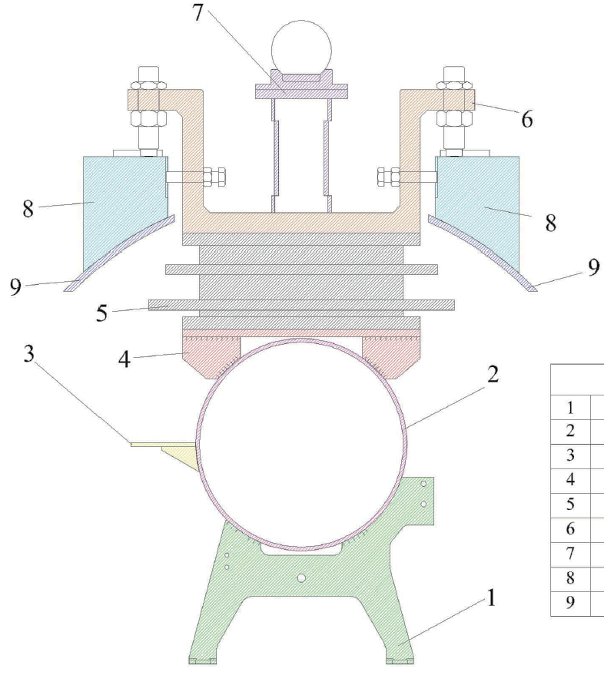
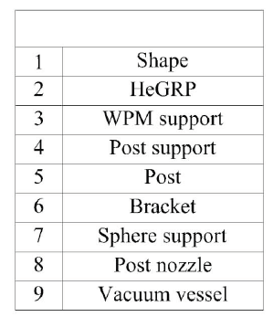
2. Support of the cavity string
The vacuum vessel is either hanging from the ceiling of the XFEL tunnel or supported on the floor in the AMTF a. CMTB
The cold mass is supported via the bracket + post assembly to the vacuum vessel. The center bracket is fixed to the vacuum vessel, while the 2 lateral ones are free to slide longitudinally, to allow the thermal shrinkage of the cold mass without introducing stresses.

Slide 16
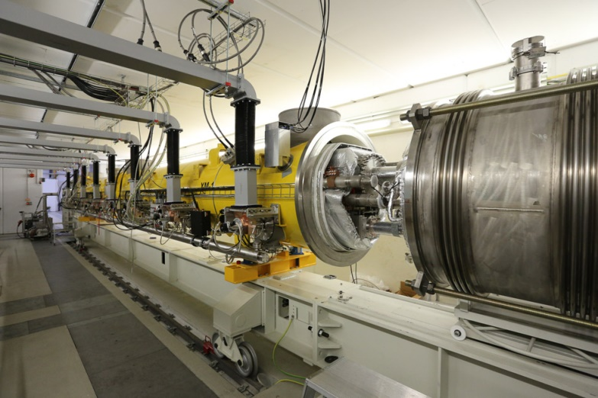
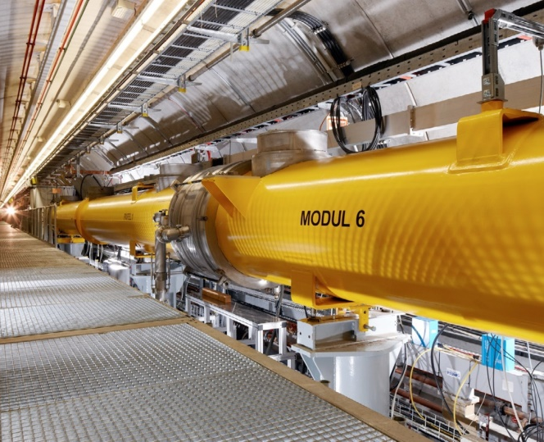
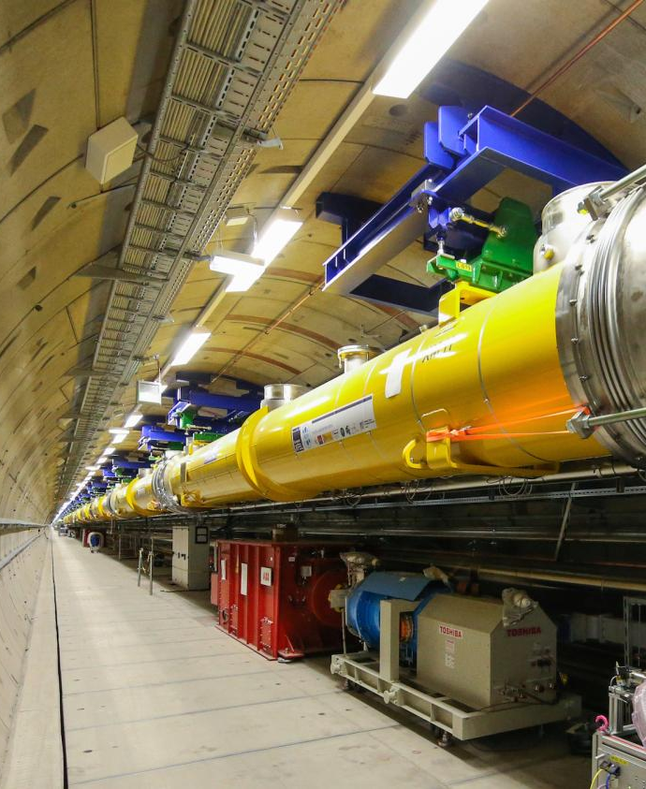
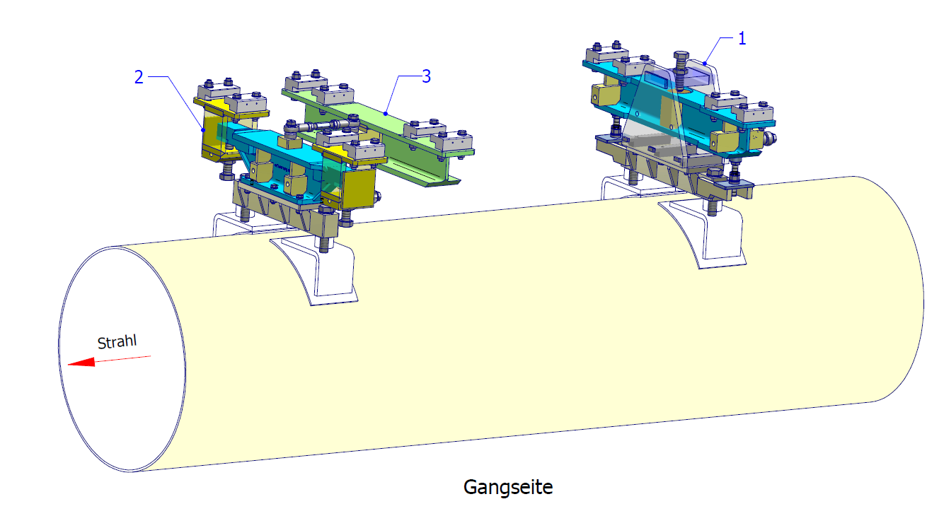
Examples: supports
AMTF a. CMTB
- Ground
Support position
FLASH – Ground
XFEL - Ceiling

Slide 17
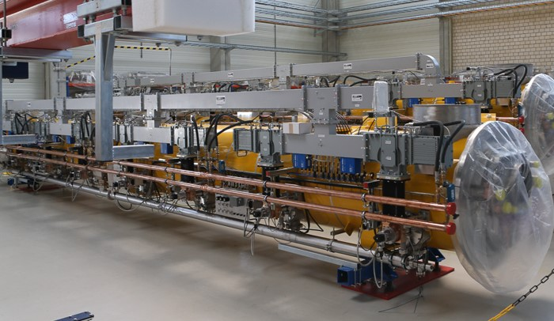
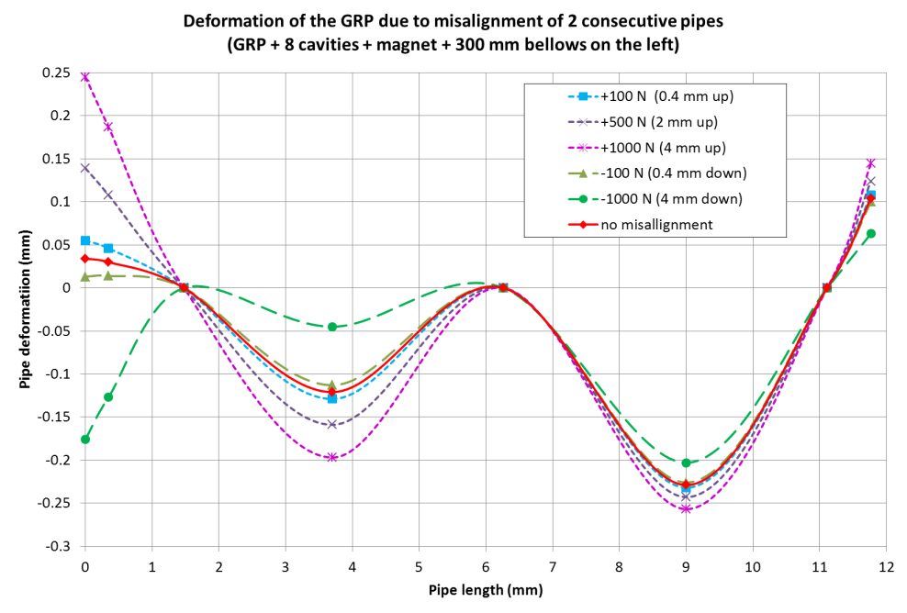
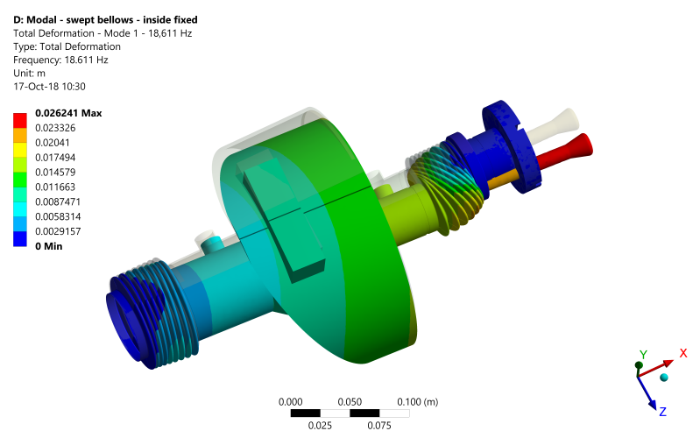
Examples: subcomponents
inside and outside
Dressed XFEL Cryomodule:
Wave Guide System with Water Cooling, Cabling, Patch Panel
Coupling of modules
coupler modal analysis

Slide 18
Cryogenics

Slide 19
The XFEL cryogenic system
A very quick overview
AMTF
Shaft
SC
SC
SC
SC
SC
SC
Warm
He-Pumps
Cold Compressors
CB44
XRTL
SC
SC
Distribution Box
XLVB
Distribution Box
XLVB
Distribution Box
DB54
Distribution Box
XLVB
Purifier XLTP
Cryo Plant
Coldbox 41
Coldbox 43
Injector
FB
Distribution Box
XIVB
EC
CM
3,9 GHz
FC
Main Linac
XLTL1
XLTL2
XLTL3
FB
L1
L2
L3
cw-upgrade
Option
EC
CM
3,9 GHz
FC
CMS
EC
FC
CMS
EC
FC
CMS
SCB
SCB
CMS
EC
FC

Slide 20
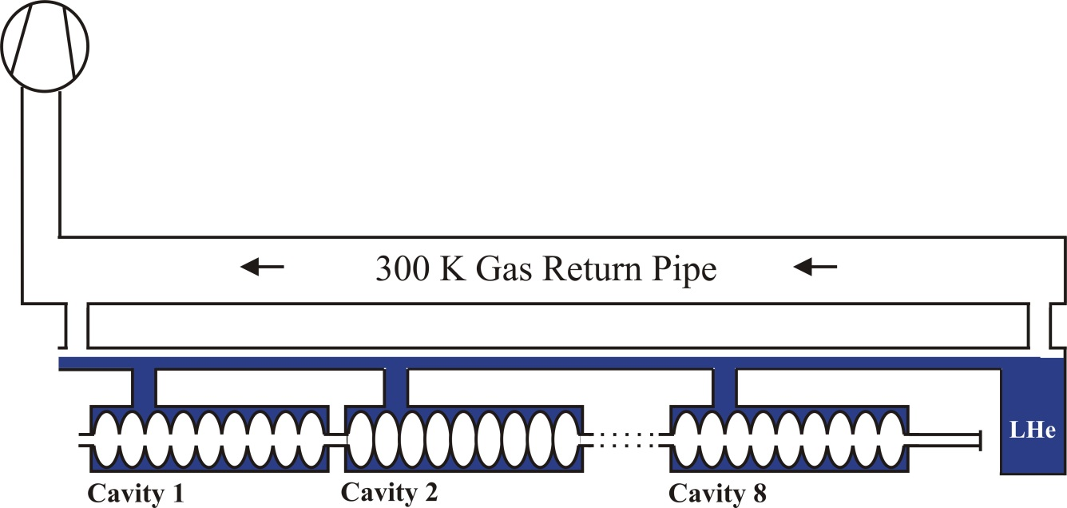
2K princip of XFEL
Cold and warm compressors
Coldbox and Cold Compressors are for standard 2K operation
Warm compressors are a backup -> only for the static losses
    Remark: The Test Benches and FLASH are operated only with warm compressors
Cold/Warm compressors is there an difference in case of vibration?
1000mbar
Warm Compressors
JT-valve
2K-supply
Coldbox 41
Cold Compressors
CB44
31mbar/2K return flow
1000mbar

Slide 21
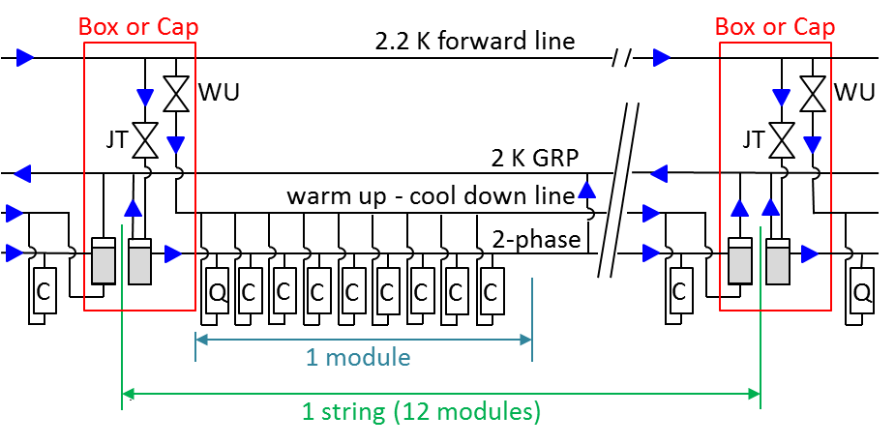
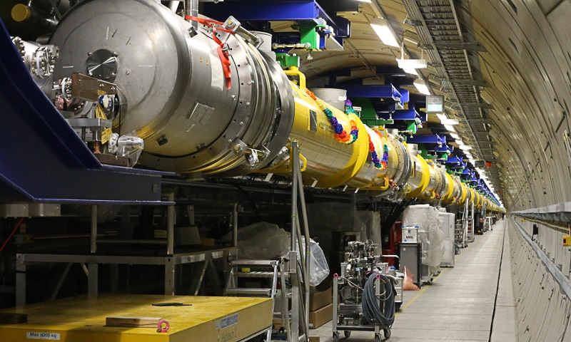
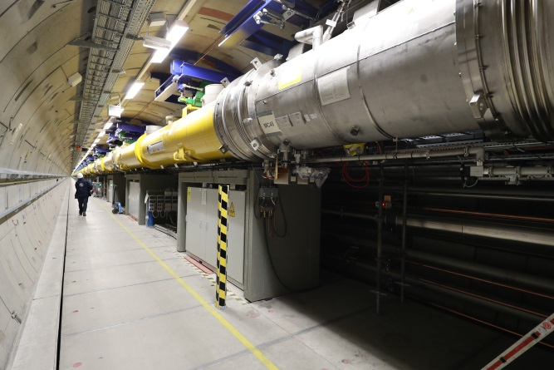
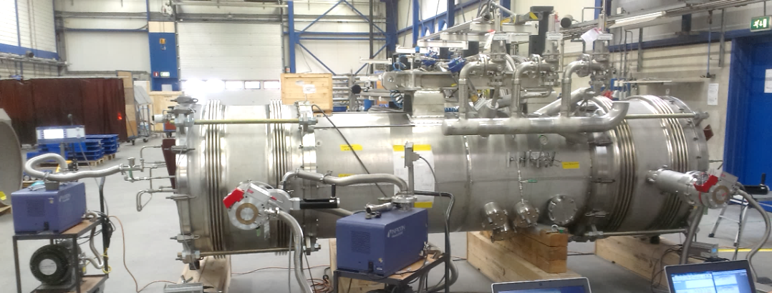
2K-He for one cold string
Flow scheme for one cold string
JT-valves only in the boxes
Boxes directly attached to the modules
Vacuum pumps attached only to the boxes

Slide 22
Main cryogenic components
From the vibration point of view
High Pressure Compressors 300K/18bar
Cold Box Turbines
Cold Compressors 2K/31mbar
Warm Pressure Compressors 300K/31mbar
Valves
Flow meters
Bellows in the He circuits warm and cold
LHe-Heaters

Slide 23
Vacuum

Slide 24
Main vacuum components
From the vibration point of view
Pumps
Rotating components -> vibration source
Fundamental for beam and isolation vacuum -> Cannot be removed!
Mitigation:
  Isolating the supports from ground (like for the washing machine)
  Decouple: use flexible hoses, avoid direct connection to the module (boxes, transfer lines)
Clean rooms
Needed during assembly work
Mitigation:
  Can be turned off during vibration studies
  Can be a problem during preliminary studies

Slide 25
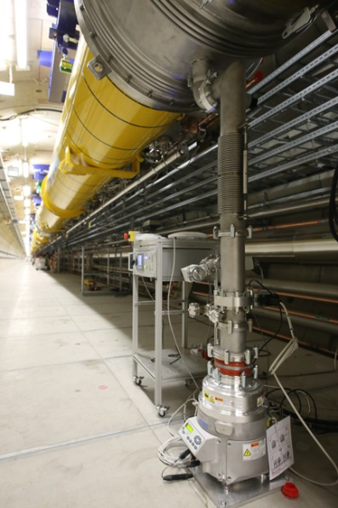
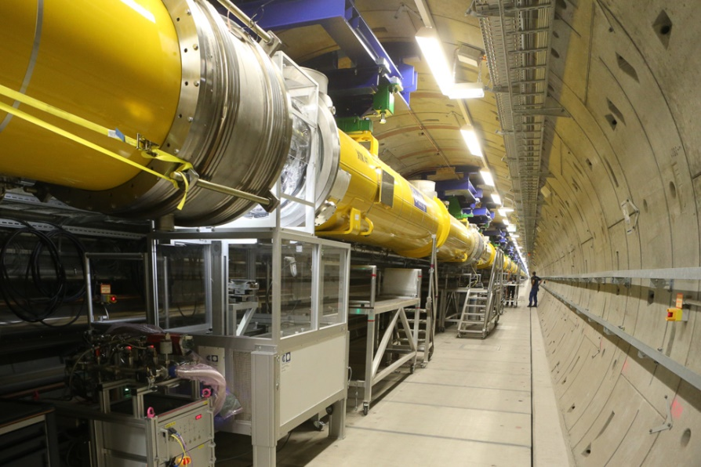
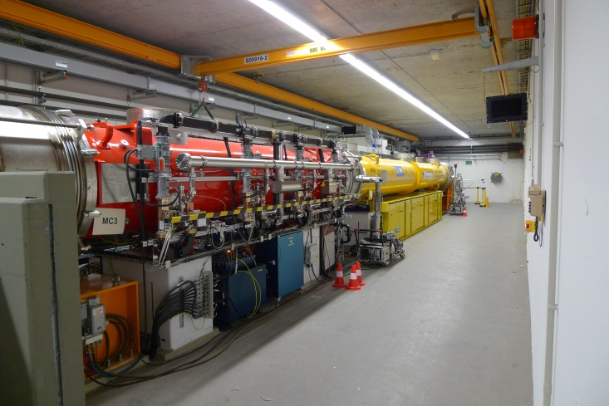
Examples
The XFEL vacuum pumps and the Injector clean room
XFEL Main Linac
XFEL Injector

Slide 26
RF cooling

Slide 27
Main RF cooling components
From the vibration point of view
Water circuit
Cooled phase shifter support fixed at the cryomodules
Cooling water pumps
Mitigation:
  No support on the Cryomodules
  Isolating the supports from ground (like for the washing machine)

Slide 28
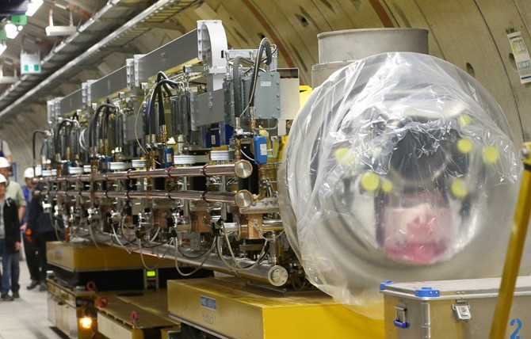
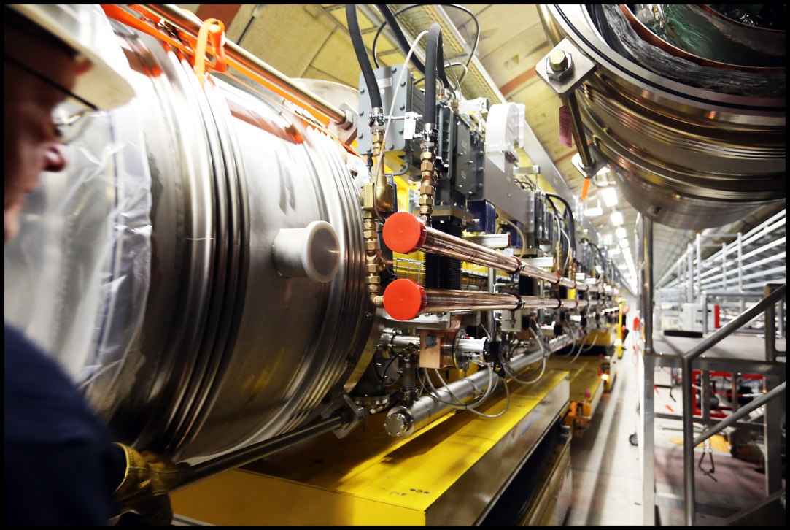
Examples
RF cooling system on the Cryomodules

Slide 29
Conclusions

Slide 30
Conclusions
From the cryo - mechanical point of view
Not an easy task?
Many sources, some can be reduced modified, but difficult to isolate
Many “interference” with other design requests
Not the typical experties in the cryo environment?
Usually affected by much slower events (see the 2KF pipe vibration in S. Barbanotti, later today)
Inter-group topic, need the close interaction of Cryo, Mechanical, RF, Control People

Slide 31
Thank you

Slide 32
Kay Jensch
MKS1
Kay.Jensch@desy.de

Slide 33
Backup Slides

Slide 34
2. Guarantee string alignment (1/2)
Only one fixed point: the middle post (no stresses due to shirinkage)
Coupler longitudinal flexibility (in the mm range)
Cavity string fixed to an invar bar
(integral shrinking coefficient 300 K – 2 K = 0.04 mm/m)
Pins between GRP and post and post and brackets, to reproduce exact position after multiple assemblies
Cavity string support system with rollers: very low friction

Slide 35
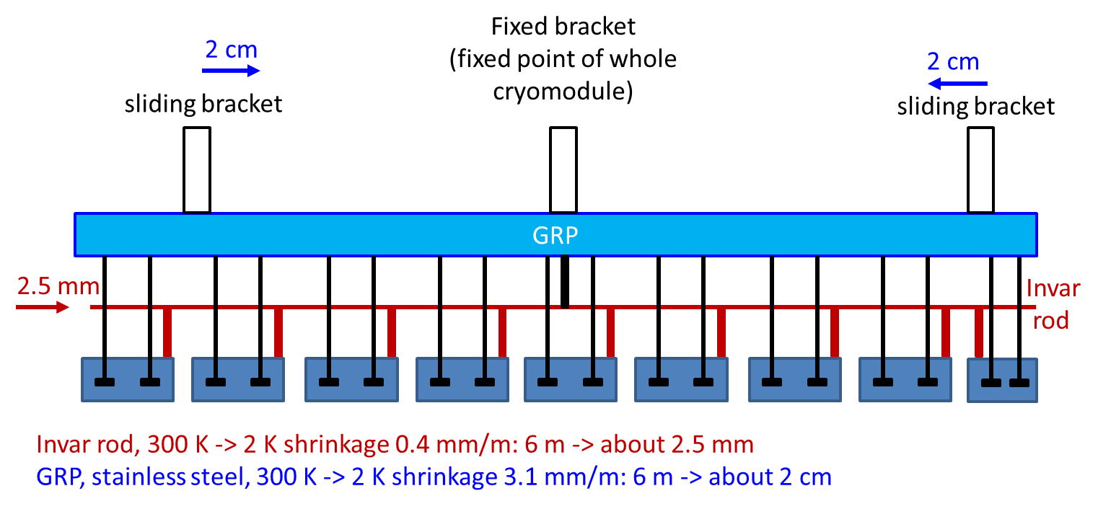
2. Guarantee string alignment (2/2)

Slide 36
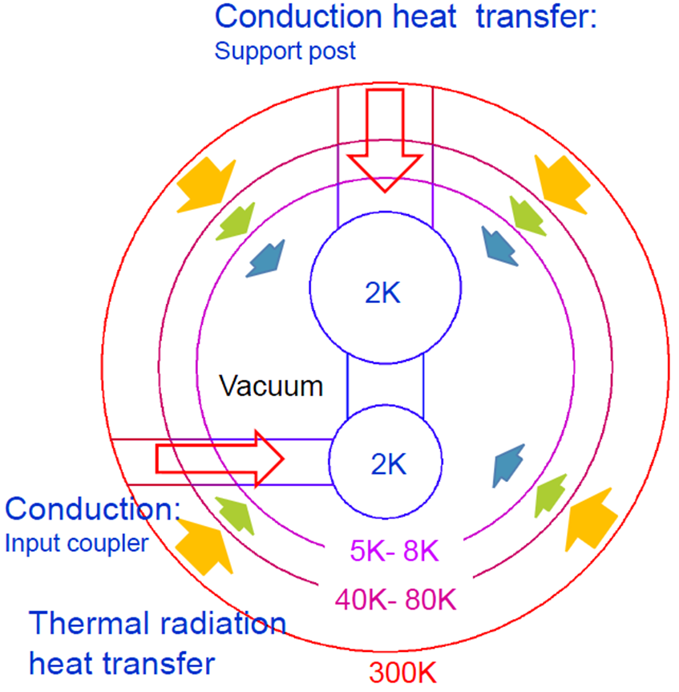
4. Thermally isolate the cavity string
Design of the support post:
- thin pipe of G10 material to reduce conduction;
- shirink-fit assembly tecnique to guarantee strength
Thermal intercepts at 4K and 80K to readuce direct conduction 2 K -> 300 K
Multi Layer Insulation (MLI)
Image cortesy of N. Ohuchi

Slide 37
Inside a cryomodule
A cryomodule has 3 main components
Cold mass: includes all the service pipes, and the
cavity string support structure
Cavity string: 8 SCRF cavities (with helium tank, 2 phase line, tuner, … ),
1 quadrupole and 8 couplers
Vacuum vessel

Slide 38
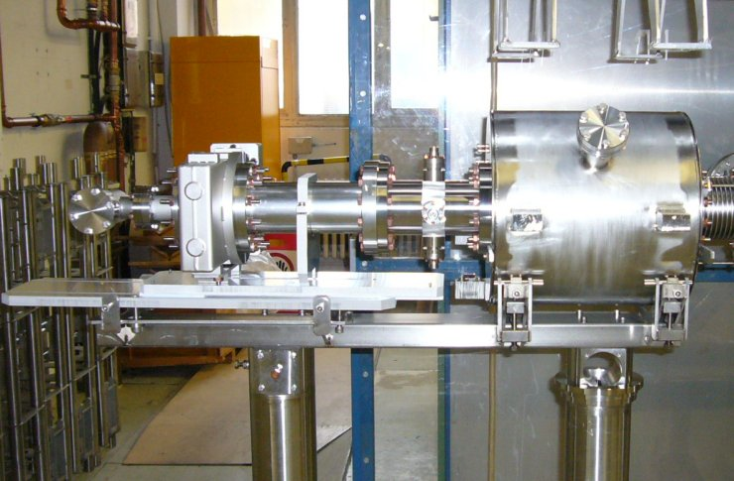
Let‘s see a bit more inside…
BPM + magnet + gave valve unit

Slide 39
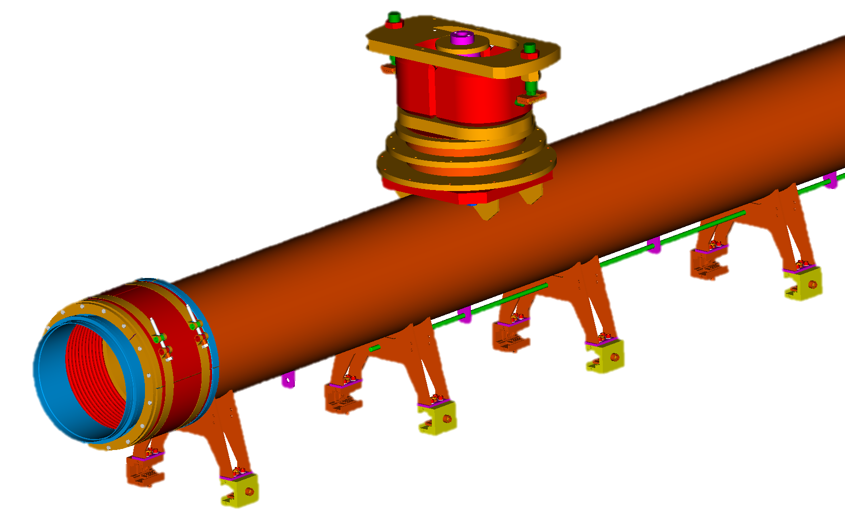
Let‘s see a bit more inside…
The cavity hanging system:
Post, brackets and GRP with C-clamps

Slide 40
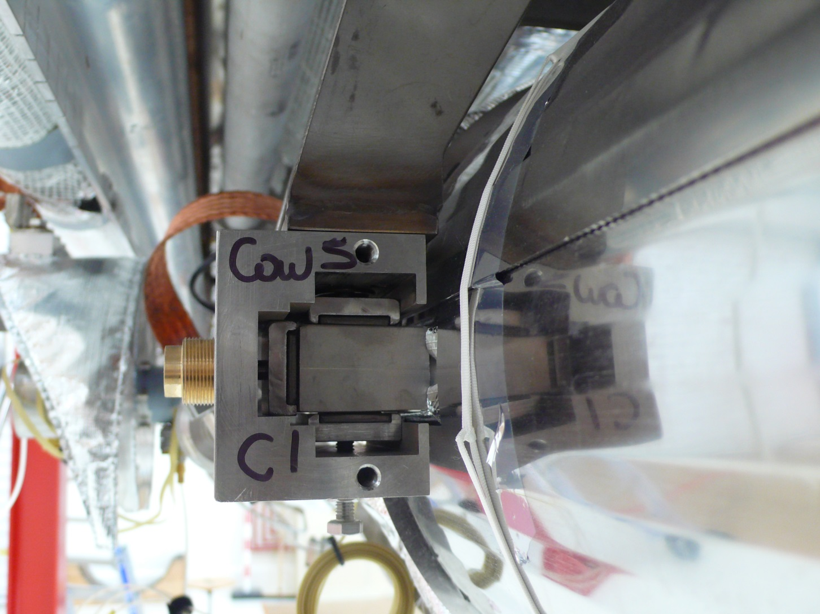
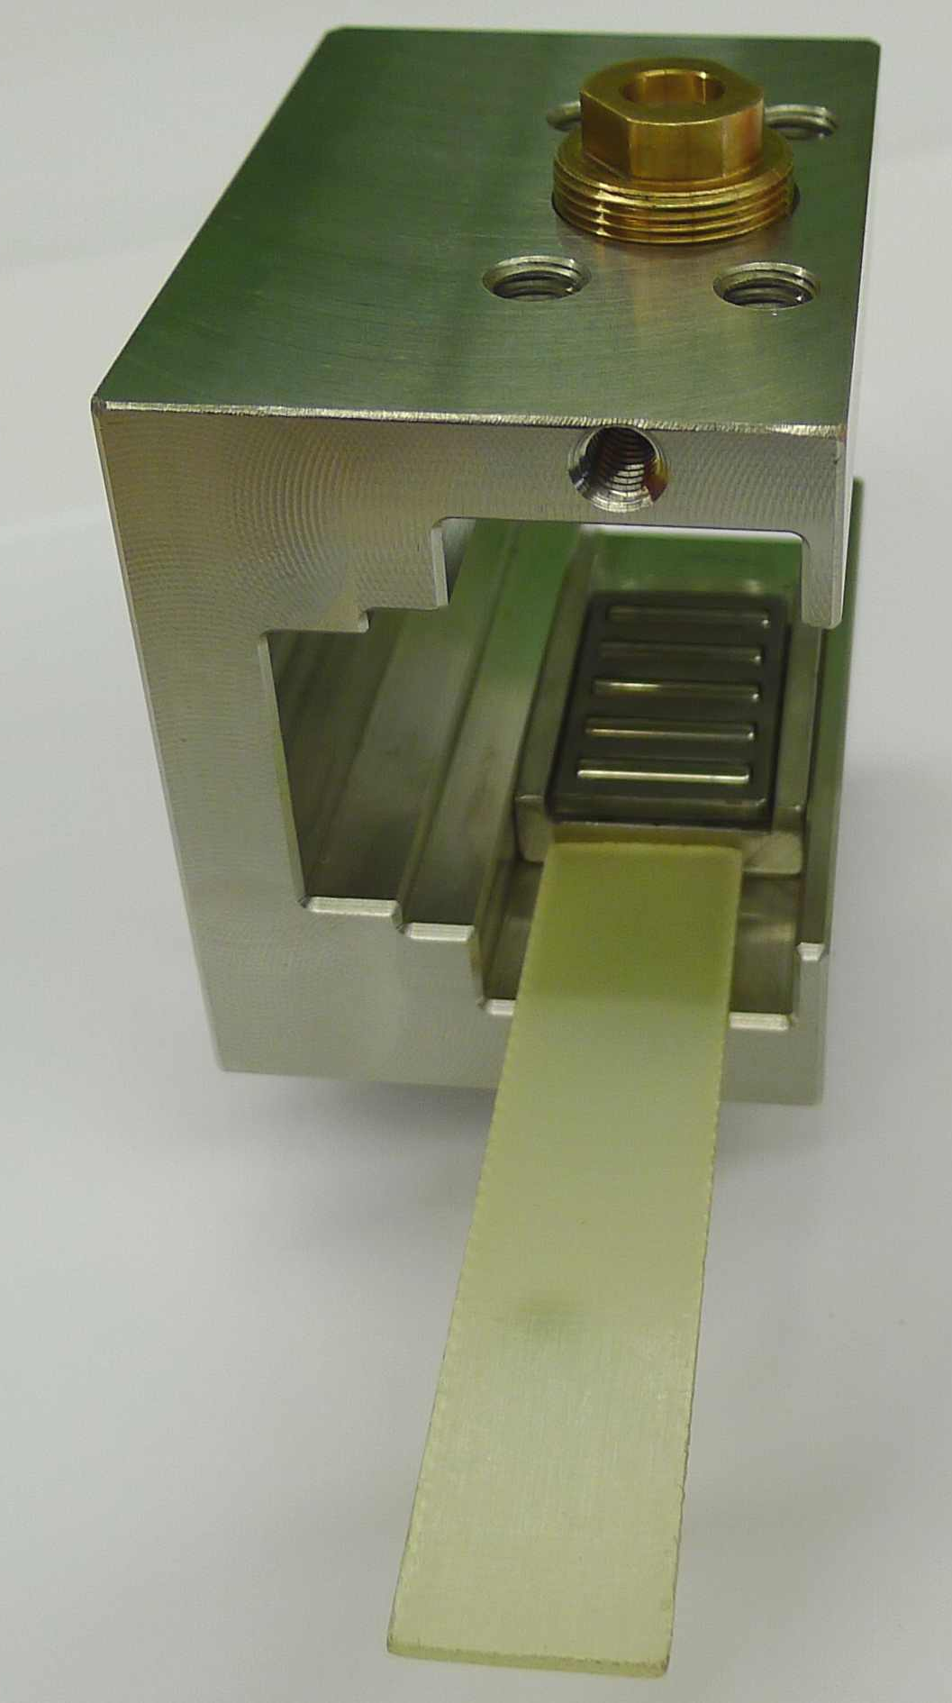
Let‘s see a bit more inside…
The cavity supports

Slide 41
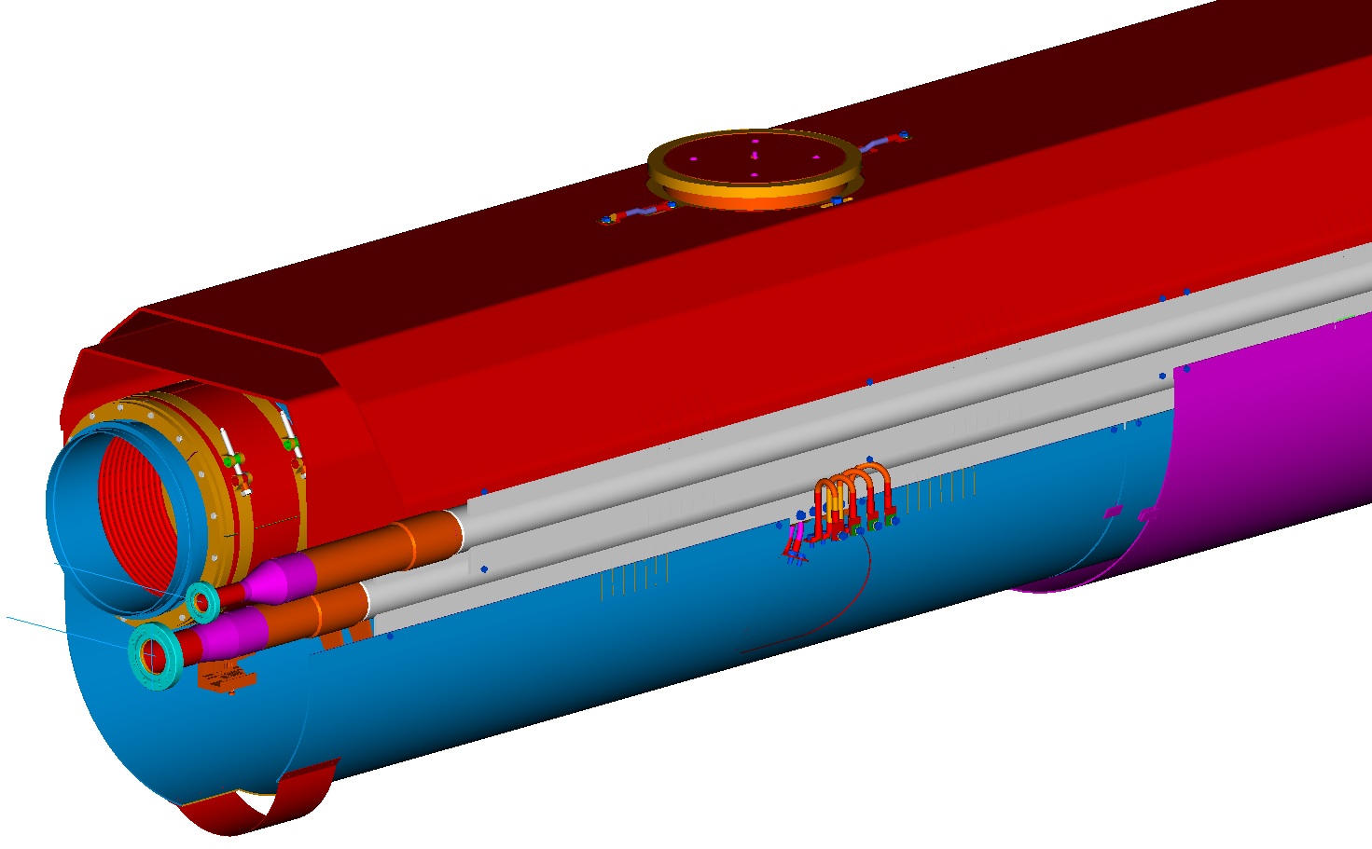
Let‘s see a bit more inside…
Thermal shields

Slide 42
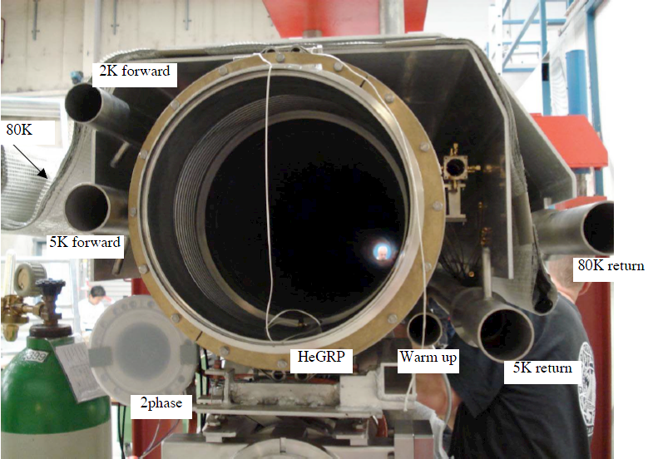
Let‘s see a bit more inside…
Cross section of the piping

