Slide 1
1.3 GHz Microphonics Measurement and Mitigations
Jeremiah Holzbauer on behalf of the Microphonics Working Group
MRCW18 - 2nd Topical Microphonics Workshop
October 25-26, 2018

Slide 2
Microphonics Working Group
The material presented is on behalf of many people including but not limited to:
B. Chase, C. Contreras, J. Einstein-Curtis, B. Hansen, E. Harms, J. Kaluzny, A. Klebaner, M. McGee, Yu. Orlov, Yu. Pischalnikov, T. Peterson, W. Schappert, R. Stanek, J. Theilacker, G. Wu
Notice that this is a diverse list of skill sets, including mechanical engineers, cryogenics engineers, electrical engineers, operations/testing experts, project management, and scientific staff
All of these were critical to the success of these efforts
I will focus on work done at FNAL/FNAL staff, but this is not to minimize the testing and effort done at SLAC/JLab

Slide 3
Outline
Background
Diagnostic Efforts Overview
Sources of Microphonics – Measurements/Mitigations
Cryogenic Valve Plumbing
Thermal Acoustic Oscillations in the Valve Stems
Helium Leakage into Cooldown Circuit
Cavity 1 Mechanical Support
Modification and Performance Improvement
Summary

Slide 4
Background – LCLS-II Cryomodule Design
The initial conception of the LCLS-II cryomodule design was the XFEL cryomodule design
The XFEL design was modified in several ways, but most importantly is the switch to CW operation with fast cooldown
Larger helium piping
Dual helium cooldown supply to each cavity
JT/CD valves added to each module to allow individual module cooldowns

Slide 5
pCM (Prototype CM) Cryogenics Distribution System

Slide 6
Background
12+10 LCLS-II cryomodules have been tested at FNAL and JLab, in general with great success (especially most recent modules)
One notable exception was the resonance stability
Linac Specification: 10 Hz Peak Detuning (excursion from 1.3 GHz)
As first tested: up to 150 Hz Peak Detuning with a very complex, dynamic amplitude and spectrum
This was not an unanticipated problem; significant changes had been made to the XFEL cryomodule design for LCLS-II
The size and complexity of the microphonics (observed at both JLab and FNAL) required a significant response to mitigate
Working group formed to guide testing and determine solutions
Devoted extensive test time to microphonics studies
At the height of testing, group met 3x a week

Slide 7
Background (2)
Limiting cavity excursion from 1.3 GHz to 10 Hz is a very stringent parameter, driven by many machine design factors
Available RF power
Coupler RF capacity
Distribution losses
Control power overhead
Cavity bandwidth tolerances
…
It is important, not only for machine operation but also for test stand operation, that the cavities are coherently locked (dark current measurement) in Generator Driven Mode (GDR)
Microphonics testing goals:
Diagnose, design, and (with project approval) implement fixes with minimal schedule delay
Propose solutions that should help and do no harm

Slide 8
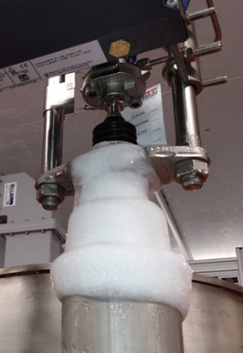
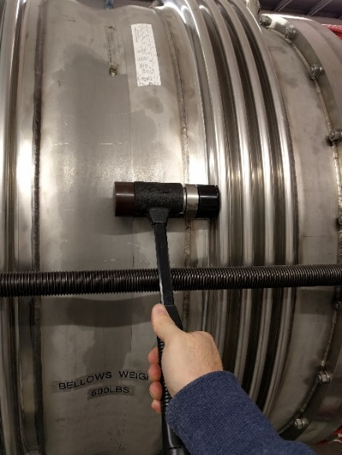
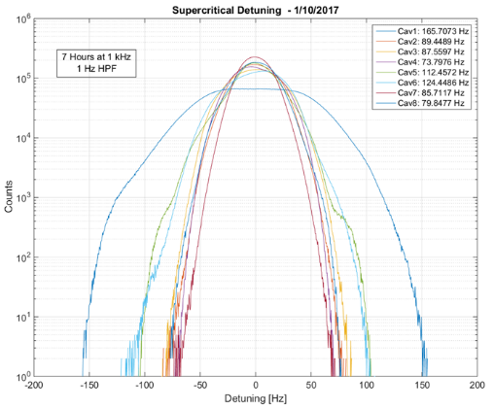
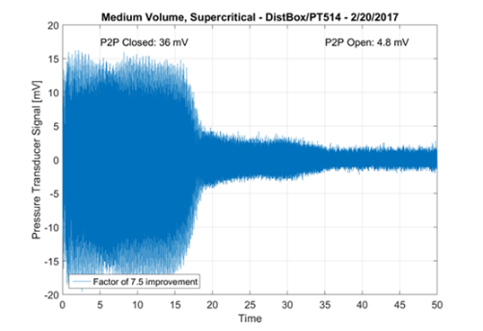
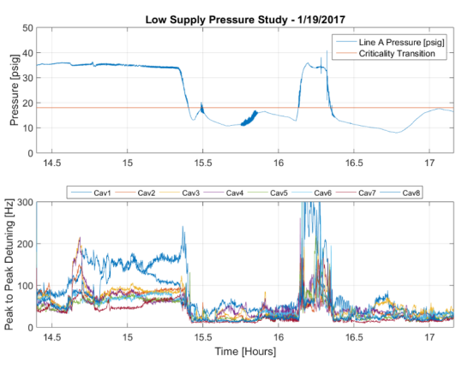
Data from the Cryomodule Testing
Significant testing effort was spent on microphonics mitigation
F1.3-01 Extended Testing (12 weeks)
Extensive Testing Program during further testing, including ongoing microphonics measurements
LLRF data capture system
>350 hours of cavity data recorded
Correlated many sources of data:
RF Data (On-line detuning capture)
Impact/Vibration Measurements
Temperatures, Pressures, etc. from instrumentation
Tested in many different cryogenics configurations
Leveraged significant work done at both labs on vibrational design and testing
GDR (fixed frequency) operation achieved at both JLab and FNAL

Slide 9
Testing Tools
Ground motion stations including seismometers and geophones at CMTF – FNAL
Impact testing of cold string and cryomodule was used at both FNAL and JLab including string mode simulations done with JLab pCM
LLRF system at FNAL captured all eight cavities detuning simultaneously and synchronously at 10 kHz
ACNET data logging on all other cryomodule sensors (temperature, pressure, valve position, etc.etc.)
Extensive scripting has been written to rapidly process and analyze these data sets

Slide 10
Sources of Microphonics – Measurements/Mitigations Cryogenic Valves

Slide 11
Cryogenic Valve Plumbing – Dynamic Detuning
F1.3-01/J1.3-01 measured detuning was very dynamic
Vibration lines shift rapidly frequency and amplitude
Includes slow drifts, sharp jumps, and oscillations
Not mechanical resonances of the cryomodule
Narrow-band cryogenic source(s) exciting wide-band, low frequency mechanical response
Detuning Spectrum [Hz]

Slide 12
Cryogenic Valve Plumbing – TAOs (2)
Cavity detuning was dominated by unstable, dynamic microphonics
This unstable microphonics was clearly correlated with cryogenic sources (both internal and external to the cryomodule)
Testing revealed Thermal Acoustic Oscillations (TAO) in the supply valves correlated with detuning (normally only of concern for heat load). When TAO was reduced (valve wipers/valve reversal):
Icing on valves stopped/Heat load dropped significantly
Microphonics dropped by factor ~10
TAOs also had destabilizing effect on cryogenic system
Changing heat load from changing TAO behavior drove cryogenic oscillations, further disturbing/detuning the cavities
Other instabilities were discovered/mitigated (e.g. JT injection, valve actuators)

Slide 13
Brief Introduction to TAOs
Thermoacoustic oscillations generally occur in long gas-filled tubes with a large temperature gradient.
Acoustic modes couple to mass transport up and down column especially well when gas density is strongly tied to temperature.
E.g. Warm gas from the top of a valve column moving to the cold bottom contracts, reducing pressure at warm region, driving the now cold gas back.
Long valves and very low speed of sound in cold helium can easily give lowest acoustic modes at dangerous frequencies.
The quarter-wave mode in a 1 meter valve filled with 5K helium has a resonant frequency of 130 [m/s] / 4 [m] = 32 [Hz].
These oscillations are generally important for the tremendous heat leaks they can represent, not microphonics.

Slide 14
Thermo Acoustic Oscillation
Dropping the helium supply pressure to below the critical point (18 psig) significantly improved microphonics levels.
Although obviously not a realistic configuration, diagnostically, this was critical in our understanding of the detuning correlation with TAOs
Wipers were installed on the valve stems
JT first, but that alone was not enough
Even with no flow, the cooldown valve still exhibited a TAO that disturbed the cavities
Best performance was with wipers in all valve stems
Temperature sensors on the valve bonnets still showed some TAO behavior, and microphonics wasn’t completely gone

Slide 15
Detuning During Low Pressure Operation
Vibration levels fell consistently at subcritical pressures
Different regime doesn’t excite strong thermo-acoustic oscillations

Slide 16
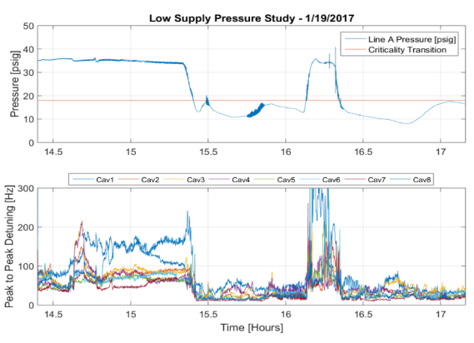
Critically Transition
Pressure below 18psig

Slide 17
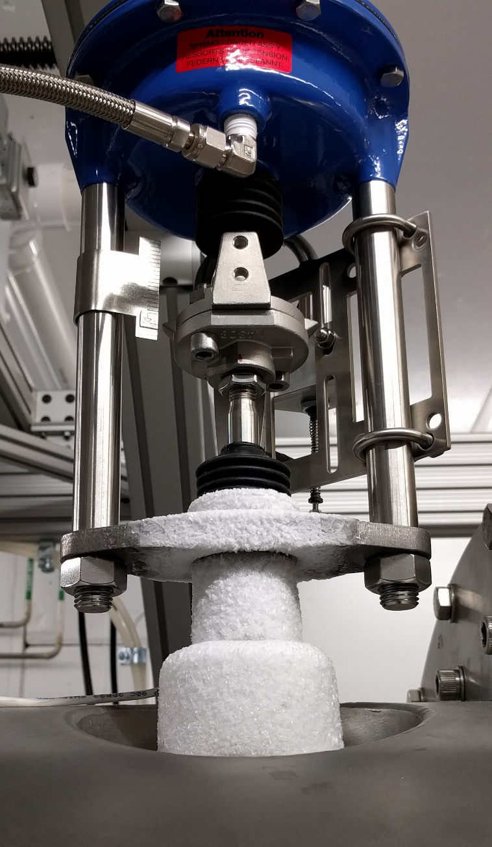
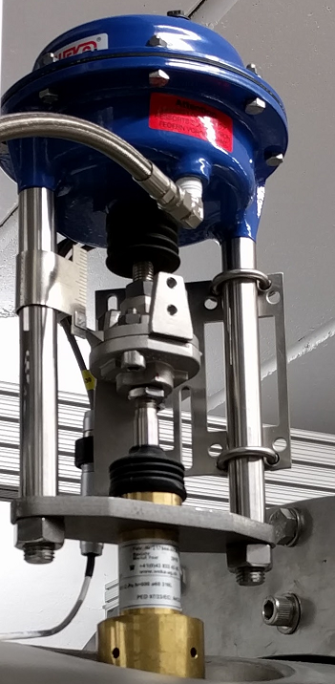
Valve Icing
Normal Operation
Low Pressure Operation
Low pressure operation consistently eliminated icing on the supply valves (JT, bypass)
Indicates suppression of thermo-acoustic oscillations

Slide 18
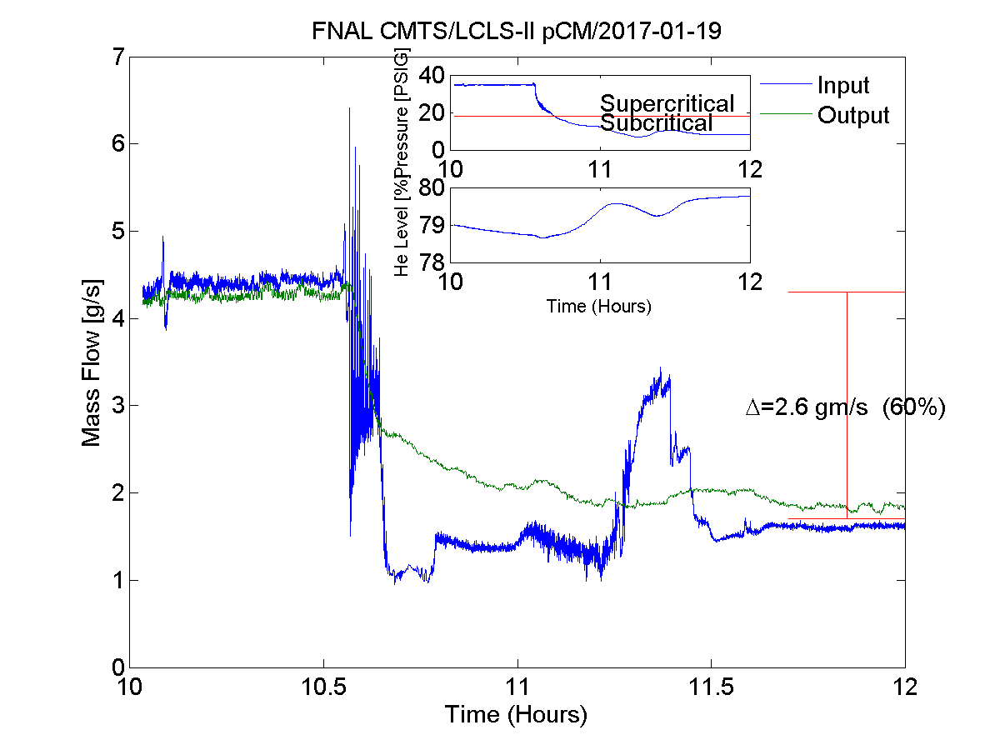
Helium Consumption
Static heat load significantly lower for lower JT inlet pressures
Helium consumption falls by 60%
Supercritical operation after fixes maintain a lower heat load (although not quite as low).

Slide 19
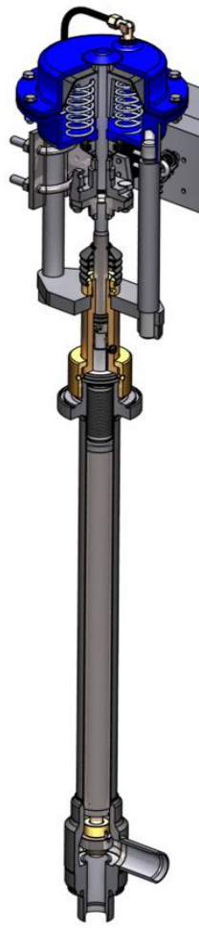
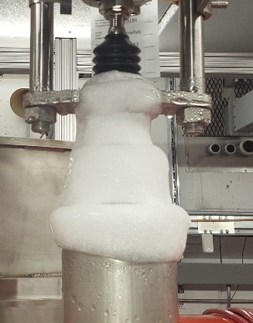
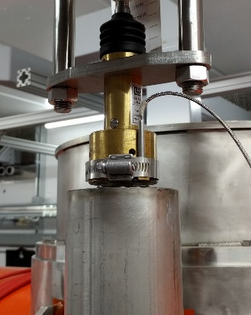
Cryogenic Valve Plumbing – Improved Valve Stems
TAOs are a pressure/temperature oscillation in cryogenic lines (in this case, valve stems)
During testing, wipers were added to close space in valve stem, acting as a damping term for the TAOs
Significant improvement in heat load and microphonics levels and stability for both F1.3-01 and J1.3-01
Optimized valve stems with wipers were used during F1.3-02 testing, and will be used going forward for both labs
4-5 wipers, positioned to keep temperature ratio <4 as recommended by literature
Radiation hard material (PEEK)
Before
After
DN6
DN10
Optimized wiper placement going forward

Slide 20
J1.3-02 Data Was Taken With Valve Stems (Not Reversed Valves)
Slides From T. Power (JLab)

Slide 21
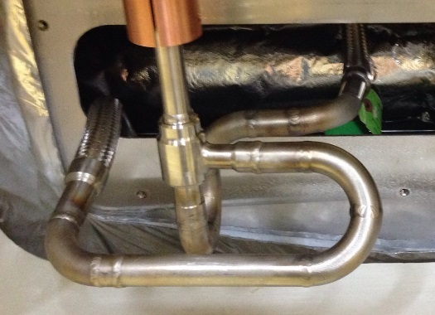
Cryogenic Valve Plumbing – Reverse Flow Path
Test results show valve reversal (lower press in stem) significantly reduces/eliminate TAOs there
F1.3-01 configuration has valve stem at supply pressure (~3 bar)
Reversing flow will lower this pressure to sub-atmospheric, requiring guard gas to prevent contamination
All cryomodules will have guard gas, reversed valves
Additional effort to mitigate TAOs in cryogenic distribution system should improve inlet temperature at test stand
Reversed additional valve on the FNAL test stand (bypass)
pCM Flow Pattern
3 bar Supply
Reversed Flow Pattern (CM2)
3 bar Supply
~23 Torr
~23 Torr

Slide 22
Need for Wipers
F1.3-02 was tested with reversed valves but no wipers on JT and CD valve
Increased valve bonnet temperature drop during cooldown
Increase in unstable microphonics lines, to which Cavity 1 is especially sensitive
4K mode will be sensitive to increased heat load without wipers

Slide 23
Valve Modification Improvement
Comparing performance of the standard cryogenics configuration, the microphonics environment in the F1.3-02/03/04 is a factor of ~10 improved
Significant improvements in stability of the system, leading to a far more predictable detuning environment
pCM As Cooled Down
F1.3-02
After Improvements

Slide 24
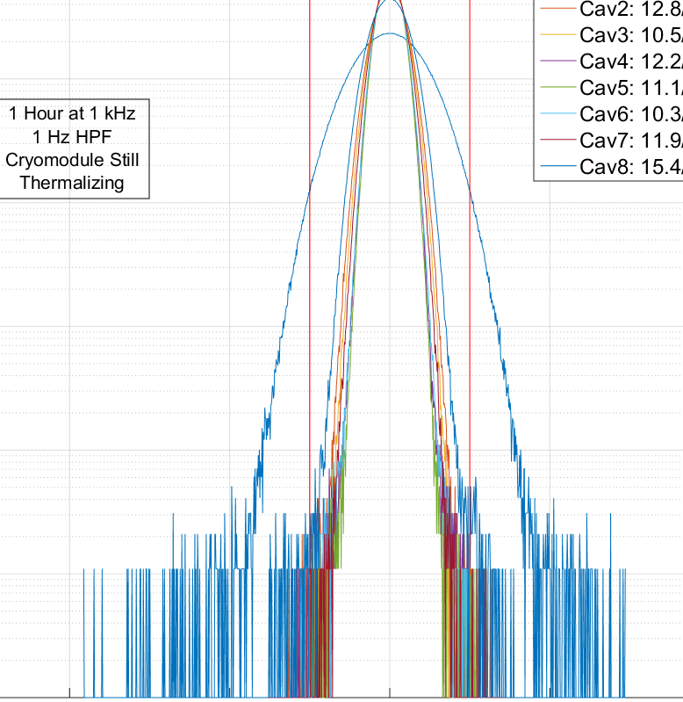
Cryogenic Valve Plumbing – Cooldown Valve Leakage
F1.3-04 presented with higher than expected microphonics, worsening as the cryomodule thermalized
F1.3-07 showed same noise after 3rd temperature bump
Both characterized by solidly low temperature cooldown line (2 K vs ~25 K), indicating active flow
Noise was narrowband and showed complex spatial and spectral distribution in cryomodule
Testing showed noise to be coherent bubbling due to cooldown valve leakage, explains noise on upstream cavities
Swapping valve stem returned expected performance in both cases
Tails seen in ‘post-swap’ data are likely due to continued thermalization of cryomodule after cooldown
Additional QA check step now included to prevent valve leakage in the future, although small leaks have been seen during other module tests
Thermalized Detuning
Post CD Stem Swap

Slide 25
Sources of Microphonics – Measurements/Mitigations Cavity 1 Mechanical Support

Slide 26
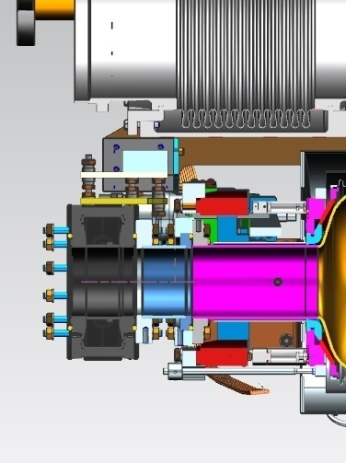
Cavity 1 Mechanical Connections
Cavity 1 was consistently worse than other cavities by factor of ~2
Cavity 1 and upstream gate valve are connected rigidly with no beamline bellows
Gate valve supported vertically by bracket, but free to move in beam direction
Gate valve acts as large backing weight on tuner, lowering resonant frequency of longitudinal modes
In machine, will also have a beam line absorber, adding even more mass
Support
Bracket
Gate Valve
Spool Piece
Cavity 1

Slide 27
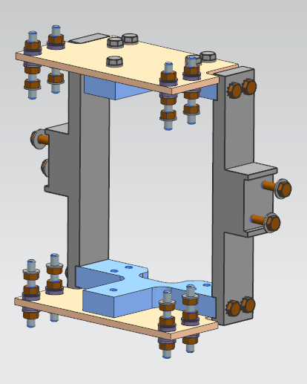
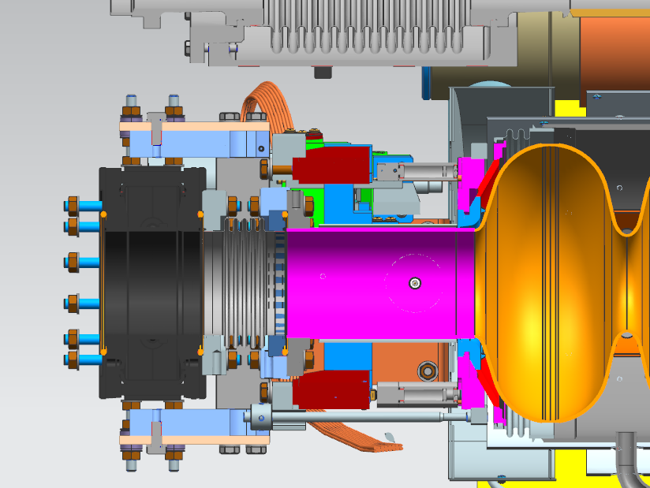
Cavity 1 Mechanical Connections – Mitigation Beamline Gate Valve Bellows
Replacing spool piece between cavity 1 and gate valve with a bellows is non-trivial
Corrective fix includes extending tuner arms with fixture to connect to gate valve
When replacing spool piece with bellows, fixture fully supports gate valve
Current supports are long arms connected to the 300 mm pipe with needle bearing for the longitudinal motion
With gate valve is supported by frame/helium vessel, the spool piece can be replaced with a bellows to separate mass from cavity/tuner system
Many cryomodules with bellows have been tested at FNAL (F1.3-06-12)
Extended Tuner Arms
Fixture with Bellows

Slide 28
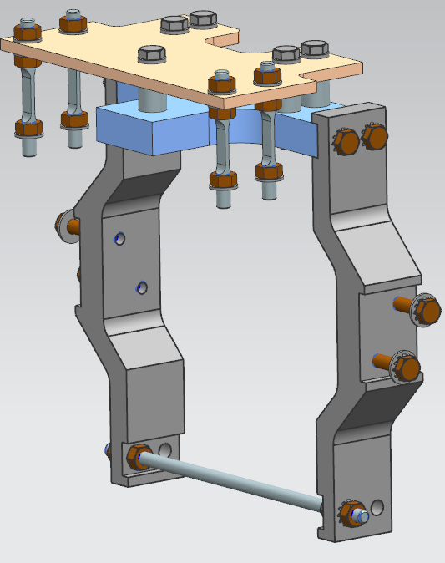
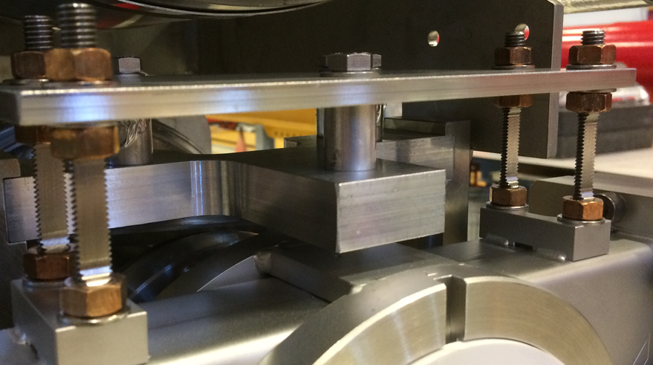
Cavity 1 Mechanical Connections – Mitigation Beamline Gate Valve Flex Joint (no bellow)
Assembled strings are impractical to retrofit with bellows
Connection between helium vessel and tuner can be added with flex joints
Eliminates connection between gate valve and 300 mm pipe
Still uses long tuner arms and a fixture
Flexures spring constant can be adjusted if needed
Installed on F1.3-04 and tested, but without major improvement

Slide 29
Piezo/Detuning Transfer Function
All eight cavities characterized by measuring piezo tuner transfer function to detuning
Originally, cavity 1 had lower first resonance (~150 Hz compared to ~180 Hz)
Bellows modification makes transfer function comparable to other cavities

Slide 30
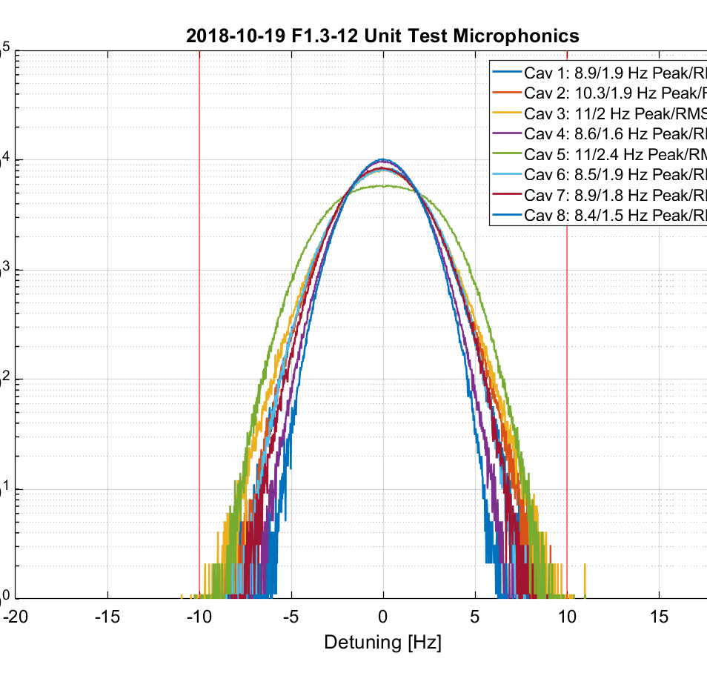
Cavity 1 Performance with Bellows
Bellows gives significantly improved cavity 1 performance, relative to the other cavities
The combination of cryogenic valve improvements and cavity 1 bellows has brought the microphonics levels to consistently at LCLS-II specification
(Technically just above specification as very infrequent events exceed 10 Hz)
GDR operation at CMTF has been maintained for >8 hours at gradient
Integrates all improvements on microphonics and LLRF control system
30 Min Capture

Slide 31
Conclusions

Slide 32
Other Mitigation Steps
Other minor sources of detuning have been identified
30 Hz line from Kinney Pump is significant contribution to detuning, but will not be present in the tunnel
Small lines are attributable to insulating vacuum pumping on test stand
Very small detuning correlated with supply pressure, flow rates, etc, but contribution is very small (<0.01 Hz RMS)
Cooldown effects are non-trivia, generally takes ~10 days before thermalization sources stop
Other modifications were made in cryomodule assembly - the effects are unclear
Replaced JT injection line with injection tee to slow injection velocity and allow some initial phase separation
Audit of cryomodule and string resulted in many small restraints being added, tying relatively loose lines together to eliminate uncontrolled motion, putting spacers and shims to eliminate potential chattering
Testing continues with good results
Reversed valves, optimized stem wipers, cavity 1 bellow, and two-phase pipe baffles/vortex injection have been successful and will be used going forward
Results from JLab are in accord with FNAL results
Continue to monitor microphonics with each test, but nothing new recently

Slide 33
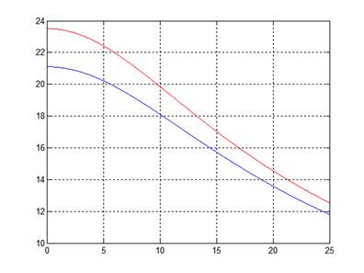
Machine Performance with Existing Detuning
Estimates of machine performance given existing SSA power availability at 60 uA gives a tolerable RMS detuning value of 2.5 Hz (15 Hz / 6σ)
Even including test stand effects (estimated at around 0.75 Hz RMS), enough RF overhead exists for 60 uA operation in recent test
No Beam Current
Potential Gradient [MV/m]
60 uA
Peak Detuning [Hz]
Cavity Number | Current RMS [Hz]
1 | 1.9
2 | 1.9
3 | 2.0
4 | 1.6
5 | 2.4
6 | 1.9
7 | 1.8
8 | 1.5
Without Active Compensation

Slide 34
Summary
Early LCLS-II cryomodules showed significantly higher than expected microphonics
A cross-disciplinary working group was formed to implement testing and mitigations
Significant progress has been made diagnosing and mitigating microphonics issues
Testing shows factor of ~10-15 improvement in microphonics
Active compensation studies show good progress proceeding on remaining microphonics environment
The cryo-mechanical improvements and active resonance control system have demonstrated 10 Hz peak detuning

Slide 35
Backup Slides

Slide 36
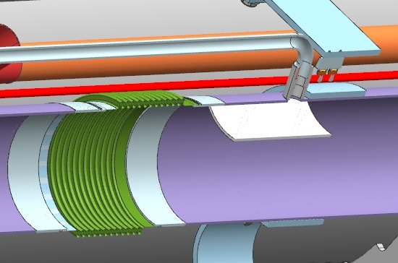
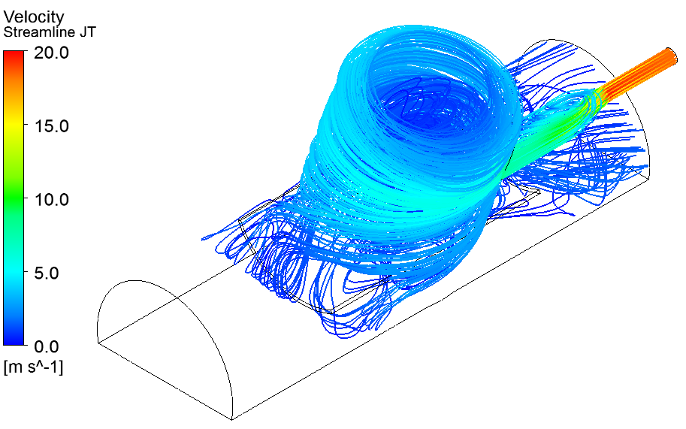
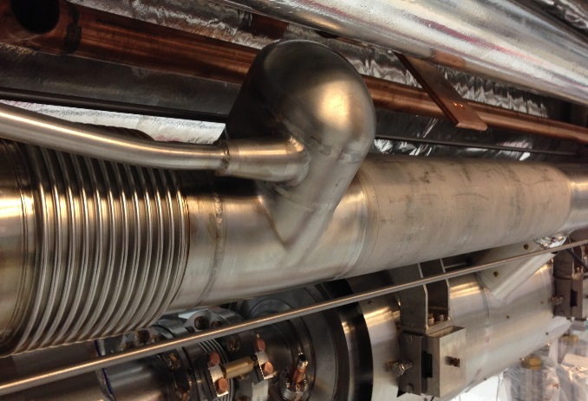
Mitigation Steps in Cryomodule Design – 2 Phase Injection
Liquid level control was coupled to input flow rate and the amount of flash gas generated across JT valve
Helium injection line impinged on liquid surface
Flash gas from JT caused liquid dragging
CM2 has baffles to protect liquid surface
CM3 has tangential injection into cap to reduce velocity and allow phase separation in addition to baffles
Should greatly reduce liquid dragging and improve liquid level stability, especially at high flow rates
Fluid simulation gives good confidence in improved injection behavior
CM2
CM3

Slide 37
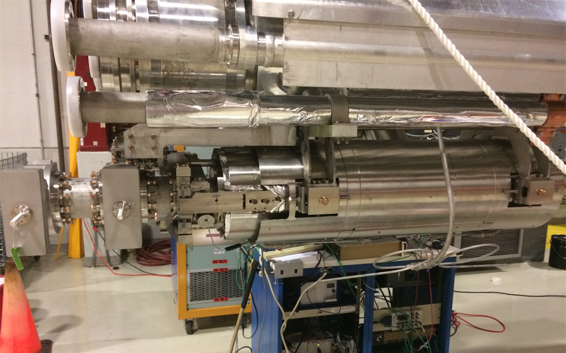
Cavity 1 Mechanical Connections - Studies
Mockup testing showed solid connection between upstream of Cavity 1 and beamline gate valve significantly increases Cavity 1 sensitivity
Two mitigation options have been designed and tested in mock-up showing promising results
Replace spool piece with short bellows and support gate valve with helium vessel
Connect gate valve to helium vessel with controllable flexure (potential retrofit for assembled modules)
AES018 Mounted on Upper Cold Mass
Integrated Response of Mockups
Frequency [Hz]

Slide 38
High JT Flow Rates
High JT flow rates (high JT inlet temperature leads to lots of flash gas) gives large flow velocities (up to 70% of the speed of sound!).
JT injection hits directly on liquid surface (changed already in CM2).
The flash gas must escape to chimney, and this will push liquid downstream.
Remember that the upstream side is higher than the downstream side.

Slide 39
Sloshing Mode in the 2-Phase Pipe
Changing the flow from JT to Bypass meant significantly reduced gas flow in the 2-Phase pipe.
When the JT is closed, the difference between Upstream and Downstream liquid level suddenly changes, rings down to a stable (hopefully level) point (40 second period).
This couples liquid level and flow rate, complicating control.

Slide 40
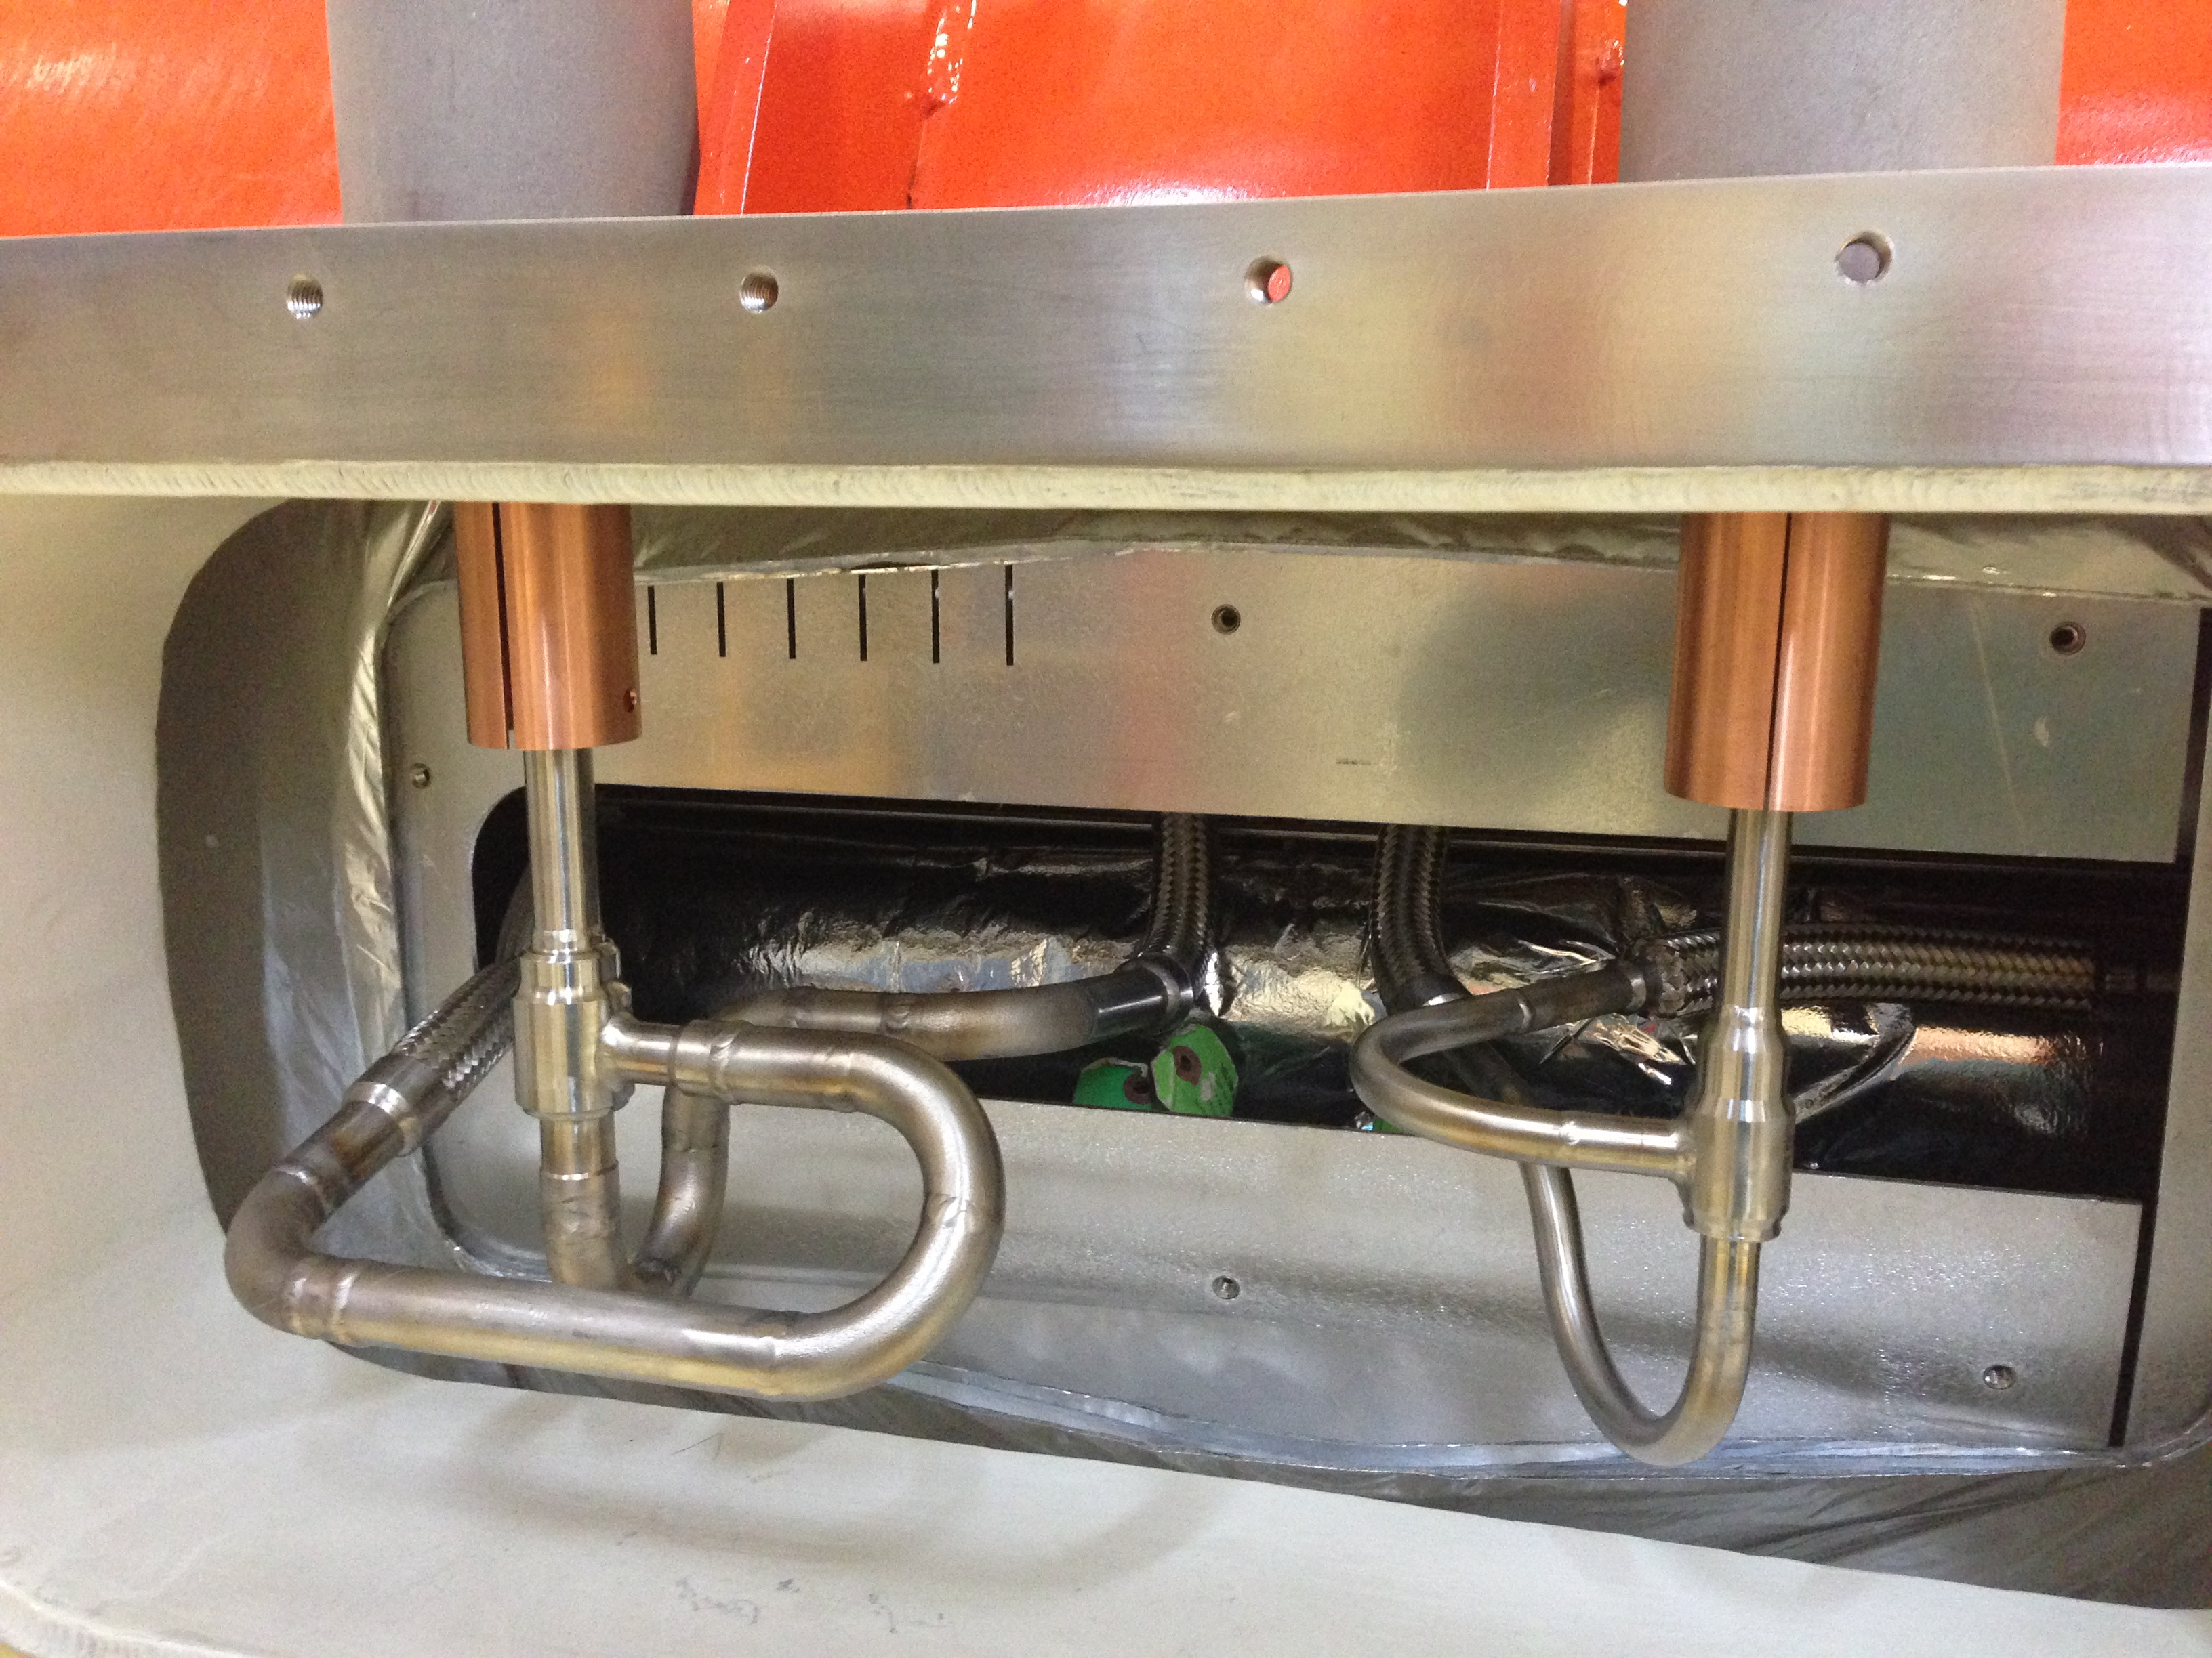
Normal Direction
Reverse Direction
From Chuck Grimm

Slide 41
Cryogenic Distribution Improvements
Needle Valve
Pressure Transducer
Volume
Slide courtesy of Ben Hansen

Slide 42
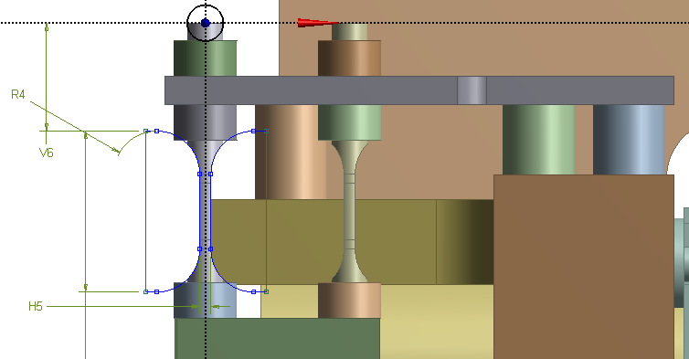
Cavity#1 Tuner performance study (F1.3-04)
Cavity #1 after cool-down to 2K landed at frequency F(2K)=1.300.149kHz
Taking into account initial (during assembly) preload ~100kHz
Cavity compressed on (149kHz+100kHz)/300KHz/mm~0.8mm.
Cavity + flex loaded each piezo-capsule on 2.8kN (blocking forces 4kN)
~7kN/mm*0.8mm=5.6kN
Measured at 2K piezo stroke for modified cavity#1 was 19.3Hz/V.
Average piezo stroke for cavities #2-#8 was 21.7Hz/V
Measured Cavity#1 Transfer Function confirmed that Flex GV support + extended tuner arms system did not introduced any low frequency (below 150Hz) mechanical resonances.
21mm
Summary
New Flex GV support + extended tuner arms system did not compromise tuner performances.
Estimated stiffness of the flex ~3kN/mm
That is in addition to 3-4kN/mm (cavity+bellow)
Tuner installed on the cavity #1 will work against
7kN/mm stiff system.

Slide 43
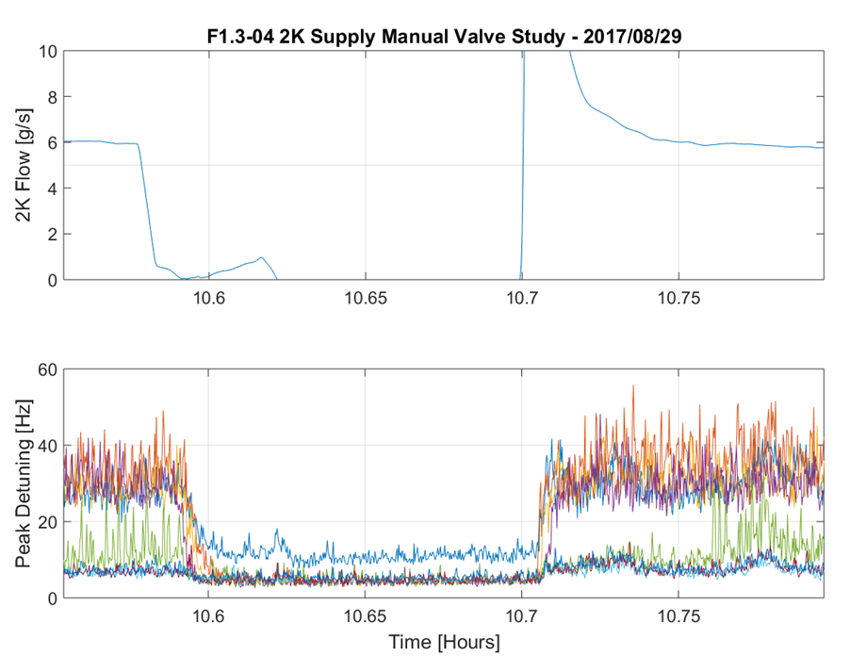
Cooldown Leakage Theory
Leakage through the cooldown valve was verified by isolation of 2K supply upstream
Gas flow through cooldown circuit caused unexpectedly narrow frequency lines which has been identified as streams of bubbles
Gas flow as a cause was determined by large harmonics of these lines and complex spatial dependence upon perturbation as gas flow shifted around module

