Slide 1
Vibration studies on TTF-like cryomodules
A summary of the work done so far
Serena Barbanotti
Second Cryomodule Microphonics and Resonance Control Workshop
New York City, 25 October 2018

Slide 2
Outlook
01 Vibration measurements at the Tesla Test Facility (now FLASH accelerator)
Ground motion measurements
Measurements on cryomodules: FLASH, CMTB
Measurements with Wire Position Monitors
02 Measurements in the XFEL tunnel
Validation of the module support system and alignment principle
03 XFEL cryomodules
Measurements at AMTF
Using piezo as vibration sensors
04 Future plans for CW XFEL Modules
Characterization of an XFEL cryomodule
Possible optimization of the module design

Slide 3
Vibration measurements at TTF-FLASH

Slide 4
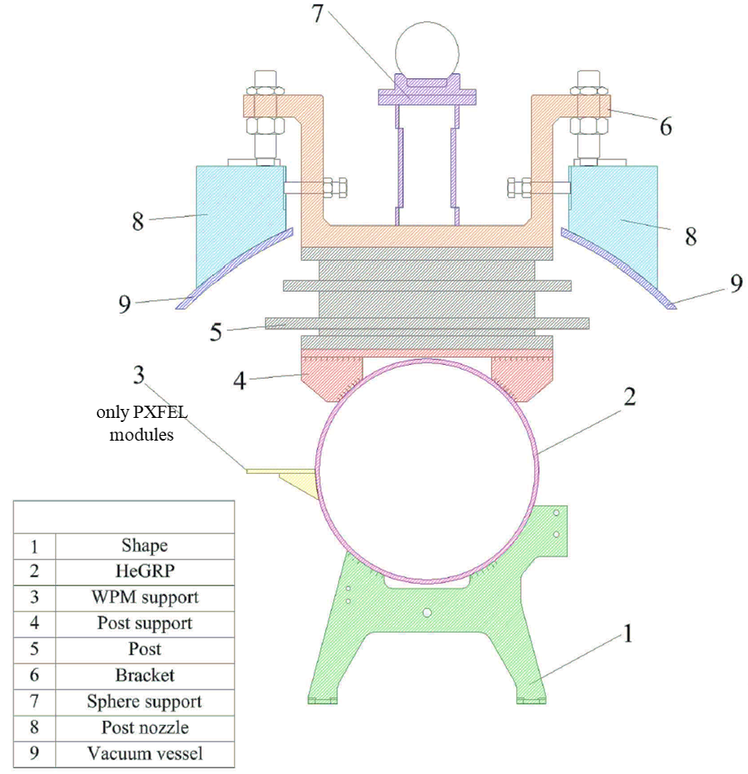
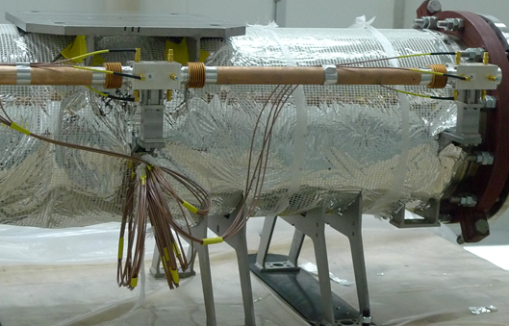
Vibration studies at FLASH and CMTB
2004-2007 – DESY vibration group and INFN Milano LASA
Tools developed to perform and compare vibration measurements
DESY: using geophones, piezo and seismometers to measure PSD / RMS
INFN-Mi-LASA: using the Wire Position Monitors as vibration sensors
Different studies performed
Ground motion at DESY and in the world
Vibration at the quadrupole at different cryogenic conditions
Vibration at the cavities
Vibration transfer functions between vessel, GRP, quadrupole

Slide 5
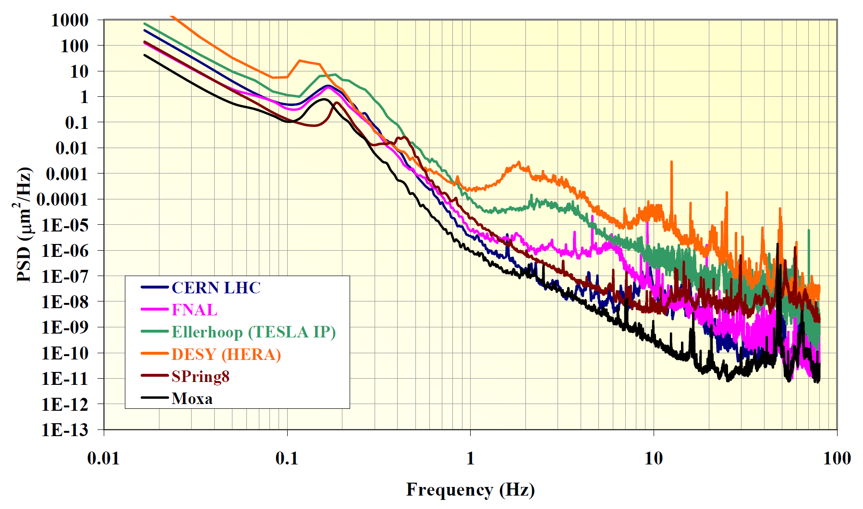
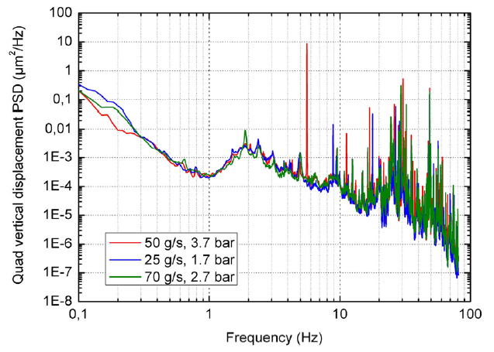
Vibration studies at FLASH and CMTB
2004-2007 – DESY vibration group and INFN Milano LASA
1
Some significant results (my personal opinion)
Ground motion studies at different DESY sites
Almost no effect of cryogenic operation conditions on vibrations at the quadrupole
Study of quadrupole stability at CMTB
Low freq. (1-30 Hz) vertical stability not affected by refrigeration system
Low freq. (1-100 Hz) vertical stability not affected by high gradient RF operation
Study of the transfer functions between vessel, GRP and quadrupole
Amplitudes of the vibrations in the hundreds of nm
Motion is transmitted almost completely from vessel to quadrupole (at low freq.)
WPM study
Comparison of vibrations at different positions along the GRP → quieter at the middle?
1
2
2

Slide 6
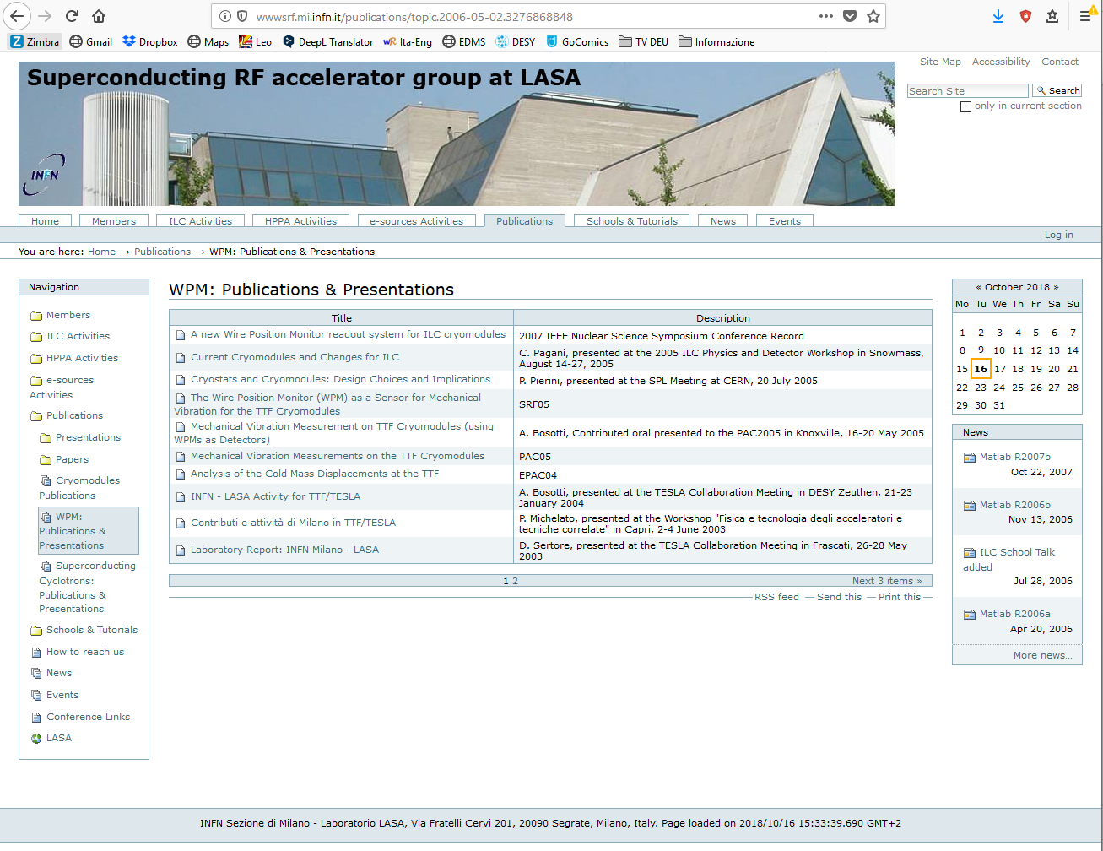
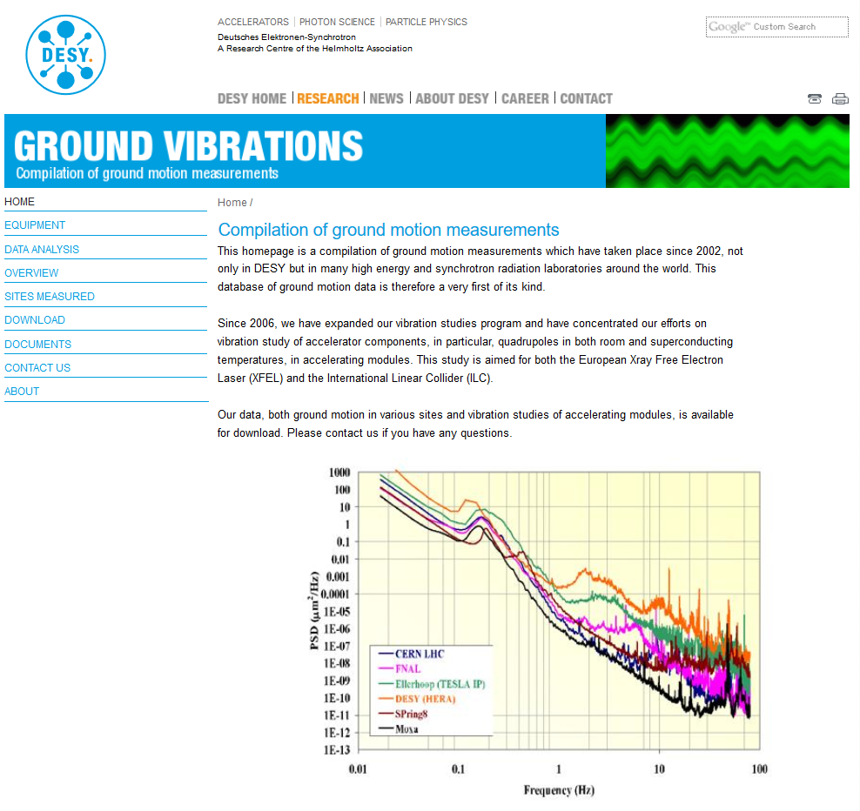
Further information
https://vibration.desy.de/
http://wwwsrf.mi.infn.it/publications/topic.2006-05-02.3276868848

Slide 7
Vibration measurements in the XFEL tunnel

Slide 8
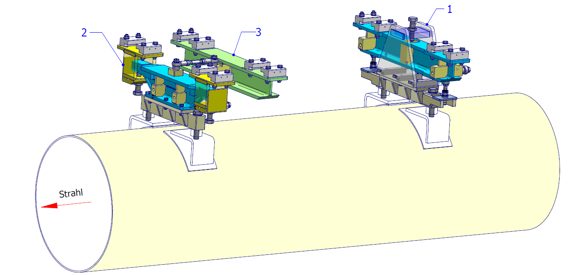
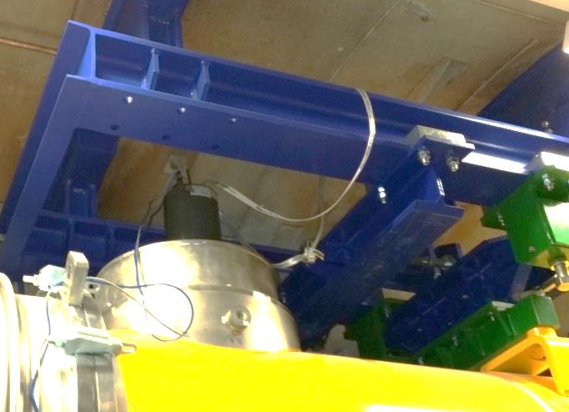
Measurements in the XFEL tunnel
2015 - DESY MEA Group (further information: N. Meyners)
Case study
XFEL cryomodules hang from the ceiling
Position is adjusted with bolts -> influence of the bolt length on the cryomodule vibration spectrum?
Measurement campaign
Measurement performed on a single hanging cryomodule with seismometers (Guralp CMG-6TD, bandwidth 30s – 100 Hz) on the tunnel ground and on the post cover
Vertical position of the support bolts changed and measurement repeated
Beam

Slide 9
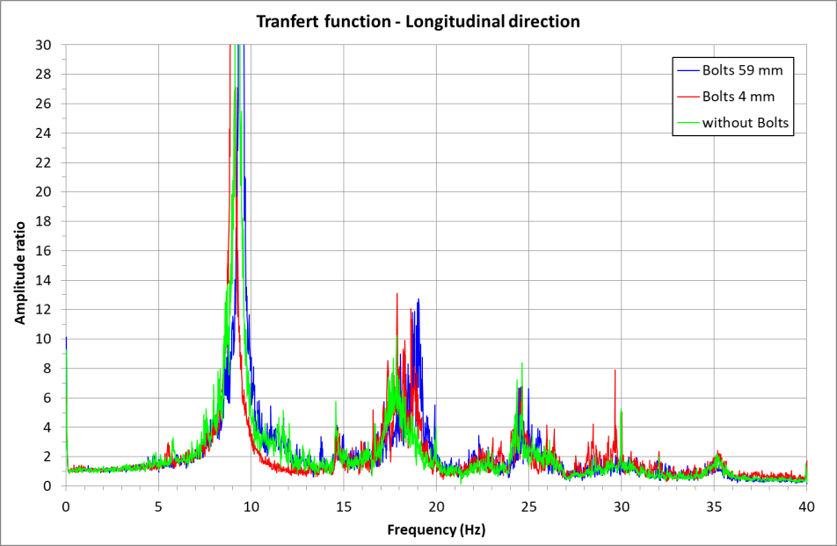
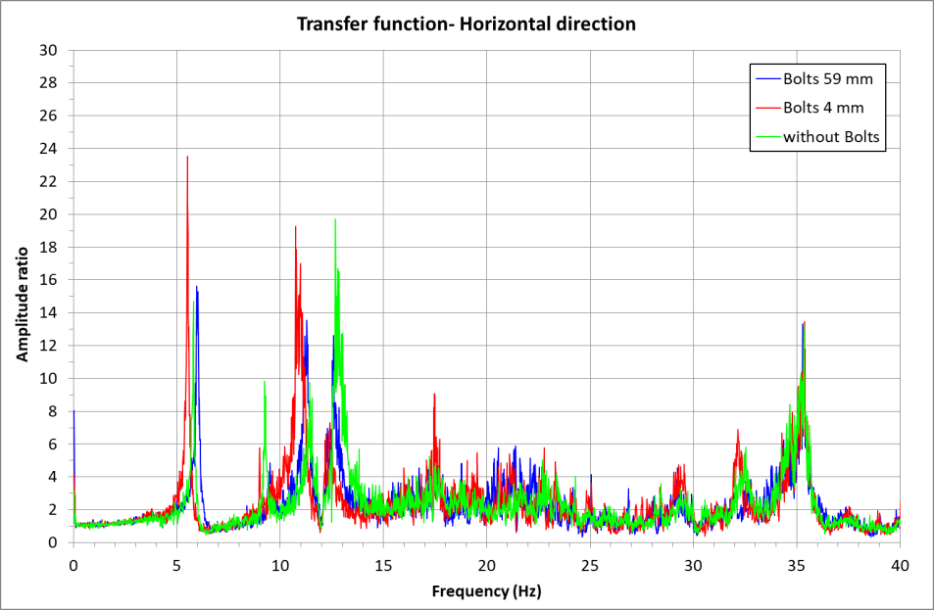
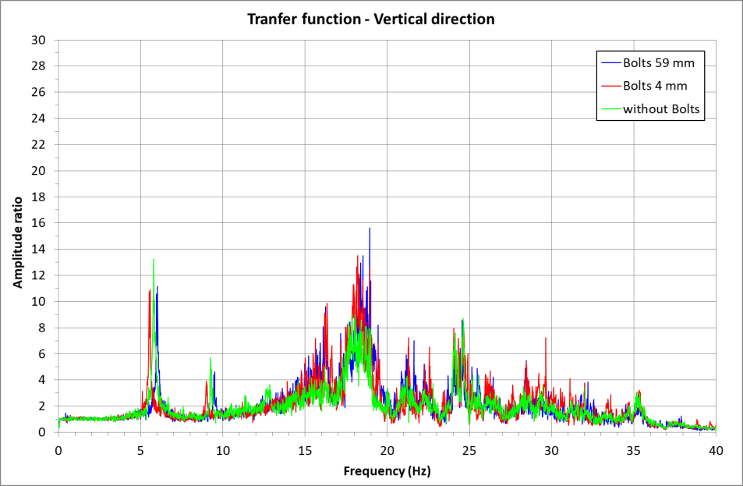
Measurements in the XFEL tunnel
2015 - DESY MEA Group (further information: N. Meyners)
Results
No real changes at different bolt positions → validation of the support system
Measurement of the vibration spectrum → can be used as comparison for further studies

Slide 10
Vibration measurements on XFEL cryomodules

Slide 11
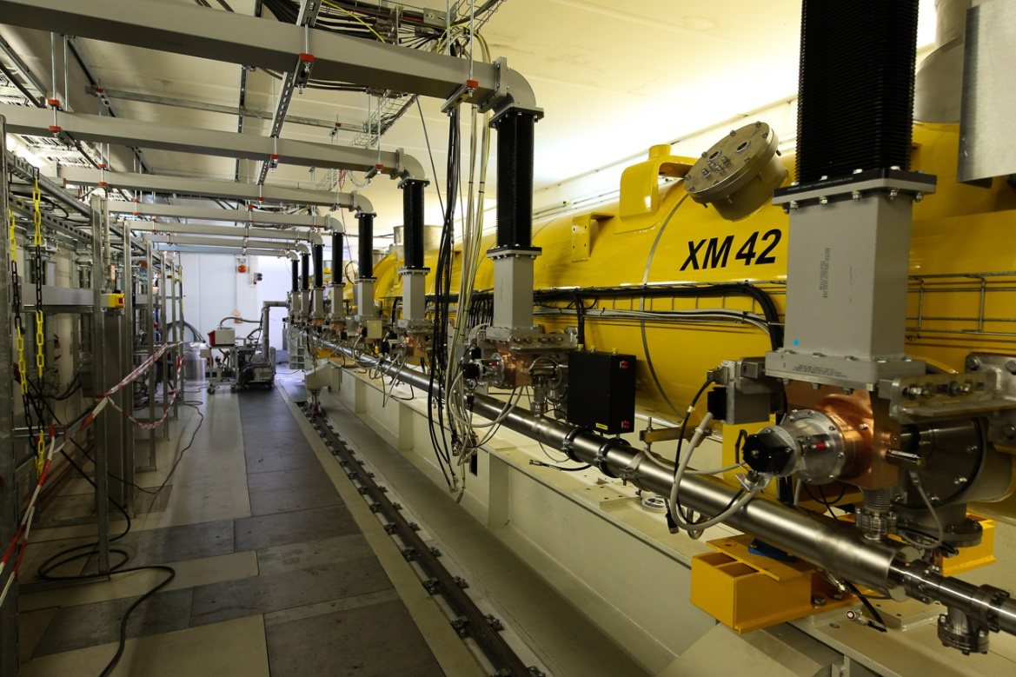
Vibration measurements on cryomodules in the AMTF hall
2014 - Internship M. Ajerrar, MSK Group (further information: J. Branlard)
Test plan
Cryomodules installed on the horizontal test stand XATB3
Measurement with geophones at one position on the vessel, longitudinal and vertical direction
Parallel measurement with the piezo sensors
Measurement with and without RF
Cold measurements
Equipment used: Endevco 7703A-1000 DeltaShear Uni-Gain Type 4379

Slide 12
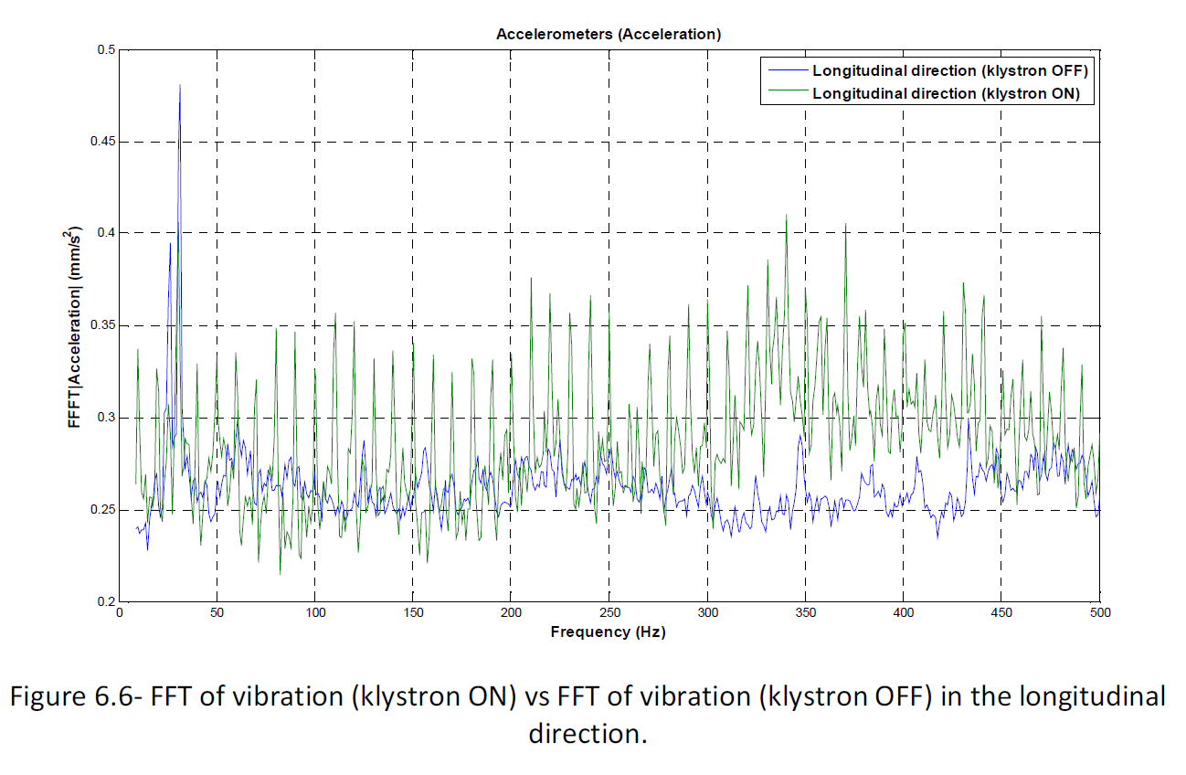
Vibration measurements on cryomodules in the AMTF hall
2014 - Internship M. Ajerrar, MSK Group (further information: J. Branlard)
Results and conclusions
Measurements on the cryomodule XM5 in the test stand 3 showed:
Higher sensitivity to vibration in the longitudinal direction (maybe depending on the test stand set up)
Main vibration contribution comes from 10 Hz RF repetition rate (Klystron farther away than in the tunnel).
Observed frequencies at 10.5 Hz and 15 Hz, might come from modes of the vacuum vessel on its support system.
Measurements on XM8 confirm the vacuum pumps as source of vibration around 50 Hz.
Some measurements on the cavities (piezo), but difficult to compare
Fluctuations at the cooling system of the klystron (modulator + klystron) might also affect the module
→ Further studies recommended

Slide 13
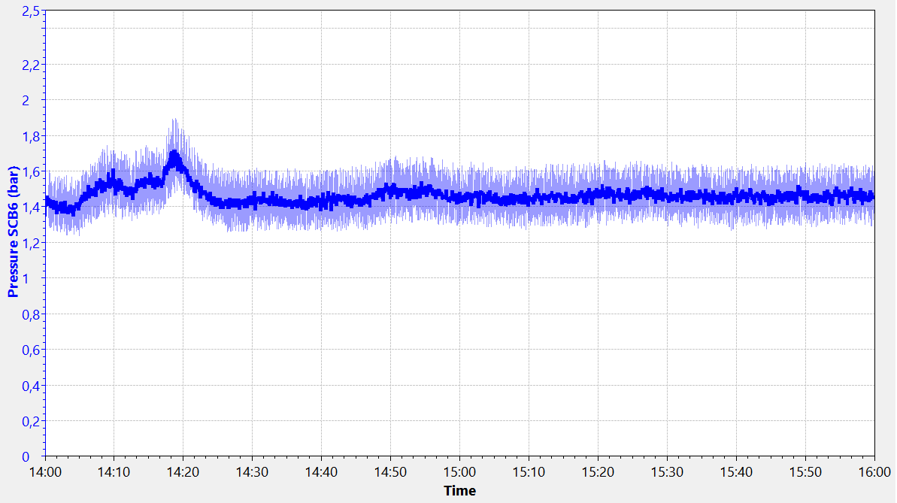
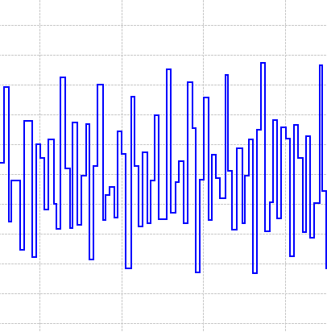
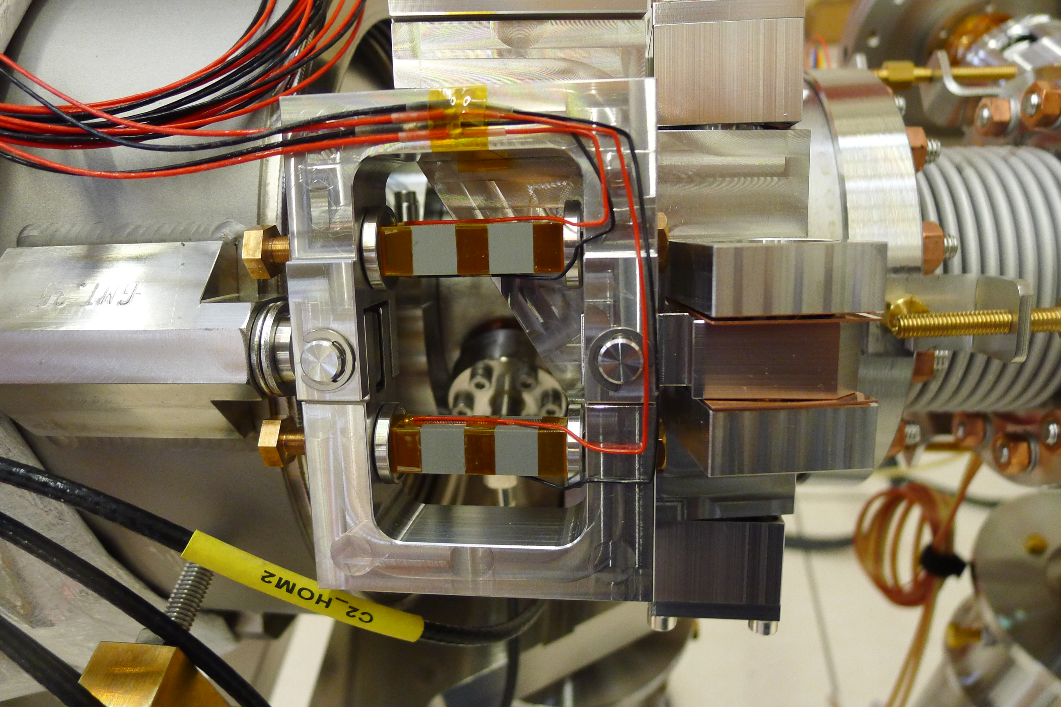
Using piezo to measure vibrations on XFEL modules
The cryogenic look into microphonics
Pressure fluctuation in the SCB6 2.2 K F pipe
Why did we come to this idea?
In 2017 we noticed pressure fluctuations in the 2.2 K forward pipe at the XFEL tunnel
Frequency ~ 0.2 Hz
The pressure sensors are at the feed / end / string connection boxes
only 12 positions along the tunnel
not representative of the cavity status
The pressure values are not constantly recorded with high resolution -> FFT data difficult to obtain
To better understand the situation and look closer to the cavities, we decided to try to use the piezo sensors at the cavities to look for this vibration

Slide 14
Using piezo to measure vibrations on XFEL modules
The cryogenic look into microphonics
How do we use the piezo?
Measure the piezo voltage with a frequency of 10 Hz
Data analysis in Matlab: FFT and, to be refined, PSD
3 RF stations investigated without RF (12 modules, 96 cavities)
Results: ~0.2 Hz frequency well visible at almost all cavities
Measurement repeated at different cryogenic status

Slide 15
Using piezo to measure vibrations on XFEL modules
Comparing different cryogenic systems
Left: Cold Compressors Right: Warm Compressors
Direct pumping at the 2K level • Pumping of the warm gas
In the same building • In the AMTF building

Slide 16
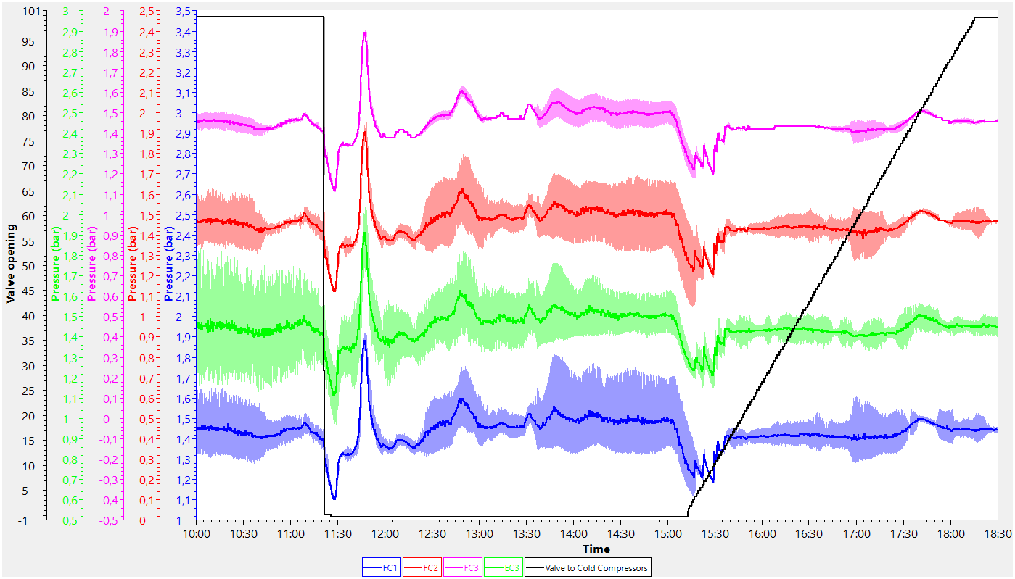
Using piezo to measure vibrations on XFEL modules
Comparing different cryogenic systems
Actually, it is much more complicated…
XFEL on Cold
Comp
XFEL on Warm Comp
Transition btw Warm and Cold Cs

Slide 17
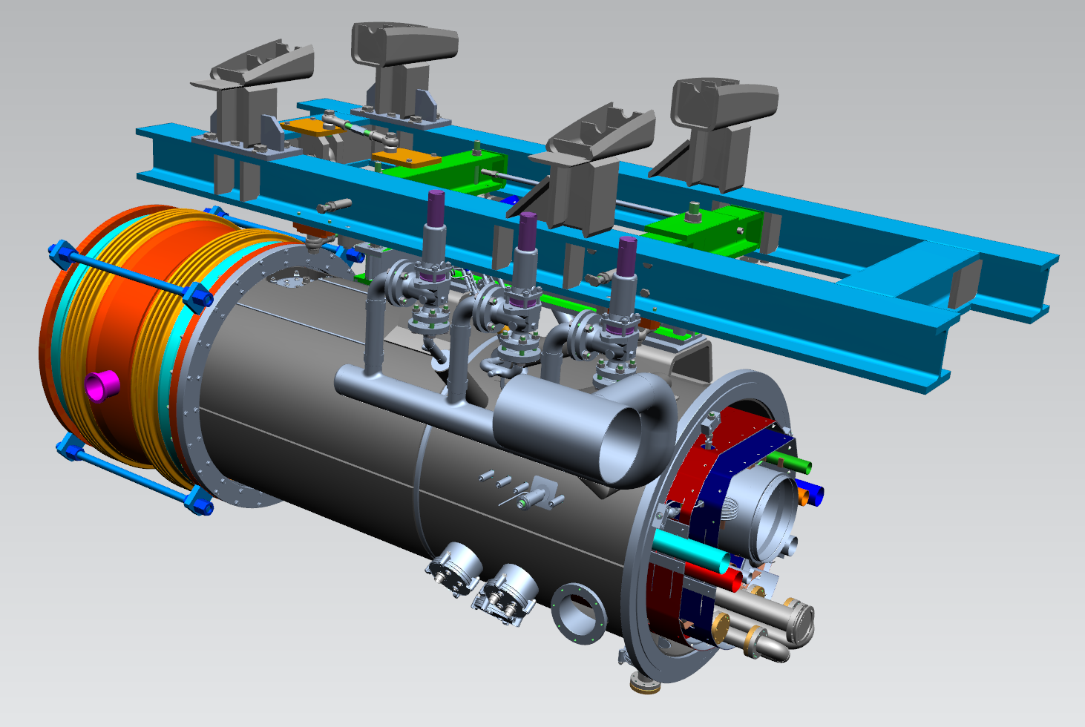
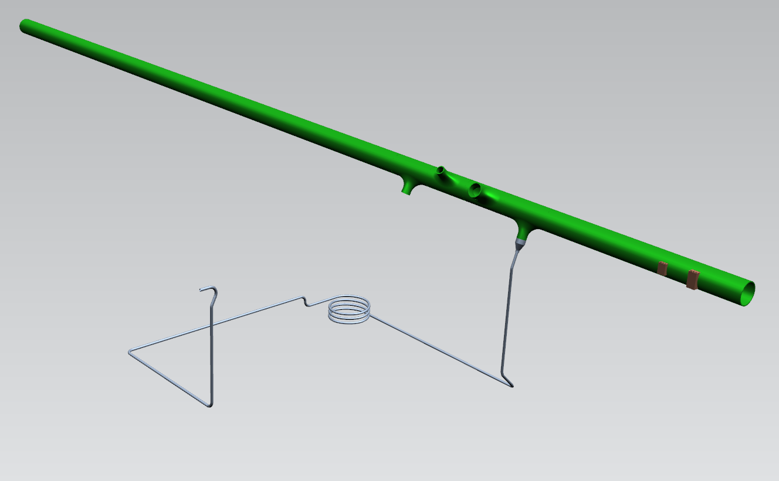
Using piezo to measure vibrations on XFEL modules
The cryogenic look into microphonics
Where are we now
We have a probable interpretation:
Travelling wave propagating along the 2.2 K He pipe with sound velocity
difficult to demonstrate
still missing the source
We have an idea for the mitigation:
Add ~20m long capillaries at the pressure sensor locations to damp the oscillations in the pipe
But… are we damping the oscillations in the whole pipe or only at the measuring point?
Pressure measuring point
20 m capillar

Slide 18
Using piezo to measure vibrations on XFEL modules
The cryogenic look into microphonics
Next steps
Further extend the capillaries at the SCB and monitor in parallel with the nearby piezo
Expand the use of piezo to all the XFEL RF stations as soon as the piezo drivers are available
More systematic work: compare different module positions in a string or cavity positions in a module
Compare different locations along the linac -> is there a way to recognize a travelling wave?
Additional options
Compare different cryogenic systems → CMTB - FLASH cryoplant, AMTF - XFEL cryoplant
Compare different working conditions → AMTF - single module test stand, warm compressors XFEL - whole linac, cold compressors

Slide 19
Plans for the XFEL CW cryomodules

Slide 20
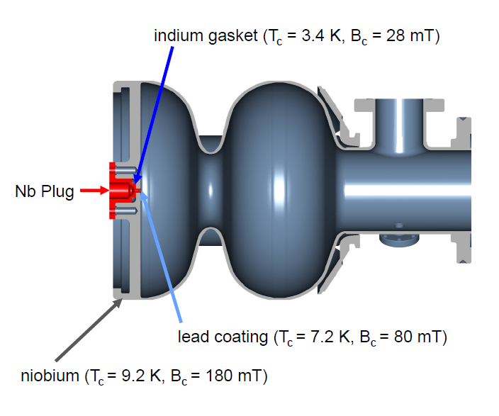
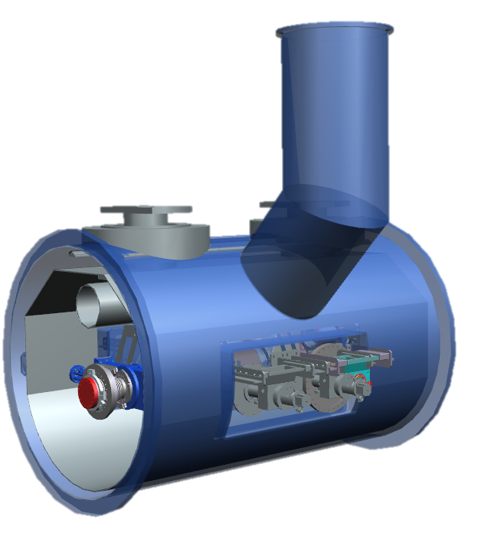
Plans for the XFEL CW upgrade
CW R&D program at DESY for the XFEL CW upgrade
CW-SRF Gun being developed at DESY
new cryomodule design needed
reduction of microphonics as parameter during the design phase
test cryomodule → can be used for optimization
Design of CW 1.3 GHz cryomodules
Need of design changes at the cavity tank level (at least)
Possibility of design modifications on the whole cryomodule
Implement lessons learnt at LCLSII
Implement lessons learnt from vibration studies
Replace with CW components

Slide 21
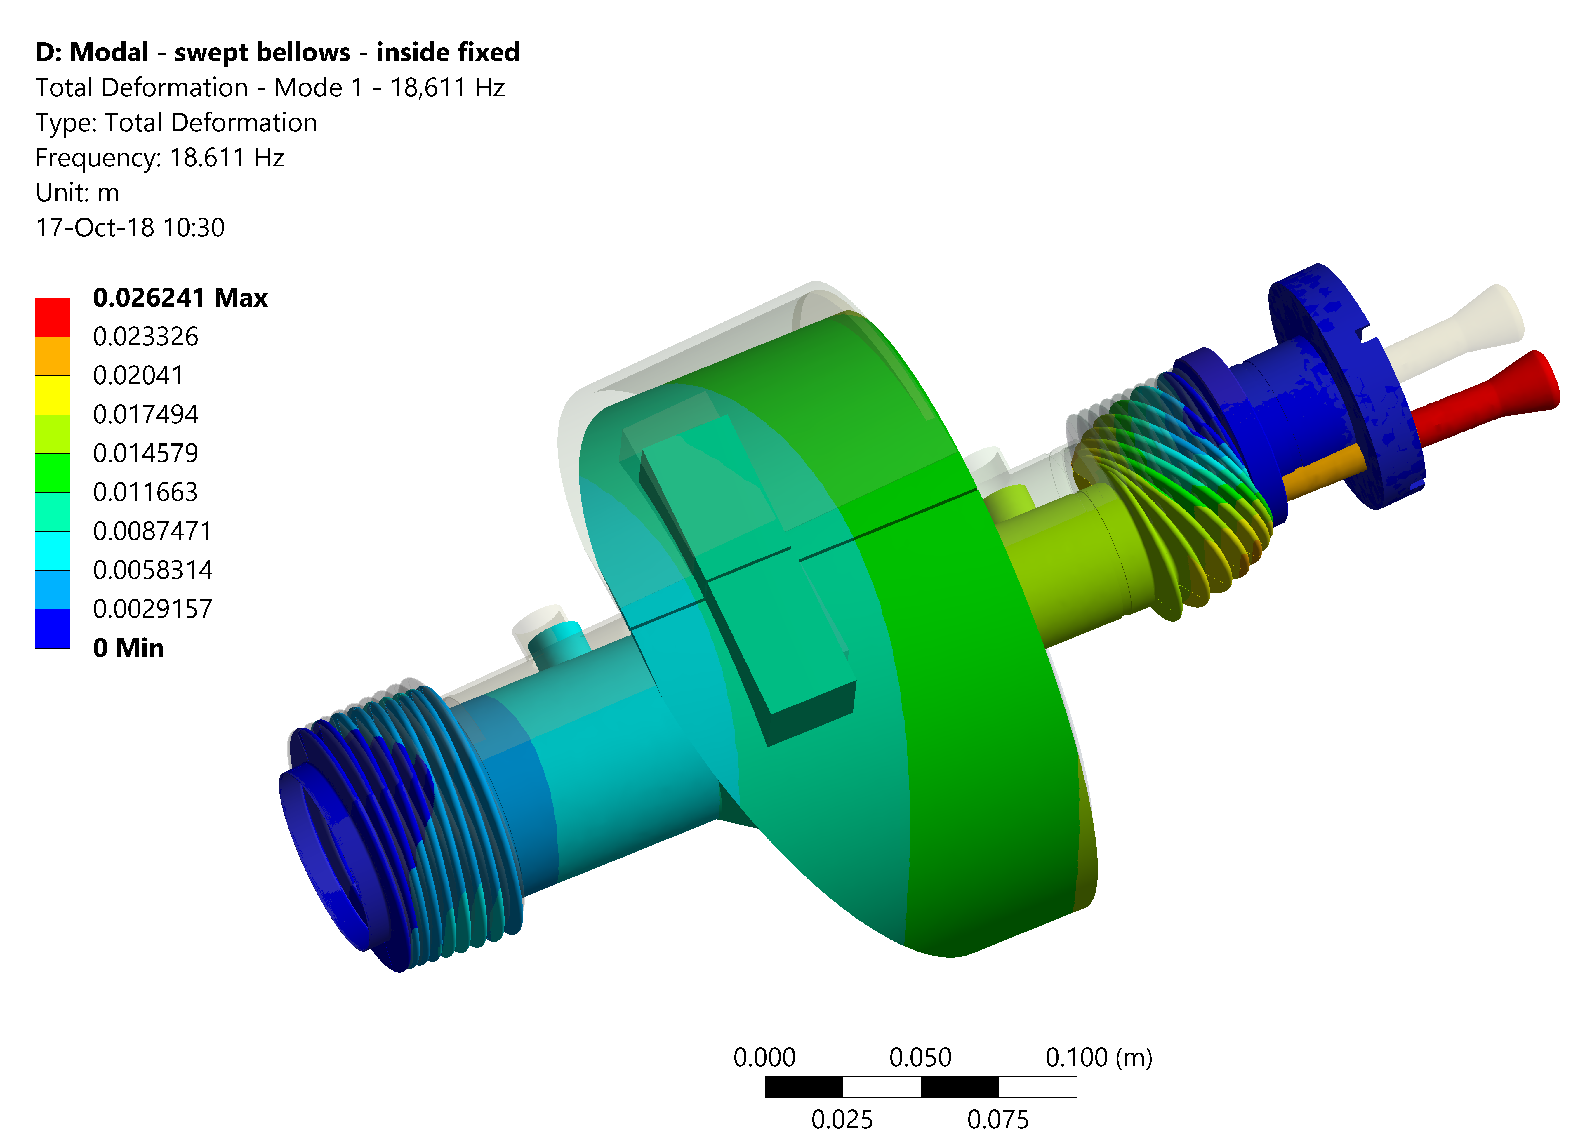
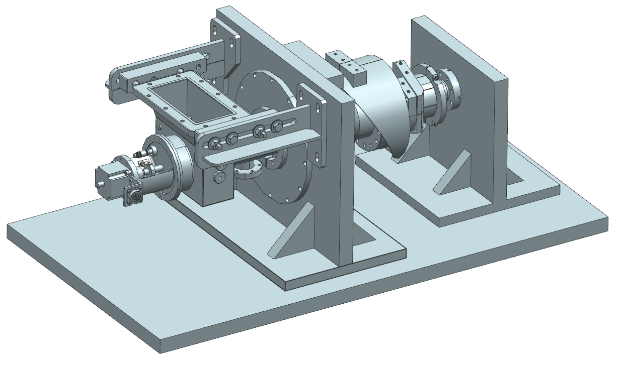
Plans for the XFEL CW upgrade
In the near future
Fully characterize a 1.3 GHz XFEL cryomodule
AMTF test stand available -> warm and cold, with and without RF
Module available
Sensors available (piezo and geophones), acquisition system and data analysis need to be improved
Compare results with calculations / simulations / …
Look for possible design optimization
Detailed analysis of subcomponents (couplers →)

Slide 22
Conclusions

Slide 23
What did I learnt so far
Lot of work done at DESY on vibration measurements
At different facilities
From different groups
With different scopes
What’s missing
A comprehensive look on the microphonics issue at the cryomodule level
Separate contributions from the cryomodule itself or the environment
Design optimization
Coordination between RF / control requirements and mechanical aspects

Slide 24
Thank you

Slide 25
Serena Barbanotti
MKS Group
serena.barbanotti@desy.de
+49 40 8998 5628

