Slide 1
MICROPHONICS STUDY of Ariel ACM1 two cavities Cryomodule
Yanyun Ma
TRIUMF

Slide 2
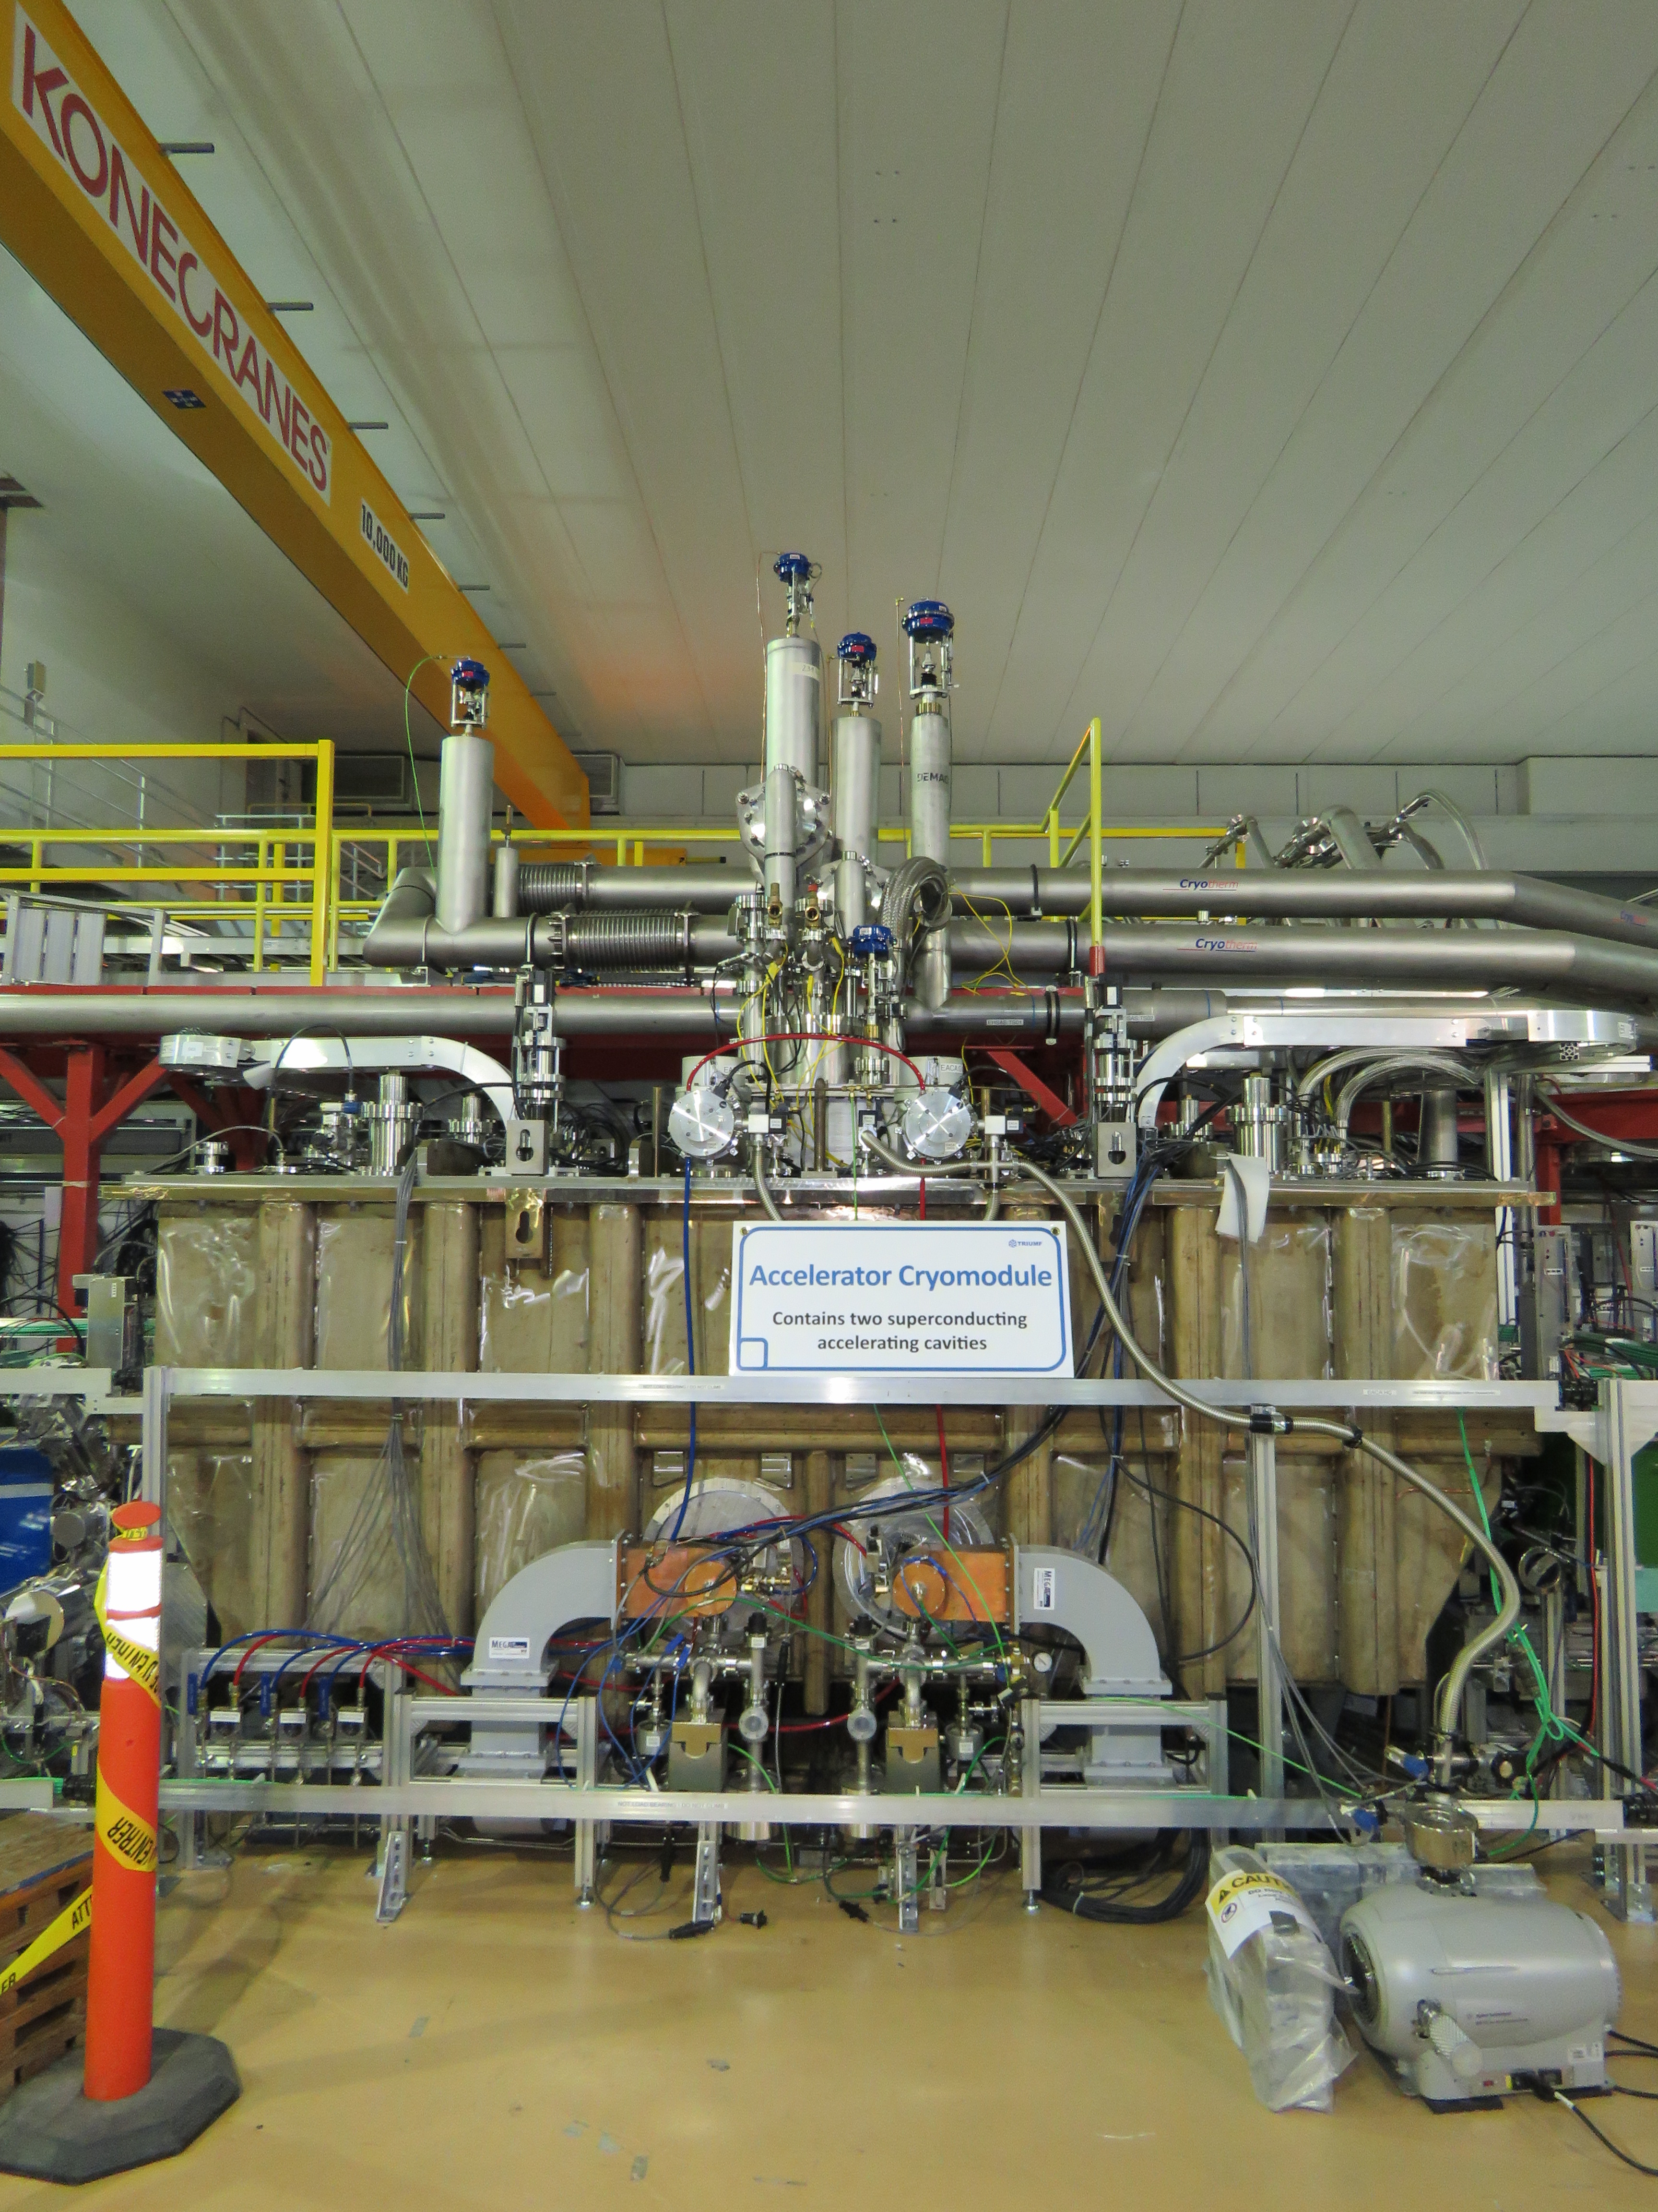
Outline
Overview of ACM1
Pondermotive effect and RF noise
LN system disturbance
Microphonics source searching
Water system investigation
Discussion

Slide 3
1.Overview of ACM1

Slide 4
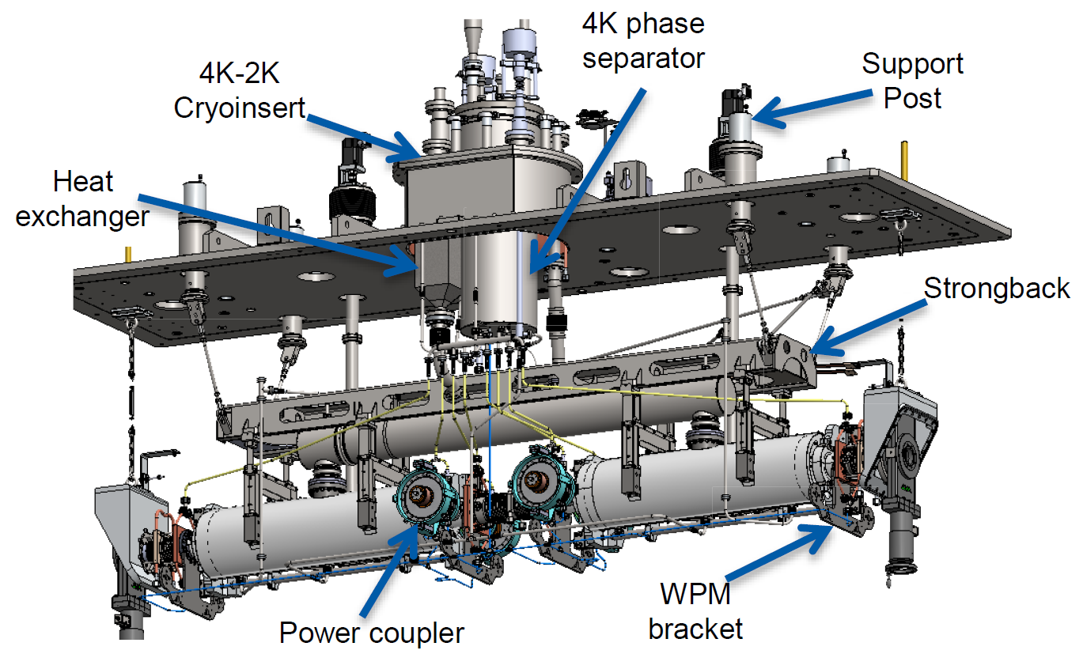
ACM1 assemble
2K Return
4K Supply
4K Cooldown
4K Return
77K Supply
77K Exhaust
4K intercepts syphon circuits
JT Valve
Cooldown Valve
An unique box cryomodule with a top-loading cold mass
Scissor tuner with warm motor
Two layers of mu metal – warm and cold
WPM based alignment
Stainless steel ribbed tank with hatches for access
4K intercepts cooled by siphon circuit from 4K reservoir；Cooldown circuit for initial cooling；LN2 cooled thermal shield
4K/2K heat exchanger unit with JT valve on board
Notes:
– expand LHe from 1.2bar to 30mbar

Slide 5
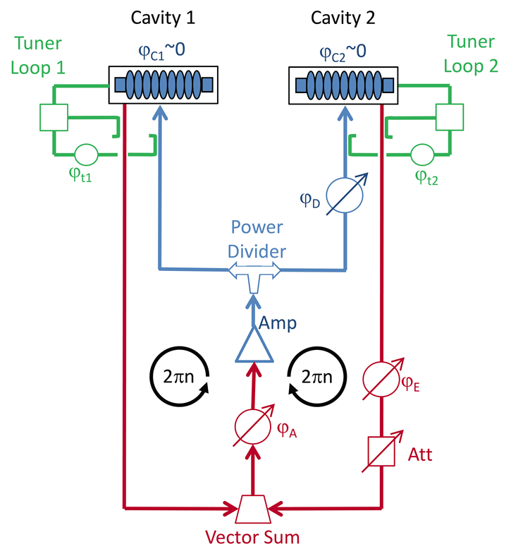
ACM1 RF system overview
• ACM1
Two cavities
Two tuners
One source
• vector-sum control of the two cavity SEL PLL
Each cavity is tuned separately with SEL then combined in a single loop
The loop phases for both cavities will be kept to a multiple of 2
Two ACM1 cavities are driven by a single klystron with vector-sum control of the two cavity SEL PLL.
Yanyun Ma et al., “First RF test results of two-cavities accelerating cryomodule for ARIEL e-LINAC at TRIUMF”, in Proc. IPAC’18, Vancouver, BC, Canada, paper THPMK090, pp. 4512-4515.
Ken Fong et al., “TUNERS ALIGNMENT ON TWO 9-CELL CAVITIES WITH SINGLE AMPLIFIER UNDER SELF-EXCITED LOOP” in Proc. IPAC’18, Vancouver, BC, Canada, paper THPMK096, pp.4527-4529
Notes:
E-gun,buncher and deflector power sources are solid state amplifiers
For Phase I we specify two 290 kW CW CPI VKL7967A klystrons with 65 kV, 10 A DC AMPEGON power supply (KPS)
•In the future, for Phase II one of these klystrons will drive next cryomodule
•We are looking for a cost effective 1.3GHz power source at ~150kW for the ICM

Slide 6
Pondermotive effect and RF noise

Slide 7
Pondermotive effect
No gradient regulation for each cavity
Individual tuner loops are established with respect to the established reference phase
Microphonics excite mechanical resonances in one cavity, coupling to the other cavity via vector-sum regulation.
The modulations of the RF field between the two cavities can drive a ponderomotive instability through Lorentz force detuning.
The threshold for excitation of this instability is impacted both by ambient microphonic noise and the precise settings of the two cavity phase loops.
The coupled oscillation deteriorates the e-Linac final energy stability.
Oscillation in counterphase under vector-sum regulations. Yellow: 1st cavity pickup signal; Green : 2nd cavity pickup signal.

Slide 8
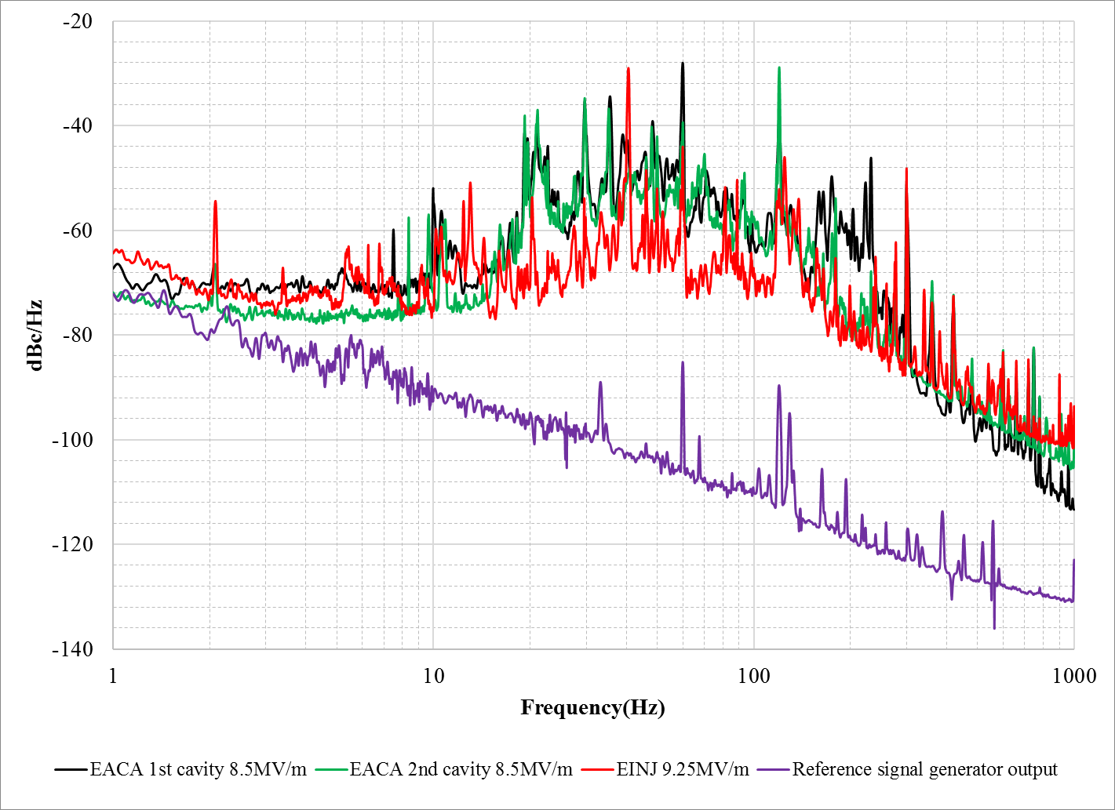
Phase noise spectrum of each cavity
f(Hz) | BW(Hz) | Q
59.97 | 0.62 | 96.73
119.96 | 1.8 | 66.64
35.56 | 0.62 | 57.36
48.30 | 0.8 | 60.37
29.65 | 0.35 | 84.72
232.17 | 2.02 | 114.93
39.02 | 0.98 | 39.82
175.13 | 3.05 | 57.42
223.27 | 2.88 | 77.52
299.90 | 1.41 | 212.7
19.24 | 0.21 | 91.65
21.01 | 0.4 | 52.53
159.65 | 2.78 | 57.42
19.64 | 0.23 | 85.40
9.98 | 0.05 | 199.73
f(Hz) | BW(Hz) | Q
120.04 | 0.89 | 135.35
35.27 | 0.38 | 93.68
60.02 | 0.30 | 199.86
29.66 | 0.60 | 49.43
47.99 | 0.30 | 159.99
49.90 | 0.30 | 166.32
19.26 | 0.19 | 100.647
21.13 | 0.32 | 66.03
300.10 | 0.60 | 498.33
19.70 | 0.10 | 197.05
180.06 | 0.97 | 185.78
22.73 | 0.10 | 227.34
175.61 | 2.40 | 73.17
360.11 | 2.85 | 126.57
164.72 | 1.2 | 137.27
Spurious List
ACM1 was under single cavity mode with low proportion gain
Equipment used: R&S®FSWP26
Noise hump (10~ 400Hz) in each pickup signal indicates the noise sources are universal for 2 cryomodules and all three cavities

Slide 9
The noise become stronger with higher gradient

Slide 10
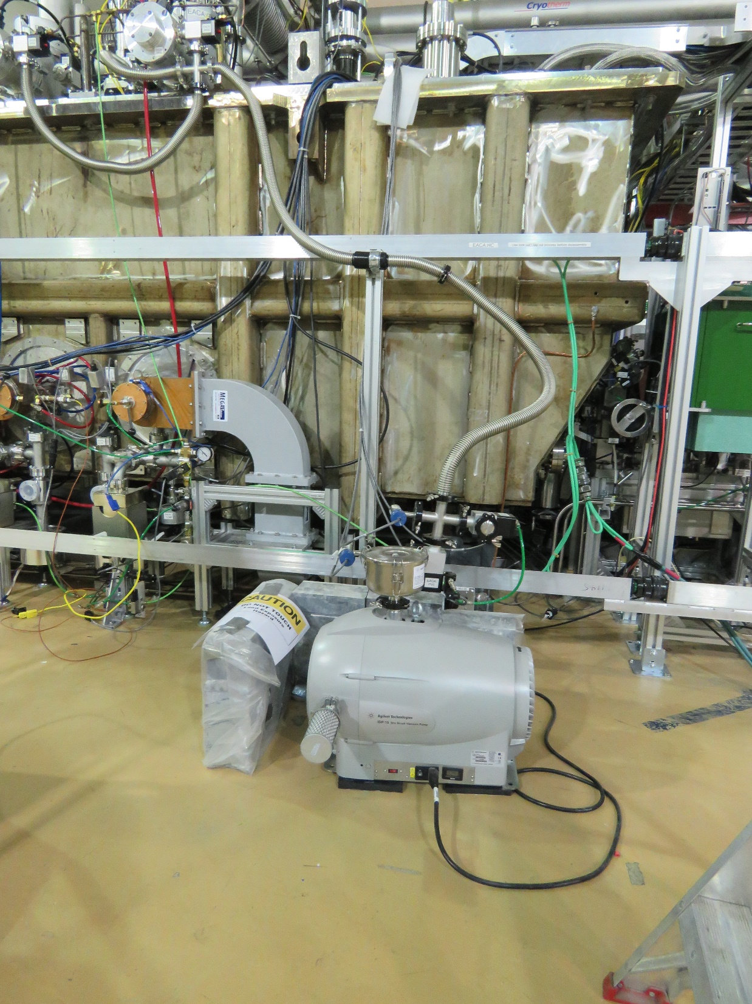
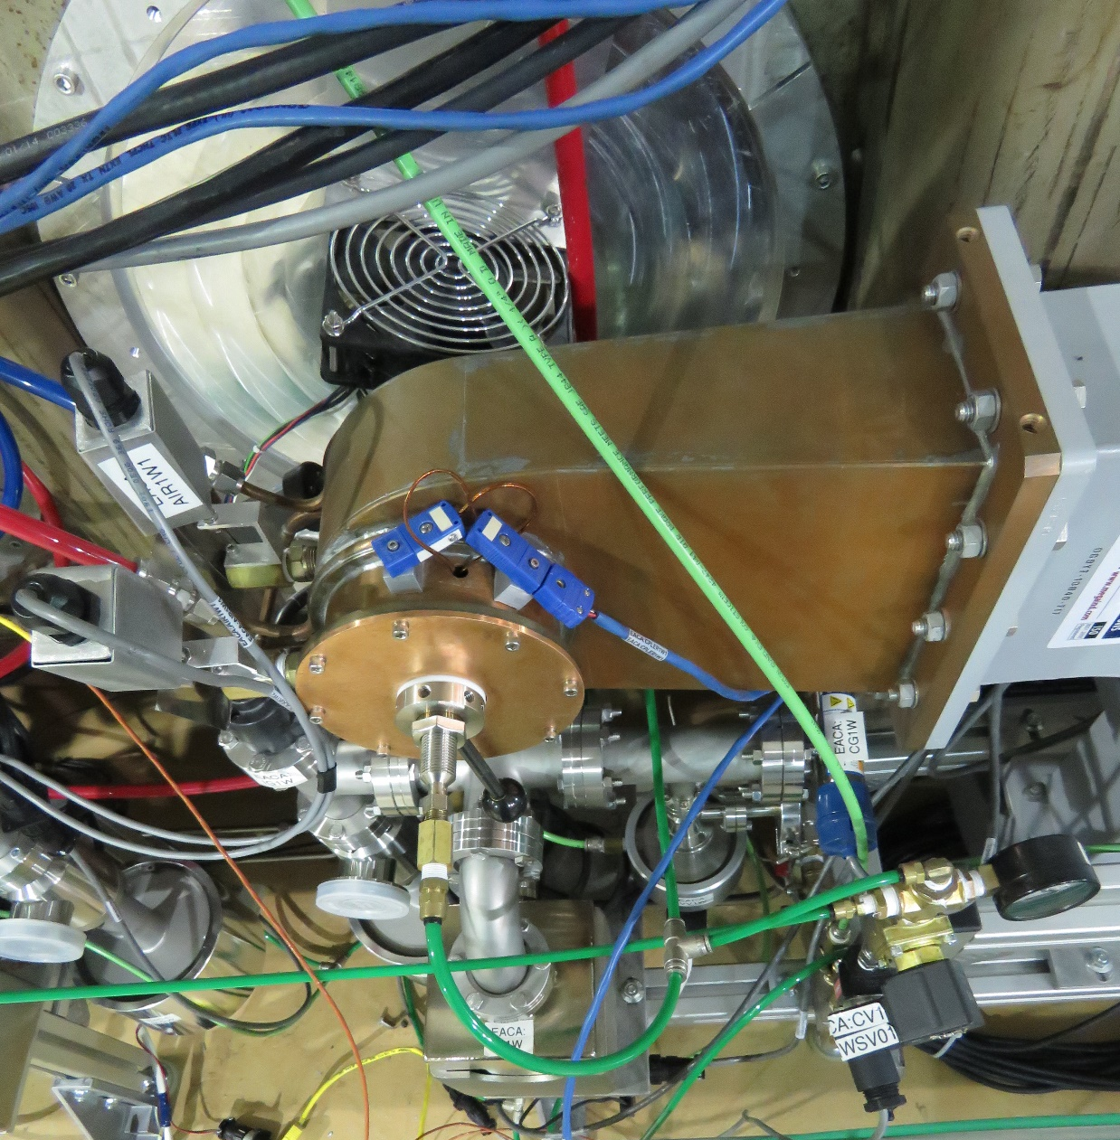
Vibration damping during beam test
Fixing roughing bellows and turn off cooling fans
most noise peaks are reduced especially the 120Hz peak
Reduced the cooling air flow
only 3 noise peaks higher than -60dB
Temporary damping of the waveguide and adding damping pad under roughing pump
the 232Hz noise peak reduced about -10dB
Measured at same setpoint

Slide 11
LN system disturbance

Slide 12
E-linac LN system
The supply valve is controlled by exhaust temperature and not regulated well. When valve closed the line between supply valve and CM will be warmed up.
The LN level is not regulated.
During refilling, there is lot of gas.

Slide 13
Disturbance caused by LN system
The RF power fluctuation with LN₂ supply valve.
Initial regulated temperature was 130K
Reverse power showed 2 kW fluctuation
Changed Regulated temperature to 120 K
the RF power fluctuation has been reduced

Slide 14
LN system disturbance during beam test
Beam energy had disturbance which correlated with LN valve status.
1mm beam fluctuating ~0.12% of energy fluctuating

Slide 15
Change LN supply valve to constant opening mode. The overall beam energy stability is about ±0.1% with 22 MeV ( 14MV energy gain from ACM1) final energy.
The LN refilling process still affects beam energy and RF power.

Slide 16
LN2 system improvement proposal
Phase Separator:
Phase separator is filled by a solenoid valve that opens when the level reaches 30% and closes at 80%.
To change the solenoid valve to a flow proportional valve and regulate the level
ACM1 LN2 Supply Valve:
The supply valve only opens a very small amount
Small band of operations makes it difficult to regulate the temperature.
Modify this valve
Give a larger band of operation and precise control.
Test and compare different regulating PVs
The couplers temperature PVs

Slide 17
4. Microphonics source searching

Slide 18
Turned on each noise source step by step
Background----all pumps off
turn on vacuum roughing pump
Turbo pumps on
B3 level pumps recovered
Provide waveguide parts cooling and Turbo pump cooling
Both Klystron pumps on
Couplers air cooling on
Equipment used:
Accelerometer Dytran 3100D24T
Agilent 35670A
Sensors position
Notes:
the waveguide temper damper is onsite

Slide 19
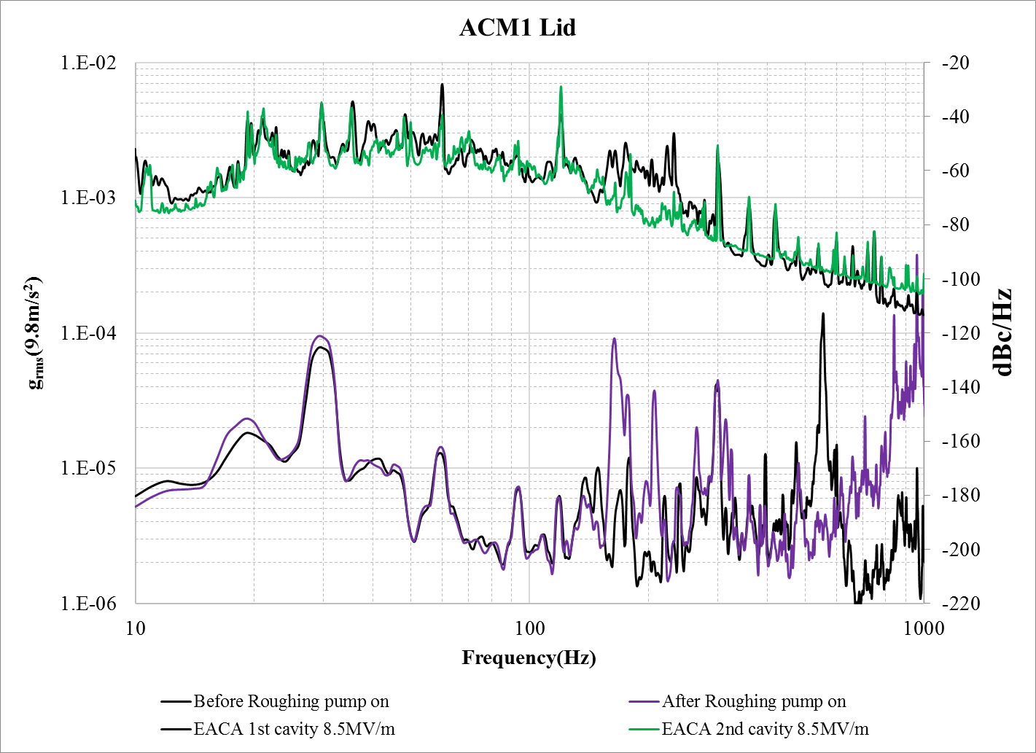
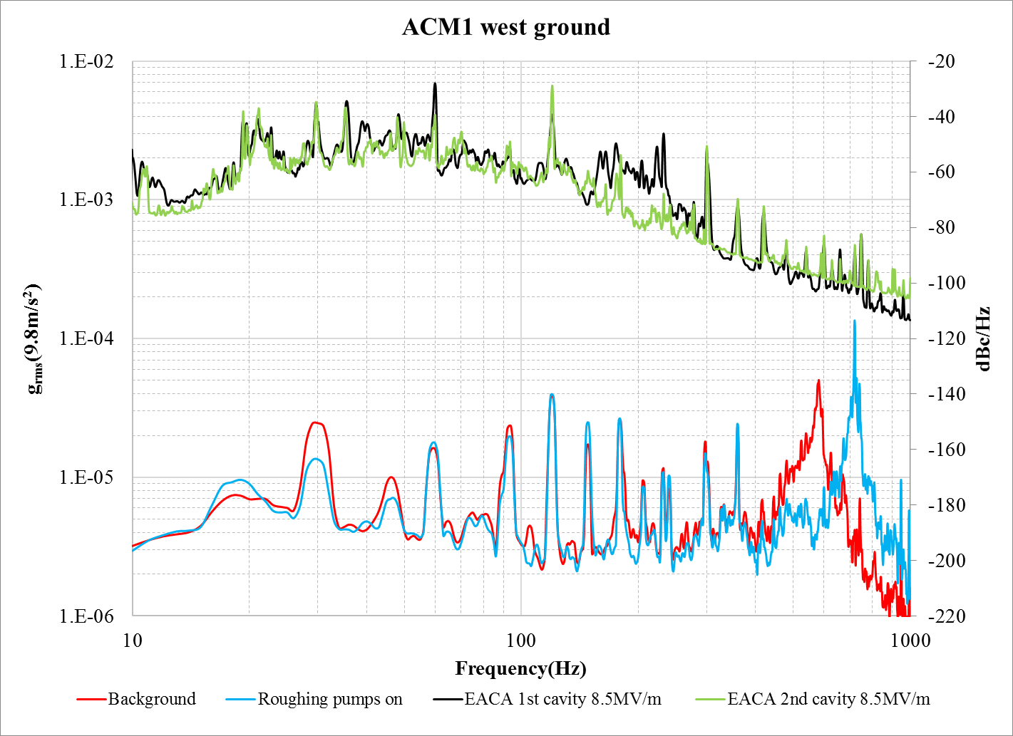
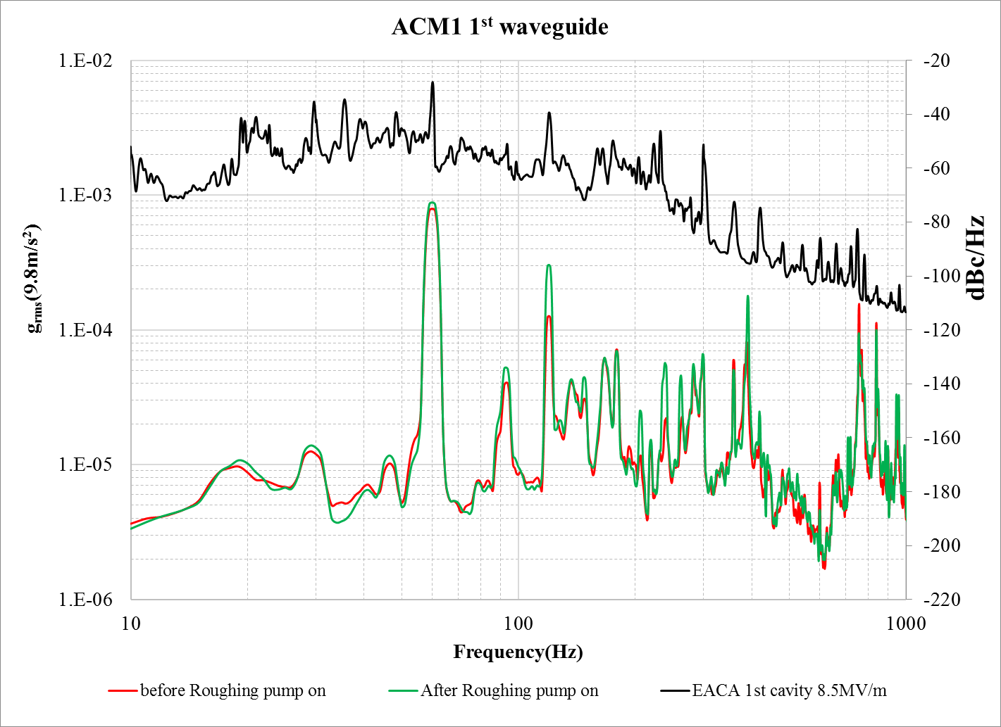
Roughing pump
160~232Hz
During beam test
The roughing pumping bellow has been fixed;
The damping pad has been insert under roughing pump;
The lid results show the pumping bellow need more damping;
Notes:
For the ground the peaks almost no change---the pump itself damping well

Slide 20
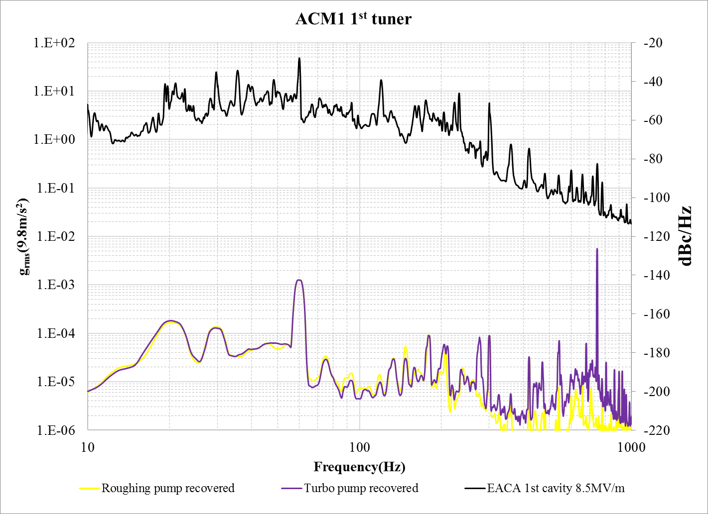
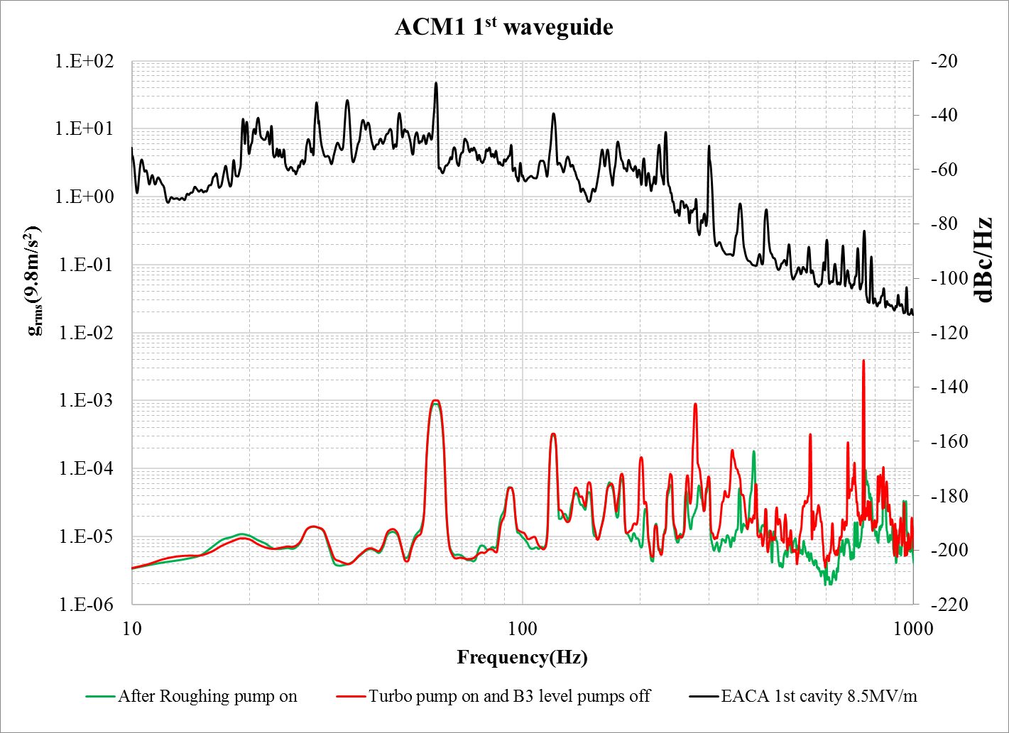
Turbo pump on
160~232Hz
279Hz
747Hz
Two turbo pumps are mounted on the top of cryomodule;
The turbo pumps contributes noise on lid at higher than 160Hz range;

Slide 21
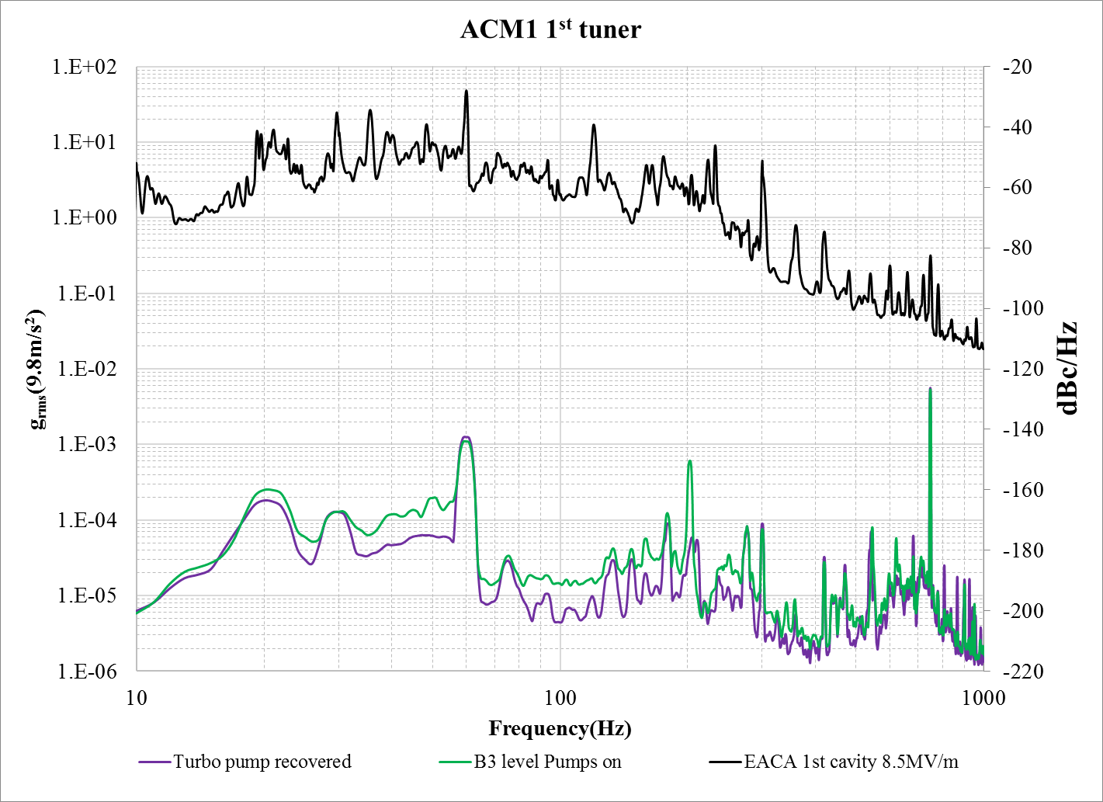
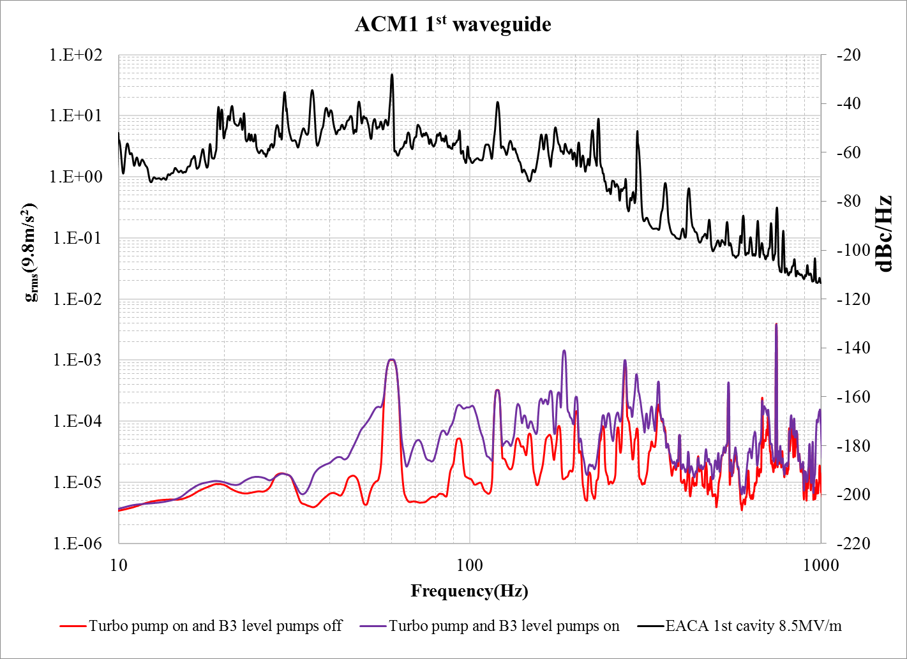
“B3 level” pump on
160~232Hz
The “B3 level” pumps provide waveguide parts cooling(including 50ohm loads, waveguide, power divide and couplers) and turbo pump cooling;
It generates vibration through turbulence
It increases the noise at lower than 300Hz, especially lower than 180Hz;

Slide 22
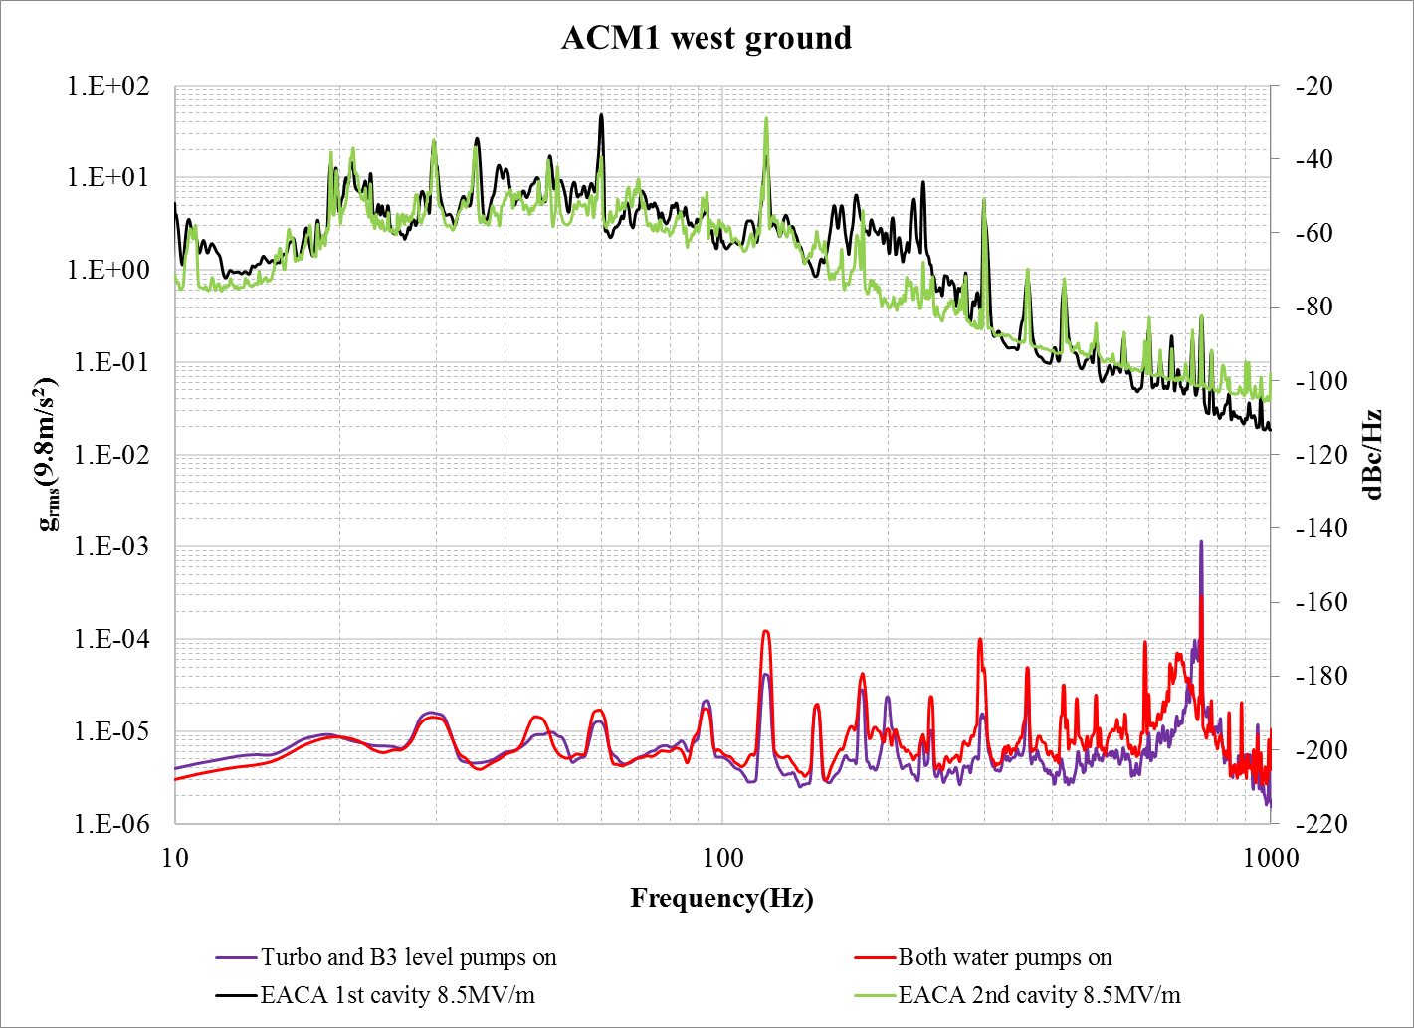
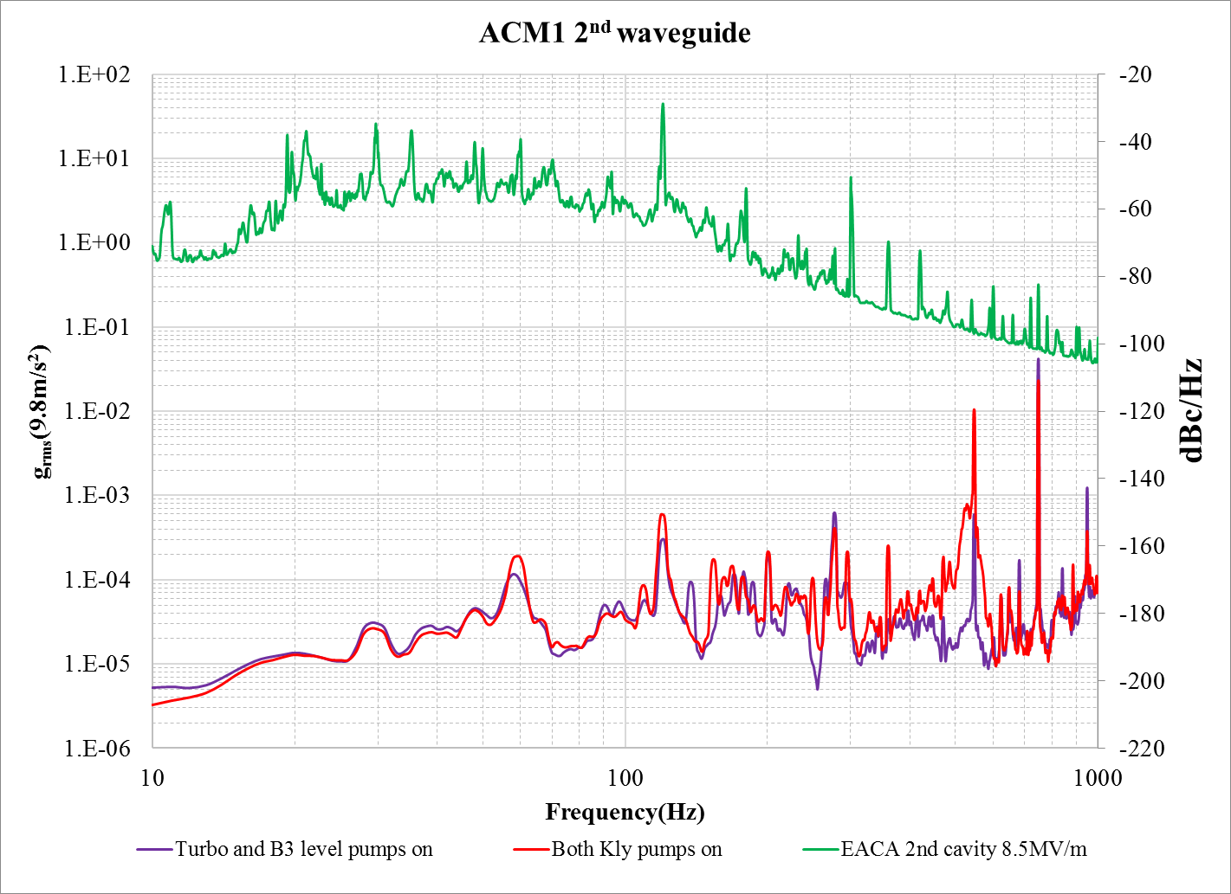
Both Klystron pumps on
160~232Hz
vibration becomes stronger with water pumps on

Slide 23
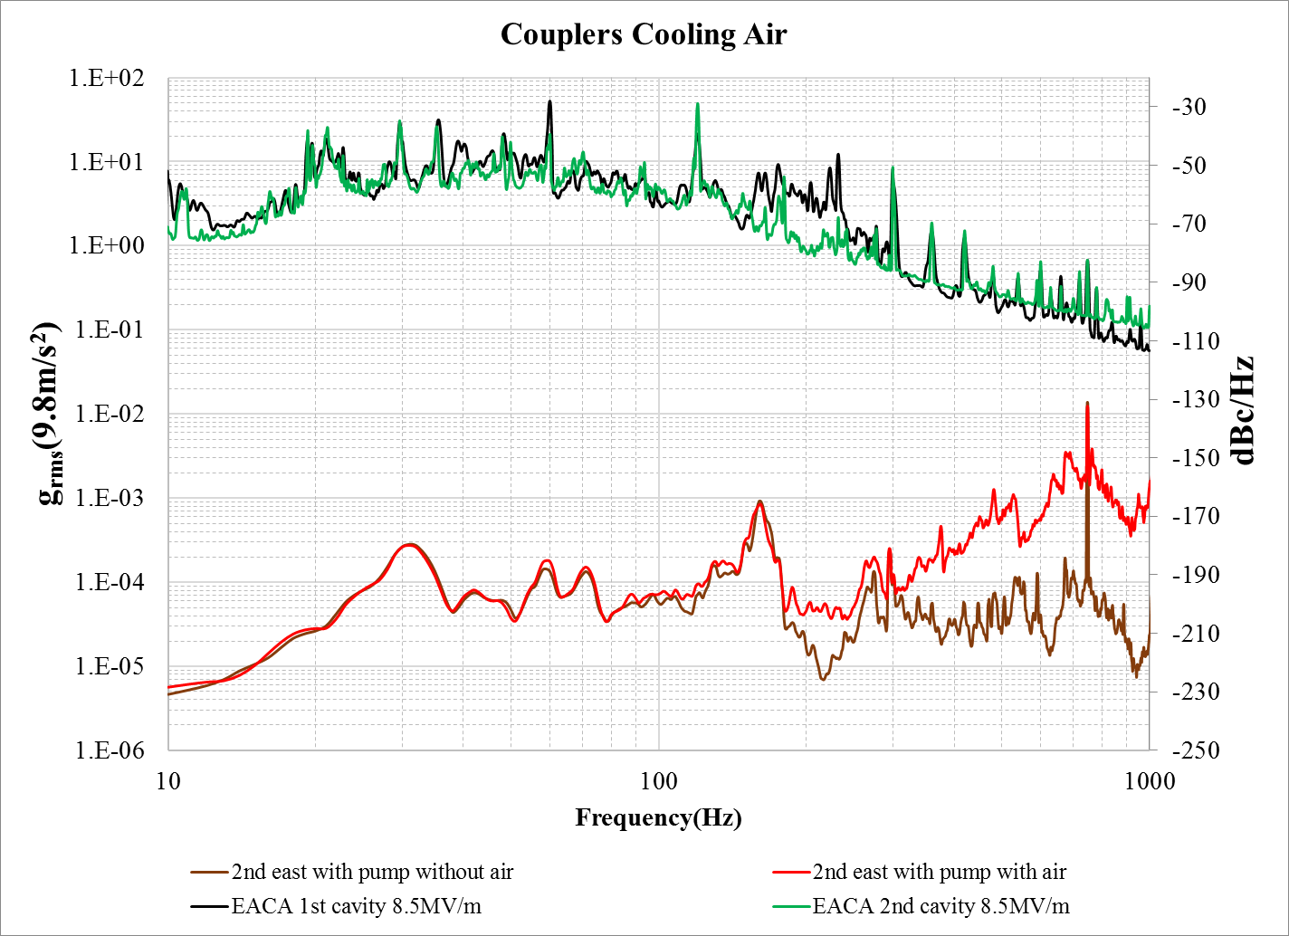
The coupler cooling air
For the 1st east coupler, the coupler cooling air flow will increase noise at higher than 180Hz range
For 2nd east coupler ,the coupler cooling air flow will increase 60 and 72Hz peak.
It increases noise at higher than 180Hz range
The B3 level pump and vacuum system are normal

Slide 24
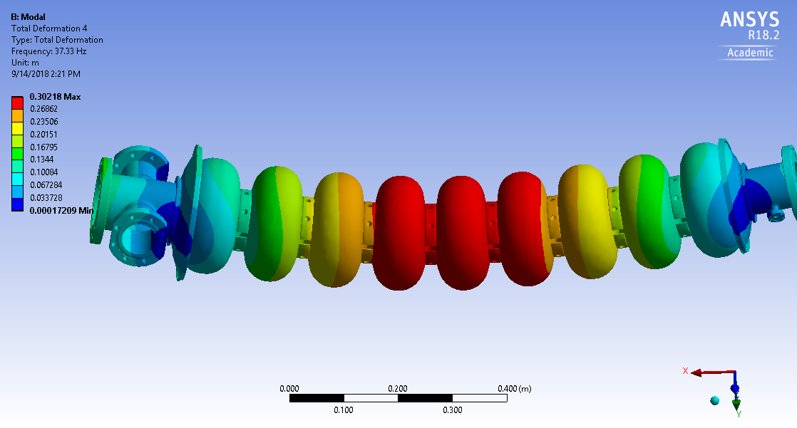
35Hz noise
The 35 Hz is a mechanical mode of cavity. The external vibration source has not been identified.
It shows correlation with couplers cooling air flow rate and the cooling fans status which was attached on the coupler warm section of the outer conductor.

Slide 25
Water system investigation

Slide 26
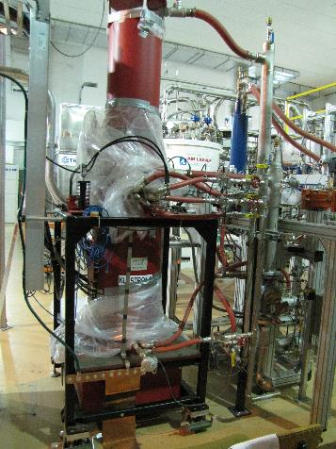
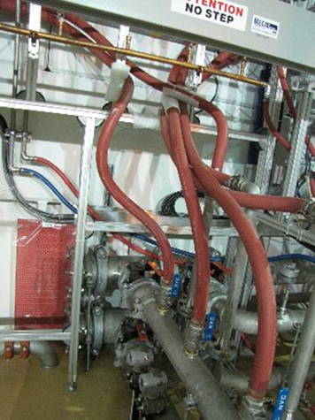
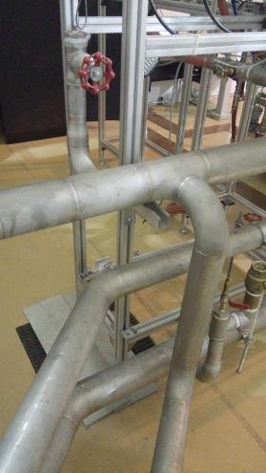
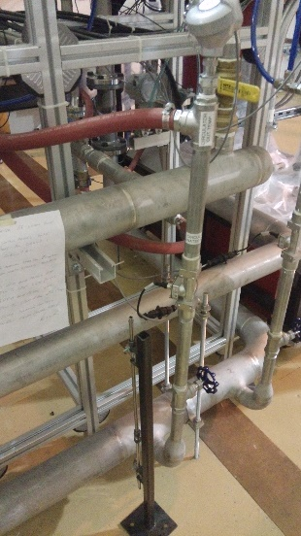
Water system
Klystrons cooling water system consists two pumps;
Klystron cooling water hoses are short;
Rubber hoses of dummy loads are touched wave guide frame;
Kly1 water supply pipe is supported by waveguide frame ;

Slide 27
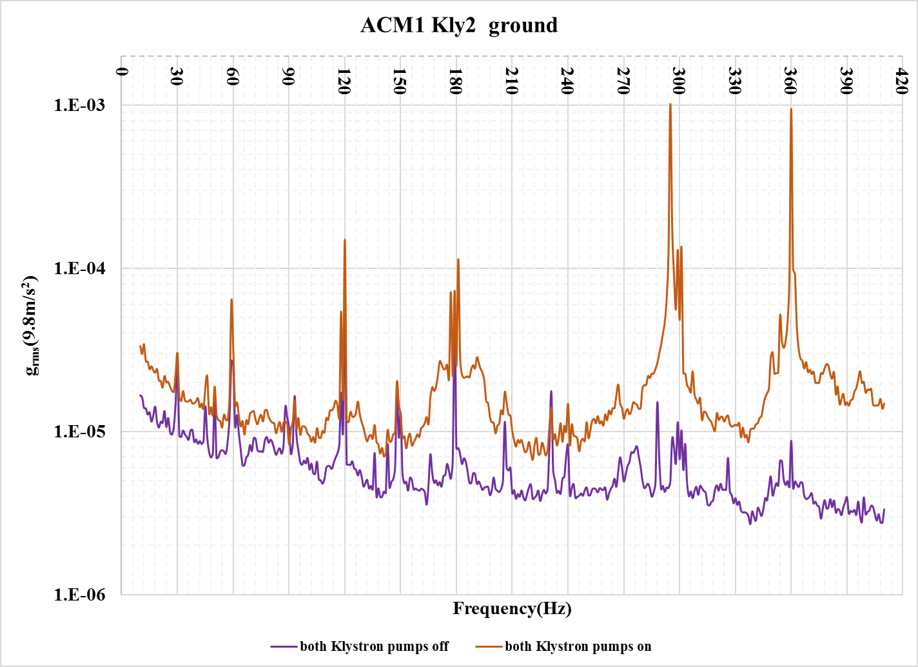
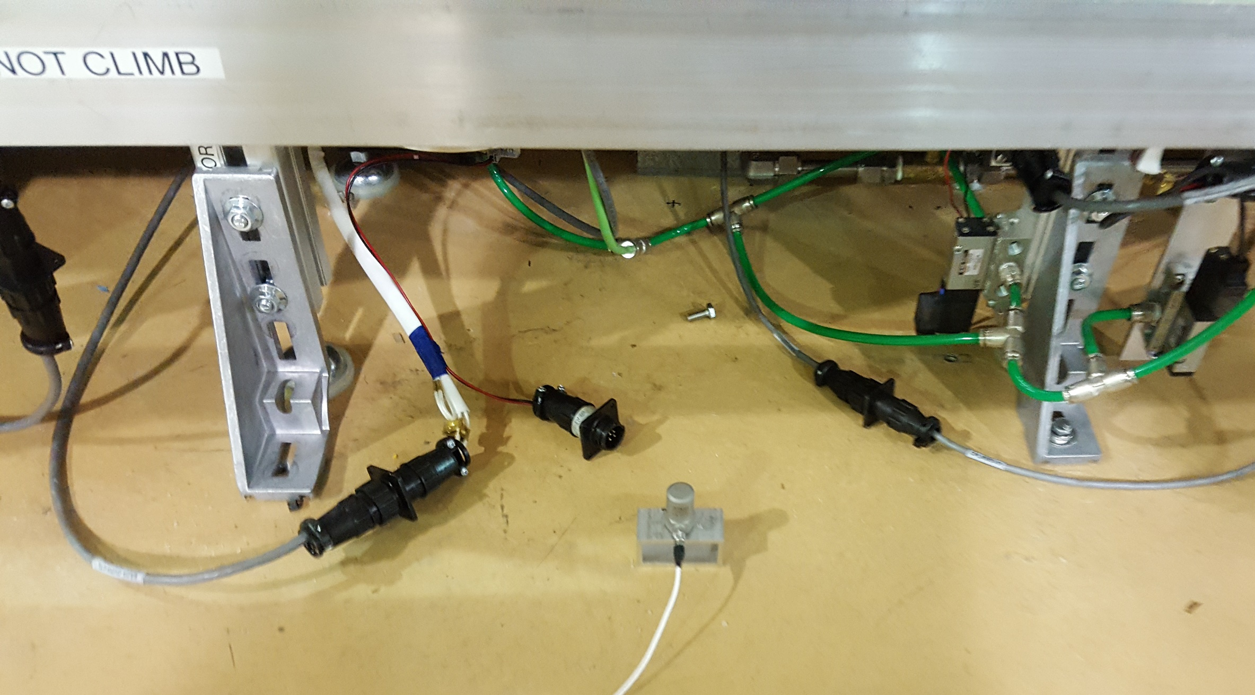
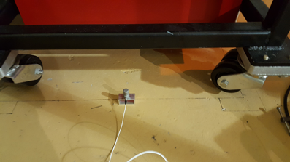
Ground vibration related with water system
ACM1 Klystron ground
ACM1 west ground
The ground vibration becomes stronger with water pumps on
746Hz Turbo pump peak

Slide 28
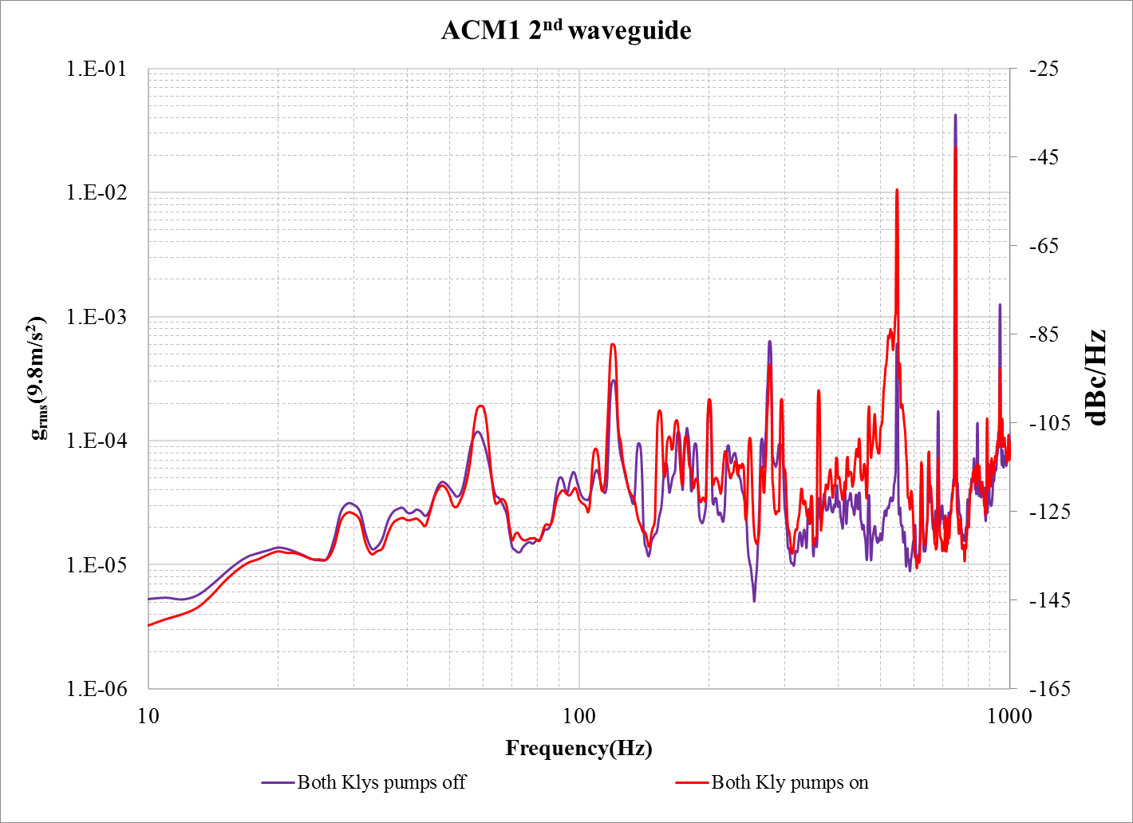
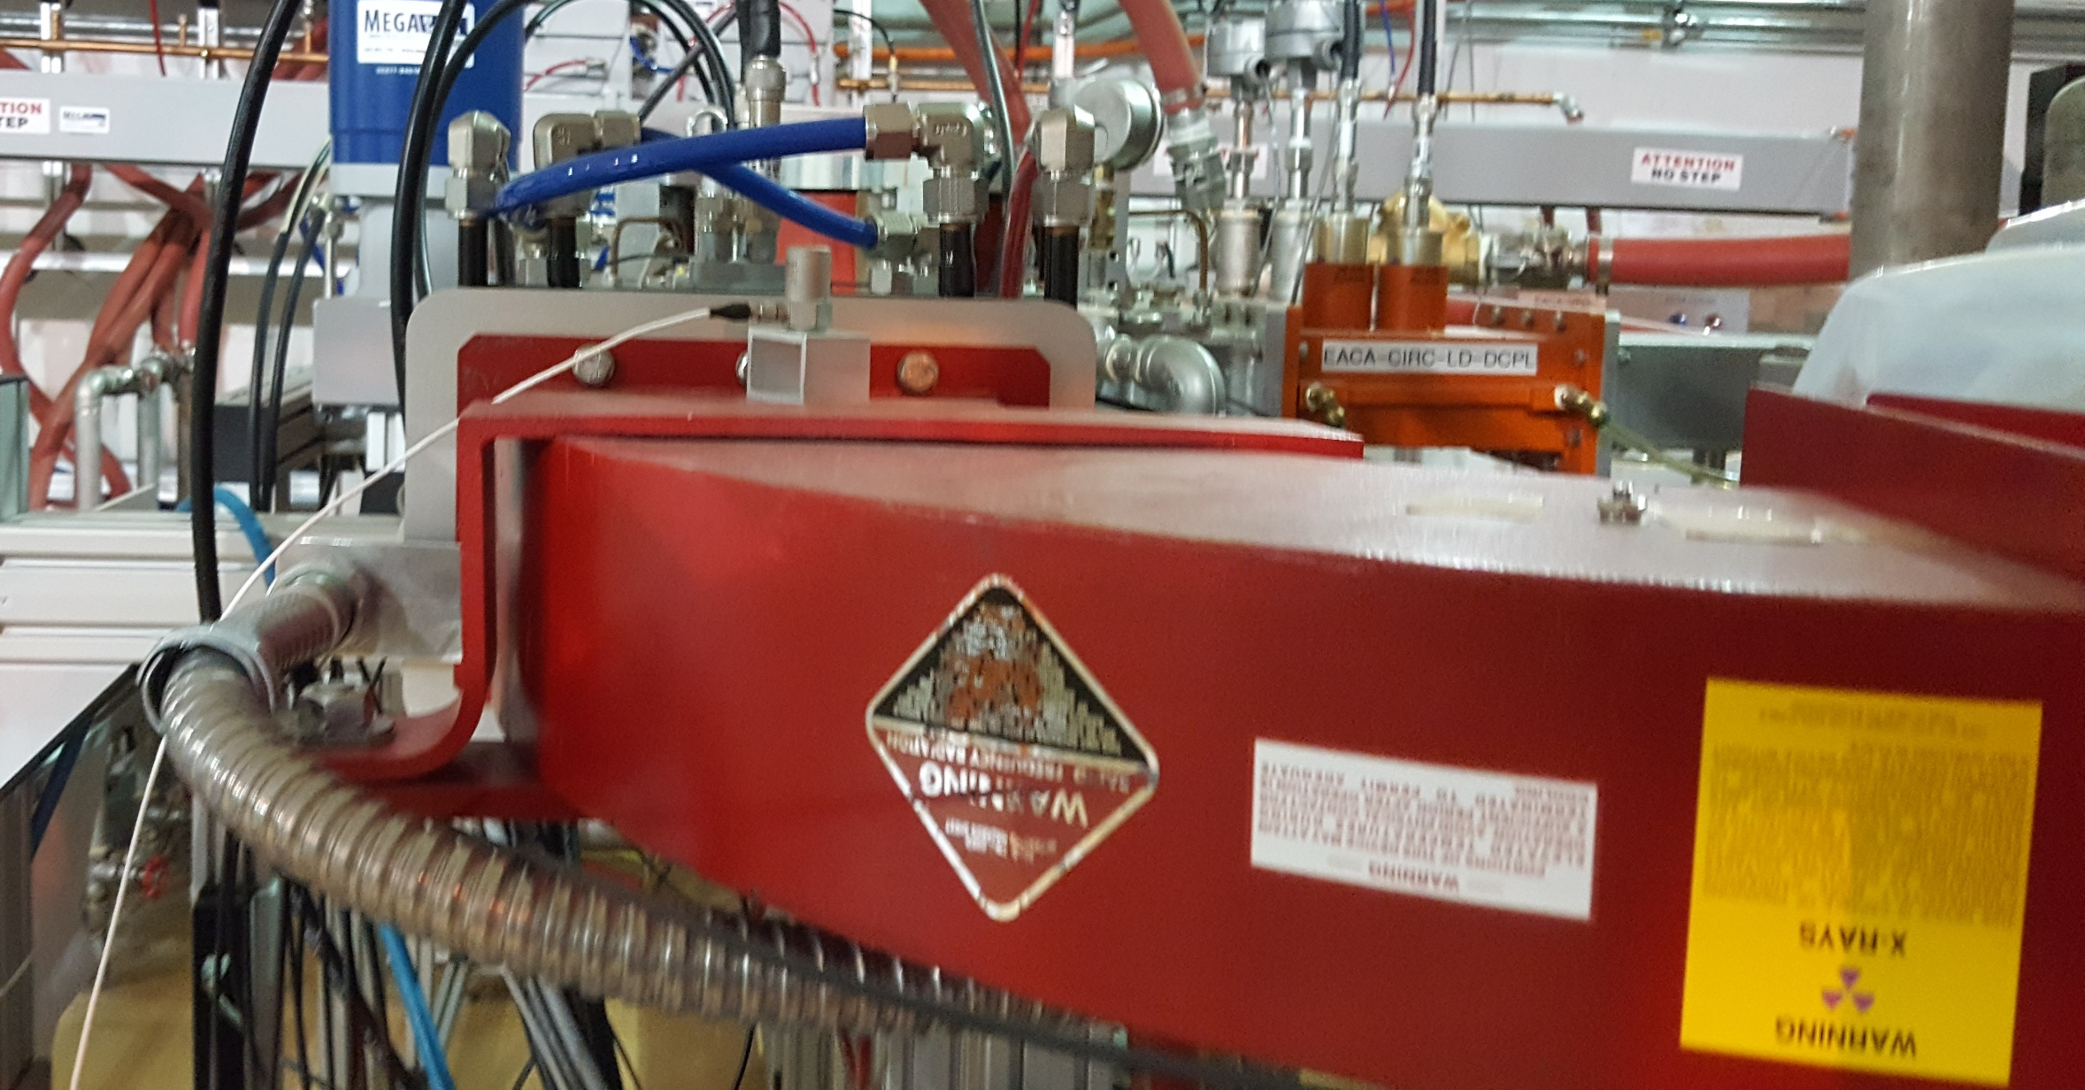
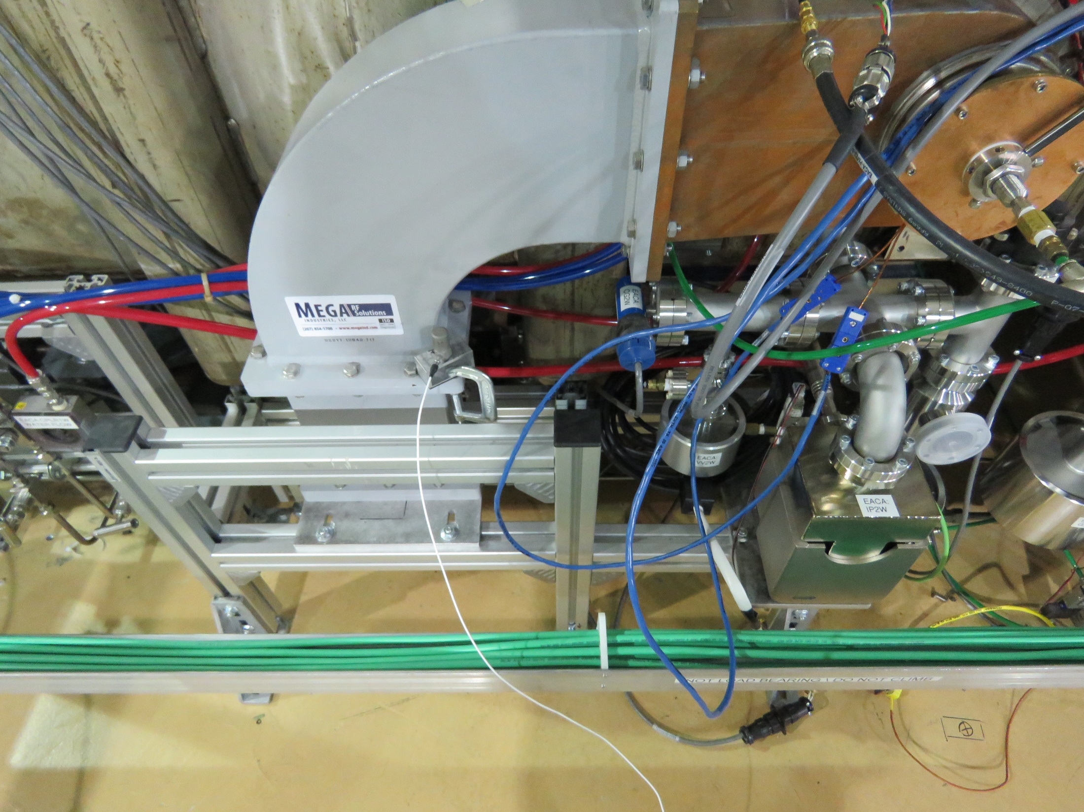
Waveguide Vibration
The waveguide vibration becomes stronger with water pumps on
746Hz Turbo pump peak

Slide 29
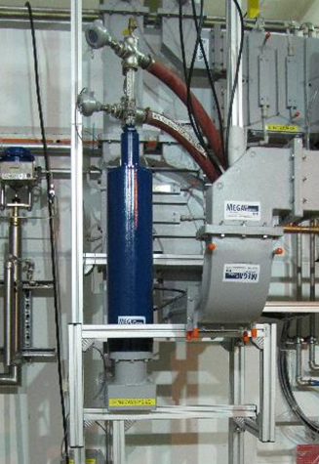
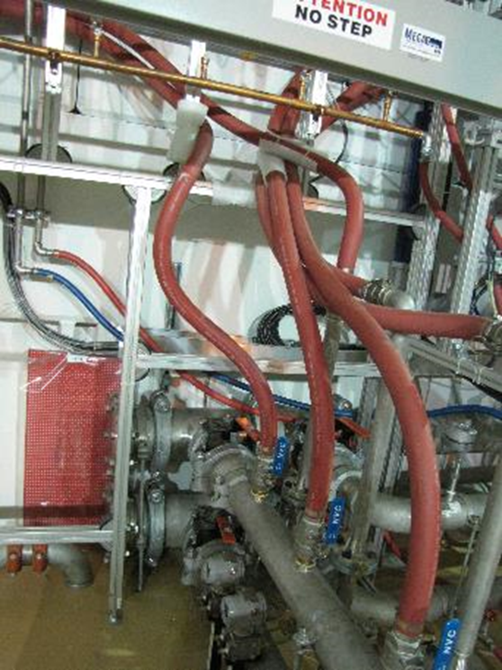
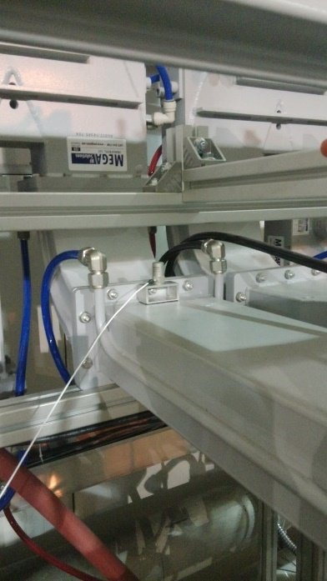
Waveguide Vibration
Six 50 ohm loads are cooled by “B3 level” pump
“B3 level” pump contribute <180Hz and ~410Hz noise
the water pumps contribute the noise higher than 180Hz (except 410Hz) and the peaks valve higher as well.
These peaks by water pumps: 180,297,360Hz

Slide 30
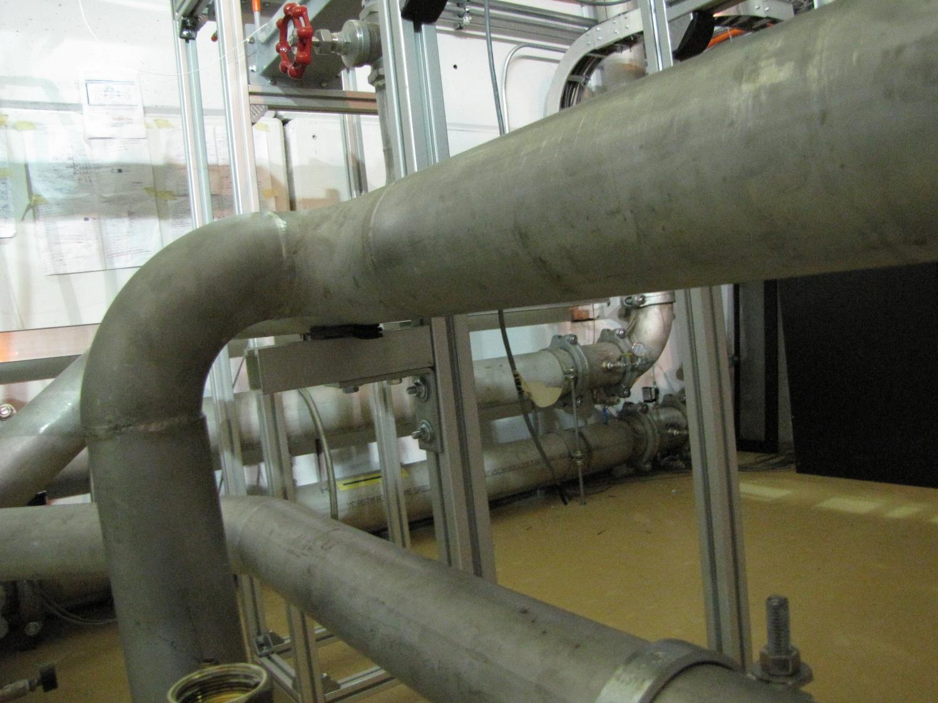
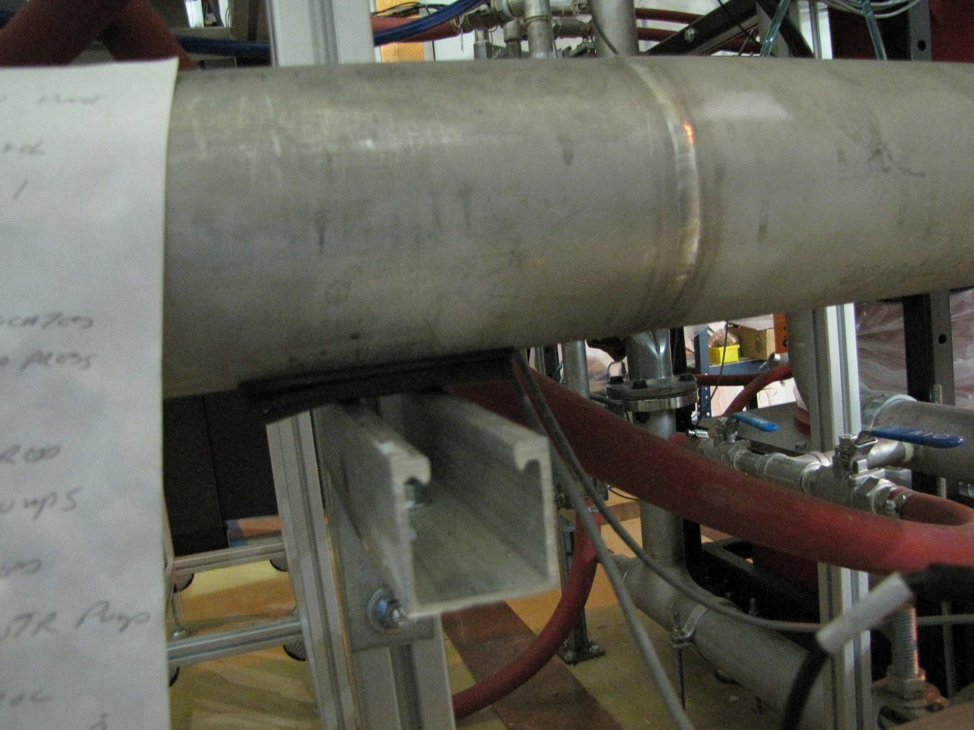
360Hz decreased to 1/8 of original.
The noise from 160 to 800Hz decreased.
160Hz and 297 is reduced ½ of the original
Sensor
1st damper
120Hz is increased
2nd damper

Slide 31
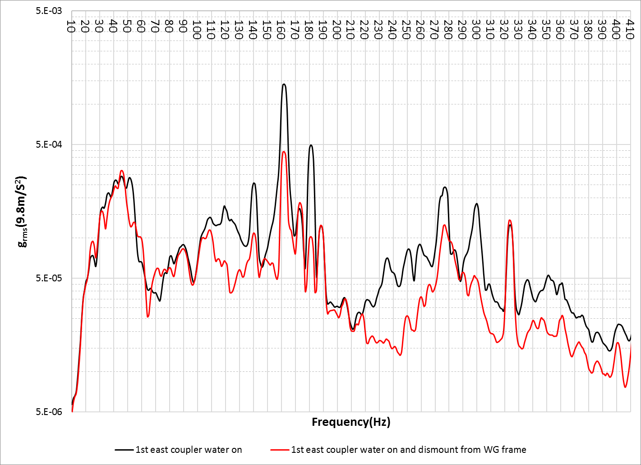
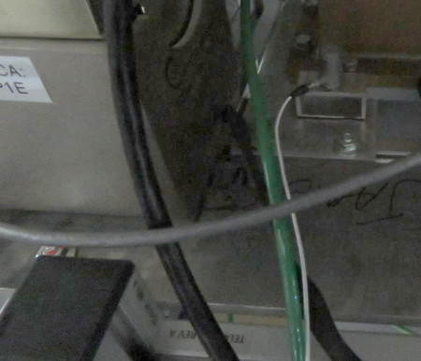
The water cooling loops for ACM1 couplers
162Hz
160Hz
After dismounted, the amplitude reduced to 1/3 of original.
181Hz
300Hz
Remaining related with waveguide and roughing pump
Mounted to WG frame directly;
The plastic pipes are short;
1st east coupler have metal pipes to supply pipe;
After dismounted from WG frame, the vibration reduced.
Based former background measurement the roughing pump bellows also contribute 160Hz noise

Slide 32
6. Discussion
The Pondermotive effect showed when the total gradient about 17~18MV;
The stability ACM1 cryomodule has been improved during beam test;
Several damping method have been implanted
LN system disturbance has been studied
the ±0.1% energy stability has been achieved with 22MeV beam
ACM1 about 14MV contribution
The water system, vacuum system and coupler cooling air are the Microphonics source
Water system and waveguide system damping is under way
To optimize the coupler cooling air flow rate and monitor the warm window temperature, infrared temperature sensors will be added to couplers
The vacuum system will be further damped
LN system upgrade is under way
The effect of the LFD driving ponderomotive instabilities needs further investigation
Push the gradient limit beyond 20MV;
Improve the beam energy instability in the range of ±0.1%;

Slide 34
40Hz
Cryogenic test result reveals the ICM 40Hz noise is related with JT valve status.
The 40Hz noise is also found in ACM1 1st cavity with less amplitude and disappear after JT valve closing.

Slide 35
ICM vibration damping
The ICM is working under SEL PLL mode. The similar vibration damping will be done.

Slide 36
40Hz

Slide 37
