Slide 1
HL-LHC Crab Cavities
R. Calaga, CERN
Special Thanks: P. Baudrenghien, T. Jones, L. Lucany, E. Yamakawa for material towards this contribution
MRCW 2018 – Brooklyn, NY

Slide 2
HL-LHC, Requirements
Voltage $=3.4 MV$ /cavity (2 cavities /beam /IP side) – 16 total
Frequency $=400.79 MHz$
$Q_{ext}=5×{10}^{5}$, $Q_{0}≈{10}^{10}$
RF power source $=40 kW−CW$ (Peak $≤80 kW, 1ms)$
Cavity tuning $=±100 kHz$ (LFD $∼3−8 kHz)$
Operating temperature $= 2.0 K$
D2
Q4
(optional)
Beam 1
IP
194 mm
<3 m
Beam 2
$$L=6.6 m$$

Slide 3
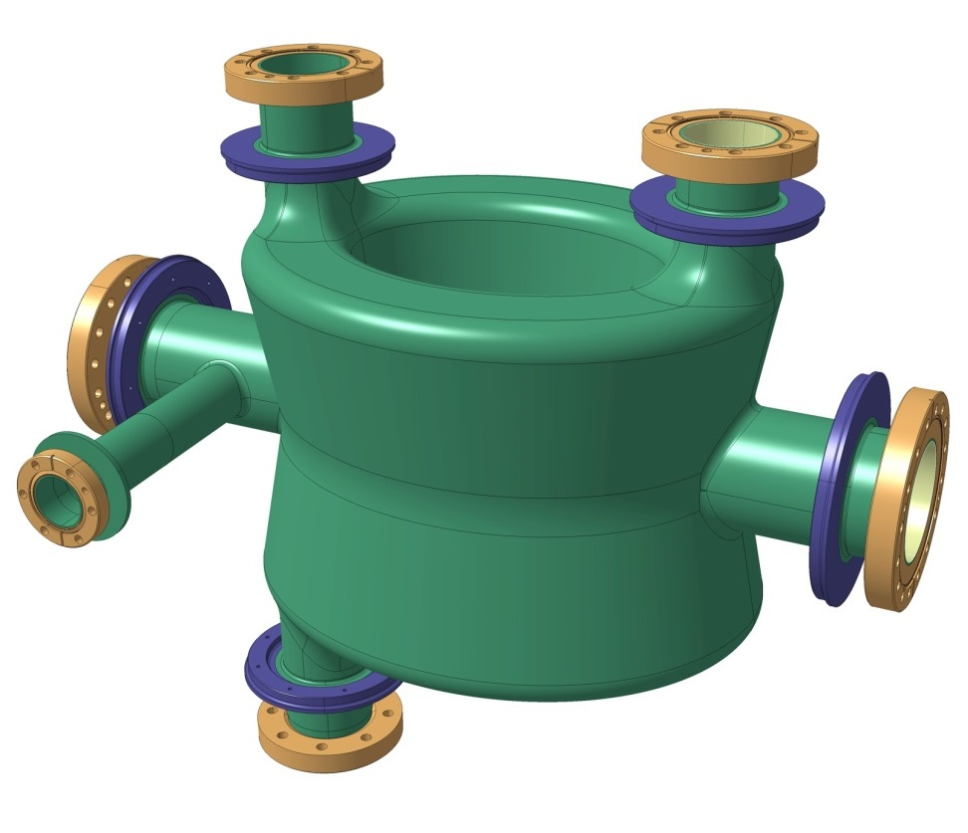
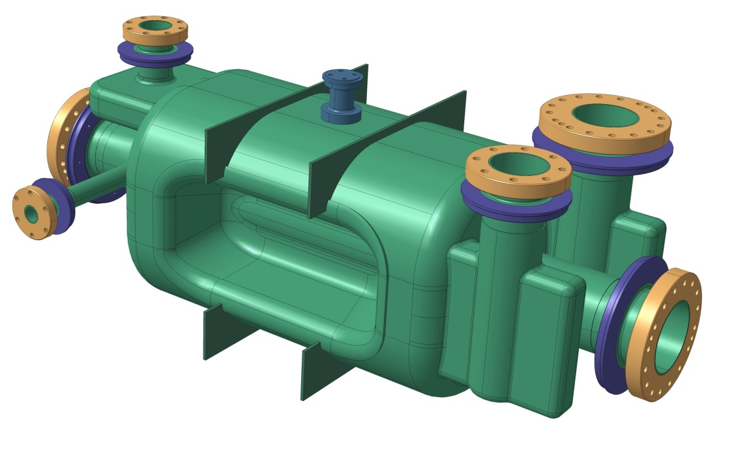
Vertical & Horizontal Crabbing
Two compact designs to accommodate vertical (DQW) and horizontal (RFD)
Double Quarter Wave (DQW) cavity Vertical – Point 1 (ATLAS)
RF Dipole cavity (RFD)
Horizontal – Point 5 (CMS)
Courtesy: EN-MME

Slide 4
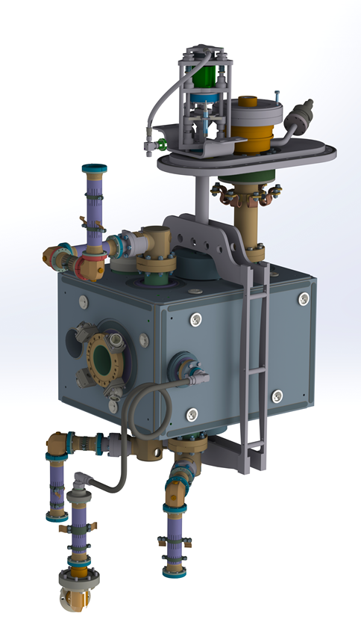
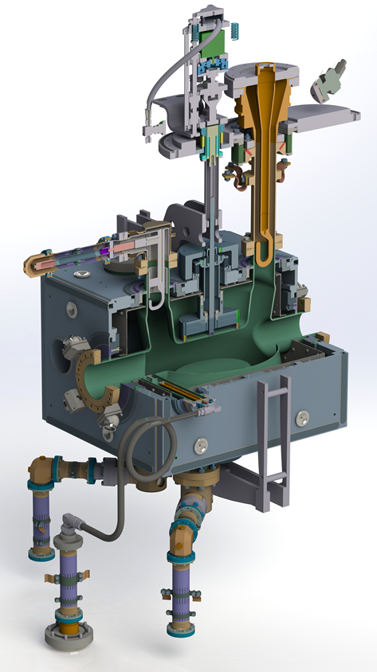
DQW Cavity
Bare DQW cavity
Dressed DQW cavity
Courtesy: EN-MME

Slide 5
DQW cavity manufacturing sequence
Courtesy: EN-MME

Slide 6
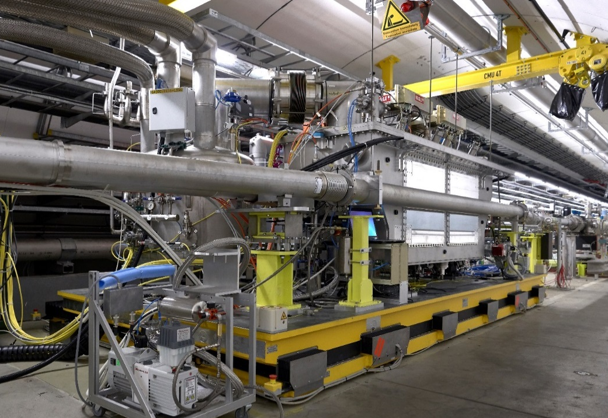
DQW-SPS Installed & Operational

Slide 7
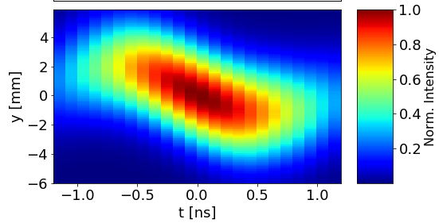
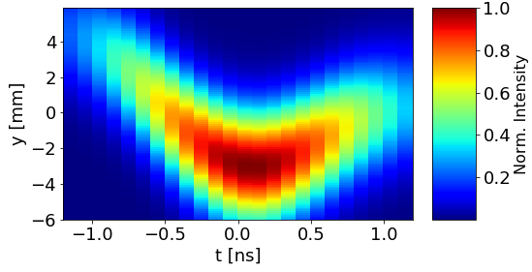
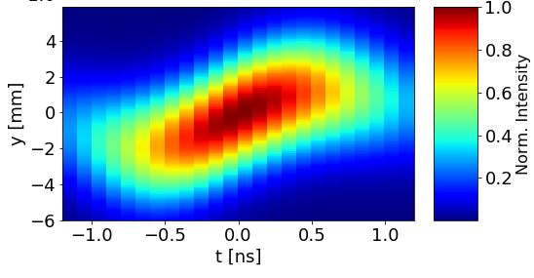
Crabbing of SPS Proton Beam
First injection – 12:55, May 23
$2×{10}^{11}$protons / bunch, $26 GeV$
RF phase scan w.r.t the beam phase with cavity 1
0 Deg
90 Deg
180 Deg
Plots: L. Carver, T. Levens et al.

Slide 8
Some Items to Consider
Direct beam coupling with field probe
Cavity filling time
LFD $∼300−800 Hz/MV^{2}$
Direct beam coupling for field regulation
3-point supporting system using FPC-outer tube as fixed point with 2-flexural blades to rigidify w/o putting stress on FPC during cool-down

Slide 9
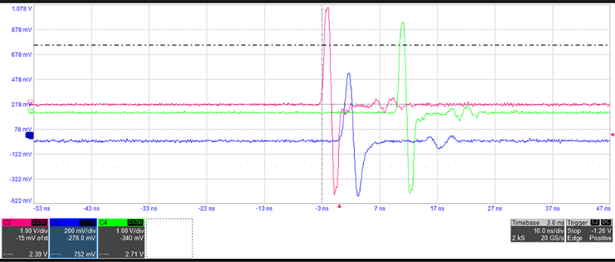
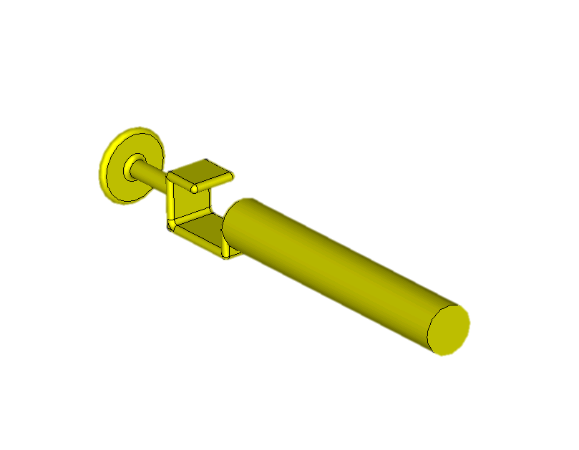
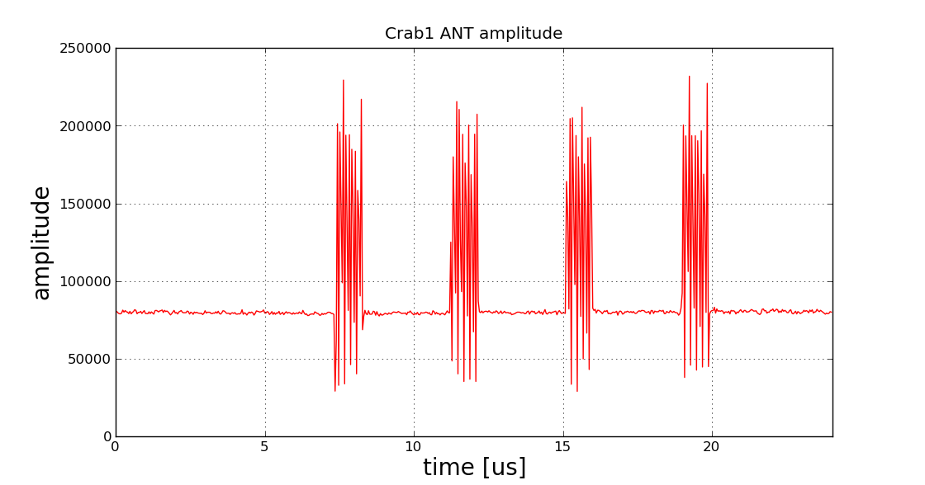
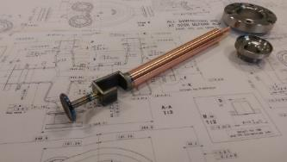
Direct Beam Coupling
Due to the hybrid field ANT & HOM coupler design, we see strong coupling to the beam passage on top of cavity field, regulation BW 10 kHz or more
ANT1
ANT2
BPM
10 ns/div
36 bunches x 4 batches

Slide 10
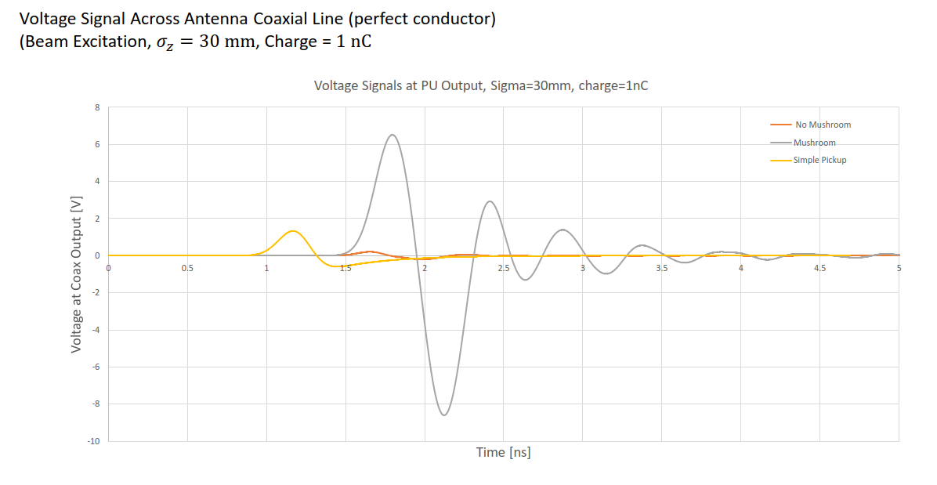
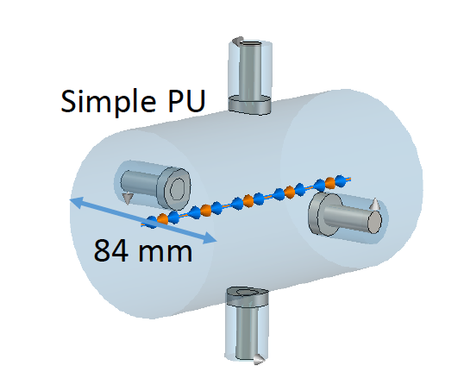
Direct Coupling to Beam
Field ANT will be simplified for HL-LHC to give ~x10 reduction of this effect
DQW SPS-series
DQW SPS-series
no ‘mushroom’
Voltage signal at pickup output from direct coupling of pickup to beam (single bunch, sigma = 30 mm, charge = 1 nC)
Pickup
S. Verdu et al.

Slide 11
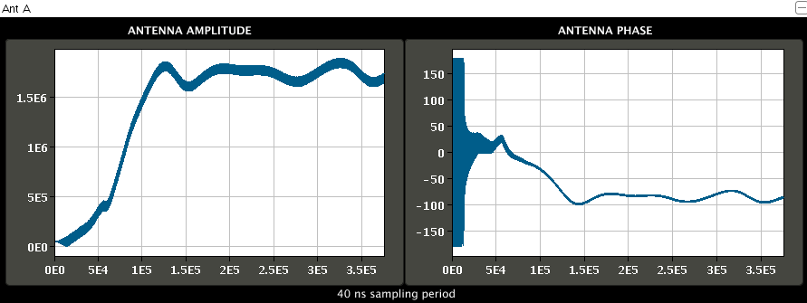
Cavity Filling Time
With a present filling time of $3.2 ms$ (linear drive) seems to be too fast despite $τ=400 μs$
Lorentz force detuning makes cavity phase ring for $>10 ms$
For operation filling time can be very slow
3.2 ms
Dynamic detuning 80 deg.
3.2 ms
Courtesy: P. Baudrenghien

Slide 12
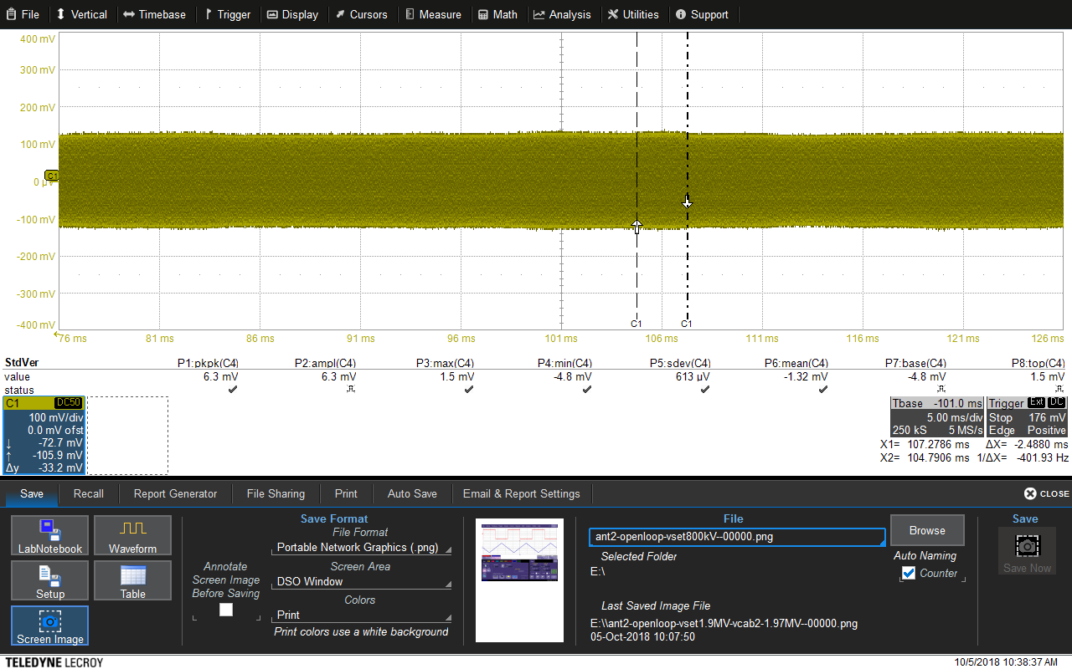
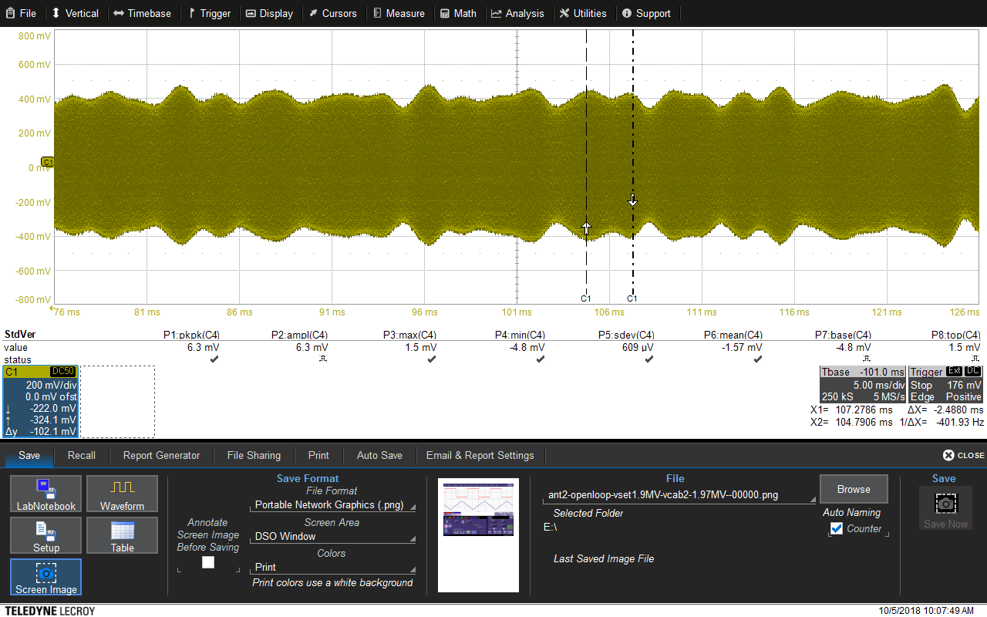
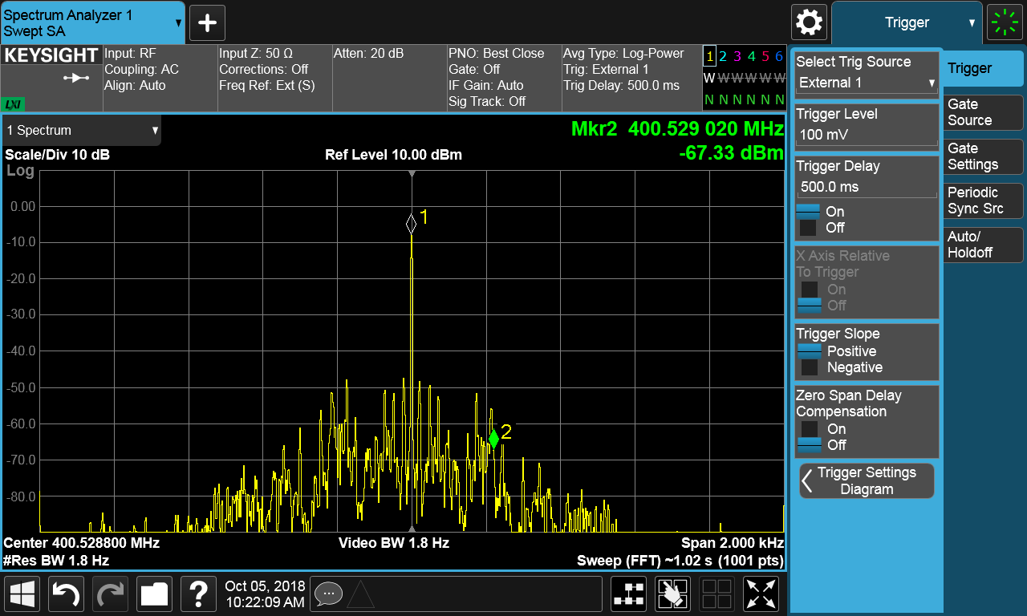
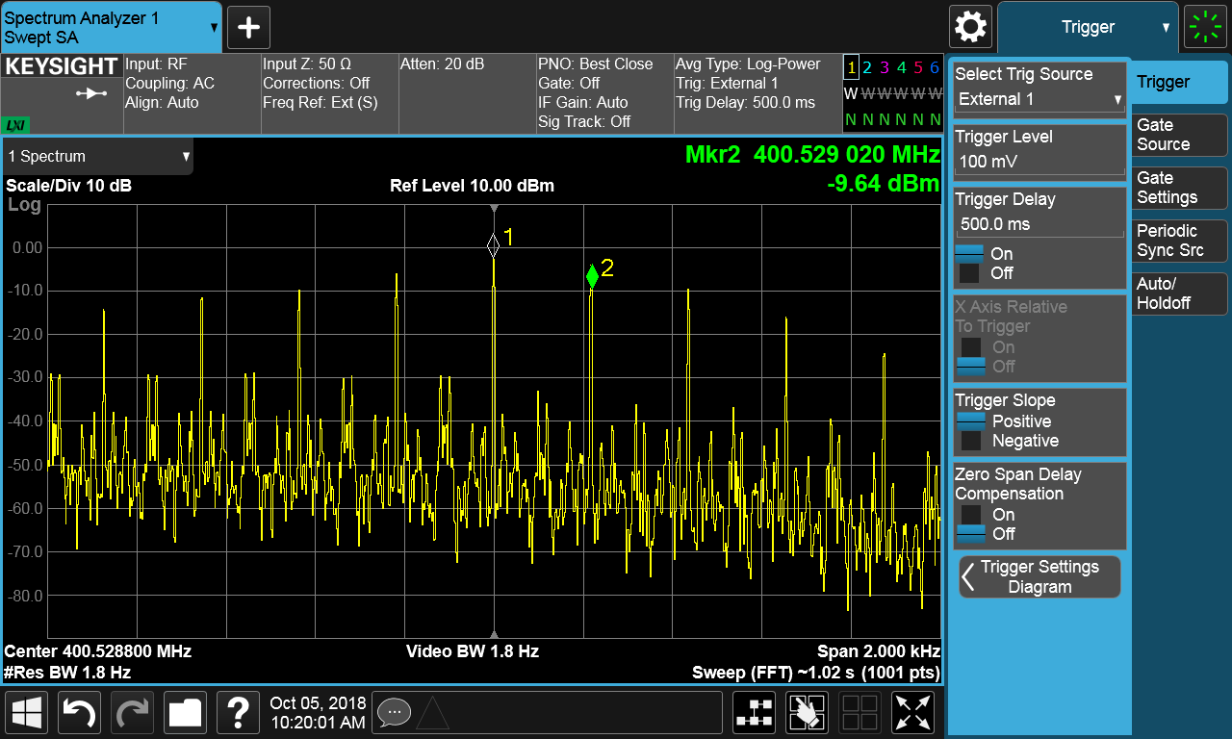
Electro-acoustic Instabilities > 1MV
At 1MV, the LFD is $\sim 400 Hz$ ($1/2$ the cavity BW)
ANT (800kV)
ANT (1.9MV)
Courtesy: P. Baudrenghien, E. Yamakawa

Slide 13
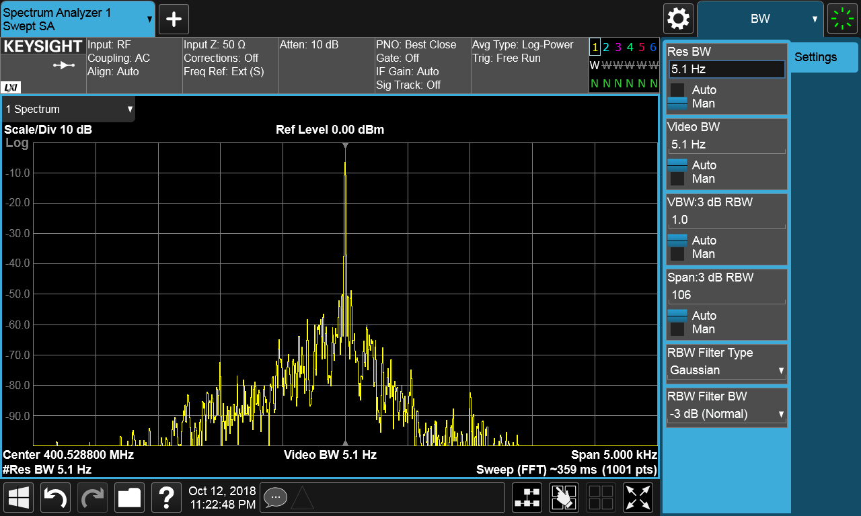
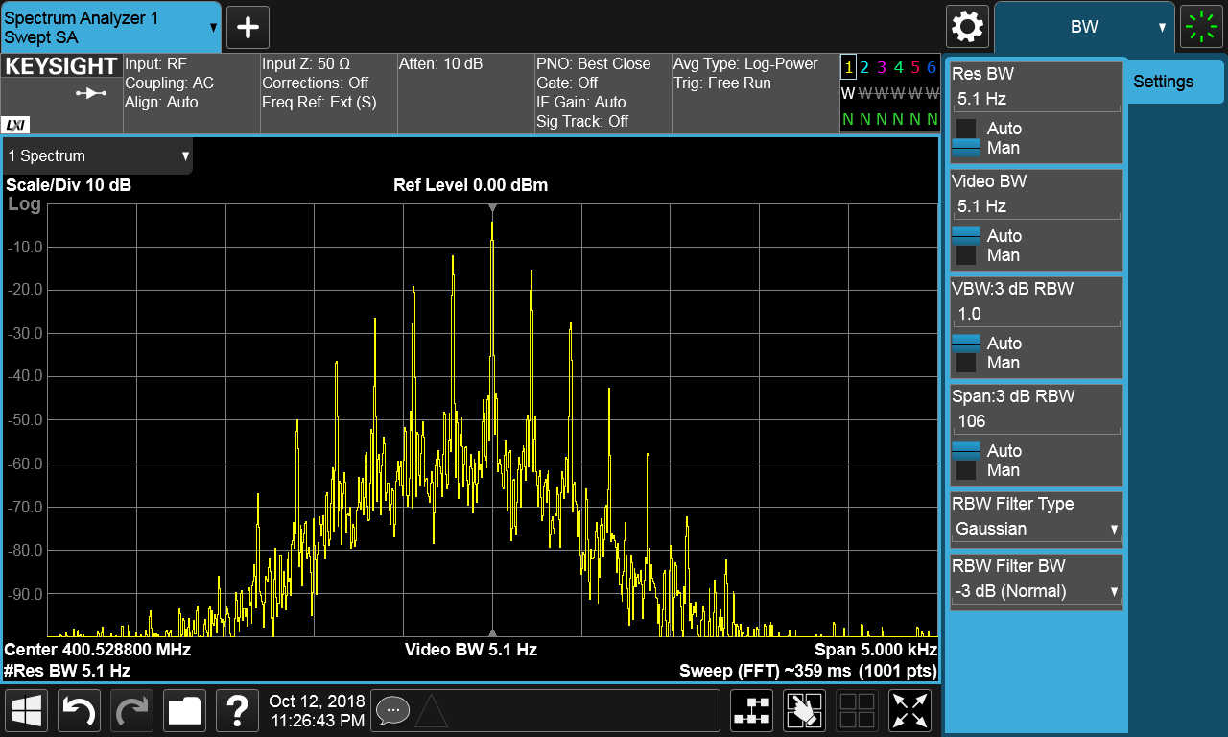
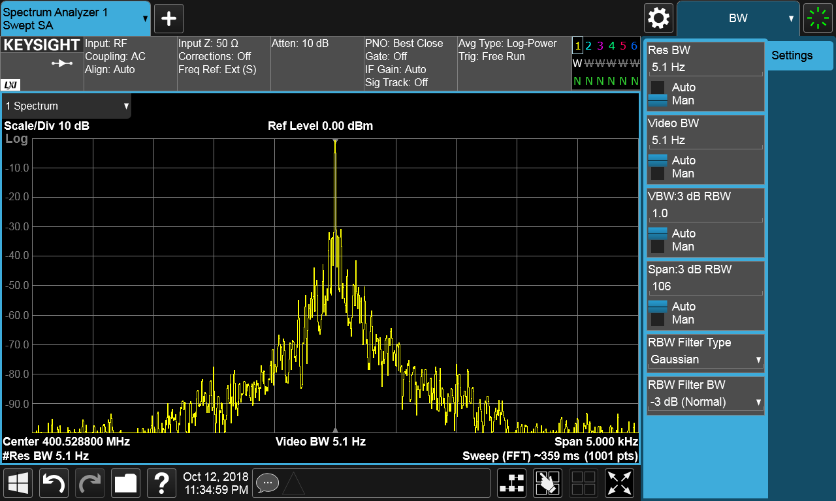
Electro-acoustic Instabilities > 1MV
Cured by with tuning loop or with feedback. following the cavity tune with slow voltage ramp & tuning loop on.
SEL was not implemented in the version used for SPS.
Field Antenna Spectrum, manual tuning

Slide 14
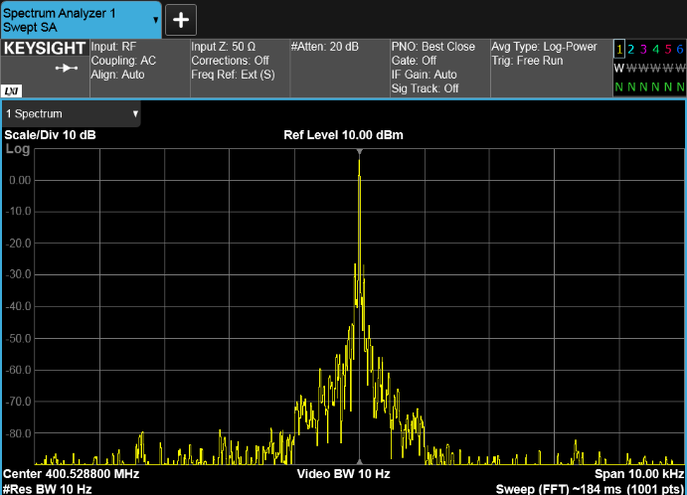
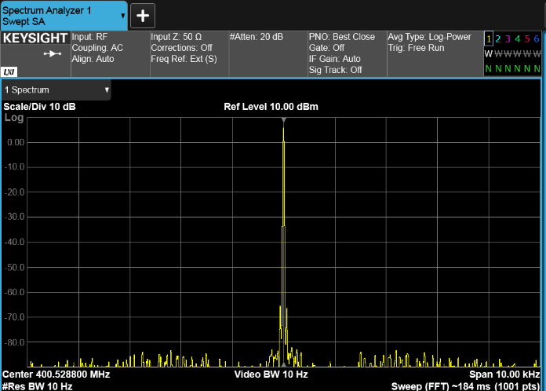
Electro-acoustic Instabilities > 1MV
Within its regulation BW (~10 kHz at present) the RF feedback regulates the cavity field as it should
Courtesy: P. Baudrenghien, E. Yamakawa

Slide 15
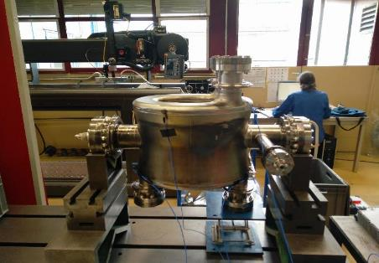
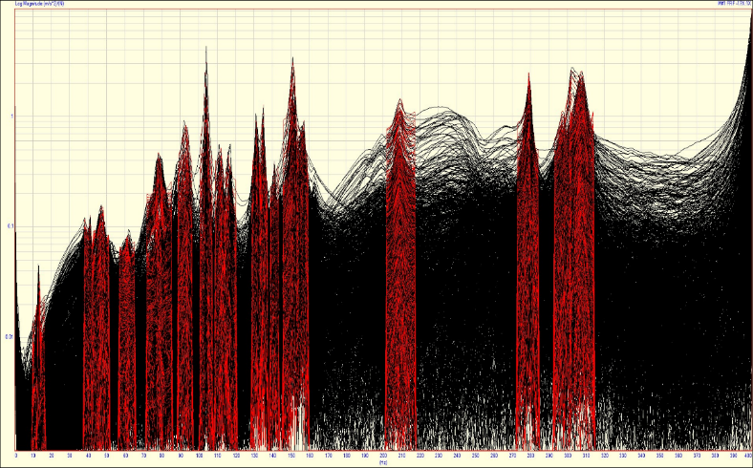
Modal Analysis of Bare Cavity
Measurements on bare cavities with 5 tri-axial accelerometers & modal hammer
Measured Transfer Functions
112, 132, 151 Hz
298 Hz
210 Hz
Calculated Frequencies
FEM Frequency [Hz] | EMA Frequency [Hz]
39.9 | 40.8
84.3 | 78.5
104.6 | 104
115.1 | 115
136.5 | 135
Courtesy: L. Lacny, M. Guinchard, T. Jones, EDMS 1771639

Slide 16
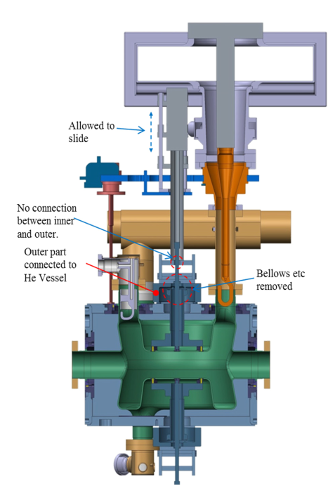
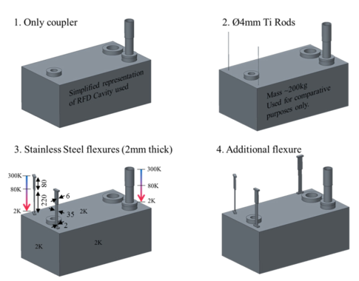
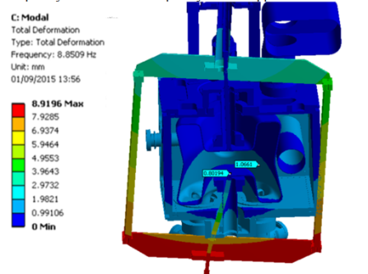
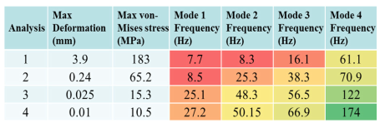
Dressed Cavity Modal Frequencies
8.5 Hz, w/o Flexural Blades

Slide 17
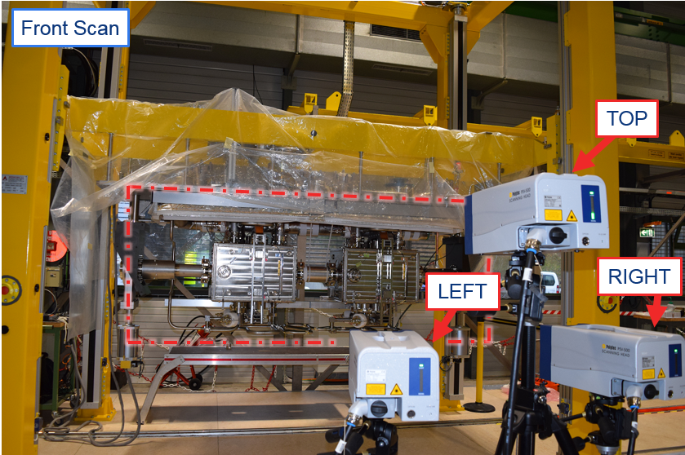
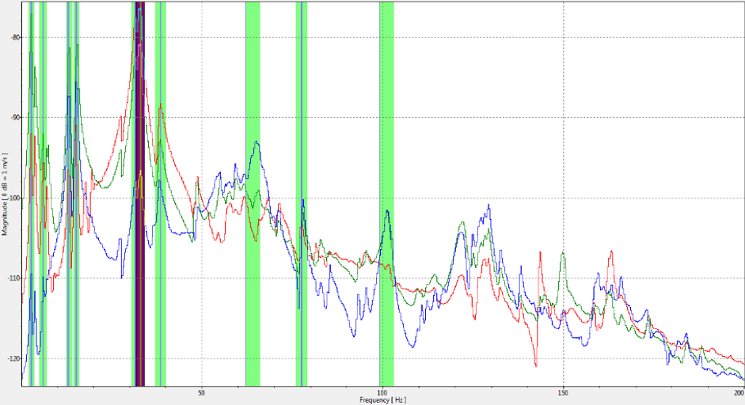
Module Vibrational Meas Setup
Frequency Hz] | Mode Shape
3.75 | Rigid Body
13 | Pendulum (Left Module)
15.25 | Pendulum (Right Module)
33 | Rotation
Courtesy: L. Lacny, M. Guinchard, EDMS 1771639

Slide 18
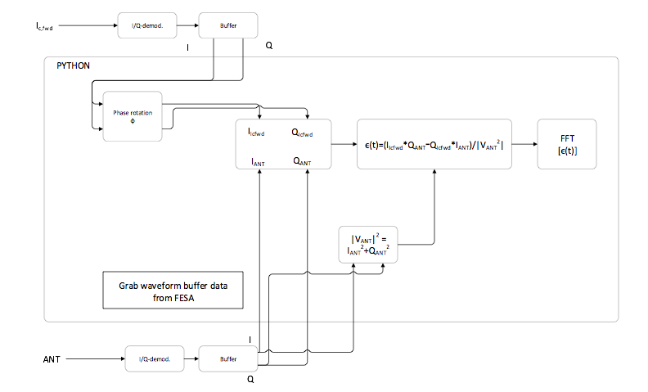
Microphonics Measurement Setup
RF FDBK OFF: microphonics modes measured in the ANT
RF FDBK ON: microphonics modes measured in the Ic,Fwd
Sampling frequency: 97.7 kHz, time window: 5.3 s
$$\frac{Δf}{f}∝\frac{Im\{V.conjugate[I_{c,fwd}]}{{\left|V\right|}^{2}}$$
Courtesy: E. Yamakawa

Slide 19
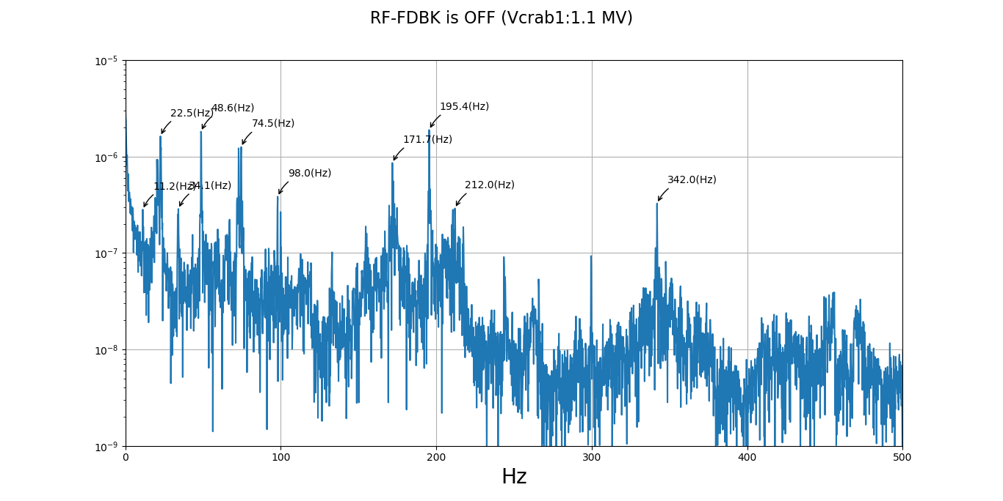
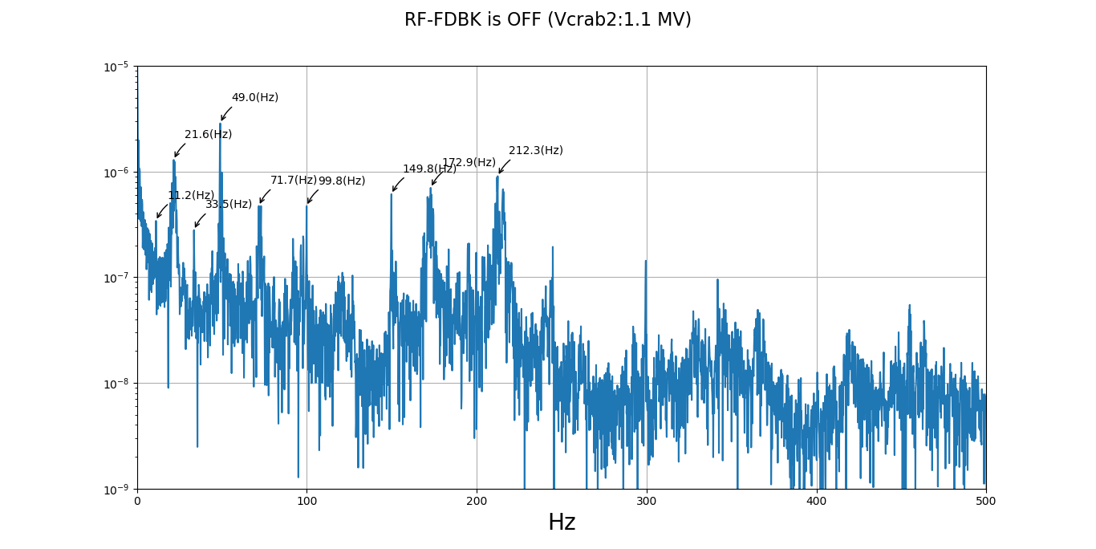
Microphonics, Feedback OFF
Cavity 1
Cavity 2
Courtesy: E. Yamakawa

Slide 20
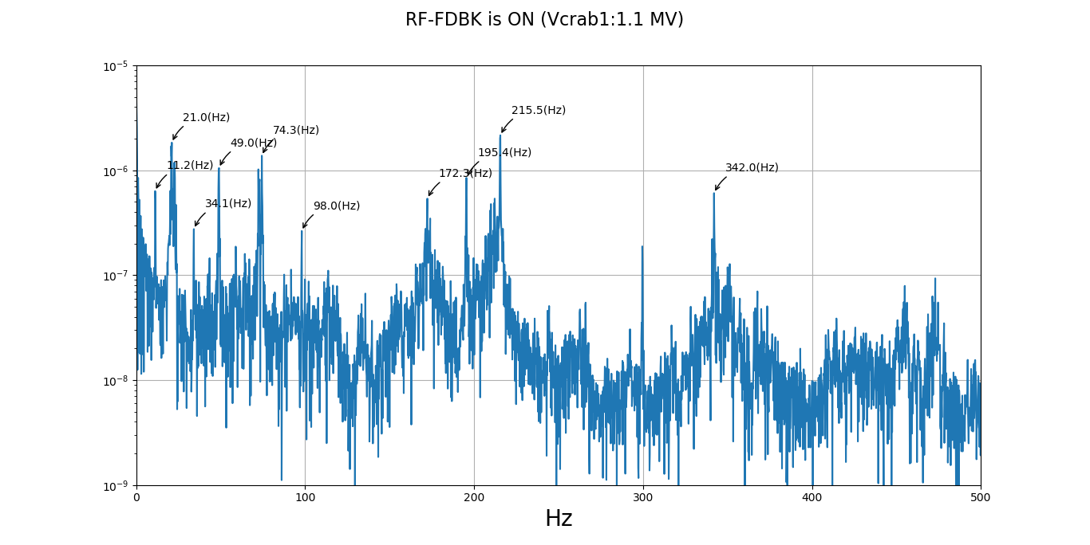
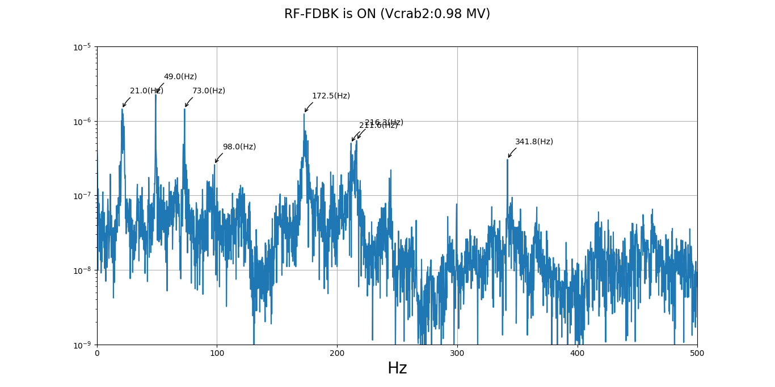
Microphonics, Feedback ON
Cavity 1
Cavity 2
Courtesy: E. Yamakawa

Slide 21
Microphonics Frequencies
 | Cav 1 [Hz] | Cav 2 [Hz]
Cryo Pumps | 20-30 | 20-30
TX HV ripple + Tuner mode | 49 | 49
Mech. mode | 74 | 73
Harmonics of TX ripple | 98 | 98
Not Identified | 171 | 172
Harmonics of TX ripple ? | 195
Mechanical Mode | 210 | 212
Not identified | 342 | 342

Slide 22
Questions/Comments ?

