Slide 1
Superconducting radio-frequency virtual cavity for Hardware-In-the-Loop testing
Science And Technology Faculty
LEIOA
GAUDEE Research group
Experimental Automatic Control
J. Jugo¹
P. Echevarria², E. Aldekoa¹, J. A. Neumann², A. Ushakov², J. Knobloch², I. Badillo¹
(1) University of the Basque Country (UPV/EHU) , (2) Helmholtz Zenrtrum Berlin
24-26 October 2018
Second Topical Workshop on Microphonics, LLRF Workshop Series

Slide 2
Superconducting radio-frequency virtual cavity for HIL testing
Outline
Introduction
Collaboration between HZB and UPV/EHU
FPGA based simulator for SRF cavities
Hardware-In-the-Loop testing: microphonics
Conclusions and future work

Slide 3
Superconducting radio-frequency virtual cavity for HIL testing
Introduction
Collaboration between HZB and UPV/EHU
in the field of LLRF control since December 2016
Helmholtz Zentrum Berlin, internationally recognized research center, operating two large scientific facilities, BER II and BESSY II
University of the Basque Country (UPV/EHU) Laboratory of accelerator technology (IZPIlab)
Experience in modeling and control of electromechanical systems
Collaboration topics:
- SRF Cavity simulator, initially developed in HZB
- Microphonics compensation algorithms studies
- RF phase drifts compensation techniques
- Experimental vibration mode determination
– Mechanical transfer function fitting
Erasmus+ stays in HZB:
Graduate and Post Graduate students from the UPV/EHU

Slide 4
Superconducting radio-frequency virtual cavity for HIL testing
Introduction
Collaboration between HZB and UPV/EHU
in the field of LLRF control since December 2016
Helmholtz Zentrum Berlin, internationally recognized research center, operating two large scientific facilities, BER II and BESSY II
University of the Basque Country (UPV/EHU) Laboratory of accelerator technology (IZPIlab)
First Collaboration Result:
Superconducting radio-frequency virtual cavity for control algorithms debugging
P. Echevarria, E. Aldekoa, J. Jugo, A. Neumann, A. Ushakov, J. Knobloch,
Review of Scientific Instruments, Volume 89, Issue 8 ,(2018)
Experience in modeling and control of electromechanical systems
Collaboration topics:
- SRF Cavity simulator, initially developed in HZB
- Microphonics compensation algorithms studies
- RF phase drifts compensation techniques
- Experimental vibration mode determination
– Mechanical transfer function fitting
Erasmus+ stays in HZB:
Graduate and Post Graduate students from the UPV/EHU

Slide 5
Superconducting radio-frequency virtual cavity for HIL testing
FPGA based simulator for SRF cavities
Simulator for SRF cavities
Main purpose: Hardware-in-the loop prototyping
- Test of different LLRF control techniques
- Microphonics compensation algorithms studies
Example in this session :
Control system design for SRF cavity based on Kalman Filter observer
Andrey Ushakov

Slide 6
Superconducting radio-frequency virtual cavity for HIL testing
Outline
Introduction
Collaboration between HZB and UPV/EHU
FPGA based simulator for SRF cavities
Hardware-In-the-Loop testing: microphonics
Conclusions and future work

Slide 7
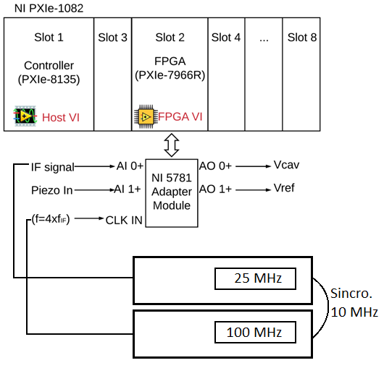
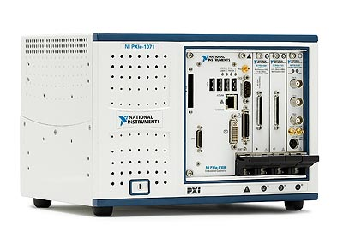
Superconducting radio-frequency virtual cavity for HIL testing
FPGA based simulator for SRF cavities
Implementation details
LabVIEW based using PXI and FlexRIO technology
Reconfigurability
Rapid prototyping
Compatible with the technology used in la UPV/EHU lab
Image: From National Instruments

Slide 8
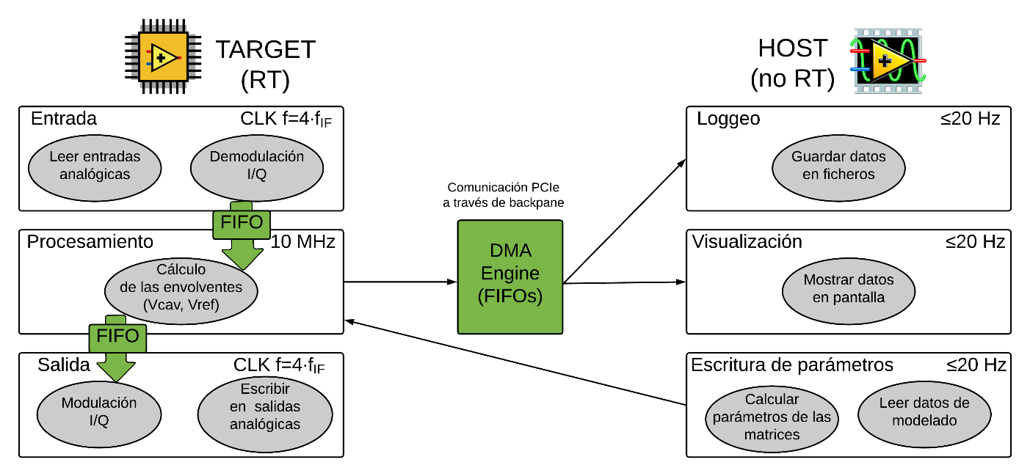
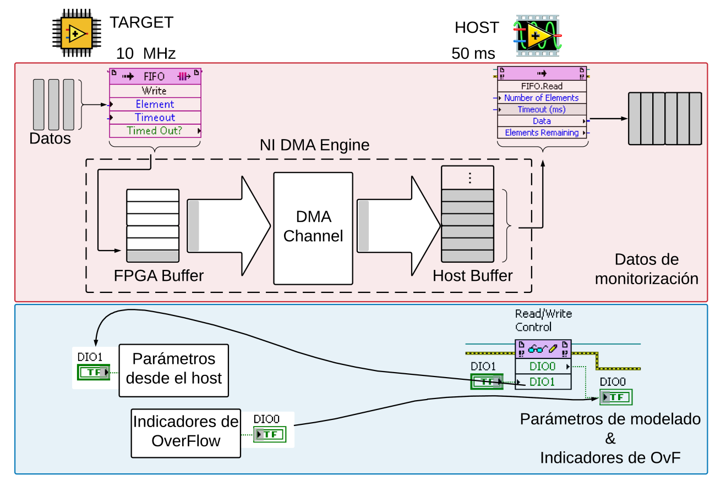
Superconducting radio-frequency virtual cavity for HIL testing
FPGA based simulator for SRF cavities
Implementation details
LabVIEW based using PXI and FlexRIO technology
Reconfigurability
Rapid prototyping
Compatible with the technology used in la UPV/EHU lab
Sampling clock (ADC) , 100MHz
Computation clock (FPGA) , 10MHz
Communication between host (LabVIEW APP) and FPGA -> DMA based FIFO

Slide 9
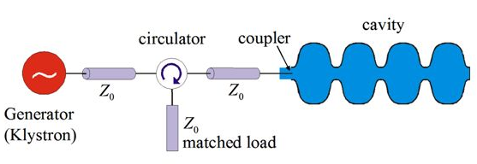
Superconducting radio-frequency virtual cavity for HIL testing
FPGA based simulator for SRF cavities
Implementation details: cavity model
Electric part model
Mechanic part model
Lorenz force detuning + microphonics effects

Slide 10
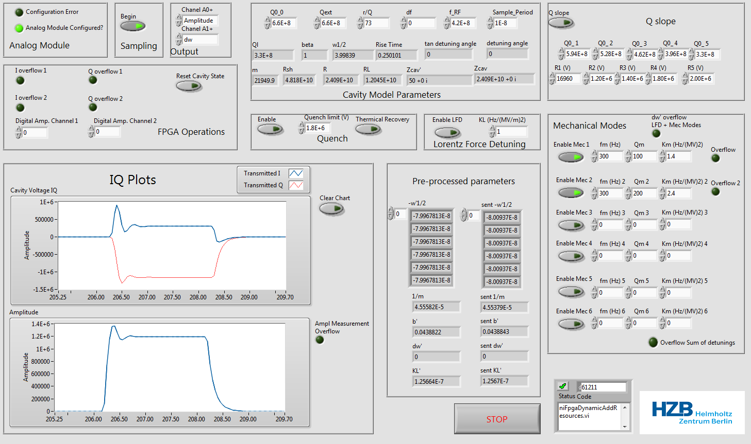
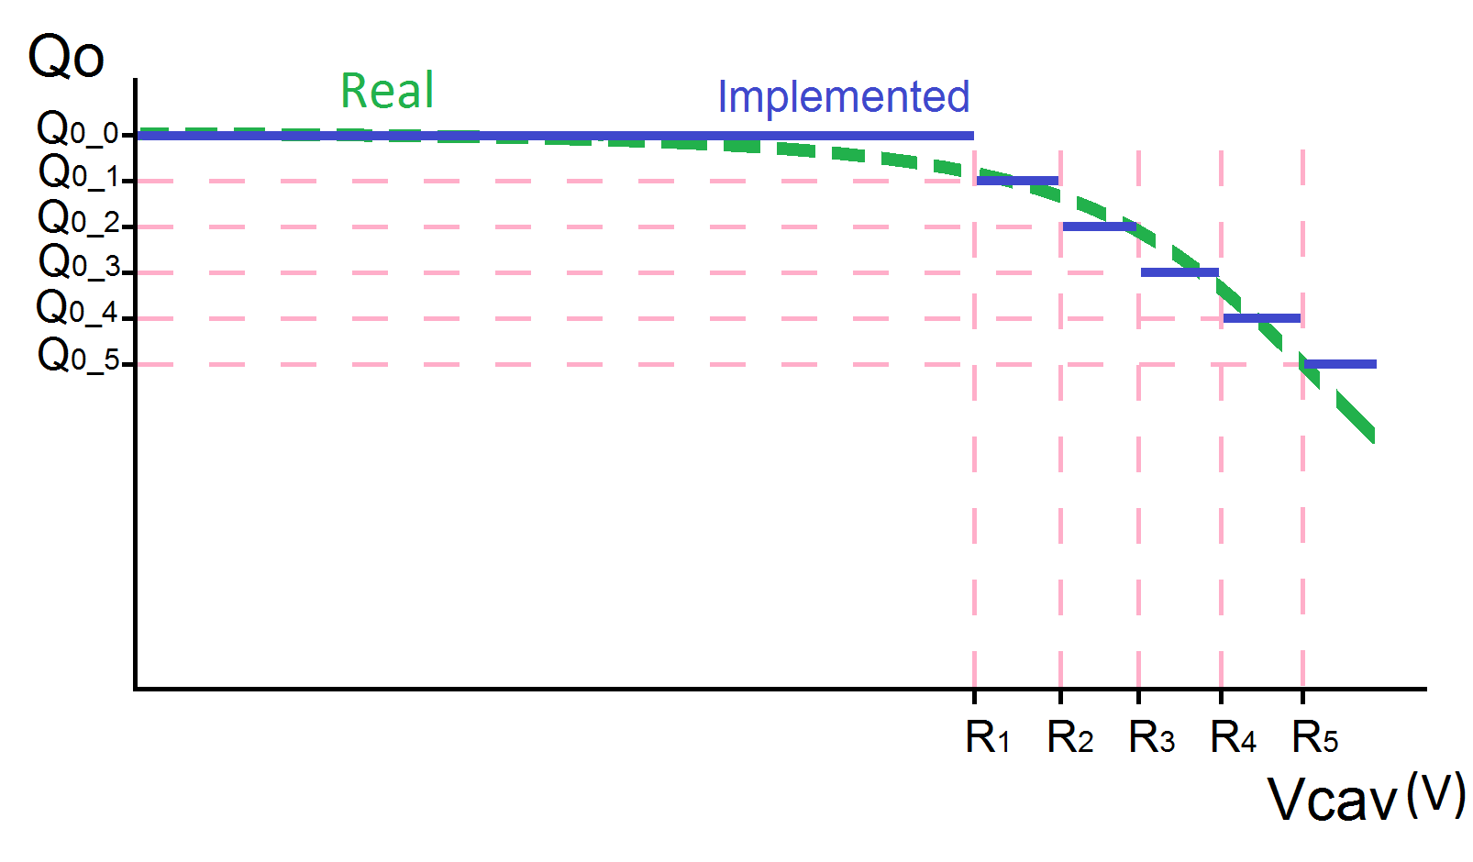
Superconducting radio-frequency virtual cavity for HIL testing
FPGA based simulator for SRF cavities
Implementation details: GUI
Host VI
Electric model parameters
Mechanical model parameters
Non linear effects
Q slope
Quench

Slide 11
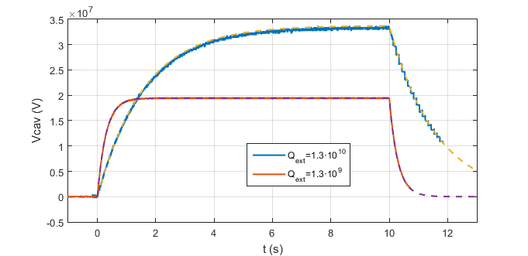
Superconducting radio-frequency virtual cavity for HIL testing
FPGA based simulator for SRF cavities
Extensive simulation tests
Individual functionalities
Electric model
Mechanic model
Microphonics
Lorenz Force Detuning
Full model
Test of TESLA (9 cells) cavity voltage with different
$$β$$

Slide 12
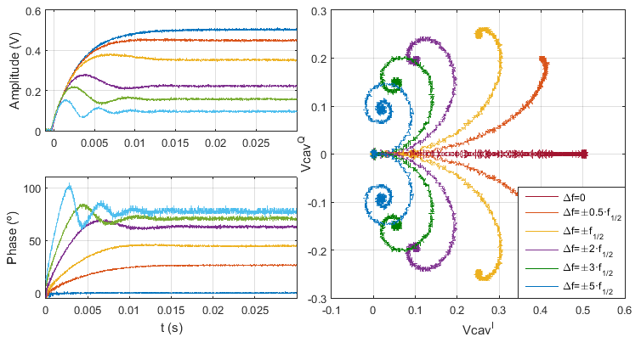
Superconducting radio-frequency virtual cavity for HIL testing
FPGA based simulator for SRF cavities
Extensive simulation tests
Individual functionalities
Electric model
Mechanic model
Microphonics
Lorenz Force Detuning
Full model
Test of TESLA (9 cells) cavity:
Amplitude and phase with different detuning
Results from Eukeni Aldekoa’s Master Degree

Slide 13
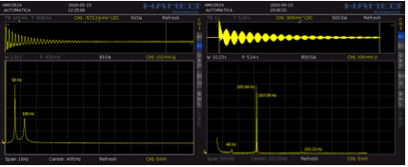
Superconducting radio-frequency virtual cavity for HIL testing
FPGA based simulator for SRF cavities
Extensive simulation tests
Individual functionalities
Electric model
Mechanic model
Microphonics
Lorenz Force Detuning
Full model
Test of TESLA (9 cells) cavity:
Detuning effect observed in the oscilloscope

Slide 14
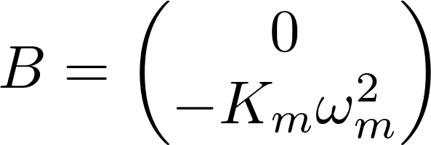
Superconducting radio-frequency virtual cavity for HIL testing
FPGA based simulator for SRF cavities
Host VI
Modelo eléctrico
Modelo mecánico
Efectos no-ideales
Q slope
Quench

Slide 15
Superconducting radio-frequency virtual cavity for HIL testing
Outline
Introduction
Collaboration between HZB and UPV/EHU
FPGA based simulator for SRF cavities
Hardware-In-the-Loop testing: microphonics
Conclusions and future work

Slide 16
Superconducting radio-frequency virtual cavity for HIL testing
HIL testing: microphonics
HIL testing of control techniques, possibilities
- Amplitude and phase
- Resonance frequency
Feedforward → LFD
and microphonics?
- Test of different disturbances:
impulse, step, sinusoidal signals, white noise

Slide 17
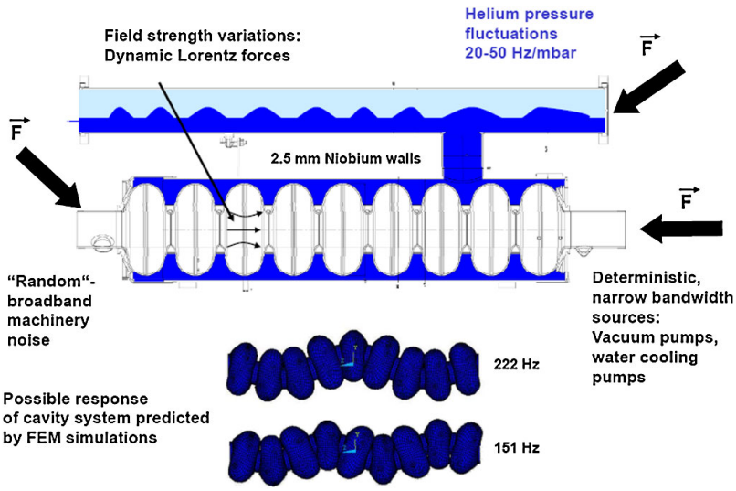
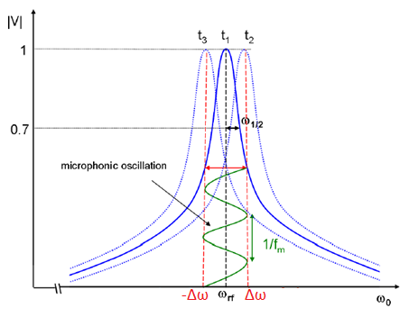
Superconducting radio-frequency virtual cavity for HIL testing
HIL testing: microphonics
Motivation
Analysis and active compensation of microphonics in continuous wave narrow-bandwidth superconducting cavities
A. Neumann, W. Anders, O. Kugeler, and J. Knobloch
PHYSICAL REVIEW SPECIAL TOPICS - ACCELERATORS AND BEAMS, 13

Slide 18
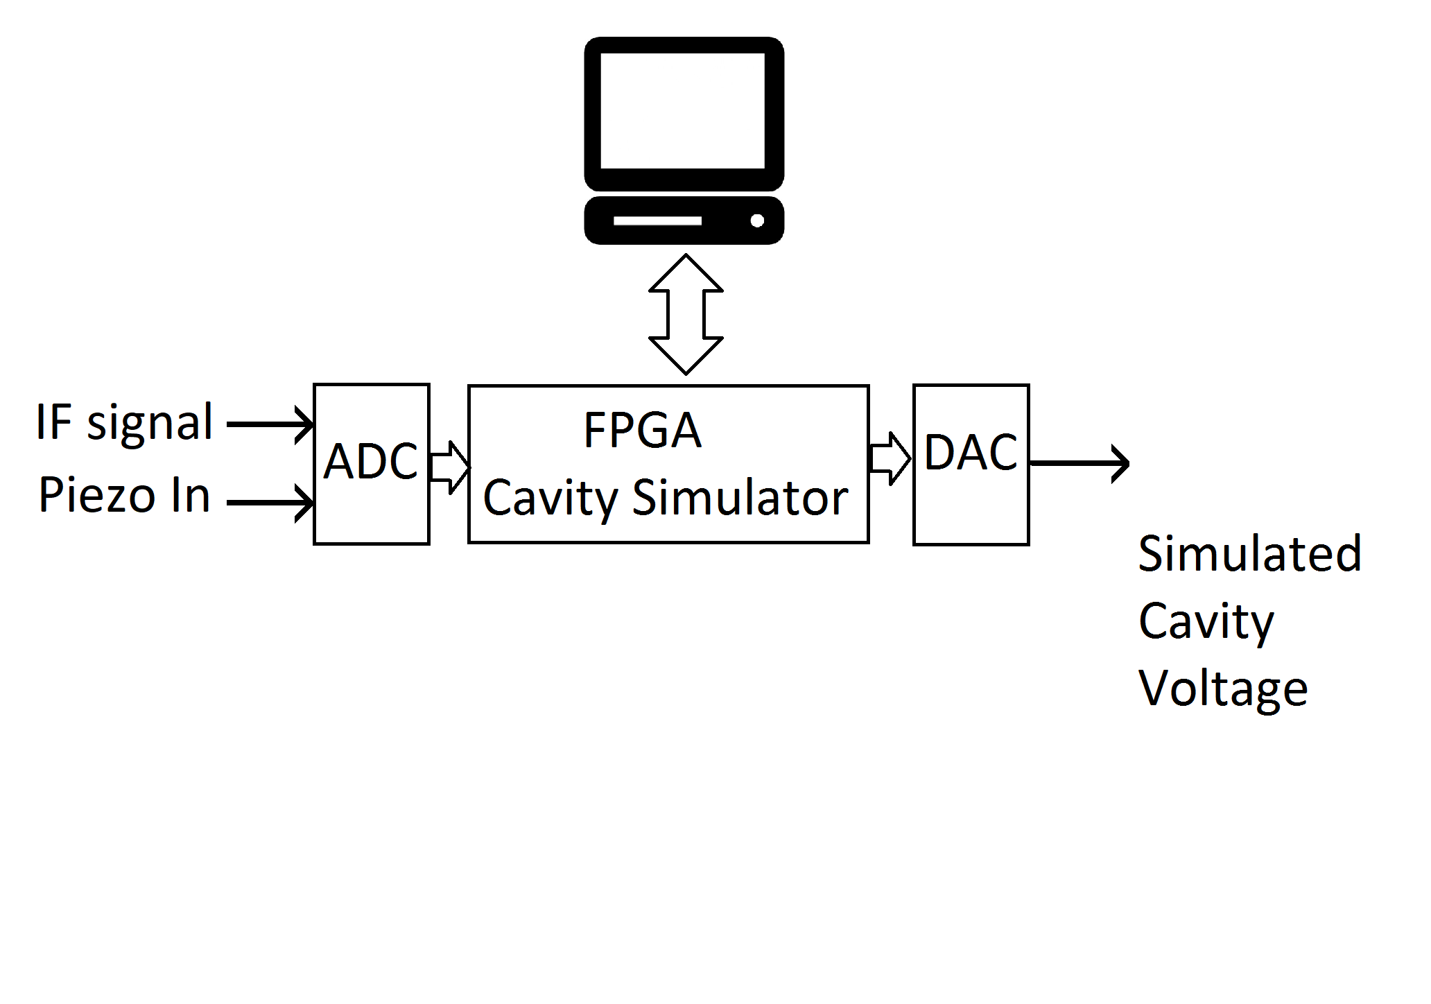
Superconducting radio-frequency virtual cavity for HIL testing
HIL testing: microphonics
New functionalities: Piezoelectric actuator model
Piezoelectric actuator model (discrete version)
New possibility: HIL testing of control techniques against microphonics effect
New possibility: HIL testing of control techniques against microphonics effect

Slide 19
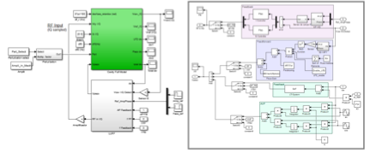
Superconducting radio-frequency virtual cavity for HIL testing
FPGA based simulator for SRF cavities
Initial pure simulation test
Matlab/Simulink
- Amplitude and Phase control
- Feedforward control for LFD
– Active vibration control

Slide 20
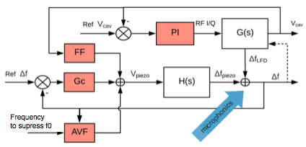
Superconducting radio-frequency virtual cavity for HIL testing
FPGA based simulator for SRF cavities
Initial pure simulation test
Matlab/Simulink
- Amplitude and Phase control
- Feedforward control for LFD
– Active vibration control

Slide 21
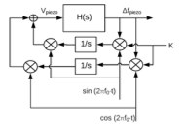
Superconducting radio-frequency virtual cavity for HIL testing
FPGA based simulator for SRF cavities
Initial pure simulation test
Matlab/Simulink
- Amplitude and Phase control
- Feedforward control for LFD
– Active vibration control
Active control using adaptative feedforward
algorithm

Slide 22
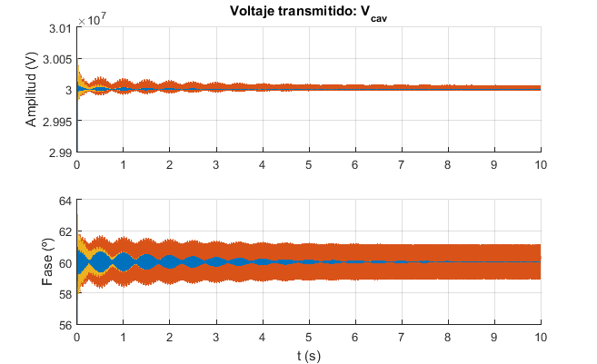
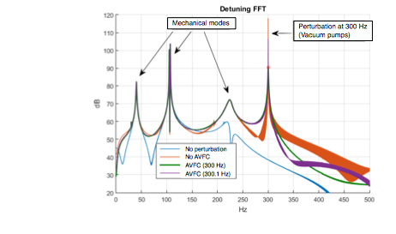
Superconducting radio-frequency virtual cavity for HIL testing
FPGA based simulator for SRF cavities
Active control using adaptative feedforward algorithm
Transmitted voltage:
Amplitude (V)
Phase (º)
Results from Eukeni Aldekoa’s Master Degree

Slide 23
Superconducting radio-frequency virtual cavity for HIL testing
Outline
Introduction
Collaboration between HZB and UPV/EHU
FPGA based simulator for SRF cavities
Hardware-In-the-Loop testing: microphonics
Conclusions and future work

Slide 24
Superconducting radio-frequency virtual cavity for HIL testing
Conclusions and future work
Reconfigurable simulator
FPGA: real time.
Realistic functionalities
Reflected wave, Quench, LFD, some disturbances
Piezoelectric actuator
Applications
HIL Simulations
Teaching
Kalman filter debugging
Microphonics: Future improvements
HIL test of active control techniques
New disturbances simulated and real
Non colocated control

