Slide 1
Potential Application of Advance Control Algorithm for Fast Tuner Control
Shen Zhao Low Level Radio Frequency Team Leader

Slide 2
Outline
Tuner Types
Control Strategy
PID
Observer based control
Simulation Study
Model
Results
Parameter tuning
Summary

Slide 3
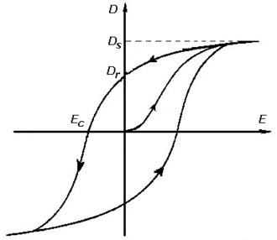
Slow Tuner vs. Fast Tuner
 | Slow Tuner |  | Fast Tuner
Frequency Range | < 1 Hz |  | > 10 Hz
Tuner Types | Stepper Pneumatic Temperature |  | Piezo Variable reactance
Detuning Sources | Bath pressure variation |  | Microphonics Lorenz force detuning
Piezo Tuner
Pros:
Fast response
Fine resolution
Cons
Hysteresis
Creep
Nonlinear gain

Slide 4
Control of Choice
Category | Analysis Method | Method | Model Dependency
Classical Control Theory | Frequency Domain (TF) | PID Lead-lag compensator Loop-shaping | No System TF System TF
Modern Control Theory | Time Domain (SS) | State observer Disturbance observer | Yes Yes / No | Advanced control?
Other |  | Robust control Adaptive control Fuzzy logic Neural network … | Yes Yes No No

Slide 5
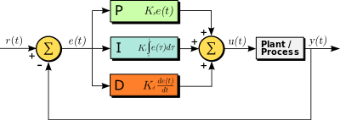
PID Controller
Pros
Simple structure
System can be treated as black box
Only three parameters to tune
Transfer function analysis
Cons
One degree of freedom
Tracking y(s) / r(s) => 1
Disturbance rejection y(s) / d(s) => 0
Ignoring knowledge of system
Performance
d_{i}
d_{o}
G⁻¹(s)
r
+
+
+
y
C(s)
+
G(s)
+
-

Slide 6
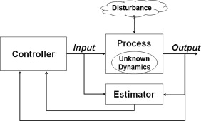
Observer based Control
Observers
Luenberger observer
Estimate system states
Unknown input observer
Estimate external disturbance
Extended state observer
Estimate external disturbance and unknown dynamics
Equivalent Transfer Function Representation
Two degree of freedom
Observer performance determines disturbance rejection performance
Controller performance determines tracking performance
Reference
Observer

Slide 7
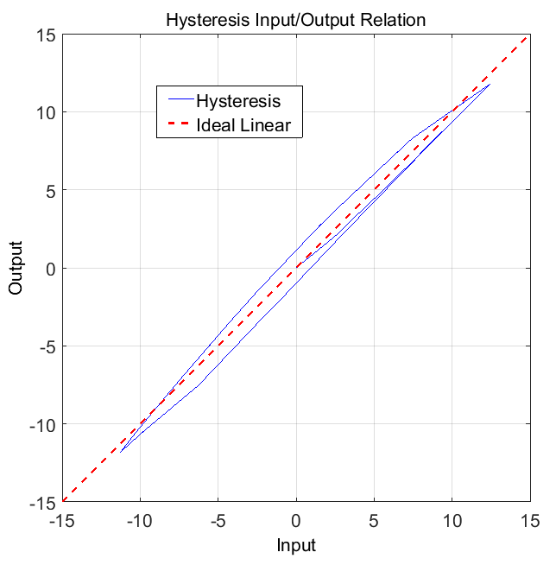
Simulation Model
Hysteresis
30 Hz
ADRC
Notes
Hysteresis is treated as disturbance and its effect is estimated by the ESO (z₂) and then cancelled in the controller
The ESO does not include any model information of the hysteresis; the estimation performance is mainly determined by the observer bandwidth, which is limited by sampling rate and noise level.

Slide 8
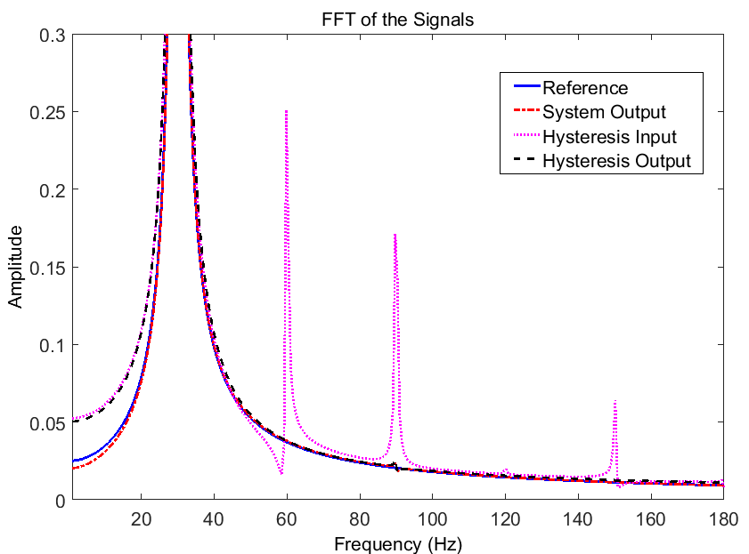
Simulation Results
The nonlinear effect of the hysteresis will distort the perfect sinusoidal input and create higher order harmonic components in the system output.
With feedback control, the third harmonic in the system output signal is greatly suppressed.
residue nonlinear effect

Slide 9
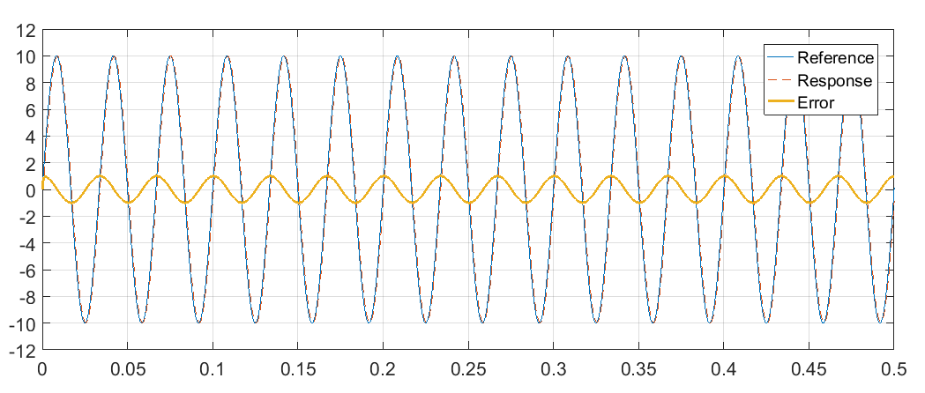
Parameter Tuning
Parameters | Case #1 | Case #2 | Case #3 | Case #4
Sine Wave Frequency (Hz) | 30 | 60 | 60 | 60
Controller Bandwidth (rad/s) | 2000 | 2000 | 2000 | 4000
Observer Bandwidth (rad/s) | 10000 | 10000 | 20000 | 10000
Tracking Error (%) | 10 | 20 | 19 | 10

Slide 10
Summary
Traditional PID controller is still dominant, but performance may be limited for challenging problems
The disturbance observer based control design may be an effective solution to deal with the hysteresis effect in the piezo fast tuner
Looking for collaborations if interested

