Slide 1
CW studies at DESY’s cryomodule test bench.
R&D effort towards continuous wave operation of the European XFEL
Julien Branlard, for the LLRF team
New York City, 25.10.2018

Slide 2
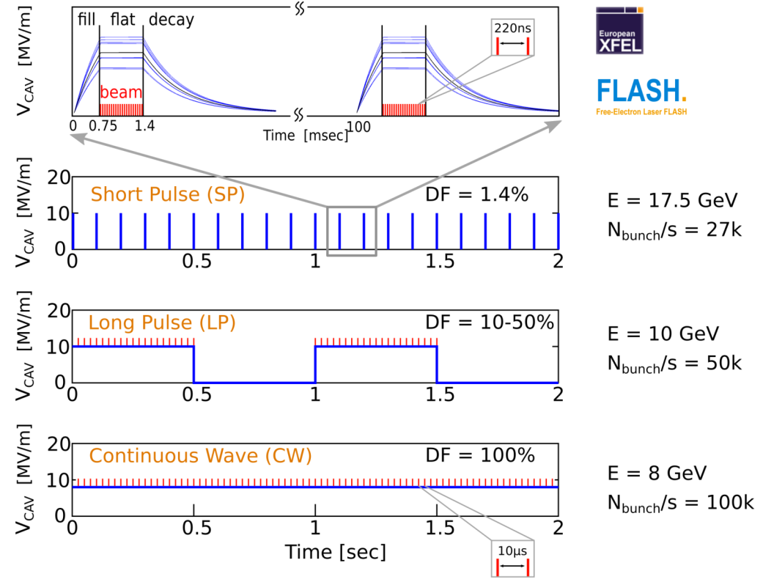
CW studies at CMTB
Motivations for CW
CW upgrade of the European XFEL
Feasibility study
Possible beam energy = 8 GeV
CW in addition to pulsed mode
Long pulse also an option
Collaboration with other Helmholtz institutes (Germany)
HZDR (Dresden)
ELBE: SRF FEL
Single cavity regulation LLRF system
Shared, HW, FW, server development
Possibility to test with beam
HZB (Berlin)
bERLinPro: SRF ERL
BESSY-VSR, storage ring
LLRF, single cavity regulation
Shared, HW, FW, server development
Talks tomorrow by
A. Neumann and P. Echevarria
Accelerator R&D program funded by Helmholtz

Slide 3
CW studies at DESY
CW studies
High Q_{L}
CW RF source
Vector sum operation
Microphonics
Q₀ and dynamic heat load
CW SRF gun
Single cavity operation
CW cryomodule
…
Simple overview
100 kW IOT
Linearization
Transients
Coupler modifications
What Q_{L} can be achieved?
What’s reasonable?
Thermal effects?
This talk
Larger 2 phase return pipe
CW cavities
Are microphonics an issue?
What are the sources?
Cavity transfer function?
Passive, active compensation
Piezo feedback
Is large grain important?
Nitrogen infusion
Operation at 1.8K? at 1.6K?
New SRF design
Avoid cathode exchange
Next talk (Wojtek C.)
High Q_{L}, high gradient
Lorentz force detuning
Static drops
RF controls
High Q_{L}, high gradient
Lorentz force detuning
Static drops
RF controls

Slide 4
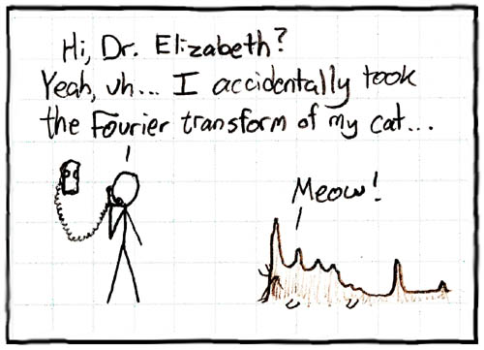
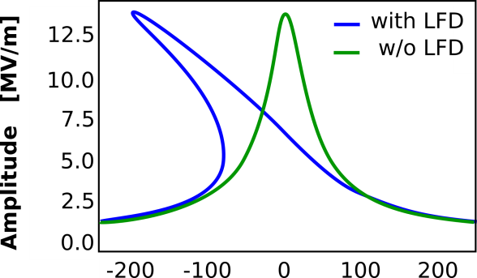
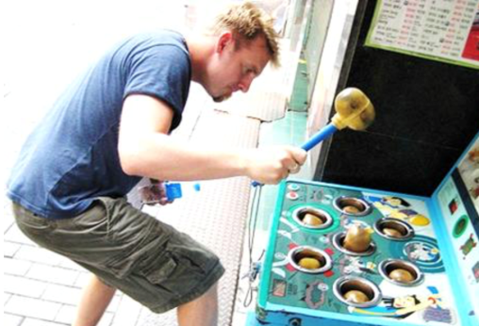
OUTLINE
Microphonics in the scope of CW studies at DESY
Microphonics and cavity modes measurements
With piezo, with RF
Frequency and stability analysis
Suppression of microphonics
Active noise cancellation
Automation of parameter optimization
Lorentz Force detuning and microphonics
Static drops
Piezo feedback
Outlook
Summary
Future tests at CMTB

Slide 5
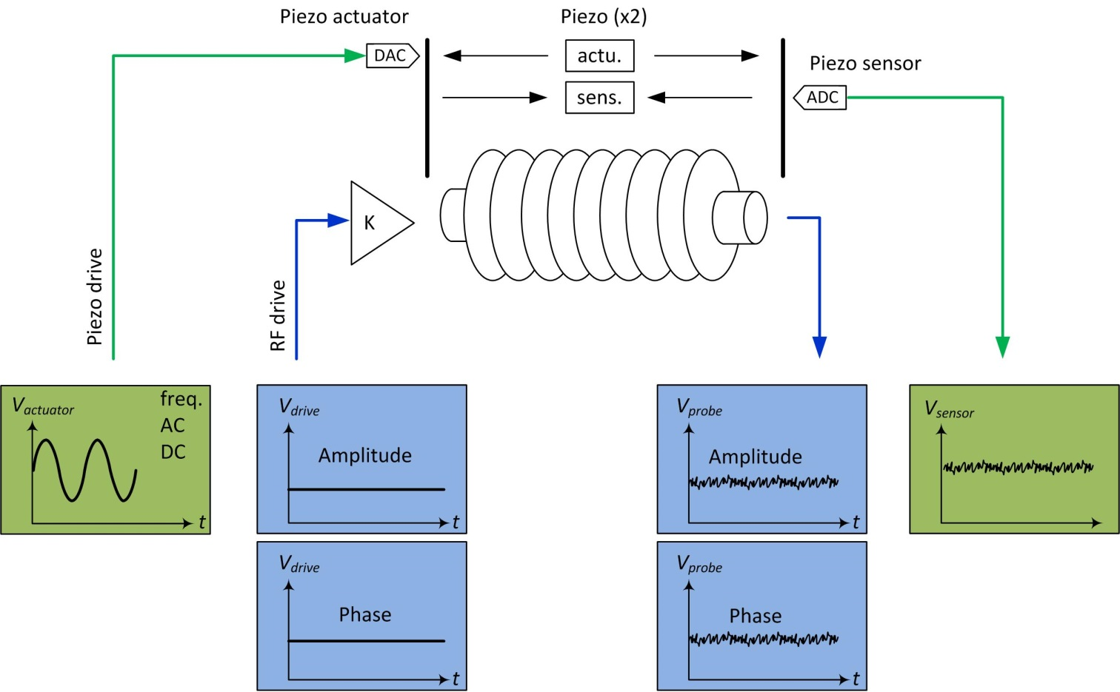
Microphonics measurements
For particle accelerators
Sources of microphonics
Natural vibrations (i.e. earthquakes)
Human factors (i.e. trucks, foot steps)
Accelerator operation (i.e. pumps, cryo bath)
RF
Piezo
Measuring microphonics
With beam
With external sensors (i.e. accelerometers)
With internal sensors (i.e. piezo)
With RF (i.e. cavity probe)

Slide 6
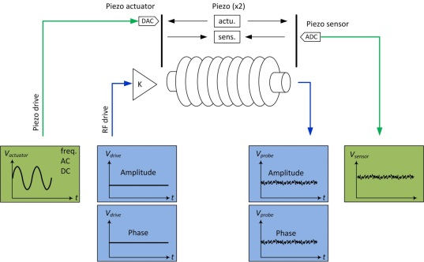
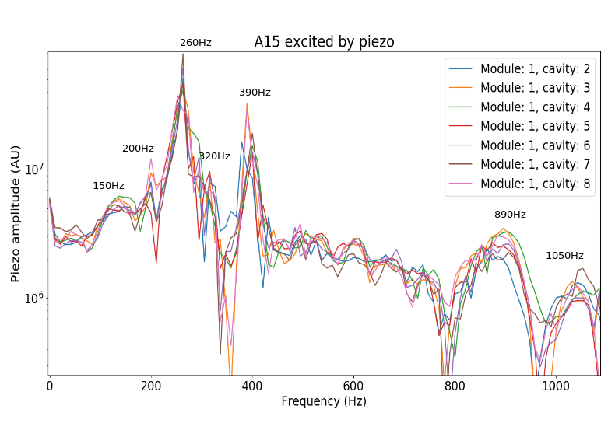
Measuring cavity mechanical modes
Transfer function: piezo → piezo
Measurement
RF is off
Excite piezo with sine waveform
2 periods at 300 Hz
FFT of piezo sensor waveform
Outcome
Dominant resonant modes are found
Here XFEL cryomodule ~ 260 Hz
Courtesy A. Bellandi

Slide 7
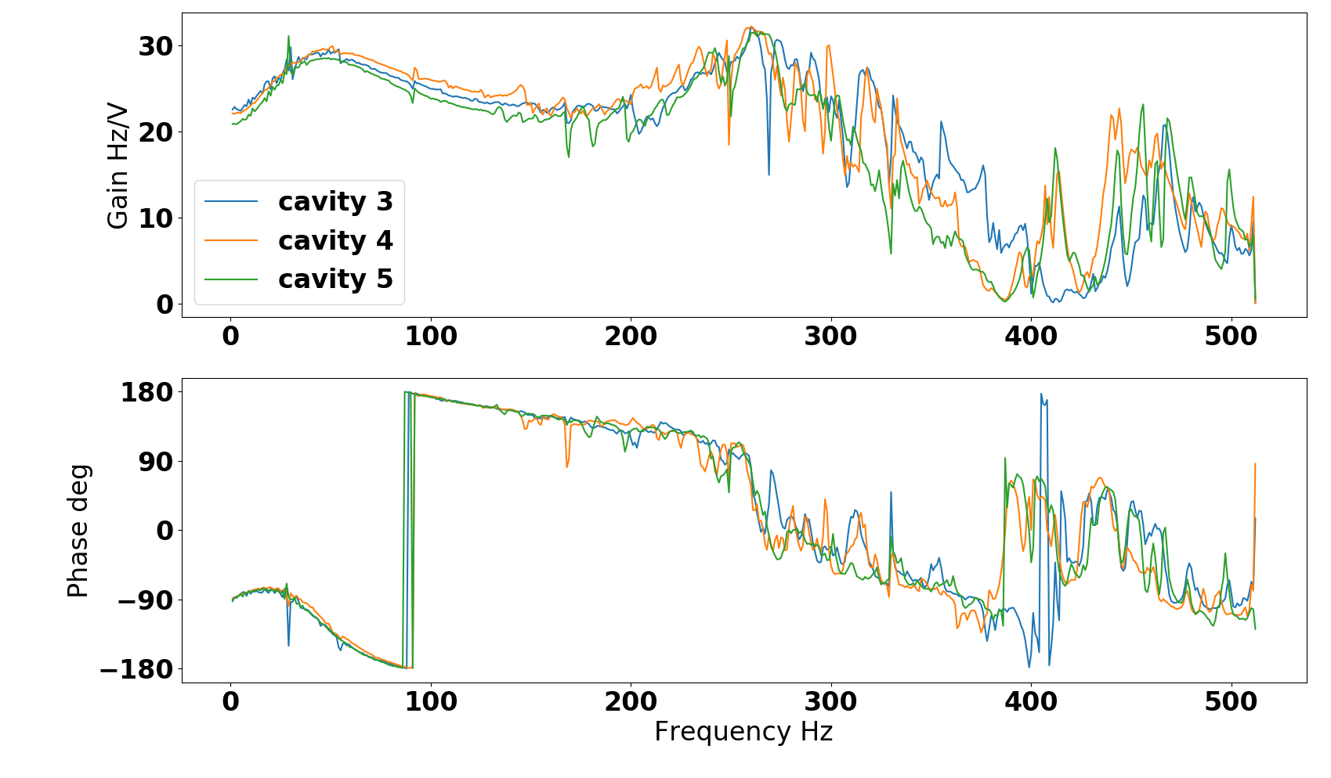
Measuring cavity mechanical modes
Transfer function: piezo → RF
Measurement
RF is on
Excite piezo with sine waveform
FFT of RF phase waveform
Sweep sine frequency
Outcome
Dominant resonant modes are found
Here XFEL cryomodule ~ 260 Hz
260 Hz
Courtesy A. Bellandi

Slide 8
Measuring microphonics – with RF
As a function of gradient
Measurement:
RF is on, different gradients
FFT of cavity RF phase signal
Outcome
CMTB: main freq: 30 Hz, 49 Hz (well known)
Independent of gradient
Courtesy A. Bellandi

Slide 9
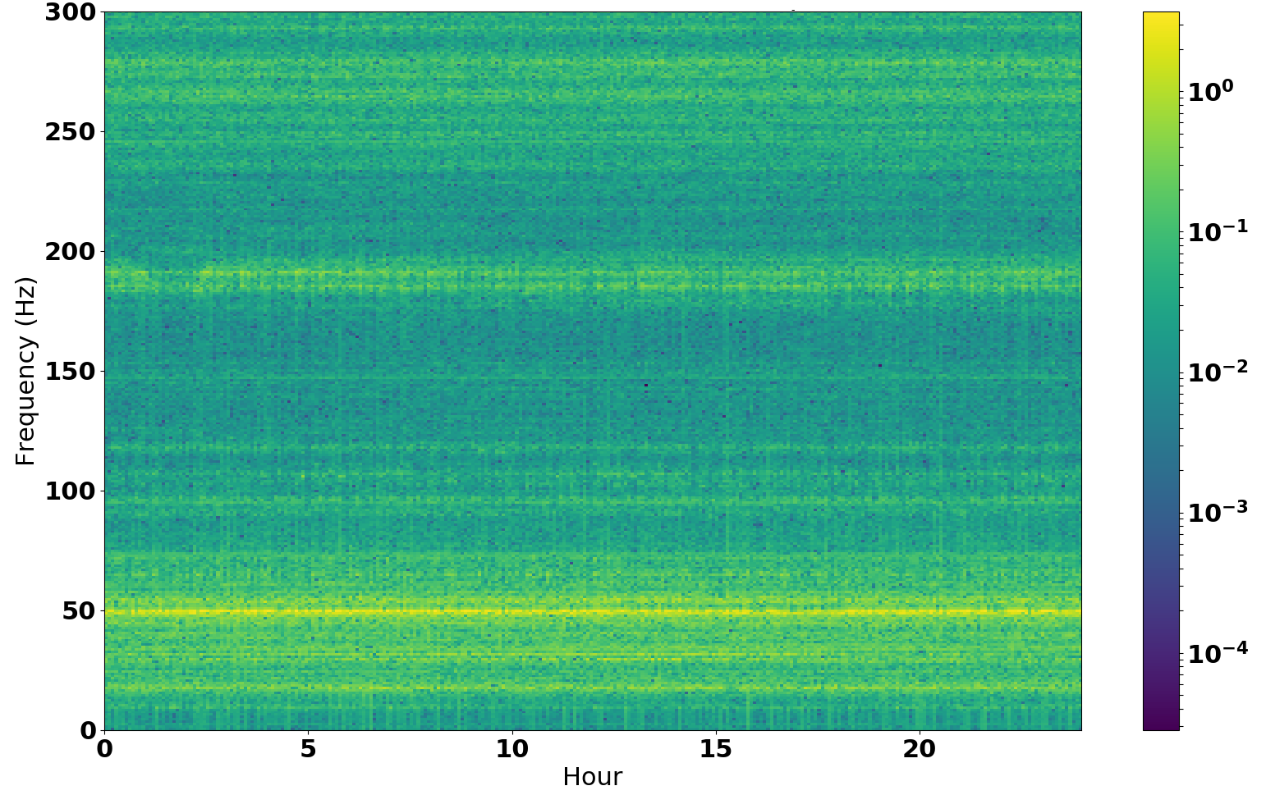
Measuring microphonics – without RF
As a function of time
Measurement
XM-3 at CMTB
Data taken with piezos
FFT amplitude of piezo sensor
Spectrogram over 1 day
Outcome
Stable background conditions (in this example)
FFT amplitude [a.u.]
Courtesy A. Bellandi

Slide 10
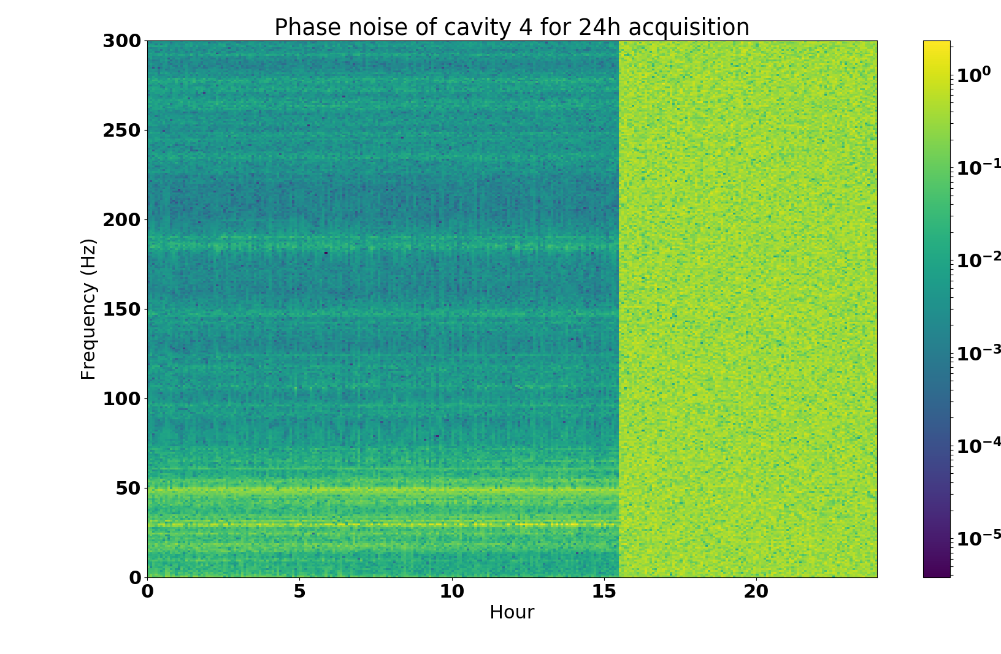
Measuring microphonics – with RF
As a function of time
Measurement
XM-3 at CMTB
Data taken with RF
FFT amplitude of probe phase
Spectrogram over 1 day
Outcome
Stable background conditions (in this example)
[deg]
IOT OFF (interlock)
Courtesy A. Bellandi

Slide 11
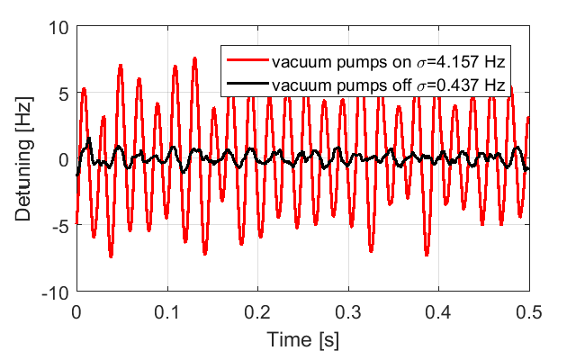
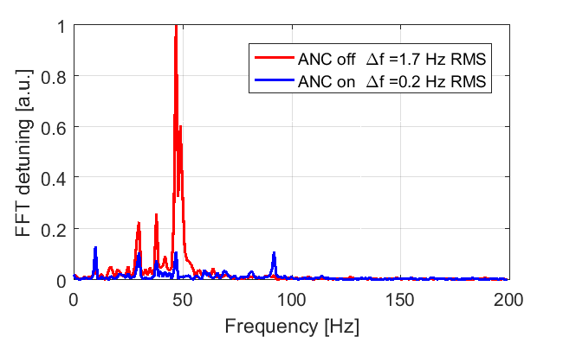
Microphonics suppression
Using Active Noise Cancellation (ANC) techniques
Source of microphonics
Main contributor are vacuum pumps (essential for operation)
Dominant frequencies around 30 Hz and 49 Hz for most cavities
Impact increased with higher Q_{L}
Microphonics suppression
Active Noise Cancellation (ANC) techniques were applied to notch these frequencies (adjusted for individual cavities)
> 20 dB suppression can be achieved
Reference: R. Rybaniec et al. “FPGA-Based RF and Piezo controllers for SRF Cavities in CW Mode”, IEEE TRANSACTIONS ON NUCLEAR SCIENCE, VOL. 64, NO. 6, JUNE 2017
Courtesy A. Bellandi

Slide 12
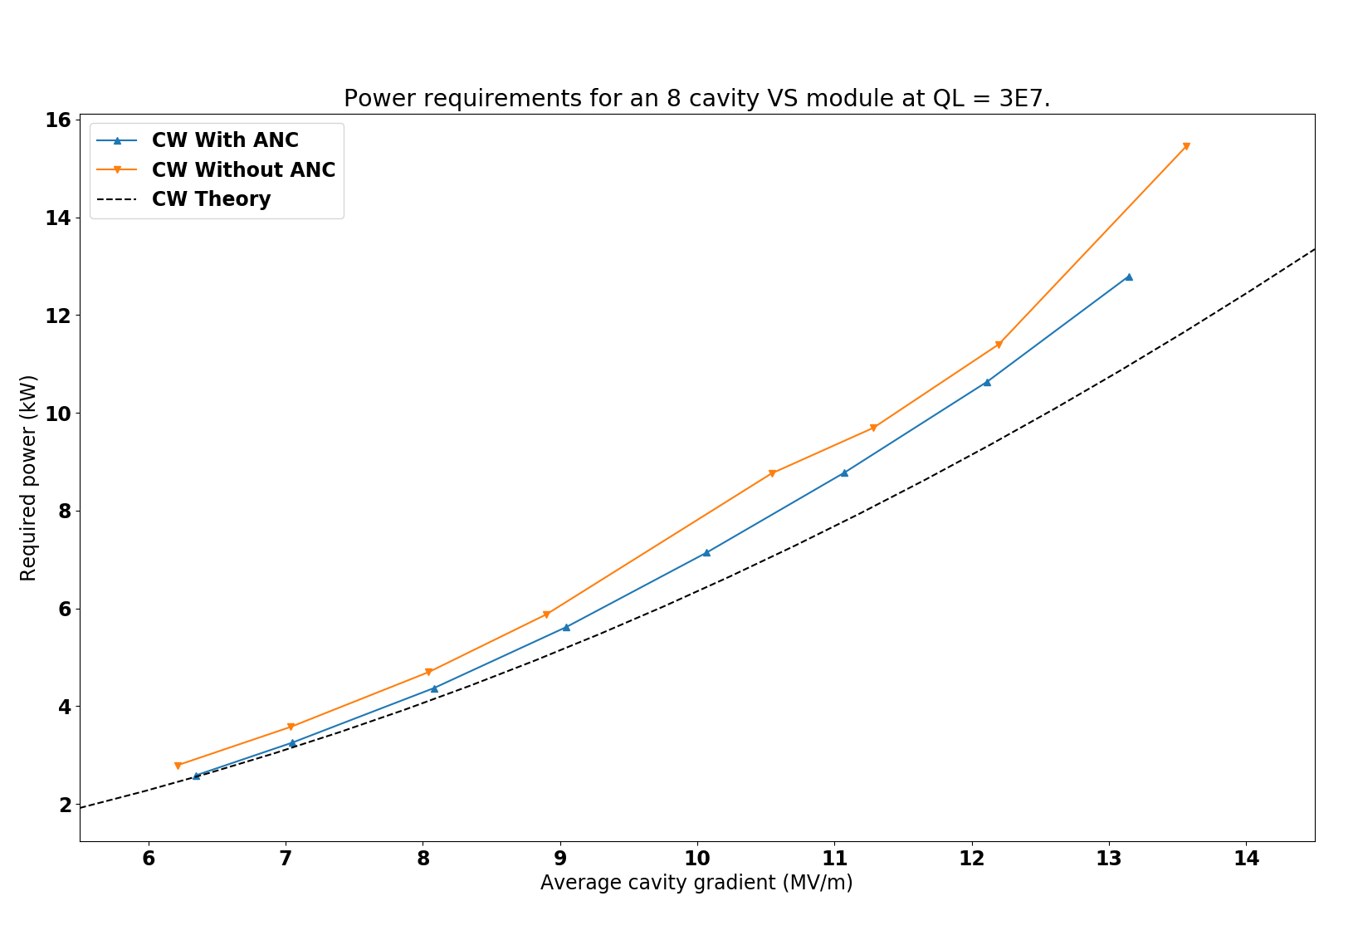
ANC: power consumption
The impact of noise cancellation on forward power
ANC also helps with power consumption
Gradients between 6 MV/m and 13 MV/m
ANC decreased the power consumption by 6% to 12%
For low gradients the consumption for the ANC measurements approaches the theoretical minimum value
Courtesy A. Bellandi

Slide 13
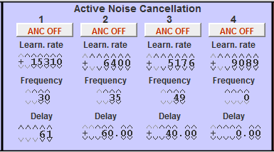
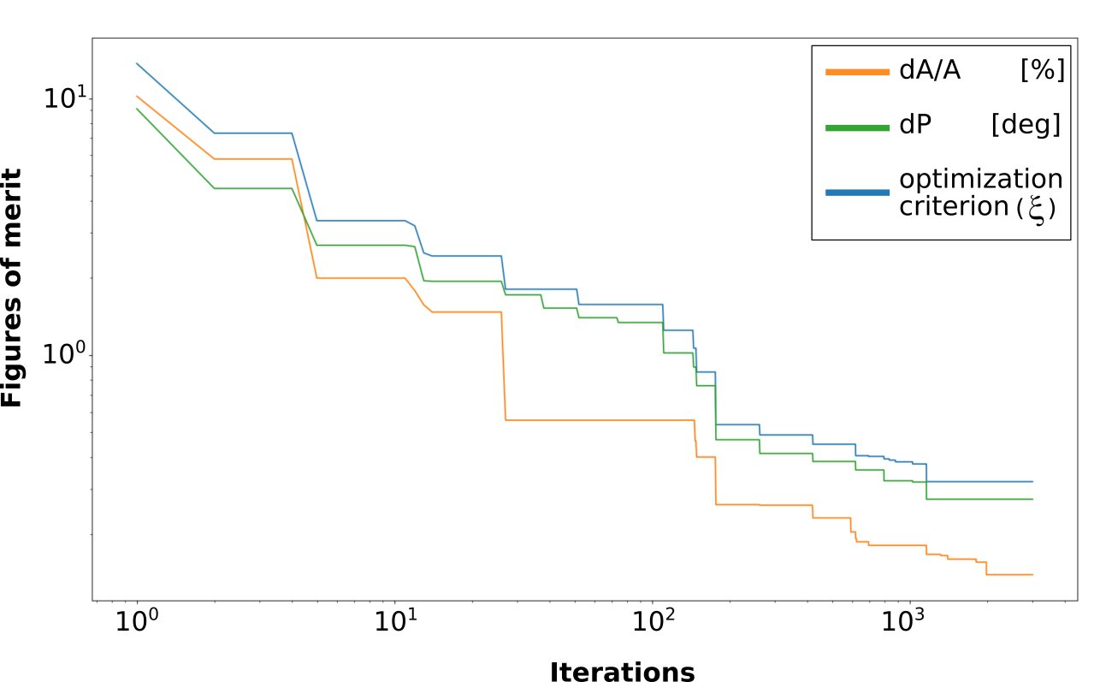
ANC: parameter optimization
x800 for XFEL !
ANC optimization
Done manually → not scalable
Based on experience
Likely change with time
Automation
First attempt
Bayesian optimization algorithm
Time consuming
Positive outcome but not as optimal as manual tuning
Work on-going
Improve optimization algorithm
Improve ANC scheme to include microphonics measurements
Courtesy A. Bellandi

Slide 14
Microphonics and LFD
1 / 3
Microphonics can/will make the cavity experience a static drop
Effect is worsened for higher Q_{L} and higher gradients

Slide 15
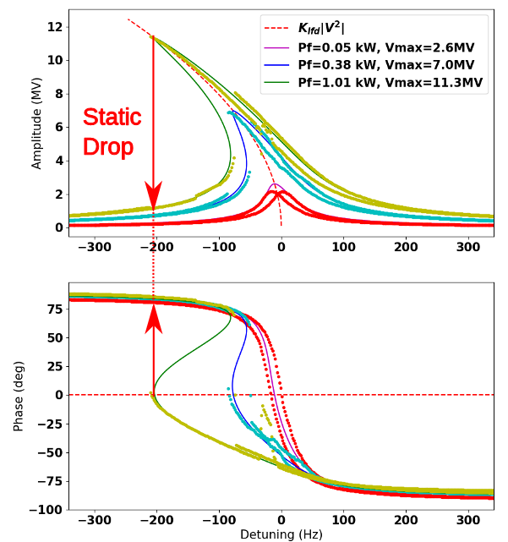
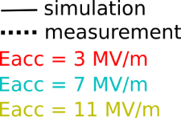
Microphonics and LFD
2 / 3
Microphonics can/will make the cavity experience a static drop
Effect is worsened for higher Q_{L} and higher gradients
Courtesy A. Bellandi

Slide 16
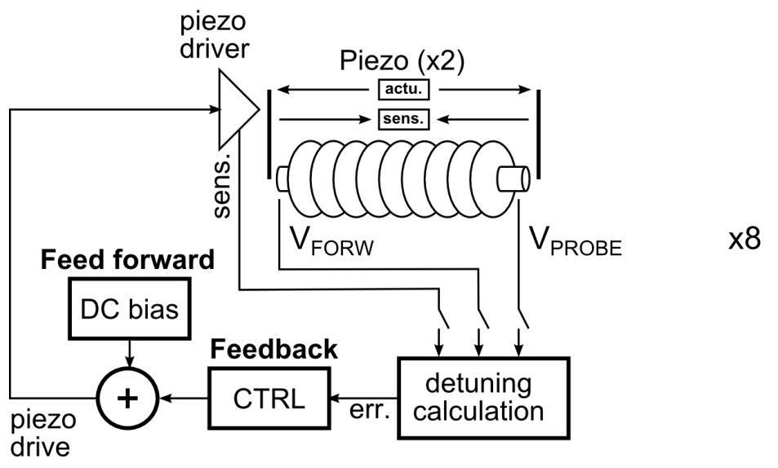
Microphonics and LFD
3 / 3
Microphonics can/will make the cavity experience a static drop
Effect is worsened for higher Q_{L} and higher gradients
In practice, piezo integrator feedback works against this effect
Choose your working point wisely
phase set point

Slide 17
Microphonics and LFD
3 / 3
Microphonics can/will make the cavity experience a static drop
Effect is worsened for higher Q_{L} and higher gradients
In practice, piezo integrator feedback works against this effect
Choose your working point wisely
phase set point

Slide 18
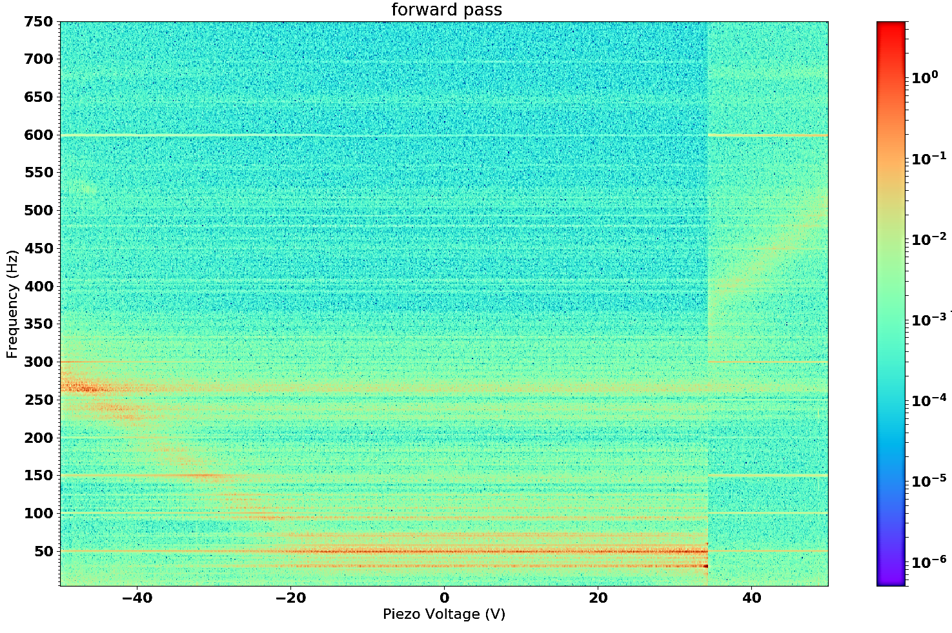
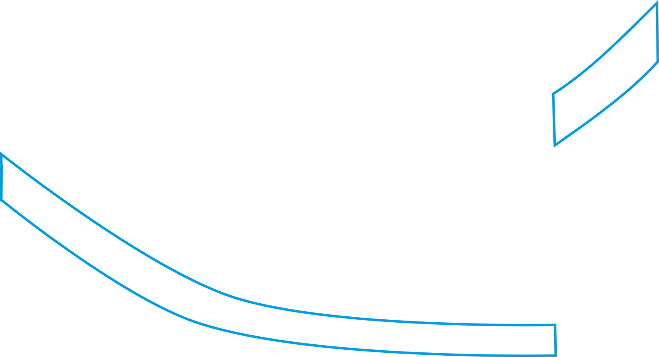
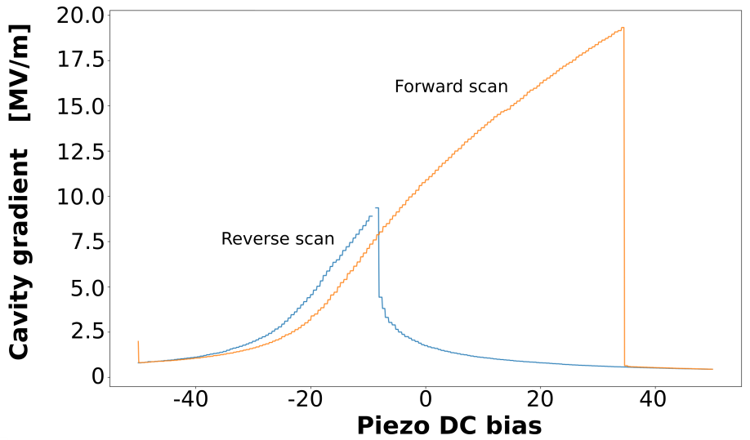
Cavity tuning
What the cavity phase spectrum can tell you
forward scan
[ deg ]
Static drop
Cavity main mechanical mode: 260 Hz
Microphonics: 49 Hz and harmonics
Frequency [ Hz ]
Cavity RF resonance peak
Piezo DC bias
Courtesy A. Bellandi

Slide 19
Summary
On going work towards CW operations
Understand microphonics signature and how to measure them
Characterize the cavity/tuner mechanical transfer function
Good results in CW in terms of
RF stability (0.01%, 0.01 deg.)
At high Q_{L} (6-8x107)
At high gradient (>20 MV/m)
BUT
Understand the limitations and how to go beyond
Limitations of current active noise compensation approach (ANC)
Automate settings
Scale to 800 cavities
Adapt settings to changing environment
Next talk by W. Cichalewski

Slide 20
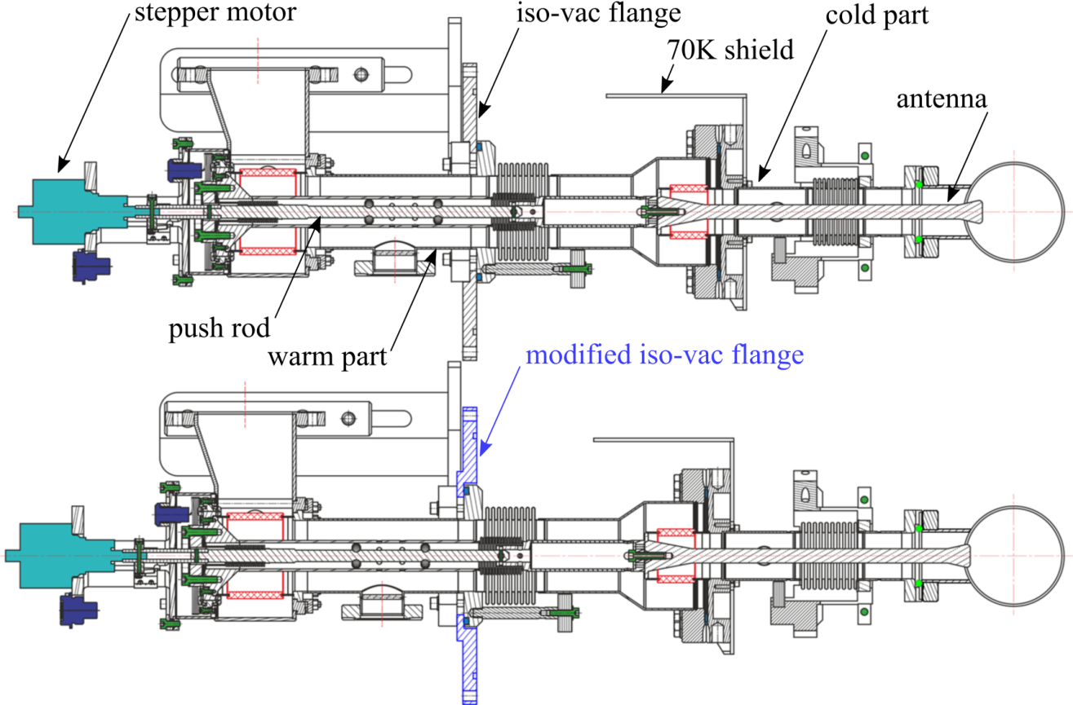
Summary
On going work towards CW operations
Upcoming tests at CMTB
XM50 and XM46
XFEL series cryomodules
Modified with extended iso-vac flange for higher Q_{L}
Difference with XM-3 (fine versus large grain, series versus prototype)
What heat load / Q₀ to expect
Extremely relevant for a CW upgrade of the XFEL (main linac)
Courtesy D. Kostin

Slide 21
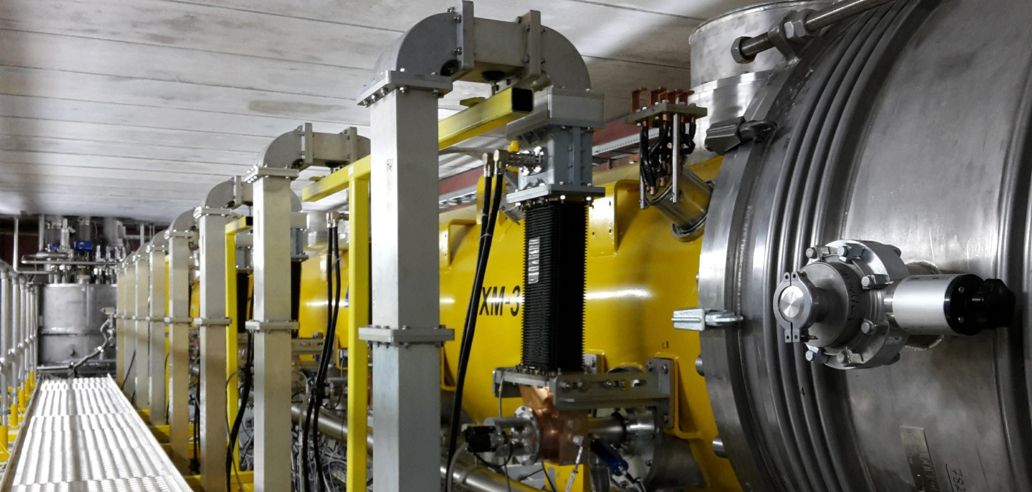
Thank you for your attention!
Special thank to my CW colleagues at DESY
Valeri Ayvazyan, Andrea Bellandi, Wojciech Cichalewski, Jürgen Eschke, Çagil Gümüş, Denis Kostin, Rüdiger Onken, Sven Pfeiffer, Konrad Przygoda, Jacek Sekutowicz, Christian Schmidt
Julien Branlard
MSK
julien.branlard@desy.de
+49 (0) 40 8998 1599

Slide 22
BACK UP SLIDES

Slide 23
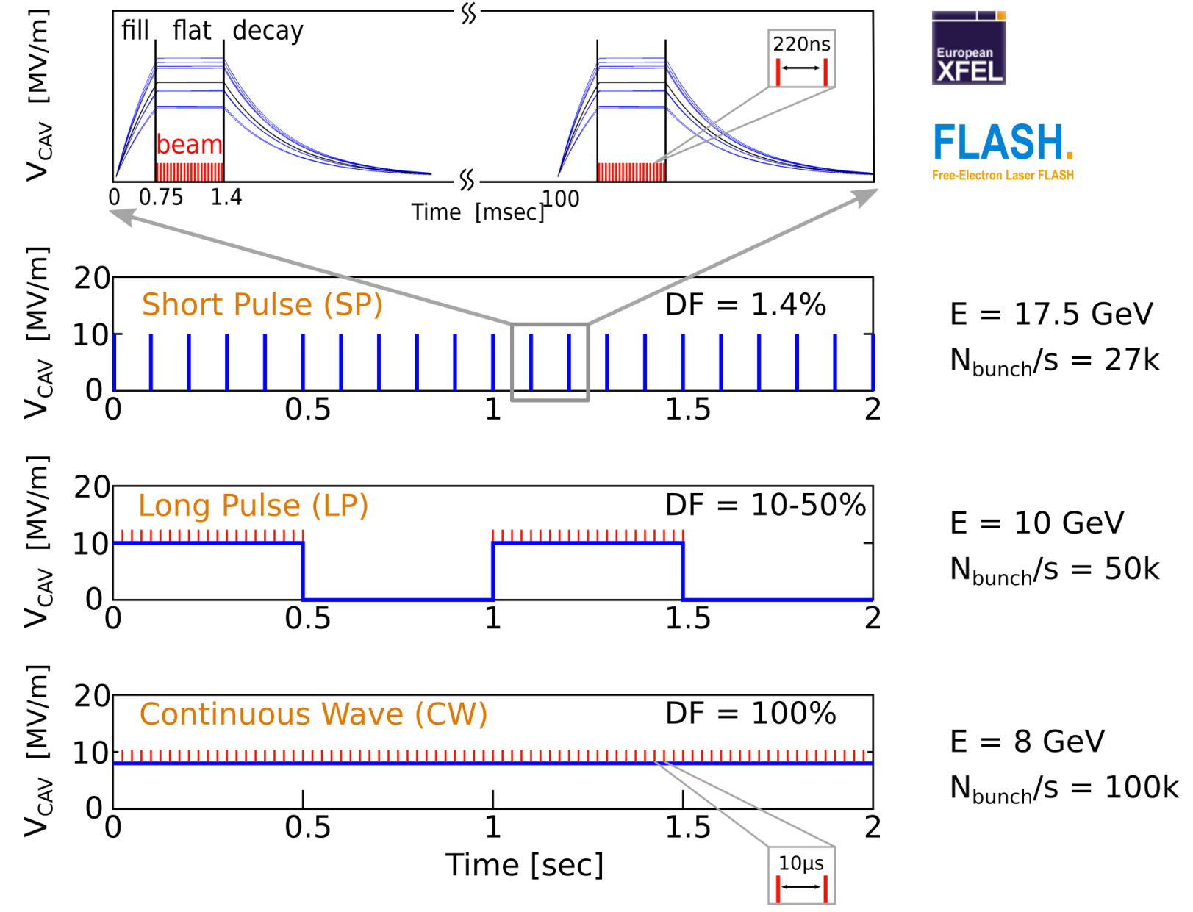
MOTIVATION FOR CW OPERATION
Benefits of Continuous Wave (CW) operation
Flexible beam patterns for detectors Almost any macro pulse structure can be offered
Slower repetition rate lasers
Fill-transients no longer an issue
Benefits of Long Pulse (LP) operation
Still high duty factor (DF = 10-50%)
Higher gradients than CW with same heat load
*
*up to 500 kHz for 20pC
*
*up to 1 MHz for 20pC

Slide 24
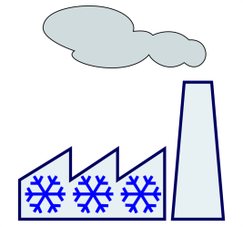
OPERATING THE XFEL IN CW
Injector
1.3 GHz module 3.9 GHz 3rd harm.
L1
4 modules (1 RF station)
L2
12 modules (3 RF stations)
L3
80 modules (20 RF stations)
SASE2
A2
A3
A4
A5
A2
A3
A4
A5
A6
A25
A6
A29
A1
AH1
A1
AH1
SASE1
1 Module
SASE3
cw optimized modules
Linac section L3
operated at moderate CW gradients
lengthened by former A2 … A5
80 + 12 modules
24 RF stations
Expected energy 8 GeV !
1 – Replace the front-end cryomodules (17x)
Larger cooling capability
CW cavities
2 – Install CW capable RF sources
1x IOT per RF station
3 – Double the cryo plant (cost driver)
2.5 → 5kW
4 – Install CW capable gun:
RF gun upgrade
The former front-end cryomodules can be installed at the end of the linac to lengthen L3 (+4 RF stations)
No further action required in L3 (>1km)
The upgraded XFEL would be capable of short pulse long pulse AND continuous wave operation

Slide 25
Coupler modifications
Modified iso-vac flange
Example of XM-3
Cavity | Q_{L} max (before) | Q_{L} min (after) | Q_{L} max (after)
C1 | 2.8E7 | 0.6E7 | 8.4E7
C2 | 1.9E7 | 0.5E7 | 6.8E7
C3 | 2.2E7 | 0.8E7 | 11.0E7
C4 | 2.0E7 | 0.6E7 | 9.1E7
C5 | 2.0E7 | 0.5E7 | 7.5E7
C6 | 1.9E7 | 0.4E7 | 6.6E7
C7 | 1.8E7 | 0.5E7 | 3.0E7
C8 | 2.0E7 | 0.5E7 | 3.0E7
Courtesy D. Kostin

Slide 26
Control of acceleration field and cavity resonance
RF feedback
Applied around individual cavities or to the vector sum
Proportional / integral feedback controller
Goal is to maintain gradient amplitude and phase
dA/A ≤ 0.01%
dP ≤ 0.01 deg.
Piezo feedback
Each cavity is equipped with a dual piezo frequency tuner
Applied around individual piezo electric element
Proportional / integral feedback controller
Goal is to keep cavity on resonance to meet phase stability requirements
Δf << cavity half bandwidth

Slide 27
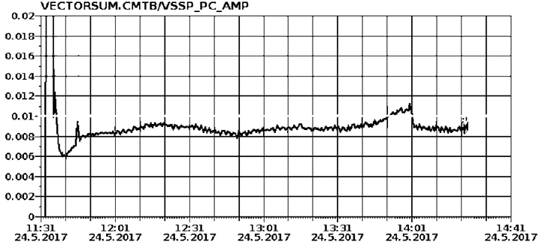
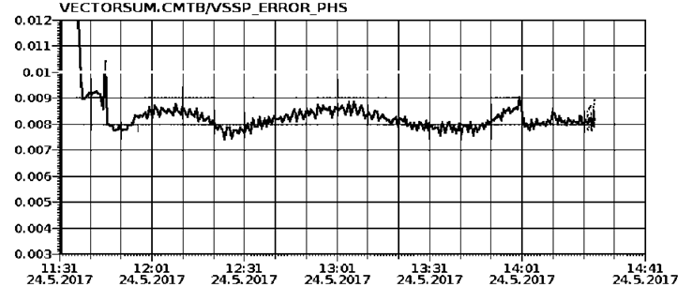
Results: RF Stability example
Vector sum amplitude stability (dA/A)
Vector sum regulation (CW)
E_{ACC} = 15 MV/m Q_{L} = 1.5-3x10⁷ (43-22 Hz half bandwidth)
Regulation performance (May 2017)
dA/A = 0.008 % dP = 0.008 deg.
E_{ACC} = 16 MV/m Q_{L} = 3x10⁷ (22 Hz half bandwidth)
Regulation performance (Dec. 2017)
dA/A = 0.007 % dP = 0.010 deg.
Single cavity regulation (CW)
E_{ACC} = 16 MV/m Q_{L} = 8.2x10⁷ (8 Hz half bandwidth)
Regulation performance (Dec. 2017)
dA/A = 0.015 % dP = 0.017 deg.
goal
RMS jitter [ % ]
3 hours
World Record !
Vector sum phase stability (deg.)
goal
RMS jitter [ deg. ]
3 hours

Slide 28
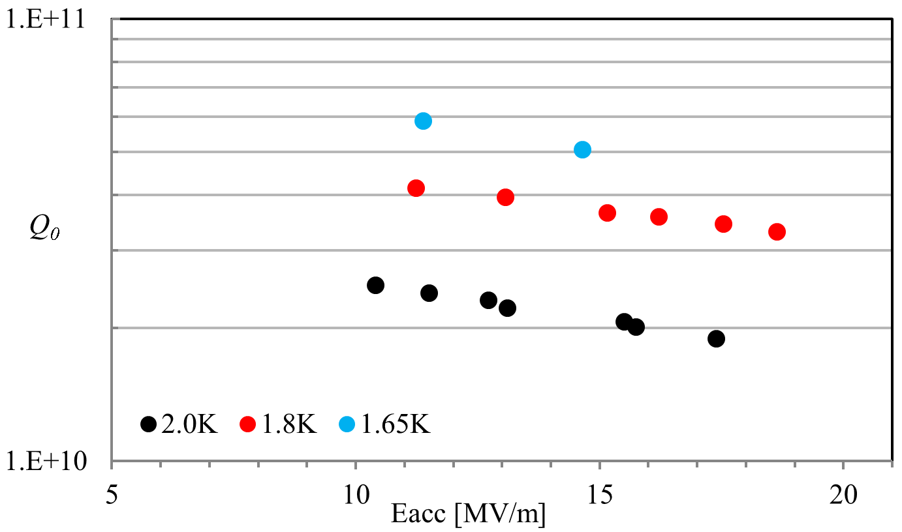
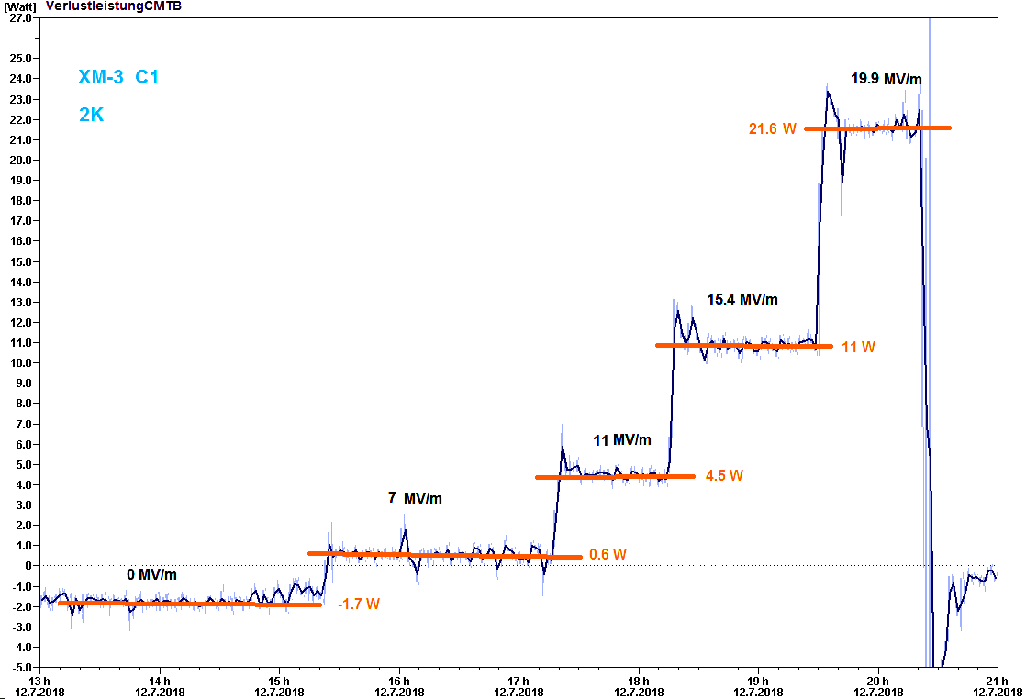
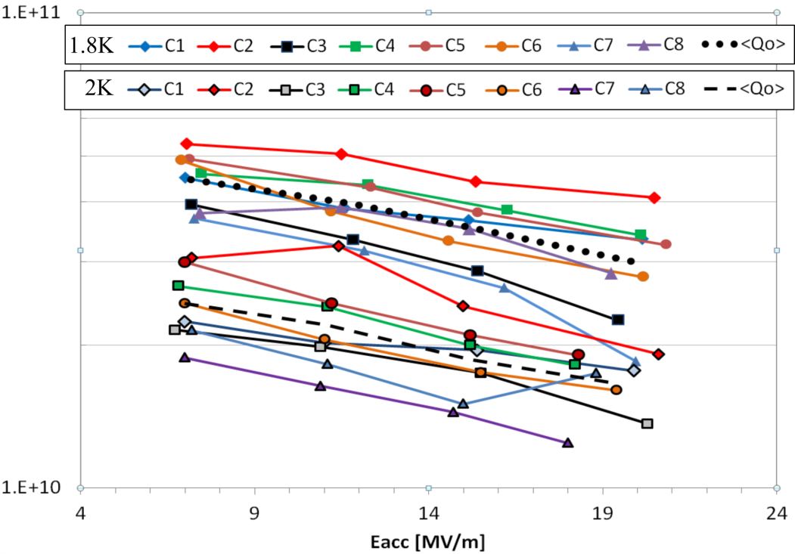
Heat load measurements
Cryomodule heat load measurements
Q₀ vs Eacc for the whole cryomodule at 2K, 1.8K and 1.65K. The gain in Q₀ for 1.8K operation compared to 2K operation is about 80%. Further investigation is required to find out if operation at 1.8K will be more efficient for the first 136 cavities (17 cryomodules in the injector section of the European XFEL accelerator)
Single cavity heat load measurements
The main linac, extended from 84 to 96 cryomodules, could operate in CW around 8 MV/m. The dynamic heat load at this lower gradient is very low and operation at 1.8K would not be beneficial due to the static heat load
The goal was to investigate the potential benefit to operate large grain cavities at temperatures lower than 2K. In these measurements Q₀ is computed by measuring the difference in helium mass flow when one (or several) cavities are in operation.

Slide 29
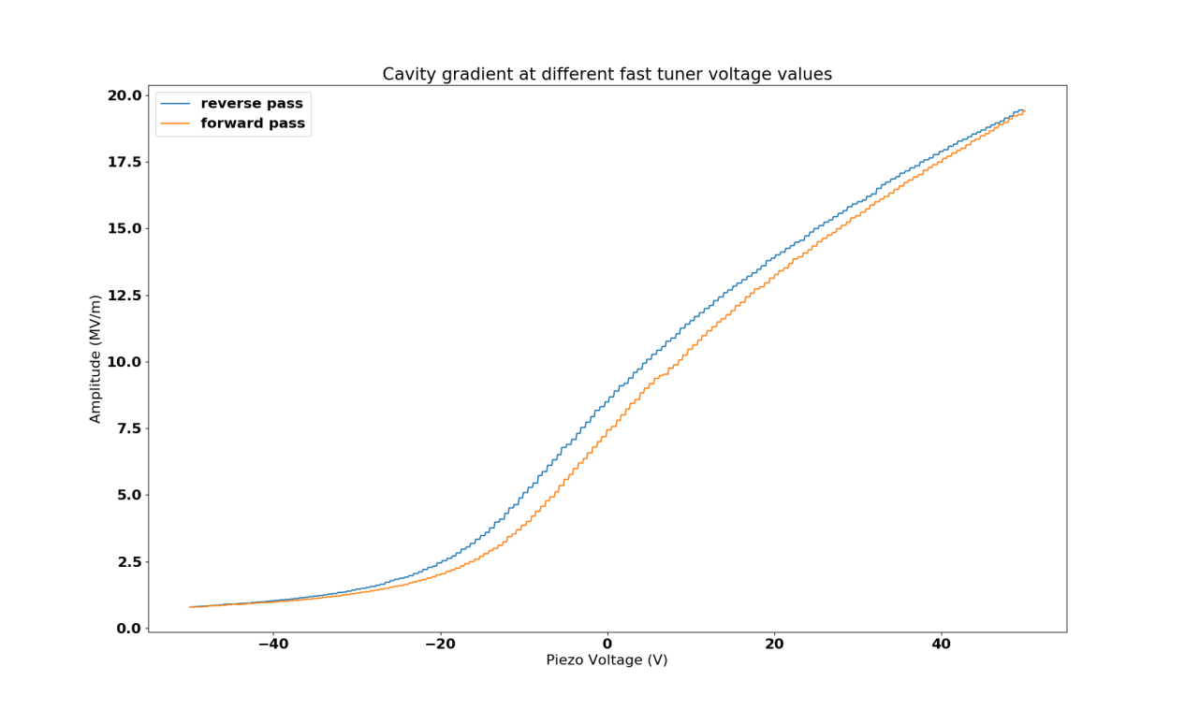
LFD and static drops
Hysteresis behavior when tuning the cavity
The “delay” between the forward and the reverse scans are due to the hysteresis induced by the tuner backlash.
If the scan is stopped just before the static drop, one can see the classic hysteresis curve.

Slide 30
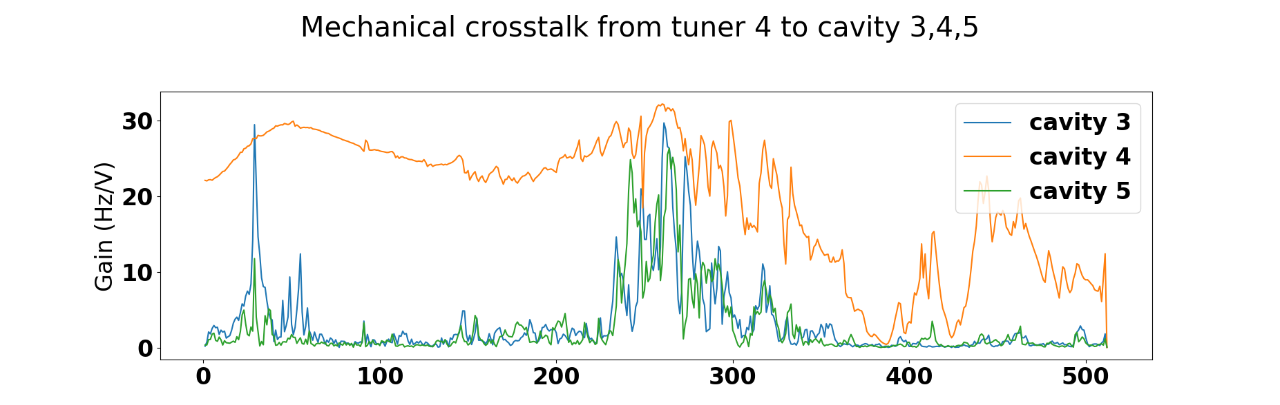
Cavity mechanical modes
Mechanical cross talk between cavities
The coupling between the excited cavity (C4) and the neighboring cavities (C3 and C5) become dominant around the cavity mechanical resonant frequency (~260 Hz)

