Slide 1

Microphonic Characterization and Active Piezo Compensation of a 56 MHz Beam Driven SRF Cavity at RHIC
Freddy Severino
October 25, 2018

Slide 2
Presentation Overview
Cavity Design Parameters
Operation and Control Requirements
Resonance Control Challenges
Operational Parameters Achieved
Identifying Sources of Microphonics
Tuning System Transfer Function Characterization
Initial Results Using Active Piezo Compensation
Summary

Slide 3
Cavity Design Parameters
HOM Damper
Tuner
FPC
Fundamental
Damper
Cavity

Slide 4
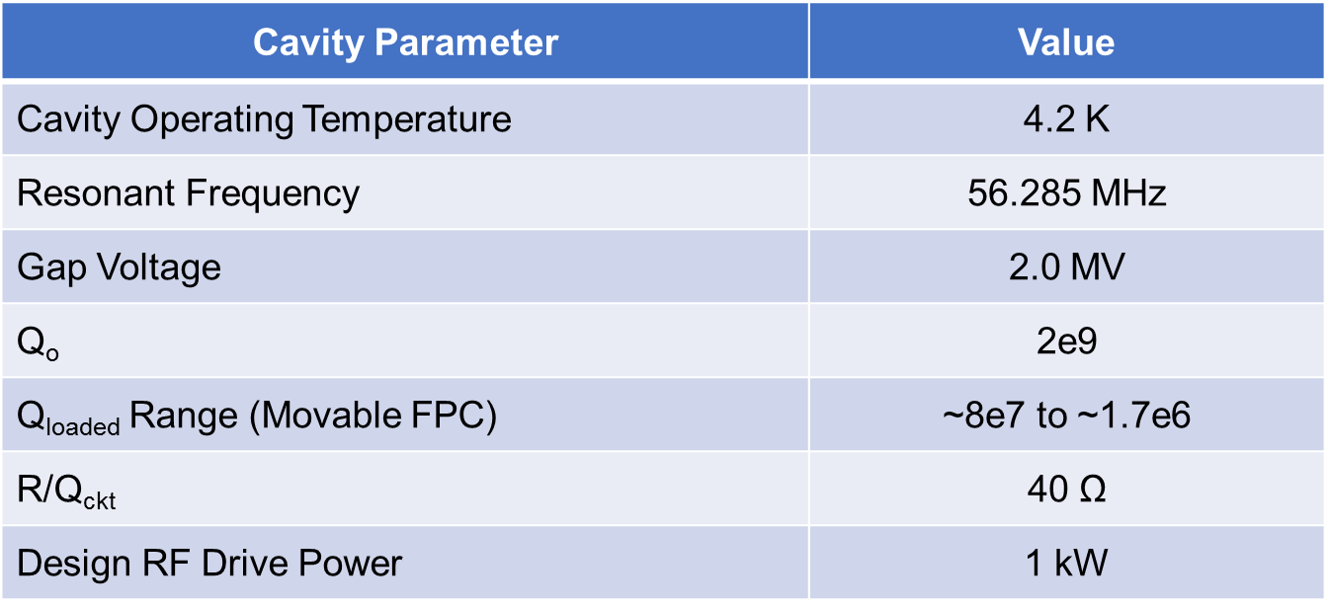
Cavity Design Parameters
Cavity is a Quarter Wave Resonator
Hadron Beam Driven Superconducting Cavity

Slide 5
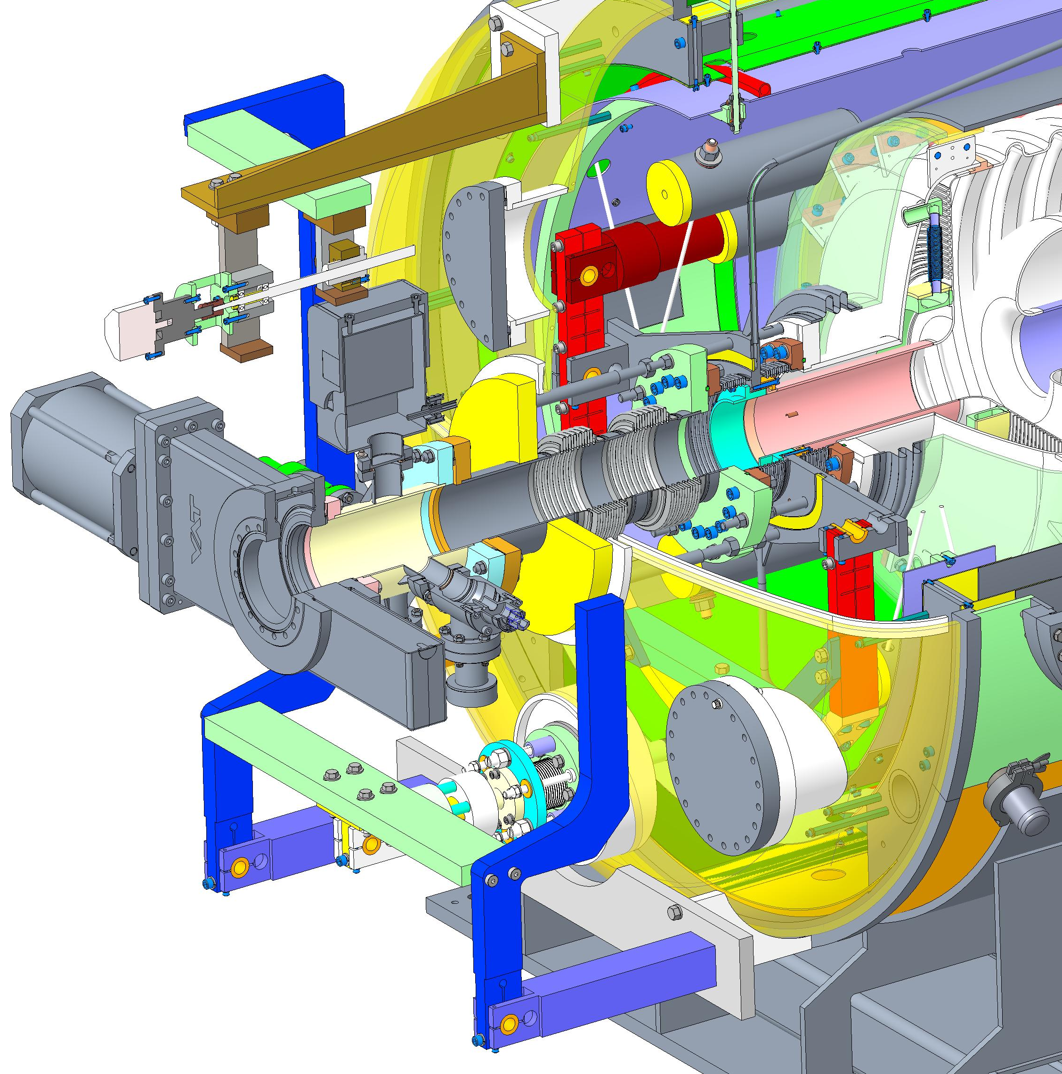
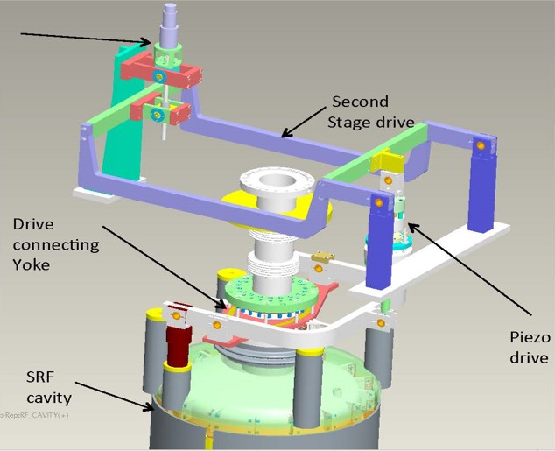
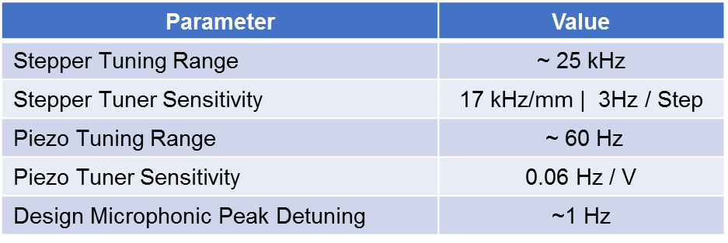
Tuner Design Parameters
Motor
Drive
Motor
Drive
Piezo Drive

Slide 6
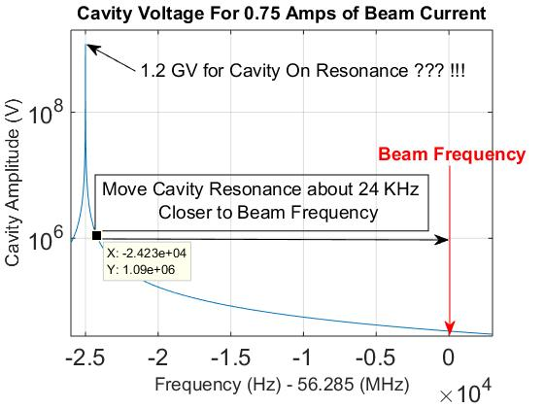
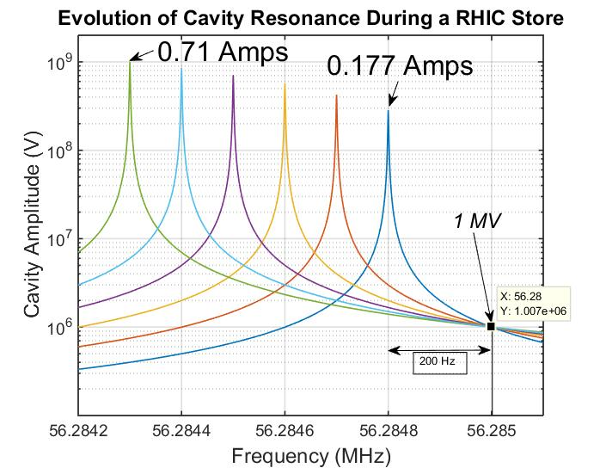
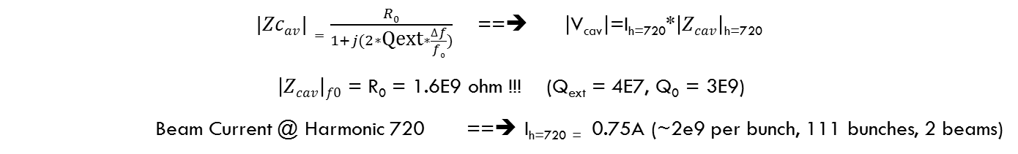
Operation and Control Requirements
      $|Zcav|=\frac{R0}{1+j(2∗\text{Qext}∗\frac{∆f}{f0})}$ ==➔ $\left|\text{V}\text{cav}\right|$=I_{h=720}*$\left|Zcav\right|$_{h=720}
      $\left|Zcav\right|f0$ = R₀ = 1.6E9 ohm !!! (Q_{ext} = 4E7, Q₀ = 3E9)
      Beam Current @ Harmonic 720 ==➔ I_{h=720 =} 0.75A (~2e9 per bunch, 111 bunches, 2 beams)

Slide 7
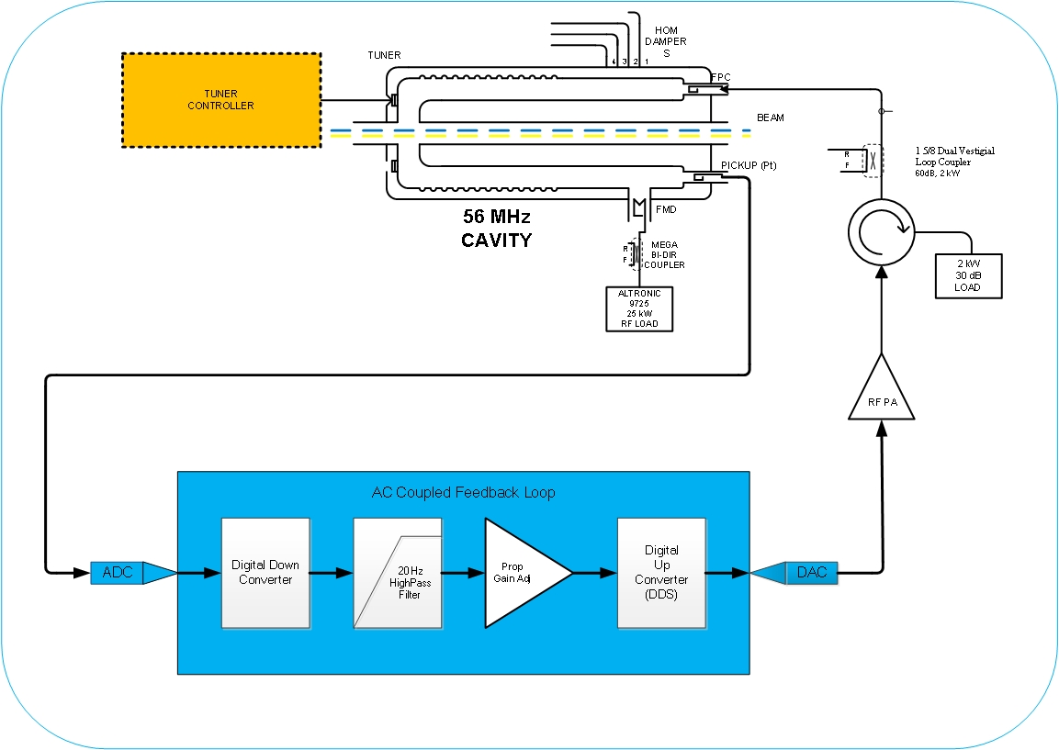
Operation and Control Requirements
Beam Driven Cavity
  AC coupled feedback loop to damp microphonic induced voltage fluctuations.
AC coupled I&Q feedback on first implementation. Later switched to AC magnitude feedback.
Large cavity voltage fluctuations would induce pondermotive instabilities.
Amplitude fluctuations on the cavity voltage < 0.1% (~2 kVpp) for operation with beam.

Slide 8
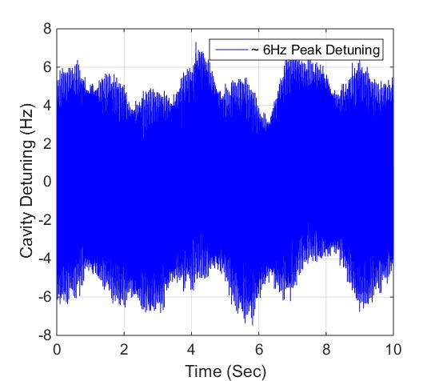
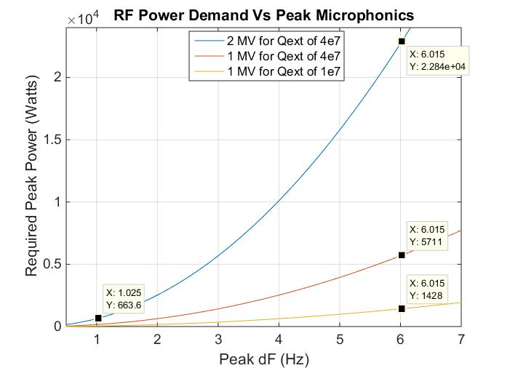
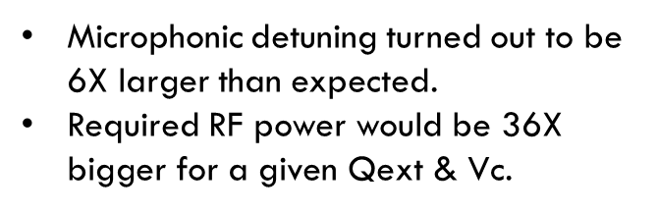
Resonance Control Challenges
Microphonic detuning turned out to be 6X larger than expected.
Required RF power would be 36X bigger for a given $\text{Qext}$ & Vc.

Slide 9
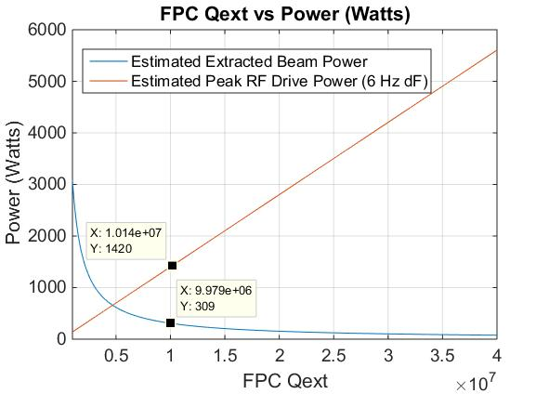
Resonance Control Challenges
  Empirically optimized FPC position (Qext)
    Trade offs between FPC emitted power and PA forward power required for stabilization.
    Required drive power
      Needed high power amplifier
      3.0 kW Amplifier
  Limit goal to operate with beam 1 MV

Slide 10
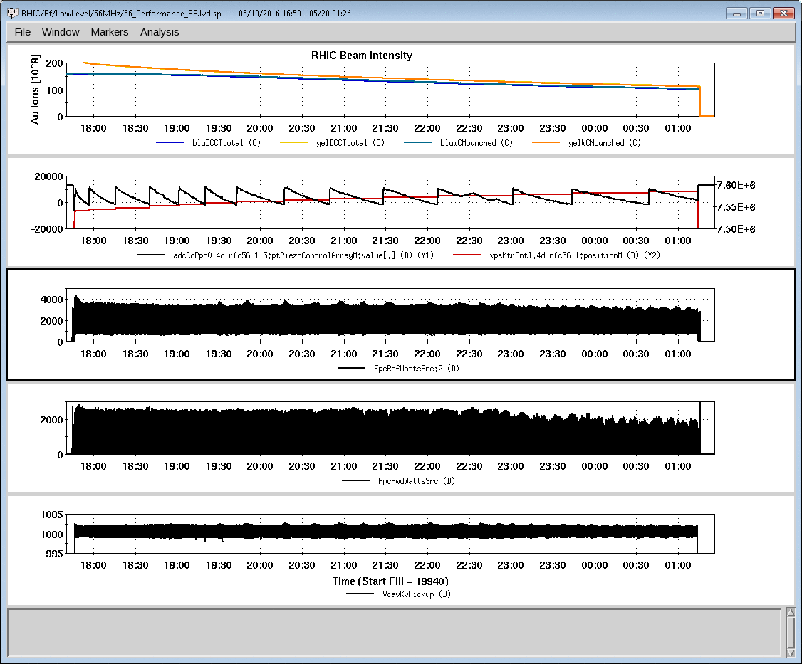
Operational Parameters Achieved
    1MV operational with beam.
    Exposed weaknesses in the cavity and RF
      Found 45 (deg) phase drift in the RF forward path (high power circulator due to water temperature and amplifier non linearities).
      Limited CW power handling in the FPC.
    Provided validation of the LLRF feedback loops used to stabilize the cavity.

Slide 11
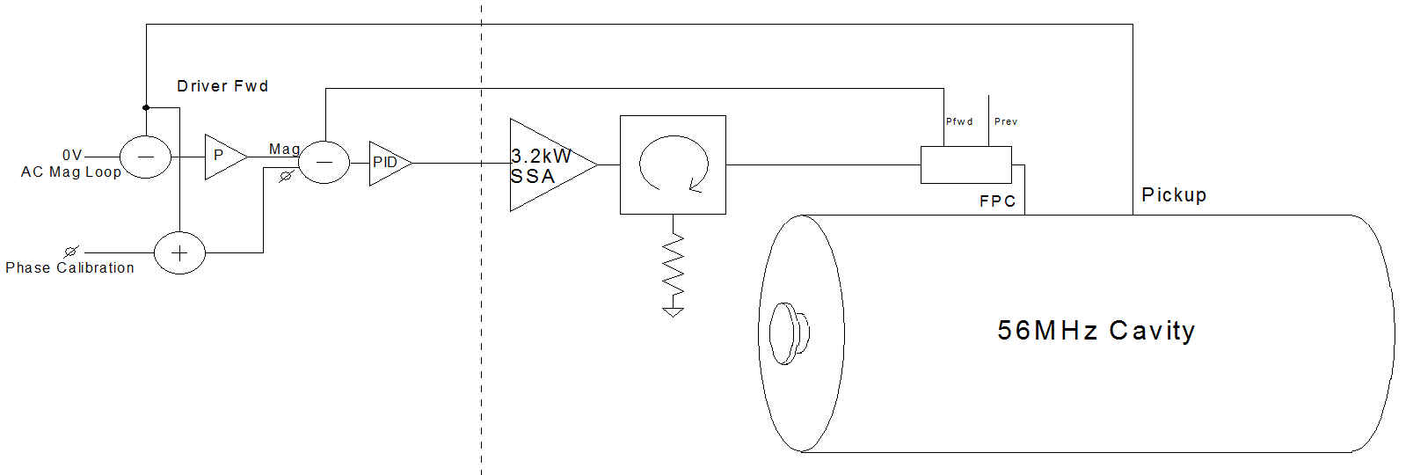
RF Feedback Improvements
  New Low Level Loop Configuration
  Drive chain feedback was implemented around the amplifier and circulator in firmware.
  Replaced I&Q AC coupled feedback around cavity with AC coupled magnitude feedback.
  Combined improvement should reduce required RF drive by a factor of 2.

Slide 12
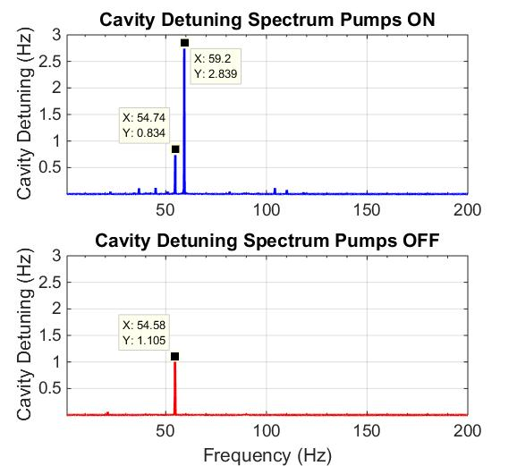
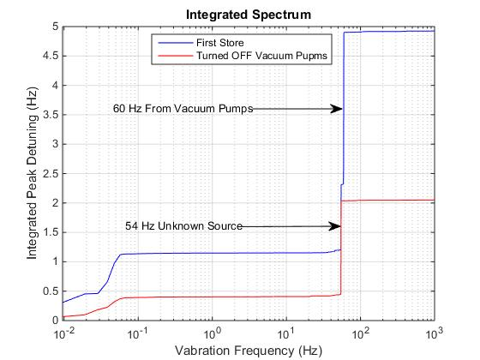
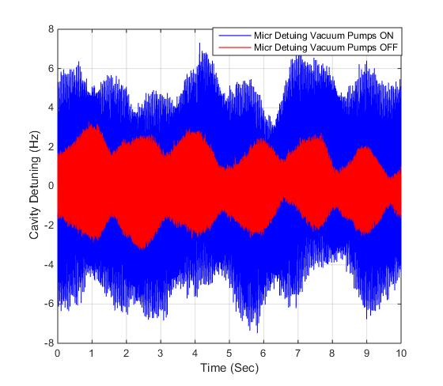
Identifying Sources of Microphonic

Slide 13
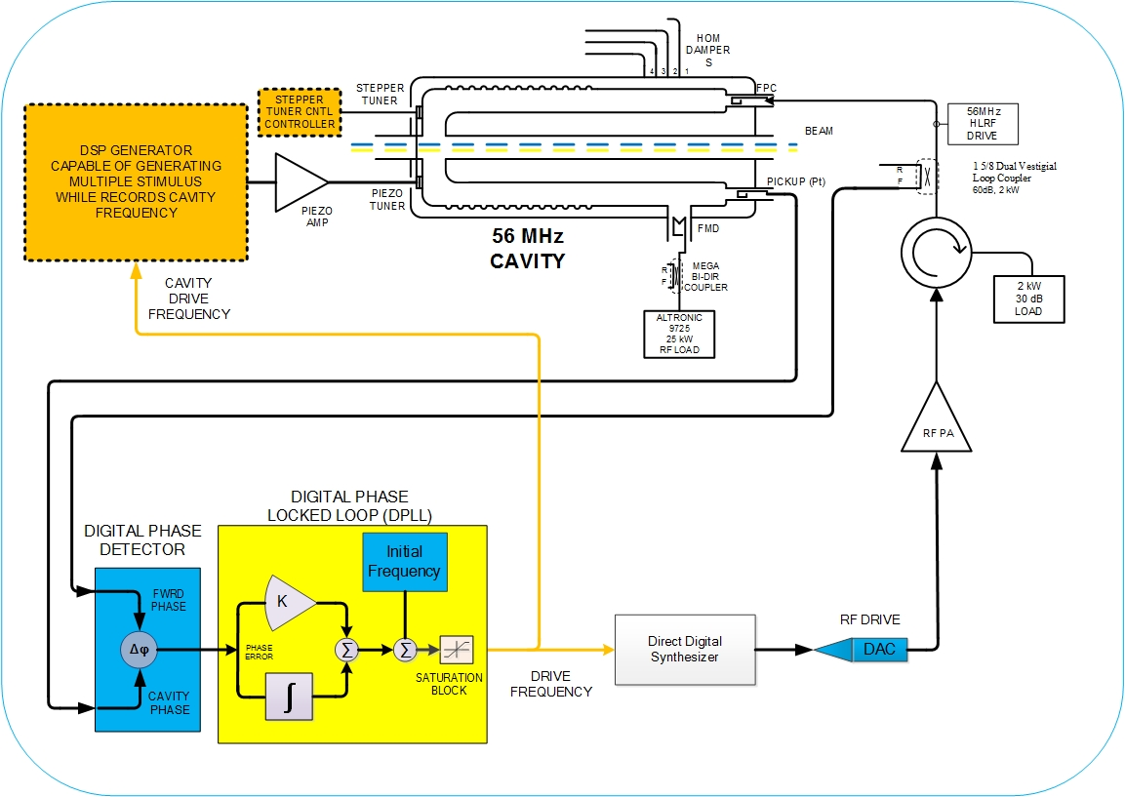
Tuning System Transfer Function Characterization
Low Level RF controller to measure piezo to cavity tuning transfer function.
The process consists of a digital PLL setup with high gain to closely track the cavity resonance frequency by keeping phase error small. This is done while driving the piezo amplifier with some kinds of stimuli.
    The DSP system simultaneously records cavity frequency data generated by the PLL and the corresponding piezo stimuli.
    The best transfer function was obtain by applying a sinusoidal signal at discrete frequency steps shifting frequency after a 3 s of delay in steps of 0.1 Hz.
    How slow is slow enough?

Slide 14
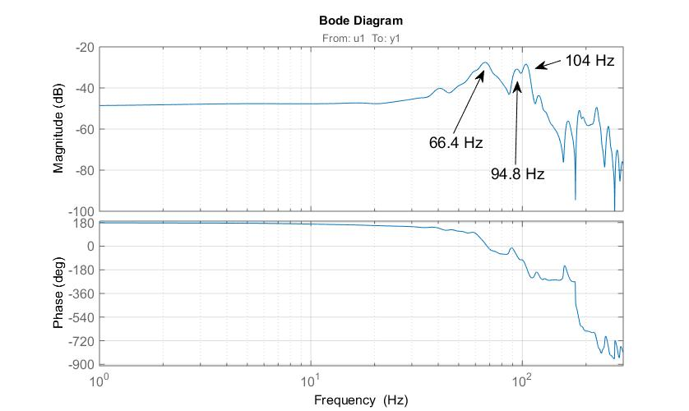
Tuning System Transfer Function Characterization
    A slow sweep type stimuli works well enough.
    Here we used (120 sec long sweep from 1Hz to 300 Hz.
    Used matlab to compute transfer function.

Slide 15
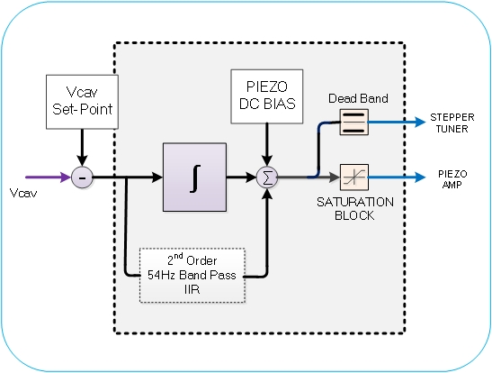
Piezo to Compensate Microphonic Detuning
  Implemented piezo control feedback on a DSP to include an integrator and a 54 Hz band pass to target largest mechanical vibration at 54 Hz.
  Optimize loop gain based on measured open loop transfer function.

Slide 16
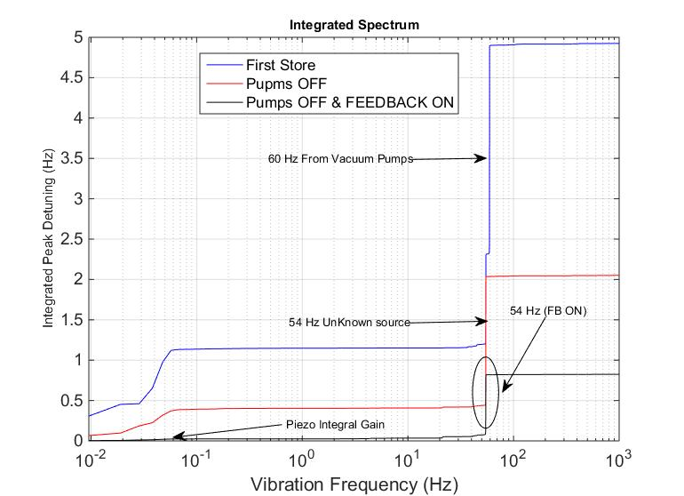
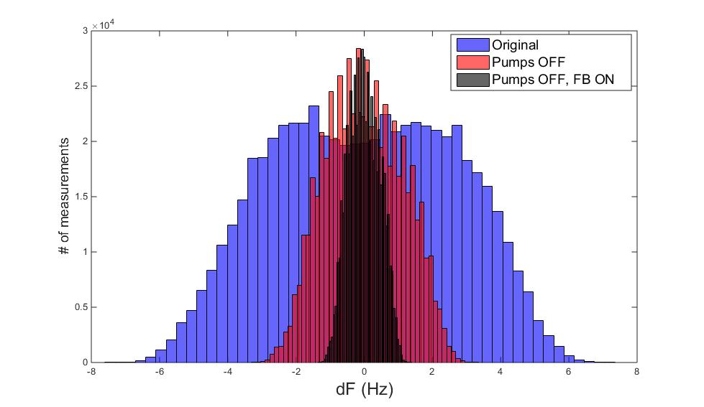
Piezo to Compensate Microphonic
  Reduced peak microphonic detuning by a factor of 2.5, about 8 dB.
  Tested concurrent operation of RF AC coupled magnitude feedback and piezo feedback without beam.
  Peak microphonic detuning was reduced to about ~1 Hz peak.

Slide 17
Summary
  Reduced required RF power enough to operate at 2 MV with beam.
    Improved RF feedback to reduced phase shift.
    Improved FPC power handling tested at 3.2 kW.
    Passive elimination of source of microphonic.
    Active compensation using piezo.
    Achieved about < 1.5 Hz peak detuning.
    Required RF power and beam extracted power will be 1 kW for 2 MV.
  Plan to improve active microphonic compensation algorithm
    Computed system model for this and other SRF cavity’s piezo transfer function.
    Plan to start working on implementing adaptive type compensation.

Slide 18
Thank you
  Kevin Smith, Salvatore Polizzo, Tom Hayes, Kevin Mernick, Geetha Narayan, Scott Seberg, Loralie Smart, Qiong Wu, Alex Zaltsman, Carlos Ramirez, Freddy Severino, more…

