Slide 1
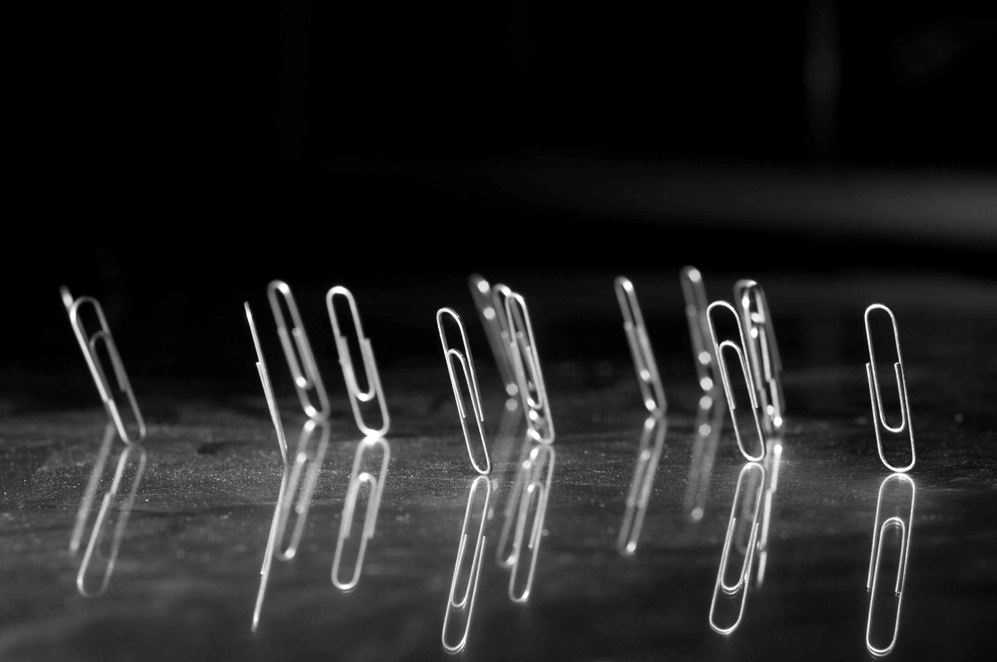
Lorentz force oscillations
Ramona Leewe,
Ken Fong,
TRIUMF
LLRF Microphonics workshop 2018
Strategic Communications at TRIUMF

Slide 2
Overview
TRIUMF’s e-Linac cavity driving configuration
First operational experiences
Parametric oscillations
Lorentz oscillation problem formulation
Nonlinear system stability analysis
Parametric oscillation in cavity with lorentz force
Simulations
Conclusion

Slide 3
TRIUMF’s e-linac driving configuration
EINJ
EACA
TRIUMF’s e-Linac acceleration cryomudule, consists of 2 9 cell cavities and is operated with a single klystron in CW mode and vector sum control.
CAV
CAV1
CAV 1
CAV 2
CAV2
M
M
M
M
M
Klystron2
300kW
150kW
Klystron1
300kW

Slide 4
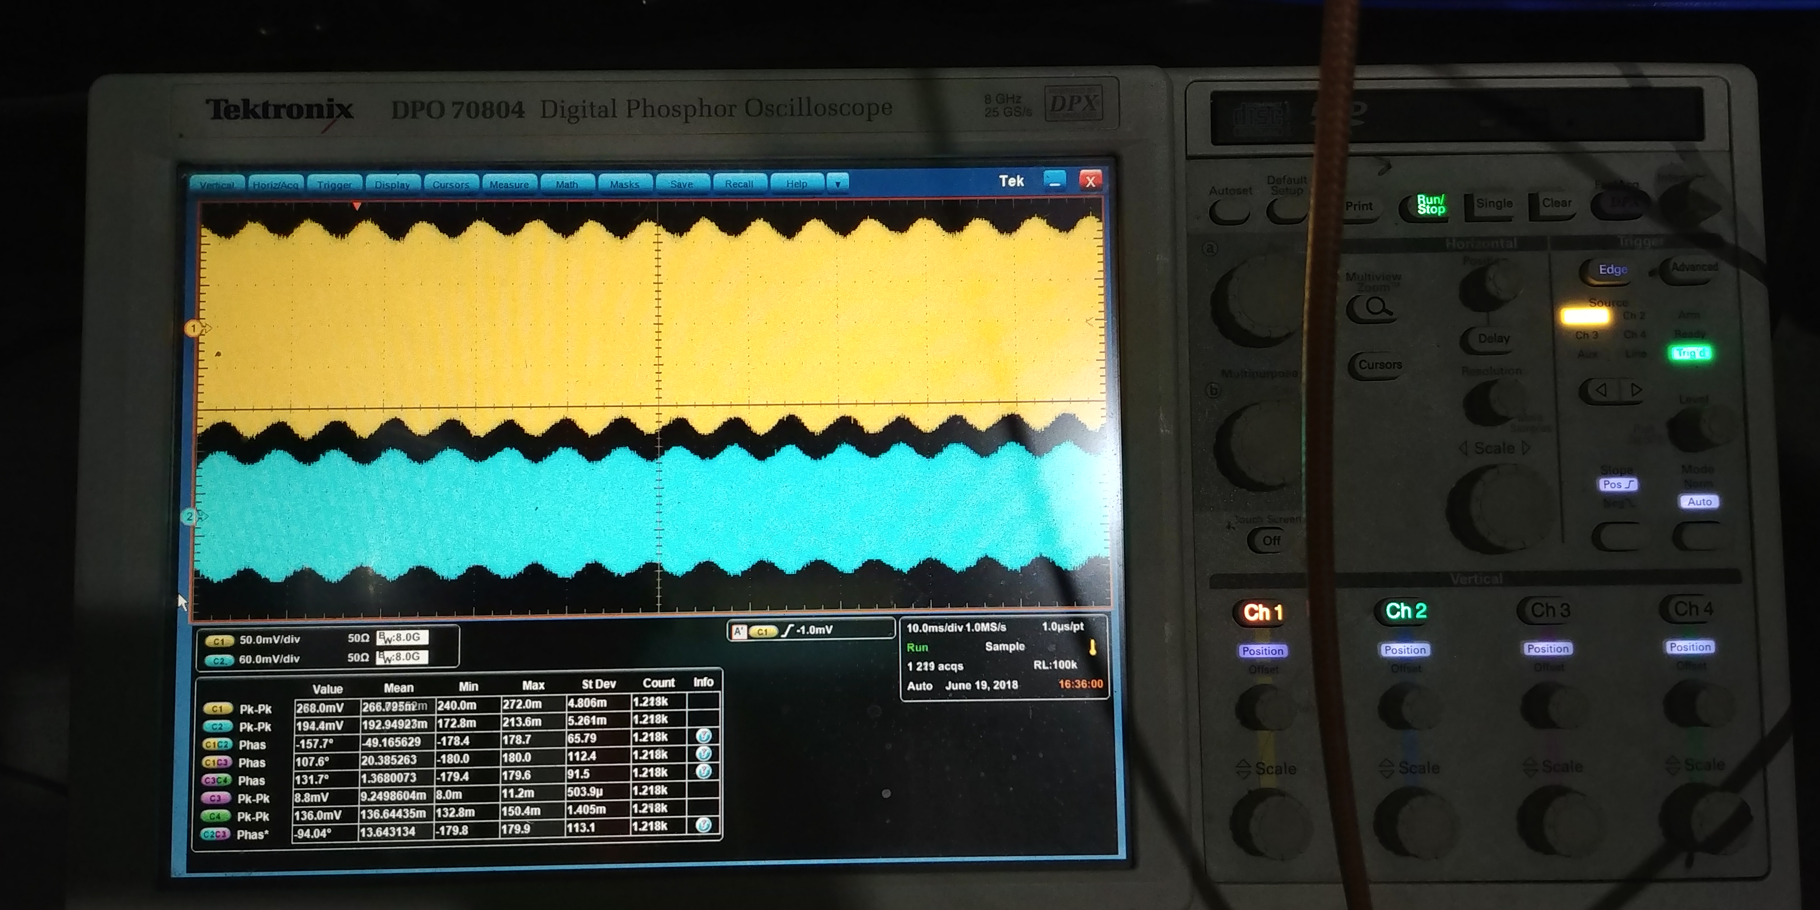
Operational experience
Amplitude oscillation in both cavities (operational gradient dependent)
Time to grow oscillations $≈6−10 seconds$
Cavity 1
Cavity 2
Notes:
Pick up signals for cavity 1 and cavity 2. In this case we have a limit cycle

Slide 5
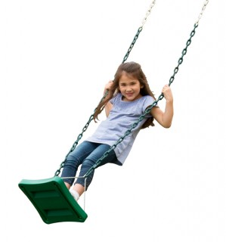
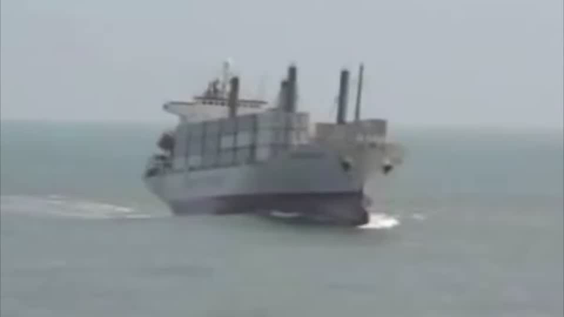
Parametric oscillations
“A parametric oscillator is a driven harmonic oscillator in which the oscillations are driven by varying some parameter of the system frequency, typically different from the natural frequency of the oscillator”, Wikipedia
Examples:
Kid on a swing
Roll instabilities of ships
Notes:
Kid on swing, parametric pumping, occurs when pumping frequency=twice the system frequency

Slide 7
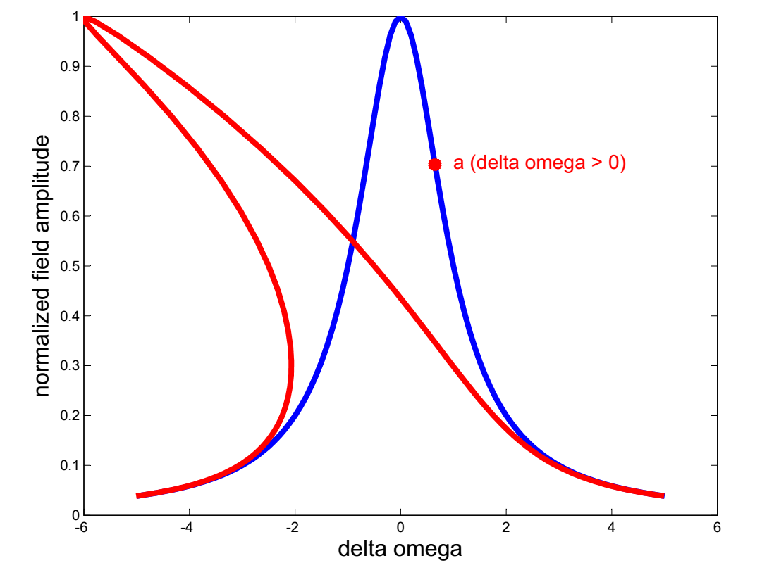
Lorentz oscillation problem formulation
Lorentz force is driving a cavity as spring mass system
$m\ddot{x}+c\dot{x}+kx=F$
$F=−K_{L}V_{acc}^{2}$
$V_{acc}=γV_{g}\cos\left(φ\right)$
$φ=\tan^{−1}(τ∆ω)$
$∆ω=bx$
Equation of motion:
$$m\ddot{x}+c\dot{x}+kx={−K}_{L}γ^{2}V_{g}^{2}\{\cos^{2}{(\tan^{−1}(τb(a+x))}−\cos^{2}\left(\tan^{−1}\left(τba\right)\right)\}$$
$$K_{L}=lorentz constant$$
$$γ=coupling factor$$
$$V_{g}=generator voltage$$
$$φ=detuning angle$$
$$τ =cavity time constant$$
$$b=cavity sensitivity$$
Lorentz force at ‘a’
Nonlinear system
Notes:
Kid on swing, parametric pumting

Slide 8
Nonlinear system stability analysis
System is said to be stable in the sense of Lyapunov if
$V\left(x\right)>0$ , $V\left(x\right)$ Lyapunov function candidate
$\dot{V}\left(x\right)<0$
With $x_{1}=x, x_{2}=\dot{x}$
$V=\frac{k}{2}x_{1}^{2}+\frac{1}{2}mx_{2}^{2}$
$\dot{V}=Λ\left(x_{1}\right)x_{1}−cx_{2}^{2}$
$$m\ddot{x}+c\dot{x}+kx=Λ\left(x\right)$$
$$Λ\left(x\right)=Lorentz force$$
Only stable if $Λ\left(x_{1}\right)x_{1}<cx_{2}^{2}$
Stability depends on the input power and the cavity spring constant
Notes:
Kid on swing, parametric pumting

Slide 9
Parametric oscillations in cavity with lorentz force
Lorentz force oscillation differential equation
General differential equation for parametric oscillation
$m\ddot{x}+c\dot{x}+kx=K_{L}V_{g}^{2}γ^{2}\cos^{2}\left(\tan^{−1}\left(τb\left(a+x\right)\right)\right)\cos^{2}\left(\tan^{−1}\left(τba\right)\right)\left(2a+x\right)x$
$m\ddot{x}+c\dot{x}+$
$$(k−K_{L}V_{g}^{2}γ^{2}\cos^{2}\left(\tan^{−1}\left(τb\left(a+x\right)\right)\right)\cos^{2}{(\tan^{−1}\left(τba\right))(2a+x))x=0}$$
Assume solution: $x=μ\cos\left(ωt\right)$ and substitute in nonlinear part to get an approximate solution
$$(k−K_{L}V_{g}^{2}γ^{2}\cos^{2}\left(\tan^{−1}\left(τb\left(a+μcos⁡(ωt)\right)\right)\right)\cos^{2}{(\tan^{−1}\left(τba\right))(2a+μcos⁡(ωt)))}$$
$\ddot{x}+β\left(t\right)\dot{x}+ω^{2}\left(t\right)x=0$
Time dependent resonance frequency

Slide 10
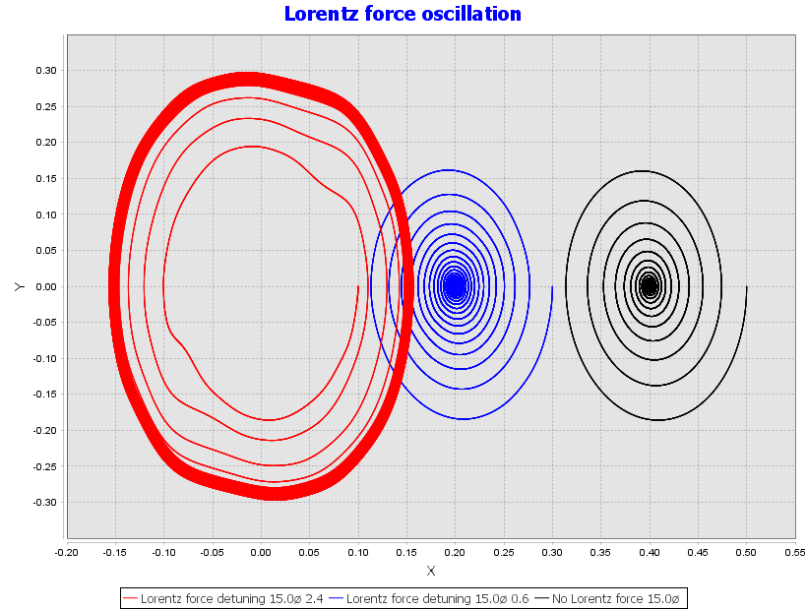
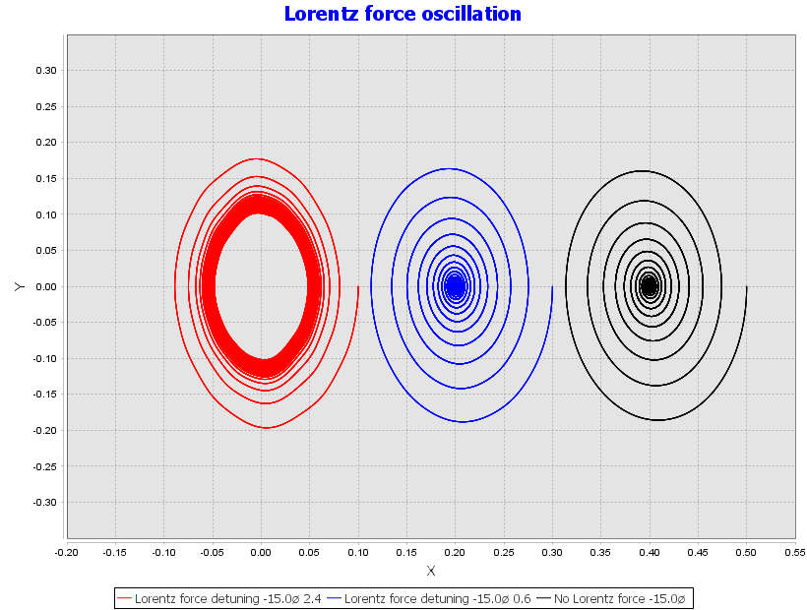
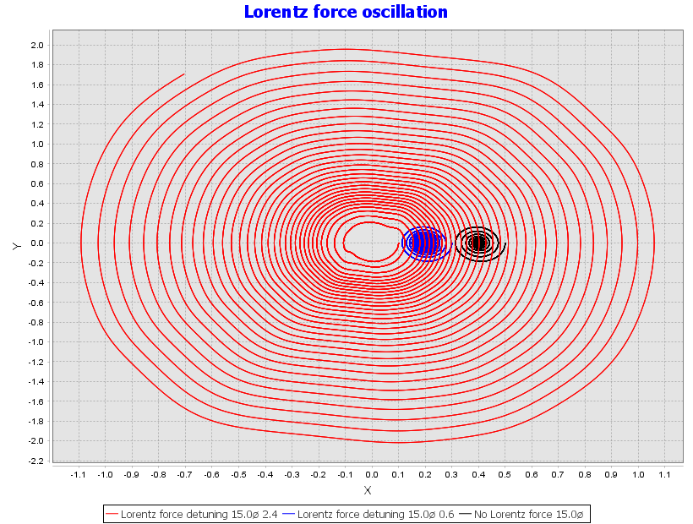
$a>0$
Simulation results
Phase portrait, $\dot{x} versus x$
Field amplitude = $V_{g}$
Field amplitude =$\frac{V_{g}}{2}$
No field
Existence of limit cycles
Stability is field dependent $Λ\left(x_{1}\right)x_{2}<cx_{2}^{2}$
$a<0$
Field amplitude slightly increased

Slide 11
Conclusion and lookout
Theory of Lorentz force has been analyzed
Stability conditions for stable operation are established
Simulated system results are in agreement with system experience
Increasing oscillation amplitude can only be observed at high gradients
Stable for $∆ω<0,$ unstable for $∆ω>0$
Next steps: Analyze double cavity system in vector sum control

Slide 12
Thank you for your consideration!

